Slide 1






Memory Organ
“The Memory Organ – Ideally one would desire an indefinitely large memory capacity such that any particular … word would be immediately … available. … It does not seem possible physically to achieve such a capacity. …We are therefore forced to recognize the possibility of constructing a hierarchy of memories, each of which has greater capacity than the preceding but which is less quickly accessible.”
Arthur Burks, Herman Goldstine and John von Neumann, Preliminary Discussion of the Logical Design of an Electronic Computing Instrument, Jun. 28,1946.
“TPC-C...were spent waiting for memory . . . . MPEG… limited by memory accesses . . . . Processor speed has seriously outstripped memory speed. . . . The real design action is in the memory subsystems — caches, buses, bandwidth and latency.”
Dick Sites, It’s the Memory, Stupid! Microprocessor Report, 10(10):2–3, Aug. 5 1996.

Slide 2
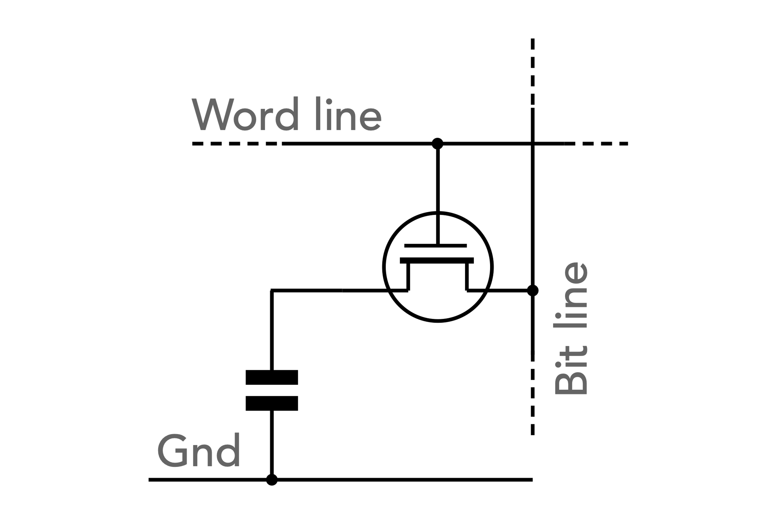
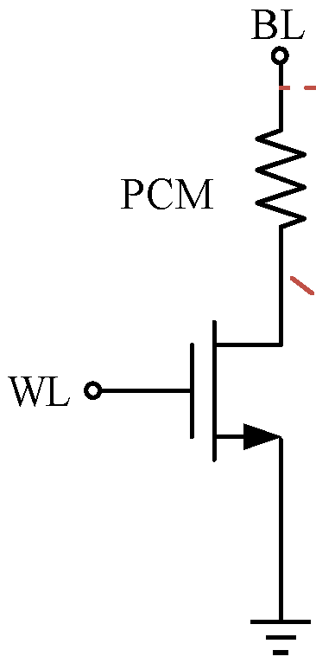
SoA Memory Organization
Host
Memory Farm
Channel
Bank Group
Bank
Channel₀
Bank Group₀
Bank₀
….
Bank_{b-2}
Macro₀
….
Macro_{b-2}
…
…
….
Channel_{n-1}
Bank Group_{g-1}
Bank₁
….
Bank_{b-1}
Macro₁
….
Macro_{b-1}
Macro
Cell
Array/Mat/Tile
Array a.k.a. Mat or Tile
Row Dec
WL Decoder / Driver
C/A
CSL
BL
BL
SA
Col Dec
WL
WL
BL Mux / SA / Data Latch
Mux / Word
DQ + Metadata

Slide 3
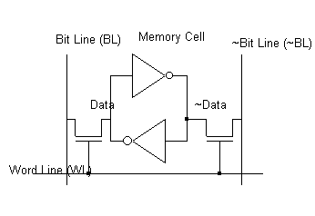

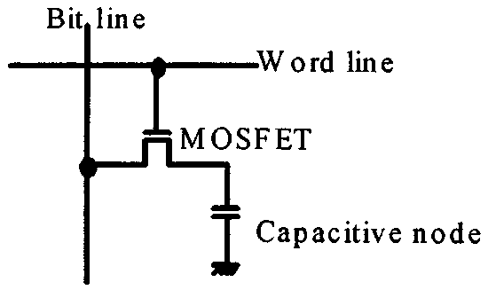
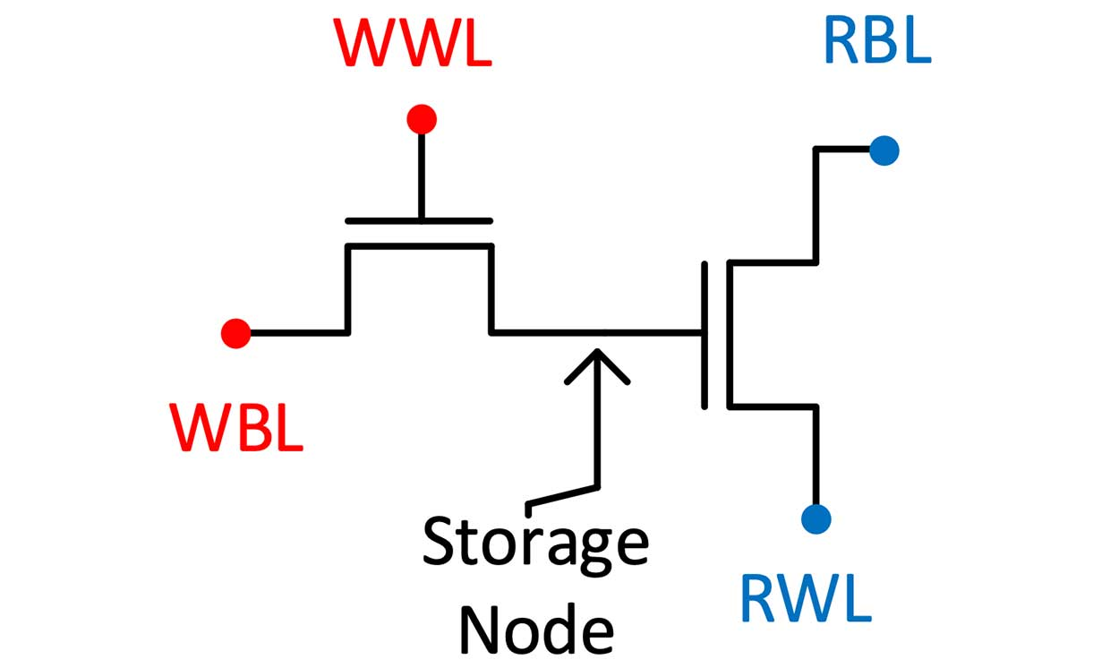
Cell Types
6T-SRAM
Cross Point Array
1T1C-DRAM
2T-DRAM
WL
BL

Slide 4
HBM3 Organization (JEDEC Spec R.95)
Bank is the lowest independently operable unit
DRAM core 250~400MHz (not scalable)
t_{CCD} (CAS2CAS delay, b2b same bank): 2.5~4ns
Hynix Spec: Open page latency (tAA) = 48ns Close page latency (tRCD+tAA) = 31ns
Bank Group is supported for fast t_{CCDF})
Number of rows (pages) is part of HBM3 spec
52
HBM3
Channel₀
Channel_{i}
…
…
Bank
Bank
Channel_{m}
….
Bank
120
RAS
SWD
Each stack of HBM die includes (equivalent to 1 Rank of DDR DIMM)
Global command for the stack (52 µbumps)
Upto 16 channels / device (stack); upto 1K DQ
Double data rate @ 4.8~6.4GT/s (2.4~3.2GHz)
Max BW = 819.2GB/s/stack
I/O voltage 1.1 V, Tx driver voltage 0.4 V
DRAM core voltage 1.1 V
Unterminated data/add/cmd/clk interfaces
Unmatched data interfaces
2b encoded temp sensor
not prohibiting manufacturer specifics such as
an optional interface die in the stack
Signal redistribution and other functions
Bank
Bank
Memory Mat
….
Channels are full independent to each other
2~32Gb channel capacity [2^{31~35}b];
16, 32 or 48 banks per channel
64 DQ + ECC, SEV per channel. BL = 8 I/O (~90µbump) & ADD/CMD (~30µbmp)
2KB physical page [2¹⁴b] 1KB addressable [2¹³b], C[6:0]
BW = 38.4~51.2GB/s/Channel, Max BW density = 205GB/s/GB
Bank grouping supported for short t_{CCD}
2 Pseudo Channel (PC) per Channel; PCs share C/A RAS/CAS for finer granularity to lower cost to scheduler.
C/A
CSL
SA
CAS
Page
DQ + Metadata
52

Slide 5
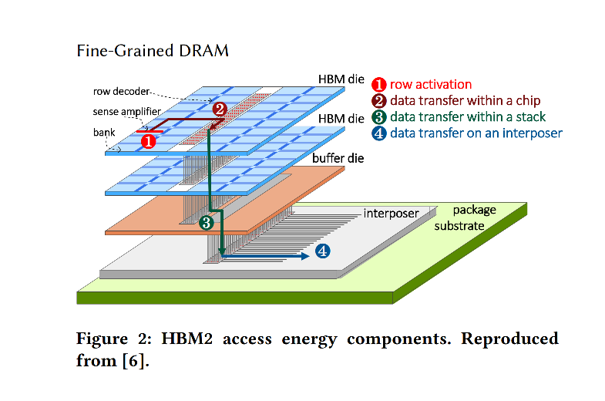
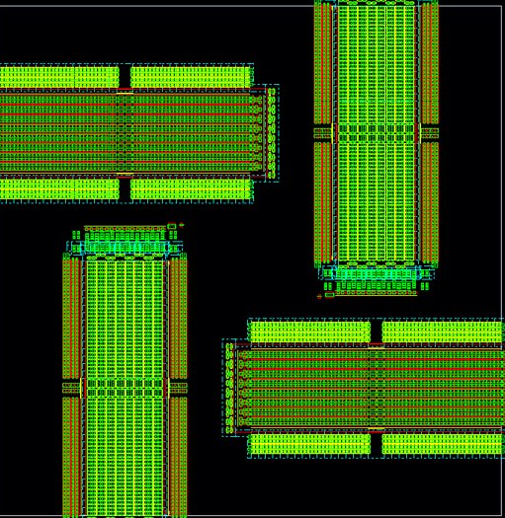
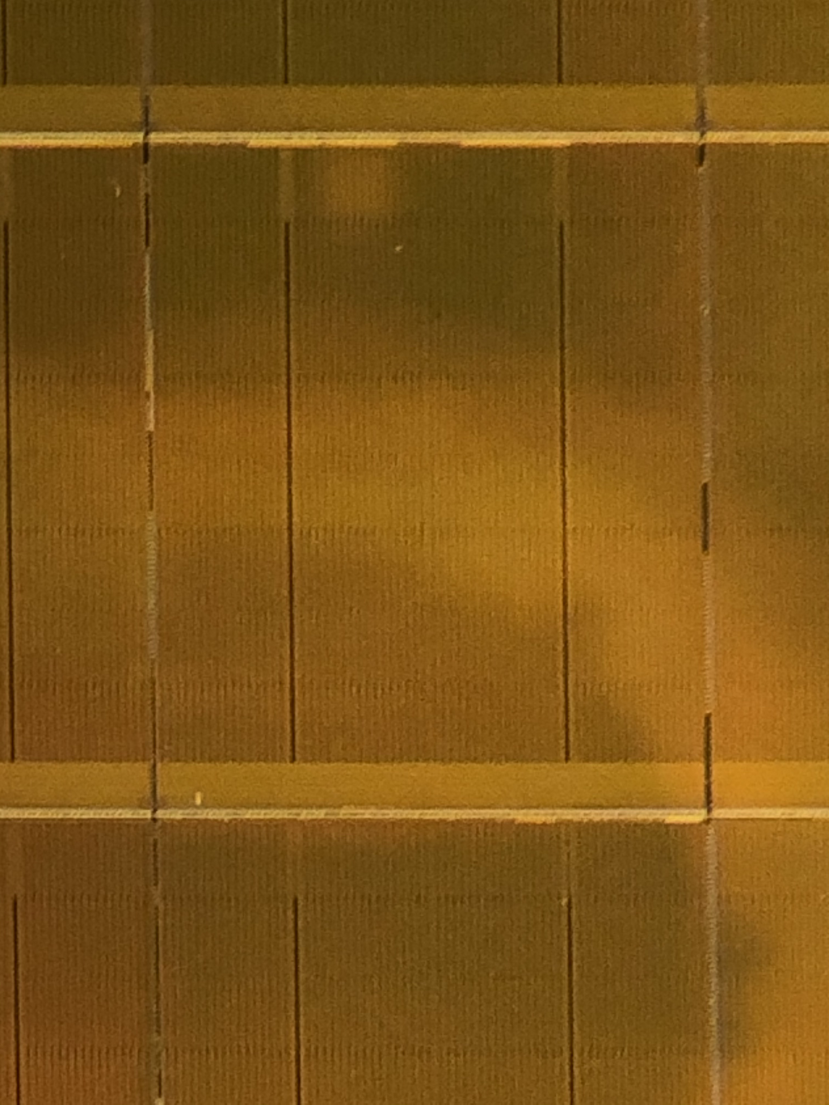
Component (64MB)
Channel: 8 Bank groups (8MB)
Bank group: 4 Banks (1MB)
64MB SRAM Cache Density 2MB/mm²
Latency ns
BW 1000(GB/s)/MB
Energy 0.1pJ/b
Channel 0
Channel 1
Bank3
Bank2
4:1
800 MT/s per lane
Channel 2
Channel 3
Bank1
512
8:1
Bank0
512
64B per channel
6.4 GT/s per lane
Channel 4
Channel 5
macro
macro
512
512
256
256
512
512
Channel 6
Channel 7
Bank Group Mux
1GBx8 HBM3
Density 20MB/mm2
Latency 30s ns
BW 300(GB/s)/GB
Energy 4.5pJ/b
1/4th Tile (1K x 1K)
32GB Optane
Density 350MB/mm²
Latency 300s ns
BW 1(GB/s)/GB
Energy 50pJ/b
Bank 31
GBLS DRVR/TERM ANALOG
Tile 127
CUA
GWLS DRVR/TERM CAPS
PCL/LBLS & LBLd DRVRS
Bank 0
Tile 0
PERIPHERY
LWLs/LWLd/PCL CTRL DRVRS
IO

Slide 6
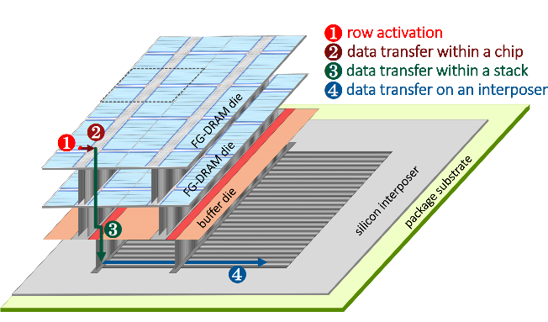
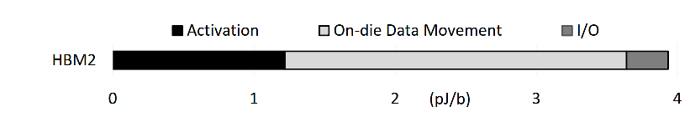
Disaggregation: An access energy consideration
Fine-grained DRAM: energy-efficient DRAM for extreme bandwidth systems
Mike O'Conner et.al, Nvidia
ACM Symposium on Microarchitecture, 2017
Developing Disaggregation Strategy
System level PPA
Build PPA Pareto by module
Monolithic Design as baseline/reference
HBM3
HBI
ADM Gen 1
ADM HBI

Slide 7
High Bandwidth Memories
 |  |  | DRAM |  |  |  | SRAM
 |  |  | HBM3 | HBM4 | LLC | ADM Gen 2 | D-Cache | V-Cache
Component | Component Capacity | Gb | 16 | 16 | 8 | 2 | 0.5 | 0.5
 | die stacking | # | 6.4 | 8 | 1 | 1 | 1 | 1
 | Density | MB/mm² | 22.6 | 21.6 | 12.0 | 6.7 | 2.2 | 1.56
 | R+W Max Bandwidth | TB/s | 0.65536 | 2.048 | 1.024 | 3.2768 | 6.5536 | 2.048
 | R/W Energy | pJ/bit | 4.5 | 3.6 | 2.7 | 0.800 | 0.1 | 0.1
 | Latency (Open) (t_{RP}+t_{CCDS}) | ns | 21 | 21 | 15 | 9 | <3 | 6
 | Latency (Close) (t_{RC}+t_{CCDS}) | ns | 55 | 55 | 33 | 14 | <3 | 6
 | R+W Max BW/GB | (TB/s)/GB | 0.32768 | 1.024 | 1.024 | 13.107 | 104.858 | 32.768
 | R+W Max BW/W | (TB/s)/W | 0.028 | 0.035 | 0.054 | 0.955 | 1.250 | 1.250
Channel | # of Channel / Component | # | 2 | 4 | 32 | 8 | 8 | 8
 | DQ per Channel | # of Lanes | 64 | 64 | 32 | 512 | 512 | 256
 | R+W Max Bandwidth | GB/s | 51.2 | 64 | 32 | 409.6 | 819.2 | 256
Bank | # Bank Group / Channel | # | 8 | 8 | 2 | 1 | 8
 | # Bank / Bank Group | # | 4 | 4 | 4 | 32 | 4
 | # Bank / Channel | # | 32 | 32 | 8 | 32 | 32
 | # Bank / Component | # | 64 | 128 | 256 | 256 | 256
 | # Bank / Cube | # | 409.6 | 1024 | 256 | 256 | 256

Slide 8
High Level Spec Comparison
 |  |  | LPDDR5 | HBM3 |  | 2Gb Macro
 | Technology Node | nm | Hynix 1z | Hynix 1z | JEDEC R.95 | TCD 1z (512)
Die, including JEDEC device / stacked-die | Capacity | Gb | 16 | 16 | 2~512 | 2
 | Footprint | mm² | 60.72 | 115.06 | n/a | 16.07
 | Density | Mb/mm² | 270 | 142 | n/a | 127
 | # of DQ / die | pins | 16 | 256 (1K allocated) | uptp 1024 | 4096
 | # of Channel /Die | # | 1 | 4 | upto 16 | 8
 | Transfer Rate | GTpS | 6.40 | 6.40 | 4.8~6.4 | 0.25
 | Bandwidth Density | GB/s/GB | 6.4 | 102 | max. 205 | 512
 | Latency (Close page) | ns | 40.00 | 48.00 |  | 19.80
 | Latency (Open page) | ns | 25.00 | 31.00 |  | 15.00
 | access latency / t_{CCD} | ns | 2.50 | 2.50 | 2.5~4.0 | 4.00
Channel | Channel Capacity | Mb/Channel | 16384 | 4096 | 2K~32K | 256
 | DQ / Channel | pins | 16 | 64 | 64 | 512
 | # of Bank / Channel | Bank/Channel | 16 | 16 | 16, 32, 48 | 8
 | BW/Channel | GB/s/Channel | 12.8 | 51.2 | 38.4~51.2 | 16
Bank, Partition | Bank Capacity | Mb/Bank | 1024 | 256 | see spec | 32
 | # of col of Mat/Tile (GBL) | n | 16 | 16 | n/s | 8
 | # of Row of Mat/Tile (GWL) | n | 64 | 32 | n/s | 16
 | Physical Page Size | bits | 16384 | 16384 | 16384 | 4096
Mat, Tile | Array Capacity | Mb/Array | 1.00 | 1.00 | n/s | 0.250
 | # of BL | Col | 1024 | 1024 | n/s | 512
 | # of WL | row | 1024 | 1024 | n/s | 512

Slide 9
High Level Spec Comparison (2)
 |  |  | LPDDR5 |  | HBM2 | HBM3 |  | 2Gb Macro | AP HVM
 | Technology Node | nm | Hynix 1z | Apple M1 Pro | Hynix 1z | Hynix 1z | JEDEC R.95 | TCD 1z (512) | 2y
Die, including JEDEC device / stacked-die | Capacity | Gb | 16 | 64, 128 | 16 | 16 | 2~512 | 2 | 32
 | Footprint | mm² | 60.72 |  | 104.17 | 115.06 | n/a | 16.07 | 220-320
 | Density | Mb/mm² | 270 |  | 157 | 142 | n/a | 127 | 100~150
 | # of DQ / die | pins | 16 | 128 | 128 (1K/stack) | 256 (1K/stack) | uptp 1024 | 4096 | 10K
 | # of Channel /Die | # | 1 | 8 | 8 | 4 | upto 16 | 8
 | Transfer Rate | GTpS | 6.40 | 6.4 | 03.20 | 6.40 | 4.8~6.4 | 0.25 | 3.20
 | Bandwidth Density | GB/s/GB | 6.4 | 12.8~6.4 | 51.2 | 102 | max. 205 | 512 | 1024
 | Latency (Close page) | ns | 40.00 |  |  | 48.00 |  | 19.80
 | Latency (Open page) | ns | 25.00 |  |  | 31.00 |  | 15.00
 | access latency / t_{CCD} | ns | 2.50 |  |  | 2.50 | 2.5~4.0 | 4.00
Channel | Channel Capacity | Mb/Channel | 16384 | 8192,16384 |  | 4096 | 2K~32K | 256
 | DQ / Channel | pins | 16 | 16 |  | 64 | 64 | 512
 | # of Bank / Channel | Bank/Channel | 16 |  |  | 16 | 16, 32, 48 | 8
 | BW/Channel | GB/s/Channel | 12.8 |  |  | 51.2 | 38.4~51.2 | 16
Bank, Partition | Bank Capacity | Mb/Bank | 1024 |  |  | 256 | see spec | 32
 | # of col of Mat/Tile (GBL) | n | 16 |  |  | 16 | n/s | 8
 | # of Row of Mat/Tile (GWL) | n | 64 |  |  | 32 | n/s | 16
 | Physical Page Size | bits | 16384 |  |  | 16384 | 16384 | 4096
Mat, Tile | Array Capacity | Mb/Array | 1.00 |  |  | 1.00 | n/s | 0.250
 | # of BL | Col | 1024 |  |  | 1024 | n/s | 512
 | # of WL | row | 1024 |  |  | 1024 | n/s | 512

Slide 10
High Level Spec Comparison (2)
 |  | LPDDR5 |  | HBM2 | HBM3 | 2Gb Macro | AP HVM
Technology Node | nm | Hynix 1z | Apple M1x | Hynix 1z | Hynix 1z | TCD 1z (512) | 2y
Pricing estimate | $/Gb | .50 | .50 | 2.00 | 2.00
Component Unit |  | Die | Package | Package | Package | Macro | Macro
Capacity / Component | Gb | 16 | 64 | 64 | 64 | 2 | 32
Footprint | mm² | 60.72 |  | 104.17 | 115.06 | 16.07 | 220-320
Density | Mb/mm² | 270 |  | 157 | 142 | 127 | 100~150
# of DQ / component | pins | 16 | 128 | 1024 | 1024 | 4096 | 10K
# of Channel / component | # | 1 | 8 | 32 | 16 | 8
Transfer Rate | GTpS | 6.40 | 6.4 | 3.2 | 6.40 | 0.25 | 3.20
Bandwidth | GB/s | 12.8 | 102.2 | 409.6 | 819.2 | 128
Bandwidth Density | GB/s/GB | 6.4 | 12.8 | 51.2 | 102.4 | 512 | 1024
Normalized Bandwidth/$ | Ref. LPDDR5 | 1 | 2 | 2 | 4
Channel Capacity | Gb/Channel | 16 | 8 | 2 | 4 | 1/4
DQ / Channel | pins | 16 | 16 | 32 | 64 | 512

Slide 11
BLOCK DIAGRAM
axn
32 Global Selects
1 Global deselect
Global Column mux
32 Local Selects
16 Local deselects
32 GBL’s
IO (PADs, Tx, Rx, DLL,..)
Local Column mux
Address Drivers
(GBL, LBL, GWL, LWL)
BL Tile Circuits
( BL Voltage mux, Mask Logic, Sense Amp)
1024 LBL’s
Periphery Logic
( Command processor, SIPO, PISO,.. )
Partition Control Logic
(Read/Write algo u-controller)
1024 LWL’s
WL Tile Circuits
( WL VDM, Mask Logic, Current Mirrors, Spike mit)
Local Row mux
Partition Analog
( VDM_DAC, iREF_DAC,…)
32 Local Selects
16 Local deselects
HV ( Fuses, redundancy matching, regulators )
32 GWL’s
Global Row mux
32 Global Selects
1 Global deselect
hnreg
IO/Periphery
Partition x32
Tile x128 per partition
Global/Local mux’s x8 per tile
LV + HV
LV + HV
LV + HV
HV

Slide 12
3DXP Component Organization
1/Tile
Array
64Mb/tile
4X4 Patches/Tile
Patch footprint is ~[50µm]²
@ 41P node
Data Buffer
Read / Write
64/Patch
Global MUX
Command /
Data
Interface
Address Tag
Analog / control
32/Patch
64/Patch
Local MUX
State Machine
(Instruction)
1K/Patch
On Pitch Via
HiZ Path
LoZ Path
LVT
Mixed
HVT
Die size = 200mm²
Shaded area is global ~ 17mm²
4KTiles (64K Patches) occupy ~155mm²
Routing takes ~20mm²

Slide 13
Modularity for 3DIC
Array
64Mb/tile
4X4 Patches/Tile
Patch footprint is ~[50µm]²
@ 41P node
TM
Data Buffer
Read / Write
1/Tile
Array
64/Patch
Global MUX
M4
Command /
Data
Interface
Address Tag
M3
Analog / control
M2
32/Patch
M1
LV / HV MOS
64/Patch
Local MUX
State Machine
(Instruction)
1K/Patch
On Pitch Via
HiZ Path
LoZ Path
LVT
Mixed
HVT
TM
TM
Array
Array
Replacement strategy – Which potion of HVT can be replaced by thin film transistor: all, Mux only, or local Mux only
Vertical placement – What is connectivity from circuit in substrate to circuit in thin film: below M1 or below M4 or other multilevel interconnect scheme.
Modularity for scaling such as wafer stacking feasibility
M4
M4
M3
M?
M2
MUX
M1
M?
HVT
M2
LV
M1
LV / HV

Slide 14
Memlet
SRAM Chiplet
Capacity 64, 256MB (30, 100mm²)
Phi:
Channel: 8 and 32
Channel Capacity: 8MB, 32MB
Lanes: 512
DQ: Duplex (x2), Simplex (x1), Simultaneous(x1)
Address pins: 20, 22
Pins per chip: 5K~20K
Max Bump Density:
Shore: 1~2.5µm pitch
Stacking: (70µm)²/pad
Memory subsystem construct
Max # of chiplet: 4
Memory construct
Chips or cube
Sea of Bits:
MCP
2.3D: embedded chips with controller on the top
2.3D: embedded controller with chips on the top
3D-2.3D: embedded cube with controller on the top
3D-2.3D: embedded controller with cub one the top
Dual-edges
2.5K on 5x6 mm²
10K on 10x10 mm²

Slide 15
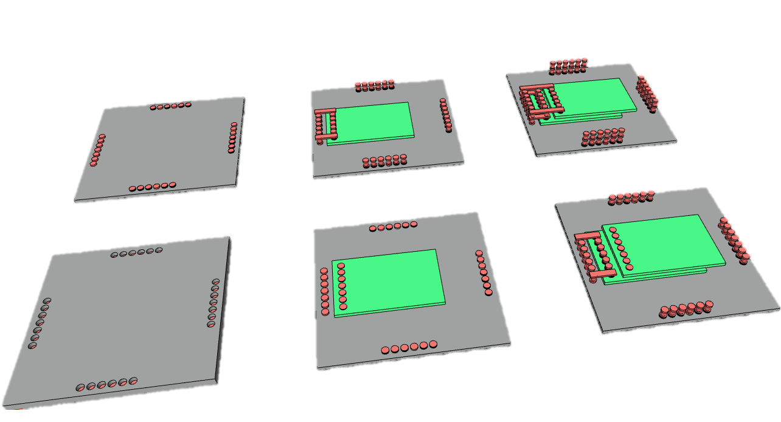
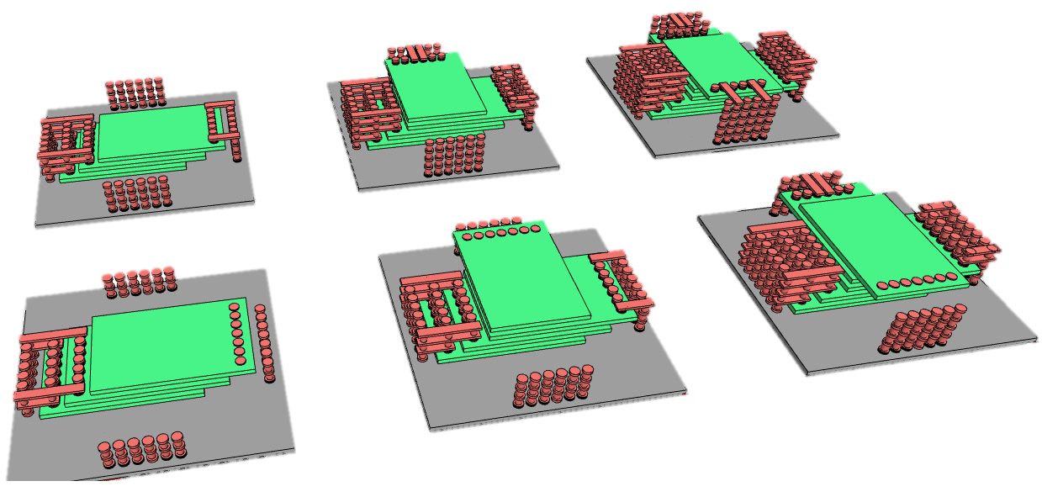
·········
·········

Slide 16
