Slide 3
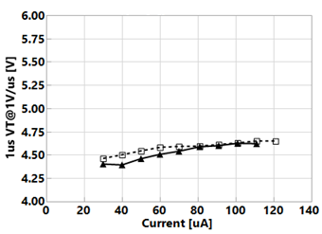
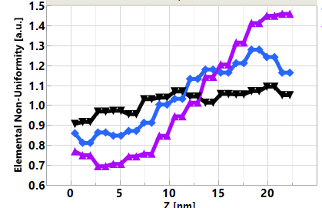
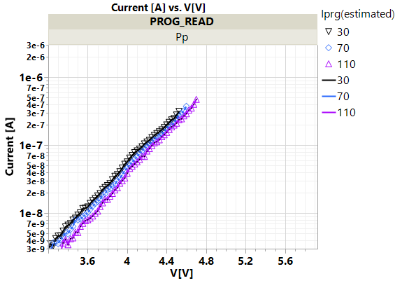
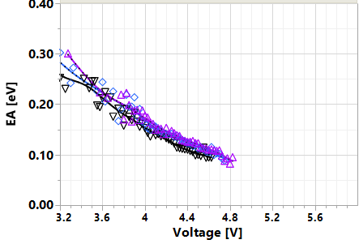
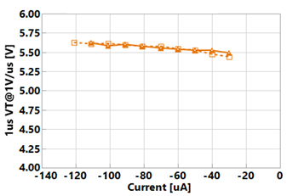
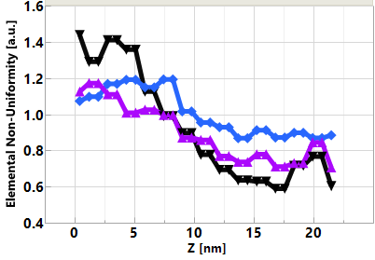
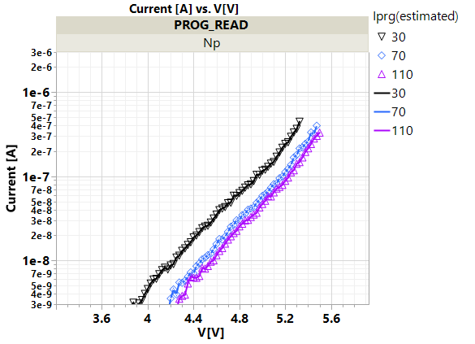
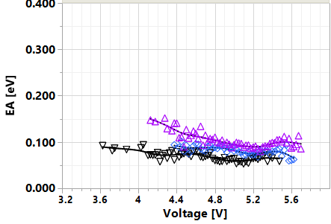
V_{T} response Vs. near threshold @ PFA
WIP
I
[Pp]
STS ~ const
I_{T} ↑ (~1.3x I_{TA})
TE BE
B
C
I_{prog}
A
?
EA ~ const (or↑) w/ Iprog
TE BE
STS ~ const
I_{T} ↓
C
B
A
TE BE
I_{prog}
II
[Np]
?
TE BE
EA ~ 0 (and ~ ↑ w/ Iprog)
Attributing the contained V_{T} shift w/in quadrant to local barrier modulation. Switching ascribed to MT w/ polarity as main driver [WIP].

Slide 4
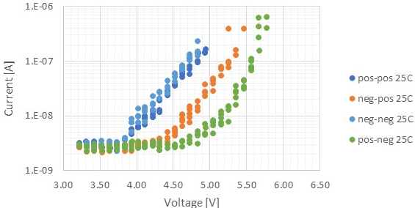


Electrical Equivalent Circuit and Possible Underline Physics
A V_{T} window (∆V_{T}) has been observed by applying programming pulses with opposite polarity. The best known ∆V_{T} physics is an electrochemical potential modulation effect subject to mass transport by polarity.
Near parallel shift on SubVt I-V on polarity effects
The equivalent circuit – a programmable battery connected to a Chal Glass Resistor serially
From empirical to physical
Pursuing the validation of heterogeneous junction model
Programmable battery is formed by the band offset
Write –Band offset switching subject to mass transport.
Read – Space Charge modulation results in voltage shift
Post
Neg
Write
C
As+/Ge+
SAG
C
SD Resistor
⊖
⊕
$$\vec{ℰ}$$
ϕ
(−)
(−)
⊖
⊕
$$\vec{ℰ}$$
ϕ
Read Polarity
0V
0V
$$\vec{ℰ}$$
ϕ
(+)
⊖
⊕

Slide 5
Basic Band Diagram of SAG and Model assumptions Electronic Structure of Amorphous Semiconductors, D. Adler and E. J. Yoffa, Phys. Rev. Lett. 36, 1197-1200 (1976)
Assumptions:
EG:2eV
Effective intrasite electronic correlation energy is negative therefore P-type is exhibited (pinned)
3 Electronic models on with SAG mass transport by polarity
Ge/As moves toward cathode
Homojunction – Correlation energy changed to positive therefore n-type (similar to tetrahedrally coordinated amorphous semiconductor)
Heterojunction-I – Band offset due to coordination changes (Michaelson’s Electronegativity Scales & The work Function, IBM JRD 1978), higher Work Function
Heterojunction-II – Band offset, but lower Work Function
0.8eV Change is used to illustrate all 3 models
C
SAG/Se+
C
Vacuum
E_{c}
E_{f}
ϕ_{e}
E_{v}
As+/Ge+
Vacuum
(I)
(II)
(III)
∆E_{f}=+0.8eV
∆χ=−0.8eV
∆χ=+0.8eV

Slide 6
1D Space Charge and Built-in Field
Trap Density [cc⁻¹]
ϵ_{SD} = 10
ε_{max} [MV/cm]
V_{bi}=1V
V_{bi}=.1V
Space Charge Width [nm]
ε[MV/cm]
Space Charge Width
ε_{max}
Trap Density [cc⁻¹]
E_{BD} : Si ~0.3MV/cm SiO₂ 10~15MV/cm, GST ~0.3MV/cm, TAG ~1MV/cm, SAG ~3MV/cm

Slide 7
Physical model – working principles & assumptions
SSM device is a string of domains serially concatenated. Node is an abstract point junction between domains.
Simplified with 1D model
Per Kirchhoff law
The nodal current is zero
Assumption – Qausi-static SubVt I-V represents device I-V at nano-second regime
The “domain” voltage drop for a current level will determine the shape of the I-V curve;
Shift right is higher threshold voltage and Voltage contribution of shifting is the memory effects
4 carrier transport mechanisms –
Conduction in delocalized state such as Diffusion and Drift
Conduction between localized and delocalized states such Poole-Frankel
Direct tunneling such as band to band and defect to defect between metallurgical junctions
Drift is linear function of electrical field – contribution is very low due to low free carrier and low mean-free path
Likewise, Diffusion contribution is also low (Einstein relation)
Electronic trap density is in the order of 1% of atomic density (inactive or pinned) ~10²¹/cc
10% structural vacancies in typical crystalline GST225, If electronically active, Debye length is < lattice constant; CV measurement exhibits Debye length in the order of μm or longer
Space charge region @ junction established by direct tunneling with build-in potential

Slide 8
1D Space Charge and Built-in Field in SAG
ε[MV/cm]
V_{bi} [volt]
Trap Density [cc⁻¹]
ε_{BD}
E_{BD} : SAG ~3MV/cm
Space Charge Width

Slide 9
Model Comparison
Model (I) – Homojunction
Model (II) – Heterojunction, higher 𝛘
Model (III) – Heterojunction, lower 𝛘
Bias
C
As+/Ge+
SAG
C
Bias
C
As+/Ge+
SAG
C
Bias
C
As+/Ge+
SAG
C
Vacuum
Vacuum
Vacuum
$$\vec{ℰ}$$
ϕ
⊕
$$\vec{ℰ}$$
ϕ
⊖
⊖
⊕
$$\vec{ℰ}$$
ϕ
⊕
(−)
(−)
⊖
$$\vec{ℰ}$$
ϕ
(−)
$$\vec{ℰ}$$
ϕ
(−)
⊕
⊕
$$\vec{ℰ}$$
ϕ
⊕
⊖
⊖
⊖
0V
0V
0V
0V
$$\vec{ℰ}$$
ϕ
⊕
$$\vec{ℰ}$$
ϕ
$$\vec{ℰ}$$
ϕ
(+)
⊖
(+)
⊖
⊕
(+)
⊕
⊖

Slide 10
Model (I) – Homojunction
(–) Bias Read, same polarity of write
Bias initially contributed to barrier reduction, very low current, shift I-V to right.
(+) Bias Read, opposite polarity of Write
Space charge region maintained or no change. Potential drop evenly cross Chal glass.
Homogeneous junction model does not support the observed polarity effect
Bias
C
As+/Ge+
SAG
C
Vacuum
$$\vec{ℰ}$$
ϕ
⊕
⊖
(−)
$$\vec{ℰ}$$
ϕ
⊕
⊖
0V
$$\vec{ℰ}$$
ϕ
⊕
(+)
⊖

Slide 11
Model (II) – Heterojunction, higher 𝛘
(–) Bias Read, same polarity of write
Space charge region maintained or little change. Potential drop evenly cross Chal glass.
(+) Bias Read, opposite polarity of Write
Bias initially contributed in compensating built-in potential, shift I-V to right.
Higher 𝛘 heterogeneous junction model supports the observed polarity effect
Bias
C
As+/Ge+
SAG
C
Vacuum
⊕
$$\vec{ℰ}$$
ϕ
⊖
(−)
(−)
⊕
$$\vec{ℰ}$$
ϕ
⊖
0V
0V
$$\vec{ℰ}$$
ϕ
(+)
⊕
⊖

Slide 12
Model (III) – Heterojunction, lower 𝛘
(–) Bias Read, same polarity of write
Bias initially contributed in compensating built-in potential, shift I-V to right.
(+) Bias Read, opposite polarity of Write
Space charge region maintained or very low. Potential drop evenly cross Chal glass.
Lower 𝛘 heterogeneous junction model does not support the observed polarity effect
Bias
C
As+/Ge+
SAG
C
Vacuum
$$\vec{ℰ}$$
ϕ
⊕
⊖
$$\vec{ℰ}$$
ϕ
(−)
⊕
⊖
0V
$$\vec{ℰ}$$
ϕ
(+)
⊕
⊖

Slide 13
Electrical Equivalent Circuit and Possible Underline Physics
A V_{T} window (∆V_{T}) has been observed by applying programming pulses with opposite polarity. The best known ∆V_{T} physics is an electrochemical potential modulation effect subject to mass transport by polarity.
Near parallel shift on SubVt I-V on polarity effects
The equivalent circuit – a programmable battery connected to a Chal Glass Resistor serially
From empirical to physical
Pursuing the validation of heterogeneous junction model
Programmable battery is formed by the band offset
Write –Band offset switching subject to mass transport.
Read – Space Charge modulation results in voltage shift
Post
Neg
Write
C
As+/Ge+
SAG
C
SD Resistor
⊖
⊕
$$\vec{ℰ}$$
ϕ
(−)
(−)
⊖
⊕
$$\vec{ℰ}$$
ϕ
Read Polarity
0V
0V
$$\vec{ℰ}$$
ϕ
(+)
⊖
⊕

