Slide 1
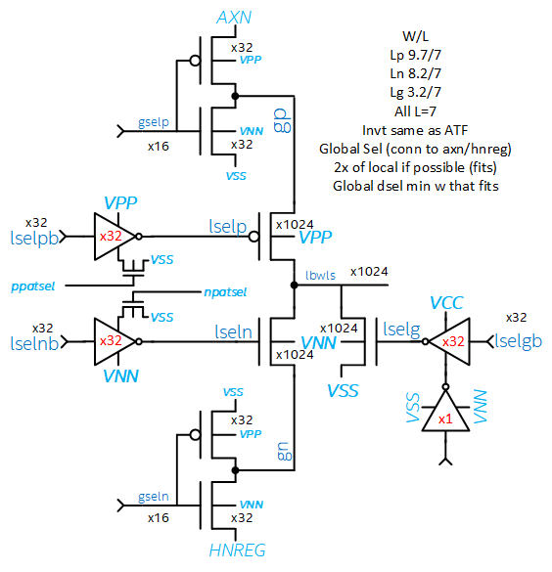
BiSM 3T DR Assessment
BiSM 3T vs. SXP architectures
  Pass +/- voltage from both sides
  One more transistor vs. SXP
BiSM bias at the same or lower than ALF
  Transistor On-state
BiSM bias higher than ALF
  Vdb bias at off-state bias condition
    Max Vdb 8.3V vs. 5.57V for ALF
  Isolation bias
    N+/N+ and P+/P+
    N+/NW and P+/PW
DR capable of providing BiSM bias, however, junction BV at 1.28x Vmax. Limited voltage margin ~2V to support HV stress (showstopper if production HV screen is required)
Decoder on 1 side of cell
(the same for WL and BL)
To cell
Max Bias Condition | Risk | Comments
Transistor On State | Low | BiSM bias at the same or lower than ALF
Transistor Off State | Med | Support max bias for BiSM operation
Isolation | Med | DR capable at BiSM max isolation bias

Slide 2
SXP and BISM Decoder Devices
Decoder Device Type |  | Transistor Type |  | W/L | W/L | W | L | W | L
ALF/ATF | BiSM | ALF/ATF | BiSM | ALF | ATF | BiSM (min) |  | BiSM WIP
GYS | GSELP_P | phv | phv | 35.6 / 7 | 20.38 / 7 | 8 | 7 | 11.2 | 7
GYD | GSELP_N | nhvlvt | ntwhv | 7.5 / 9.7 | 3.16 / 9.7 | 3.16 | 7 | 11.2 | 7
LYS | LSELP | phv | phv | 20 / 7 | 8.52 / 7 | 8 | 7 | 9.7 | 7
LYD | LSELG | nhv | ntwhv | 5.2 / 5.52 | 3.16 / 5.52 | 3.16 | 7 | 3.2 | 7
LXS | LSELN | ntwhv | ntwhv | 16.4 / 7 | 8.52 / 7 | 8 | 7 | 8.2 | 7
GXS | GSELN_N | ntwhv | ntwhv | 14.5 / 7 | 11.64 / 7 | 8 | 7 | 11.2 | 7
GXD | GSELN_P | ntwhv | phv | 8.2 / 7 | 4.24 / 7 | 8 | 7 | 11.2 | 7
LXS | LSELP INV P | phv | phv | 10 / 7 | 4.24 / 8 | 4.24 | 7 | 5 | 7
LXS | LSELP INV N | ntwhv | ntwhv | 10 / 7 | 4.24 / 8 | 4.24 | 7 | 5 | 7
LYS | LSELN INV P | phv | phv | 5.2 / 12 | 4.24 / 8 | 4.24 | 7 | 5 | 7
LYS | LSELN INV N | nhv | ntwhv | 5.52 / 12 | 4.24 / 8 | 4.24 | 7 | 5 | 7
LYD | LSELG INV P | phv | phv |  | 4.24 / 8 | 4.24 | 7 | 5 | 7
LYD | LSELG INV N | ntwhv | ntwhv |  | 4.24 / 8 | 4.24 | 7 | 5 | 7
Local Select and Deselect devices see higher Vdb than ALF/ATF → higher junction leakage
No go for L=5.52 device with higher well doping drain. Junction BV risk at max BiSM bias of 8.3V

Slide 3
Max VDB higher than ALF
POS
4.3V
NEG
4.3V
0V
4.3V
0V
4.1V
0V
0V
4.3V
0V
3.8V
-4V
0V
-4.5V
0V
0V
0V
0V
0V
0V
0V
-4.5V
0V
-4.3V
-4.5V
NHV | ALF | ATF | BiSM
Gate Length (nm) | 350 | 350 | 350
Max Vds | 5.57 | 5.57 | 4.3
Max Vdb/Vsb | 5.57 | 5.57 | 8.3
Max Vgs/Vgd | 5.57 | 5.57 | 4.3
-4.5V
PHV | ALF | ATF | BiSM
Gate Length (nm) | 350 | 350 | 350
Max Vds | -5.57 | -5.57 | -4.5
Max Vdb/Vsb | -5.57 | -5.57 | -8.3
Max Vgs/Vgd | 5.57 | -5.57 | -4.5
High
Med
Low

Slide 4
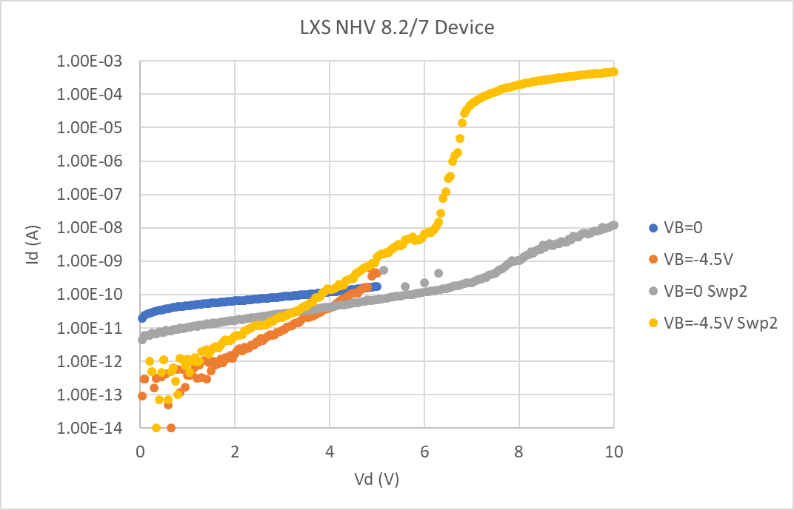
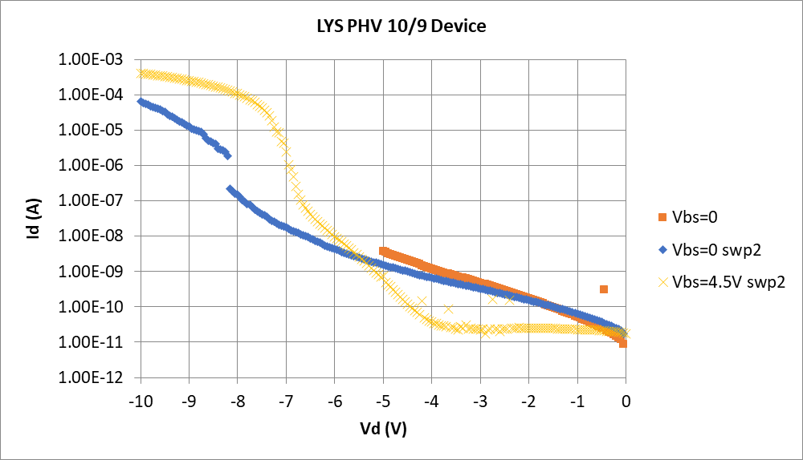
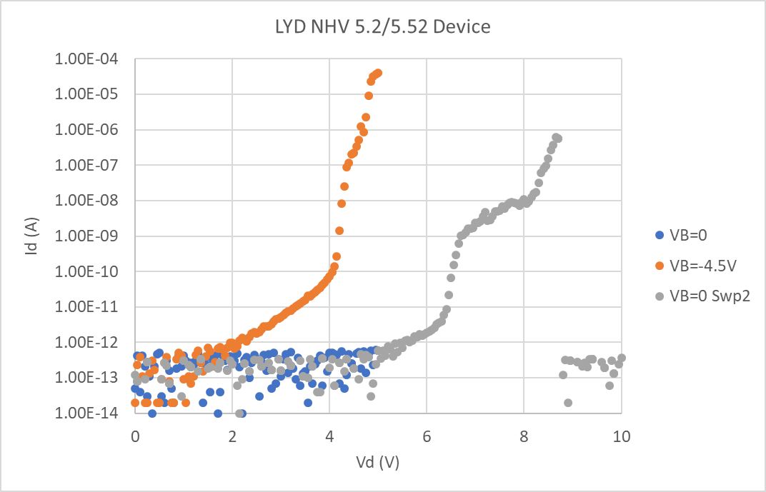
BiSM Off-State Leakage
Junction BV ~10.6V
Junction BV ~11.1V
6.1V
6.6V
PHV 10/7 device can support BiSM max operation voltage (Vds=-4V and Vbs=4.3V), with limited (2.5V) margin to support HV stress
BVJ 8.6V
(4.1+4.5V)
NHV 8.2/7 SSH device can support BiSM max operation condition (Vds=3.8V and Vbs=-4.5V), with limited (2.3V) margin to support HV stress
NHV 5.2/5.52 HVT device cannot support BiSM max operation voltage condition (junction breakdown risk)

Slide 5
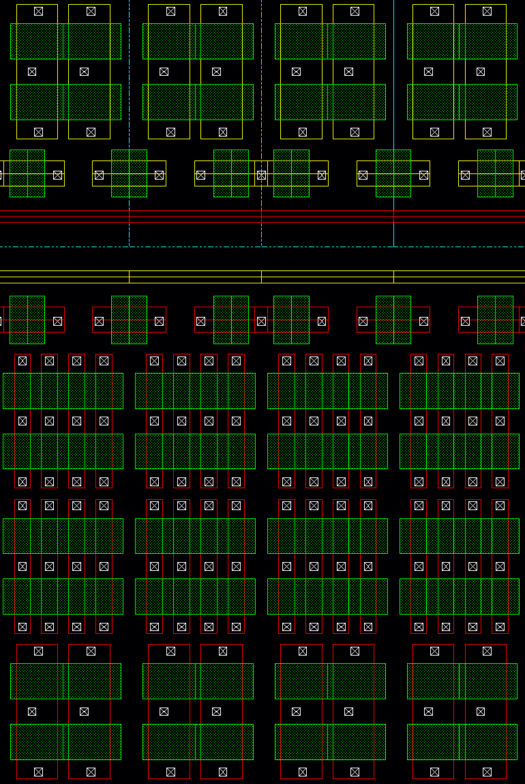
BISM Design Rule Assessment
 | DR Drawn (dum) |  |  | DR Physical (nm)
Design Rules | ALF | ATF | BiSM | ALF | ATF | BiSM
N+ to N+ | 2.2 | 2.2 | 2.2 | 110 | 110 | 110
P+ to P+ | 2.2 | 2.2 | 2.2 | 110 | 110 | 110
N+ to NW | 12 | 12 | 12 | 600 | 600 | 600
P+ to PW | 16 | 12 | 12 | 800 | 600 | 600
Poly EC to EC | 2.4 | 2.4 | 2.4 | 120 | 120 | 120
Field Poly to Active | 2.6 | 2.6 | 2.6 | 130 | 130 | 130
Contact Width | 2 | 1.6 | 1.6 | 80 | 80 | 80
Contact to Gate | 1.9 | 1.7 | 1.7 | 105 | 85 | 85
Con Enclosure Full | 1.1 | 0.75 | 0.75 | 65 | 37.5 | 37.5
Con Enclosure Partial | 0.5 | 0.1 | 0.1 | 35 | 5 | 5
Tap Width | 4.2 | 2.4 | 2.4 | 210 | 120 | 120
Tap to Active | 4.8 | 4.8 | 4.8 | 240 | 240 | 240
Tap to Well | 4.8 | 4.8 | 4.8 | 240 | 240 | 240
LSELP Drain
-4V
250
135
LSELP INV Gate 4.3V
LSELP INV S/D 4.3V
600
NWELL 4.3V
PWELL -4.5V
600
LSELN INV S/D -4.5V
250
3.8V
LSELG Drain
Isolation Bias | ALF | ATF | BiSM 5.57V | BiSM 8.8V | ALF | ATF | BiSM
N+ to N+ | 110 | 110 | 110 | 250 | 5.57 | 5.57 | 8.3
P+ to P+ | 110 | 110 | 110 | 250 | 5.57 | 5.57 | 8.3
NW to N+ | 600 | 600 | 600 | 600 | 5.57 | 5.57 | 8.8
PW to P+ | 800 | 600 | 600 | 600 | 5.57 | 5.57 | 8.8
Contact to Gate | 105 | 85 | 85 | NA | 5.57 | 5.57 | 5.57
Contact to Field Poly | 155 | 135 | 135 | 135 | 5.57 | 5.57 | 8.3
High
Med
Low
DR capable of max BiSM bias, with limited voltage margin to support HV stress

Slide 6
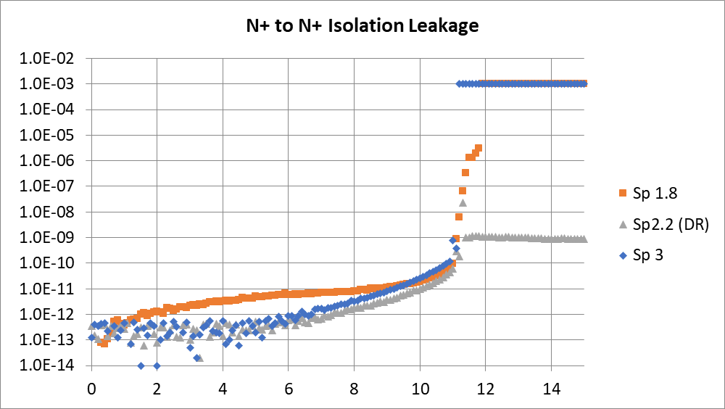
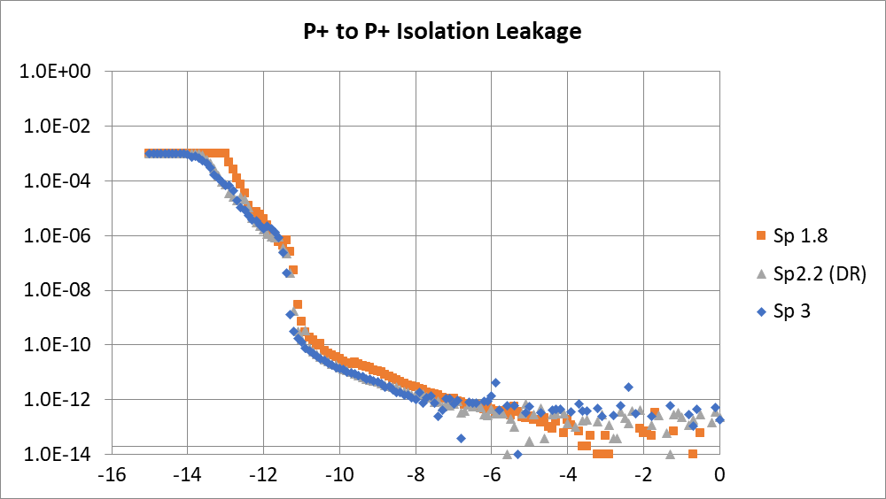
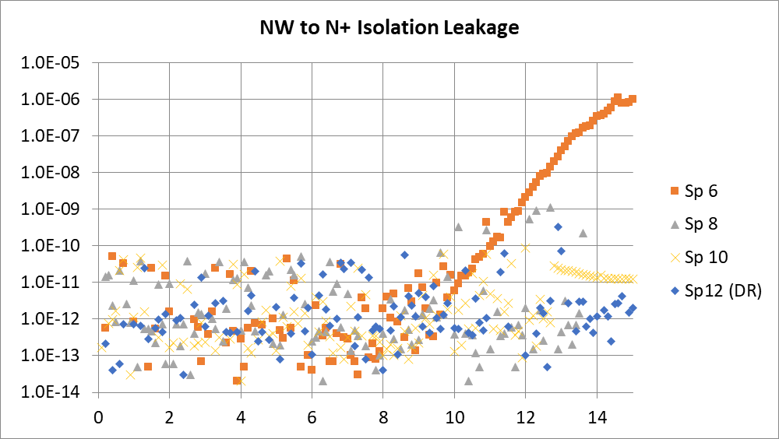
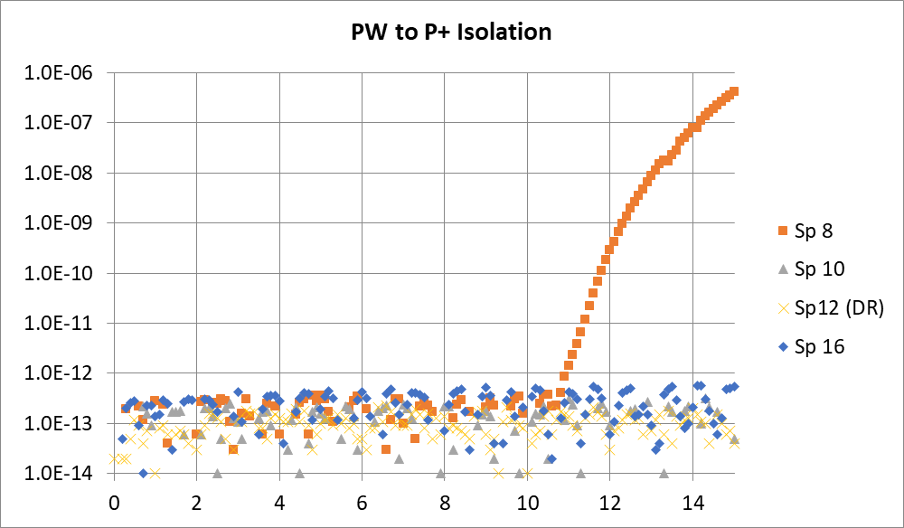
Isolation Design Rule
N+/N+ and P+/P+ isolation DR support BiSM max bias of 8.3V, with limited (2.7V) margin to junction BV
N+/NW and P+/PW isolation passing on sub-DR structures with margin to support HVQK (1.3-1.5x Vmax)
N+ Voltage Sweep
P+ Voltage Sweep
BVJ 11V
BVJ -11V
Pass 15V for DR/sub-DR spacing down to 8
Sub-DR spacing of 6 punch through at 10V
Pass 15V for DR/sub-DR spacing down to 10
Sub-DR spacing of 8 punch through at 10.6V
NW Voltage Sweep
PW Voltage Sweep

