Slide 1
BiSM re-start for low risk α-product definition
WIP
Team BiSM
α-product definition
Critical paths to restart BiSM at F11x
BiSM vs. Full Stack (Baseline – P1240.1/ALF32)
  Technology, RWB, Reliability, Algorithm, Array Architecture, die size, performance, energy
Perspective – Higher density, higher speed, lower BER

Slide 2
α-product definition
Definition placeholder & Process/Design dependency
  Low Risk BiSM Demo: Product level validation by matching HVM full stack (S26)
  Technology Demo: Product level demonstration of BiSM stack with main TD collateral (ATF32)
  (See backup Material on S26 and ATF32 definition)
  G+1 scaling: P1242 candidate; pitch scaling, new collateral may be required
Definitions | Goal (ref. to ATF32) |  |  | Process and Design Dependency
 | BiSM Demo | Tech Demo | G+1 Scaling | Design Collateral & CMOS | Pitch Decision & Integration | DTS/MTS | Algorithm
Wafer Cost | 90% | 90% | 90% | X | X | X
Capacity | match | match | match | X | X
Die size | 1.4X | match | 85% | X | X
Tile Capacity | match | match | match | X | X | X
Read BW | 1.5X | 1X | 1.5X | X |  | X | X
Read Energy | 1.2X | match | match | X | X | X | X
Write BW | 1.5X | 1.5X | 1.5X | X |  | X | X
Write Energy | 1.2X | Match | Match | X | X | X | X
Power | 1.8X | 1.5X | 1.5X | X | X | X | X

Slide 3
Logistics for BiSM Si based learning
 | TC03/04 | S26/SR71 | ALF32/Bantu | ATF16X/SR71 | S24SX | ATF32 (double scribe)
Design Collateral & CMOS | X |  | X
Pitch Decision & Integration |  |  |  | X | X | X
DTS/MTS |  |  |  | X | X | X
Algorithm |  | some | X | some | X | X
Vehicle | Coverage
TC03 | Only needed if CMOS and collateral require significant change to P1241.0
S26 | No need. Training for new array/cell engineer.
ALF32 | Only useful with Bantu. Good for algorithm exploration and development @ 41P
ATF16X | SR71 for scaling learning, smaller density, low thru put testing (5 array / wafer), low visibility to RWB and reliability tail, some but limited learning on algo development
S24SX 3T Decoder | New design required. 3T decode design with live die; enables algo development (for latency, energy assessment) and float deselect development (~3% die size opportunity.)
ATF32 3T Bantu | New Bantu with 3T decode design for cell/array/algo development; enable algo, float deselect, single cell chax, smaller density (low visibility to RWB and reliability, tail)
True DTS/MTS learning pending on PVD, 1st cut last partial and 2nd cut tool isolation.

Slide 4
Value Proposition
BiSM vs. Full Stack 3DXP

Slide 5
BiSM vs. Full Stack and Scalability
Process: Integration and Module
SLC: RWB, Set, Reset
Algorithm: Set, Reset, Read
Reliability: endurance, disturb, retention
Array: density and energy and performance
Si Policy: Compatible with full stack; no additional scaling challenge is expected

Slide 6
BiSM Silicon Empiricals
Last silicon Rev 6.6, In doped SAG and DOE, in June/2018.
Yield learning curves with 100s of wafers (one lot every 2 weeks)
Rev 6.6 SD.k2 BKM process demonstrated PG1 structure yield (S26 live die):
>75% 1D & >40% 2D (on par with full stack at the same time frame)
1st & 2nd cut profile meets MTS; SWA @ 87.5° & 88.5° correspondingly.
Parametric and reliability sampling – 8 lots, 40 wafers, 5 die per wafer.
PG4 capable RWB (SR71 based, limited by array size 3.3σ)
PG1 capable of endurance; good/upper quartile die passing 2M cycles FW
No ULR performed

Slide 7
Process Technology
Metric | Full Stack |  |  |  |  |  |  |  |  | BiSM |  |  |  |  | Scaling Challenge
Periphery | LVT, HVT + 5~6 interconnect
Cell Stack | BE | SD | ME1 | ME2 |  | PM |  | TE |  |  | BE | SD | TE
Array Metals | W, 30nm First Cut, 30/40 nm 2nd Cut |  |  |  |  |  |  |  |  | ½ or more metal thickness reduction possible (>50% I_{pgm}/I_{lkg} reduction)
Patterning | Partial etch and Liner are required |  |  |  |  |  |  |  |  | Single etch, no liner required; lower AR, lower scope for hard-mask
Seal | Nitride seal required |  |  |  |  |  |  |  |  | Required, lower AR, more options
Gap fill | No air gap, 1st/2nd R_{θ} tuning for TD |  |  |  |  |  |  |  |  | No air gap, no visible TD issue
CMP | Similar challenges as nodes scale, socket size scaling limitations may impact
Ambient | Required
On Pitch Via | Scaling challenges expected at 28 pitch and below for via resistance

Slide 8
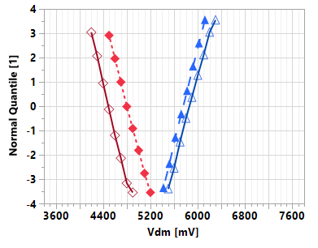
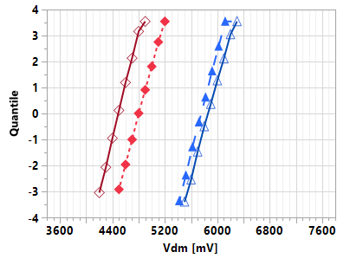
SLC RWB @ 41nm Pitch
Metric | Unit | Full Stack^ | BiSM^
ΔV_{T} @ 1μs ( = RST-SET ) | mV | 1140 | 1380
E2 Consumers
σ_{Vt} | mV | 95 | 100
Drift: 1μs-10s (3s-48h) | mV | 260 (320) | 330 (220)
GB (WE,RD,BD) | mV | - | -
E3 Consumers
σ_{Vt} | mV | 100 | 105
Drift: 1μs-10s (3s-48h) | mV | 630 (>1100) | 590 (1050)
GB (WE,RD,BD) | mV | 100 | 100
Array Op.
x-tile | mV | 30 | 30
Leakage: SET (RST) | mV | 5nA (2nA) | 5nA (0.2nA)
E1 | mV | 4030 | 4040
E4 | mV | 7600 | 7500
Full Stack op. (unipolar)
BiSM op. (bipolar)
RST
SET
Pulse Amplitude
RST
SET
time
time
1μs
10k FW
10s
RWB
E2
E3
RBER goal
^ 10s Qual SORT for full-stack, while non-opt. TBD for BiSM
V_{inh}

Slide 9
Set State
Metric | 41nm Pitch Full Stack | 41nm Pitch BiSM | Scaling Challenge
V_{T} | Tunable by SD MTS (thickness, alloy, transfer function)
MLC feasibility | Lower tuneability by waveform | More flexibility (without PM)
σ_{Vt} | SD MTS + cross contaminations | SD MTS
Drift | SD structure relaxation
Evolution_{Vt} | SD + PM WE, higher V_{T} turn-around | SD WE at lower power
Leakage | SD MTS + cross contaminations | SD MTS
E1 | SD WE + cross contamination | SD WE
E2 | SD WE + PM set-ability + RD | SD WE

Slide 10
Reset State
Metric | Full Stack | BiSM | Scaling Challenge
V_{T} | Tunable by PM material & thickness | Tunable by SD material
MLC feasibility | Tunable by waveform | Tunable by waveform
σ_{Vt} | (SD + PM) MTS + cross contamination | SD MTS
Drift | SD + PM structure relaxation | SD structure relaxation
Evolution_{Vt} | SD + PM WE | SD WE at lower power
Leakage | SD intrinsic (low α-PM contribution) | SD intrinsic subVt shift right
E3 | SD + PM WE + TD | SD WE + RD
E4 | SD + PM WE + PM drift + Leakage | SD WE

Slide 11
Set Operation
Metric | Full Stack | BiSM | Scaling Challenge
Mechanism | Crystallization: Nucleation/Growth | Mass transport @ T_{G} (Segregation)
I_{Program} | 25uA + 60uA (ambipolar) | 50uA (polarity dependent)
t_{pulse} | 130ns+70ns | 50ns
V_{Selection} | E4 | E4
Spike Miti. | Needed for PM endurance | No

Slide 12
Reset Operation
Metric | Full Stack | BiSM | Scaling Challenge
Mechanism | Vitrification (Glass) | Mass Transport @ T_{G} (Segregation)
I_{Program} | 110uA (ambipolar) | 50uA (polarity dependent)
t_{pulse} | 5ns | 50ns
V_{Selection} | E2 | ”E4”
Spike Miti. | Needed for PM endurance | No

Slide 13
Read Operation
Metric | Full Stack | BiSM | Scaling Challenge
Mechanism | Demarcation Read/Set Back/Termination | Demarcation Read(/termination?)
I_{read} | 25uA/60uA/25uA | 25uA or higher (/25uA)
t_{pulse} | 35ns/35ns/30ns | 35ns(/35ns)
V_{Selection} | E2 | E2
Spike Miti. | Needed to PM RD | No

Slide 14
Reliability
Metric | Full Stack | BiSM | Scaling Challenge
WE (Write End.) | Limiter: E2 (PM turn-around) Tuning: (SD + PM) MTS, waveform | Limiter: Extrinsic E1/E4 Tuning: SD MTS (SD ‘health’)
Array init. (Seasoning) | SD stabilization (low PM contribution) Tuning: SD MTS (SD ‘health’) | SD stabilization Tuning: SD MTS (SD ‘health’)
WD (Write dist.) | PM proximity disturb + (SD+PM) BD Tuning: Stack MTS, waveform | SD BD (‘reverse’ dominating) Tuning: SD MTS
RE (Read End.) | SD WE + (PM+SD) disturb Tuning: (PM + SD) MTS, waveform | SD WE Tuning: SD MTS
RD (Read Dist.) | PM disturb (low SD contribution) Tuning: PM MTS, and waveform | SD WE + SD BD (‘reverse’) Tuning: SD MTS and waveform
Retention | SD + PM structure relaxation Tuning: (SD+PM) MTS, and waveform | SD structure relaxation Tuning: (SD) MTS, and waveform

Slide 15
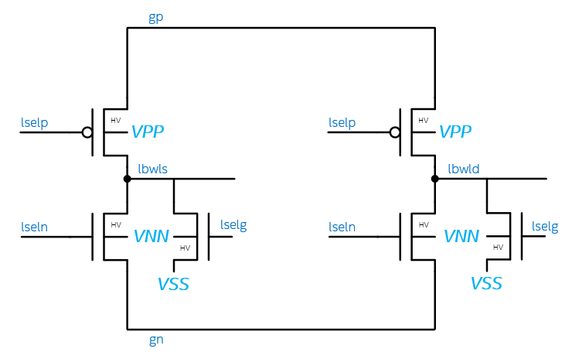
3T Bipolar Decoder
 | 3T
 | POS |  | NEG |  | IDLE
 | SEL | DESEL | SEL | DESEL
gp | 3.7 | 3.7 | 0 | 0 | 0
lselp | 0 | 3.7 | 0 | 3.7 | 3.7
lbwl | 3.7 | 0 | -3.7 | 0 | 0
lseln | 0 | -3.7 | 0 | -3.7 | -3.7
gn | 0 | 0 | -3.7 | -3.7 | 0
lselg | 0 | 1.2 | -3.7 | 1.2 | 1.2
vss | 0 | 0 | 0 | 0 | 0
#/patch | 32 | 992 | 32 | 992 | 1024
3.7
0
3.7
POS
NEG
IDLE
0
3.7
3.7
0
0
-3.7
3.7
0
3.7
3.7
0
0
0
0
-3.7
1.2
0
0
-3.7
1.2
-3.7
1.2
-3.7
1.2
0
-3.7
-3.7
3T Solves the energy problem present in 2T POR
  No Deselect Toggle
  At Cost of adding on transistor. (Small N Xtr.)
Decoder footprint is expected on par with 2T POR
  [Med P + Med N + Small N] vs. [Big N (or P) + small P (or N)]
  Need decoder layout to drive assessment.
 | ALF32 | S24S | 3T
Status | POR | POR | Pre POR
Cell Arch | Unipolar | Bipolar | Bipolar
Decode Type | 2T | 2T | 3T
Deselect Togl. | No | Yes | No
Float Deselects | No | No | No
Energy | 104 | 154 | ~104
Die size | 198 | 221 | 227

Slide 16
Read
3DXP Full Stack
SET Pulse 3 (25ns)
BL 1st Termination (20ns)
Yes
Start
Read Pulse incl. Ramp
(37.5ns)
Sense Amp &
Latch
(12.5ns)
Set? (5ns)
No
BiSM Read
Start
Read Pulse incl. Ramp
(37.5ns)
Sense Amp Latch
(12.5ns)
BL 1st Termination (20ns)

Slide 17
Set a reset cell
3DXP Full Stack
WL/BL Ramp
(211ns)
Incl.
Spike Miti (71ns)
Snap Detect (45ns)
C-cell (95ns)
Start
I_{low} (P1)
(30ns)
I_{high} (P3)
(103ns)
P4
(30ns)
BL1st
(20ns)
BiSM
WL/BL Ramp
(140ns)
Incl.
Snap Detect (45ns)
C-cell (95ns)
Start
I_{high} (P3)
(50ns)
BL1st
(20ns)

Slide 18
Reset a set cell
3DXP full Stack
Reset Pulse (15ns)
Yes
Start
WL/BL Ramp
(37.5ns)
Sense
(12.5ns)
Set? (5ns)
No
BiSM
WL/BL Ramp
(140ns)
Incl.
Snap Detect (45ns)
C-cell (95ns)
Start
I_{high} (P3)
(50ns)
BL1st
(20ns)

Slide 19
Memory Hierarchy expansion
Perspective in Memory Displacement Strategy of Von Neumann Architecture

Slide 20
Multi Level Cell capable for high density/high speed Storage
Read V_{TH}
+V_{DM2}
+V_{DM1}
1
0
1
-PA2’
-PA1’
+PA1
+PA2
Write PA
Write PA
SLC
-V_{DM1’}
+PA1
Y
+V_{DM2}
0
Write PW
-PA1’
1
.5
0
1
.5
1.5 b/c
Write PA
+PA2
+PA1
Y
Y
Write PW
+V_{DM1}
+V_{DM2}
0
-PA1’
11
10
01
00
11
10
01
Write PA
+PA2
MLC
+PA1
Y
Y
Y
00
Write PW
-PA1’
+V_{DM1}
+V_{DM2}
-V_{DM1’}
-PA2’

Slide 21
Multi Level Cell (II)
Read V_{TH}
+V_{DM2}
+V_{DM1}
1
0
1
-PW2’
-PW1’
+PW1
+PW2
Write PA
Write PW
SLC
+PW1
-PW1’
-V_{DM1’}
Y
0
Write PW
+V_{DM2}
1
.5
0
1
.5
1.5 b/c
Write PA
+PW2
+PW1
-PW1’
Y
Y
0
Write PW
+V_{DM1}
+V_{DM2}
11
10
01
00
11
10
01
Write PA
+PW2
+PW1
-PW2’
-PW1’
MLC
Y
Y
Y
00
Write PW
+V_{DM1}
+V_{DM2}
-V_{DM1’}

Slide 22
Multi Level Cell (III) – TLC or more
111
110
101
100
-PW1
Read V_{TH}
+PW2
+PW2
+PW1
+PW1
Write PA
+PA2
+PA1
-PW2
Write PW
+PW1
+V_{DM4}
+V_{DM3}
+PW2
+V_{DM2}
+V_{DM1}
-PA2’
-PA1’
+PA1
+PA2
-V_{DM1’}
Write PA
-V_{DM2’}
-V_{DM3’}
011
010
001
000
-PW2’
-PW2’
-PW1’
-PW1’
Write PW
Write PA
-PA1’
-PA2’

Slide 23
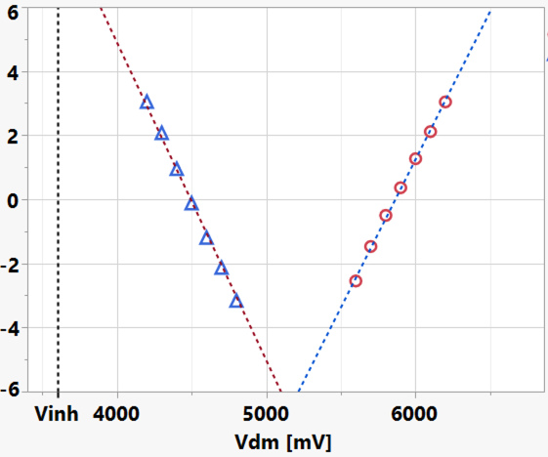
High speed / lower RBER for Random Word Access Application
DRAM RBER is < 1E-9 or 5.998σ
Bianca Schroeder et.al, 'DRAM Errors in the Wild - A large scale field study’ https://doi.org/10.1145/1897816.1897844
  Studied in Google server farm for 2½ years
  25,000 to 70,000 FIT of 'ECC correctable error’ of 64-bit-word per Megabit
  one single-bit-error every 14 to 40 hours per Gigabit
Disclaimer: This statistical analysis of RBER can not be used universally for all applications
Distribution focus include
Noise (traps), snapback (charge multiplication process) stability as manifest in threshold bounce
Glass metastability related to drift and seasoning
Cycle endurance
Extrapolation based on
Rev 6.6,
In doped SAG SD.k2
SR71 (3.3σ)
Post 1µses
After seasoning
Sigma of bit

Slide 24
BackUp Materials

Slide 25
Optane Media Roadmap (Pre-POR)
Key Spec | S26A | Atlantic Falls 32
Technology node | 2nd | 3rd
Density | 32GB | 32GB
Die Size | 199mm2 | 136mm2
Cost $/GB vs. S26A (TCS) | 1X | 0.75X
Alpha Fab Memory PRQ | EOY 2019 | Q1-Q2’ 2022
Read BW | 1600 MB/s | 3200 MB/s
Write BW | 800 MB/s | 1100-1600 MB/s
Read Energy | 49 pJ/b | 47 pJ/b*
Write Energy | 112 pJ/b | 95 pJ/b*
IO Interface | 1600 MT/s/pin DDR4 | Combo Phy (DDR4+ LPDDR4x w/o DFE)
Package | 256b | 392b 2-ch
Server Memory/Platform | CrowPass/SPR | DonahuePass/GNR
Server Memory PRQ | Q2’21 | Q2-Q3’22
Server Memory perf. GnG 2R:1W 256GB | 1X | 1.5X (w/ Media), 3X (w/ controller)
Datacenter Storage | Alderstream (G4) | Alderstream Refresh (G4)
Storage PRQ | Q4’20 | Q2’22
Storage Perf 70/30 BW 0.8TB | 1X | 1X

