Slide 1
Multicurrent pulse in BiSM – impact on RWB
Goal:
  Understand settling times in bipolar and unipolar transition
  Evaluate opportunity for multicurrent pulses in BiSM
Summary:
  Transition in bipolar requires 10s of ns at low-currents (<45ns), but happens much faster at higher currents (<40ns @ 80uA)
  Unipolar transition within a pulse is very fast for ramp-up pulse (settling times is <20ns for VTs to settle); ramp-down pulse requires more time to transition to steady-state VTs (longer than bipolar transition)
  DVT shows improvement with ramp-down pulses; drift follows iso-plane that is max(PA) driven
    Highlights some opportunity in using ramp-down pulse for programming

Slide 2
DOE
Silicon:
  0224662 W25 A4 (Die 3,1), K2 BiSM
Experiment flow:
  4k bits cycled to 10k, NPT blocks 98/99/101/102
  Skews:
  Data collected:
    1us / 1s histos for NPn/PNn/NPp/PNp
Case | Algo | I1 | PW1 | I2 | PW2
No P1 | POR | 0uA | 0ns | 30/45/65/80uA | 20/30/40/60/80/120/160/240
P1 = 45uA | I1I2 | 45uA | 60ns | 30/45/65/80uA | Variable
P1 = 80uA | I1I2 | 80uA | 60ns | 30/45/65/80uA | Variable
P1 = 65uA | I1I2 | 65uA | 60ns | 30/45/65/80uA | Variable
PA1
60ns
I2= Var PA / Var PW
P
p
N
WT

Slide 3
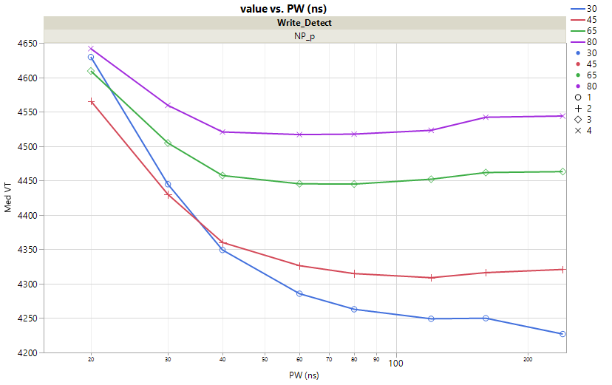
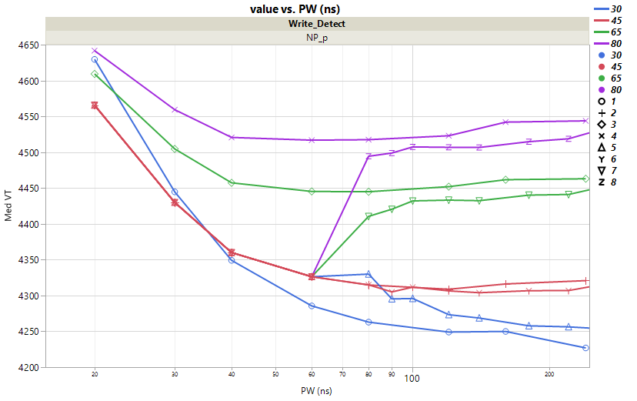
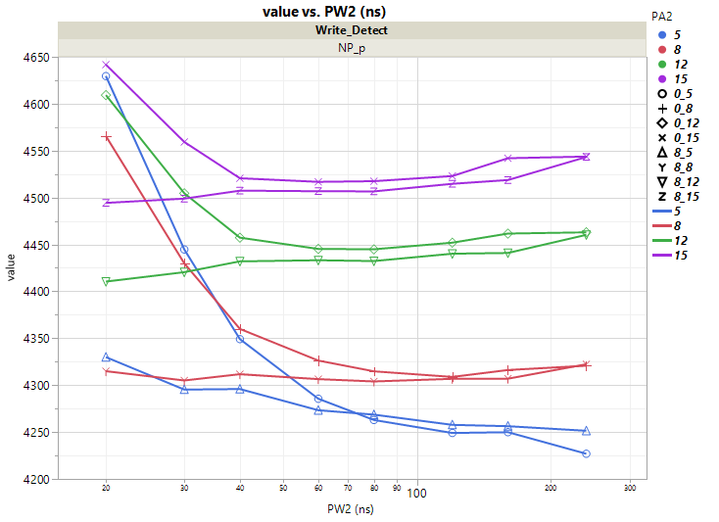
Settling times in unipolar vs. bipolar transitions
45uA
60ns
I2= Var PA / Var PW
I= Var PA/Var PW
P
p
P
p
N
WT
N
WT
80uA
80uA
65uA
65uA
45uA
45uA
30uA
30uA
PW (ns)
Time after change in current
Total PW (ns)
Same data, represented with 0ns as the time for change in current (e.g. second current)
VT settling time is 40-60ns within currents of 30-80uA
  High currents settle faster (~40ns)
  Low currents require longer times (~60ns)
Transition to higher currents is very fast; most time spent is cumulative
  Lower currents (45uA → 30uA) still requires long times to settle

Slide 4
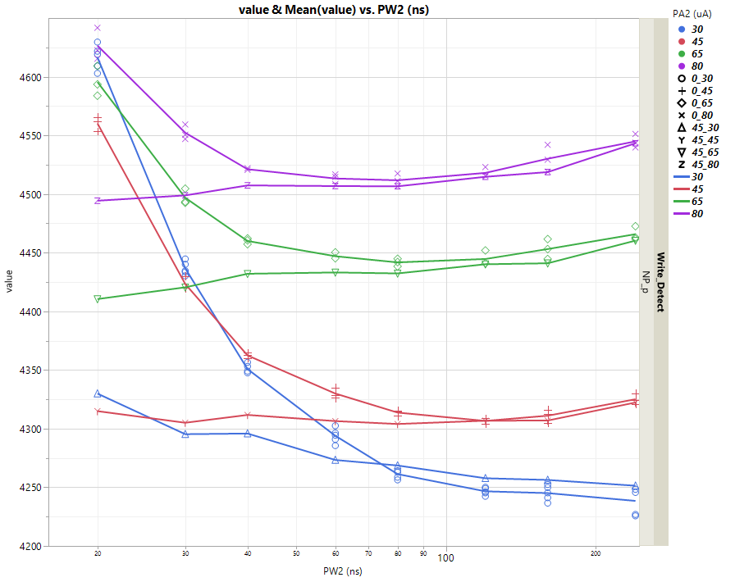
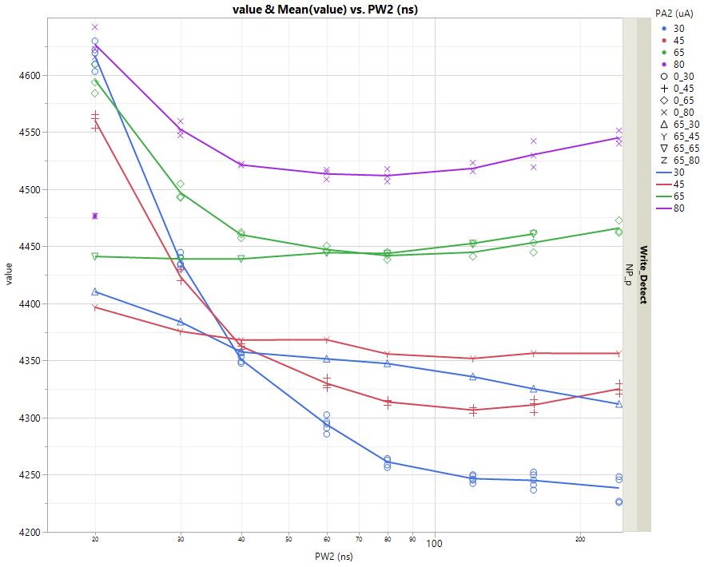
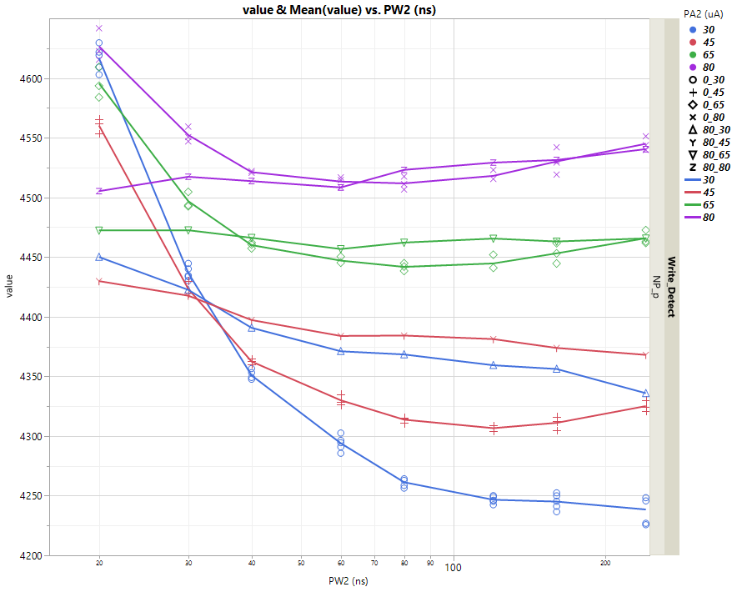
Transition from
I2= Var PA / Var PW
I2= Var PA / Var PW
80uA
60ns
I2= Var PA / Var PW
45uA
60ns
65uA
60ns
P
p
P
p
P
p
N
N
N
WT
WT
WT

Slide 5
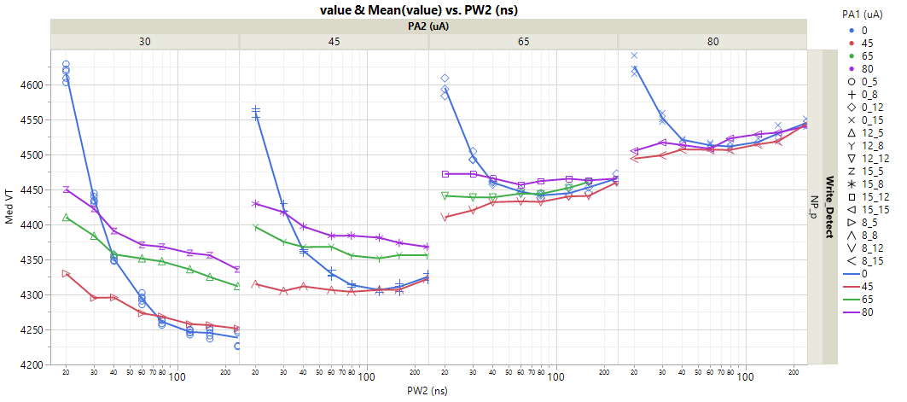
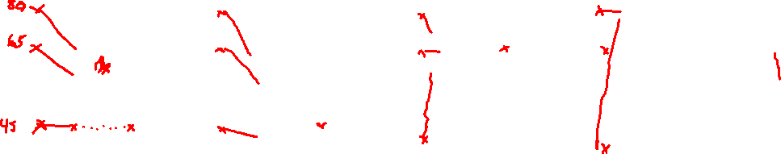
PW2 requirements vs. PA1 settling time
PA1 = 80uA
PA2 = 45uA
PA1 = 80uA
PA2 = 30uA
PA1 = 45uA
PA2 = 80uA
VT @ 30uA steady state = ~4.25V
High PA1 & low PA2 (ex: PA1=80uA/PA2=30uA)
→ leads to very slow convergence back to ~4.25V
VT @ 80uA steady state = ~4.525V
Low PA1 & High PA2 (ex: PA1=45uA/PA2=80uA)
→ Rearrangement for high PA2 is very fast

Slide 6
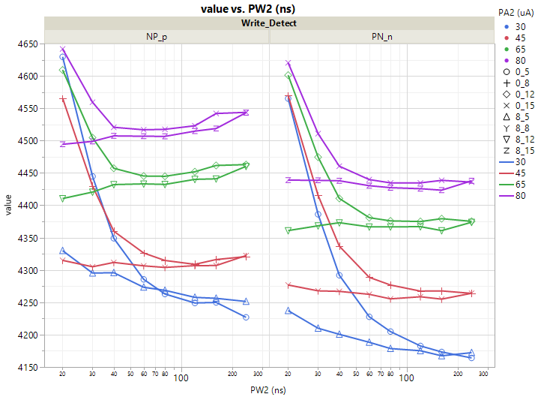
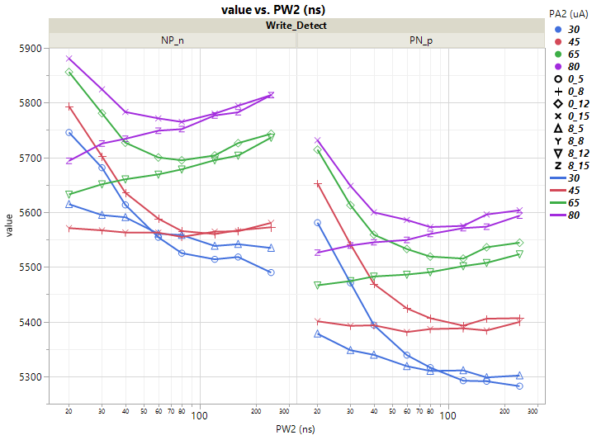
Dual pulse – PW requirements after 45uA/60ns
Low VT states
High VT states
I= (30-80uA
@ Var PW
P
p
N
WT
80uA
65uA
45uA
60ns
I2= (30-80uA
@ Var PW
P
p
45uA
N
WT
30uA
PW (ns)
Time after change in current
PW (ns)
Time after change in current
Similar behavior for both low-VT and high-VT states
  Higher currents time for VT to converge is lower pulses

Slide 7
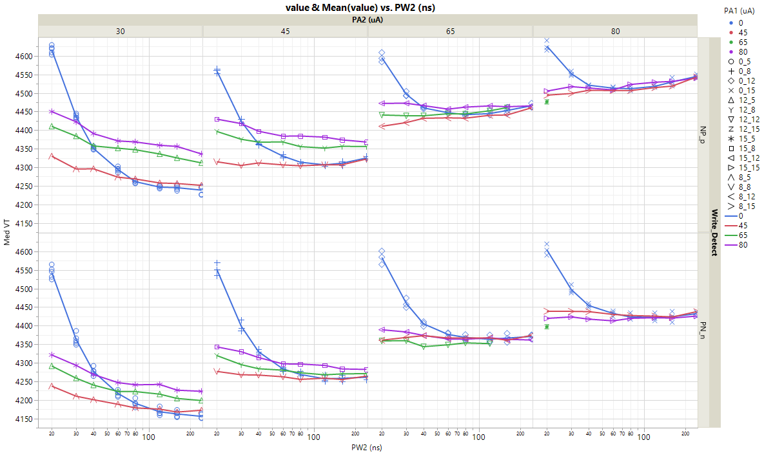
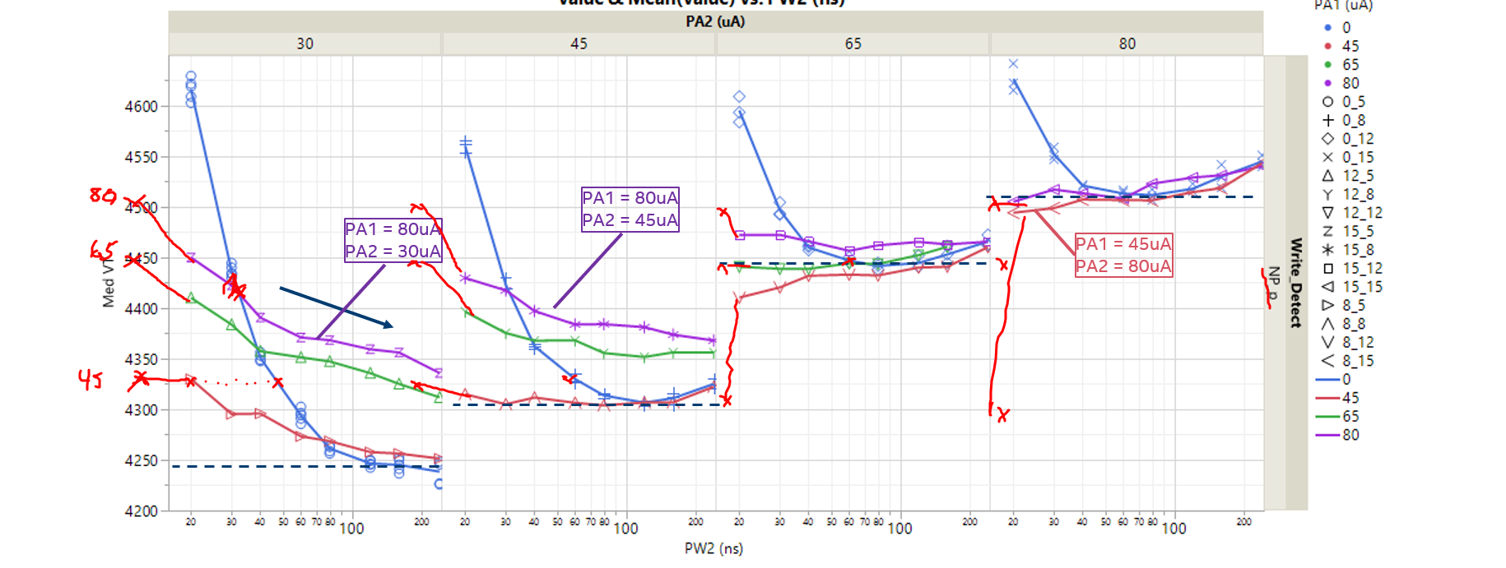
Setting time on low-VT states
PA1 = 80uA
PA2 = 45uA
PA1 = 45uA
PA2 = 80uA

Slide 8
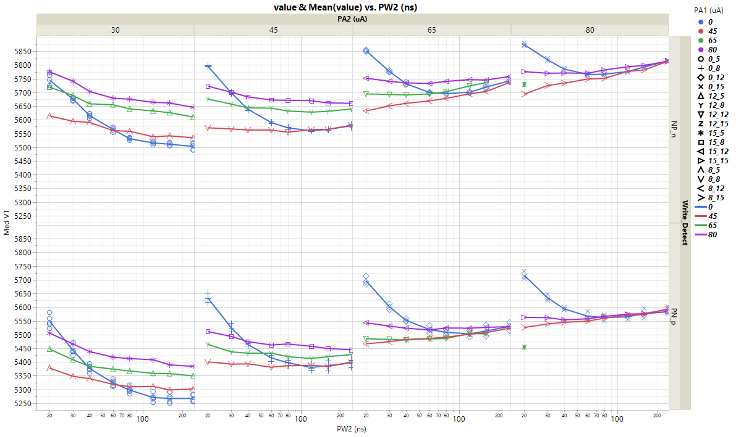

Settling times on high-VT states

Slide 9
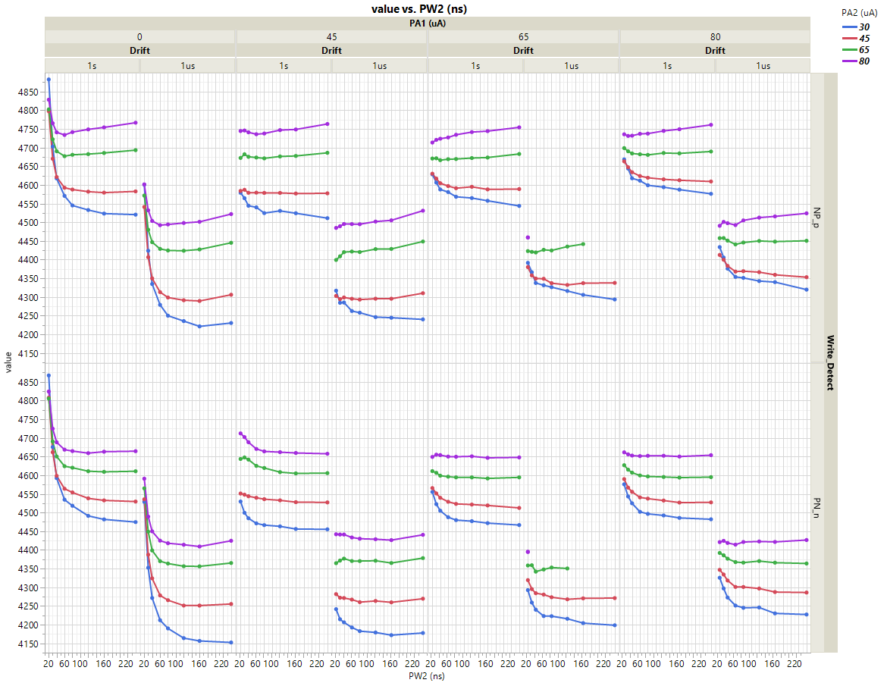
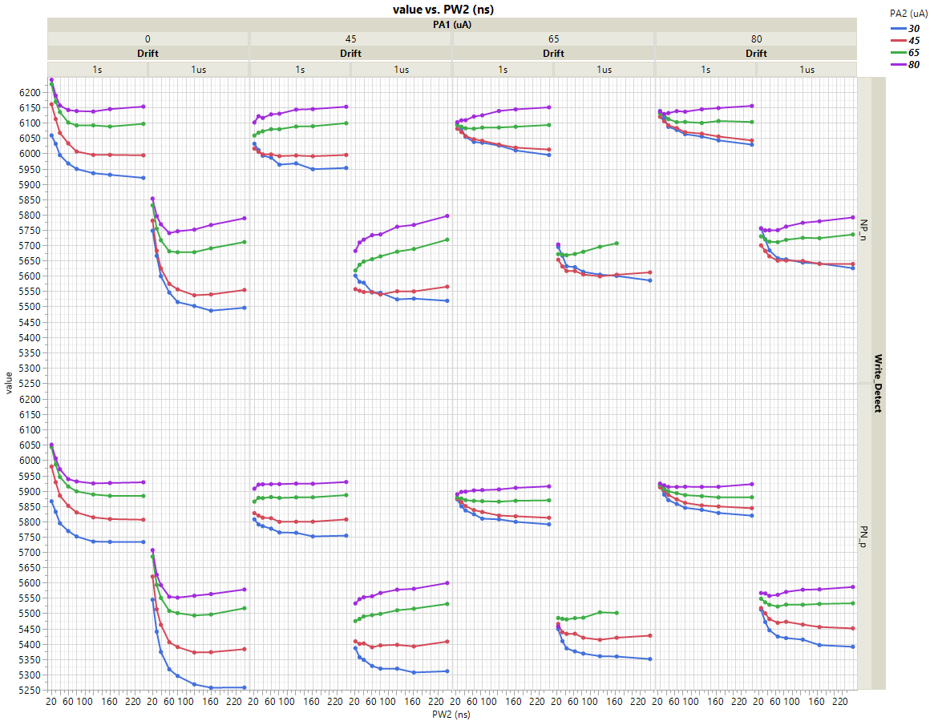
VT 1us / 1s
Low-VT states
High-VT states

Slide 10
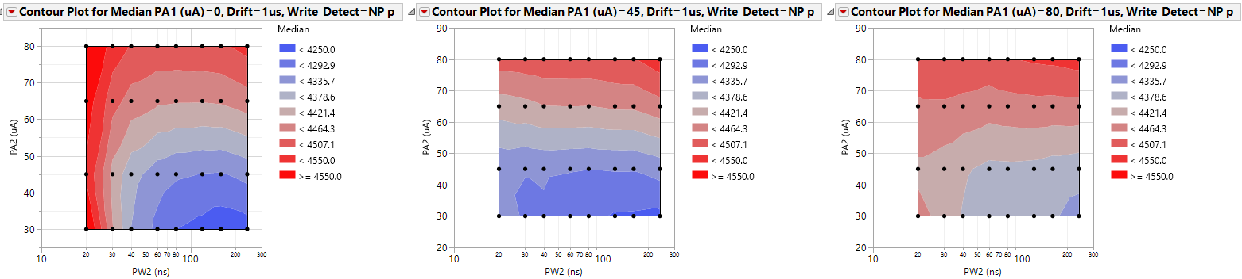
VT contour plots
Ramp-up pulse
Ramp-down pulse
NP_p
1us
Bipolar transition settling time:
  Transition in bipolar requires 10s of ns in low-currents → happening much faster in higher currents (<40ns)
Unipolar transition settling time:
  Ramp-up pulse has very fast settling times → <20ns for VTs to settle
  Ramp-down pulse takes longer, with a transition time longer than bipolar transition
I1=PA1/60ns
I2= PA2/PW2
P
p
N
WT

Slide 11
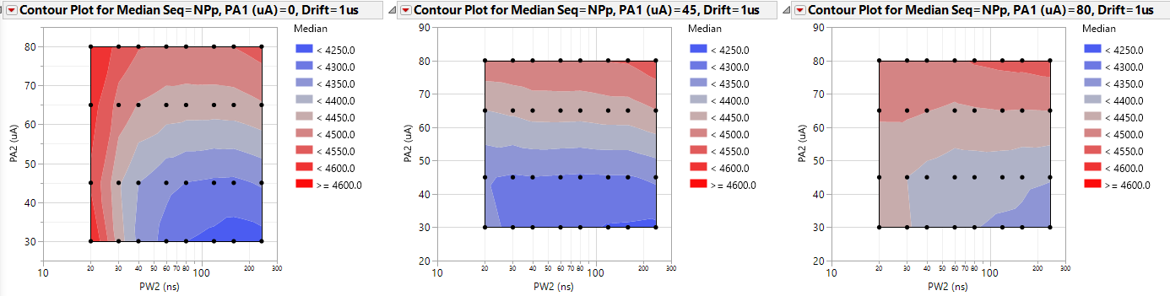
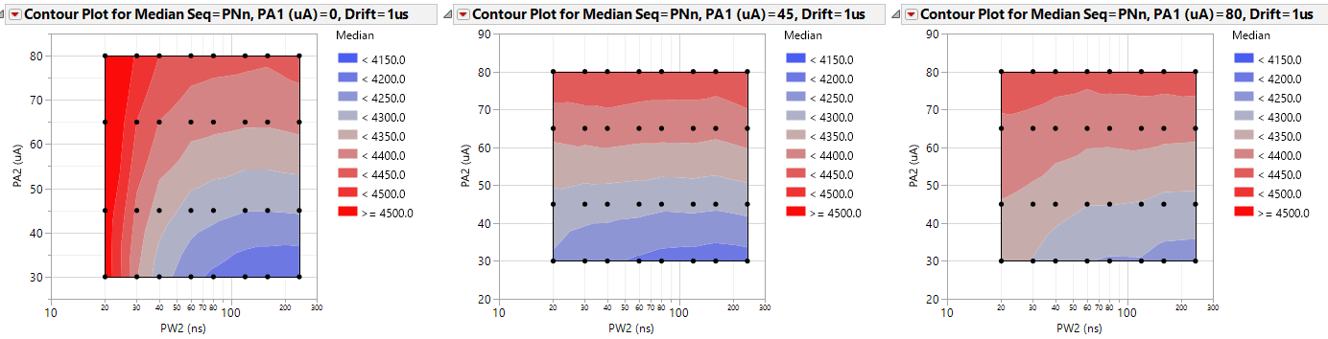
VT contour plots
Low-VT states (NPp / PNn)

Slide 12
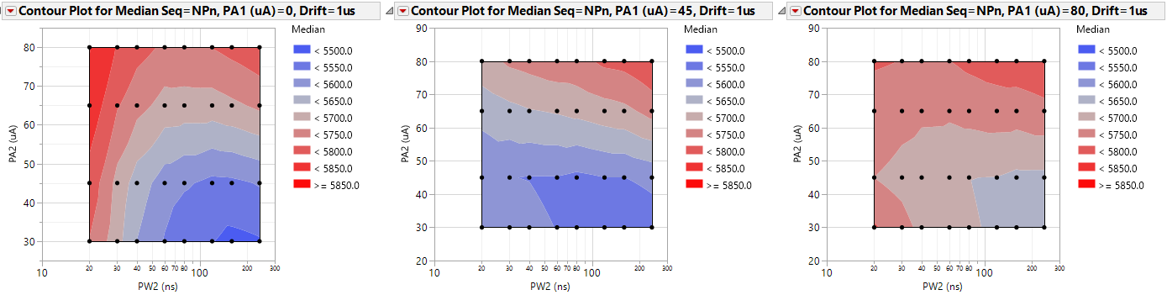
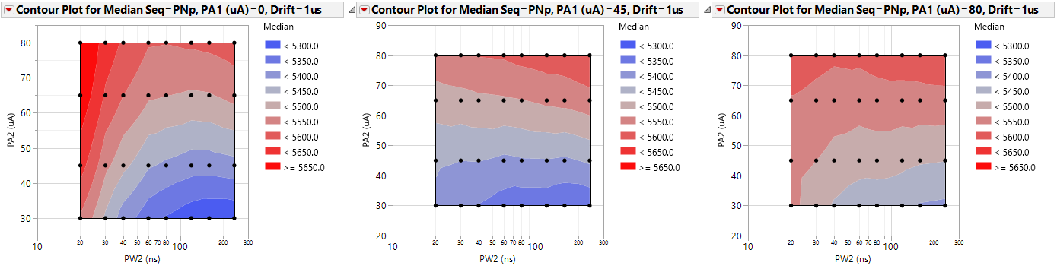
VT contour plots
High-VT states (NPn / PNp)

Slide 13
Metrics
 | POR | POR | POR | POR | I1I2 | I1I2 | I1I2 | I1I2 | I1I2 | I1I2 | I1I2 | I1I2
PA1 (uA) | 0 | 0 | 0 | 0 | 45 | 45 | 45 | 45 | 80 | 80 | 80 | 80
PW2 (ns) | 60 | 60 | 60 | 60 | 60 | 60 | 60 | 60 | 60 | 60 | 60 | 60
PA2 (uA) | 30 | 45 | 65 | 80 | 30 | 45 | 65 | 80 | 30 | 45 | 65 | 80
Median NP_n 1us | 5546 | 5574 | 5680 | 5740 | 5546 | 5548 | 5655 | 5733 | 5658 | 5650 | 5710 | 5749
Median PN_n 1us | 4212 | 4279 | 4370 | 4425 | 4193 | 4267 | 4371 | 4434 | 4251 | 4301 | 4368 | 4414
Median NP_p 1us | 4279 | 4313 | 4429 | 4492 | 4263 | 4295 | 4422 | 4495 | 4354 | 4368 | 4441 | 4493
Median PN_p 1us | 5317 | 5406 | 5508 | 5554 | 5328 | 5389 | 5494 | 5556 | 5424 | 5469 | 5522 | 5561
Median NP_n DRF-1us-1s | 371 | 405 | 366 | 348 | 385 | 391 | 368 | 342 | 363 | 372 | 336 | 331
Median PN_n DRF-1us-1s | 275 | 239 | 207 | 200 | 233 | 222 | 208 | 190 | 206 | 192 | 190 | 191
Median NP_p DRF-1us-1s | 239 | 233 | 203 | 193 | 225 | 233 | 201 | 189 | 208 | 206 | 193 | 190
Median PN_p DRF-1us-1s | 407 | 403 | 359 | 337 | 401 | 374 | 337 | 320 | 382 | 358 | 323 | 309
Median DVT_n | 1277 | 1235 | 1253 | 1262 | 1299 | 1227 | 1232 | 1250 | 1354 | 1293 | 1289 | 1282
Median DVT_p | 995 | 1047 | 1039 | 1024 | 1021 | 1045 | 1025 | 1010 | 1033 | 1057 | 1040 | 1023
Median NP_DVT | 1220 | 1218 | 1212 | 1206 | 1240 | 1206 | 1191 | 1191 | 1261 | 1239 | 1228 | 1210
Median PN_DVT | 1054 | 1072 | 1083 | 1079 | 1078 | 1068 | 1069 | 1071 | 1116 | 1110 | 1103 | 1093
Sigma NP_n | 142 | 154 | 165 | 163 | 144 | 147 | 150 | 146 | 180 | 176 | 169 | 172
Sigma PN_n | 115 | 113 | 115 | 115 | 106 | 106 | 109 | 103 | 128 | 121 | 121 | 117
Sigma NP_p | 106 | 116 | 117 | 116 | 108 | 107 | 107 | 106 | 135 | 131 | 123 | 122
Sigma PN_p | 143 | 145 | 142 | 138 | 144 | 136 | 131 | 131 | 154 | 149 | 146 | 145

Slide 14
Experiment plan
SLOT in BOAT | STATUS | LOT# | NICK | WAFER | SPLIT | Reticle | Deck# | REV | DOE | Dies Available | Priority | Median SET VT (1us 2k FW) (mV) | Median RST VT (1us 2k FW) (mV)
5 | loaded | 0217342.003 | LOT#66 (G1) | 5 | 01E | A1 | 1D0 | r6.5 | 22nm SD.k2 | iPR run | 1 | 4332 | 5659
2 | loaded | 0217342.003 | LOT#66 (G1) | 2 | 02E | A1 | 1D0 | r6.5 | 22nm SD-g01 | iPR run | 1 | 4725 | 6119
10 | loaded | 0217342.003 | LOT#66 (G1) | 10 | 04E | A1 | 1D0 | r6.5 | 22nm SD-g03 | iPR run | 2 | 4716 | 5997
18 | loaded | 0217342.003 | LOT#66 (G1) | 18 | 06E | A1 | 1D0 | r6.5 | 22nm SD-g05 | iPR run | 1 | 5178 | 6492
24 | loaded | 0204232.003 | LOT#58 (E2) | 5 | 01C | A1 | 1D0 | r5.3 | 22nm SD.k1 | iPR run | 1 | 4483 | 5617
25 | loaded | 0204232.003 | LOT#58 (E2) | 8 | 05E | A1 | 1D0 | r5.3 | 22nm SD.k2* | iPR run | 1 | 4252 | 5627
20 | Loaded | 0215642.003 | LOT#72 (tSD) | 20 | 05E | A1 | 1D0 | r6.x | 20nm SD.k2 | iPR run | 1 | 4275 | 5650
23 | on MPI (lower priority) | 0215642.003 | LOT#72 (tSD) | 23 | 01E | A1 | 1D0 | r6.5 | 22nm SD.k2 | iPR run | 2 | 4459 | 5822
16 | on TEL08 (Louis to load) | 0215642.003 | LOT#72 (tSD) | 16 | 06E | A1 | 1D0 | r6.6 | 24nm SD.k2 | iPR run | 1 | 4721 | 6134
21 | loaded | 0215642.003 | LOT#72 (tSD) | 21 | 08E | A1 | 1D0 | r6.x | 26nm SD.k2 | iPR run | 1 | 4850 | 6352
 |  | 0224662.003 | LOT#71 (nAC) | 25 | 02E | A3 | 1D0 | r6.5 | in use (Dany) | All (no ipr data) | 0 | NA | NA
SD k1/k2/g1/g3/g5
SD k2 thickness skew

Slide 15
Changes to flow:
  A1 support (minor changes to algos)
  Spread experiment on different groups of bits → reduce total cycling count; initialize @ 20k
  Expand on higher currents

Slide 16
DOE
Silicon:
  0224662 W25 A4 (Die 3,1), K2 BiSM
Experiment flow:
  4k bits cycled to 10k, NPT blocks 98/99/101/102
  Skews: (repeated 3 times)
  Data collected:
    1us / 1s histos for NPn/PNn/NPp/PNp
Case | Algo | I1 | PW1 | I2 | PW2
No P1 | POR | 0uA | 0ns | 30/45/65/80uA | 60ns
P1 = 45uA | I1I2 | 30uA | 60ns | 30/45/65/80uA | 60ns
P1 = 45uA | I1I2 | 45uA | 60ns | 30/45/65/80uA | 60ns
P1 = 80uA | I1I2 | 80uA | 60ns | 30/45/65/80uA | 60ns
P1 = 65uA | I1I2 | 65uA | 60ns | 30/45/65/80uA | 60ns
PA1
60ns
I2= Var PA / Var PW
P
p
N
WT

Slide 17
Metrics
 | POR | PW = 60ns, single PA |  |  |  | PW=60ns+60ns |  |  |  |  |  |  |  |  |  |  |  |  |  |  |  | POR @ END
PW1 (ns) | 0 | 0 | 0 | 0 | 0 | 60 | 60 | 60 | 60 | 60 | 60 | 60 | 60 | 60 | 60 | 60 | 60 | 60 | 60 | 60 | 60 | 0
PA1 (uA) | 0 | 0 | 0 | 0 | 0 | 30 | 30 | 30 | 30 | 45 | 45 | 45 | 45 | 65 | 65 | 65 | 65 | 80 | 80 | 80 | 80 | 0
PW2 (ns) | 40 | 60 | 60 | 60 | 60 | 60 | 60 | 60 | 60 | 60 | 60 | 60 | 60 | 60 | 60 | 60 | 60 | 60 | 60 | 60 | 60 | 40
PA2 (uA) | 45 | 30 | 45 | 65 | 80 | 30 | 45 | 65 | 80 | 30 | 45 | 65 | 80 | 30 | 45 | 65 | 80 | 30 | 45 | 65 | 80 | 45
MED PNn 1us | 4576 | 4472 | 4541 | 4618 | 4678 | 4439 | 4516 | 4603 | 4667 | 4445 | 4503 | 4585 | 4647 | 4469 | 4520 | 4582 | 4640 | 4484 | 4537 | 4602 | 4656 | 4562
MED NPn 1us | 5737 | 5601 | 5694 | 5790 | 5855 | 5551 | 5653 | 5767 | 5843 | 5616 | 5665 | 5760 | 5830 | 5673 | 5729 | 5789 | 5837 | 5705 | 5770 | 5830 | 5865 | 5734
MED NPp 1us | 4552 | 4445 | 4529 | 4627 | 4692 | 4399 | 4498 | 4605 | 4680 | 4427 | 4492 | 4593 | 4667 | 4470 | 4523 | 4597 | 4662 | 4497 | 4551 | 4624 | 4680 | 4542
MED PNp 1us | 5592 | 5467 | 5549 | 5632 | 5686 | 5419 | 5504 | 5604 | 5670 | 5456 | 5514 | 5596 | 5660 | 5512 | 5557 | 5609 | 5663 | 5533 | 5584 | 5642 | 5682 | 5581
Sigma PNn 1us | 113 | 104 | 110 | 116 | 124 | 104 | 112 | 118 | 124 | 97 | 111 | 118 | 123 | 101 | 107 | 115 | 124 | 99 | 105 | 115 | 123 | 112
Sigma NPn 1us | 150 | 146 | 144 | 145 | 148 | 152 | 143 | 143 | 147 | 143 | 145 | 143 | 141 | 144 | 145 | 145 | 146 | 146 | 145 | 147 | 148 | 142
Sigma NPp 1us | 108 | 103 | 106 | 106 | 111 | 241 | 106 | 108 | 111 | 103 | 107 | 109 | 113 | 101 | 102 | 108 | 112 | 97 | 99 | 105 | 111 | 106
Sigma PNp 1us | 134 | 137 | 137 | 132 | 132 | 134 | 136 | 132 | 138 | 138 | 140 | 141 | 146 | 138 | 147 | 139 | 144 | 133 | 135 | 141 | 140 | 133
MED PNn DRF-1us-1s | 191 | 226 | 192 | 172 | 167 | 234 | 227 | 199 | 184 | 225 | 219 | 208 | 202 | 216 | 201 | 201 | 205 | 202 | 188 | 187 | 190 | 209
MED NPn DRF-1us-1s | 398 | 406 | 393 | 364 | 347 | 399 | 400 | 382 | 355 | 397 | 383 | 372 | 358 | 395 | 374 | 358 | 348 | 389 | 375 | 352 | 342 | 400
MED NPp DRF-1us-1s | 182 | 214 | 182 | 165 | 158 | 251 | 223 | 195 | 177 | 230 | 221 | 202 | 190 | 217 | 204 | 195 | 193 | 205 | 188 | 182 | 182 | 198
MED PNp DRF-1us-1s | 403 | 411 | 395 | 369 | 343 | 417 | 406 | 386 | 363 | 417 | 390 | 382 | 363 | 413 | 390 | 368 | 354 | 400 | 387 | 372 | 355 | 401
MED DVT_n 1us | 1122 | 1086 | 1112 | 1133 | 1139 | 1070 | 1094 | 1121 | 1135 | 1128 | 1121 | 1130 | 1146 | 1158 | 1166 | 1163 | 1157 | 1176 | 1190 | 1187 | 1169 | 1131
MED DVT_p 1us | 995 | 978 | 977 | 960 | 949 | 986 | 966 | 957 | 946 | 987 | 980 | 961 | 953 | 998 | 993 | 973 | 961 | 987 | 986 | 975 | 958 | 1000
MED DVT_P 1us | 1144 | 1117 | 1125 | 1122 | 1119 | 1123 | 1114 | 1118 | 1120 | 1149 | 1132 | 1123 | 1123 | 1159 | 1163 | 1145 | 1132 | 1162 | 1174 | 1162 | 1142 | 1149
MED DVT_N 1us | 972 | 948 | 963 | 971 | 969 | 936 | 946 | 960 | 962 | 967 | 968 | 971 | 974 | 998 | 995 | 991 | 982 | 1003 | 1003 | 999 | 984 | 977
Experiment repeated on another die (4,3), 4k cells
Removed the PW2 skews to reduce experiment dimensions

Slide 18
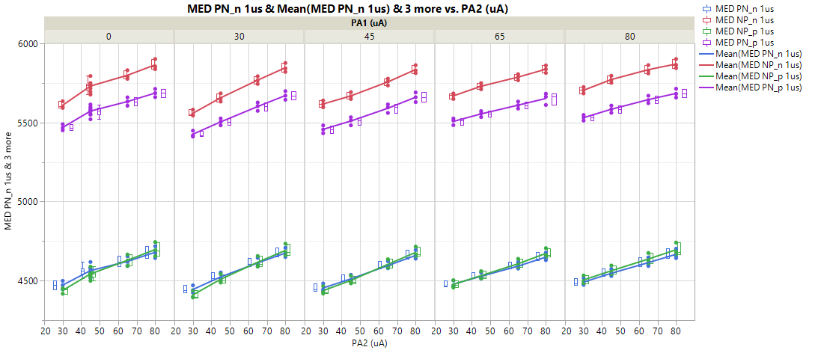
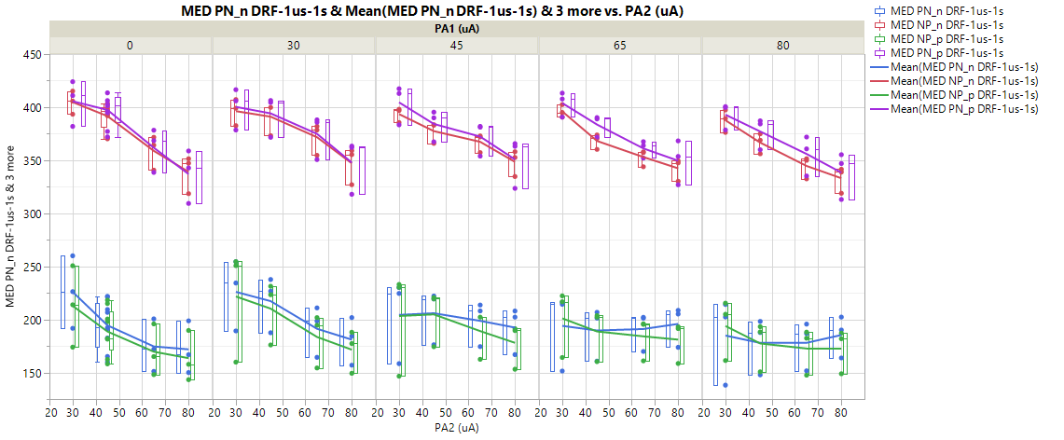
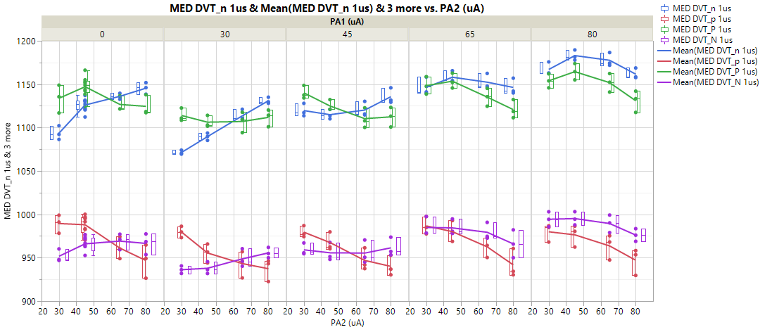
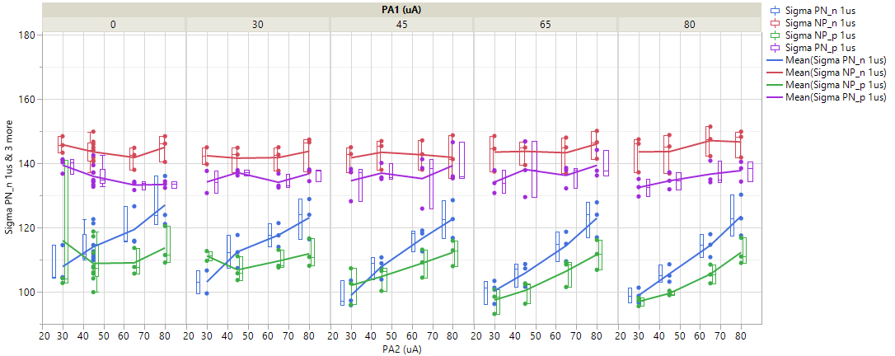
Metrics across repetitions

Slide 19
Metrics
DVT_P
Cumprob:
VT
Drift
DVT
Metrics (x/y plots)
X-parameters: I1 (uA) / I2 (uA) / PW1 / PW2
Y-parameters:
VT MED
Sigma (robust, P1S/M1S) (1us, 1s)
Drift MED (4x)
DVT MED (4x)
Projected E3-E2 window (in mV) @ 3.29sigma = DVT 1us-1us - Drift (1us-1s) – 3.29 x sigma
BER capability (Sigma capability) at 0mV projected E3-E2 window
Time to steady-state VT
I1=PA1/60ns
I2= PA2/PW2
P
p
N
WT
I1=PA1/60ns
I2= PA2/PW2
n
P
N
WT

Slide 20
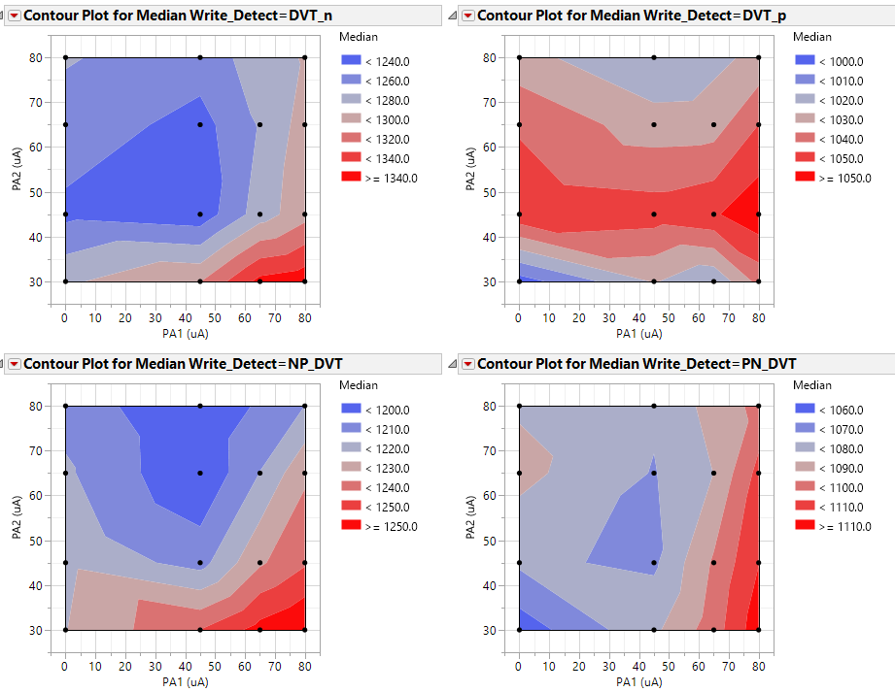
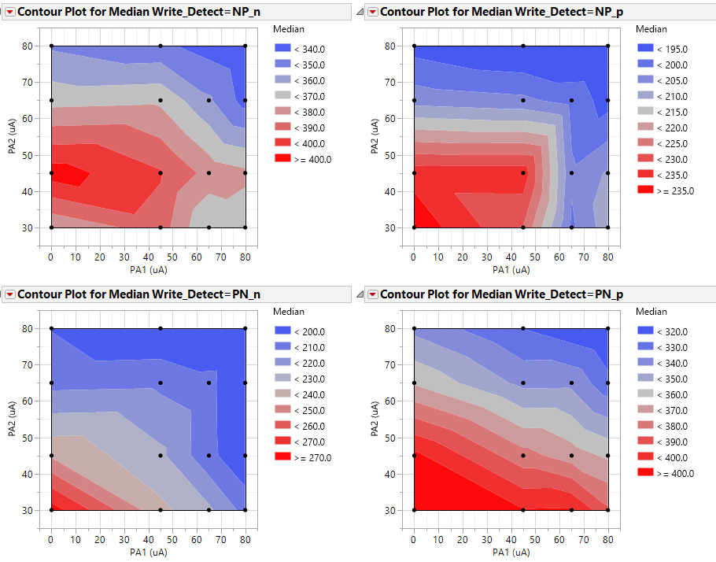
Window components
Focus is on evaluating window impact for PA1/PA2 components
  Analysis focused on 60ns / 60ns pulse, to provide enough time for VT to settle
I1=PA1/60ns
I2= PA2/60ns
Lower drift
P
p
N
WT
Higher DVT
  DVT shows improvement with higher PA1 / lower PA2 (ramp-down pulse)
    The low-right corner leaves the bits in a “transient’ state, where VTs have not reached steady-state
  Drift responds to highest PA → iso-plane in drift with highest PA

Slide 21
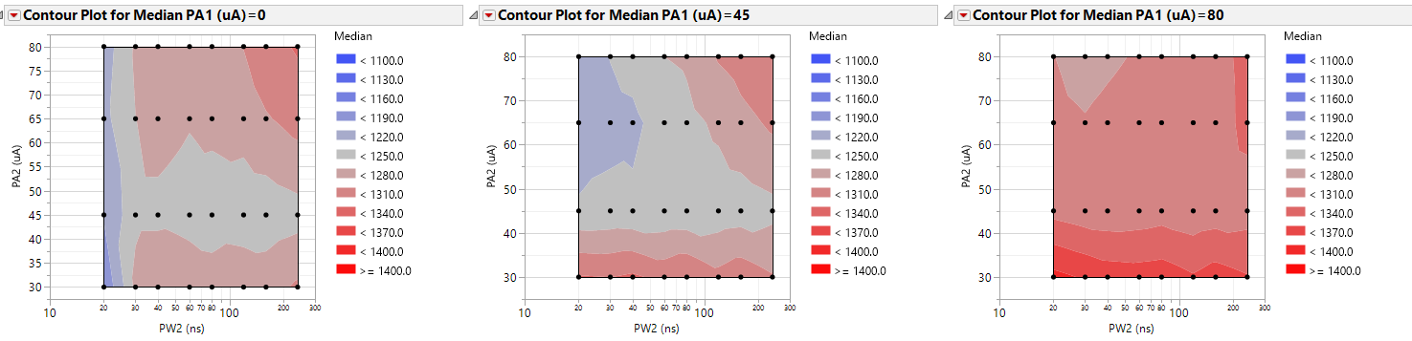
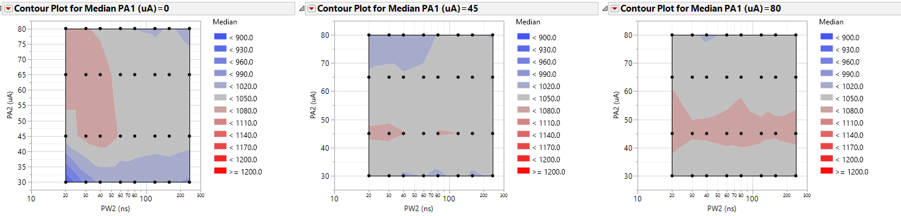
Window components - DVT
DVT_n
DVT_p

Slide 22
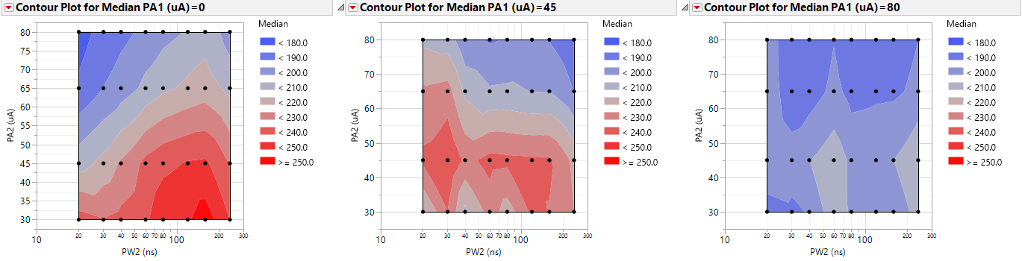
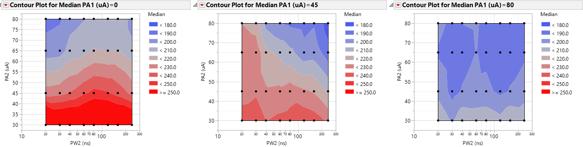
Window components - Drift
NP_P
Drift 1us-1s
PN_N
Drift 1us-1s

Slide 23
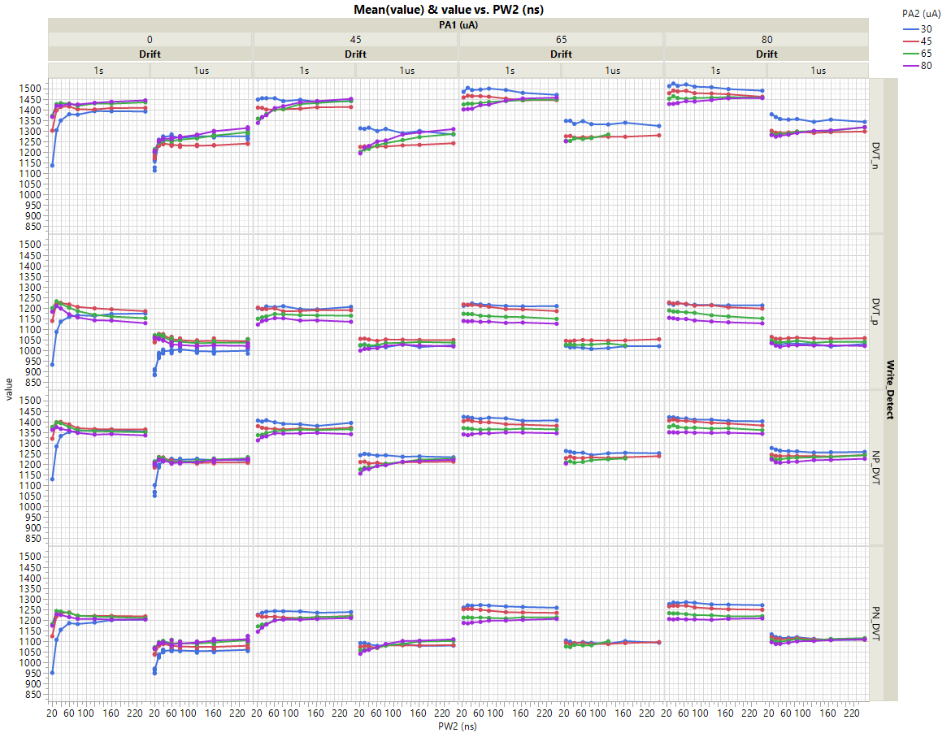
DVT
  DVT dataset

Slide 24
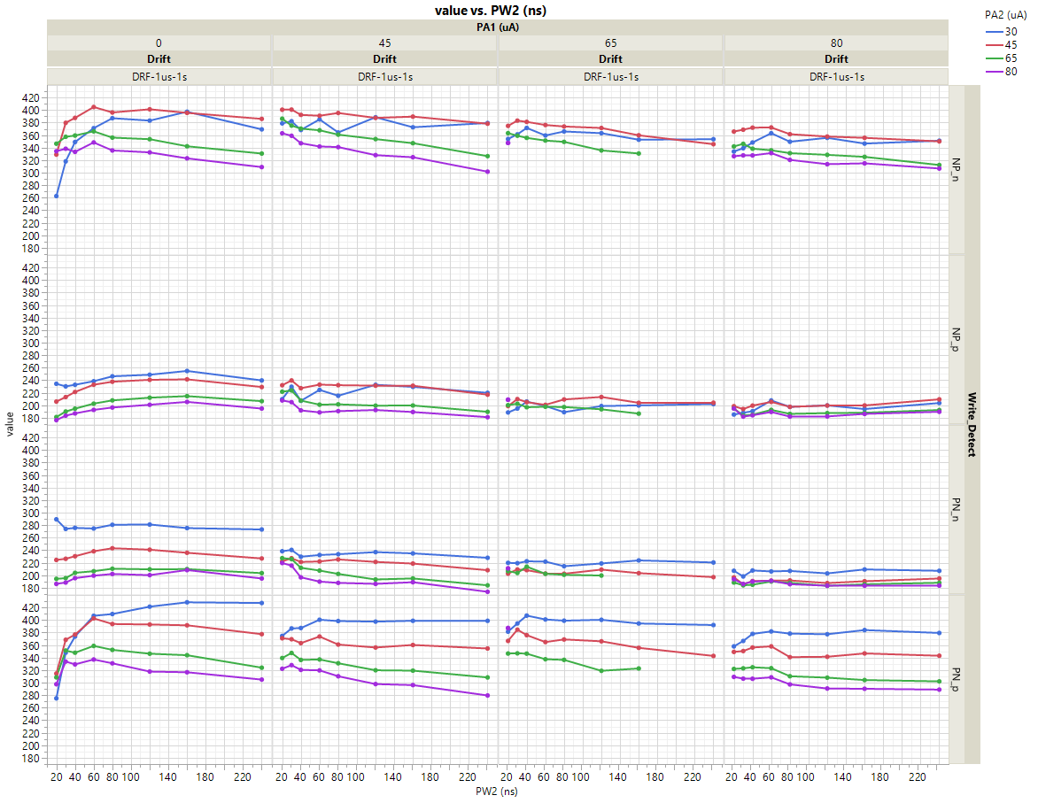
Drift
  Drift dataset

Slide 25
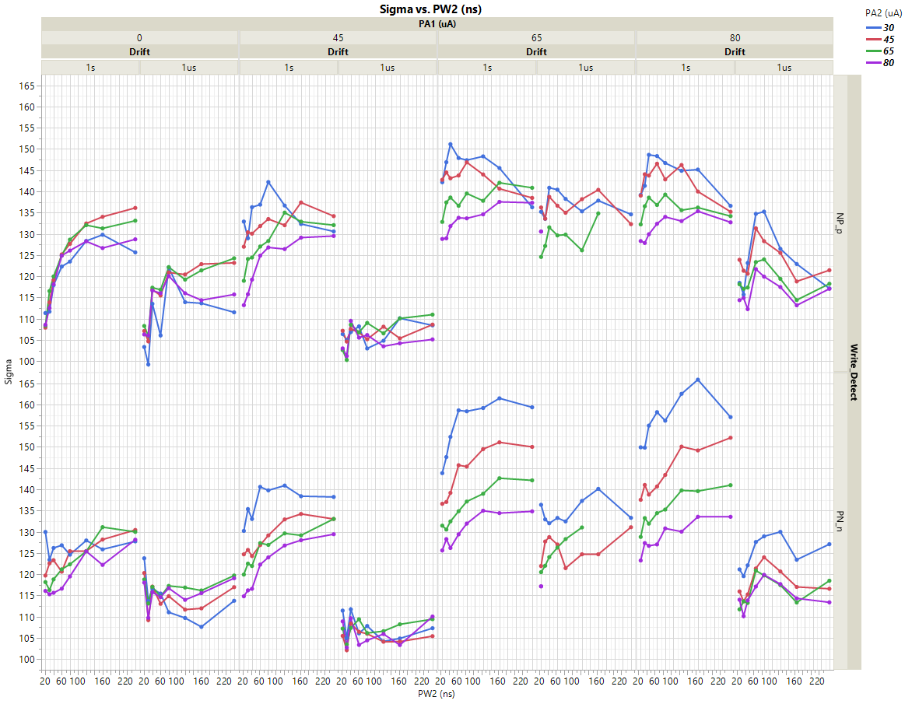
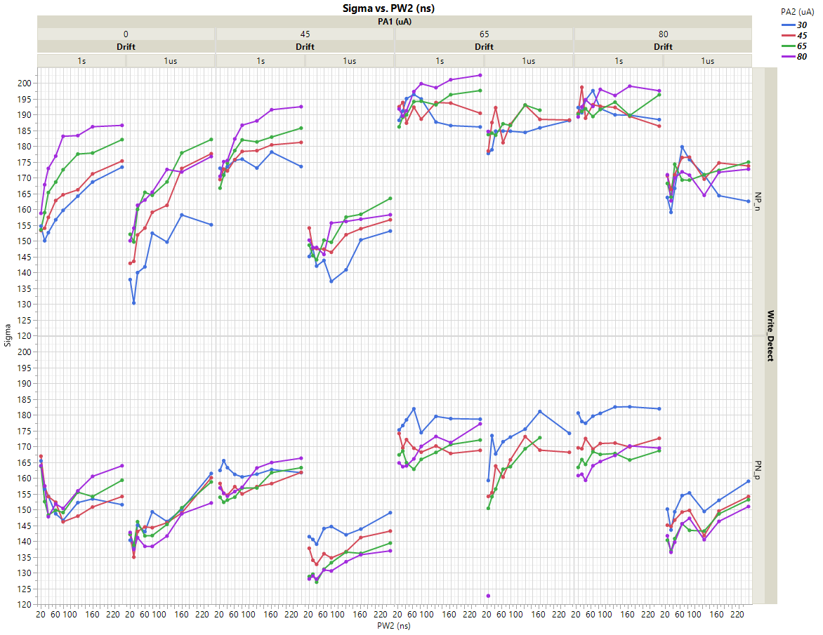
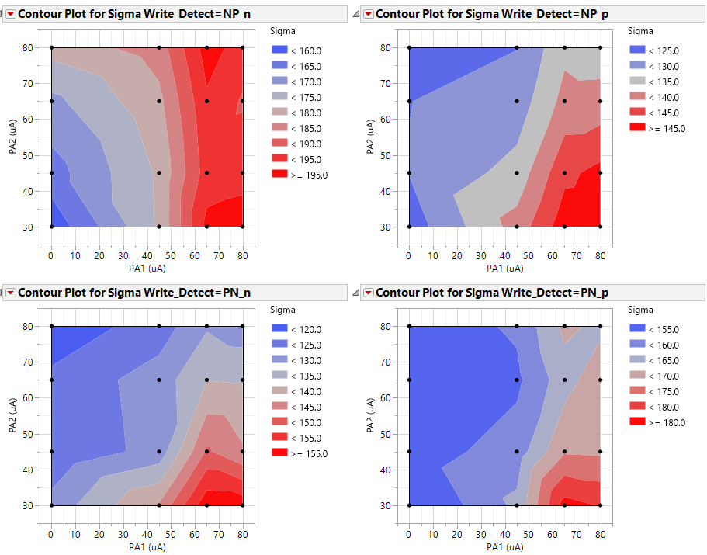
Sigmas
  Sigma data was extracted from this dataset, but degradation limits its use
  Additional experiments are run to evaluate sigma impact on I1/I2 currents, reducing space

Slide 26
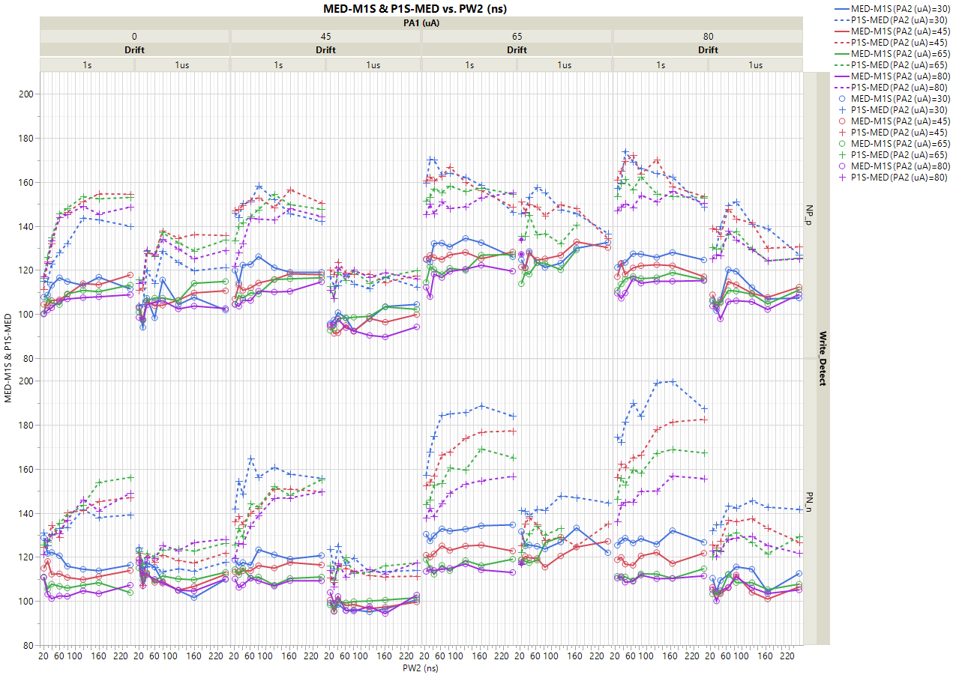
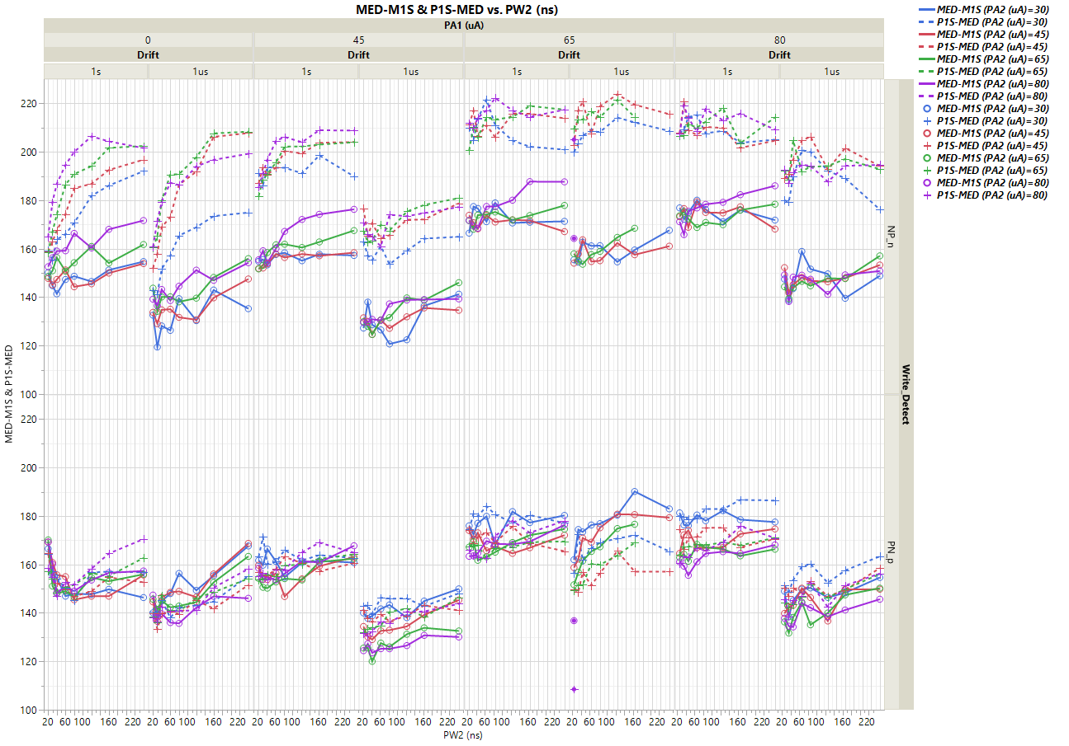
1us/1s sigmas

Slide 27
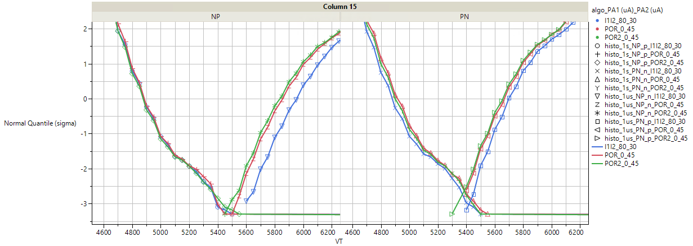
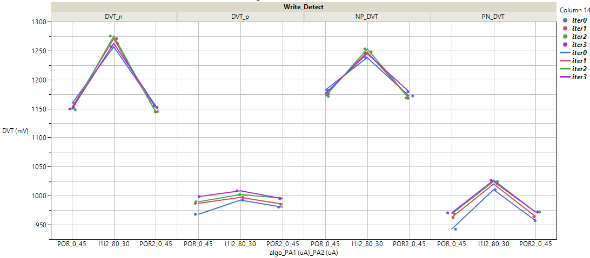
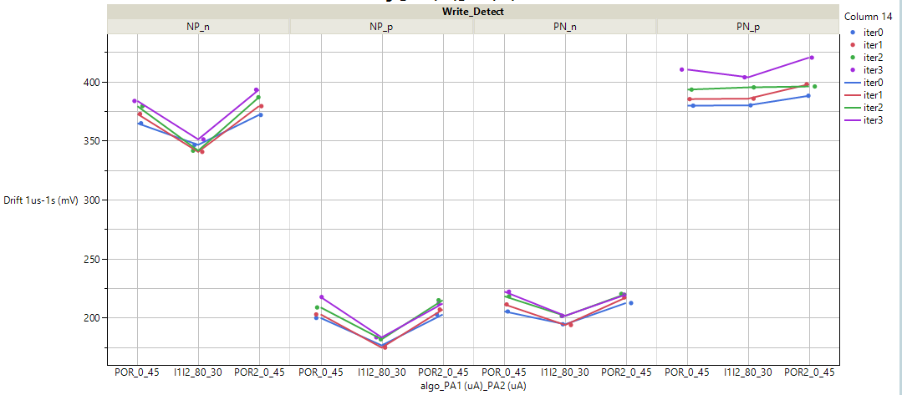
80uA/30uA DVT
  Experiment repeated on few corner case skews to evaluate vs POR
I= 40ns/45uA
NP_p
@ 1sec
NP_n
@ 1us
PN_n
@ 1sec
PN_p
@ 1us
POR pulse
p
P
N
WT
POR (post)
POR (pre)
I1=80uA/20ns
80/30uA
I2= 30uA/20ns
80uA/30uA pulse
P
p
N
WT
DVT_n
DVT_p
DVT_P
DVT_N
DVT improvement
4 repetitions
80/30uA
Similar / slightly improved drift in low-VT state
80/30uA
POR
POR
POR
POR

Slide 28
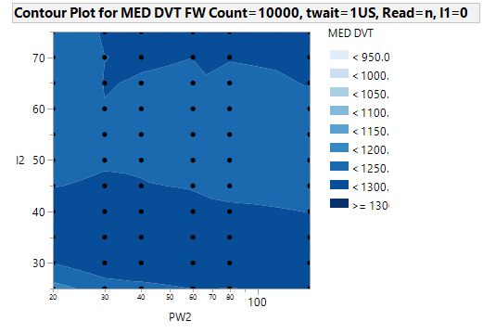
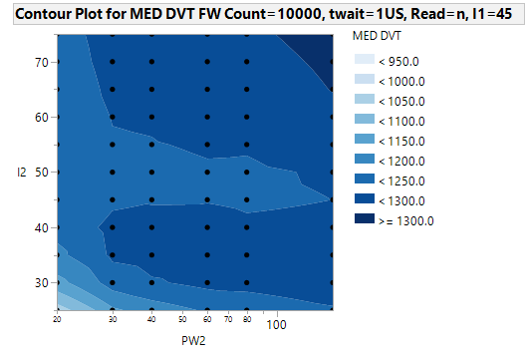
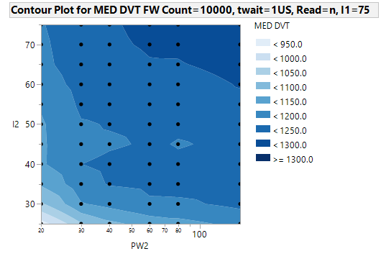
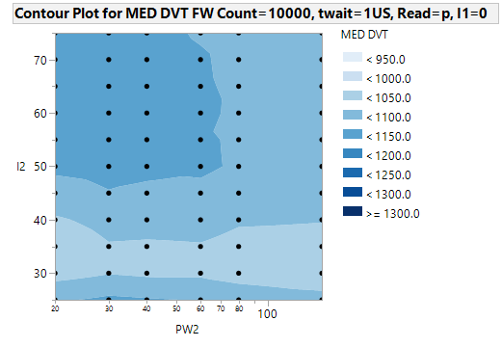
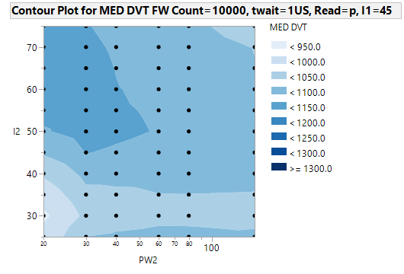
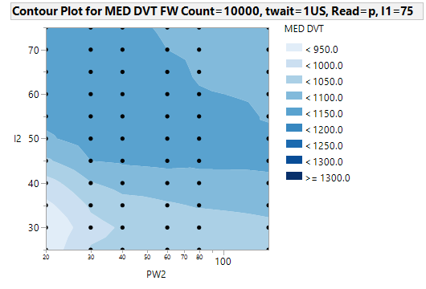
V_{T}(I,PW) response: ΔV_{T}(0σ) n- & p-read
n
n
  n
I1=I2
I1=45μA
I1=75μA
I2 [uA]
I2, PW2
I2 [uA]
I2 [uA]
I2, PW2
I1, PW1
I1, PW1
p
p
  p
I1=I2
I1=45μA
I1=75μA
I2 [uA]
I2, PW2
I2 [uA]
I2 [uA]
I2, PW2
I1, PW1
I1, PW1
PW_{2,nom} [ns]
PW_{2,nom} [ns]
PW_{2,nom} [ns]
ΔV_{T}: Too complex trends to be easily generalized; high-level low-I2, low-PW2 lead to program marginality, especially w/ high pre-conditioning current (I₁).

