Slide 1
Memory Switching 10:00-10:10
One of three SSM Pathfinding Objectives*
SSM Seek for fundamental understandings of non-volatility of bipolar operation of SSM by demonstrating reliable Read Window Budget.
Milestone – Key Results for “Setp-up or Not” indicators
Q3/2018: SR71 dual deck RWB demonstrated.
Q1/2019: Cell scaling physics understood for path development
Q3/2019: S24S PG1 Qaul
Expectations to this meeting
Check point: to communicate what we know and don’t know
Seeking feedback: including unknown unknowns
Preparation: to achieve EOQ Objectives
Expecting a closing report at WW29 (with additional silicon segmentation)
Q2 objectives | As measured by
Secure structural capability gaining confidence on memory switching | SD.K1 2D structure yield matched to S26A
 | SD.K2 1D structure yield > 70% PG4
Fundamental understandings of memory switching | SR71 demonstrate reliable RWB (piecewise calibration to product usage & roadmap to within 100mV determined)
 | Empirical cell models developed and predictive (read, write, disturb, imprint & retention up to 2M cycles)
*: SSM Physics, Array Architecture, & Scalable Product

Slide 2
Start | End |  | Duration | Topic and Expectation | Coordinators
10:00 | 10:10 |  | 10 | Welcome, Meeting logistics, Agenda and Expected Outcome | DerChang
10:10 | 10:50 |  | 0:40 | CR5.4 Electrical & Physical A14 (K1 is used for reference) RWB (PR5 based) OSIR – high level synthesis Gap to goal Risk and Mitigation | Ago/Kolya
10:50 | 12:20 |  | 1:30 | Cell Characterization (K1 and A14) Program Transfer Curves SubVt & on-state I-V Memory switching transition a.k.a. Region-II of “Square” Vt-I switching activation process Write vs. Disturb | Fuga
Lunch (1hr reserved)
1:20 | 2:50 | 1:30 |  | Array Characterization Variability components of sigma cross tile temp-co PA/PW/algo Impact Deck to deck (symmetry discussion) Drift: UD/BD of set/reset (post disturb?) Disturb: RD/WD of set/reset (post drift?) Cycling Endurance: set/reset/∆V_{T} Imprint: SSR vs. RSR, RRS vs. RSR | Enzo/Mattia
Break (15min)
3.05 | 3:30 | 0:25 |  | SSM Memory switching Benchmark | Fuga
3:30 | 3:50 | 0:20 |  | AR recap and follow up planning for Memory Switching model building | DerChang
3:50 | 4:40 | 0:50 |  | S24S Startup gap DTS Rev1.0 Dual Deck on device symmetry Strategy to Qual CR6.4 readiness Contingency, including alternative material (E*, G*) Critical Path building with key results Memory switching scalability Physical scaling – lateral/vertical Cell Architecture | Ago/Kolya

Slide 3
Unknowns
Yield: (structure yield on-track)
SD.K2: Leakage, SWA, SWL
RWB gap within 100mV and unknowns include
The basics of V_{T}:
Pulse termination and μP traces on SR71 and 2XCMOS
Bias drift uses SXP methodology
Seasoning fundamental @ low current seasoning:
Seasoning empirical and strategy (DC, AC, x’tile)
Cross tile bathtub
SD Composition, Electrodes or geometry
Drift fundamental
E3: what has been changed from “V12/16” to “K1/K2”
Post drift distribution & RWB
E1 vs. E4
Read Disturb RWB empirical and strategy
E3RD – Intrinsic but different mechanism?
Memory switching
How many mechanisms: ON conduction, SubVt and interactions
CV
Extended temperature
Optical sensitivity

Slide 4
Discussion on WW24.3
Review of unknowns
Model Segmentation ➔ yielding a operable model for RWB for 48-hr retention upto 4M NW and 3K read before refresh
Start from Fuga’s model sheets
Validation Strategy
Action Plan
Array Char on program transfer curves and reliability of operating point
Program trimming algorithm
Demarcation method
Read Algo

Slide 5
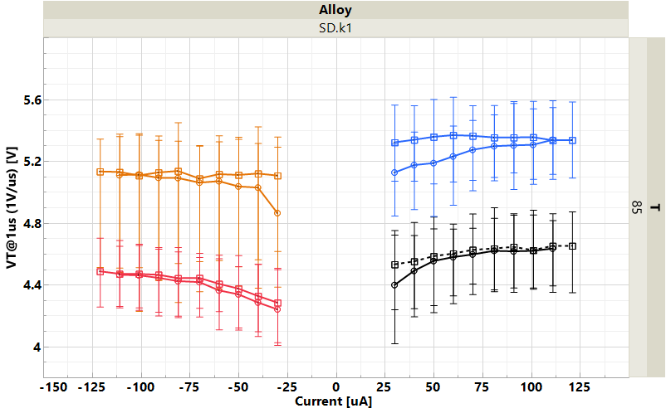
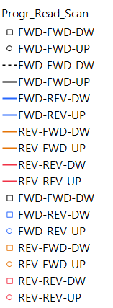
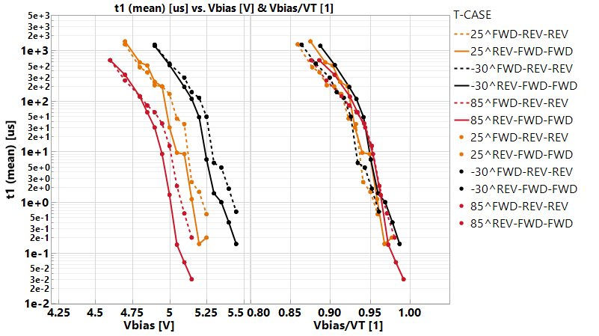
(4x7(3) bits) x 4 repetitions median for SD.k1(A14); ZoneA-C
IV
[FWD-REV]
II
[REV-FWD]
?
I
III
[REV-REV]
[FWD-FWD]
T
~3k rd op’s (DTS)
-100
mV/dec
Case
– REV-FWD
-- FWD-REV
Temperature
-30 C
25 C
85 C
FWD-REV
REV-FWD

Slide 6
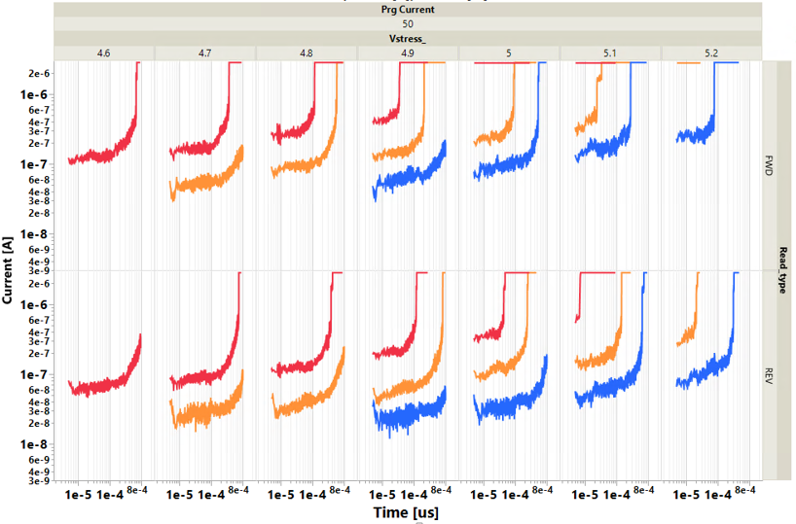
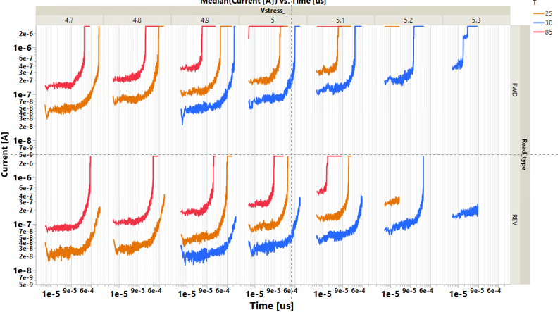
[V]
85C
25C
-30C
T
Time [s]

Slide 7
CR6.x readiness
Objectives:
Single deck reproducible RWB within 100 mV from DTS goal and with >70% PG4 structure yield by WW22: CR6.x
Status:
Line converted to CR6.4 (ww20) and CR6.5 (expected ww24)
Single deck CR6.4 meets the objective criteria (SSM58, SSM63, SSM60)
CR6.5 DD demonstration (SSM64) – ETP ww24
SD.k2 1st cut and 2nd cut profile improvement WIP with PROD evaluation gated by meeting MTS on L1D – 2-3 month for complete evaluation of developed options through probe.
Issues:
Low Vt/high leakage risk for SD.K2 needs continuous monitoring and SD thickness re-centering
SD.k2 profile remains main MTS gap on 1st and 2nd cut
Yield issues limit learning with alternative etch approaches, that demonstrate MTS gap closure in-line (SSM60) – potential integration interactions to be understood.
Recommendations:
Establish robust CR6.5 baseline on DD flow by end of June (ww26-27) and identify yield gap to goal pareto
Need better understanding of 1st cut/2nd cut profile modifications interactions with rest of integration through PFA effort and in-line metrology

Slide 8
Additional Materials

Slide 9
SSM Goals Switching
SSM Pathfinding Objectives
SSM Seek for fundamental understandings of non-volatility of bipolar operation of SSM by demonstrating reliable Read Window Budget.
Validate bipolar decoder and power supply scheme with a multi-deck product by benchmarking density, energy and latency against the incumbent.
Develop world leading memory product roadmap based on SSM physics, low cost process enablers and high efficiency decoding scheme.
Deliverables for “step up” or not

