Slide 1
ISO JDP on Chal electrodes
Q3, 2015 experiment results from D2 and RH

Slide 2
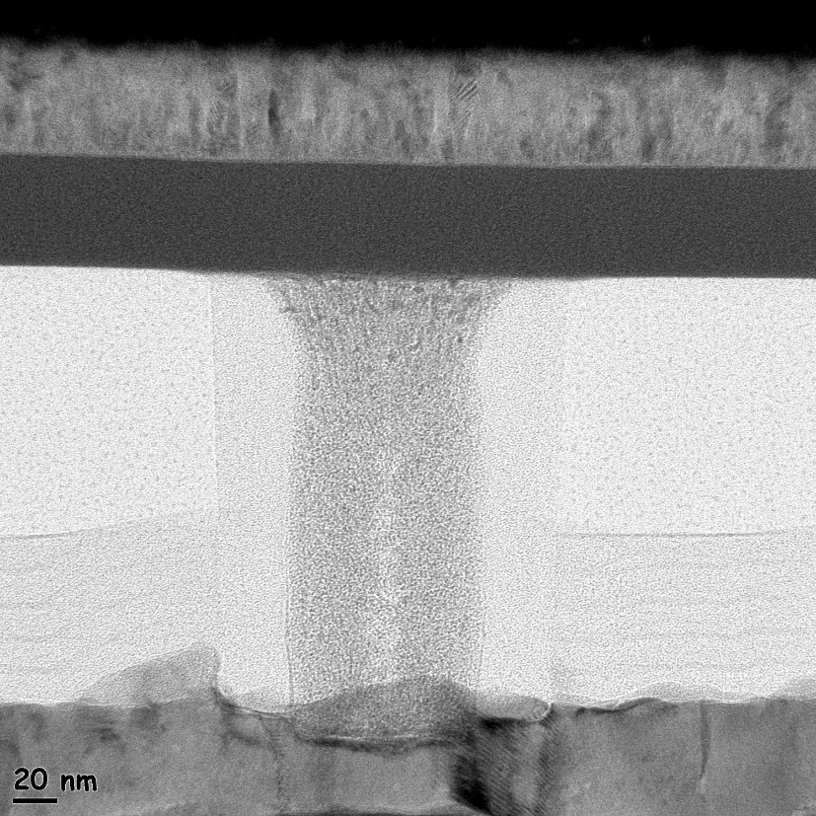
OTS Plug process flow
Lot OTS_SL9, Wafer 302
Die B, X2y3, CPAD Area
D2 deposited 1040 Prime,
OTS SL9
SLD TiSiN plug OTS flow
CMP’d TiSiN Bot electrode
500A OTS
750A TiAlN
~ 110 nm

Slide 3
Cycling Evolution
D2 deposited 1040 Prime,
OTS SL9
SLD TiSiN plug OTS flow
CMP’d TiSiN Bot electrode
500A OTS
750A TiAlN
IV 1 1st_RI b31
IV 2 2nd_RI b31
IV 3 RI1Cyc_1E+0 b31
IV 4 RI1Cyc_1E+1 b31
IV 5 RI1Cyc_1E+2 b31
IV 6 RI1Cyc_1E+3 b31
IV 7 RI1Cyc_1E+4 b31
IV 8 RI1Cyc_1E+5 b31
IV 9 RI1Cyc_1E+6 b31
IV 10 RIFCyc_1E+6 b31

Slide 4
Fountain of Youth?
Following 175C anneal for ~1hr, Vth returns to near-Vff value(?) What would happen with higher temperatures and/or longer times?
1st 10 IV scans at 25C. Notice Vff of ~4.1V.

Slide 5
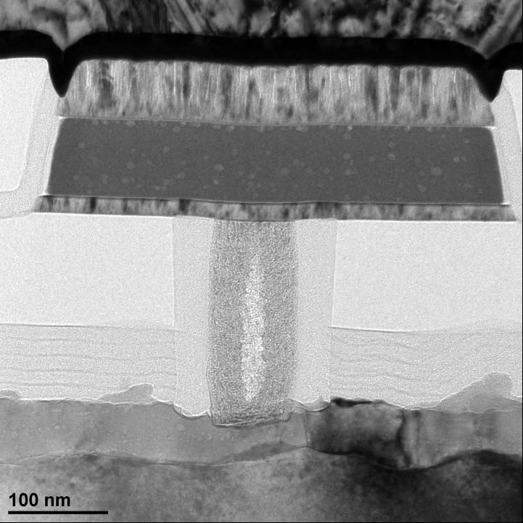
Plug vs. Elevated Pore (EP), DOT
Plug
EP
DOT
5

Slide 6
OTS Plug process flow
EP OTS process flow
DOT OTS process flow
D2 deposited 1040 Prime OTS
SL9
SLD TiSiN plug OTS flow
CMP’d TiSiN Bot electrode
500A OTS
750A TiAlN
D2 deposited 1040 Prime OTS
wfr 55BR:
TP2 elevated pore
TiAlN Bottom electrode: 60A Spt etch
500A OTS
750A TiAlN / 1000A Ti
D2 deposited 1040 Prime OTS
wfr 235 (SL4):
DOT planar OTS flow
TiAlN Bottom electrode: 250A TiAlN
500A OTS
750A TiAlN
Plug TiSiN: V_{t} ~ 5 (at 100 cycles) V_{offset} ~ 1.9 >95% yield
EP TiAlN: V_{t} ~ 4.1v V_{offset} ~ 0.9-1.2 >95% yield
DOT TiAlN: V_{t} ~ 1.3-2.1 V_{offset} ~0.5 5-40% yield

Slide 7
Plug Process: BE – TiSiN
Vth migrates down with cycling. Relatively stable from 2nd to 1E3 cycles.
Both 300ns and 1us pulse width shows similar Vth migration down with cycling.

Slide 8
SubVth Cycling Evolution
1x10⁵ Cycles
100 Cycles
The subthreshold characteristics shown in the plot below are not normalized to the pulsed V_{T} data.
The absolute leakage is observed to increase during cycling.
1st Cycle

Slide 9
SAG Lot S095147KTT

Slide 10
TP2
LE = TiAlN
OTS = 250A SAG
TE = 400A Carbon
(Control)
→
TP2
LE = TiAlN
TE = 500A TiAlN
←
Lot S095147KTT Electrical Test Results
Initial I-V
TP2
LE = TiAlN
TE = Ti / TiAlN 20 / 500A
→
TP2
LE = TiAlN
TE = Ti / TiAlN 70 / 500A
←

Slide 11
R_{load} = 2.5kΩ
TP2
LE = TiAlN
OTS = 250A SAG
TE = 400A Carbon
(Control)
→
TP2
LE = TiAlN
TE = 500A TiAlN
←
TP2
LE = TiAlN
TE = Ti / TiAlN 20 / 500A
→
TP2
LE = TiAlN
TE = Ti / TiAlN 70 / 500A
←

Slide 12
Scratch Pad

Slide 13
IV 1 1st_RI b31
IV 2 2nd_RI b31
IV 1 1st_RI b31
IV 1 1st_RI
IV 3 RI1Cyc_1E+0 b31
IV 2 2nd_RI b31
IV 2 2nd_RI
IV 4 RI1Cyc_1E+1 b31
IV 3 RI1Cyc_1E+0 b31
IV 3 RI1Cyc_1E+0
IV 5 RI1Cyc_1E+2 b31
IV 4 RI1Cyc_1E+1 b31
IV 4 RI1Cyc_1E+1
IV 6 RI1Cyc_1E+3 b31
IV 5 RI1Cyc_1E+2 b31
IV 5 RI1Cyc_1E+2
IV 7 RI1Cyc_1E+4 b31
IV 6 RI1Cyc_1E+3 b31
IV 6 RI1Cyc_1E+3
IV 8 RI1Cyc_1E+5 b31
IV 7 RI1Cyc_1E+4 b31
IV 7 RI1Cyc_1E+4
IV 9 RI1Cyc_1E+6 b31
IV 8 RI1Cyc_1E+5 b31
IV 8 RI1Cyc_1E+5
IV 10 RIFCyc_1E+6 b31
IV 9 RI1Cyc_1E+6 b31
IV 9 RI1Cyc_1E+6
IV 10 RIFCyc_1E+6 b31
IV 10 RIFCyc_1E+6
10

