Slide 1
SSM: compare/contrast to other memory types

Slide 2
“Hysteresis” of Transfer characteristics
Output traces subject to input and prior history in a cyclic loop
SRAM PCM
Input (WRITE) metrology actuates the switching mechanism
Output (READ) metrology manifests the switched physics
It’s a phenomenological “duck test”. Using abductive reasoning to prioritize possible switching mechanism for SSM risk assessment – also to eliminate unlike mechanisms.
It can also serve for inductive reasoning to derive physics from specific observations – assumptions will be called out for additional tests.
o/p [v]
V_{T} [v]
i/p
o/p
i/p [v]
Pulse [μA]

Slide 3
Classes of Ducks
See also: https://en.wikipedia.org/wiki/Resistive_random-access_memory
https://semiengineering.com/what-happened-to-reram/
https://semiengineering.com/a-new-memory-contender/ (FECAP/FEFET)
2-T NVM (focus on memory element)
Other NVM (not benchmarked)
PCM (Samsung, Micron, IBM/Macronix)
SSM (Intel/Micron)
VMCO/CMOx (IMEC, Unity)
  4DS: PCMO (CMOSx) with HGST/WD partnership?
  WD/Toshiba: Binary conductive oxide instead of PCMO
  IMEC: VMCO
  CMOx: Unity (Rambus)
V_{O}RAM/CBRAM (Redox)
  Weebit: Porous SiO, TaO
  Panasonic/Fujitsu/HP: TaO
  TSMC/ITRI: HfO
  Macronix: WO
  Adesto: Te in AlO
  Micron/Sony: Cu in GdO
  NEC: Cu in oxide(?) – targeting FPGA
  Crossbar: Ag/Cu in α-Si (with Si/SiO diode)
STT (too many)
FTJ
  Toshiba: HfO + interface layer
  AIST consortium: UoTokyo and etc
SXP-like
  Intel/Micron
  Macronix/IBM: Si-STAG + N doped 225
  Hynix: As doped SiO + ReRAM(?)
  IMEC: N doped GeSe (selector only)
  LETI: GeSe + HfO
FECAP as in 1T1C
  IMEC, NAMLAB (GF), MFC, Hynix/LAM : HfO
  TI: PZT in production/ research HfO
  Panasonic: PZT in production
  Sony: SBT in production
FEFET
NRAM (Nantero)
Charge trap

Slide 4
Transfer Charx Summary
Log(I@0.4V]
Log(I@3V)
❸
❷
Log(I@3.5V)
❷
❹
❶
❸
❶
❸
❷
❹
❶
Pulse [μA]
Pulse [μA]
❹
Pulse [V]
PCM
SSM
VMCO/CMOx
Log(I@0.5V)
I@0.1V
Log(I@3V)
❷
❹
❶
❸
❷
❸
❶
❸
❷
❹
❶
❹
Pulse [V]
Pulse [V]
Pulse [V]
V_{O}RAM/CBRAM
STT
FTJ

Slide 5
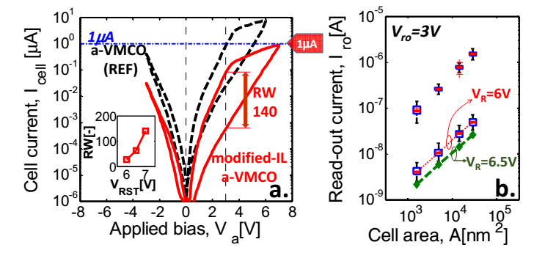
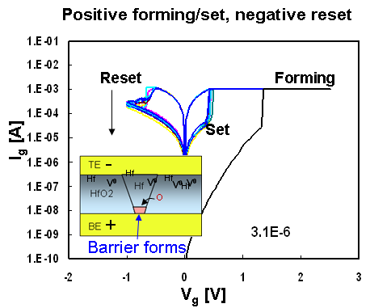
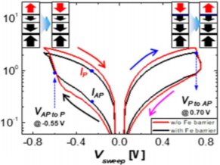
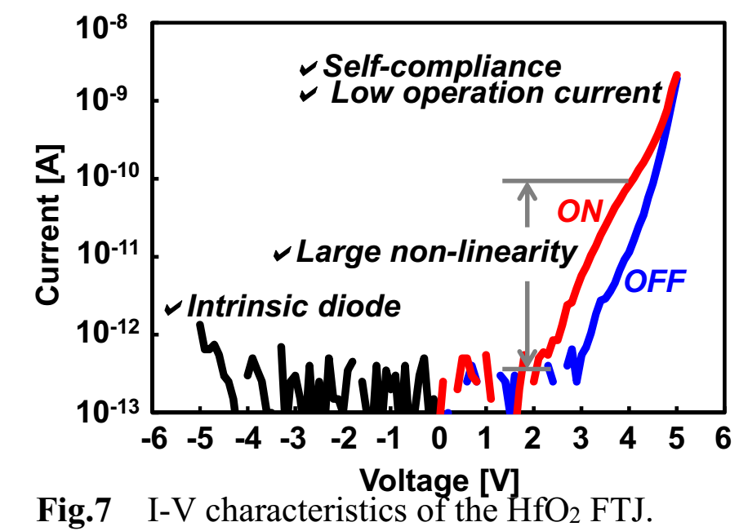
Transfer Charx Summary
?
?
Set
Set
Reset
Set
Reset
Reset
Set
Reset
Quad-3
Quad-1
SXP
SSM
VMCO/CMOx
E
❸
❹
❷
❶
V_{O}RAM/CBRAM
STT
E
FTJ

Slide 7
Overview of Memory Types and Characteristics
 | Memory Types
 | Filamentary |  | Bulk |  | interfacial/bulk transition that exhibits area dependance of resistance
 |  |  |  |  | non-linear RRAM (built-in selectivity)
 | Ox-RRAM (RRAM) | Metal-RRAM(CBRAM) | Phase Change | STT-MRAM | VMCO | Unity (CMOx) | Ferro Tunnel Junction
Typical materials/stack | TE/OEL/MeOx/BE | TE(ion)/Oxide/BE | TE/GST/BE | CoFeB/MgO/CoFeB | TE/AlOx/Si/BE | TE/PCMO/IL/BE | TE/Ferro/IL/BE
Typical Test Structures | 1T-1R, 1S-1R | 1T-1R, 1S-1R | 1S-1R, 1T-1R | 1T-1M | cross-point / dot | cross-point / dot | cross-point / dot
Physical Characterization | TEM/EELS/STM/c-AFM (image local conduction) | TEM/EELS/STM/c-AFM (image filaments) | TEM/EELS/STM/XRD | TEM/EELS/STM/XRD | TEM/EELS/STM/c-AFM (image areal conduction) | TEM/EELS | TEM/EELS
Electrical Characterization | EBIC, temp/area dep IV | EBIC, temp/area dep IV | R-Temp; temp dep IV | R-Temp; temp dep IV | Temp/area dep IV | temp dep IV, IPE | P-E, temp dep IV
Products? | Panasonic (~1Mb) | Adesto (~1Mb) | 1S-1R (3DXP); 1T-1R (samsung, micron 40nm) | 90/65nm STTRAM (everspin) | - | - | -
Key Challenges | filament instability at low currents (<100uA) | filament instability, integration | scaling currents | TMR, endurance, retention at scaled dimensions | Scaling voltage and increasing non-linearity | integration (PCMO); scaling with Ron/Roff | variability and non-linearity
Switching Mechanism? | Modulate filament of oxygen vacancies | Modulate filament of metal atoms | Amorphous ⬄ crystalline | Modulate MTJ Tunneling Resistance by spin alignment | Modulate plane of oxygen atoms/vacancies | Modulate IL tunneling resistance by oxygen transfer | Modulate IL tunneling resistance by Ferro Polarization
Non-linear
SSM
cross-point / dot
TEM/EELS ?
SSM is distinctively different from filamentary; also appears different from interfacial
SSM shows built-in selectivity & Vth tunable characteristics
Characterizations needed to decipher mechanism?

Slide 8
Supporting Materials

Slide 9
PCM
Write: Polarity symmetry
  Current pulse from 5 to 40 MA/cm²
  (20~160uA of 20nm cell)
  Pulse width from 10ns to 200nsc
  Typical I_{melt} ~15MA/cm²
  Typical I_{sat} ~ 25 MA/cm²
Read: Polarity symmetry
  Vt detect, either by SCU 30ns pulse or QS I-V scan for 1uA or snapback detect, in both polarity.
  Typical Set Vt is ~0.1V
  Typical Reset Vt is ~1V
Pulse width effect
  Insignificant impact from low to high Vt
  Strong influence from high to low Vt
Polarity Symmetry: Axial symmetry both in read and write
V_{T} [v]
❹
❷
❸
❶
Pulse [μA]
10ns
200ns
Pulse [μA]

Slide 10
PCM
Write: Polarity symmetry
  Current pulse from 5 to 40 MA/cm²
  (20~160uA of 20nm cell)
  Pulse width from 10ns to 200nsc
  Typical I_{melt} ~15MA/cm²
  Typical I_{sat} ~ 25 MA/cm²
Read: Polarity symmetry
  FVMI in both polarity.
  Typical I_{Set} 10~50μA
  Typical I_{Reset} is ~0.1 50 1μA
Pulse width effect
  Insignificant impact from high to low I_{READ}
  Strong influence from low to High I_{READ}
Polarity Symmetry: Axial symmetry both in read and write
Log(I@0.4V]
❸
❷
❹
❶
Pulse [μA]
200ns
10ns
Pulse [μA]

Slide 11
SSM
Write:
  Current pulse from 7.5 to 25 MA/cm²
  (30~100uA of 20nm cell)
  Pulse width from 20ns to 500nsc
Read
  FVMI or Vt detect, either by SCU 30ns pulse or QS I-V scan for snapback detect, in both polarity.
  Typical Set Vt is ~4.8@22nm
  Typical Reset Vt is ~5.7V@22nm
Insignificant pulse width effect on the range explored (20ns to 500ns)
Polarity Symmetry: Point Refection at origin
❹
V_{T} [v]
Slope 2~5KΩ
❸
❷
≈
❶
≈
Pulse [μA]
Log(I@3.5V)
Pulse [μA]

Slide 12
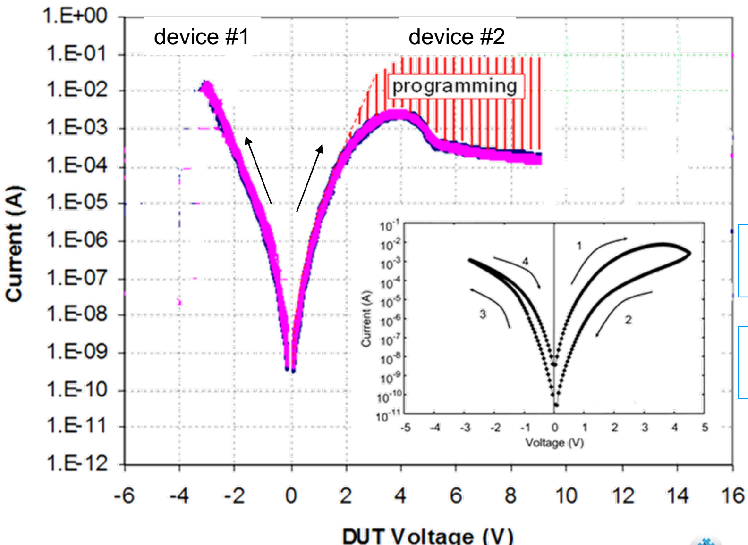
VMCO and CMOx
Write: Asymmetry in time to write
  Voltage pulse @ 4~8nm film
  +V Pulse width μs to reset
  −V Pulse width 10ns to Set
Read: Asymmetry in impendence (injection)
  Current reading with +bias,
  − bias read yields “Mid current” (no window)
Pulse width effect
  Insignificant impact from low to high Vt
  Strong influence from high to Vt
Log(I@3V)
❹
❶
❸
❷
Pulse [V]
IMEC VMCO
Unity CMOx
Log(I@3V)
10ns
10ns
(or longer)
~1μs
Pulse [AV]

Slide 13
V_{O}RAM / CBRAM
Log(I@0.5V)
Write: Asymmetry
  Pulse width from ~1ns to ~1μs
  R2S: Voltage pulse with current clamp
  Typical V_{set} 1.2V/100ns@50uA
  S2R: current pulse with Voltage clamp
  Typical V_{stop} 1.8V/100ns
Read: Polarity symmetry in Set (electrode dependent)
  FVMI in both polarity.
Polarity Symmetry: Axial symmetry on read
❸
❷
❹
❶
Pulse [V]
Current Compliance
Pulse [V]
Pulse width
Pulse [AV]

Slide 14
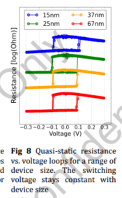
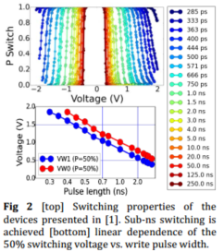
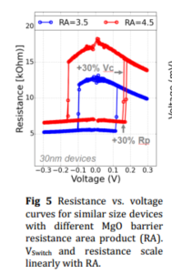
STT
Write: Polarity symmetry with point reflection @ 0V
  Pulse width @ ~1ns
  Voltage pulse @ 0.5V
Read: Polarity symmetry
  FVMI in both polarity.
I@0.1V
❷
❸
❶
❹
Pulse [V]
I@.1V
10ns
~1μs
10ns
Pulse [V]

Slide 15
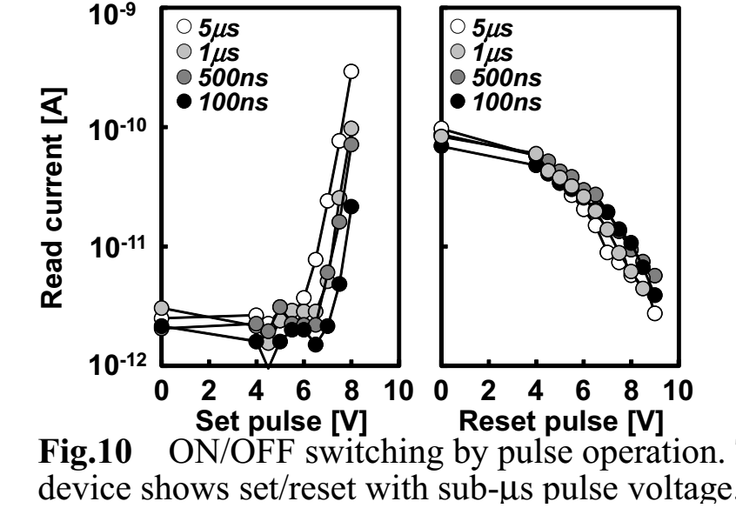
FTJ
Write: Asymmetry in volt-time to write
  +8V Pulse width 100n to reset
  −8V Pulse width 100ns to Set
Read: Asymmetry in impendence
  Current read @ +4V,
  − bias read yields very low current (no window)
  Read window is a strong function of pulse width
Log(I@3V)
❹
❶
❸
❷
Pulse [V]
Log(3V)
5μs
100ns
Pulse [AV]

Slide 16
Overview of Memory Types and Characteristics

Slide 17
Overview of Selector Types and Characteristics
 | 2T Selector Types
 | OTS | Volatile CBRAM | Poly-Si diode | Tunneling Based | MIT | MIEC | SSM
Typical materials/stack | TE/OTS/BE | TE(ion)/Oxide/BE | TE/N-Si/P-Si/BE | M/I/M, M/S/M | TE/MIT/BE | TE/Cu-Chalco/BE
Typical Test Structures | 1S-1R | 1S-1R | 1S-1R (unipolar) | 1S-1R | 1S-1R | 1S-1R
Physical Characterization | TEM/EELS/STM/XRD | TEM/EELS/STM/XRD | TEM/XRD | TEM/EELS/STM/XRD | TEM/EELS/XRD | TEM/EELS/XRD
Electrical Characterization | R-Temp; temp dep IV | R-Temp; temp dep IV | R-Temp; temp dep IV | R-Temp; temp dep IV | R-Temp; temp dep IV | R-Temp; temp dep IV
Products? | 1S-1R (3DXP); | - | Matrix | - | - | -
Key Challenges | drift | speed, memory at high currents | not high enough Jc for BE | high Jc and non-linearity | high non-linearity, voltage scaling | speed, integration
SSM is a “Memory with Built-in Selectivity”, by uniquely “tuning” Vth by Voltage polarity

Slide 18
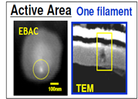
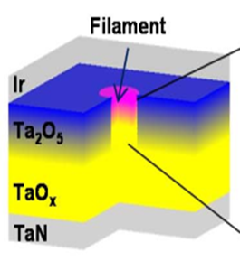
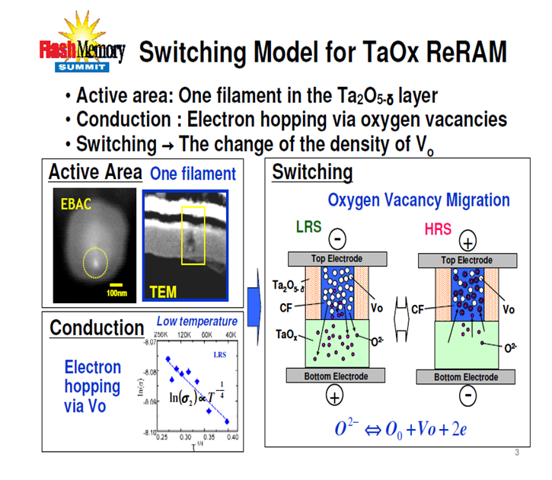
Salient Characteristics of OxRAM (Vo Filament)
Structure / Mechanism
Supporting Physical Characterization
Panasonic RRAM
Modulating filament gap
Ir/Ta2O5/TaOx/TaN w/ Cu IC scheme
Supporting Electrical Characterization
Critical Challenges

Slide 19
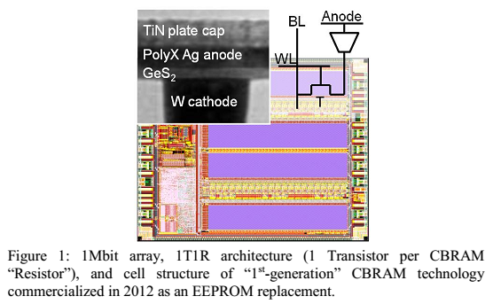
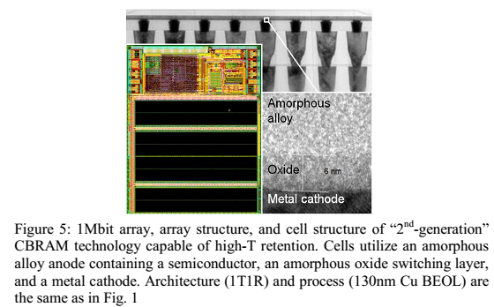
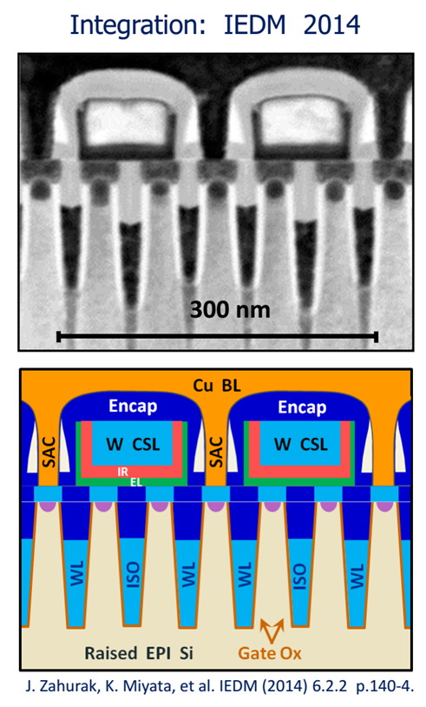
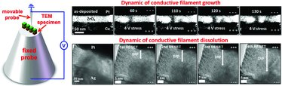
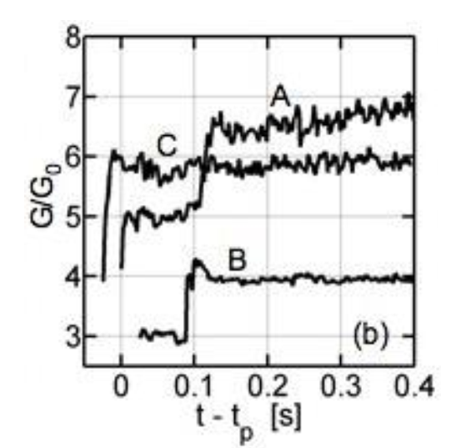
Salient Characteristics of CB-RAM (Metal Filament)
Structure / Mechanism
Supporting Physical Characterization
Supporting Electrical Characterization
Critical Challenges
Quantized conductance

Slide 20
Salient Characteristics of PCRAM (Phase Change)
Structure / Mechanism
Supporting Physical Characterization
Supporting Electrical Characterization
Critical Challenges

Slide 21
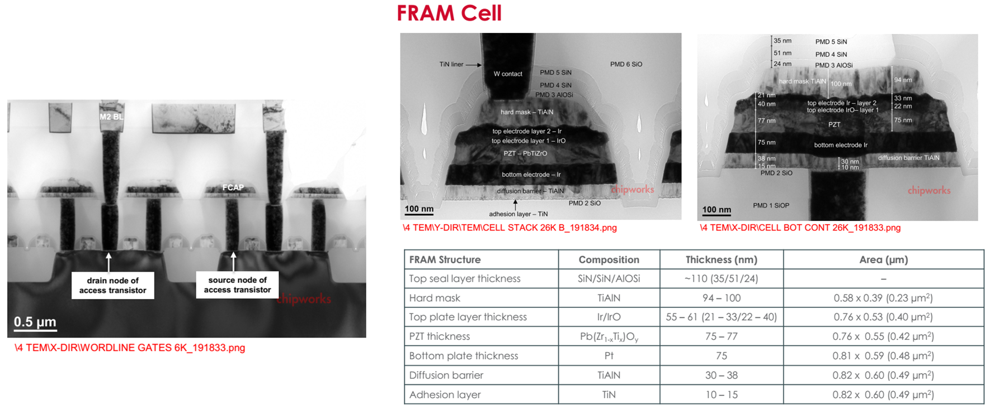
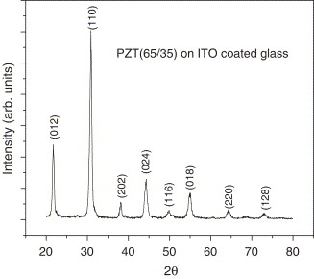
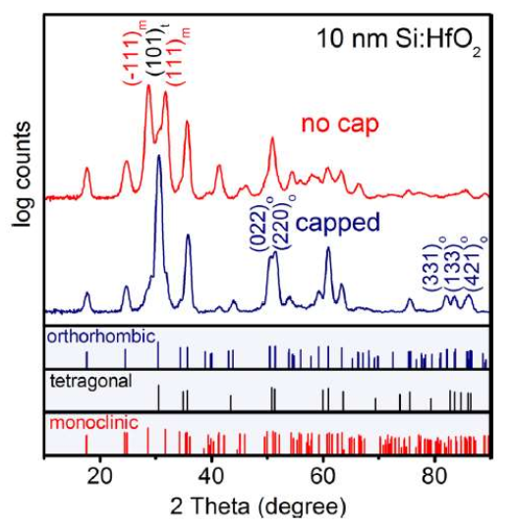
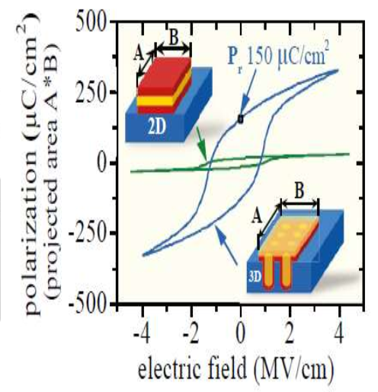
Salient Characteristics of FeRAM
Structure / Mechanism
Supporting Physical Characterization
XRD for Ferro HfO
XRD for perovskite PZT
Ferroelectric Switching
Supporting Electrical Characterization
Critical Challenges

Slide 22
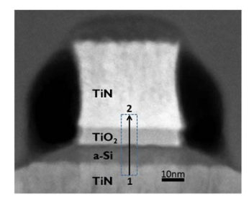
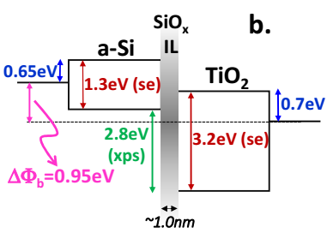
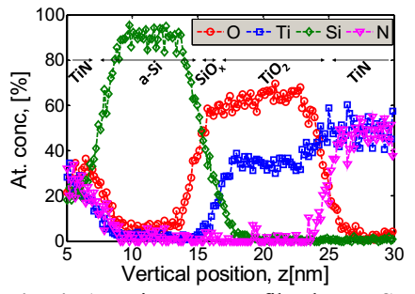
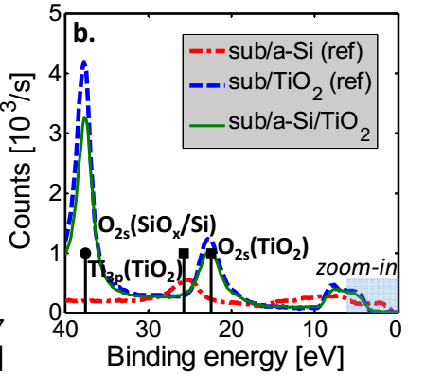
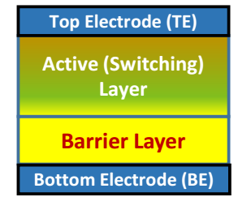
Salient Characteristics of VMCO (Vacancy Modulated Conductive Oxide)
Structure / Mechanism
Supporting Physical Characterization
Oxygen transfer changes TiOx conductance
Supporting Electrical Characterization
Critical Challenges

Slide 23
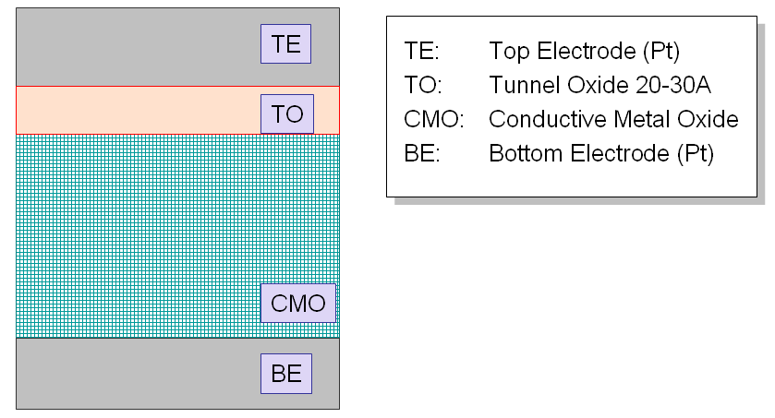
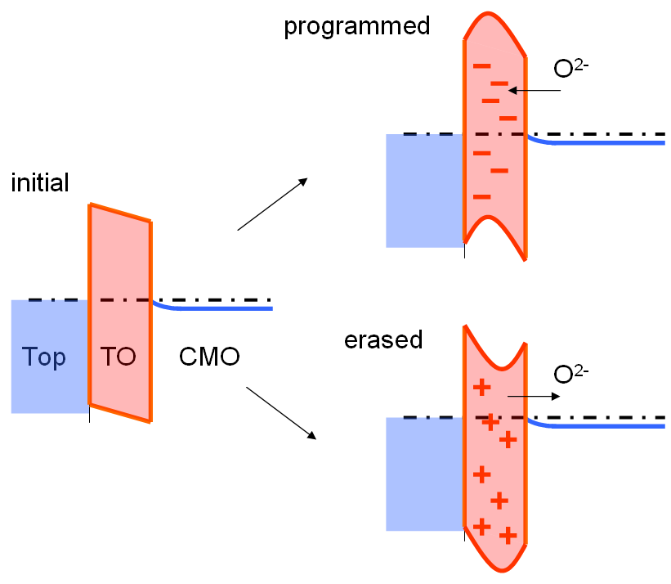
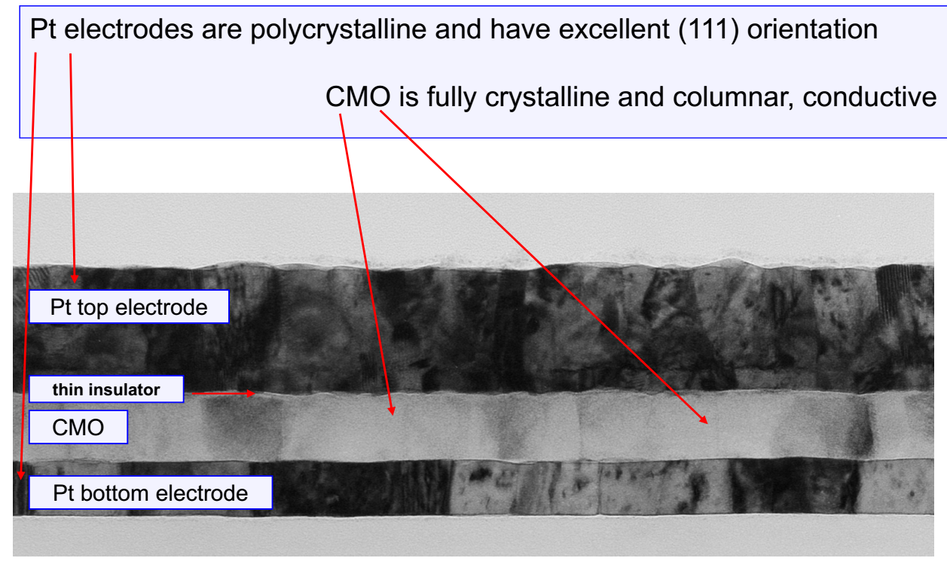
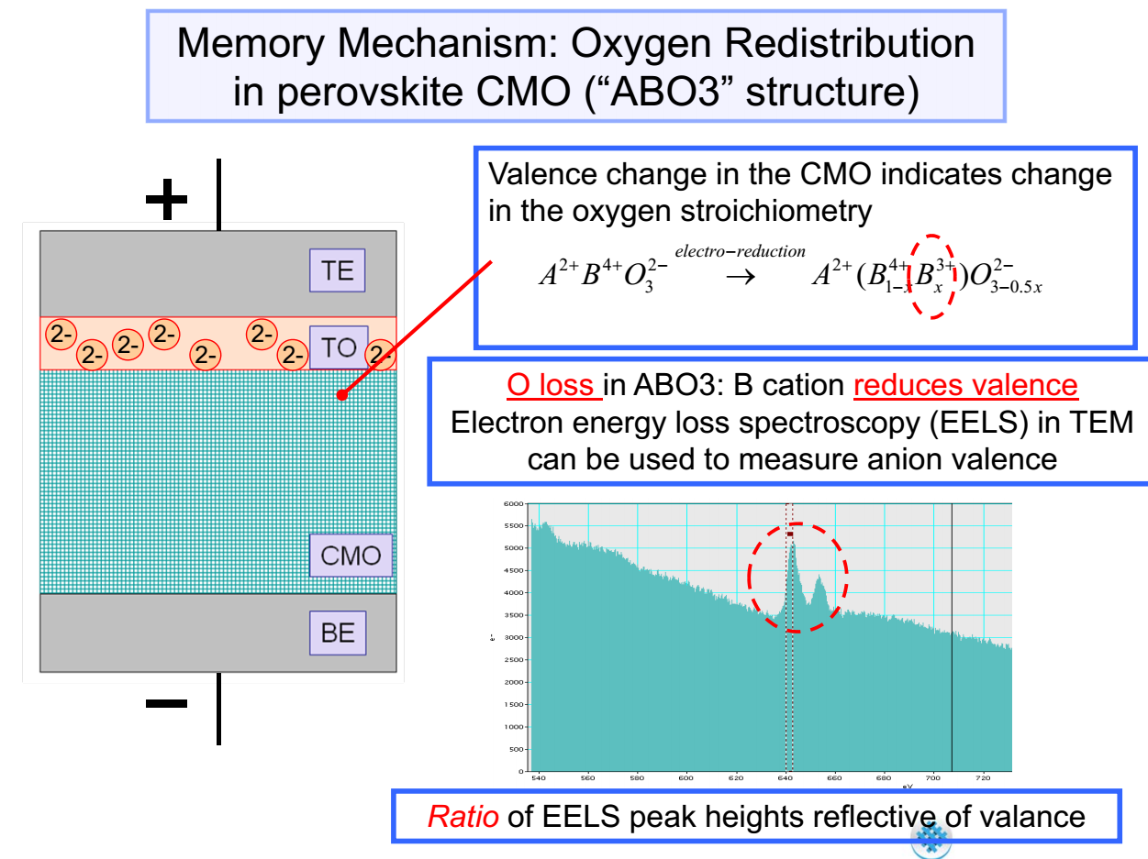
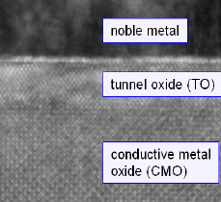
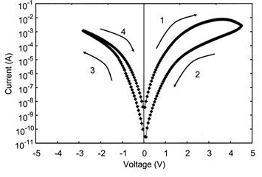
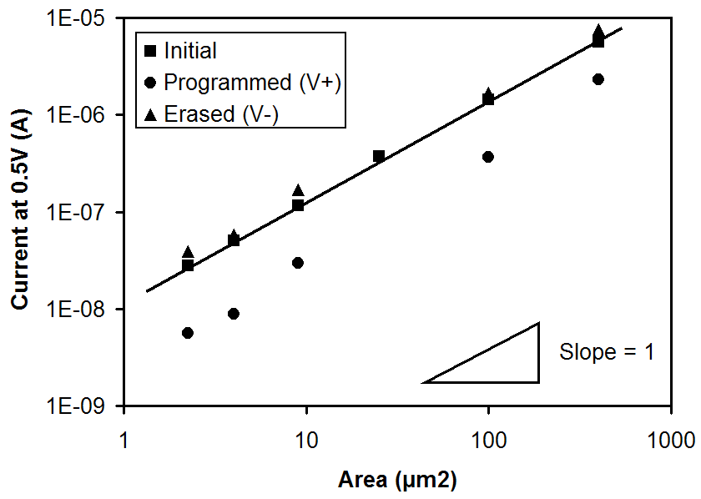
Salient Characteristics of Unity CMOx
Structure / Mechanism
Supporting Physical Characterization
Supporting Electrical Characterization
Critical Challenges

Slide 24
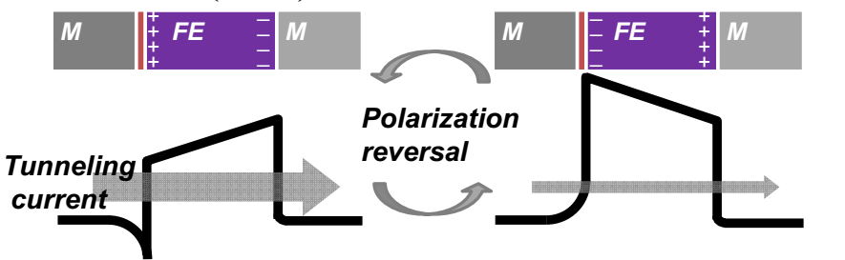
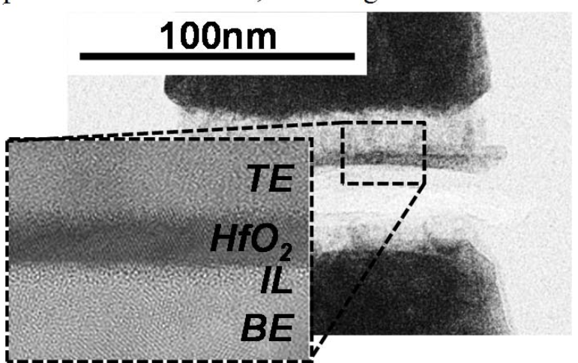
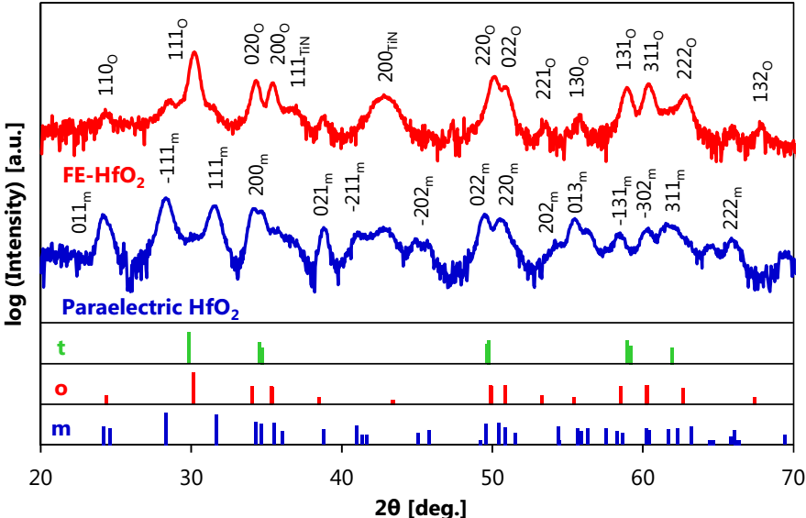
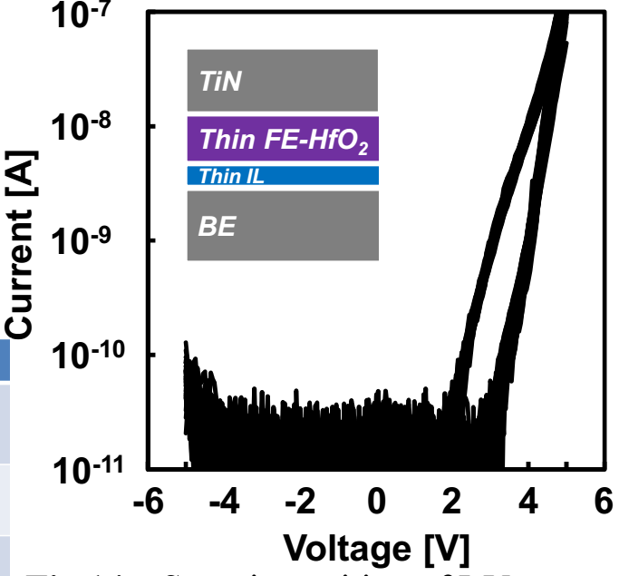
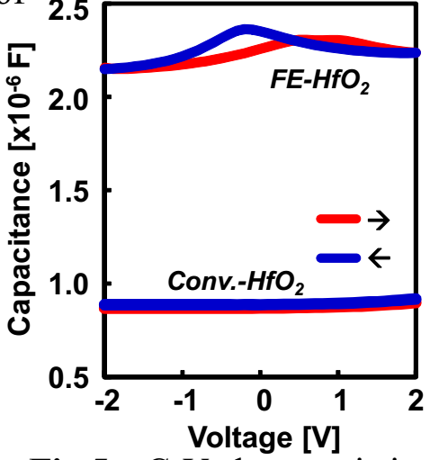
Salient Characteristics of FTJ
Structure / Mechanism
Supporting Physical Characterization
Supporting Electrical Characterization
Critical Challenges

Slide 25
Salient Characteristics of SSM
Structure / Mechanism
Supporting Physical Characterization
Supporting Electrical Characterization
Critical Challenges

Slide 26
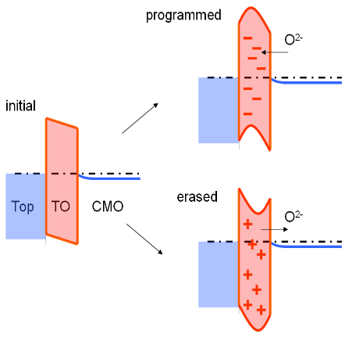
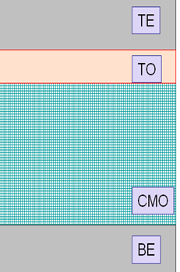
Non-Linear (selector-less) RRAMs – vs – SSM
VMCO
Oxygen transfer changes TiOx conductance
UNITY (CMOx)
FTJ

Slide 27
Scratch Pad

Slide 28
V_{T} [v]
Pulse [μA]
V_{T} [v]
Pulse [μA]

Slide 29
V_{T} [v]
Pulse [μA]
V_{T} [v]
Pulse [μA]

Slide 30
❶❷❸❹
V_{T} [v]
❶❷❸❹
❶❷❸❹
Pulse [μA]
❶❷❸❹
V_{T} [v]
Pulse [μA]

Slide 31
FECap
C
Pulse [V]
Log(I@.5V)
Pulse [AV]

Slide 32
FEFET
Vt
Pulse [V]
Vt
Pulse [AV]

