Slide 1
TGnMOST Mitigation Plan
DerChang, Matt, Balaji, WW06.4
TGnMOST Positive supply needs additional 400mV for selection
Increasing Vpp and reducing E4 are planned for mitigation – further analysis on SSM DTS and energy risk will be followed.

Slide 2
TGnMOST Requirement
+3.8V
+0.5V
-3.5V
+0.0V

Slide 3
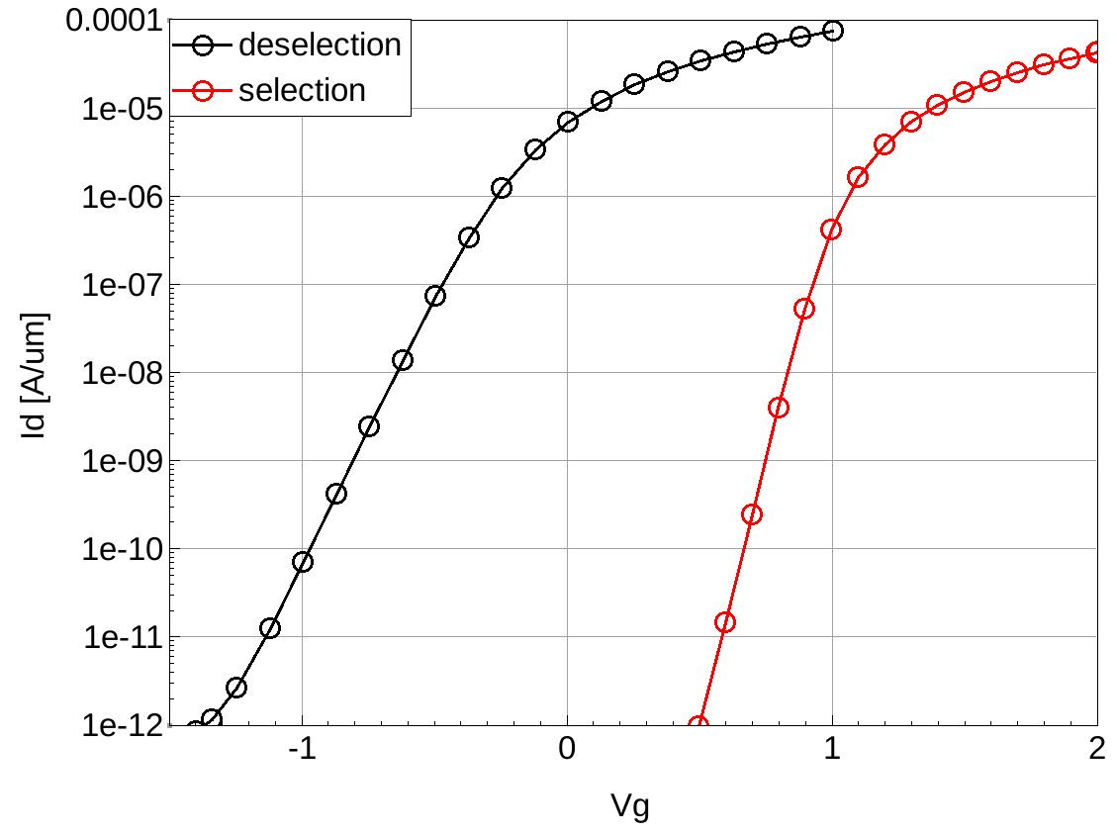
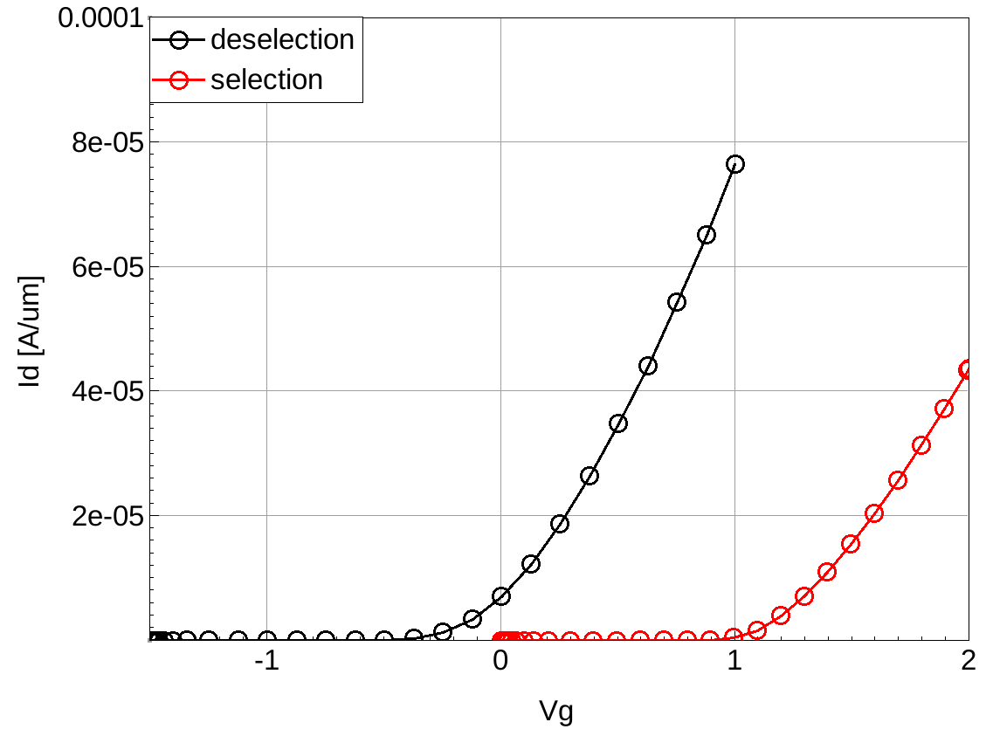
Best Simulated TGnMOST @ 175Å
Tg: 12 uA
Tg: -0.8V
1.42V
=
5.22V
(+420mV)

Slide 4
Mitigation Plans
S26A DTS requirement
Best Simulated TGnMOST capability
+3.8V
+3.4V
+0.5V
+0.5V
-3.5V
-3.5V
+0.0V
+0.0V
Plan-1: Increase Vpp by ~400mV
Plan-2: Drop Vnn by ~400mV
Plan 3: Drop E4 by ~400mV
+3.8V
+3.4V
+3.4V
+0.5V
+0.0V
+0.0V
-3.5V
-3.9V
-3.5V
+0.0V
-0.5V
+0.0V

Slide 5
Decision Process and
 | Design | Cell/Array | CMOS
Owner/ECD | Balaji / | Agostino / | Alan /
Increase Vpp | Energy assessment | No impact | Junction breakdown and reliability
Reduce Vnn | No go due to -0.5C Cell bias is needed
Reduce E4 | No impact | DTS change | No impact

