Slide 1
Self-selector pathfinding
SOW
fpellizz, apirovan

Slide 2
Self-selector concept
S15B SD-only, lot 8792062, 18nm SDδ ver 4
Positive programming pulse
VTH
Negative Vth detection → Vth=5.6V → VTHigh
Negative programming pulse
VTL
Negative Vth detection → Vth=4.7V → VTLow
A Vth window has been observed by applying programming pulses to the SD device with opposite polarity
The mechanism underlying this effect is unknown (atomic species electromigration is the leading candidate model), but the effect has been experimentally observed on several vehicles (PTX SD-only, S15 SD-only, S15 FS) and for various SD compositions (SD1 and several version of SDδ)

Slide 3
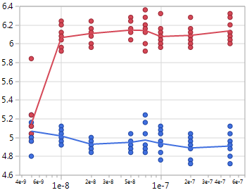
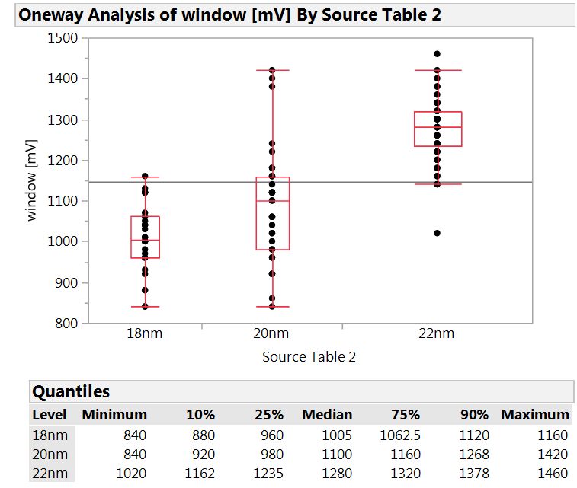
Key features
Simpler process integration, with lower aspect ratio and no cross-contamination
Flat VT-I with programming currents as low as Ihold (25uA)
Fast program (20ns easily achieved) and short delay between program and read (100ns demonstrated)
Vth window depends on SD thinckness (70mV/nm sensitivity on SDδ)
W BL
Carbon
PM
W BL
Carbon
Carbon
SD
SD
Carbon
Carbon
W WL
W WL
Self-selector
SxP
VTH
Vth [V]
Vth window [mV]
VTL
SD thickness
Pulse width [s]

Slide 4
SD polarity effect exploitation
SD polarity effect may be exploited for
Stand-alone self-selecting memory device with
Simpler process integration
Lower programming current
Faster program speed
Less reliability issues
Enabling eMLC capability in the SxP configuration, with 3 and 4 level intrinsic feasibility demonstrated
Widening the Vt window in the SxP configuration

Slide 5
Additional test structures on S26A
On S15C the reverse polarity measurement capability is limited to the 2xCMOS test structure, but it is demonstrating very useful to investigate the behavior of second deck.
2xCMOS structure can provide intrinsic information, but no statistics and no info on ED variation impact.
Reverse polarity capability will be added to S26A test vehicles in order to support both the investigation on single deck wafer of the second deck behavior, and the reverse polarity effect on SD-only, in particular on:
A sub-set of cells in QTT
IG88
SR71 (new test vehicle added to the test pattern)

Slide 6
Pathfinding activities
~ 2-3 lots/month on the SD-only vehicle will be devoted to support the full assessment of the concept
Resources will be used to troubleshoot and characterize the structures on the S26A
These activities will be contained within the current JDP budget

Slide 7
This SOW relates to a Micron innovation in the path-finding stage at Micron. Micron and Intel agree that the product qualifies as a ‘Comparable Technology Product’ as such is defined in the JDPA, and hereby acknowledge that Intel has properly exercised its opt-in rights as set forth in Section 3.4(a) of the JDPA. The Parties further agree that the Comparable Technology Product as defined in this SOW will be treated as a Designated Technology Device under the JDPA.

Slide 8
Back-up slides

Slide 9
Intrinsic Performance
Comparable leakage (same SD material).
More flexible Read algo (no spurious reset of Set bit).
Similar Set Vt, but much faster (~20ns demonstrated) and simple (no pulse shaping needed) and lower current Set operation.
Similar ΔVt, but much lower reset current (~1/3 of actual SxP current).
Negative polarity needed for reset operation (added decoder complexity/area).
A thicker SD is preferable (better Vth window, leakage and drift), so higher voltages may be needed.

Slide 10
Reliability
Comparable Drift for Set (same SD material) and better Drift for Reset (no additional Drift of reset PM).
No Read Disturb on Set
Read Disturb on Reset represents the only failure mode specifically related to the proposed approach → > 10⁴ reads feasible up to 125C
No Proximity Thermal Disturb (very low current and temperatures).
Similar Write and Read Endurance.
Good retention up to 125C, but activation energy still to be quantified (wip).
> 1E4 reads

