Slide 1
Self-Select Memory IM JDP SOW
Version 2.0
January 31, 2018

Slide 2
Signature Page
This 3DXP Joint Development Program Statement of Work Rev 2.0 (“Self-Select Memory SOW”), having been approved by the JDP Committee is hereby approved by Intel and Micron respectively effective as of mmm dd, 2018, as signified by the signature of each company’s authorized representative below. It is understood and agreed that this JDP SOW may be amended in due course in accordance with the procedures set forth in the Joint Development Program Agreement.
MICRON TECHNOLOGY, INC |  |  | INTEL CORPORATION
By: |  |  | By:
Name: |  |  | Name:
Date: |  |  | Date:

Slide 3
Revision Page
Approval Date | REV | Pages Affected | Was | Is | Comments
Jan-20-2016 | 1.0 | ALL |  | Initial Self-Select Memory SOW
Jan-dd-2018 | 2.0 | ALL |  | SSM technology and product SOW
Notes:
3

Slide 4
SOW Contacts
Name | Function | Company
Russ Meyer | JDP co-manager | Micron
Al Fazio | JDP co-manager | Intel
Mark Helm | Design | Micron
Matt Goldman | Design | Intel
Geetha Jayaraman | Array Development and Product/Test | Intel
Fabio Pellizzer | Technology Development | Micron
DerChang Kau | Technology Development | Intel

Slide 5
SOW Contents
0.0 Purpose
1.0 Introduction
1.1 Background
1.2 Mission and Scope
3.0 Strategy
3.1 Overview
3.2 Development Vehicle
3.3 Alpha Product
3.4 Scaling Roadmap
4.0 Milestones & Check points
5.0 Cost analysis
6.0 Process Development
7.1 Cell Stack Definition
1.2 Structure Yield
7.0 Design SOW
7.1 decoder
8.0 Product Development SOW
8.1
9.0 Budget & Assumptions
Backup (success criterial, spec and other placeholder)

Slide 6
0.0 Purpose
The goal of the work is to validate Self-Select Memory, SSM, fundamentals for a Go/No-Go decision fast.
The intent and purpose of the document are –
To introduce SSM
To illustrate the strategy for “fast fail or succeed” with an alpha product
To establish incremental milestones based on the strategy
To define key activities and deliverables through the milestones
To define metrics and success criteria for progress tracking and decision making
To define the resource and the budget to achieve the targeted deliverables

Slide 7
1.0 Introduction
Background, Mission and Scope

Slide 8
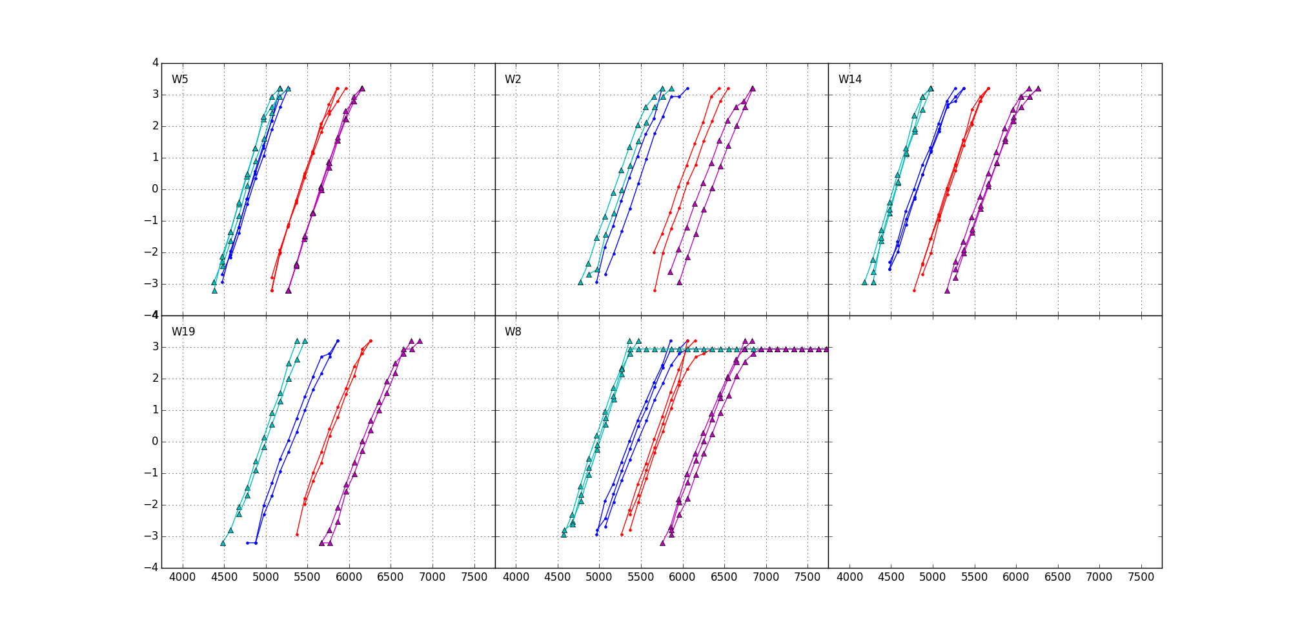
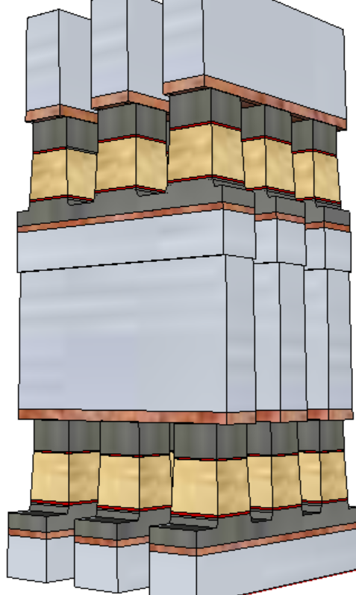
1.1 Bakground
+/+
−/+
S15B SD-only, lot 8792062, 18nm SDδ ver 4
Write/Read
Polarity
−/−
+/−
V_{T,High}
Positive
Write
σ of bit distribution
Pulse Polarity
Negative
read
TE
900mV
SD
V_{T,Low}
Negative
Write
Negative
read
BE
V_{TH} [mV]
Fundametally, it is a 3DXP technology.
  Physical construction of SSM array is BEOL 3D stackable X-Y cross point comptatible with mainstream CMOS.
  Read/write is to threshold a cell in a tile while the rest of cells are inhibited in subthreshold bias.
A V_{T} window (∆V_{T}) has been observed by applying programming pulses with opposite polarity.
The best known ∆V_{T} physics is an electrochemical potential modulation by polarity.
  Write – Band offset switching subject to mass transport (memory effects)
  Read – Space Charge modulation resulting in voltage shift (memory window)

Slide 9
1.2 Mission & Scope
Mission
  Pathfinding of an alternative 3DXP technology for roadmap and scalability development
Scope
  Seek for fundamental understanding of non-volatility of bipolar operation by demonstrating reliable Read Window Budget meeting storage class memory attributes.
  Design a bipolar decoder and power supply scheme with a multi-deck product vehicle to demonstrate operating energy and read/write latency
  Develop product roadmap based on SSM physics, lost cost process enablers and high efficiency decoding scheme.

Slide 10
3.0 Strategy Overview

Slide 11
Plan for SOW: Strategy Overview
Bipolar Decoder Design
Fast implementation: based on S26A floor plan
Low risk execution: based on S26A design collateral + TGnMOST development
Algo development leverage by reusing S26 test
Enable probe synergy with S26 PG1 specs with shorter write completion time
S26S Tapeout meeting S26A spec
Product vehicle: 256Gb in 197mm²
½ write completion time
Dual Deck compatible with S25A spec
Fail or Succeed
20nm Startup Flow Defined
Structure and RWB demonstrated
DTS/MTS/RWB are consistent
Scaling Roadmap
Process architecture
Stack (S26A like) vs.
Tier (3DNAND-like)
SSM Switching Physics w/ 20nm Cell
Cell development (DTS/MTS) based on S26A scribe mini array and single cell structures (SR71, QTT, 2XCMOS)
Develop fundamental understanding of switching mechanism to tune window and reduce distribution
20nm SSM Structure Yield
Establish S26A SSM-flow baseline and change control
Leverage with S26A yield improvement

Slide 12
S26S Design and TGnMOST Intercept
TGnMOST Collateral Development
Silicon meeting Vt, leakage and Idlin/Idsat
S26S Design Start
100% S26A collateral
CMOS Bipolar Decoder for placeholder (no HV Stress)
20~50% high switching energy
Wafer level testable for SSM functionality @ ½ of set time
Power/thermal envelope prohibitive for full throttle component test
(system level validation)
EoQ1 assessment for Q3 TO
Favorable to
‘fast fail’
(Criteria
to be developed)
First Stepping
w/o TGnMOST
system validation at lower BW
TGnMOST
Collateral Ready
Change CMOS decoder scheme to TGnMOST decoder scheme
Design to S26A full spec, compatible to S25A full spec
Spec-compliant S26S stepping
w/ TGnMOST

