Slide 1
SSM RWB cell roadmap - r5.3-based SDk1/SDk2 status -
Fuga
ww15.1 v1
Presentation folder: TBD
Link to DTS0.3 (and DTS0.4 pre-discussion)

Slide 2
Summary
Objective: Q2 key milestone is demonstrate dual-deck SSM operation, including assessment of cell/structural d2d gaps (if any) and closure path definition towards effective S24S ramp-up (Q3)
Status:
Cell assessment based on SR71B w/ limited statistics shows ~ -400 mV (-25 mV) for SD.k1 (SDk-Alloy14)
Structural (periphery) yield for r5.3 SDk1 is ~30% (<70%), projected ~ <10% (<40%) for SDk-Alloy14 (aka SD.k2)
Recommendation for PI/Cell strategy:
r5.3 SD.k1 as POR for dual-deck demonstration and related cell/structural work towards S24S start-up
SWRs in view of dual-deck mismatch segmentation to be planned in advance (DE, t_{SD}, t_{BE/ME}, etc.)
SD.k2 to be promoted to pre-POR based on confidence path on structural/morphology yield gap closure
What is our current estimation for timeline to address cell morphology / interaction w/ alloy composition?
Result from Campaign E*,G* to allow further alloy tuning, while PI centering trials on SDk2 carried out
Fingerprint cell fundamentals and process related interactions based on above
Areas which need further analysis to provide solid projection for main array operation (S26A, S24S):
Address vertical leakage w.r.t. compositional directions and comparison w/ S24S: Any known gap?
Parametric R, C: Are the trends w/ cell parameter an artifact from test-structure or need cell roadmap follow-up?
Enablement of S26A-PRB to SR71B die level correlations to enable dataset confidence: Started?
BD and E3 WE/RD GB projections: consolidation needed in terms of both metrology and prediction estimates.

Slide 3
r5.3 RWB estimations
SR71 1D0 PG4 Cell RWB (Piecewise Built) S26A1 silicon (Neg Read) |  | DTS0.3 [mV] | DTS0.4 [mV] | SDk-A06 CR5.3 85C [mV] | SD.k1 CR5.3 85C [mV] | SDk-A14 CR5.3-based 85C [mV] | Comments
Structural Yield |  | >70% |  | 20% | 20% | 0% | Largest toggle in SDk alloys campaign: (In,Ge) Vs. As role still to be decoupled
Periphery Yield |  | >70% |  | 70% | 70% | 10%
Vdm1 | ΔVt (1 μs) | 1600 | 1380 | 935 | 915 | 1340 | Largest toggle in SDk alloys campaign: (In,Ge) Vs. As role still to be decoupled
 | SET σ (Vt) | 105 | 80 | 85 | 85 | 92 | Clear modulation observed w/ SDk alloys & beyond VT normalization: Understanding/containment path needed
 | RST σ (Vt) | 105 | 100 | 101 | 100 | 120
 | SET drift (1 μs-10 s) | 300 | 240 | 220 | 220 | 280 | Limited toggles observed: any metrology impact?
 | E3 GB WE | 30 | 100 | 95 | 95 | 95 | Item high in pareto ranking, resulting from limited focus on VT evol. (array pre-conditioning)
 | E3 GB RD | 300 | 0 | 380 | N/A | 240 | Eng. segmentation to ratify/refine DTS assumptions (Vdm1-2, FW# depend.)
 | Gap to goal |  |  | -420 | -435* | -25
Vmd2 | Rst drift (1 μs-3 s) | x | x | 245 | 245 | 620 | Large toggle in SDk alloys campaign: Need assessment on reliability (see post cycles)
 | Set drift (10 s-48 h) | x+200 | x+200 | 320 | 320 | 320 | Assess BD component, currently assumed negligible (any data?) -> release metrology
 | Gap to goal |  |  | -495 | -495* | +275
True Window: SDk-A14 alloy composition promising for expansion, mainly thanks to <DVT> & RST drift expansion
VT sigma toggle is partially counterbalancing the expansion from median window: Need root-causing (PI Vs. device)
Additional toggles from E3 RD GB need to be understood for reliable assumptions going fwd
PI strategy: What is our current estimation for timeline to address 1st/2nd cut cell morphology and structural yield for SDk1 (mono-target) and SDk2 (mono-target available from ww16 emulating A14)?
Understanding for process integration artifacts Vs. actual compositions toggles needed in the risk assessment
Test methodology: while monitors update in SR71 to address RWB component breakdown, strategy in view of S24S needs discussion (see VT evolution and ‘seasoning’ as key topics)
E3 Guard-bands: WE and RD VT shift need dedicated char. to enable robust accounting & algo-knobs id

Slide 4
RWB breakdown
Full calculations, including x-tile (more robust estimation needed)
* If not noted, everything assumed @3.54s and write/read ipd @135ms
** When sampling limits sigma visibility, data used @3.0s and extrapolated @3.54s w/ normal assumption; Use 10S E3 read, if no 3s read available
In grey elements for segmentation or w/ metrology to be developed
In light pink numbers to be validated for consistency w/ proper extrapolation method

Slide 5
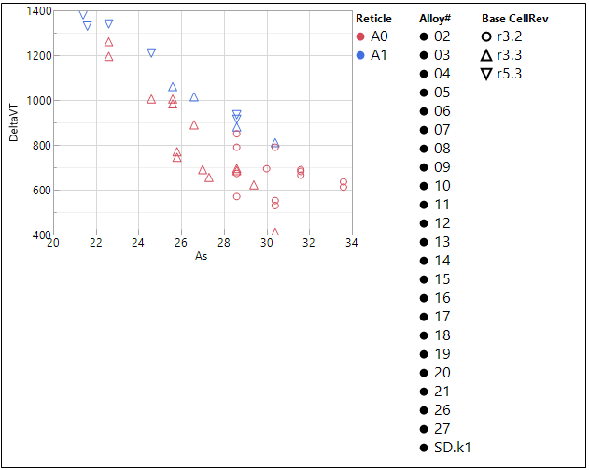
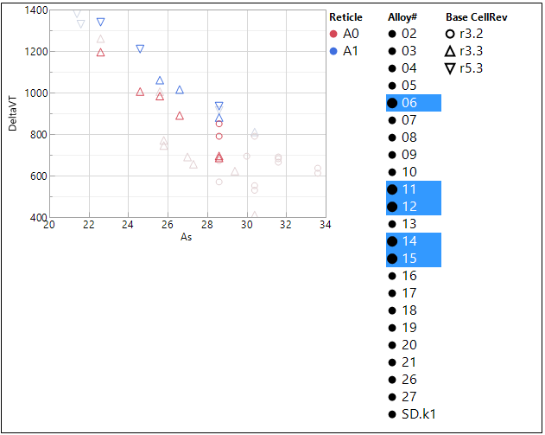

<ΔV_{T}> Vs. SDk alloy & rev (test, process)
A1 + r5.3
r3.3 -> 5.3
<DVT> [mV]
<DVT> [mV]
A1
r3.2->r3.3
At same alloy selected:
PI [r3.3 Vs. r3.2]: ~ -150 mV (decrease)
PI [r5.3 Vs. r3.3]: ~ +50 mV (increase)
PE [A1 Vs. A0]: ~ + 150 mV (increase)

Slide 6
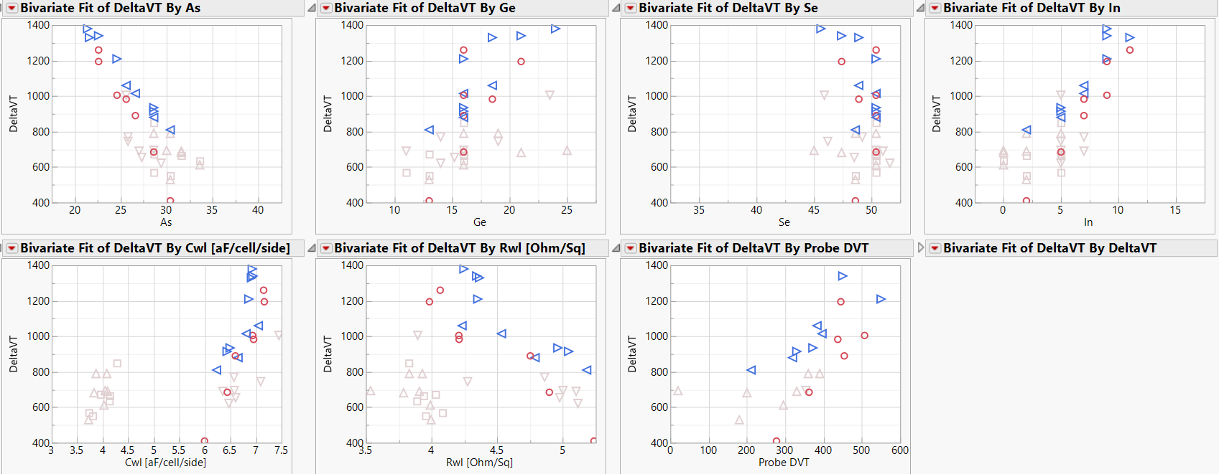
SDk campaign

Slide 7
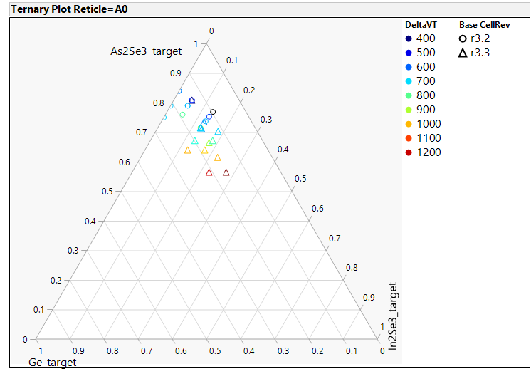
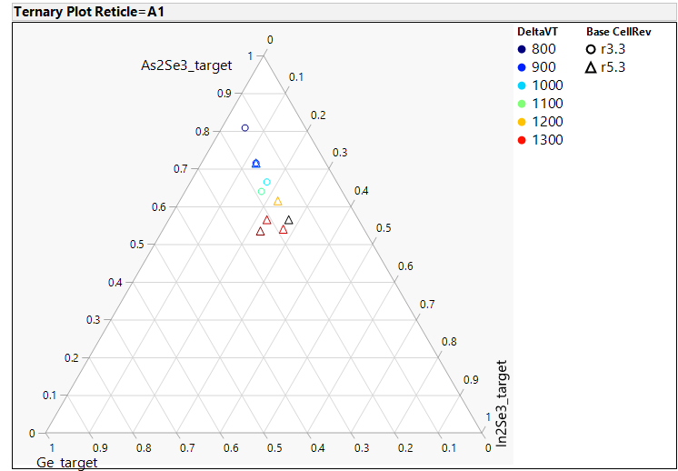
SDk campaign

Slide 8
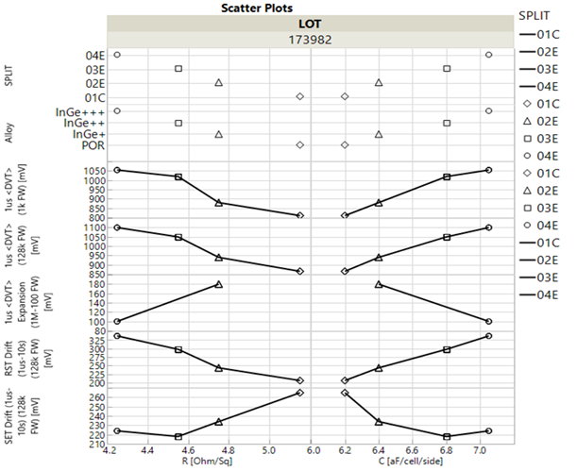
Alloy Vs. effective CD

Slide 9
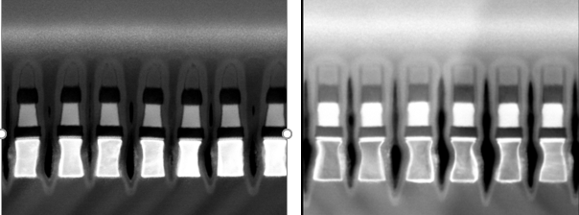
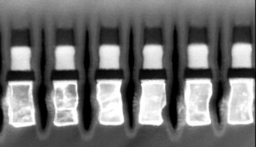
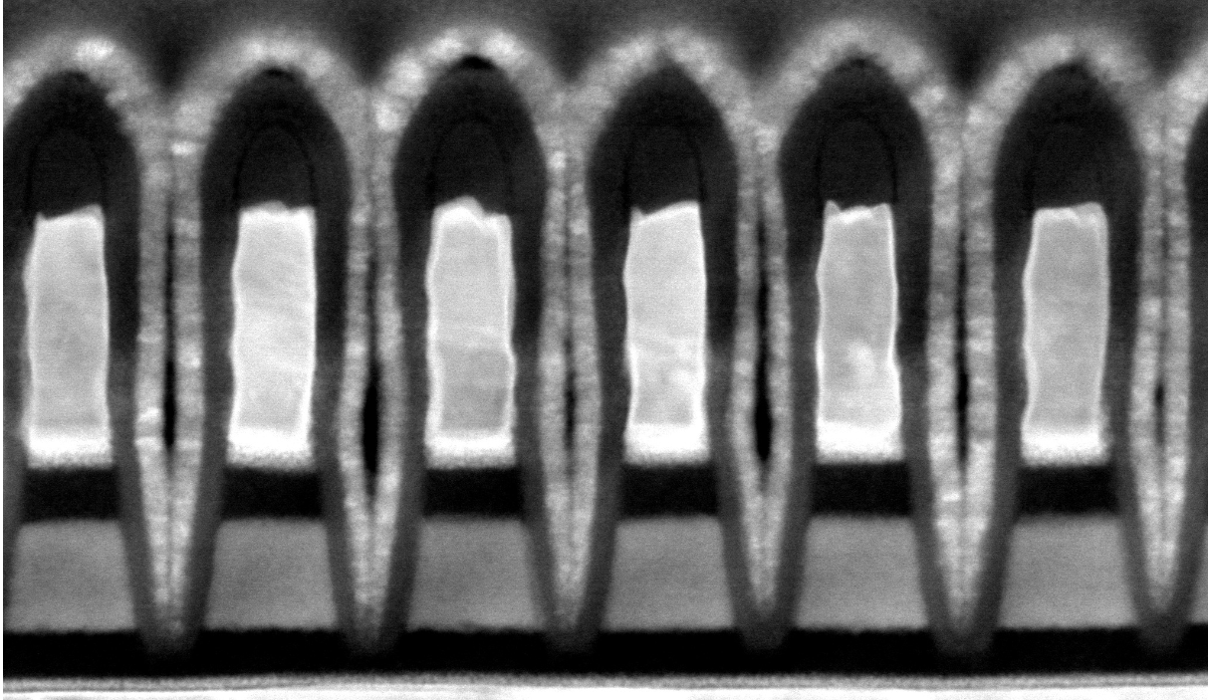
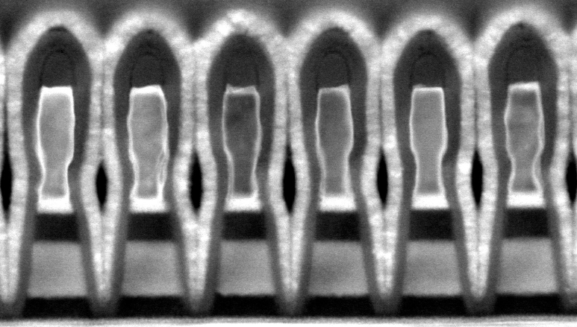
SDk Campaign: Structural health
Kyle R. (PI Alignment meeting)
Alloy 6
Alloy 14
Along Bitline
SD etch = 27s
SD etch = 33s
Along Wordline

Slide 10
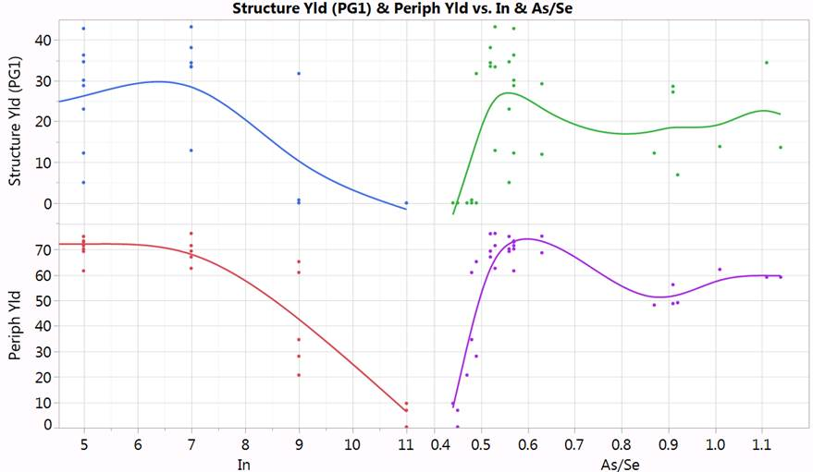
Structural and periphery yield (SDk)
Kyle R.

Slide 11
SUPPORTING MATERIAL

Slide 12
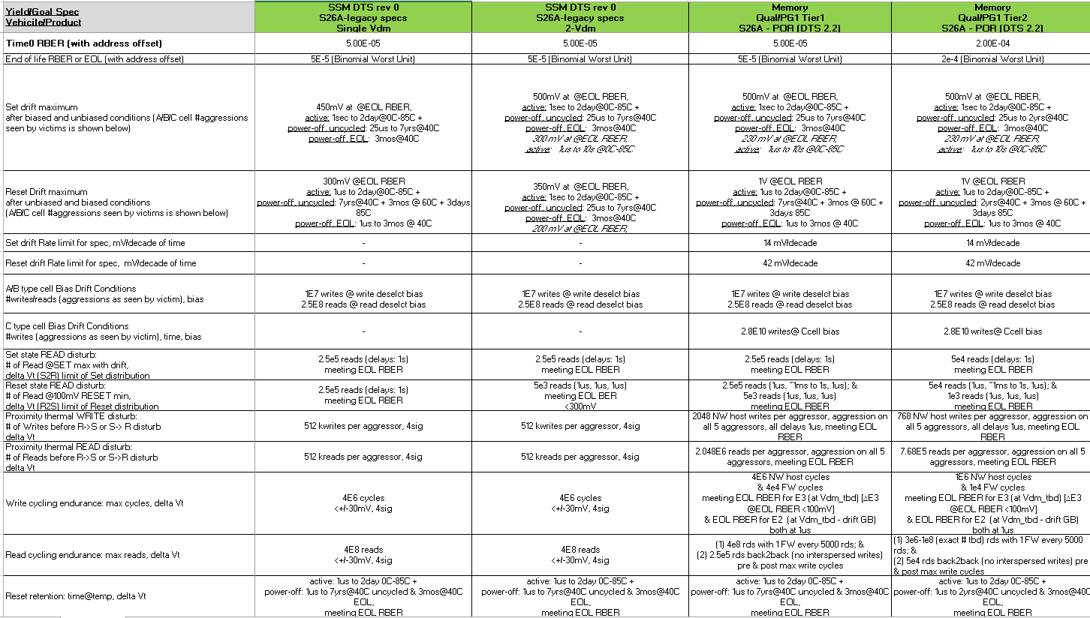
DTS0.3: Read related goals
Link to DTS0.3
DTS reported here is a placeholder (further details being worked out)

Slide 13
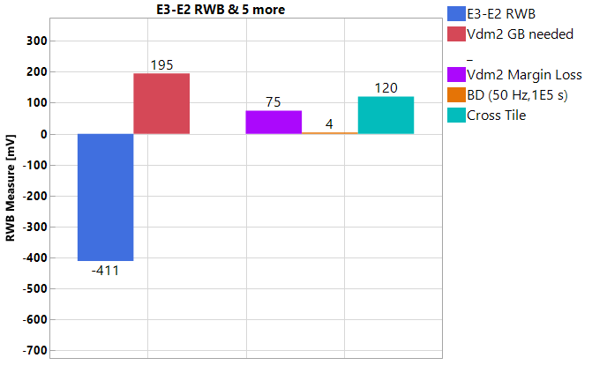
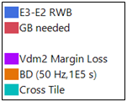
SSM RWB Pareto Methodology
ww12.2
RWB measurement (3.54σ RBER goal; 135 μs write ipd) | DTS0.3 [mV] | Definition | r5.3 status | Comments / Follow-ups
RWB (E3-E2) | >230 | E3(@3.54σ, 1us, 10k FW, 5k rds) - E2(@3.54σ ,10s) | -411 | To be > success criterion (sum of items below); Vdm distributions collected and extraction at RBER of interest
GB needed | <230 | Vdm2 Margin Loss + BD (50 Hz,1E5 s) + Cross Tile | 195 | Success criterion, w/ breakdown as below
Vdm2 Margin Loss | 200 | E2_drift(@0σ,10s-48h*,1 FW) - E3_drift(@0σ, 1us-3s*,10k FW) | 75 | * Projection from 3h (10s) for E2 (E3)
BD (50 Hz,1E5 s) | 0 |  | 0 | Test release to intercept PR4(?): Methodology dev. to be aligned to 3DxP
Cross Tile | 30 |  | 120 | Test release to intercept PR4(?)
Methodology: Rev0 RWB Measurement and Pareto released
Measured RWB to include worst-case E3/E2 @RBER goal (3.54σ), w/ E3 to include WE & RD GB @1μs t_{wait}, while E2 being @10s
Measured RWB success criterion set by Vdm2 GB needed, as determined by UD/BD Vdm2 margin loss and cross-tile
Recommendation: Metrology and Analysis gap closure
PR3 (& PR4) release to include missing elements to drive RWB opt.
SWR analysis alignment to Rev0 methodology (line trend included)
RWB gap Pareto in r5.3 and rev5.3⁺ projections to drive roadmap
Draft in next slides
Success
criterion
r5.3
GAP
success criterion
(break-down)
RWB

Slide 14
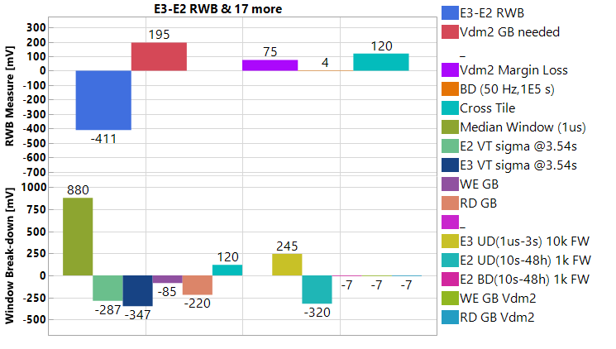
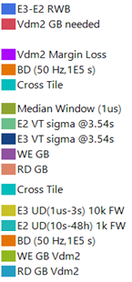
SSM RWB breakdown (Dual-Vdm)
ww12.2
RWB measurement (3.54σ RBER goal; 135 μs write ipd) | DTS0.3 [mV] | Definition | r5.3 status | Comments / Follow-ups
RWB (E3-E2) | >230 | E3(@3.54σ, 1us, 10k FW, 5k rds) - E2(@3.54σ ,10s) | -411 | To be > success criterion (sum of items below); Vdm distributions collected and extraction at RBER of interest
GB needed | <230 | Vdm2 Margin Loss + BD (50 Hz,1E5 s) + Cross Tile | 195 | Success criterion, w/ breakdown as below
Vdm2 Margin Loss | 200 | E2_drift(@0σ,10s-48h*,1 FW) - E3_drift(@0σ, 1us-3s*,10k FW) | 75 | * Projection from 3h (10s) for E2 (E3)
BD (50 Hz,1E5 s) | 0 |  | 0 | Test release to intercept PR4(?): Methodology dev. to be aligned to 3DxP
Cross Tile | 30 |  | 120 | Test release to intercept PR4(?)
Success
criterion
Methodology: Rev0 RWB Measurement and Pareto released
Measured RWB to include worst-case E3/E2 @RBER goal (3.54σ), w/ E3 to include WE & RD GB @1μs t_{wait}, while E2 being @10s
Measured RWB success criterion set by Vdm2 GB needed, as determined by UD/BD Vdm2 margin loss and cross-tile
Recommendation: Metrology and Analysis gap closure
PR3 (& PR4) release to include missing elements to drive RWB opt.
SWR analysis alignment to Rev0 methodology (line trend included)
RWB gap Pareto in r5.3 and rev5.3⁺ projections to drive roadmap
Draft in next slides
GAP
RWB
Success criterion
(break-down)
Vdm2 Margin related
cross-tile
r5.3

Slide 15
SSM RWB Pareto (calc’s)
ww12.4
Link to excel
Objective: Establish RWB model & tracking, including POR/Pre-POR/Idea-phase overall methodology:
* If not noted, everything assumed @3.54σ and write/read ipd @135μs
** When sampling limits sigma visibility, data used @3.0σ and extrapolated @3.54σ w/ normal assumption; Use 10S E3 read, if no 3s read available
^ In grey elements for segmentation or w/ metrology to be developed

Slide 16
SSM RWB Pareto (r5.3)
ww12.4
Link to excel
True Window: Top limiter is <ΔVT>, w/ focus on K* campaign wave#2-3 learning harvesting (ww12-13), opportunities in σ(VT) TBD
SDk1 (mono-target) not meeting expectations; SDk2 ordered (alloy#14 – decision reviewed?)
E3 Guard-bands: WE and RD VT shift need dedicated char. to enable robust accounting & algo-knobs identification
Cross-tile: Strategy to be defined towards S24S actual scenario based on ad hoc char. plan / results
Vdm2 Margin Loss: Directions to be set based on K* campaign data synthesis
Risk Assessment: Accelerate enablement of S26A-PRB to SR71B die level correlations to enable dataset expansion & roadmap robustness (only 3 dice tested in SR71)

Slide 17
SSM RWB Pareto (r5.3)
ww12.4
Link to excel
True Window: Top limiter is <ΔVT>, w/ focus on K* campaign wave#2-3 learning harvesting (ww12-13), opportunities in σ(VT) TBD
E3 Guard-bands: WE and RD VT shift need dedicated char. to enable robust accounting & algo-knobs identification
Cross-tile: Strategy to be defined towards S24S actual scenario based on ad hoc char. plan / results
Vdm2 Margin Loss: Directions to be set based on K* campaign data synthesis
Risk Assessment: Accelerate enablement of S26A-PRB to SR71B die level correlations to enable dataset expansion & roadmap robustness (only 3 dice tested in SR71)

Slide 18
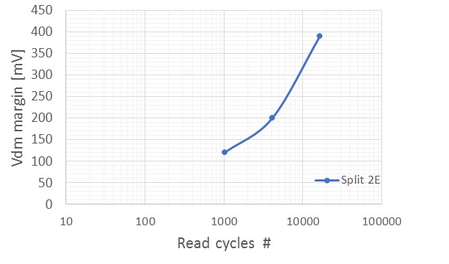
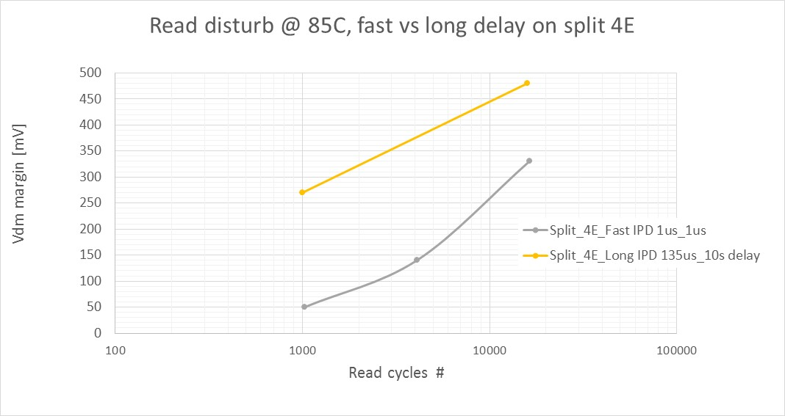
E3 RD: Introduction
E3 RD GB: Iterated reads induce RST RD, manifested as E3 V_{T} tail formation trending w/ log(rd#)
Margin loss is function of the margin (bits w/ higher VT will show less disturb)
Margin loss after few 10³ reads is recovered w/ single FW pulse (not shown; full char. Vs. rd# to be completed )
@3.54σ (extrapolated)
@3.54σ (extrapolated)
t₁
t₁
ipd
ipd
t₃
t₃
…
…
t₂
t₂
T = 85C
t₁ = 1us
ipd = 1us
t₃ = 1us
r5.3
T = 85C
t₁ = 1us, 10s
ipd = 1us, 135us
t₃ = 1us, 2s
r5.3, r5.3**
Enzo T.
Enzo T.

