Slide 1
SSM process development update
ww1646

Slide 2
Acknowledgments
Area
SSM development owners
DE:
Photo
PVD
CVD
CMP
RDA
PI
mhonjo; yuezhao; teallen; jfisher; jkeen
tgawai
pyzheng; dreconomy
asaxler
lhongqi; jjebarajjohn; skorkmaz
amajumdar; pwhite, twood
ccasella, kyastreb, 20s PI team support, layout team

Slide 3
Outline
Process deviations from POR stack flow
WL, BL specs, current structural issues
PROD SWRs status update
Gantt chart
Next steps

Slide 4
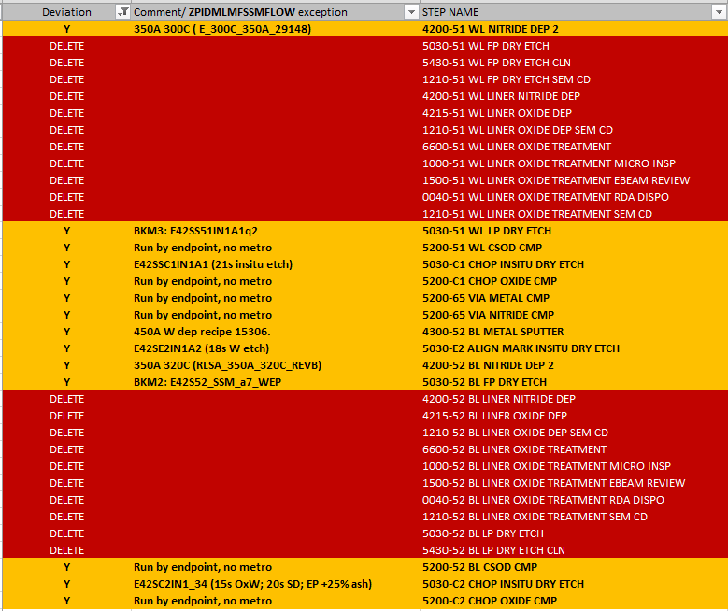
List of exceptions for ZPIDMLMFSSMFLOW single deck S26A
Validated
Major changes:
Single step 1st cut and 2nd cut etch
Adjusted to the stack E1,E2, C1,C2 etch
CMP steps running similar to POR
52 Reg tuning is required to meet specs
SD thickness increase
Will require all etch steps to be retuned
Attribute based exceptions to be set up based on lot1/1BU demonstrated health at testing;
Metrology setup will be required then (Scatter)

Slide 5
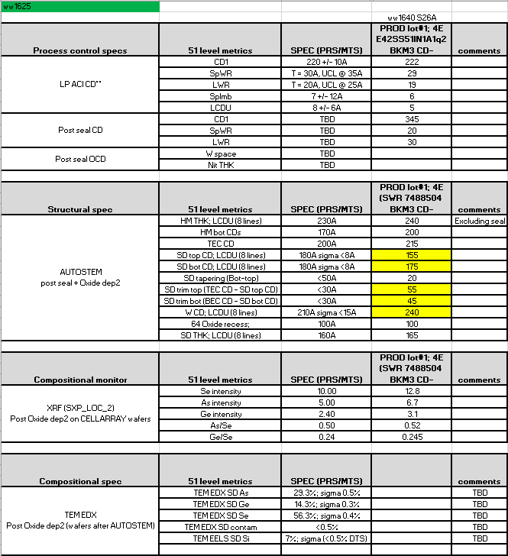
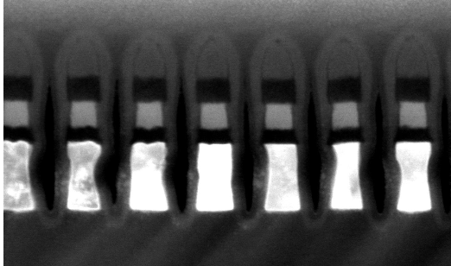
1st cut (51 WL) MTS tables
W spacing spec to be validated by probe
SD width is ~155-175A
TEM was not submitted

Slide 6
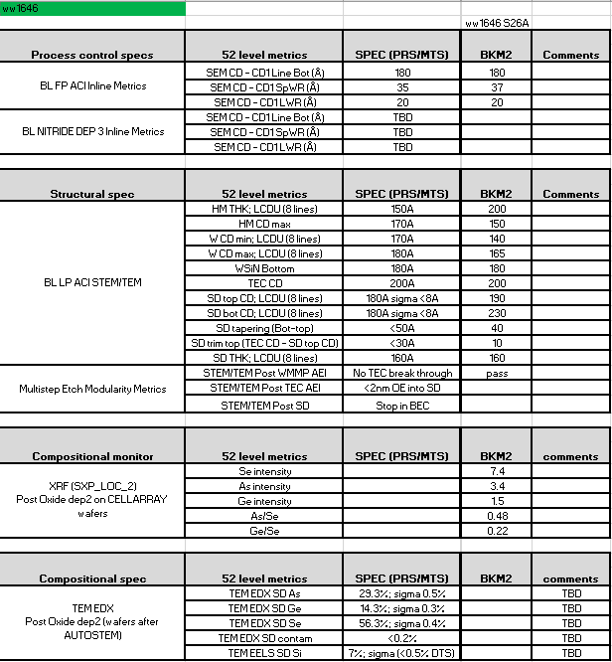
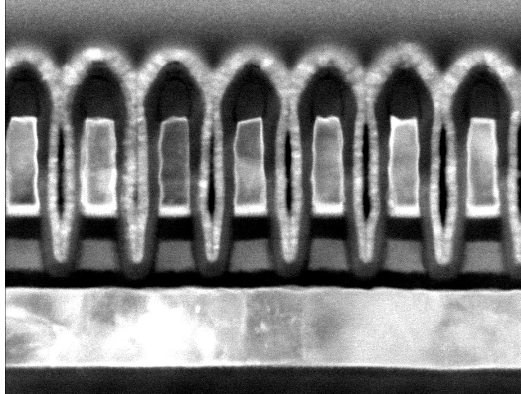
2nd cut (52 BL) MTS tables
Overall satisfactory 2nd cut profile.
Further targets introduced CDU improvement and W EP
Prod lot#1 will have W OE and CD+ skew

Slide 7
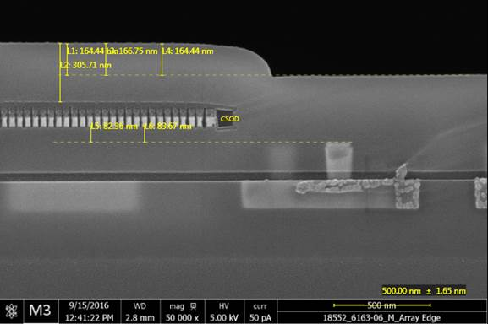
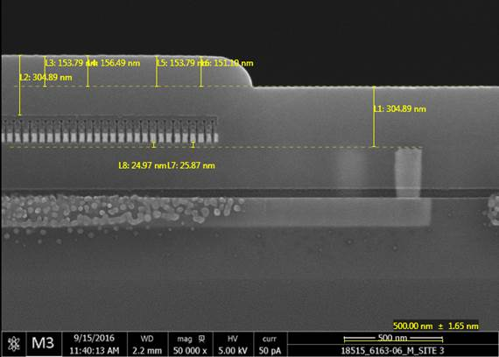
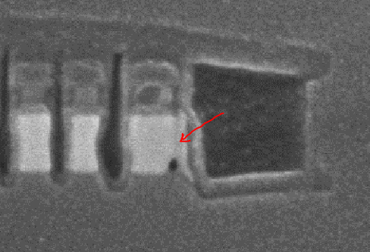
C1 chop layout on main array vs scribe mini-arrays
Scribe
In-die
10s style chop and 51 fill – edge of tile issue is present
20s style chop and 51 fill – no edge of tile issues
W residue on the tile edge – shorting potential
S26AC1AK3B-1 is expected to fix scribe layout
Expected to tapeout ww47

Slide 8
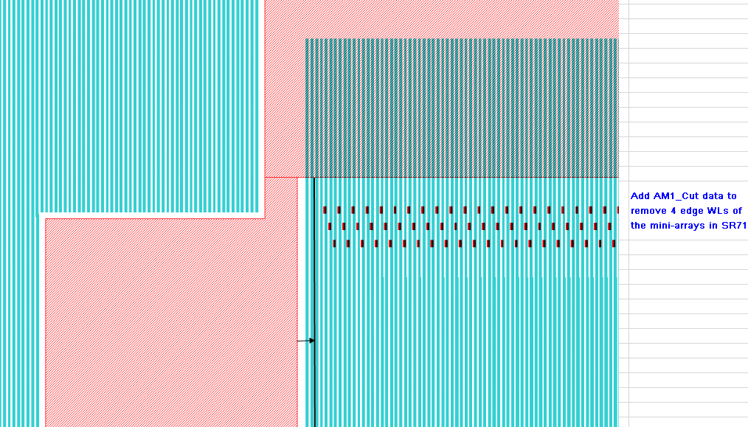
C1 mask edits to apply edge of tile 51 lines chop
S26AC1AK3B-1
C1 chop edge

Slide 9
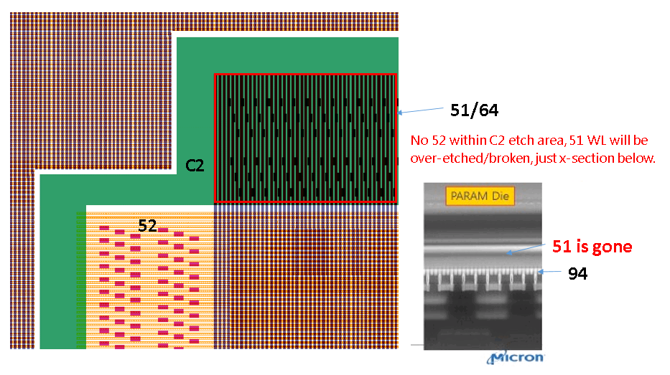
52 mask fix to prevent C2 etch over 51uncovered by 52 pattern
S26A52AA3B-1 – mask with the fix in 52 frame layout
The plan is to intercept prod lot#1
The mask is expected in Fab4 by 11/12

Slide 10
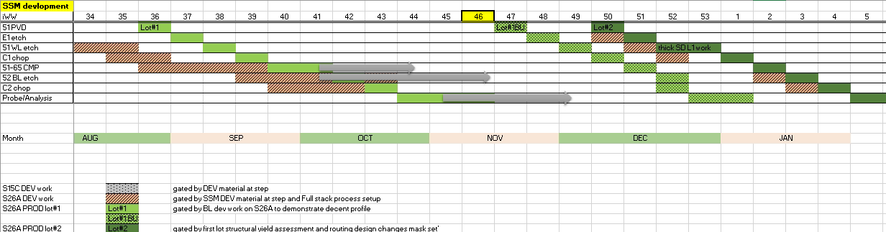
Si readiness Gantt chart
S26AC1AK3B-1 is the C1 mask for SSM mini array fix (expected in F4 by ~11/24) – will intercept SSM PROD lot#2;
S26A52AA2B-1 is the 52 mask to fix the WL chop out (expected in F4 by 11/12 - will intercept SSM PROD lot#1; and lot#1BU
PROD lot # 2 start is being pushed out by lot#1 delay;
Cumulative delay so far is ~4-5 weeks from original schedule
65 CMP line down (at 52 Nitride/Oxide cap) – 2wk
C1 CMP tools downtime – 1wk
52 mask -1-1.5wk

Slide 11
PROD lots status
PROD lot #1 9673132.003 status update
PROD lot #1 9768252.013 status update
At 52 Nitride dep2 (waiting for 52AA3B mask);
The lot ran with Oxide cap flow. Via health and impact on Param structures is unclear.
Lot#1 BU lot was launched this week from 64 level; Will run with Nitride cap.

Slide 12
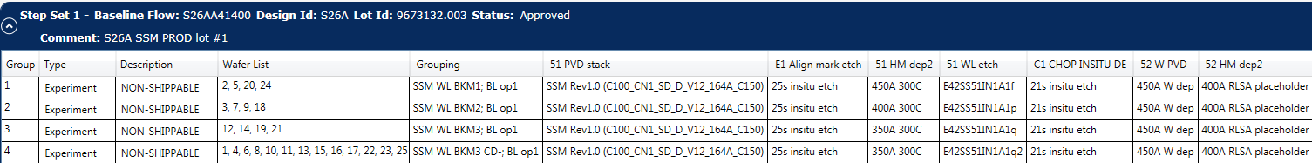
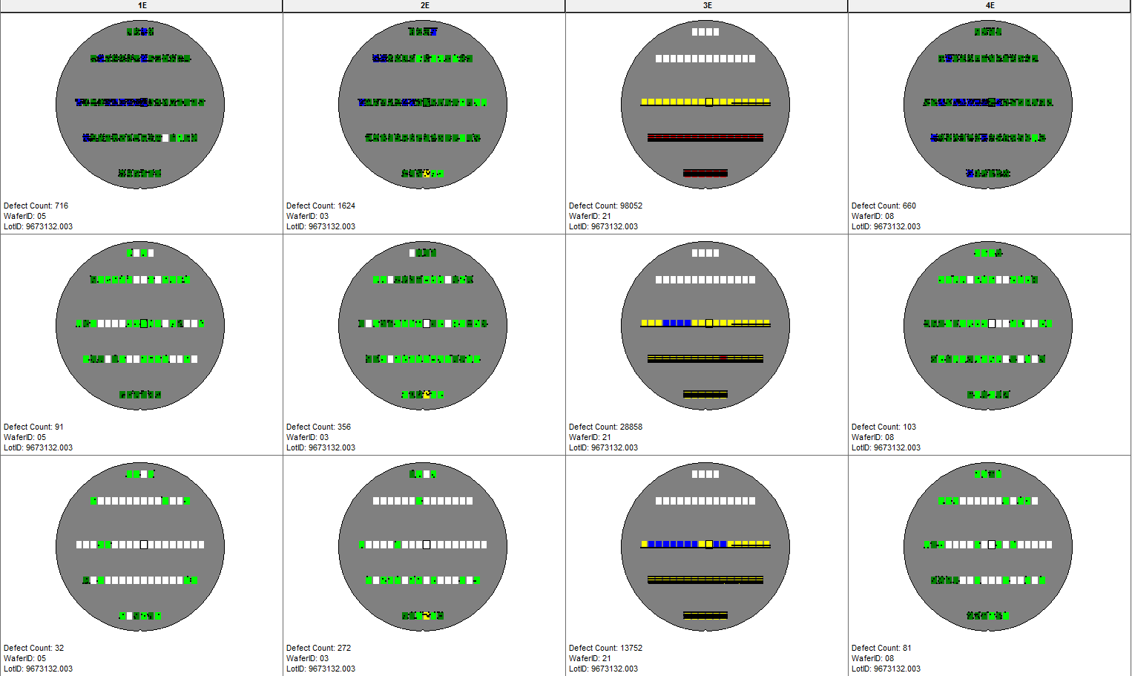
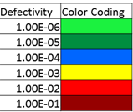
65 NCMP Opens/Shorts lot#1
All groups are primarily driven by opens defects.
Shorting counts for groups 1E, 2E, and 3E are lower than what is seen on full stack POR.
Single line glow defects are neither an open or a short rather they appear to be a resistance issue that causes WLs that are intact to appear brighter when charged.
Opens
Shorts
Glow
WL Opens/Shorts

Slide 13
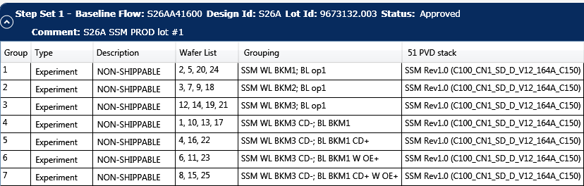
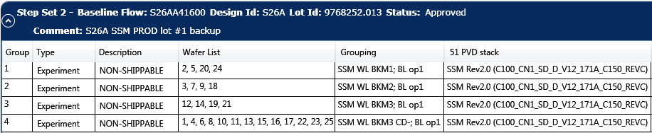
Current PROD SWRs setup
Status
Lot#1 @ 52 level
Lot#1BU @ 64 level

Slide 14
Next steps
L1D work priority for Q1’17
Addressing structural issues based on the end of line feedback from first prod lots
SD thickness increase towards 25nm
2-step 1st cut etch (isolating SD from W etch with exsitu liner post BEC etch)
PROD SWRs preliminary outlook for Q1’17:
Structural improvements based on initial end of line testing feedbacks
SD thickness / composition skew
1-step vs 2-step 51 etch with SD etch chemistry alternatives
Seal conditions skew
Electrodes skew

Slide 15
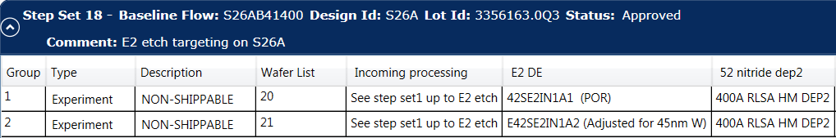



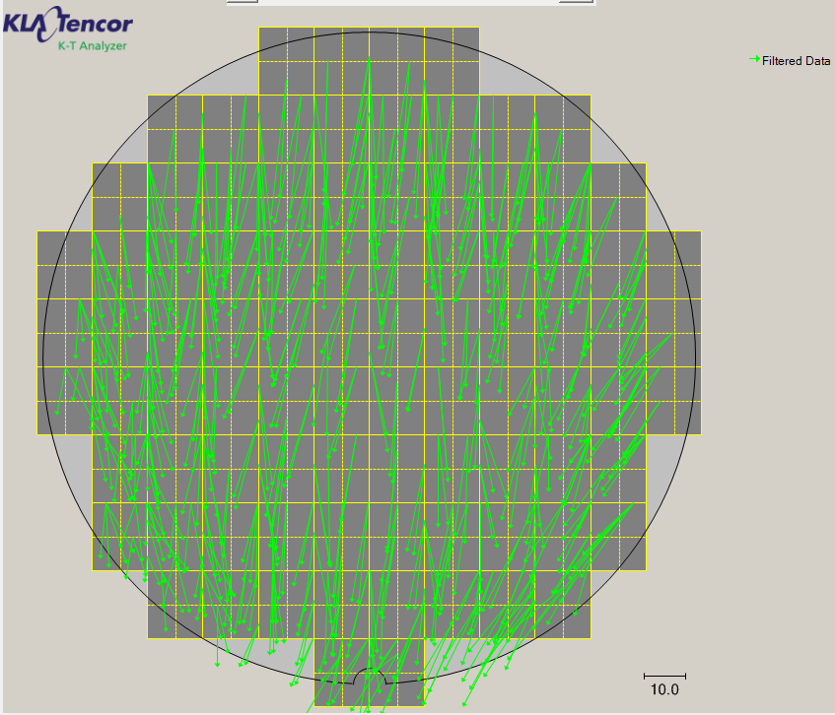
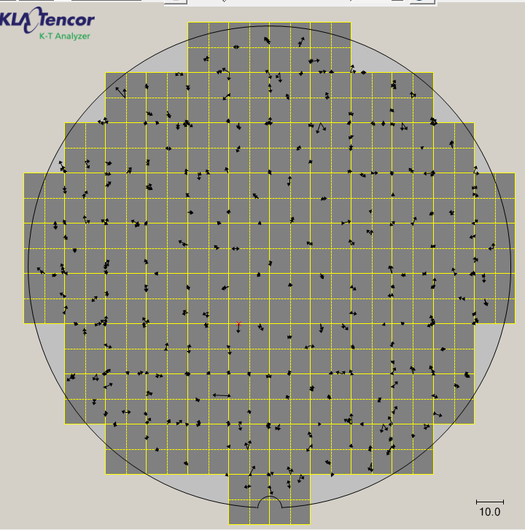
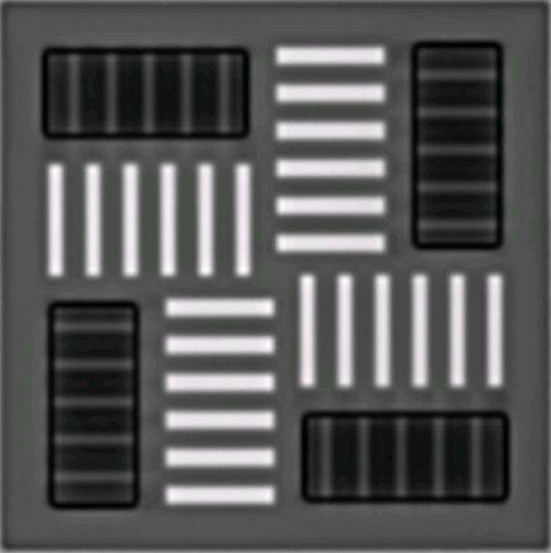

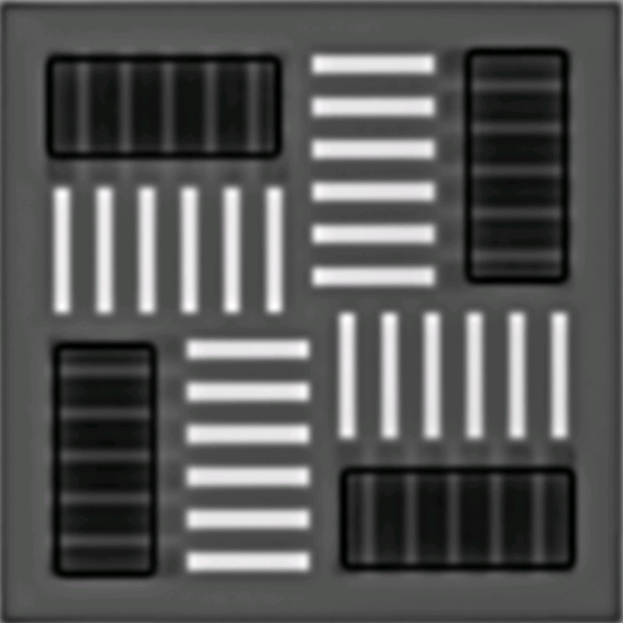
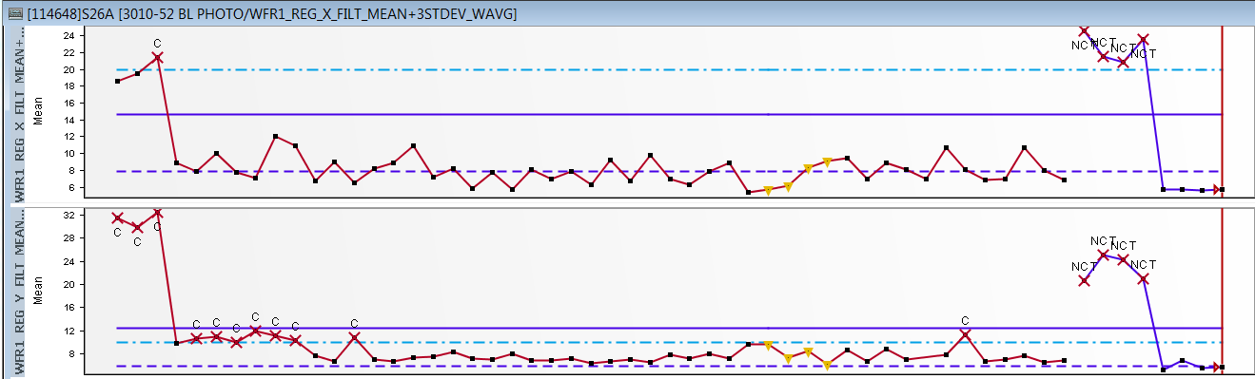
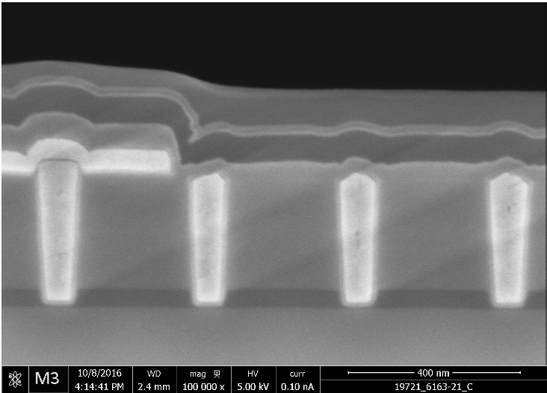
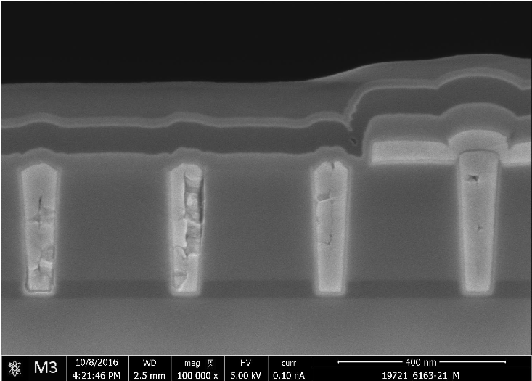
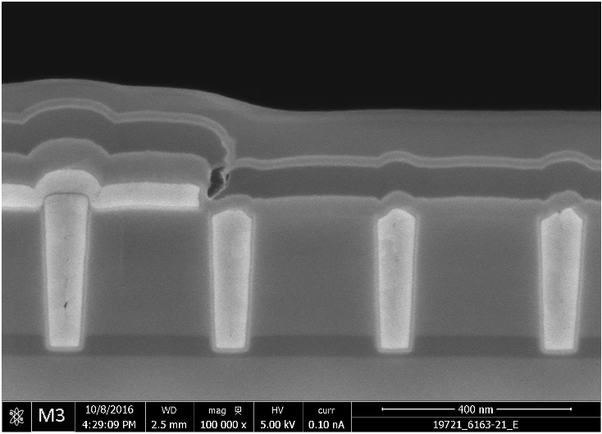
3356163.0Q3 (SSM E2 etch skew)
CoW
MoW
EoW
 | Wafer 20 | Wafer 21
Mean +3sigma Reg X | 14.23/20 | 17.09/20
Mean +3sigma Reg Y | 36.86/10 | 37.78/10
Residual Error X | 3.45 | 3.71
Residual Error Y | 4.42 | 4.62
Wafer 20
Wafer 21
S26A baseline is 8 nm for Reg X and 6nm for Reg Y.

