Slide 1
 | Lot | Purpose
1 | 9819882 | SD thickness
2 | 9839232 | Top/Bottom Electrodes (C vs. CNx)
3 | 9917082 | AlOx lamina
4 | 9876602 | AlOx co-sputter
5 | 9897002 | In doping
6 | 9883972 | O2 flash
7 | 9763612 | On Vt Sigma
8 | 9809752 | On Vt distribution and cycling (with electrode DOE)

Slide 2
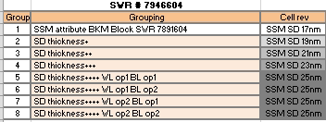
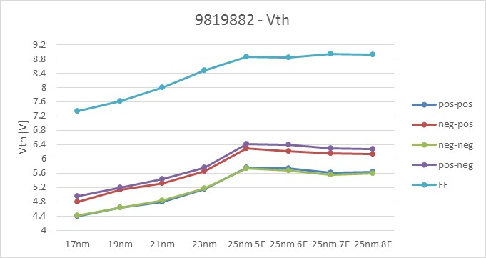
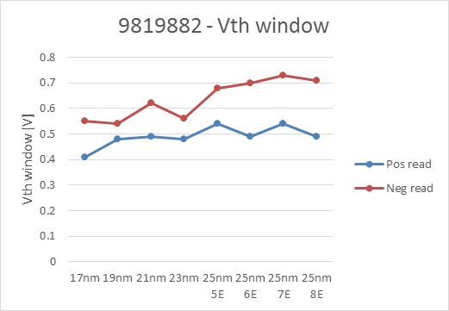
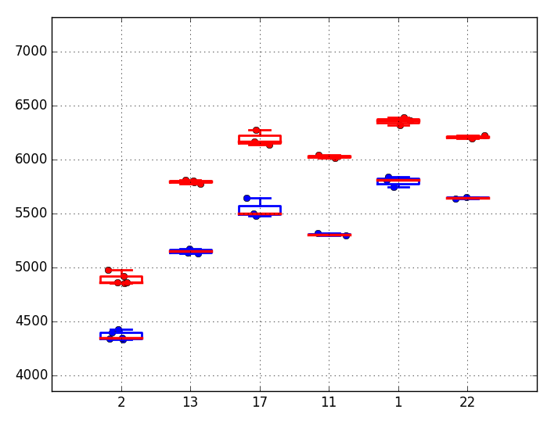
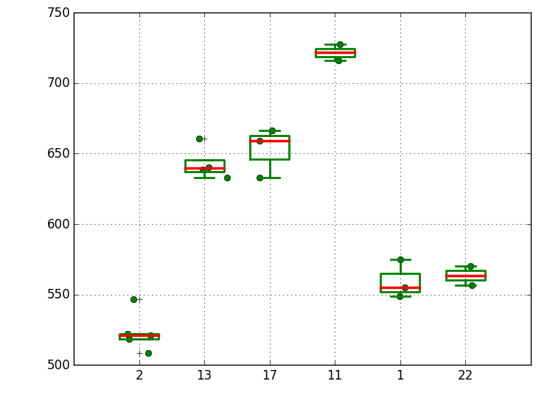
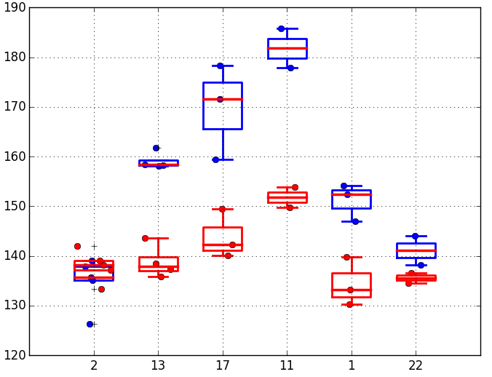
9819882 2xCMOS results on SD Thickness
Trial | SD | BE | TE | Wf
1C | 17nm | POR (30A/70A HUC/CNx) | POR (150A C) | 2,5,20,24
2E | 23nm | POR | POR | 6,13,15,16
3E | 25nm | POR | POR | 4,9,17,18,21
4E | 25nm | 100A HUC | POR | 3,11,14,23
5E | 25nm | POR | 100A/80A CNx/HUC | 1,7,12,19
6E | 25nm | POR | 70A/80A CNx/HUC | 8,10,22,25
9839232 SR71 results on Electrode
Set/Reset
Window
Set/Reset

Slide 3
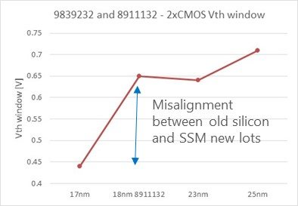
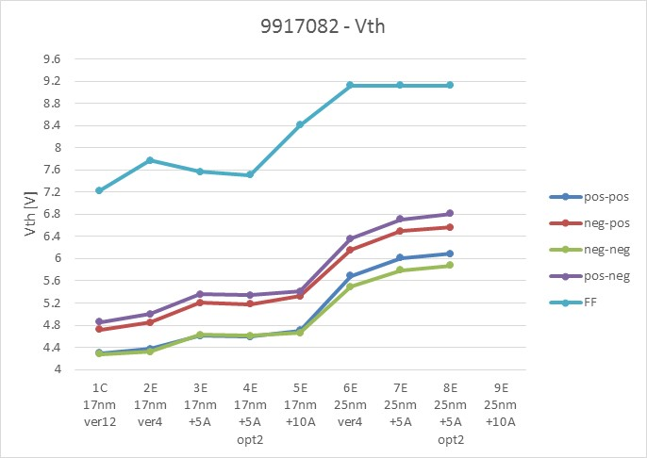
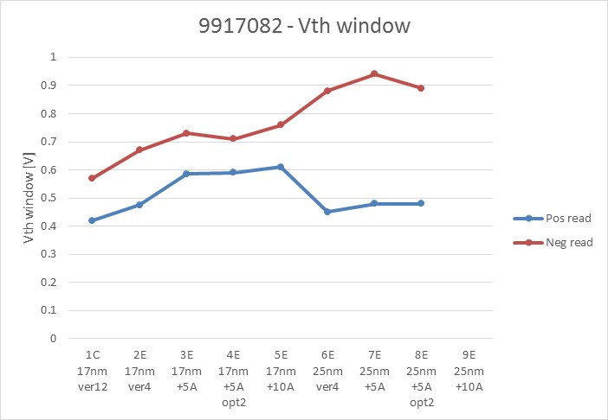
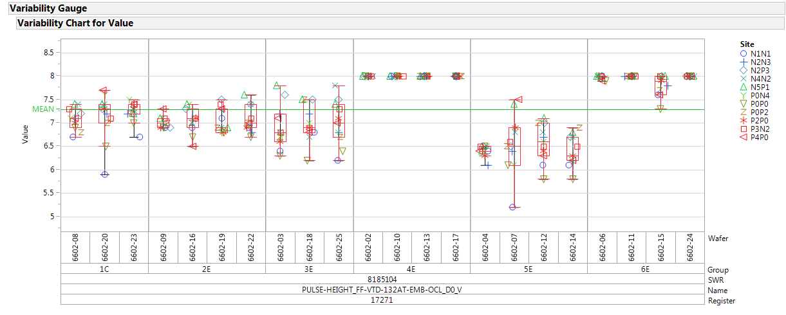
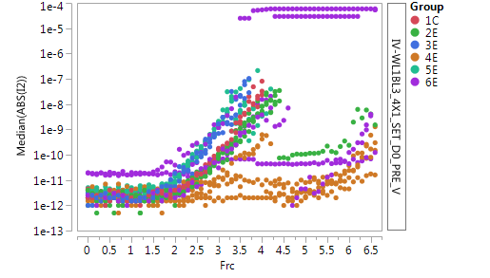
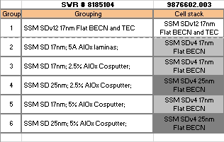
9917082.003 AlOx lamina 2XCMOS
SDd ver4 increases the Vth window as for old SD-only lots, but the lower FF is not confirmed
 | SD thk. | SD Version | AlOx lamina | 51 WL W etch | Wf
1C | 17 | Ver12 | None | 15/20s | 5,20,24
2E | 17 | Ver4 | None | 15/20s | 1,16,23
3E | 17 | Ver4 | 5Å | 15/22s | 3,8,14
4E | 17 | Ver4 | 5Å | 15/24s | 10,25
5E | 17 | Ver4 | 10Å | 18/25s | 13,18,19
6E | 25 | Ver4 | None | 15/24s | 2,7,17
7E | 25 | Ver4 | 5Å | 15/26s | 6,22
8E | 25 | Ver4 | 5Å | 18/25s | 4,11,21
9E | 25 | Ver4 | 10Å | 22/26s | 9,12,15
9876602.003 AlOx co-sputter No Vt data….
17nm SD groups show working cells with reasonable FF and I-V
AlOx cosputter trials show a reduced FF (and probably slightly lower Vths)
25nm SD testing limited by the high FF

Slide 4
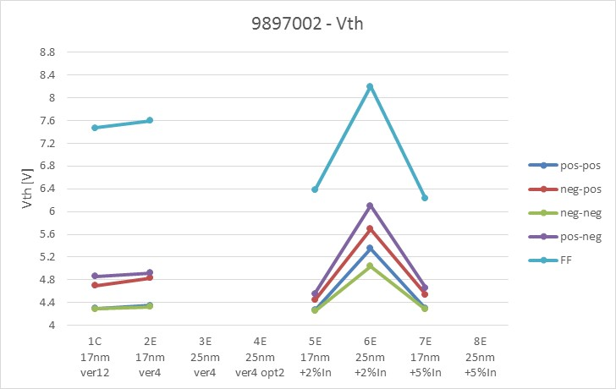
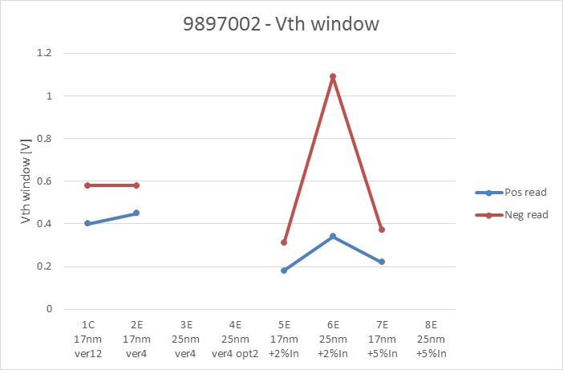
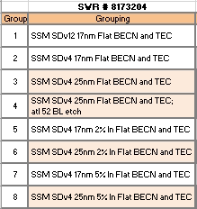
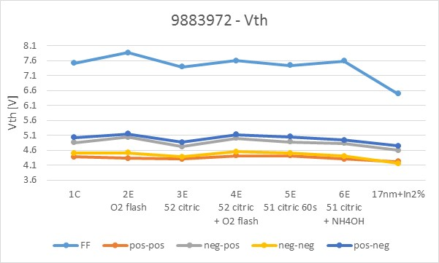
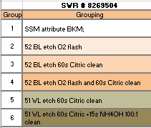
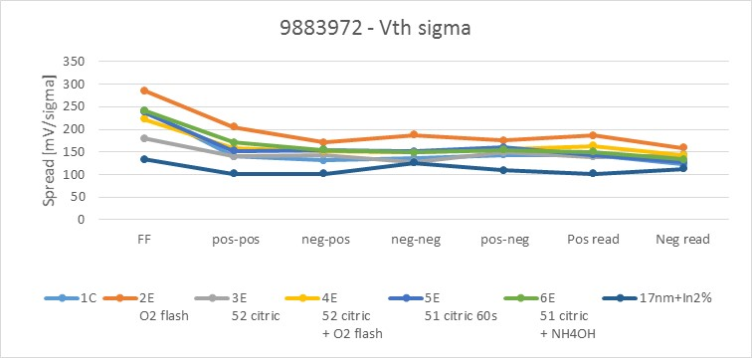
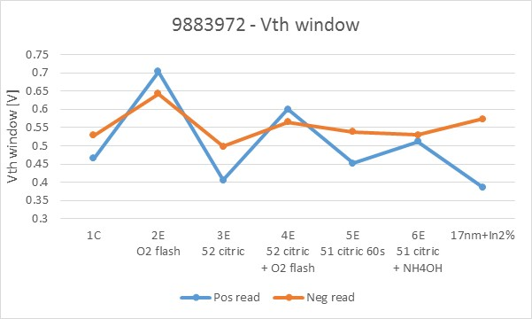
9897002.003 In doping partial 2XCMOS
17nm SD groups show working cells with reasonable FF and I-V
In-doped SD groups have 1V less of FF
IV for In-doped SD show more leakage at 0V but a different slope of the IV-curve (overall leakage worsening is not so bad)
25nm SD testing limited by the high FF
In-doped SD trials look working (FF is probably low enough for param testing)
9883972.003 O2 flash

Slide 5
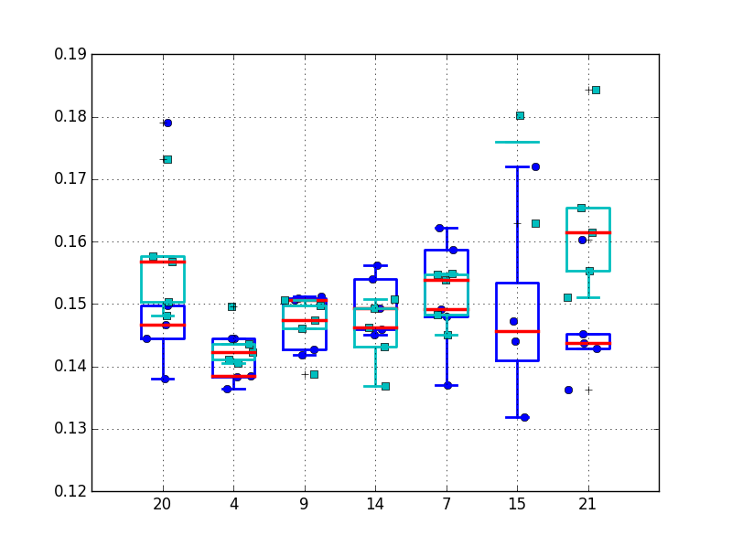
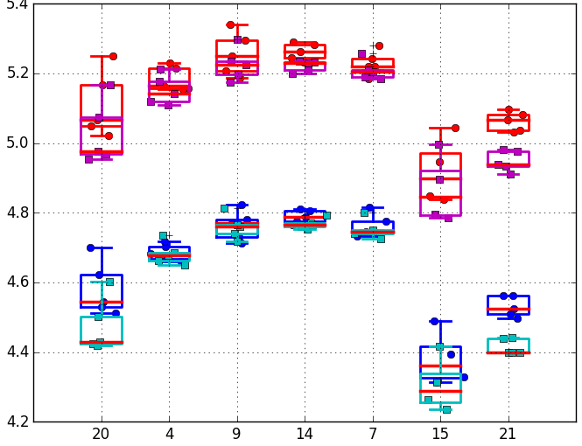
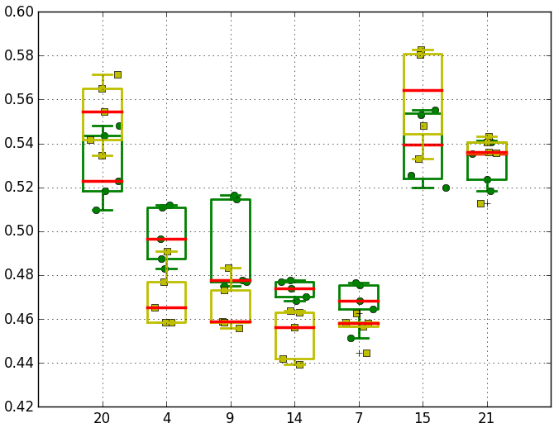
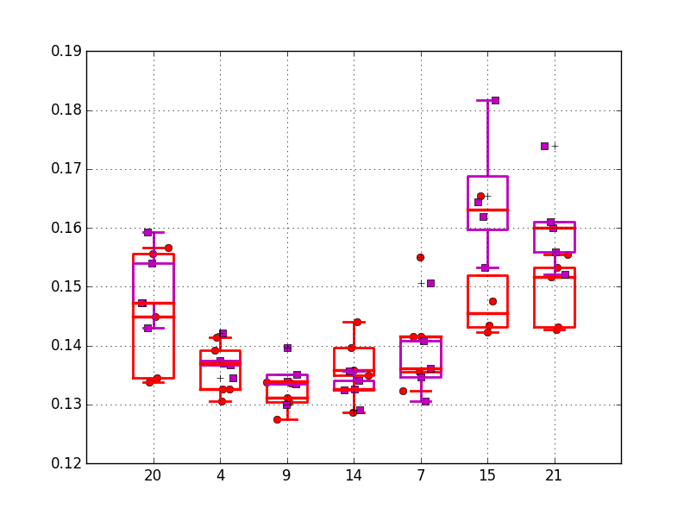
Set Sigma on 9763612
Flow:
First fire;
128k set/reset cycles with the highest set PA used in the experiment;
Interlaced set distribution with variable clamp current;
Interlaced reset distribution
Trial | BE | TE
1E | POR (30A/70A HUC/CNx) | POR (150A C)
2E | POR | 70A/80A CNx/HUC
3E | POR | 100A/80A CNx/HUC
4E | POR | 120A/80A CNx/HUC
5E | 30A/96A HUC/CNx | 100A/80A CNx/HUC
6E | 100A HUC | POR
8E | POR | POR
SET sigma
Vt distribution of 9809752
Blue/Red: 1k cycles Cyan/Magenta: 128k cycles
Green: 1k cycles --- Yellow: 128k cycles
RESET sigma

