Slide 1
SD polarity effect and Self-Select Memory (SSM) Research Update
12-04-2017

Slide 2
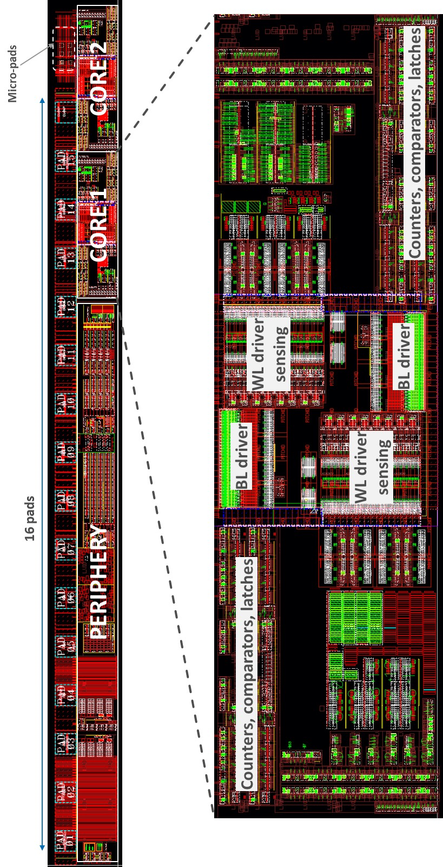
Silicon and test vehicles used for the assessment
SD-polarity effect deeply investigated on S15 silicon
SSM flow is based on S26A SxP process → 7 SSM lots out and tested up to now
Main vehicle for the assessment is the SR71B test chip on S26A test pattern
  2x256kb test chip arrays (active cells are spread inside a 2x4Mb physical arrays) with dual polarity program capability and single polarity read
  Experiments are usually run on 32x32 cells sub-arrays (1kb statistics, 3 sigma visibility)
Additional characterizations not feasible on SR71B are performed at intrinsic level on single cell structures (2xCMOS structure)
256kb active array
(physical array is 4Mb)

Slide 3
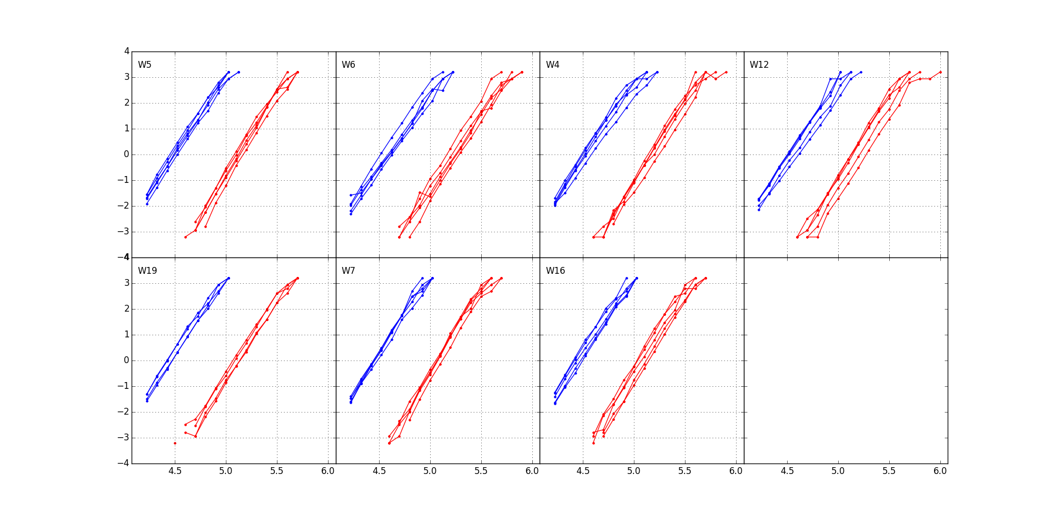
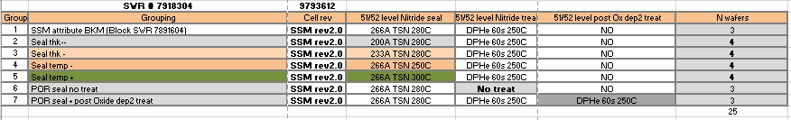
SR71B array probe: Set and Reset distributions
1
2
3
4
5
6
7

Slide 4
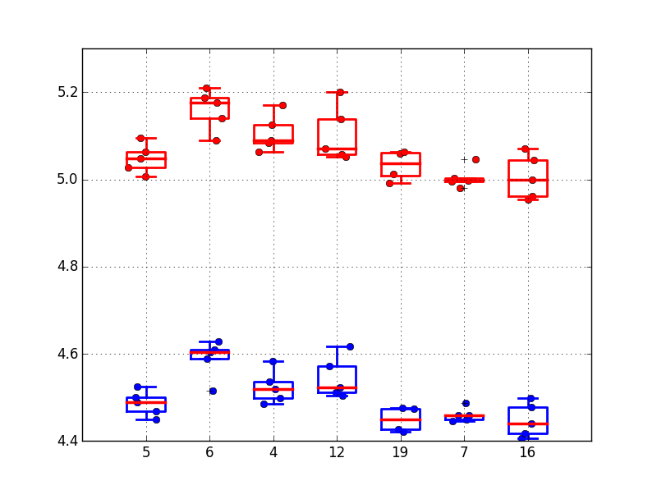
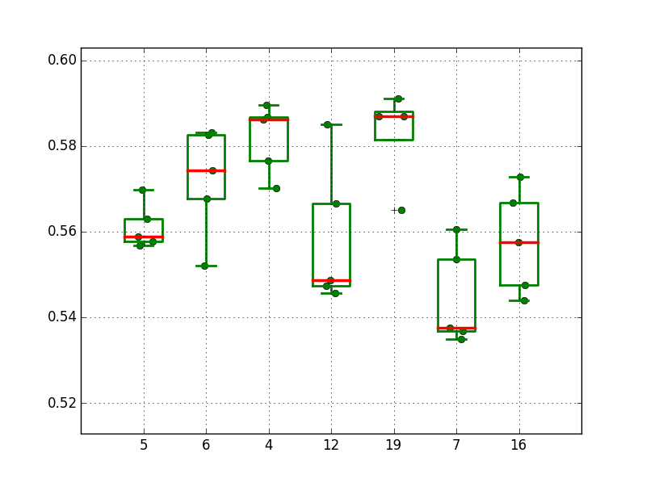
SR71B array probe: Medians and window
1
2
3
4
5
6
7
1
2
3
4
5
6
7
Median Vt
Window
@ 0sigma

Slide 5
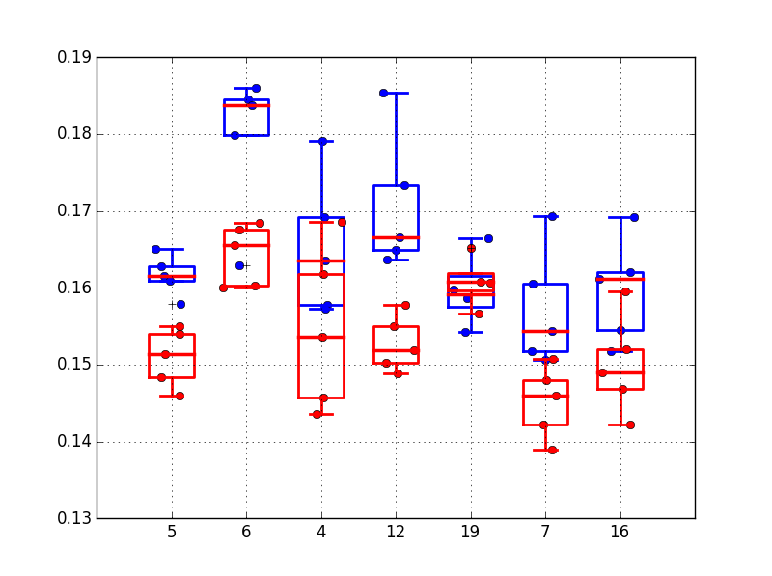
SR71B array probe: Robust sigma
SET - RESET
1
2
3
4
5
6
7
2xCMOS data

Slide 6
SSM silicon tested
7 SSM lots out and tested
  First and second lot dedicated to SSM process baseline definition with 17nm SDd
  1 lot for sealing thickness and sealing temperature trials
  1 lot for TE and BE trials
  1 SD thickness trial up to 25nm → thickness dependence of the Vth window is demonstrated, but lower than functionality window
  1 combo lot: SD thickness + electrode trials
  1 lot for BL cleanings

Slide 7
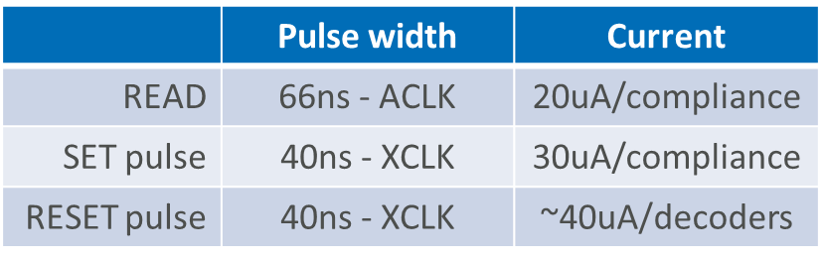
SSM write/read performance
SR71B standard algos
SD polarity effect is an extremely fast, symmetric, low latency and low-current mechanism
  Standard SR71B set pulse is 40ns/30uA, reset is 40ns/40uA
    No significant dependence on the pulse width for values longer than 20ns
    Pulses are effective for currents higher than 25uA
    Higher programming currents decreases the distribution spreads and may slightly enlarge the Vt window
  Interlaced distribution are collected with a typical delay time between program and read of about 100ms
    Intrinsic capability of 100ns delay time demonstrated without impact on the Vt window
  Reading pulse is 66ns/20uA
    Short read time looks beneficial for a slight increasing of the Vth window, without significant impact on the distribution spreads
    SR71B can read only with positive polarity, a larger Vt window is projected for negative polarity reading based on intrinsic cell characterization → this feature will be added to SR71B with the S26A1 DBR
  Bipolar operation is responsible for a worsening of the distribution spread compared to unipolar functionality (standard SxP set distribution spread)
  Higher FF and operating voltages than SxP are projected
Distributions from 5 dies on a SSM wafer
Percentage [σ]
Vt [V]
Reading PW dependence
Vt window

Slide 8
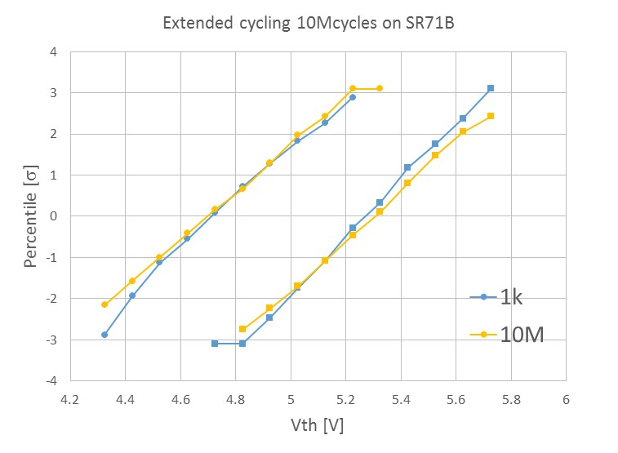
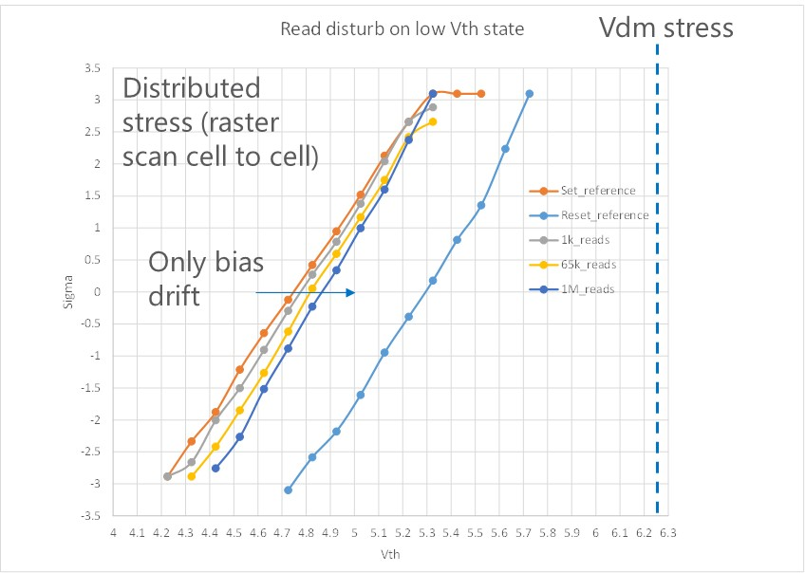
SSM reliability – Endurance
Time0 BER (distribution tails, open, short) is very low (<3e-5)
Write endurance is >10Mcycles (cycle=set+reset) without Time0 BER degradation
    100Mcycles endurance test shows a significant increasing of the BER (distribution tail at 1 sigma), being close to the intrinsic cell capability (<1Gcycles)
Read endurance is strictly related to the write endurance capability (it is equivalent to a Set-on-Set operation)
  Tested up to 1Mreads without any issue
  Projected to >50Mreads (considering the statistical occurrence)

Slide 9
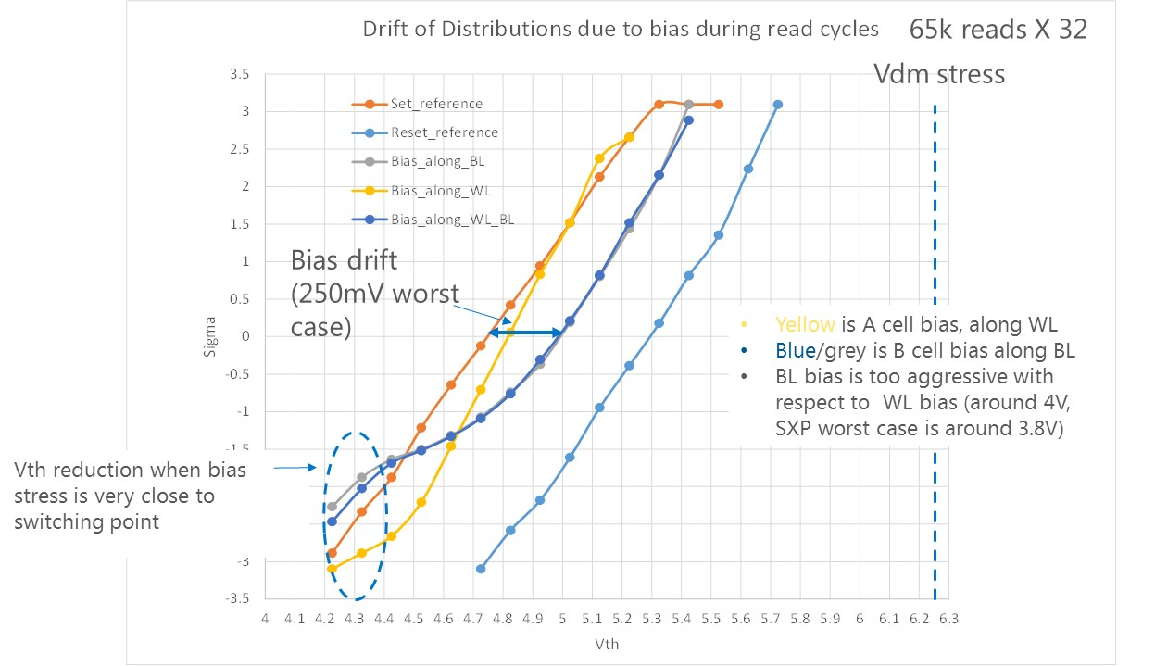
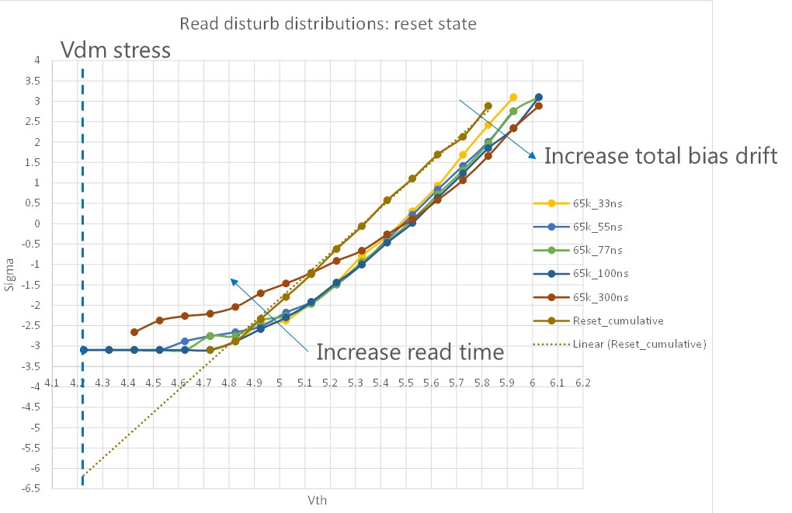
SSM reliability – Read disturb
Read disturb on set
  No set read disturb issue (SoS)
  The high bias condition for unselected cell (4V in this experiments) induces bias drift
    Evidence of low Vth states with anomalous bias drift (lowering of vth) → similar effect observed in SxP too
    May be critical for selection, proper C-cell bias is recommended for mitigation
Read disturb of reset
  If Vdm is correctly margined for Vt bounce, no spurious switching events are observed
  Evidence of bias-induced Vt reduction of reset state
    Not visible in SxP for the contribution of PM drift, but for SSM it may require additional margin on reset read

Slide 10
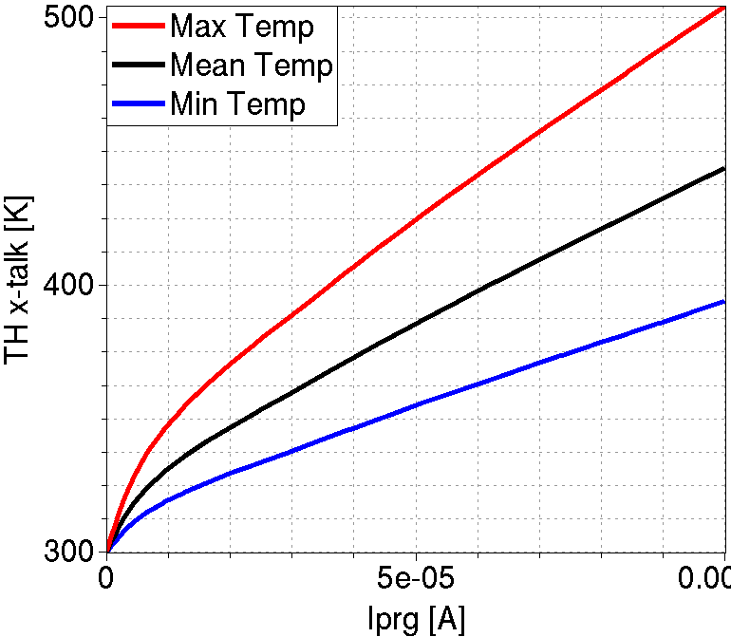
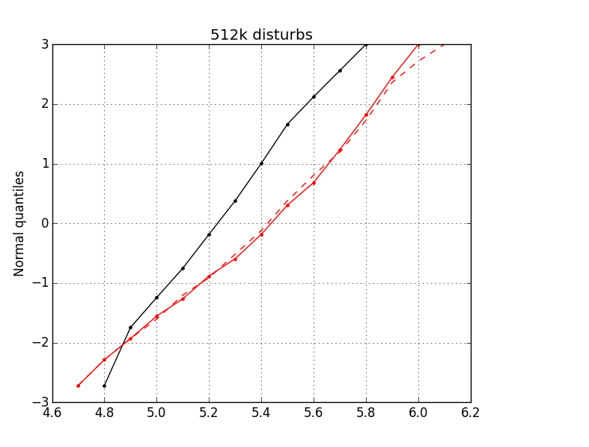
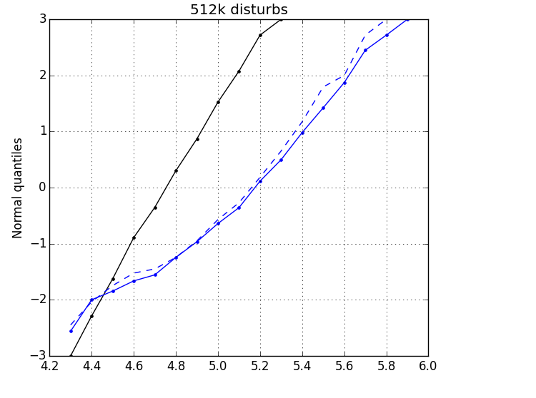
SSM reliability – Program disturb
Simulated temperature on victim cell
No thermal disturb in SSM
  Due to the low programming current and the closer thermal boundaries, the temperature rise during program operation is much lower than in SxP → simulated victim temperature is in the range 90-125C
  SD-polarity effect shows almost no temperature dependence
  Main impact of the temperature increase is related to drift acceleration, but the contribution looks negligible compared to the drift requirements (stress time in the range of few seconds considering the endurance capability of the aggressor)
  No impact (apart bias drift) measured up to 512kcycles for the aggressors
  SxP PG1 specs is 2048 Normal Write operations
Operating conditions
Set
Reset
Solid black – Time0 victims
Solid colored – After 512kcycles disturb
Dashed colored – After 512kcycles bias drift
Vth [V]
Vth [V]

Slide 11
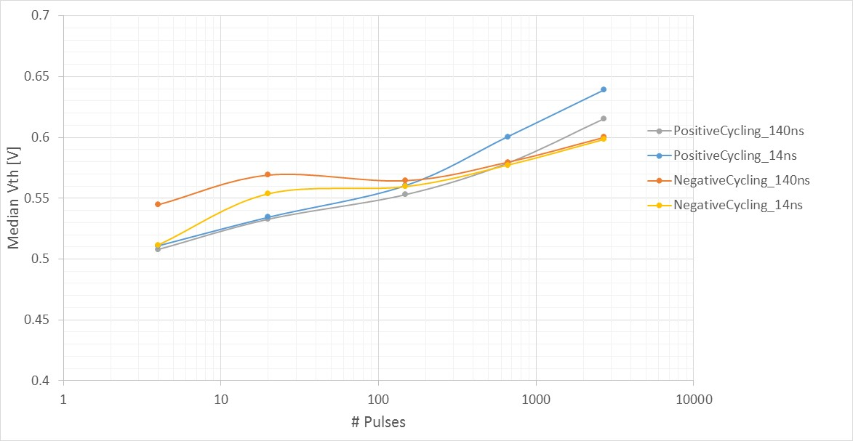
SSM reliability - Imprinting
SSM functionality (Set and Reset operation) after continuous unipolar cycling has been checked to exclude imprinting effects
Intrinsic validation already done on 2xCMOS, statistical validation was missing
SR71B data confirms that no imprint effect is detectable for SSM
Vth window is not affected after unipolar (positive or negative) cycling

Slide 12
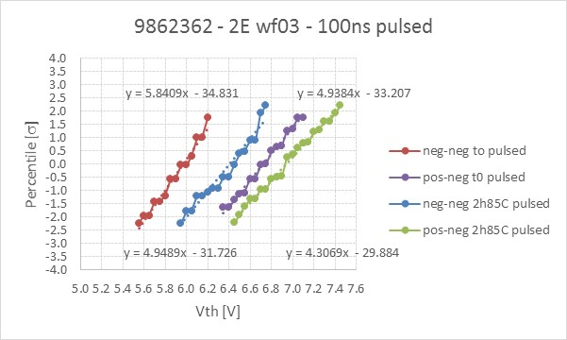
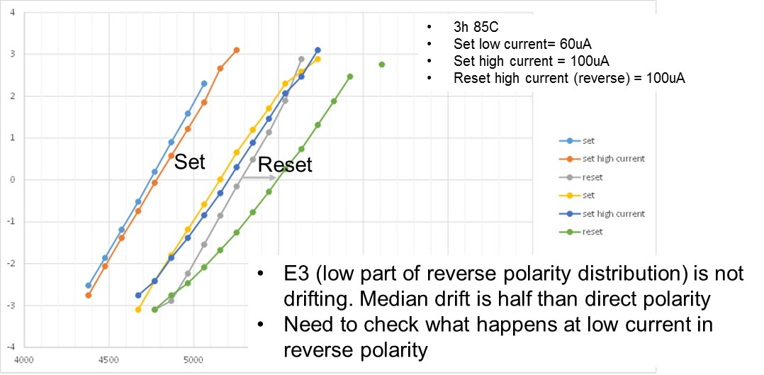
SSM reliability – Drift and Retention
2xCMOS data on 84 cells
Drift is the most critical effect in SSM because it translates in a data retention issue
  Set states drift similar to SxP
  Reset state drift less in median and it shows a significant degradation of the distribution spread
    Need additional investigations to clarify the physical mechanism
If the different Reset drift behavior is confirmed
  Vdm tacking strategies cannot be exploited
  Drift evolution must be accounted for in the RWB
  Power-on spec may be relaxed with the introduction of a refresh strategy
  Alternative motogation strategies are required for power-off spec
→ Need to improve the comprehension of the underlying physical mechanism
SR71B data

Slide 13
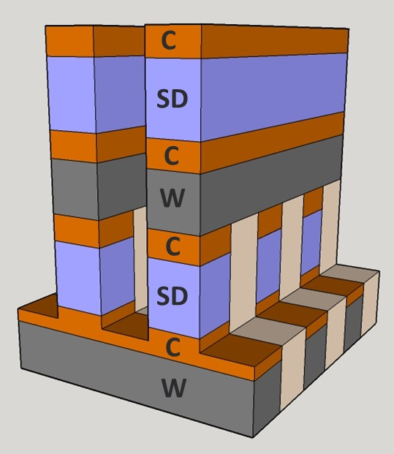
SSM advantages over SxP - Process simplification
Removing several of the major integration issues currently faced by SxP
  High-aspect-ratio etching and sealing
  Cross-contamination between PM and SD is removed
Time0 defectivity is very low
The SSM structure is inherently more suitable for scaling
  Clear path to 30s
Low-cost option with a reduced number of masks per deck can be envisioned
  A low-cost process with N+1 critical masks (instead on 2N) for fabricating N decks with max aspect ratio similar to actual SxP was proposed
Electrical properties fine tuning with SSM stack optimization is simpler due to the reduced number of electrical variables
  no set speed/thermal cross-talk/programming current trade-off to manage
SSM Low-cost option
Combined definition of two decks with one critical mask (55/57 masks combined)
Aspect ratio is similar to today’s SxP

Slide 14
SSM advantages over SxP PG1 specs - Performance
Set/Reset operations have the same latency
SSM energy/bit is at least 3x lower than SxP PG1 specs
  SSM Set operation is at least 6x faster than SxP (40ns compared to 245ns PG1 spec) with slightly lower average current
  SSM Reset is about 4x longer (40ns compared to 10ns) but current is at least 3x lower
  Projected reduction can be up to 8x considering pulse width reduction to 20ns and program currents to 25uA
  Lower BL and WL capacitance (reduced W thickness) for the same tile size
No pulse shaping required (easier design and less system energy consumption)
Full-float read feasible (no set-back required)
No wait time constraint between program and read
 | SSM | SxP PG1
Set pulse total duration [ns] | 20-40 | 245
Set current [uA] | 25-30 | 25-60uA (shaped)
Reset pulse total duration [ns] | 20-40 | 5-10
Reset current [uA] | 25-30 | <125
Prog-to-read delay [ns] | 100 | 1000
Read method | SSR/FFR | SSR

Slide 15
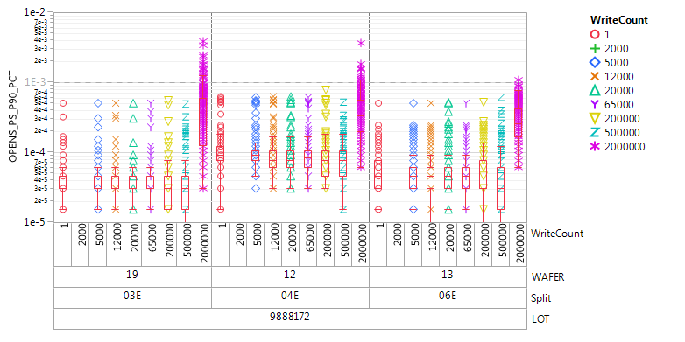
SSM advantages over SxP PG1 specs- Reliability
Extended bipolar cycling on SR71B
SSM write endurance is at least 10x better than SxP PG1 specs
Read endurance matches SxP PG1 specs (close to 10⁹ reads)
No intrinsic thermal/program disturb
No need for set-back after read to mitigate Read disturb issue
The higher drift of the Set state compared to Reset in SSM does not allow to solve it by Vdm tracking as in SxP
  Observed on intrinsic cell, need validation on statistical vehicle SR71B
  Need to include it in the RWB calculation
Percentage [σ]
Vt [V]
SxP cycling experiment

Slide 16
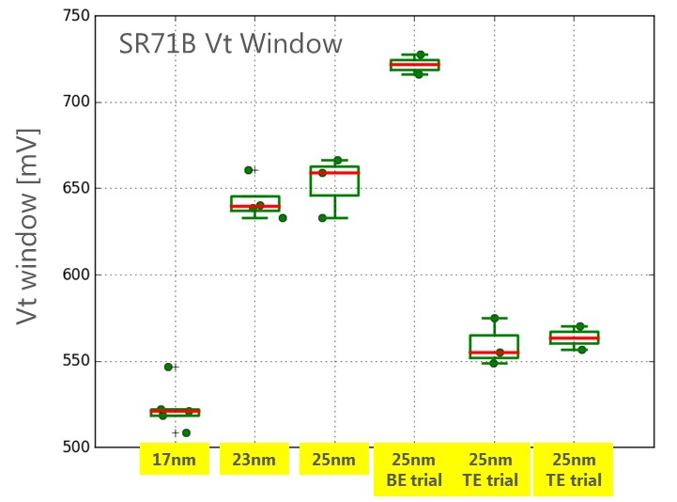
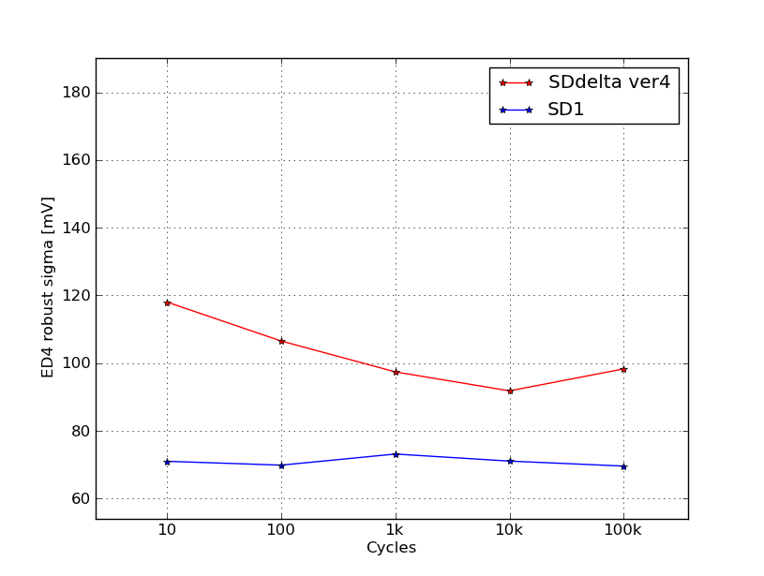
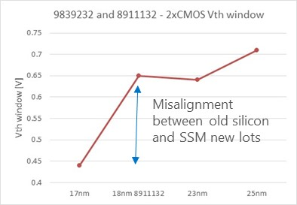
SSM risks – Vth window
Today: 9839232 SSM lot
Today’s Vt window for positive reading is 0.55V for 17nm SDδ with a thickness sensitivity of 20mV/nm
  Old measurements showed a 70mV/nm sensitivity
Actual Vt window for 17nm SDδ looks 150-200mV lower than originally measured on old SD-only lots with 18nm SDδ (2xCMOS data) → process induced window lowering (SDδ composition modification) is in segmentation
S15B 8792062 SD-only main array

Slide 17
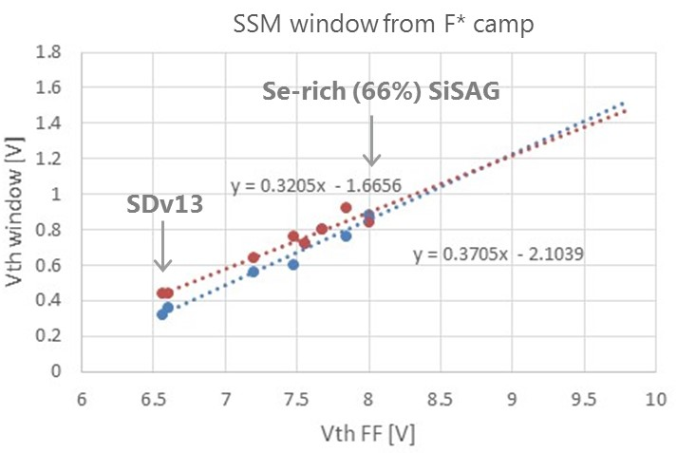
SSM risks – Vth window enlargement
SSM window with Al₂O₃ lamina
Vth window was modulated by AlOx lamina in old S15 SD-only wafers
Strong Vth window modulation observed in F* Camp
Need to run dedicated experiments on silicon
5 SSM lots running with AlOx trials, In-doped SiSAG, annealing and cleaning trials
Extended F* Camp planned → to be execute by the end of April

Slide 18
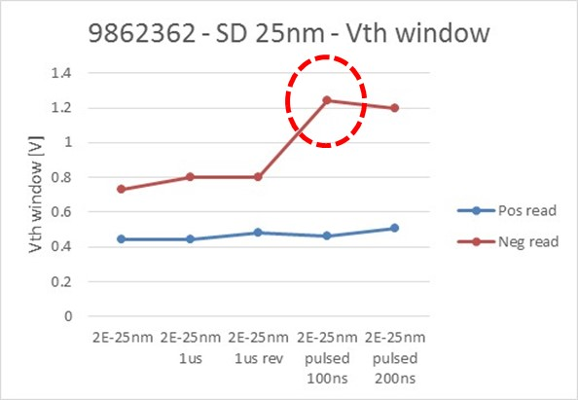
Negative reading on 2xCMOS: Ramp vs. pulse detection
 | 10us ramp detection |  | 100ns pulse detection
 | Pos reading | Neg reading | Pos reading | Neg reading
Vth window [V] | 0.44 | 0.73 | 0.46 | 1.24
Spread [mV/sigma] | 113 | 116 | 119 | 127
SNR | 3.88 | 6.28 | 3.85 | 9.74
With pulse detection (100ns pulses) a SNR close to 10 is obtained → good for Time0 functionality window
SR71B negative reading capability will be available with S26A1 (DBR in wk21, silicon testing after summer) → workaround to anticipate the neg reading validation are available with some metal reticles edits

Slide 19
SSM risks – High voltages and design complexity
SSM cell optimization for enlarging the Vt window will rise the requirements for FF and, to a lesser extent, the operating voltages
  Unselected cells leakage will be reduced
SSM array require dual polarity decoders and more design complexity to manage both polarities
  SSM reduced current requirements allow for much smaller decoders
  Lower current implies less issue of IR drop
Low current and low leakage allows for larger tiles that can accommodate more easily the bipolar decoders (that are smaller)
Several design options adopted in SxP must be reconsidered and re-evaluated

Slide 20
Next activities
Vth window enlargement by process trials
  AlOx lamina trials
  SD composition
Validation of the negative reading window on SR71B
Reset drift understanding
  Clarification of the physical mechanism
  Mitigation strategies

Slide 21
Detailed plan for SSM silicon
By Y. Kolya
AlOx trials evaluation by the end of April

Slide 22
SXP Boosted Window opportunities
12-04-2017

Slide 23
Basic operation
Set pulse (25uA nucleation step + 50uA growth step) and read with same polarity
Reset pulse (130uA) in opposite polarity with respect to set and read polarity
Best window obtained with reset in same polarity of actual SXP (positive) while set and read in negative polarity (2X-CMOS data)
SR71B at the moment can sense only in positive polarity (set pulse positive, reset pulse negative)
Growth (50uA)
Vdm read (positive)
Vdm read (positive)
Nucleation (25uA)
Neg reset (130uA)
Pos set

Slide 24
SxP boosted window
Increased intrinsic time zero window @1us (+0.55V with actual SXP stack)
Larger sigma visible on SR71 as main risk (+30mV)
+340mV gain in window @ 3.5 sigma
Boosted window @ 1us: 0.55V increase
  Blue/Red: Vt window, program and read with same polarity, either FWD or REV
  Green: Vt window with Reset (FWD prog / REV read) and Set (REV prog / REV read)
  Black: Vt window with Reset (REV prog / FWD read) and Set (FWD prog / FWD read)
Array Sigma increase with bipolar operation:
+0.55V
+0.55V
+30mV
SR71B
(Mattia R.)
2X-CMOS (Luca)

Slide 25
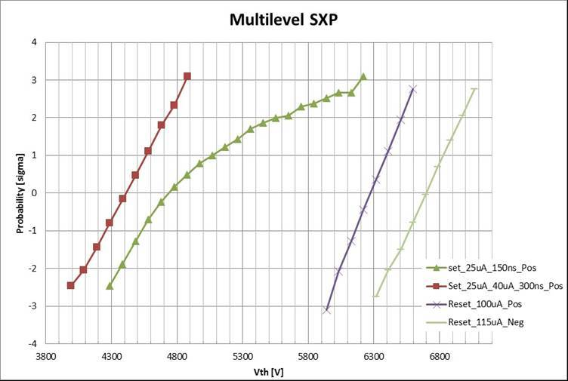
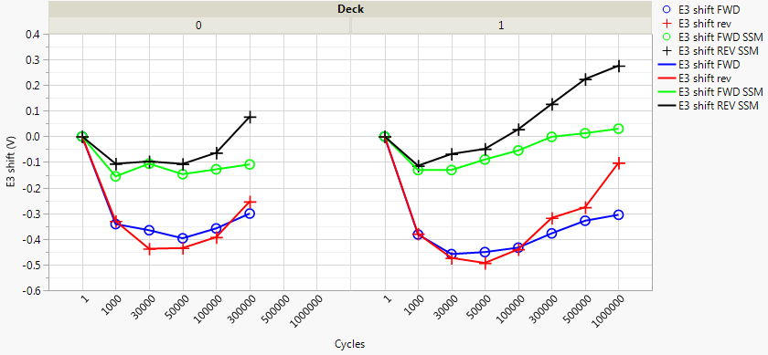
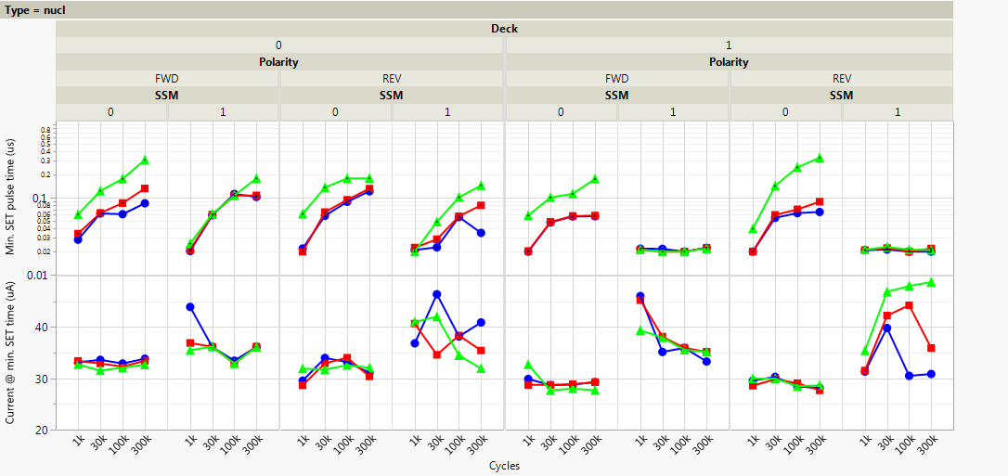
Bipolar Cycling stability, PG1 pulses
SR71B data
Legend
  Blue/Red: Vt window, program and read with same polarity, either FWD or REV
  Green: Vt window with Reset (FWD prog / REV read) and Set (REV prog / REV read)
  Black: Vt window with Reset (REV prog / FWD read) and Set (FWD prog / FWD read)
2X-CMOS (Luca)
E3 shift improvement
Better nucleation time with bipolar operation
SD-polarity effect shows a boost of 400mV on the SxP reset distribution (15ns reset pulse width)

Slide 26
Conclusions
SxP boosted window is confirmed without device performance drawbacks
Improved E3-shift and set-ability through cycling, but other SxP issues are not addressed (drift, thermal disturb,…)
  Wider Vth window may allow more process trials to address the remaining issues

