Slide 1
SD polarity effect and Self-Select Memory (SSM) Research Update
13-12-2016

Slide 2
Outline
Update on SSM assessment
S26A activities
  Test vehicle validation
  First SSM lot results
    2xCMOS
    SR71B
Planned activities for Q1/17
  Vt window enlargement strategies
  Allocated silicon and planned SWR

Slide 3
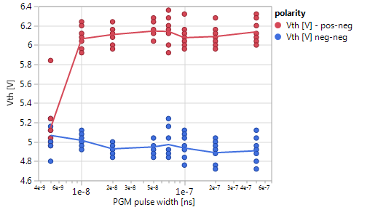
Intrinsic SSM performance on S15C
SD polarity effect is an extremely fast, symmetric, and low-current mechanism
  A programming speed of 20ns is easily achieved
    13x better than Memory Ship Release spec for set
    39x faster than POR 3E set pulse in SxP
  Vth-I characteristic is flat, thus allowing to use programming currents as low as 20-30uA
    2-3x lower than Memory Ship Release spec for reset
    5x lower than POR reset pulse in SxP
  Average power consumption is 15x lower than SxP
  SD polarity effect has no asymmetry for set and reset operation
  SSM requires dual polarity decoders but with a much lower current capability
VTH
Vth [V]
VTL
Programming pulse width [s]
VTH
VTL

Slide 4
Intrinsic SSM reliability on S15C
Polarity effect is not interfering with the known SD functionality
  Endurance is the same as for SD in SxP cell
    More room for improvements due to lower programming currents and shorter pulses
    Read endurance PG1 specs may be above today capability, but the SD-only flow is not optimized
  No active or passive imprinting effect observed (in agreement with the actual model of the physical mechanism)
  Read disturb is not visible for low and high Vt state
    High Vt state disturb is related to bounce/delay time statistics
    No “SoS” issue observed for low Vt state, just endurance limitation
  No thermal disturb expected (apart drift activation)
    Experimental data will be collected on S26
  Drift of the low Vt state is the main reliability concern
    Same contribution as in SxP, but impacting the overall Vt window
    Same mitigation path as in SxP in term of technology, but may require different approaches in term of mitigation by design
    High Vt stability allows to keep under control the maximum voltage

Slide 5
Overview of SSM window budget
Mean SD-polarity effect Vt
Mean SD Vt
Low Vt
drift
E4
V_{inh} = inhibit margin
V_{Srm} = SET read margin
V_{Rrm} = RESET read margin
V_{Rwm} = RESET write margin
V_{inh}
V_{Srm}
V_{Rrm}
V_{Rwm}
V=SELBL
(write)
V=DESWL/BL
(write)
E1
E2
E3
V_{target}
V=SELWL=0
V=SELBL
(read)
For SSM, the contributions to the window budget come from:
  Available window between the low and high median Vt
  Low Vt state sigma (bit variability+bounce, as measured on SD-only lots)
  High Vt state sigma (bit variability+bounce, should be the same as for low Vth state)
  Low Vt state drift (bias+unbias, as measured on SxP lots for set state)
  xTile (as measured on SxP)

Slide 6
Activities on S26A
Silicon with the new SSM flow
  Baseline process (SD-only flow) → first SSM out end of wk48, electrical characterization on-going
  There are some known knobs for enlarging the Vt window
Dual-polarity test-structure testing
  2xCMOS → validated on FS in wk42
    Intrinsic properties
    SSM flow validation vs. S15C
  IG88 → partially validated, metal opt-in is needed for activating this vehicle
    Intrinsic properties with more statistics (52 cells)
    More robust intrinsic assessment for forming/seasoning impact and for long-time drift/retention
  QTT → design validation on-going
    ED impact
    Thermal disturb
  SR71B → design validation on-going, first results available
    4σ statistical validation with product-like algos

Slide 7
SSM Lot #1 - 9673132.003
Scope of the lot
  baseline SSM flow definition
  demonstrate the SSM concept functionality on S26A
  assessment of the intrinsic properties and reliability
  SR71 and QTT validation
  SSM concept demonstration on SR71 and readiness for statistical assessment
Milestones
  Lot out end of wk48
  Param testing done, main array probe skipped
  Characterizations on-going, lot complete assessment by wk53

Slide 8
SSM lot #1: 2xCMOS results
2xCMOS setup is working
  In most of the experiments the Vth detection is limited to values higher than 4.65V (on S15C similar biases allow to detect Vth as low as 4.2V) → different body terminals connection for the pMOS BL decoders, it can be compensated by lowering all the biases
Cell functionality
  SD-polarity effect detected
    Vth window of 0.3V for positive reading and 0.5V for negative reading, respectively
      Value consistent with recent S15C FS silicon, but lower than old SD-only lots
  Programming speed characterization shows good programmability with pulses ranging from 20ns to 500ns at RT and 125C
  Cells are quite robust, no cell failure during electrical testing, preliminary cycling experiments >1Mcycles
  Low Vt states show the usual drift, high Vt states look stable
SWR analysis with small statistic characterization
  Observed Vth sigma is similar for all the polarities, around 140-145 mV/sigma
  No clear toggle in the split, all tested trials are working
  FF has the expected spread (230mV/sigma) and the median is around 6.85V with the 1us pulse detection

Slide 9
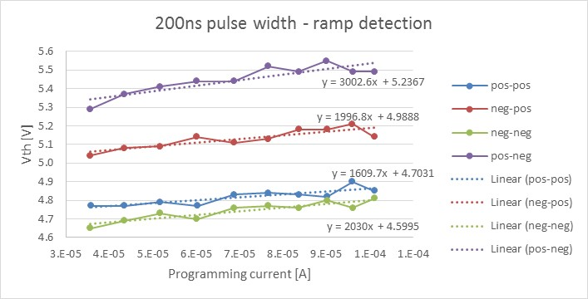
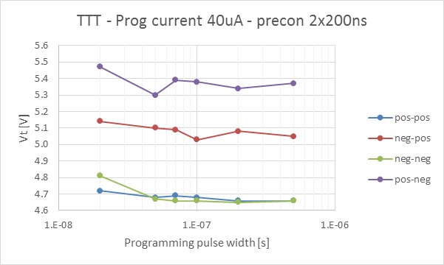
VTI and pulse-width dependence
VTI showing a small (100-150mV) memory effect
Consistent programmed window in the range 20ns-500ns
A small time dependence of the Vth on all the states is visible

Slide 10
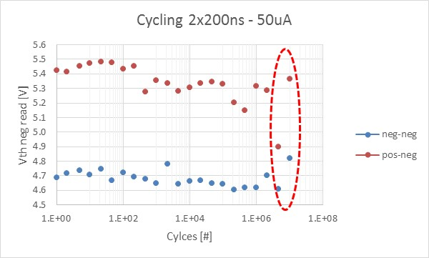
Intrinsic endurance
Single cell – 4E trial, pos-neg cycling
Cells are quite robust, no electrical failure detected during characterization
Single cell endurance test shows good stability >1Mcycles (each cycle corresponds to 2 programming pulses 50uA-200ns each)

Slide 11
SR71 probe results
7 wafers tested: 1,2,3,4,6,8,12, one wafer per split, automatic probe done in Vimercate lab
(plus 7 wafers ran end of last week)
Vcc=1.4V
Good register & SRAM functionality (w/ workaround, no SI fix)
CLK and CLAMP aligned with skip-array silicon
1st run of buffer read not consistent on all dice → updated supply voltages provided for more robust functionality (to be implemented)
Large spread of CMOS leakage on wafer (radial trend on HPP,HSS)
Overall good structural yield for WL and BL leakage (need to set pass/fail criteria for a better assessment)
Embedding of array basic routines (FF, read, write) in UM3

Slide 12
Array shorts and Transistor leakage in non-40L material
(9673132, Wafer 8, tested in Folsom lab)
Array structure
Example from die (-3,2)
HPP_leakage(uA): | 537
DESBL_leakage(uA): | -90
DESWL_leakage(uA): | -12
HSS_leakage(uA): | -429
Single WL-dummy short
~10uA
Array shorts:
Very few array shorts in wafer 8. All good periphery die appear to have workable array areas.
Detection appears feasible above the variability of the transistor leakage.
Transistor leakage:
Variability indicates leakage in both NHV and PHV devices.
Transistor leakage ~12uA
Single BL-dummy and pairs of BL-BL shorts. ~10uA
Possible decoder transistor marginality - TBD
Transistor leakage ~90uA

Slide 13
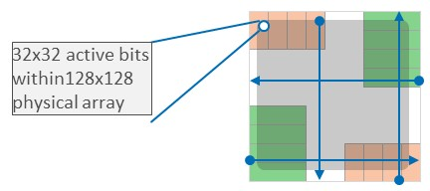
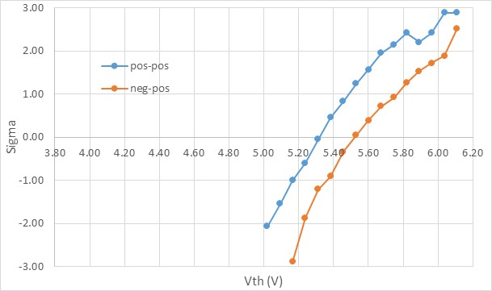
First array tests on SR71/first SSM lot/non-40L
Folsom lab/ESB system
Write 0
Margin read
Write pure 1
Margin read
Basic capability of SR71 for array operations demonstrated
  First fire 1K bits (32x32 section)
    ~7v, 10usec positive pulse width, 20uA compliance.
  Bipolar write –checkerboard.
    ~20ns pulse width. ~30uA for positive pulses, ~50uA for negative pulses
  Margin read
    ~50ns selection pulses, ~20uA compliance
    Program-to-read delay ~1s
Small memory effect observed
  In line with 2XCMOS measurements
  More calibration needed
Write checkerboard
Margin read
Bit count
VDM (Vth) scale based on simulations – not calibrated
Lot# 9673132
Wafer8, die(0,0)

Slide 14
SSM Lot #1 - Summary
SSM flow baseline is working → SSM attribute BKM defined
SD-polarity effect with 2xCMOS intrinsic assessment is confirmed on S26A
SD-polarity effect observed on SR71B, additional characterizations to be completed by the EoY
Vt window is quite small, but expected
  aligned to recent S15C FS and to the first S26A FS, but much lower than the one observed on old thick SD-only lots
Need to address the Vt window enlargement with next SSM lots

Slide 15
Vt window modulation
Known Vt window knobs
  SD thickness
  BE C/CNx composition
  SD composition
  AlO lamina layers
A quite large Vt window (>1.2V) was originally measured on the SD-only lot 8792062 (split 5E-6E-7E)
  SDd ver 4, nominal thickness of 18, 20, 22nm
  Very different process integration and probably BE composition (it is contemporary to rev 5.x on FS silicon)
  There is a gap in the testing history of cell rev due to the lack of SD-only lots and to the poor functionality on the 2xCMOS of the FS rev6

Slide 16
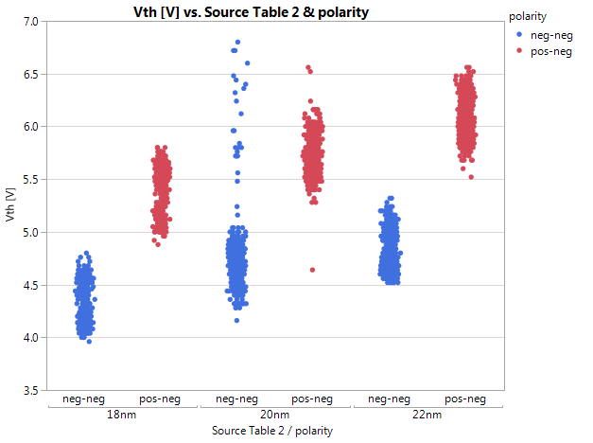
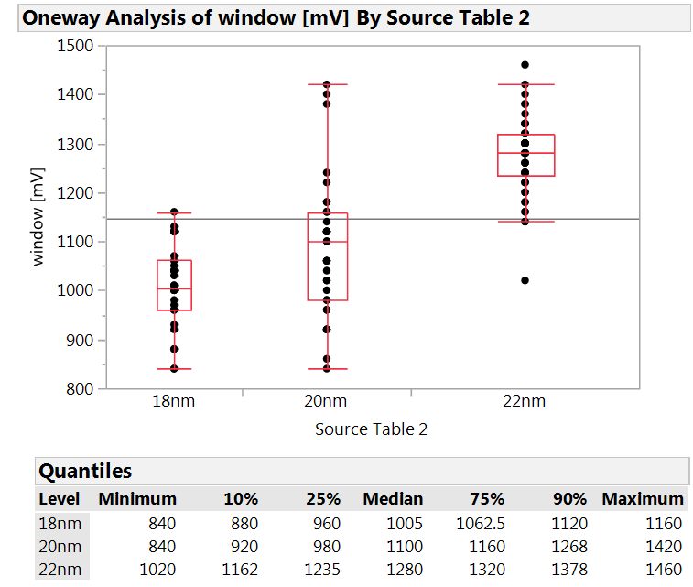
SD thickness dependence (SDδ ver 4)
Sensitivity: ~170mV / nm
window
Sensitivity: ~100mV / nm
Resulting sensitivity of Vth window is 70mV/nm
A previous estimate with larger statistics but limitations in low Vth detection provided a sensitivity of 100mV/nm
Estimated SD thickness to get enough Vth window on SR71 is 25nm

Slide 17
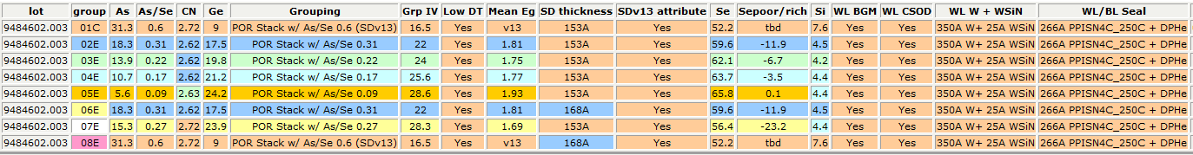
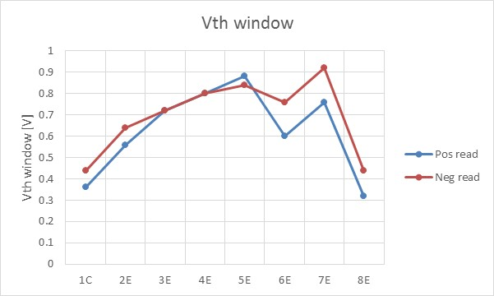
SD-polarity effect: F* campaign
SD-polarity effect looks modulated in term of Vth window by the SD composition
No significant asymmetry with read polarity
Strong correlation with FF

Slide 18
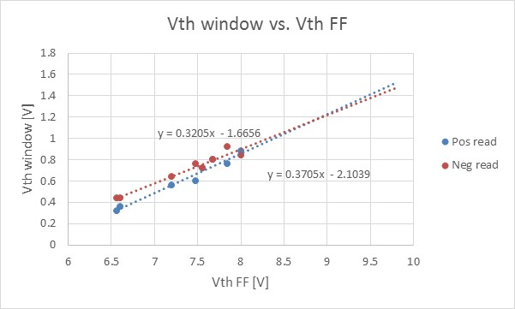
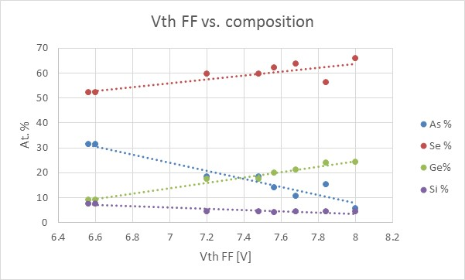
SD-polarity effect and FF – SD F* campaign
Vth window shows a strong correlation with the Vth FF
Vth FF depends on the SD composition
  Usual trend with Se (and maybe the optical energy gap)
  Best fit obtained with the Ge concentration, then with As and last with Se (but FF is expected to correlate with Se concentration first)

Slide 19
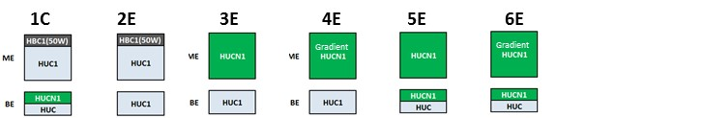
BE and ME trials: single deck and DD lot
Trial lot with experiments on BE and ME composition
The lot was splitted into single-deck and DD part
  Single-deck wafers were all tested with 1kcycle on 2xCMOS → no FF data
  DD part is virgin

Slide 20
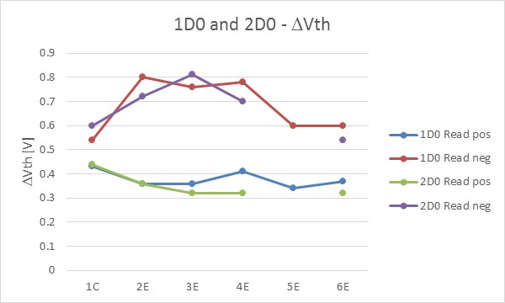
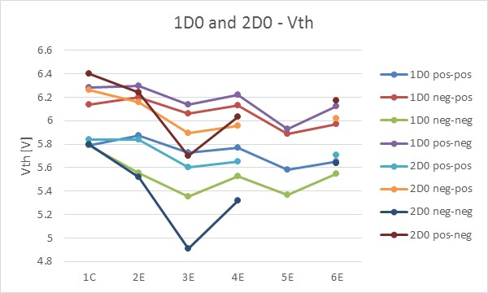
Experimental results
Significant modulation of the Vth window dependence on read polarity
  SD-polarity effect looks dominated by BE composition
  BE HUC increases the Vth window with negative reading
  Results confirmed on both single-deck and DD part of the lot
Why is BE HUB the main knob? → Electrode roughness?

Slide 21
AlOx thin layer on SD1
POR 22nm
POR 22nm
PVD 20nm
PVD 20nm
ALD 20nm
ALD 20nm
PVD 22nm
PVD 22nm
With positive reading, 22nm SD1 shows a constant Vt window, with no clear AlOx layer contribution
For negative reading, PVD AlOx seems to boost the Vt window
SD-polarity effect looks affected by the SD interfaces, but it is not peculiar of the C-SD interface

Slide 22
Next activities
Optimization of the SSM flow for S26
Validation of the dual-polarity test-structure on S26
  QTT validation
  Continuous leverage on SR71B capabilities
Short term key questions
  Statistical behavior on array
  ED impact
  Confirmation of SD thickness as a knob for enlarging the window
  Other trials for Vt increasing

Slide 23
SSM silicon running
SSM lot #1
  Out in wk48.7, param and 2xCMOS OK, SR71 array testing on-going
SSM lot #2 (#1 BU)
  BU of lot #1, out end of wk51
  Interesting for 40L for SR71 testing
Next SSM lot already allocated
  Scope of the lot is to explore the impact of the seal treatment and to improve the robustness of the baseline
  symmetrical 51 and 52 level TSN thickness/temp skew, Seal treat skip group and post oxide treat addition group
  New C1 reticle
  Launched in wk50 → Out beginning of Q1/17

Slide 24
Si plan for Q1/17 – under discussion
Goal
  Assessment with large Vt window for the end of February
Suggested trials
  Lot #5: SD thickness → L1D already started, WL etch shows generally stable structure
  Lot #6: BE and TE C and CN → deposition generally available, limited L1D work since some info can be already available form some derivation of the BE/ME work (C vs several flavors of CN…) being finalized on SXP
  Lot #7: SD thickness (BU or slightly different range)
  Lot #8: SD composition → main limitation is the deposition availability, timeline to be clarified with the PVD team

Slide 25
Backup

Slide 26
S26A IG88 debug
Shift register for cell selection has been debugged and it looks working properly
Shorted 2xCMOS cells have been addressed and they look conductive
At this stage the complete debug of the polarity switching on the 2xCMOS cells has been impeded by the fact that
  On 2xCMOS cells logical states 0 and 1 are coded as 3.6V and 4.8V
  In IG88 cell, the logical state 0 must be coded as 0.0V, otherwise cells selection is not working → no capability to turn-off legacy cells when 2xCMOS biases are used
Conversion from legacy cells to 2xCMOS cells is gated by QTT cell functionality (in standard polarity)

Slide 27
S26A QTT debug
Debug activity started on CMOS-only wafers
  Overall good functionality for the CMOS
  Identified issue for buffer calibration → M1/V1 fix needed, edits are done, new layer will be requested in January
  Buffer issue may limit ON-IV and AC-Ith, all the other measurements should be feasible
First S26A FS lot show a WL connection issue, no WL was connected → debug on hold
Debug activity is now re-started on the first SSM lot and on FS lots with correct WL connections

Slide 28
Lot trials
Trial | WL | BL
1E | BKM1 | BKM1
2E | BKM2 | BKM1
3E | BKM3 | BKM1
4E | BKM3 CD- | BKM1
5E | BKM3 CD- | BKM1 CD+
6E | BKM3 CD- | BKM1 W OE+
7E | BKM3 CD- | BKM1 CD+ W OE+
Cell stack: BE 10nm / SD 16.4nm / TE 15nm

Slide 29
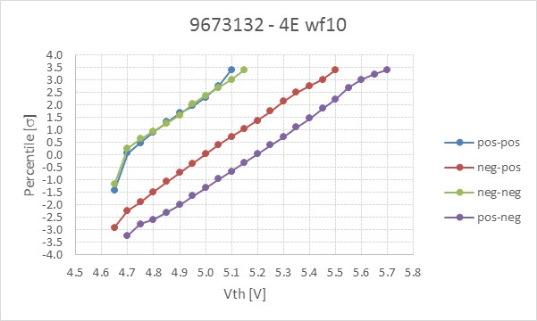
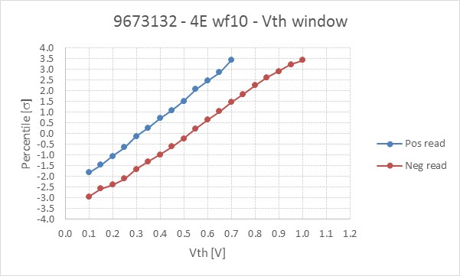
2xCMOS cell on SSM lot #1 – trial 4E
FS values, including PM in reset state (1.35V higher)
Vehicle | S15C |  |  |  | S26A
Lot/rev | 7.13 | 7.13+N2 bake | 7.16 D0 | 7.16 D1 | 9622442 wf 16
FF | 7.16 | 7.20 | 6.99 | 7.05 | 6.96
pos-pos | 5.88 | 5.85 | 5.97 | 6.02 | 6.11
neg-pos | 6.28 | 6.2 | 6.33 | 6.4 | 6.38
neg-neg | 5.95 | 5.85 | 5.87 | 6.03 | 6.02
pos-neg | 6.41 | 6.25 | 6.52 | 6.51 | 6.62
DVth read pos | 0.4 | 0.35 | 0.36 | 0.38 | 0.27
DVth read neg | 0.46 | 0.4 | 0.65 | 0.48 | 0.6
Vth detectability limited to 4.7V (lower boundary) → to be understood
Distributions obtained by measuring 32 cells, 10 programming currents, 10 measurements each
Comparable spread for the various polarities, around 140-145mV/sigma
Vth window of about 0.3V and 0.5V for positive and negative reading, respectively → quite close to S26A FS lot, similar to recent S15C FS lots (but lower than old SD-only S15C lots)

Slide 30
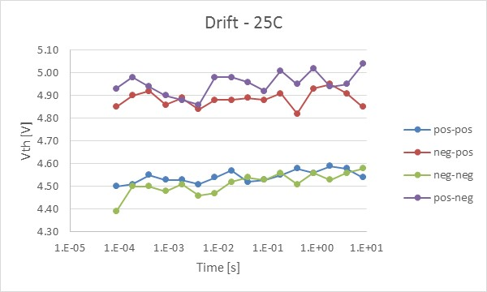
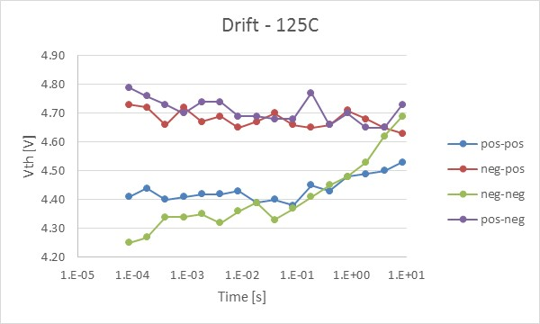
High Temperature functionality - Drift
Low Vt states are the ones drifting more
Neg-neg (D1 polarity) state is the one drifting more
High Vt states are stable at RT and 125C

