Slide 1
TL170718005
SD only SSM flow on S26A WL etch development with In doped SD stack; PROD SWR # 8527404 group 5E,6E:
Prepared by : (Tim Conroy)

Slide 2
Job Description
wf#24 SWR # 8527404 group 5E: SSM SDv12 22nm 4% In; 21s SD etch no SO2; 2-step etch CD-; 20/20s W etch
wf#19 SWR # 8527404 group 6E: SSM SDv12 22nm 4% In; 21s SD etch no SO2; 2-step etch CD--; 20/18s W etch
Need EDS composition estimates, maps, and line scan across TE,BE and SD.
Including Si/O/N/Al maps in addition to chalc. composition elements.

Slide 3
010
0024682.0J3-24
Center
X-Direction

Slide 4
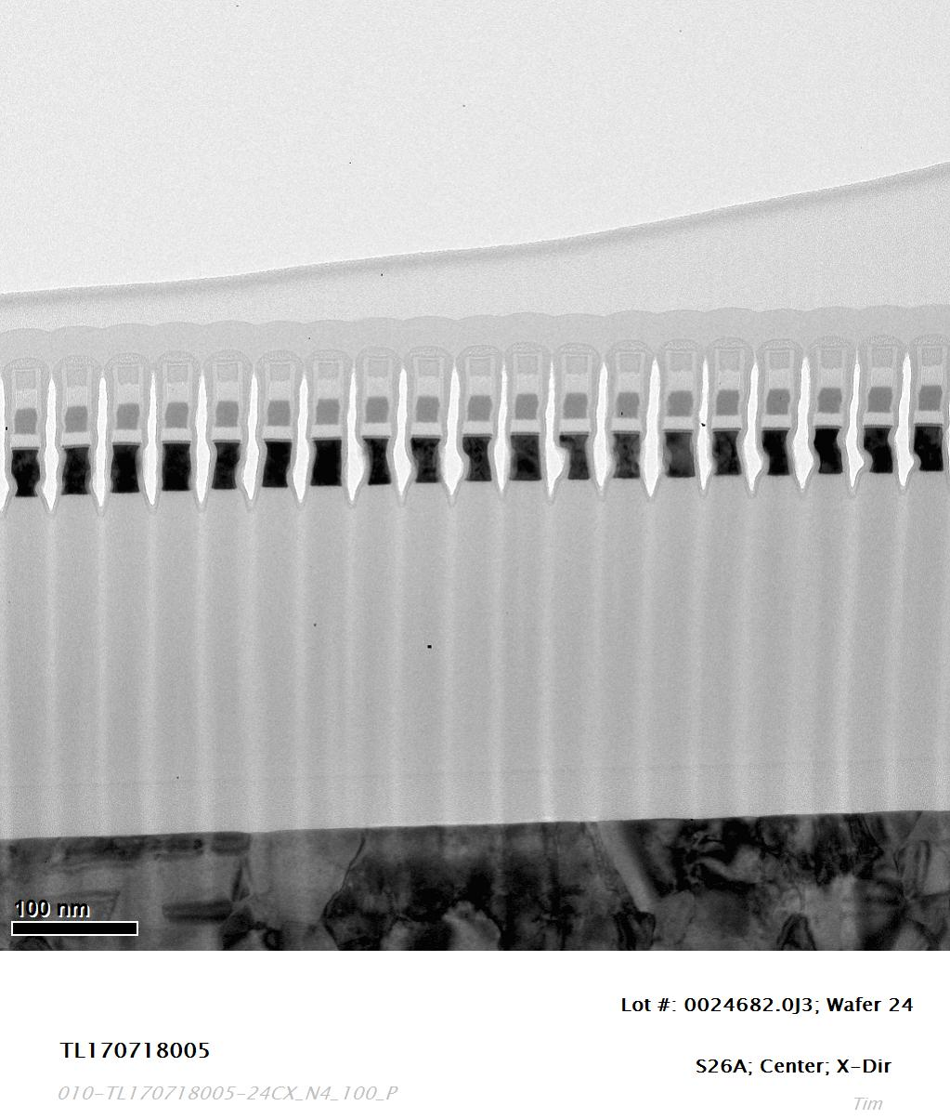

Slide 5
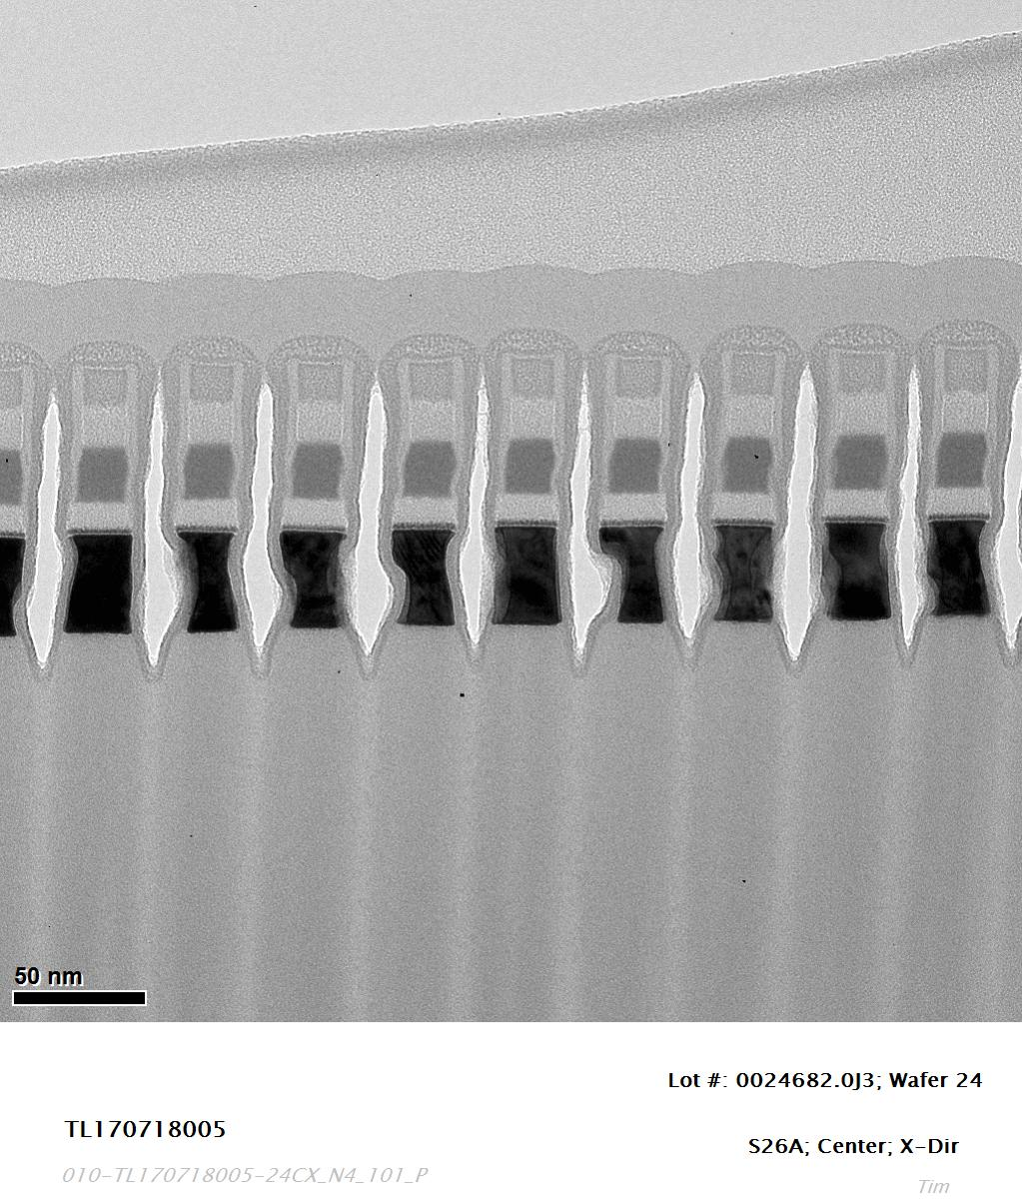

Slide 6
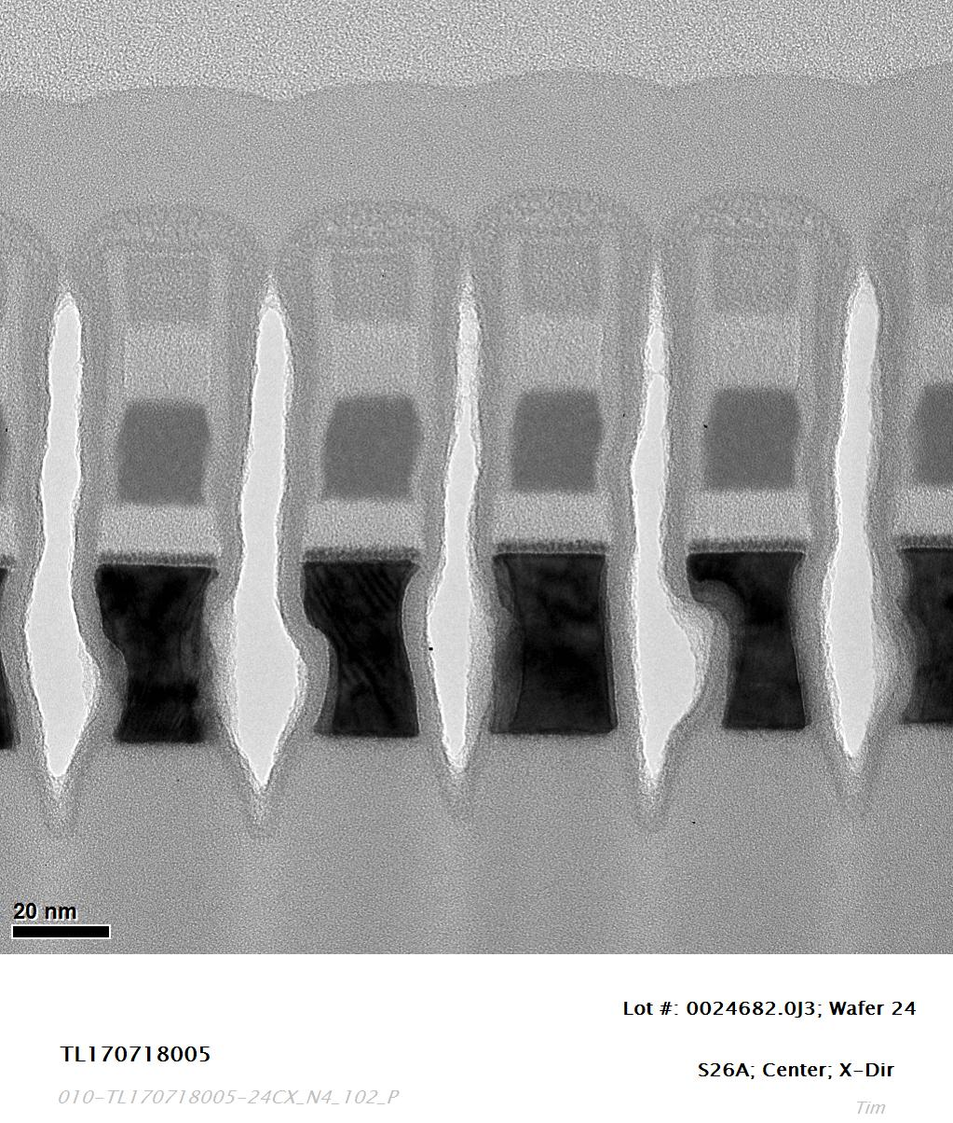

Slide 7
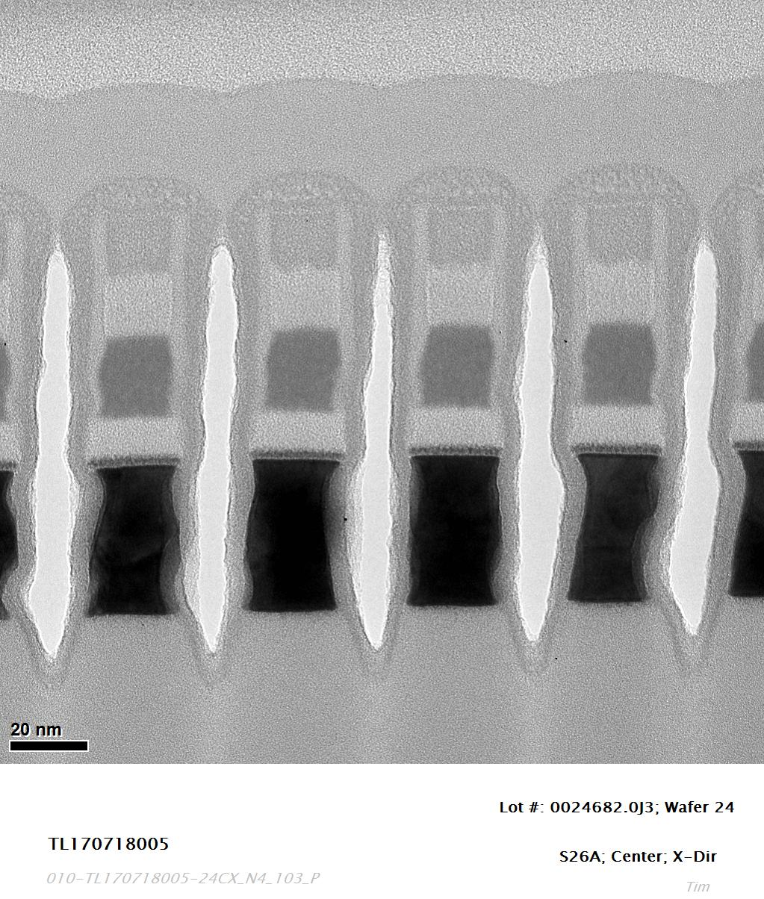

Slide 8
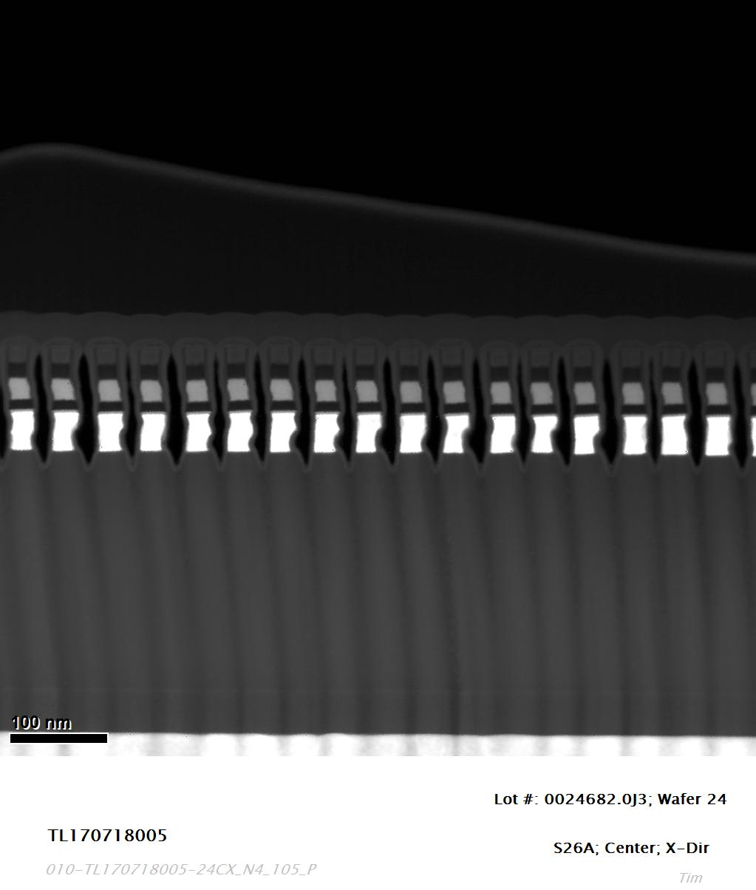
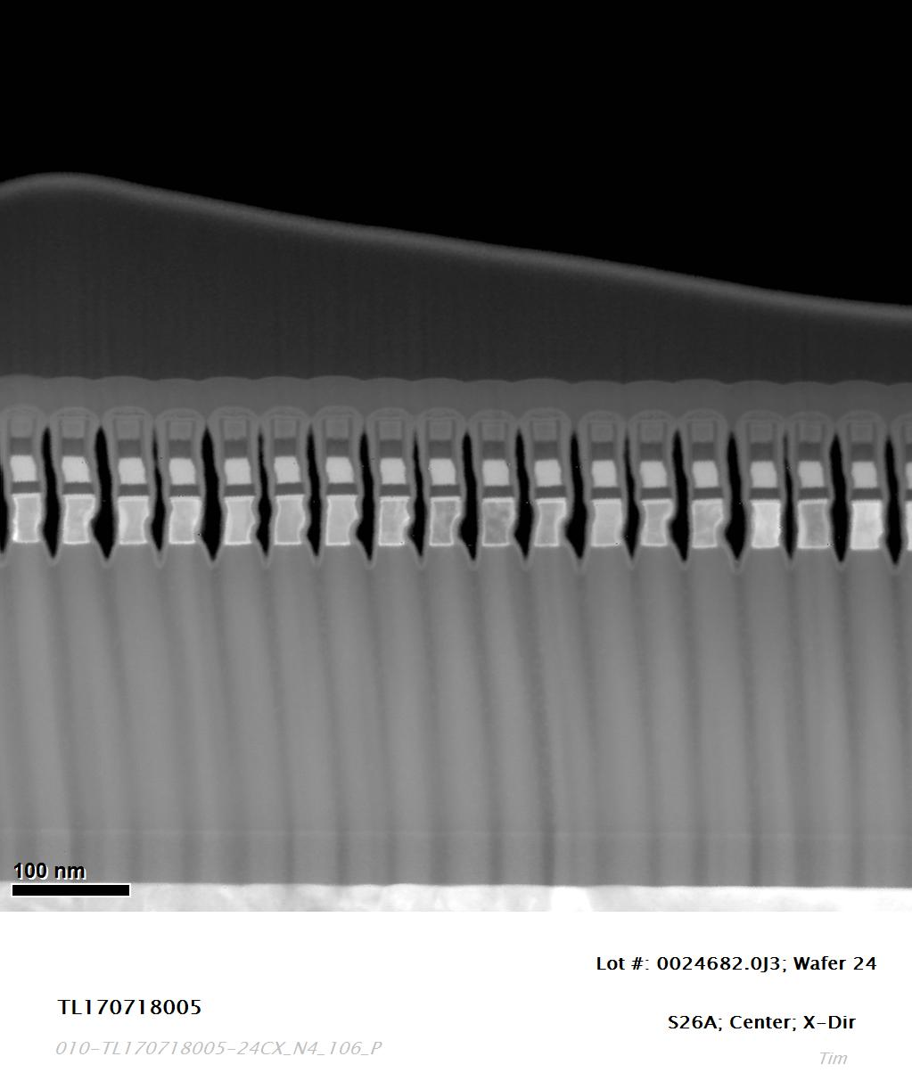

Slide 9
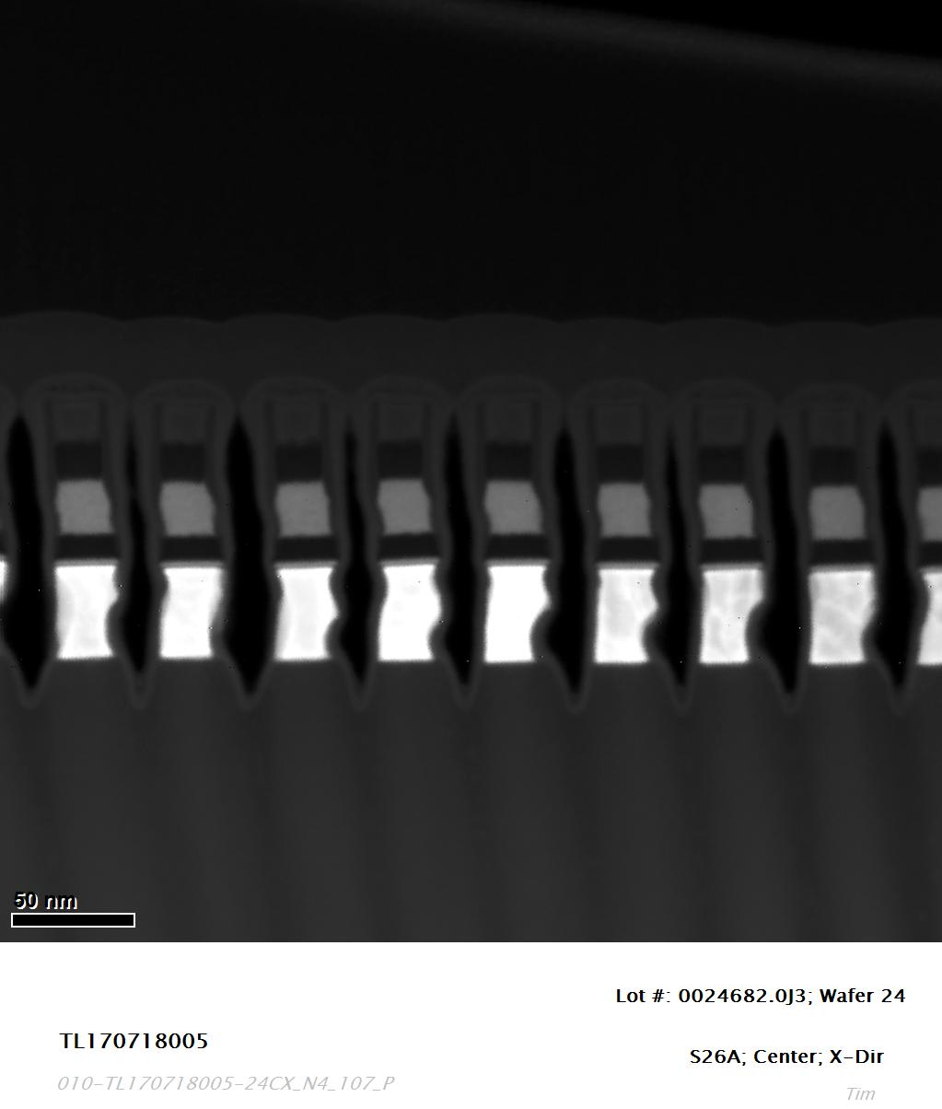
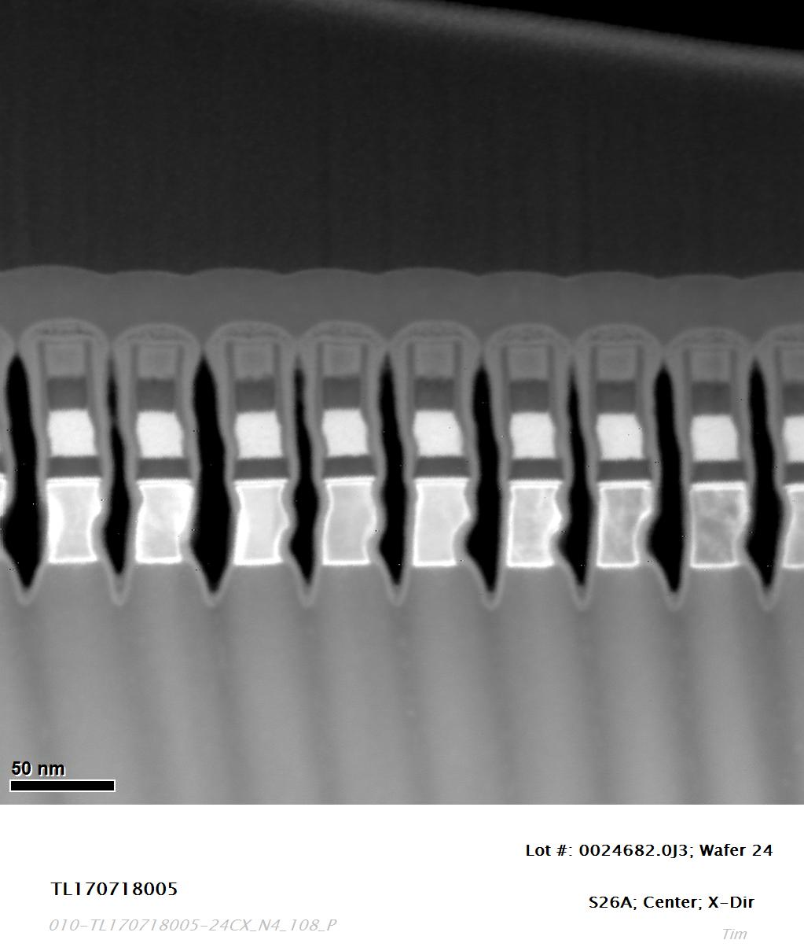

Slide 10
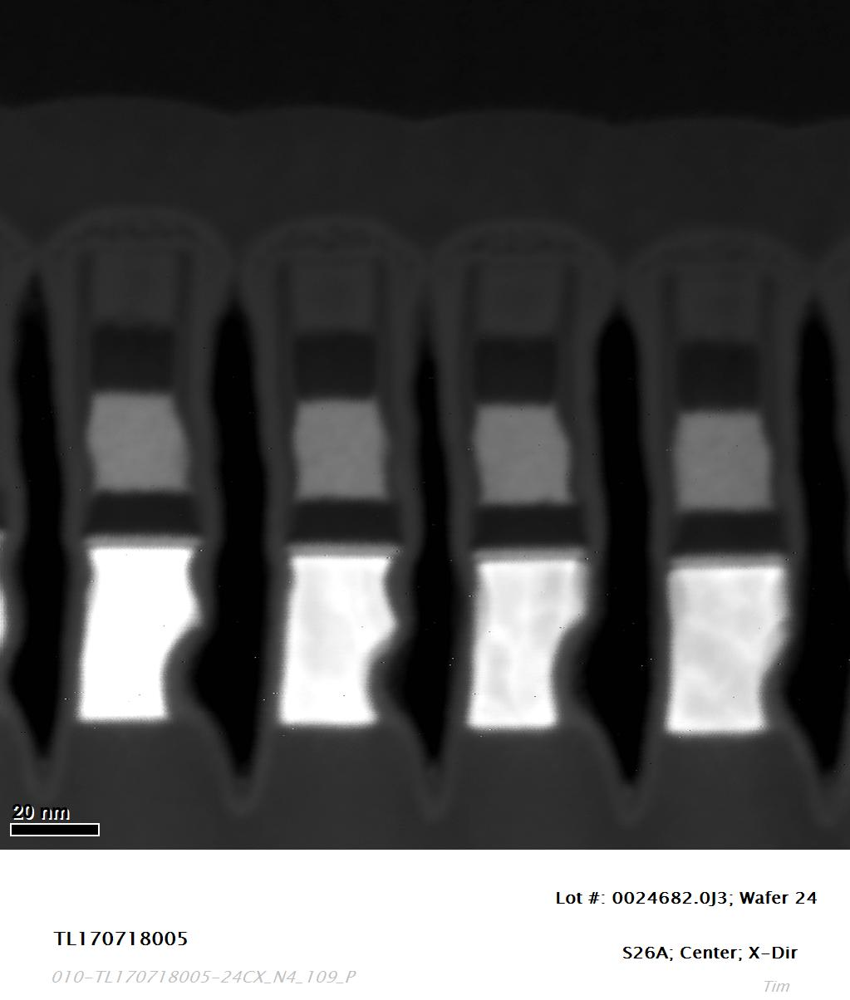
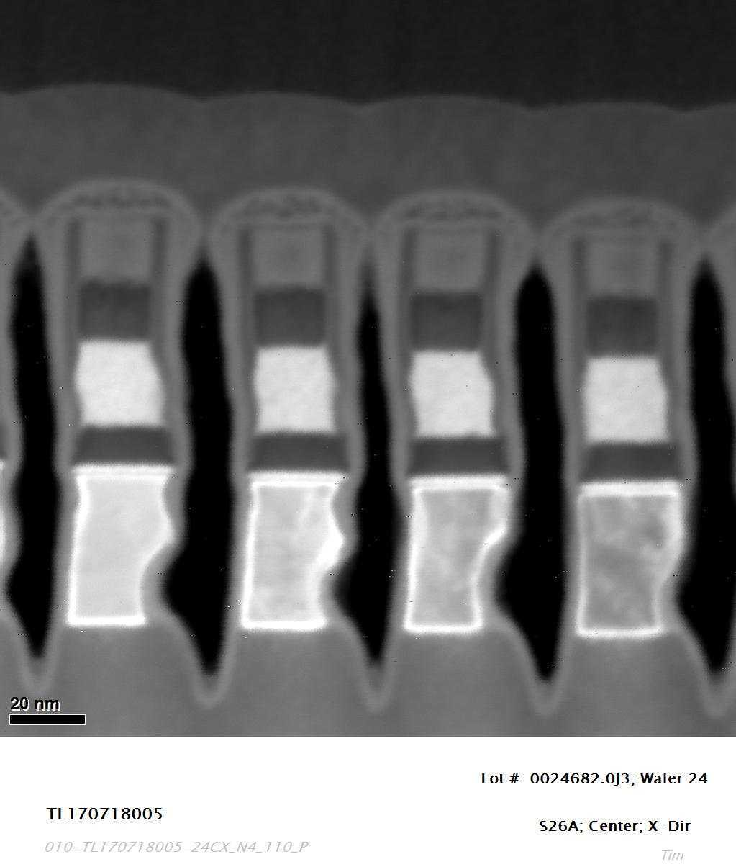

Slide 11
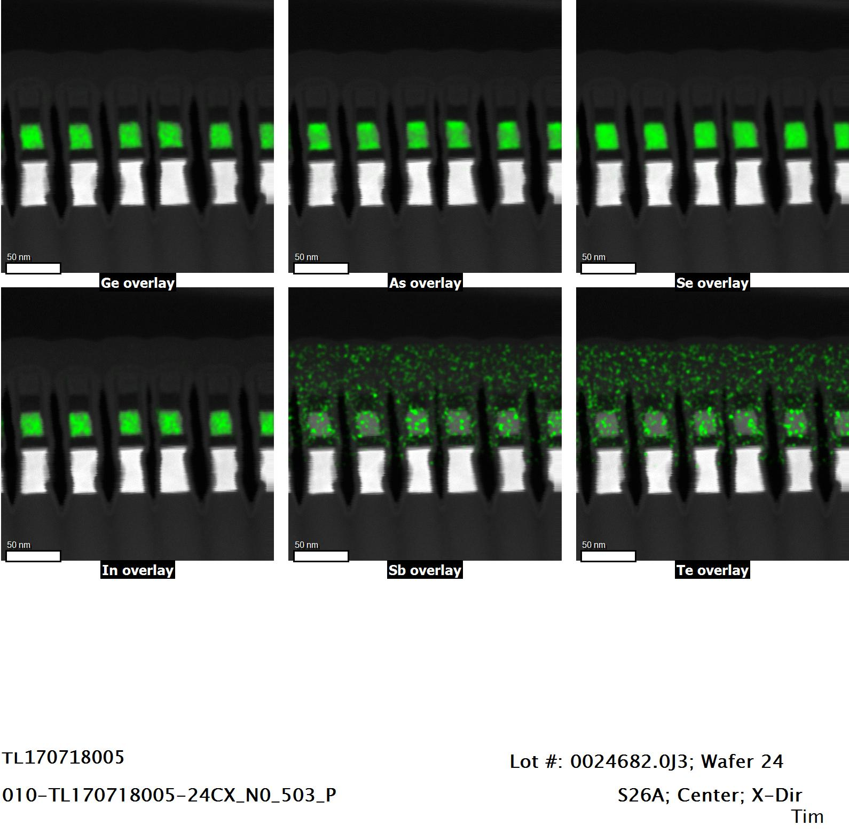
80kV EDS Mapping

Slide 12
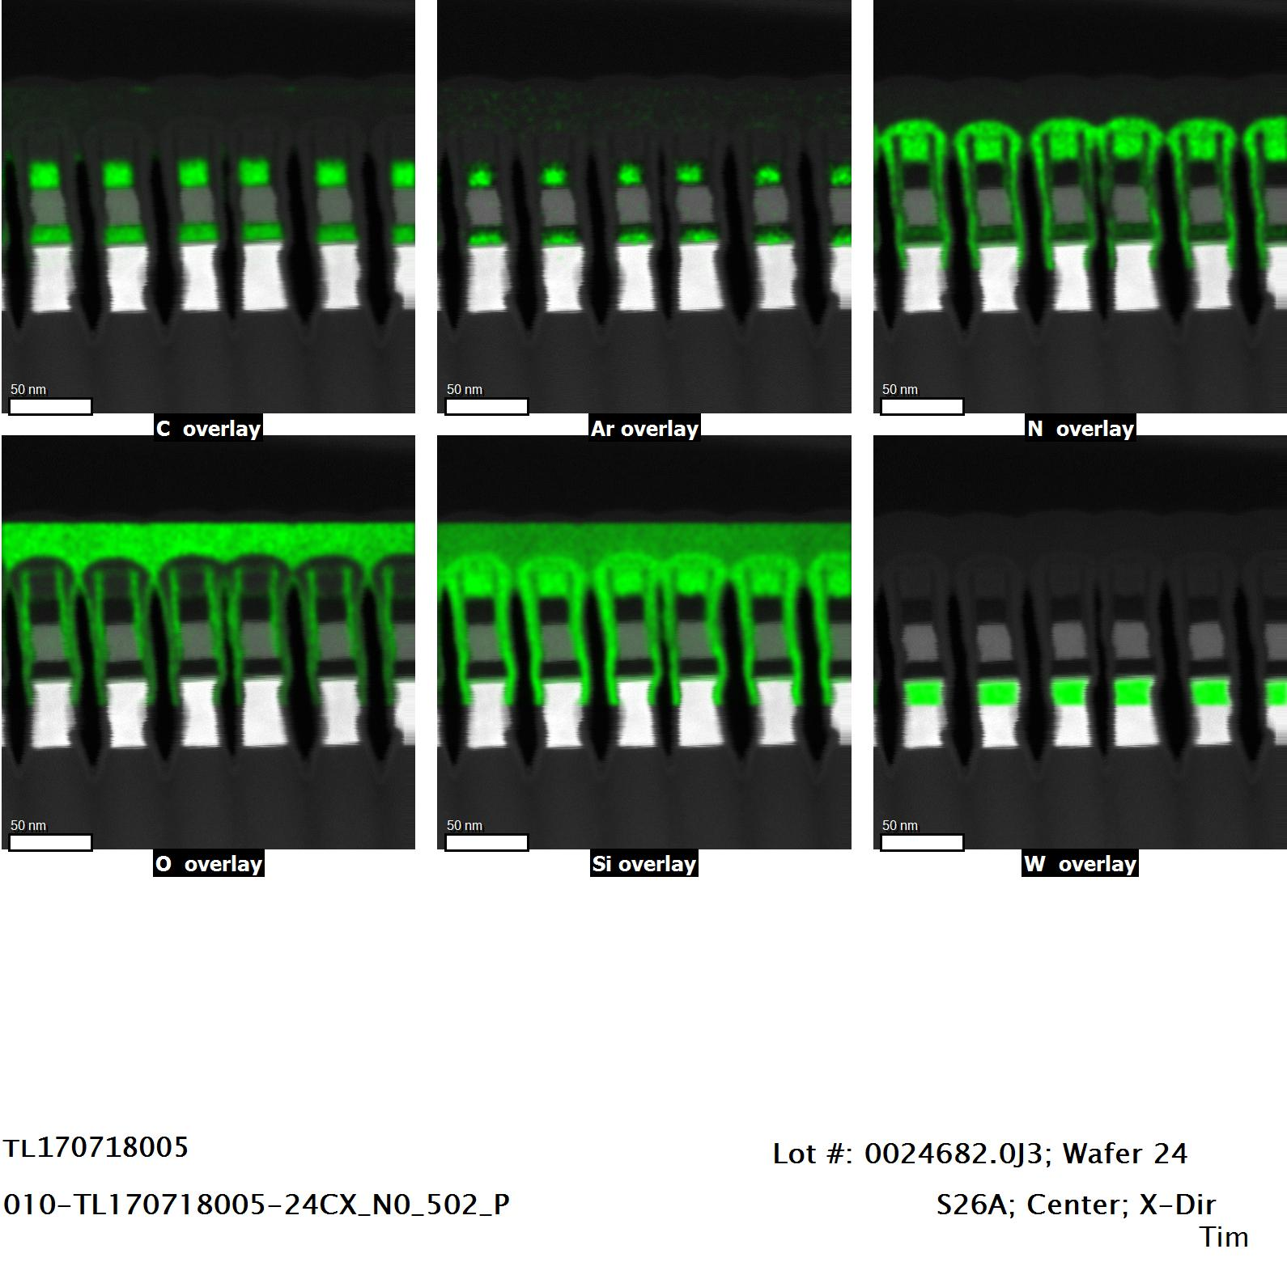
80kV EDS Mapping

Slide 13
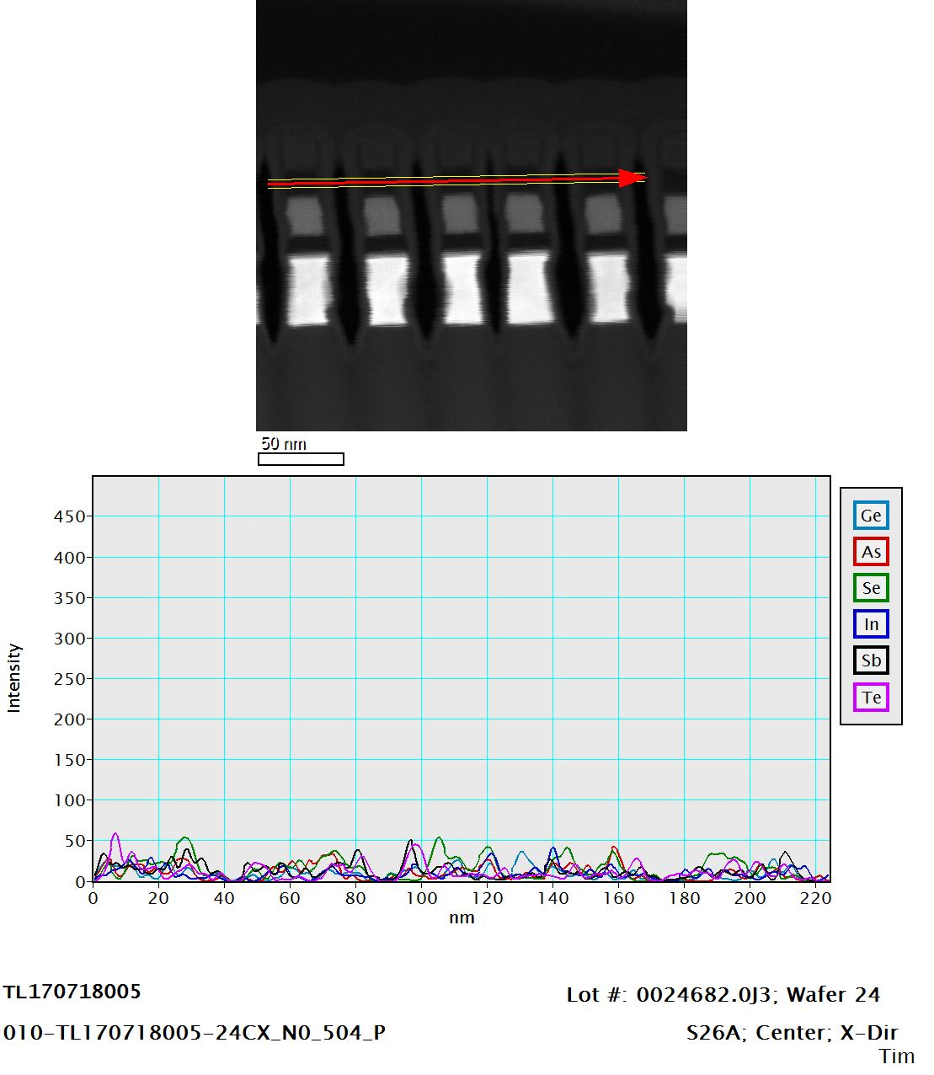
EDS Line Scan

Slide 14
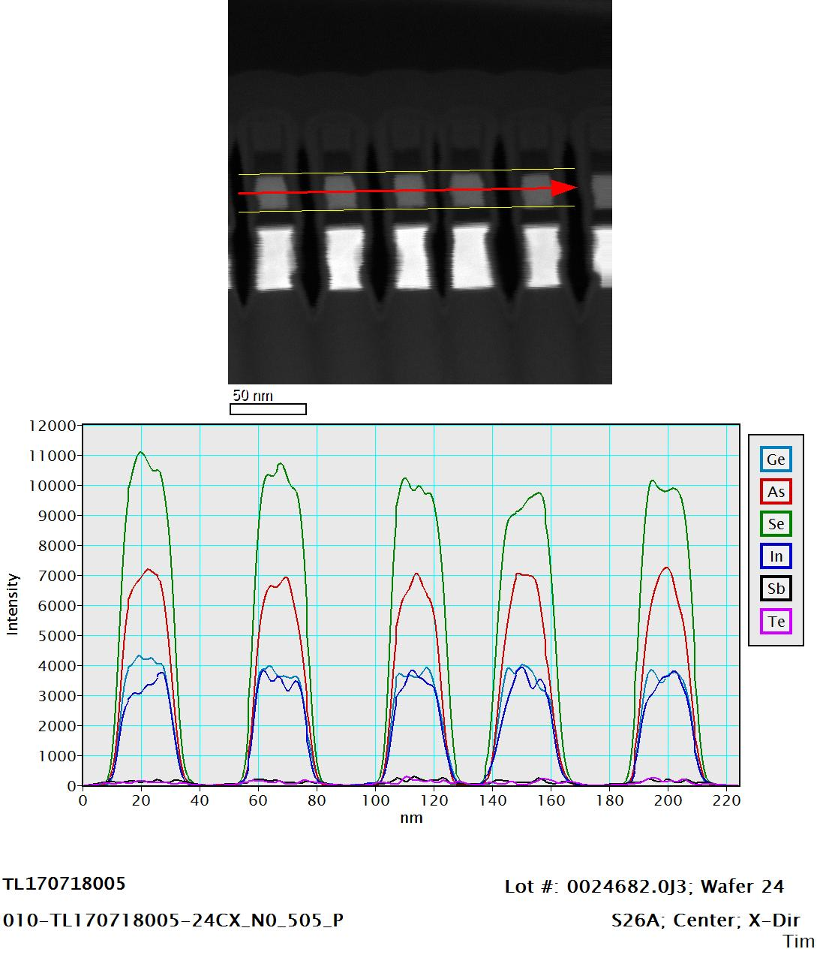
EDS Line Scan

Slide 15
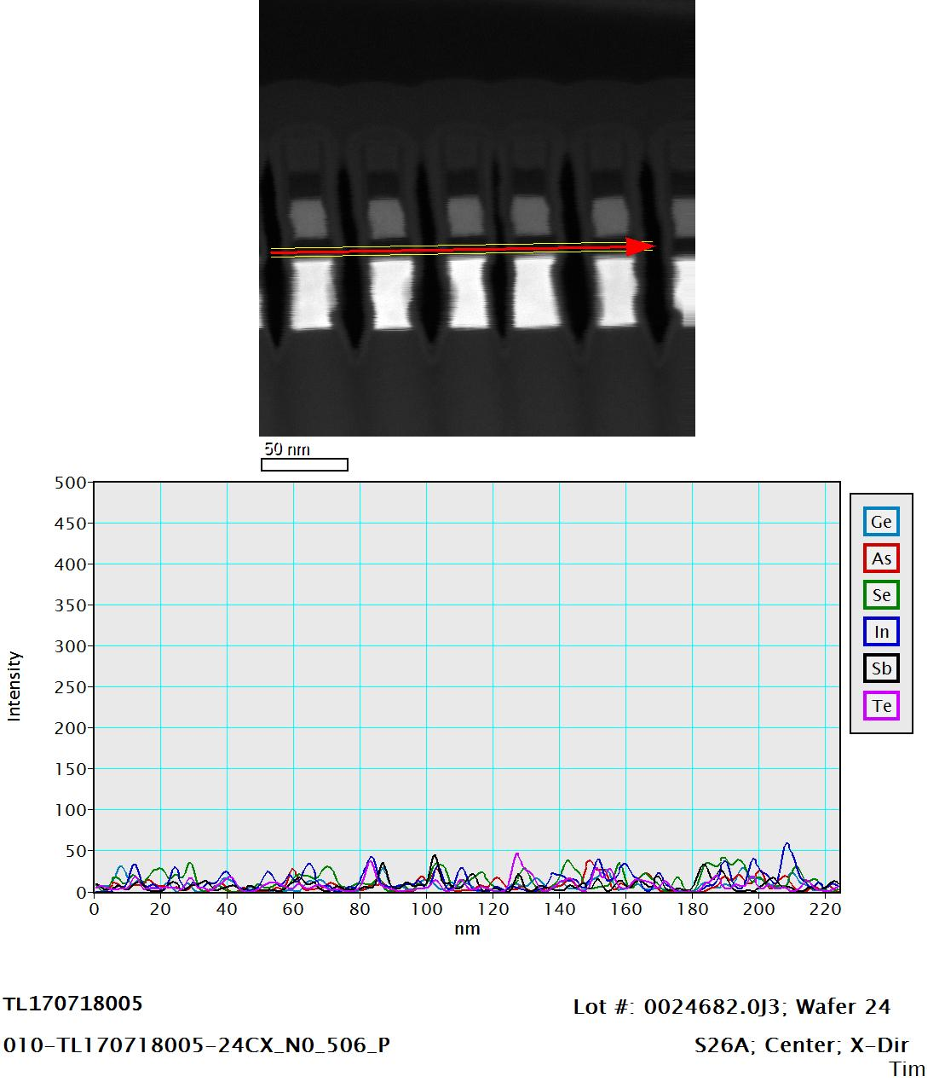
EDS Line Scan

Slide 16
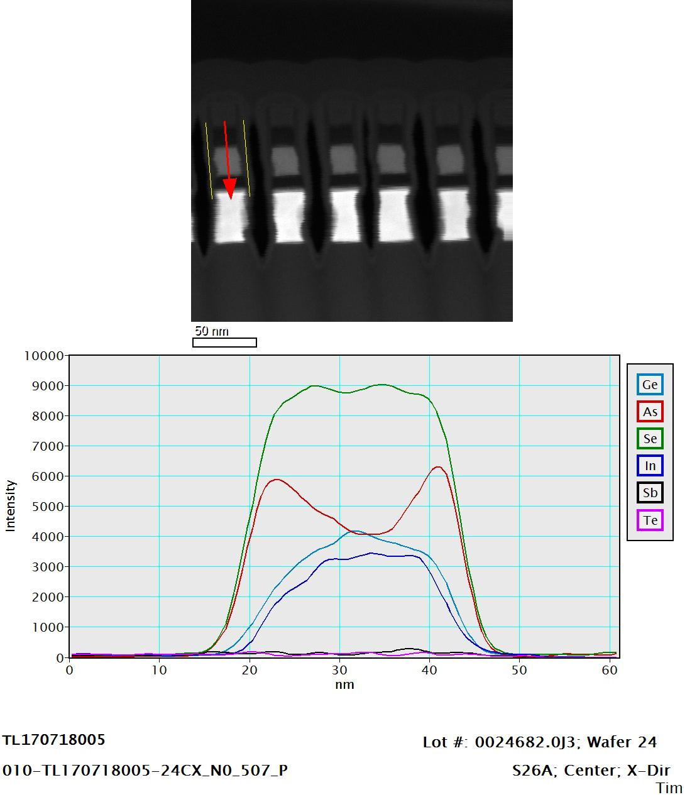
EDS Line Scan

Slide 17
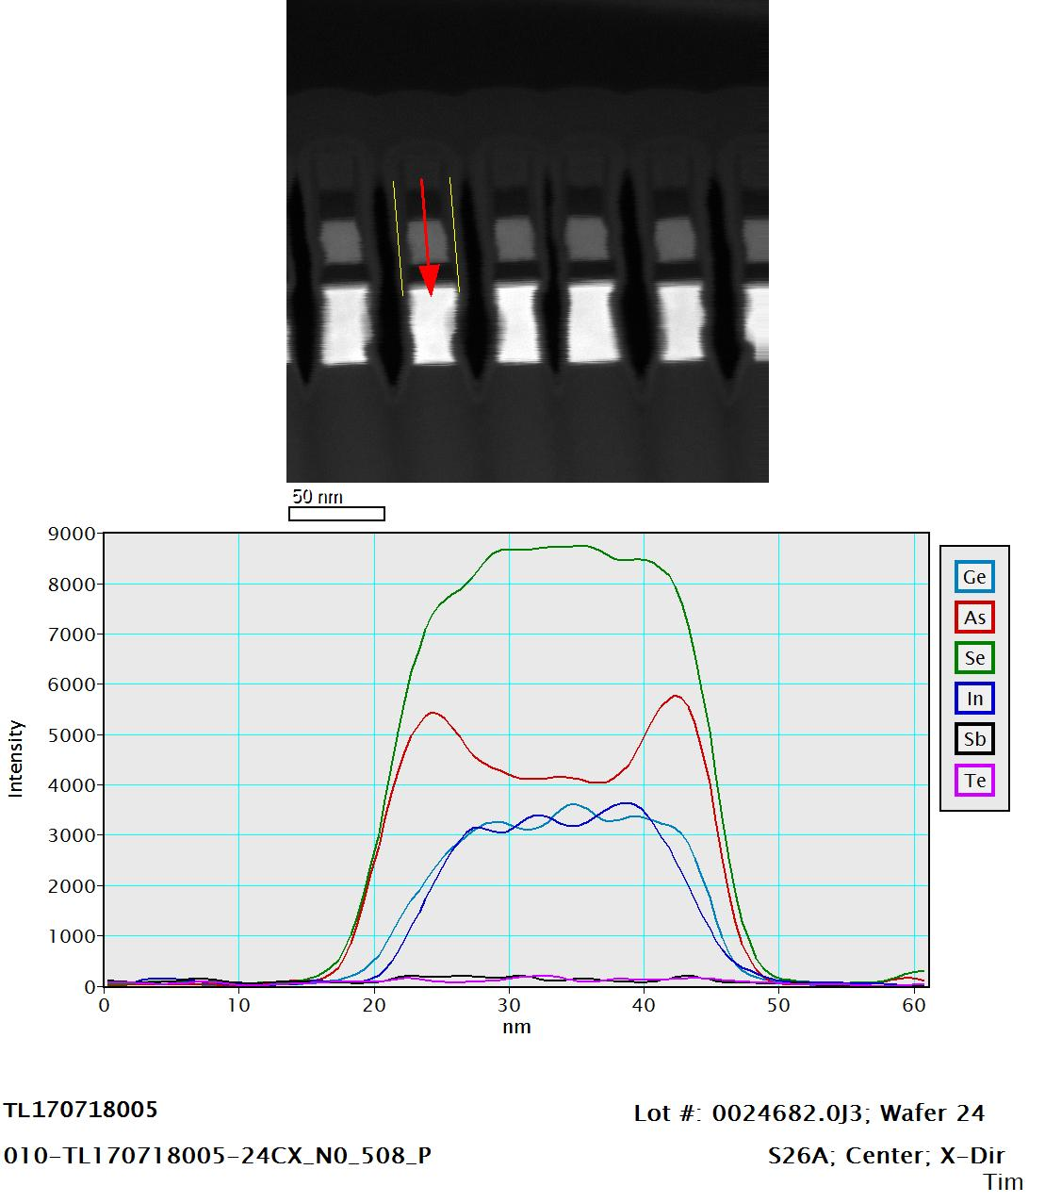
EDS Line Scan

Slide 18
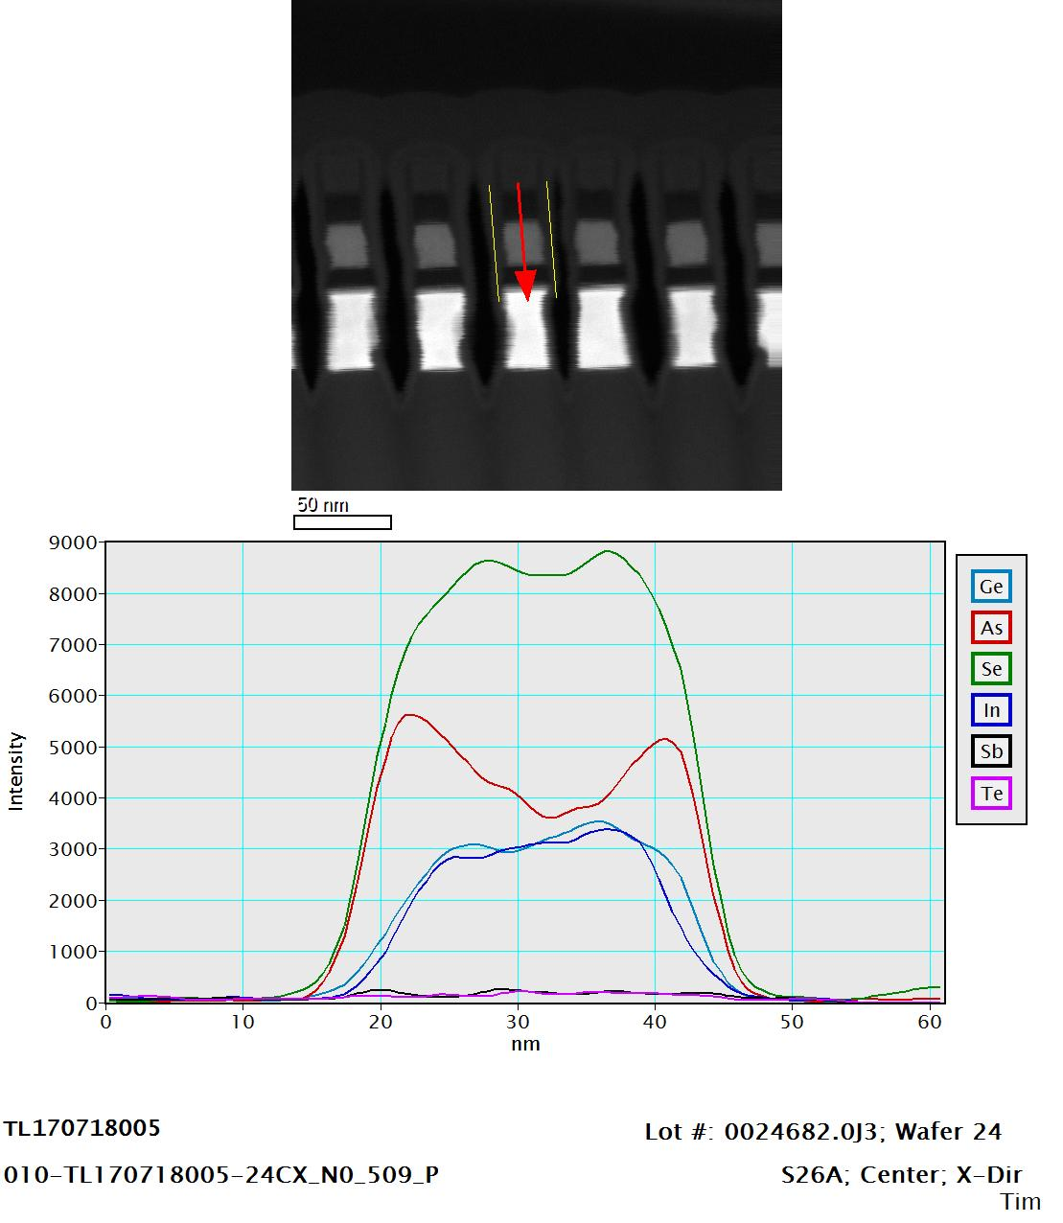
EDS Line Scan

Slide 19
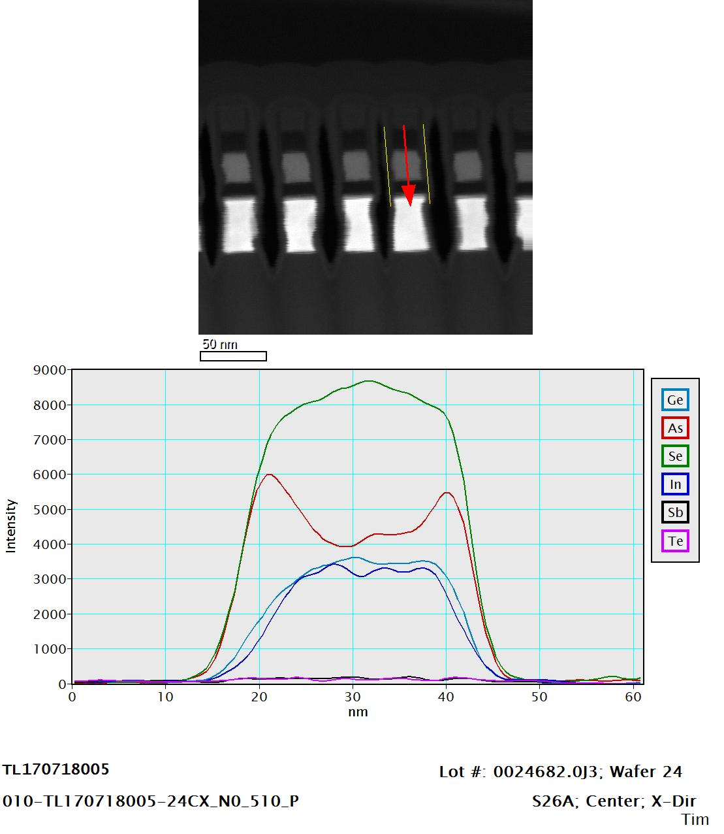
EDS Line Scan

Slide 20
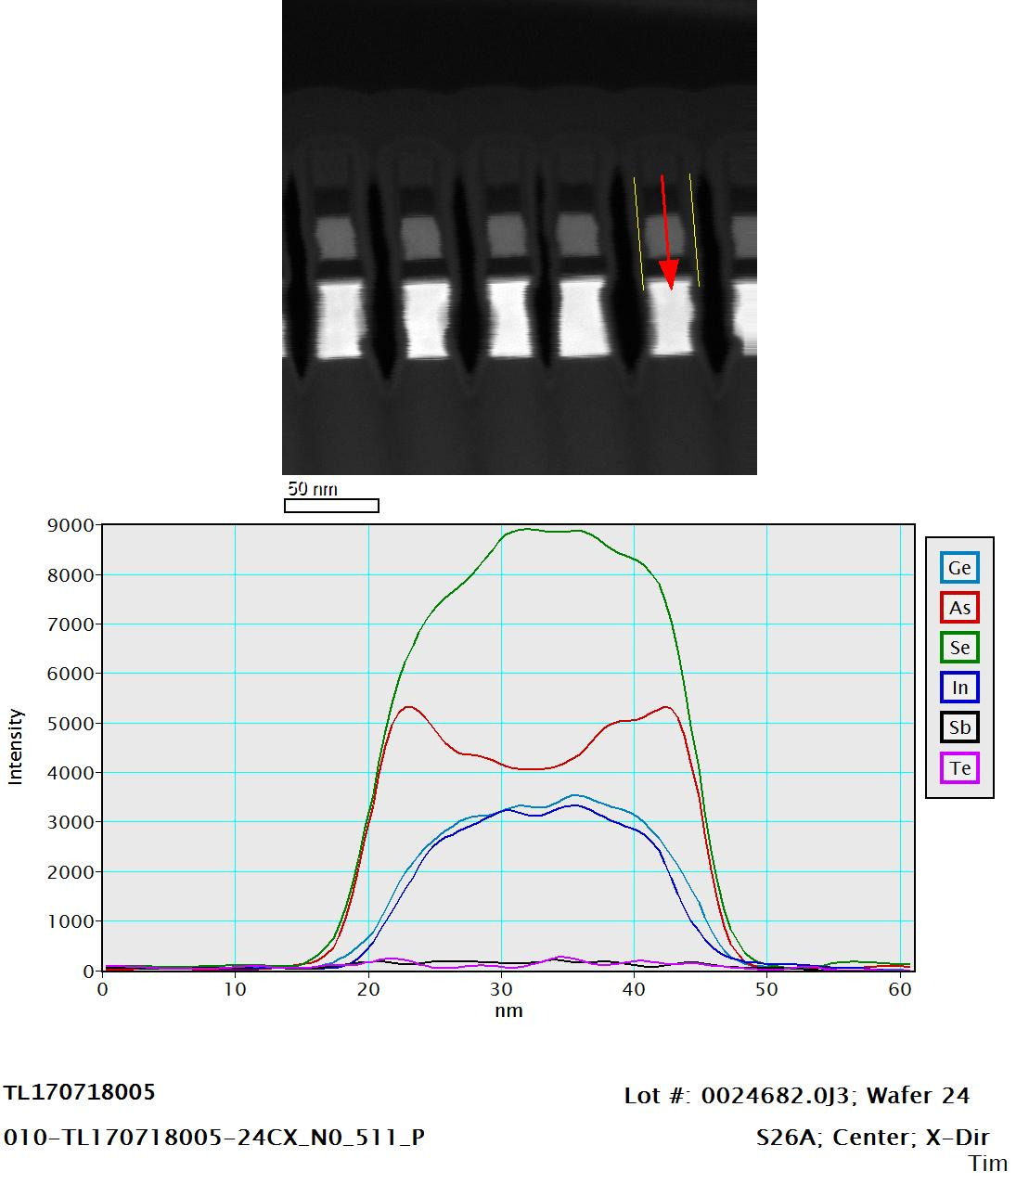
EDS Line Scan

Slide 21
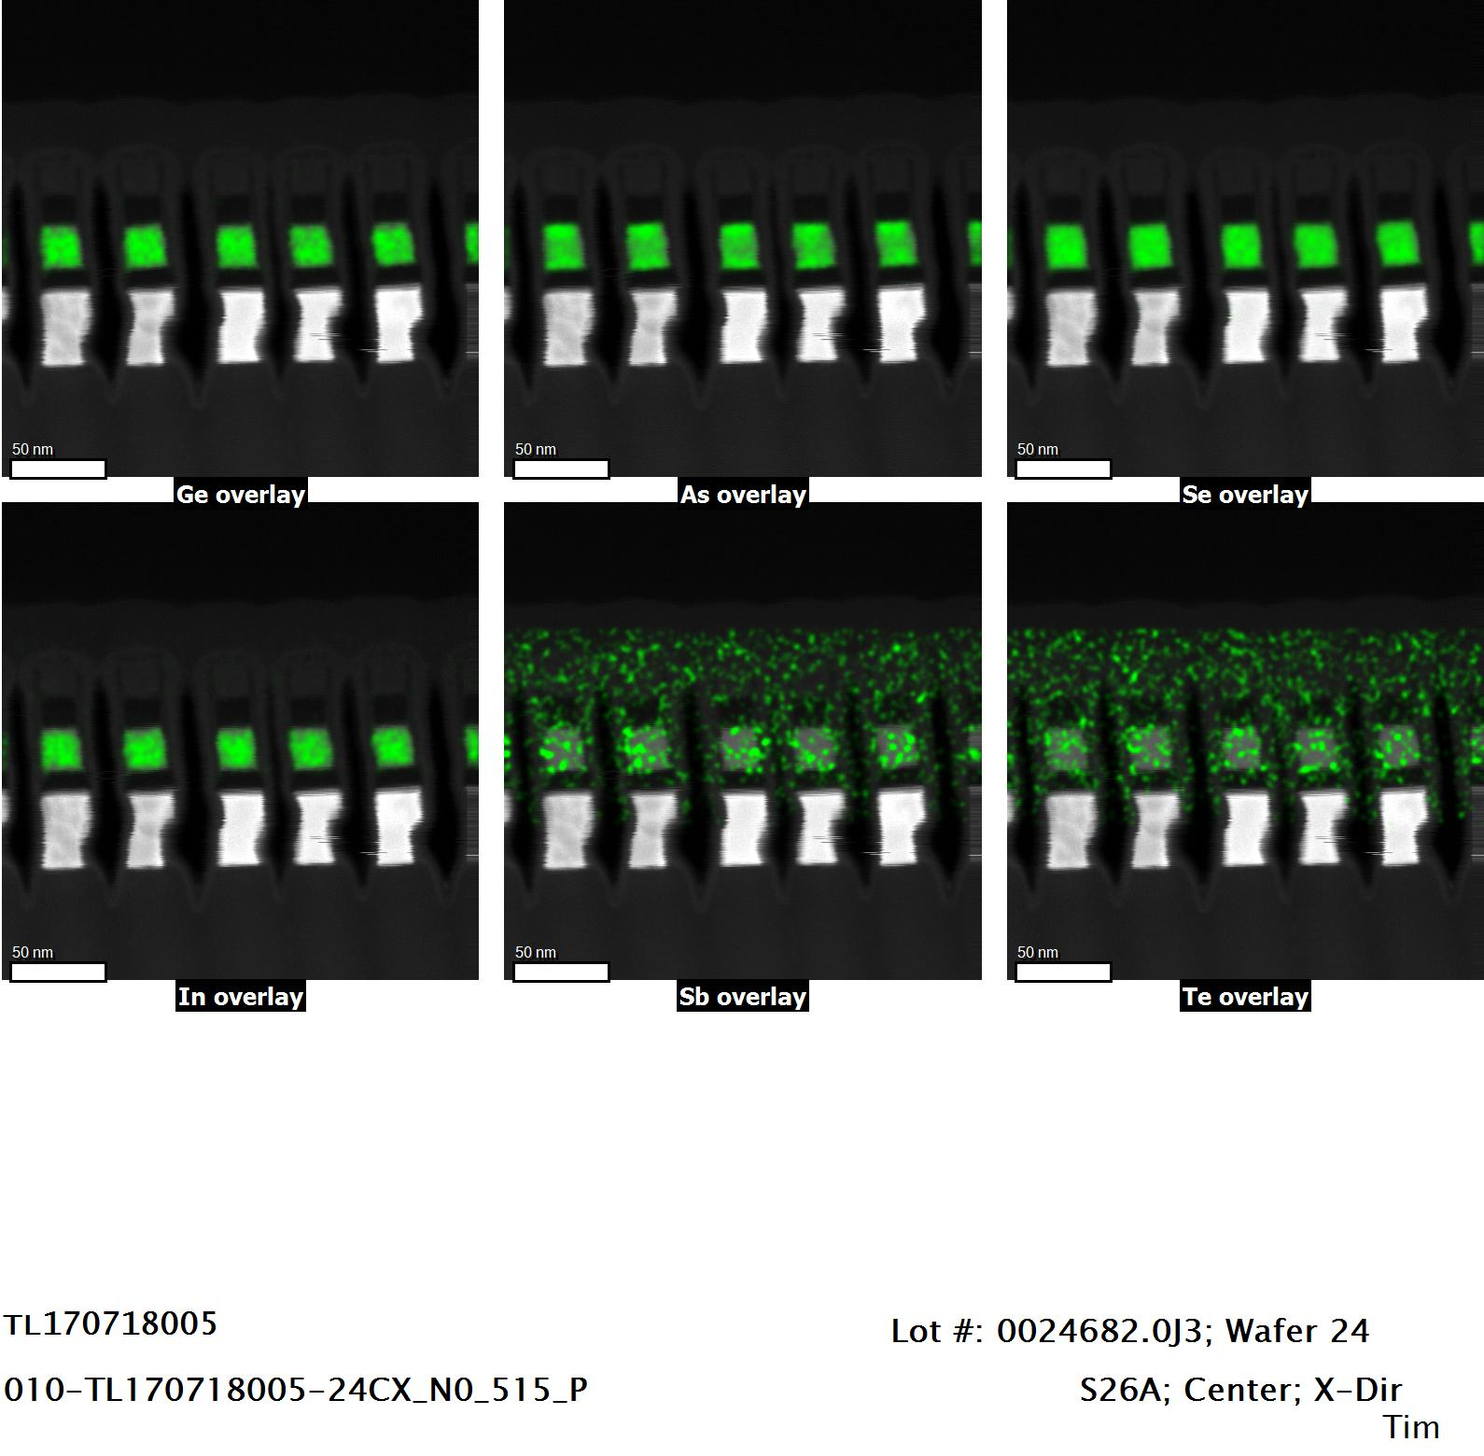
80kV EDS Mapping

Slide 22
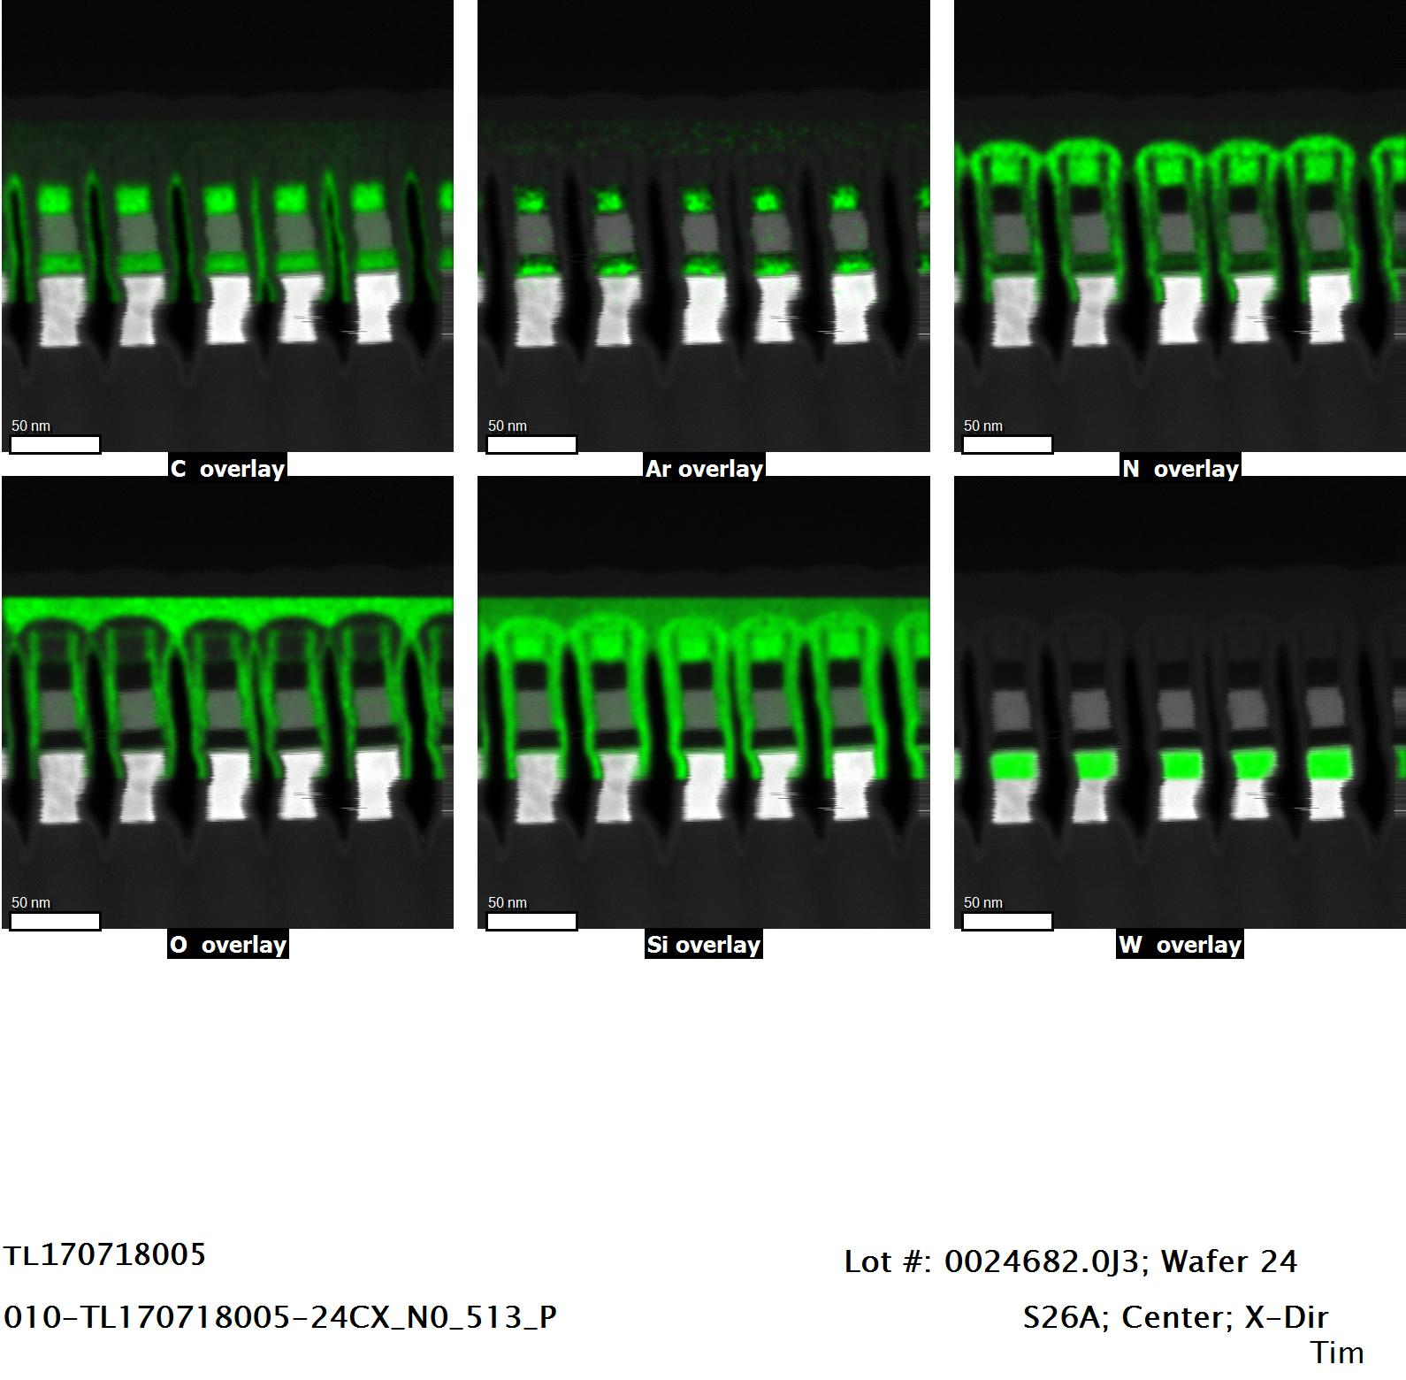
80kV EDS Mapping

Slide 23
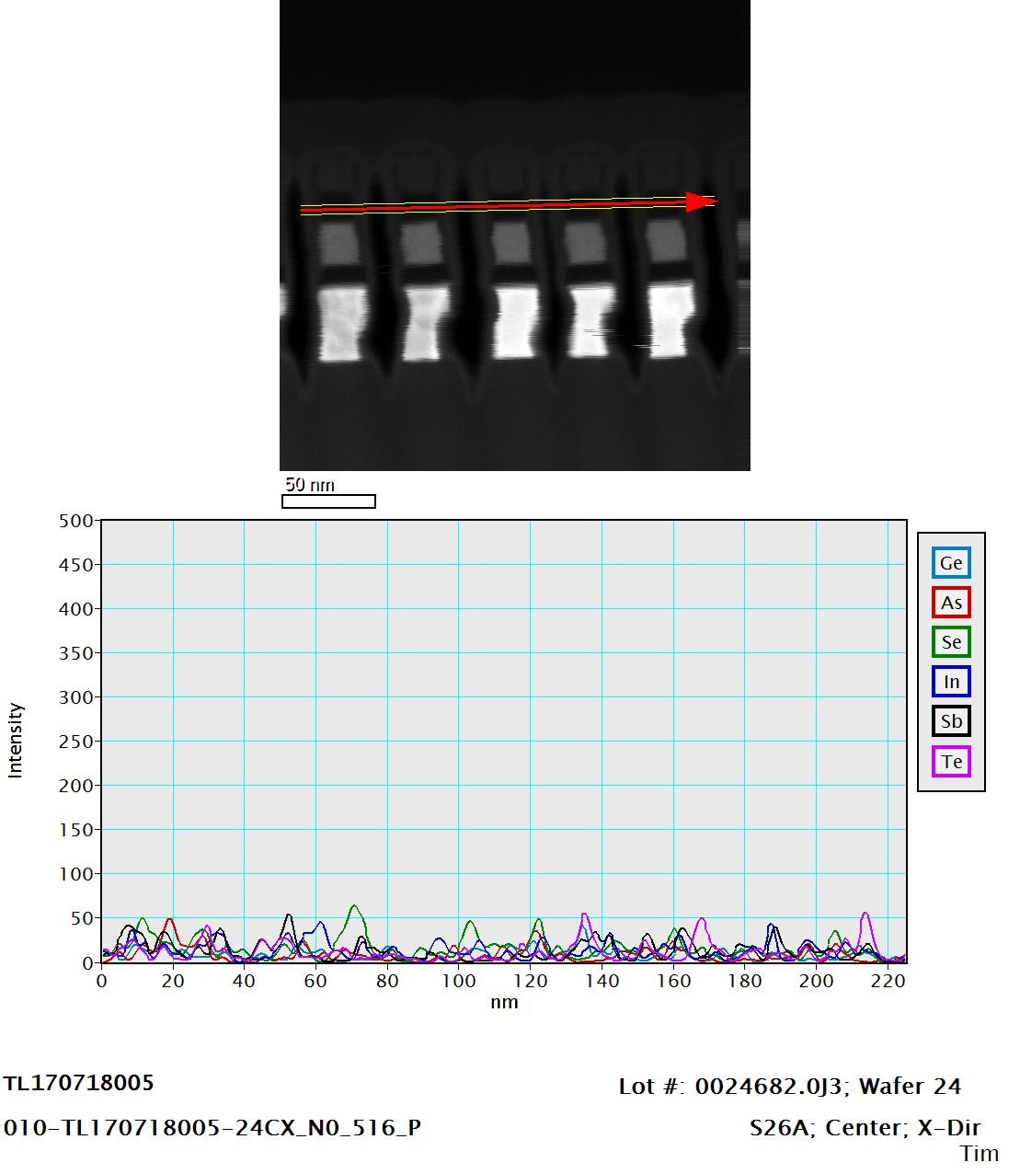
EDS Line Scan

Slide 24
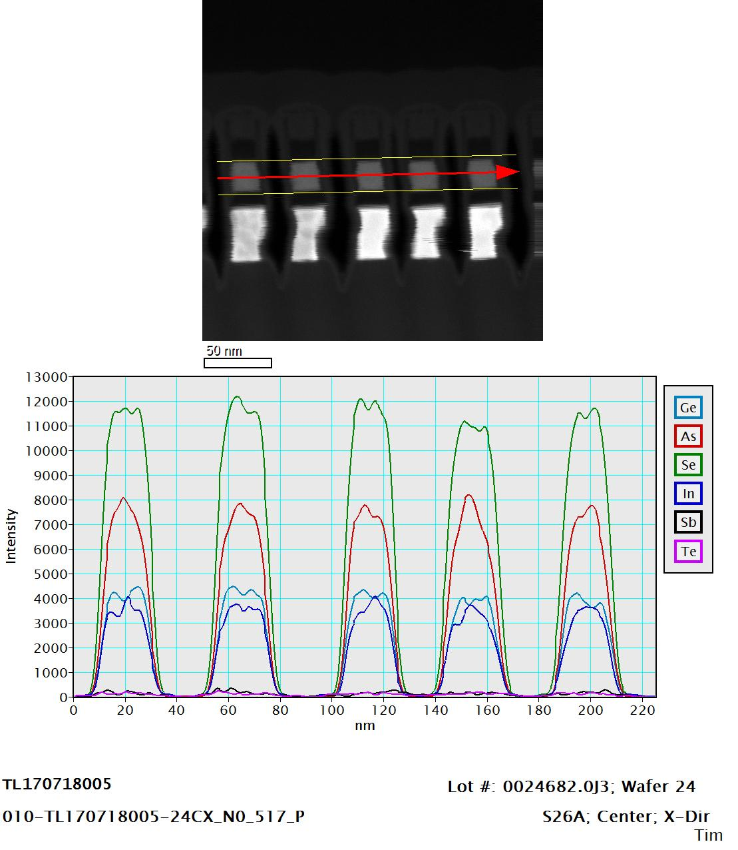
EDS Line Scan

Slide 25
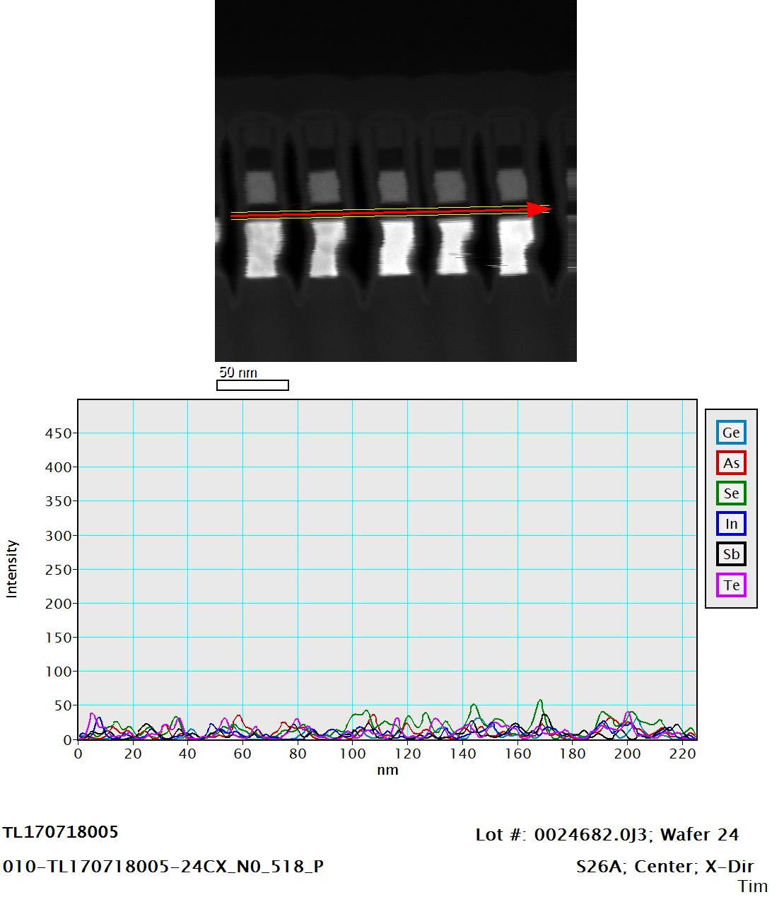
EDS Line Scan

Slide 26
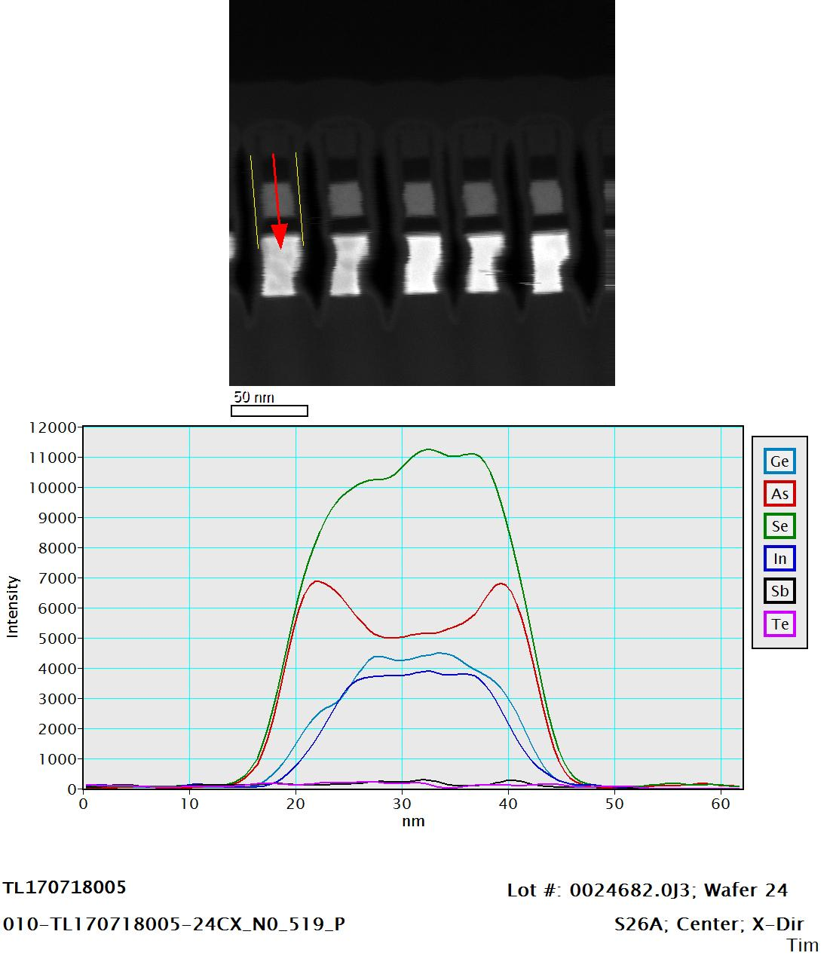
EDS Line Scan

Slide 27
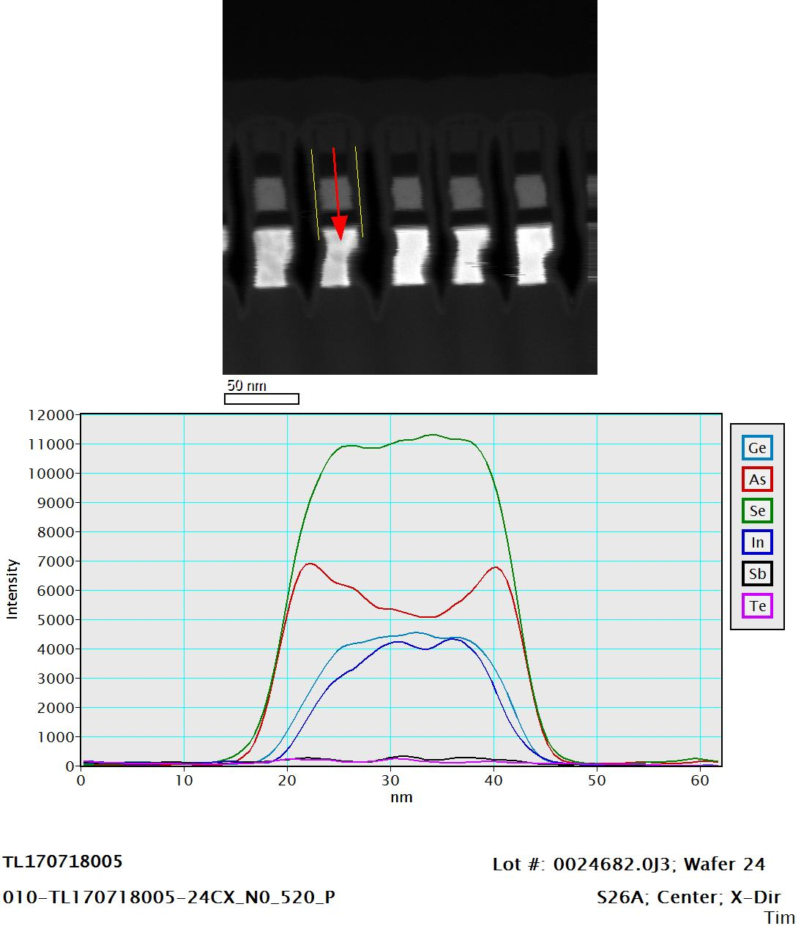
EDS Line Scan

Slide 28
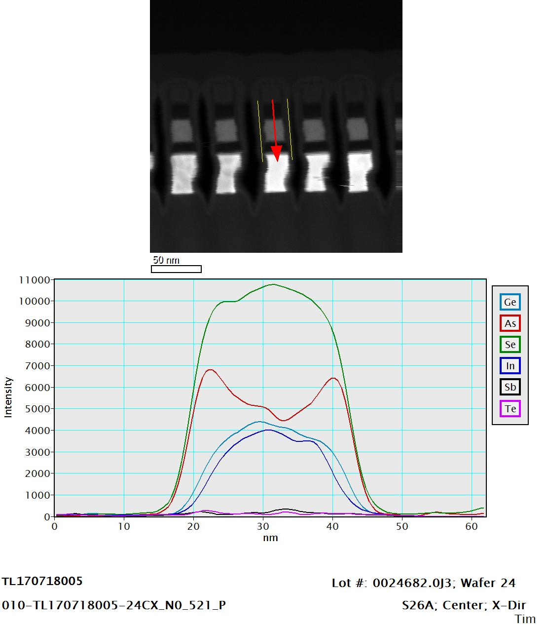
EDS Line Scan

Slide 29
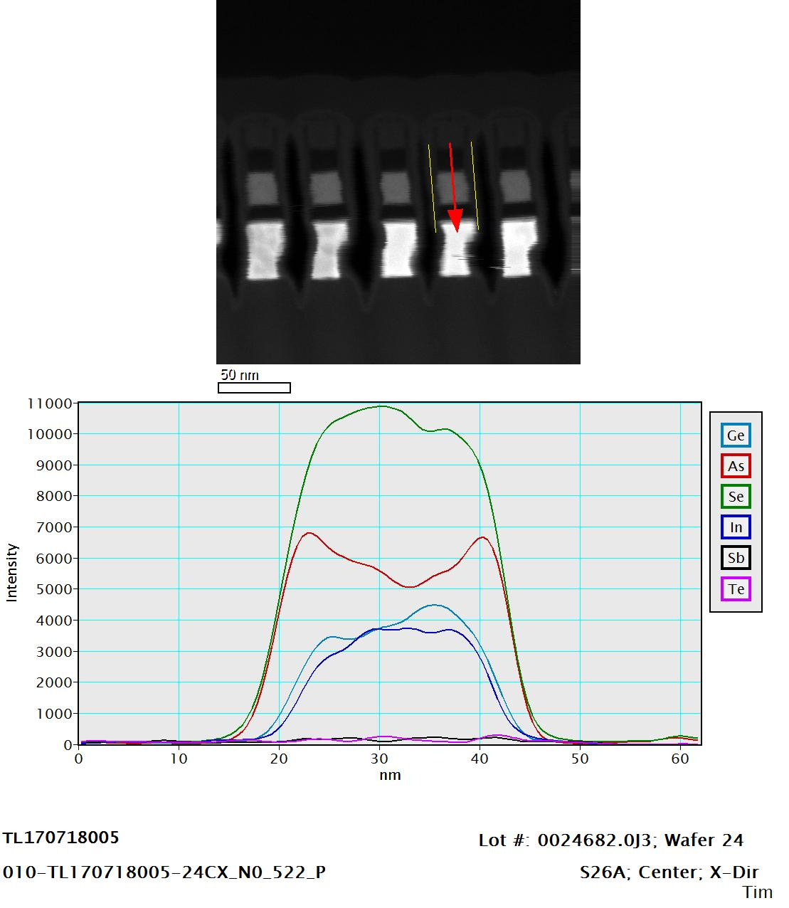
EDS Line Scan

Slide 30
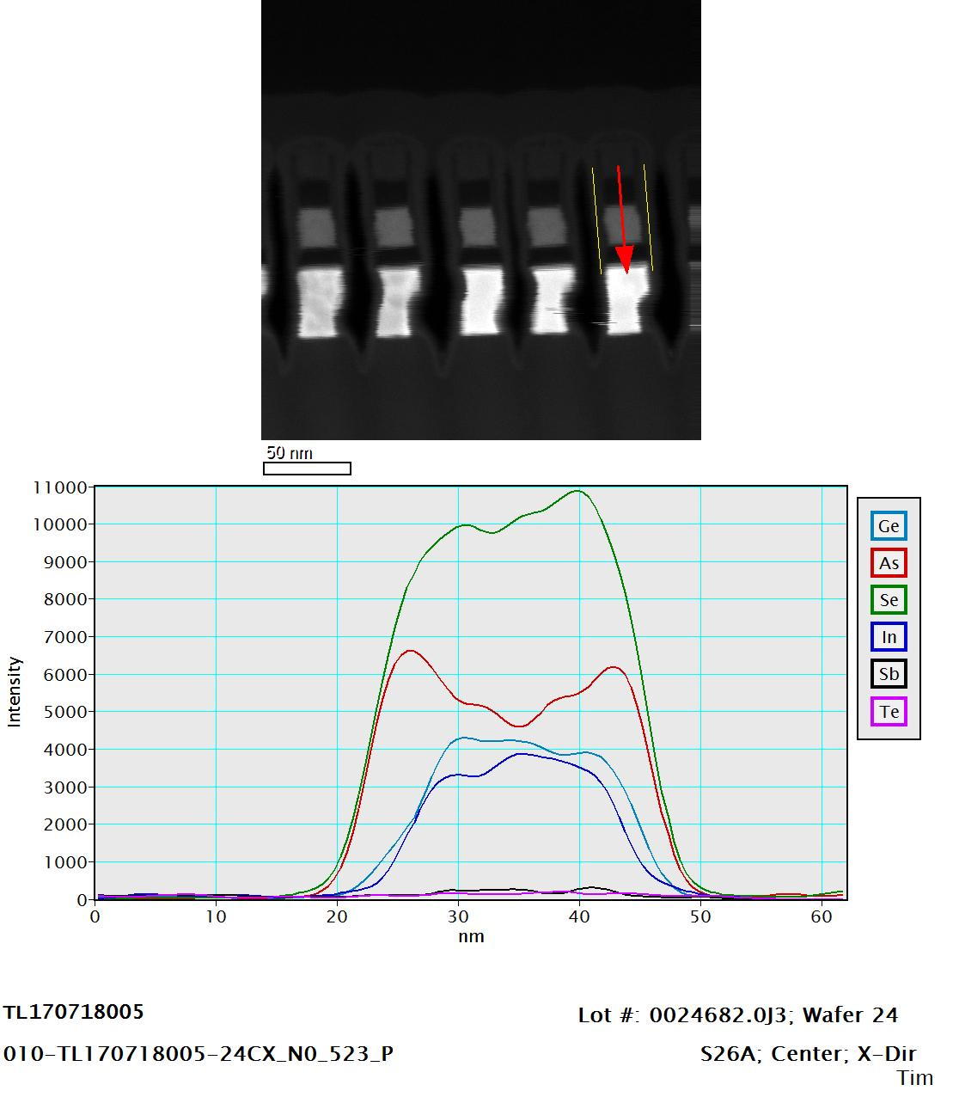
EDS Line Scan

Slide 31
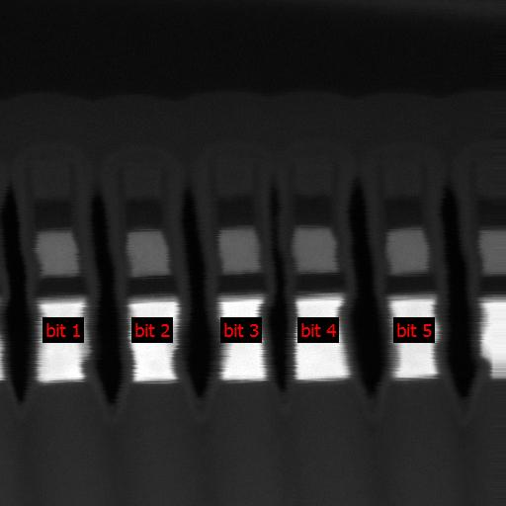
EDS Atomic Percent Estimate
Sample | lot | wafer | design | location | direction | Deck Bit | SD Ge-K | SD As-K | SD Se-K | SD In-L | SD Sb-L | SD Te-L
010 | 0024682.0J3 | 24 | S26A | Center | X-Dir | bit 1 | 14.67 | 27.3 | 50.01 | 8.02 | --- | ---
010 | 0024682.0J3 | 24 | S26A | Center | X-Dir | bit 2 | 14.17 | 27.08 | 49.99 | 8.77 | --- | ---
010 | 0024682.0J3 | 24 | S26A | Center | X-Dir | bit 3 | 13.86 | 27.31 | 50.3 | 8.17 | 0.24 | 0.12
010 | 0024682.0J3 | 24 | S26A | Center | X-Dir | bit 4 | 14.33 | 27.91 | 48.79 | 8.97 | --- | ---
010 | 0024682.0J3 | 24 | S26A | Center | X-Dir | bit 5 | 15.2 | 26.1 | 50.06 | 8.58 | --- | 0.07

Slide 32
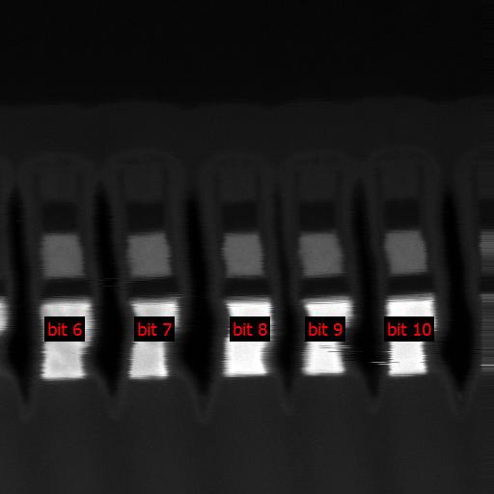
EDS Atomic Percent Estimate
Sample | lot | wafer | design | location | direction | Deck Bit | SD Ge-K | SD As-K | SD Se-K | SD In-L | SD Sb-L | SD Te-L
010 | 0024682.0J3 | 24 | S26A | Center | X-Dir | bit 6 | 14.09 | 26.8 | 50.94 | 8.04 | 0.06 | 0.07
010 | 0024682.0J3 | 24 | S26A | Center | X-Dir | bit 7 | 14.11 | 26.38 | 50.72 | 8.58 | 0.14 | 0.07
010 | 0024682.0J3 | 24 | S26A | Center | X-Dir | bit 8 | 13.71 | 27.32 | 51.08 | 7.89 | --- | ---
010 | 0024682.0J3 | 24 | S26A | Center | X-Dir | bit 9 | 13.7 | 28.4 | 49.87 | 7.96 | --- | 0.08
010 | 0024682.0J3 | 24 | S26A | Center | X-Dir | bit 10 | 14.18 | 26.65 | 51.16 | 8.01 | --- | ---

Slide 33
020
0024682.0J3-24
Edge
X-Direction

Slide 34
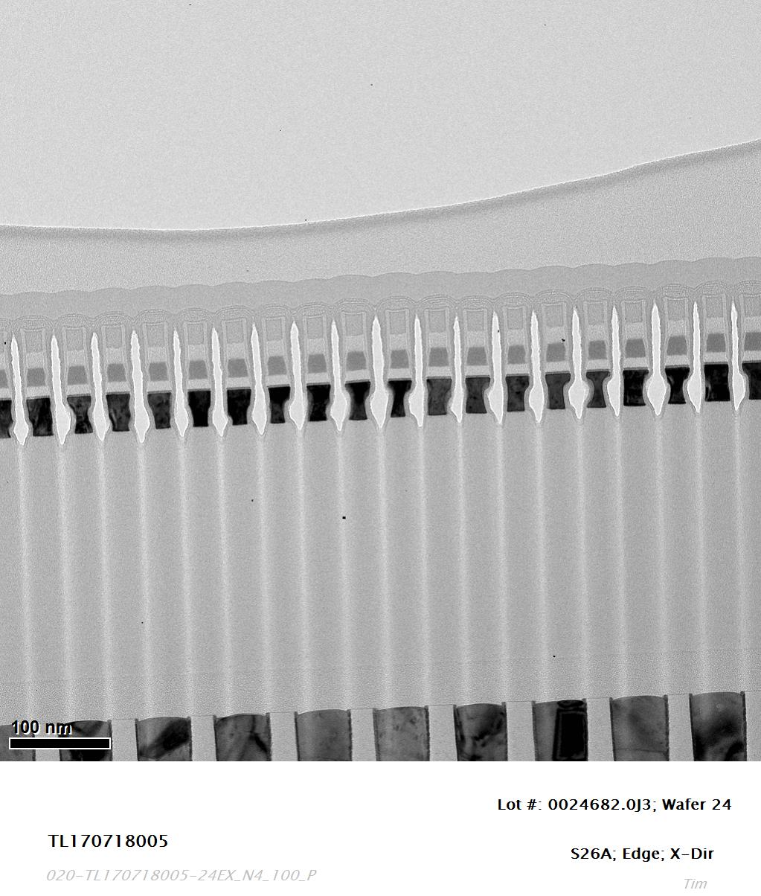

Slide 35
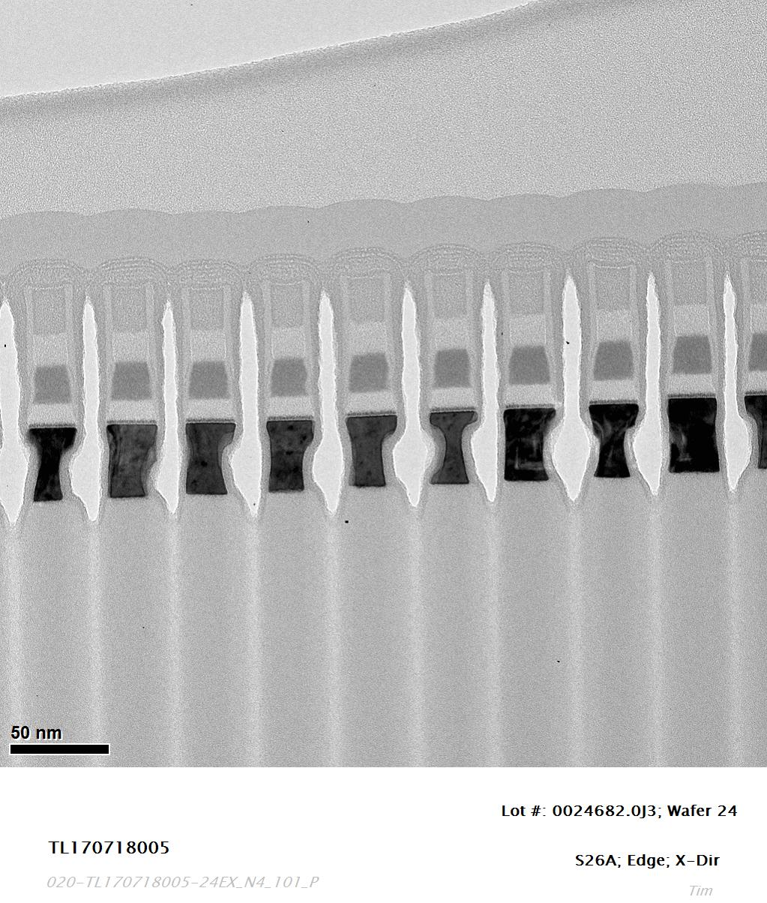

Slide 36
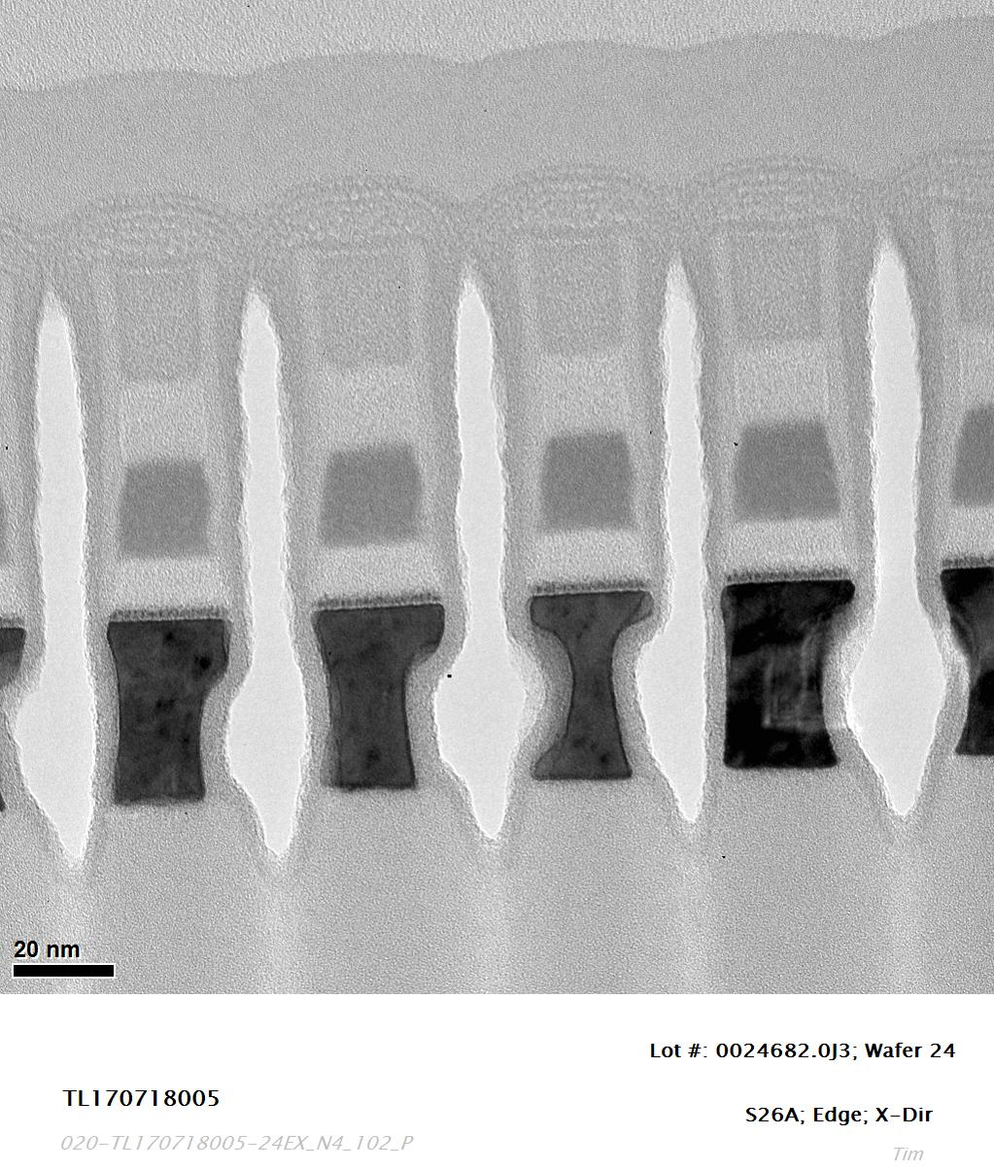

Slide 37
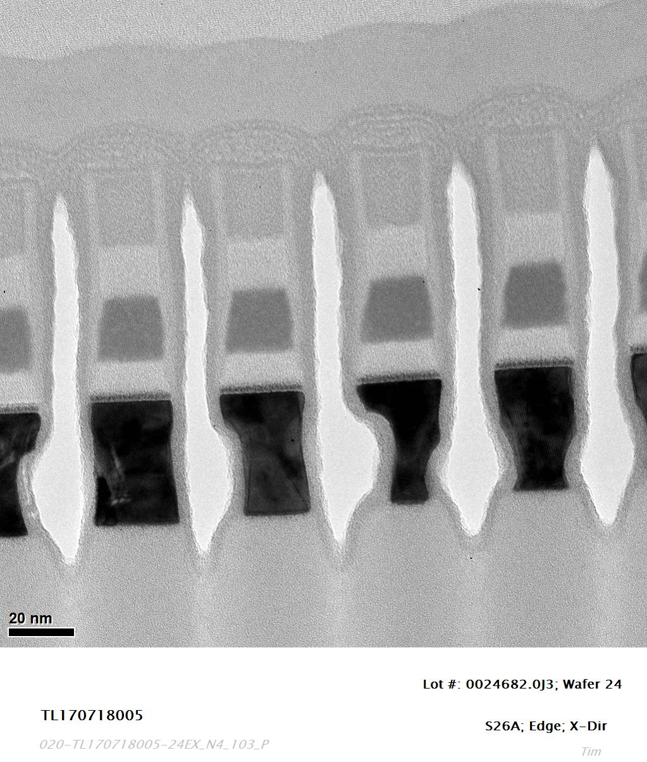

Slide 38
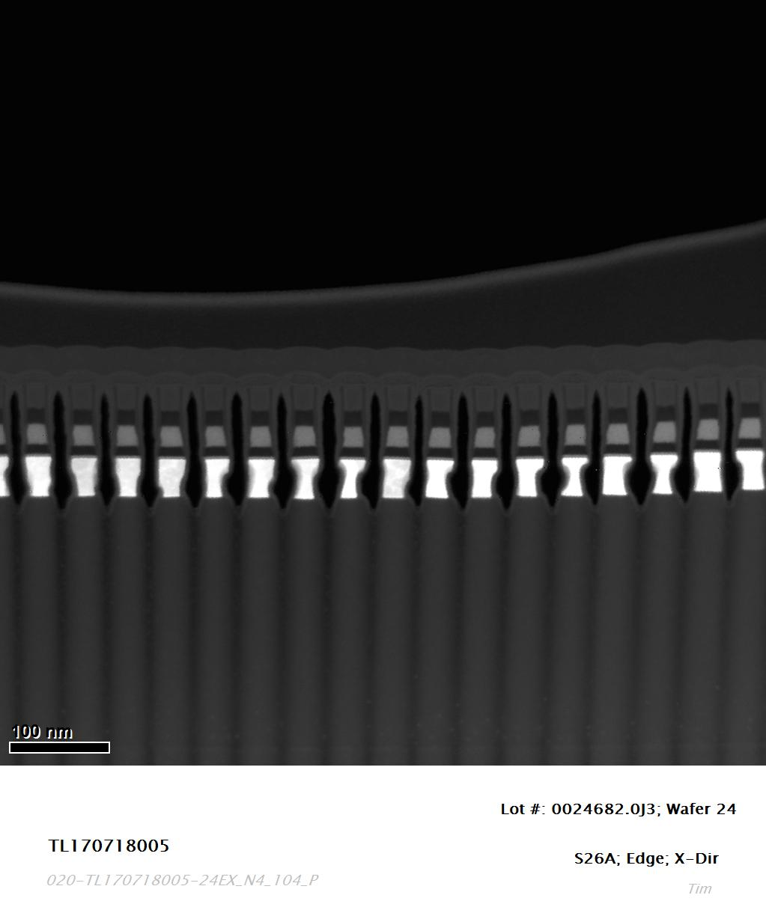
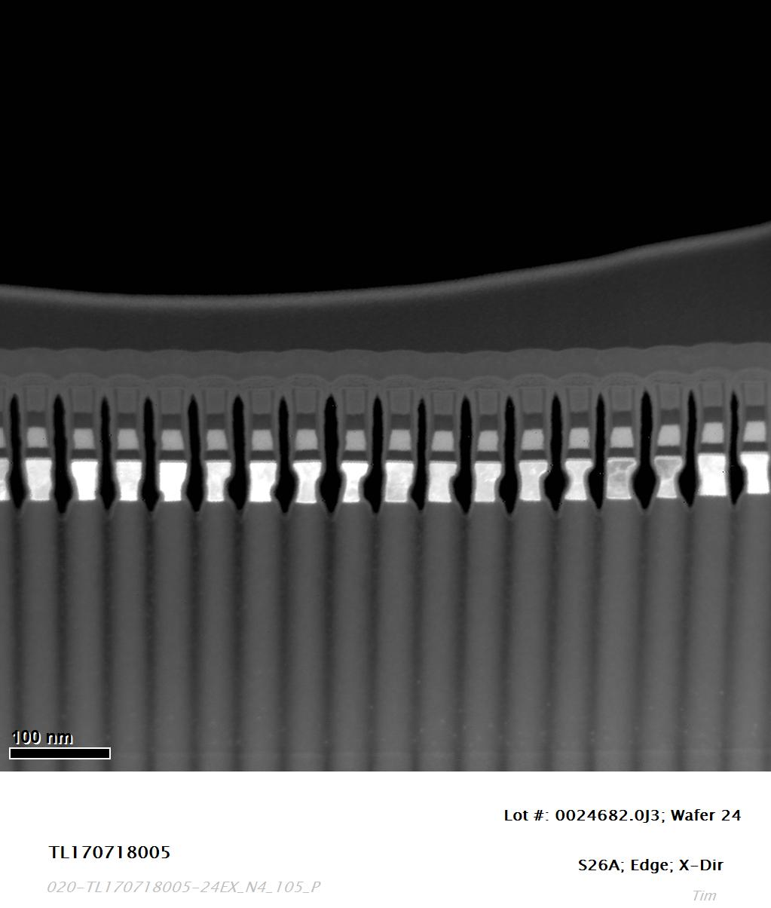

Slide 39
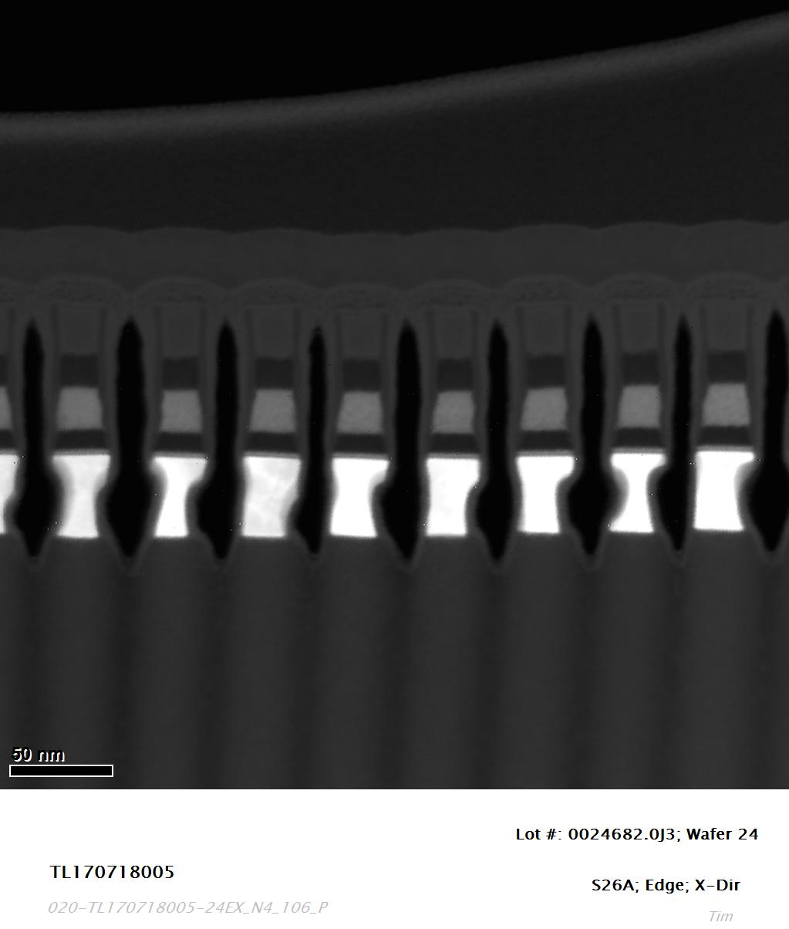
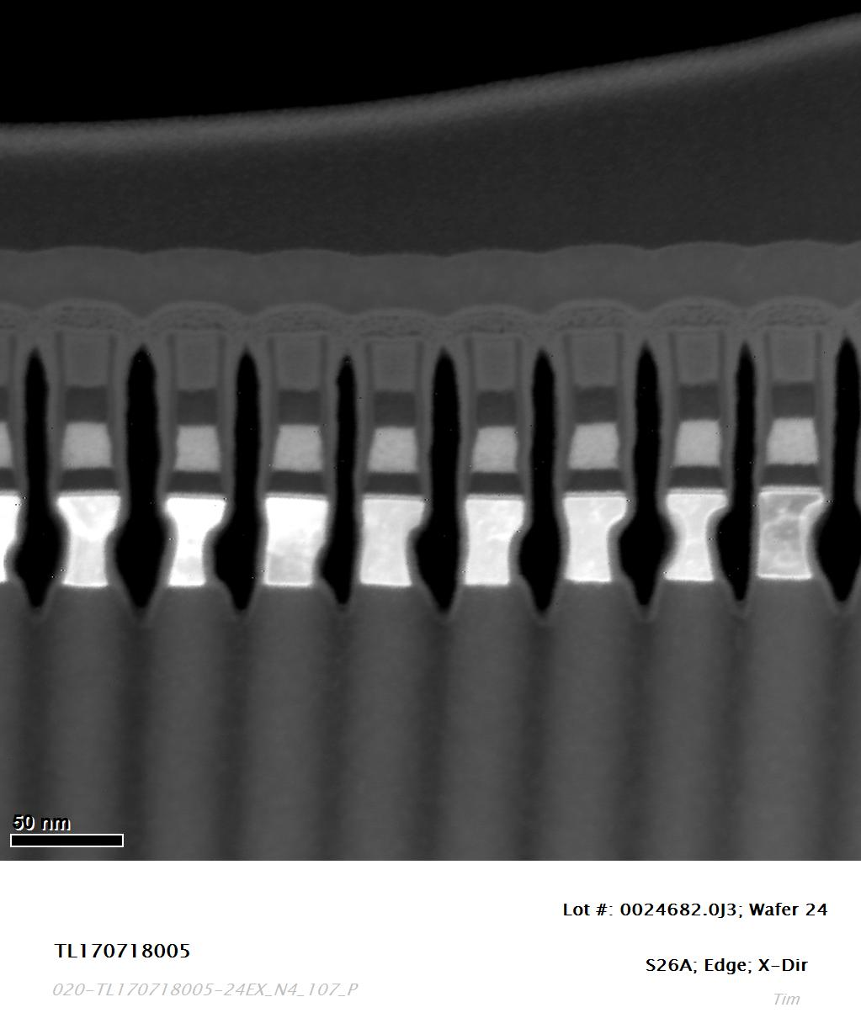

Slide 40
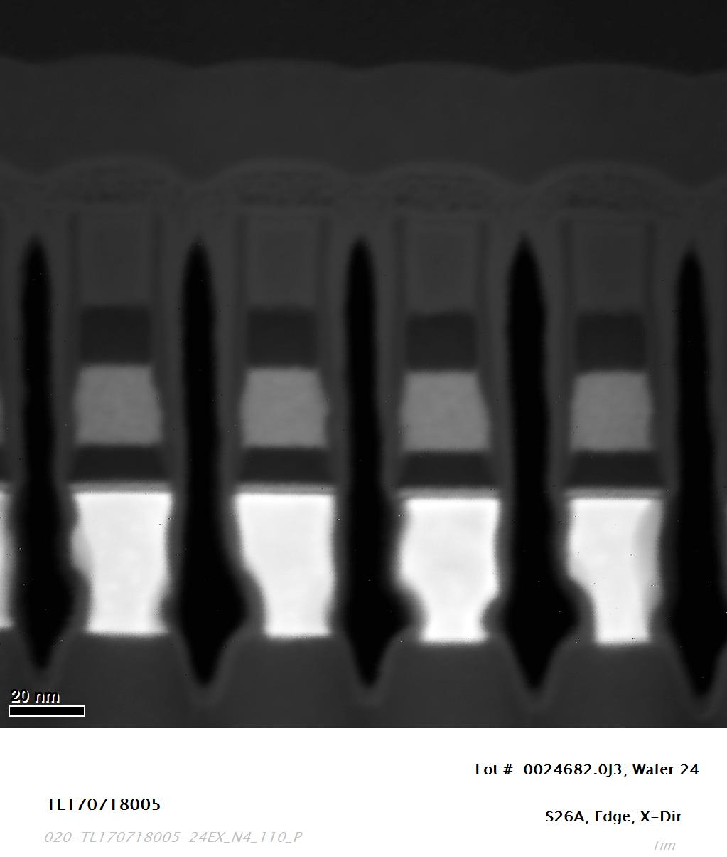
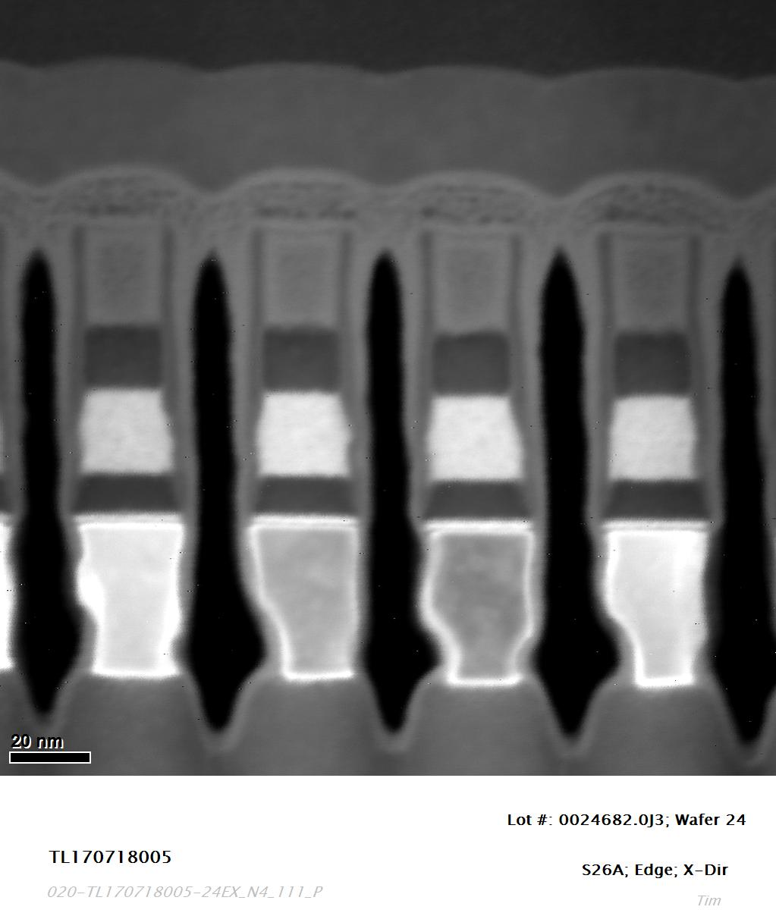

Slide 41
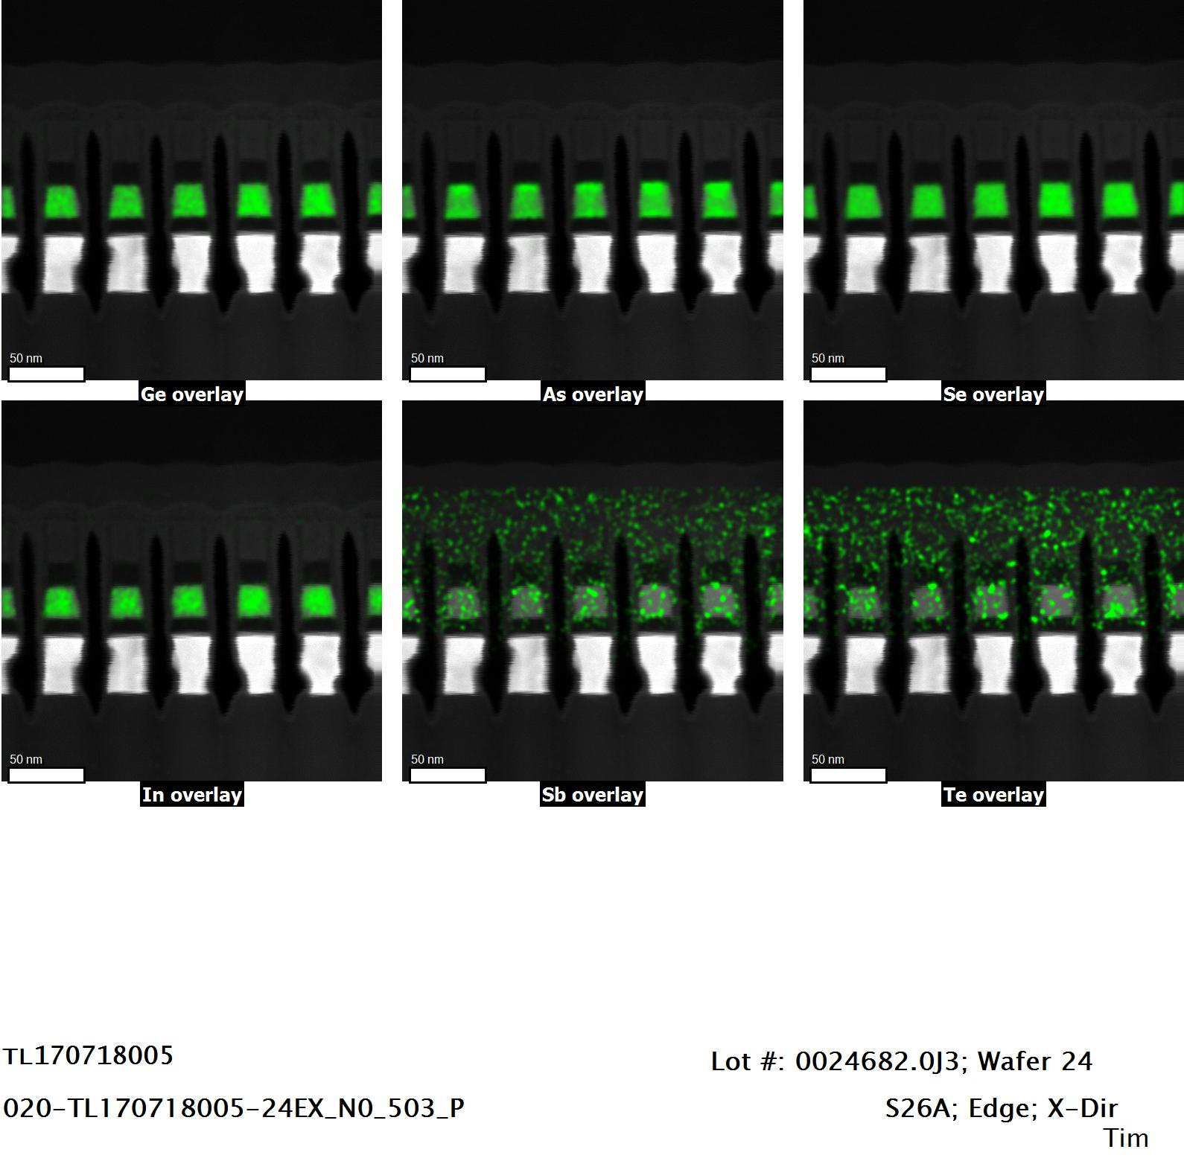
80kV EDS Mapping

Slide 42
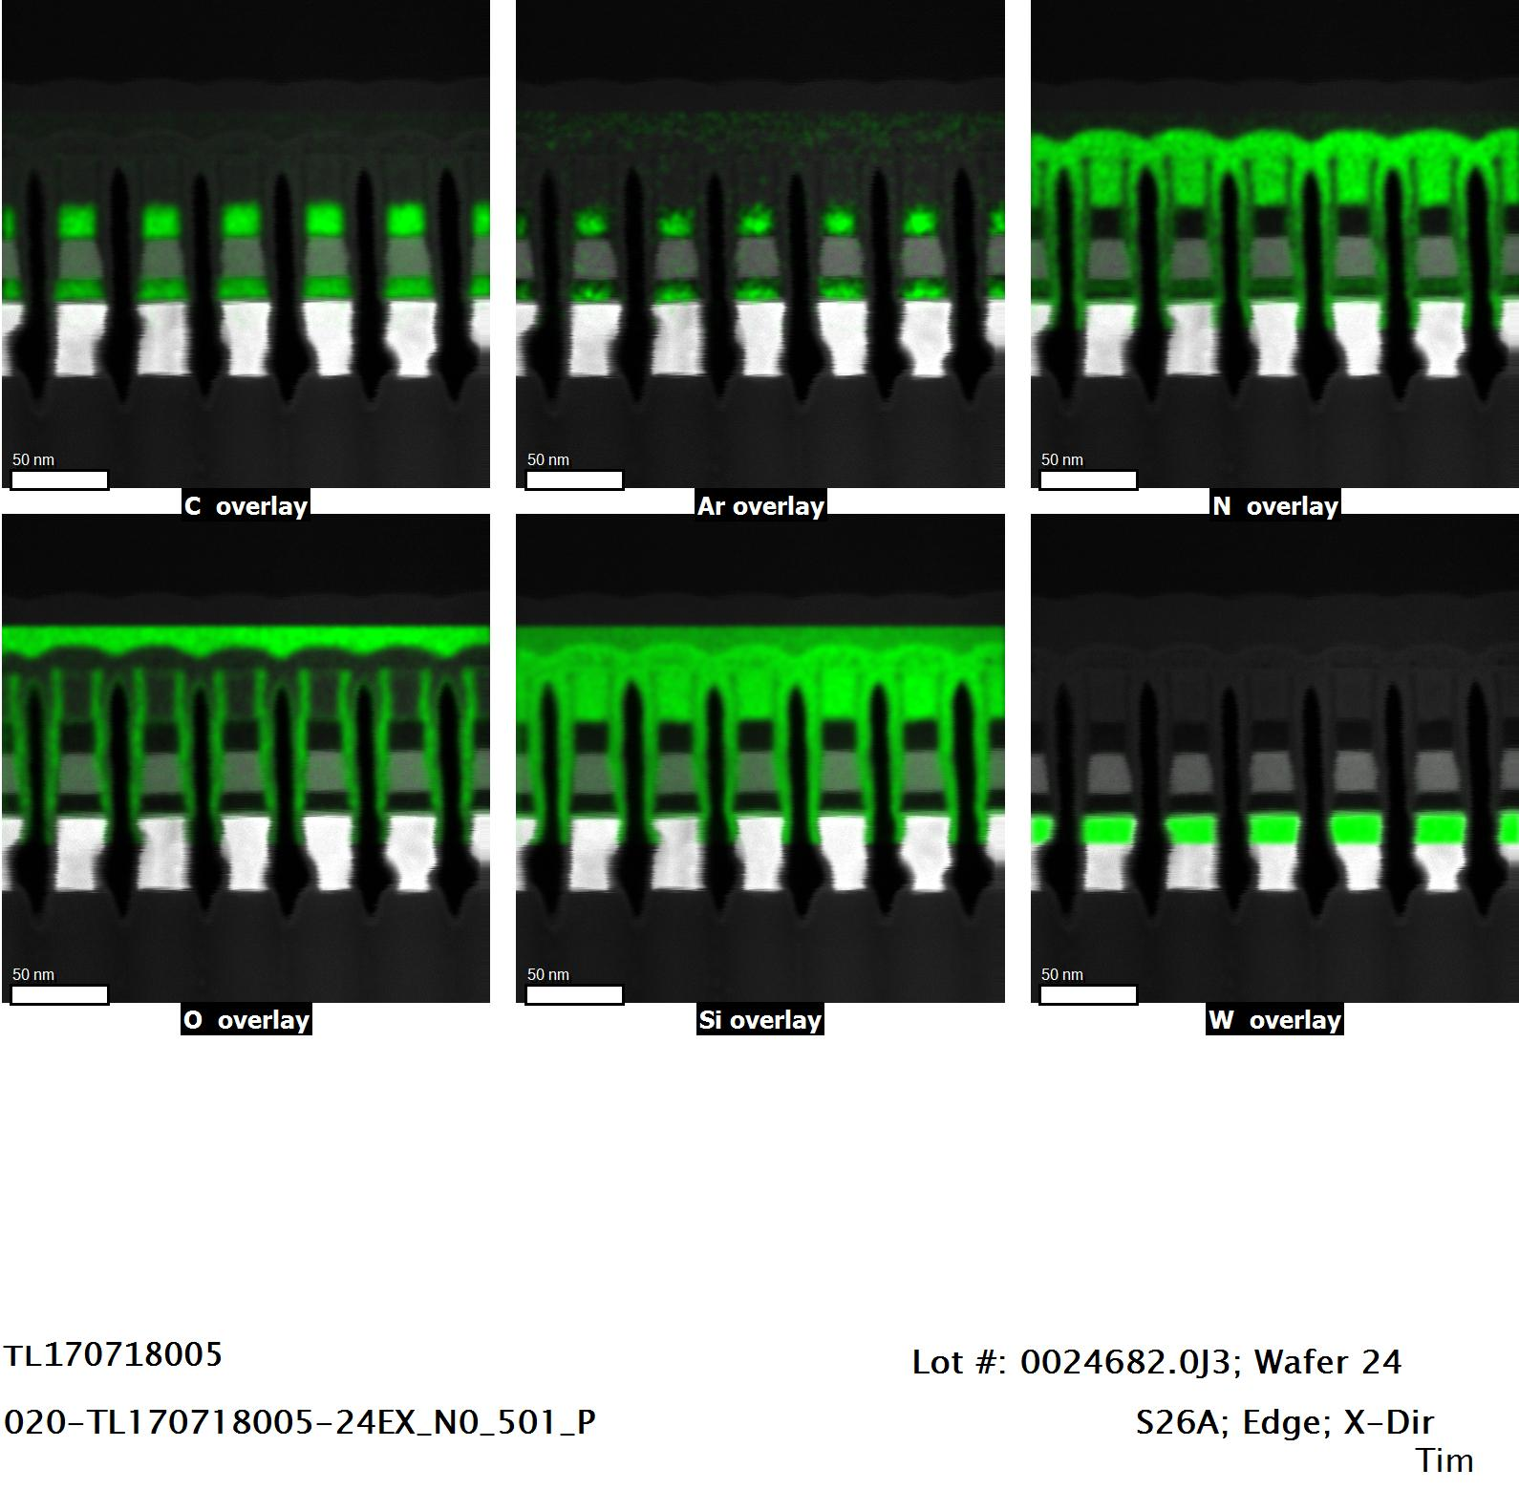
80kV EDS Mapping

Slide 43
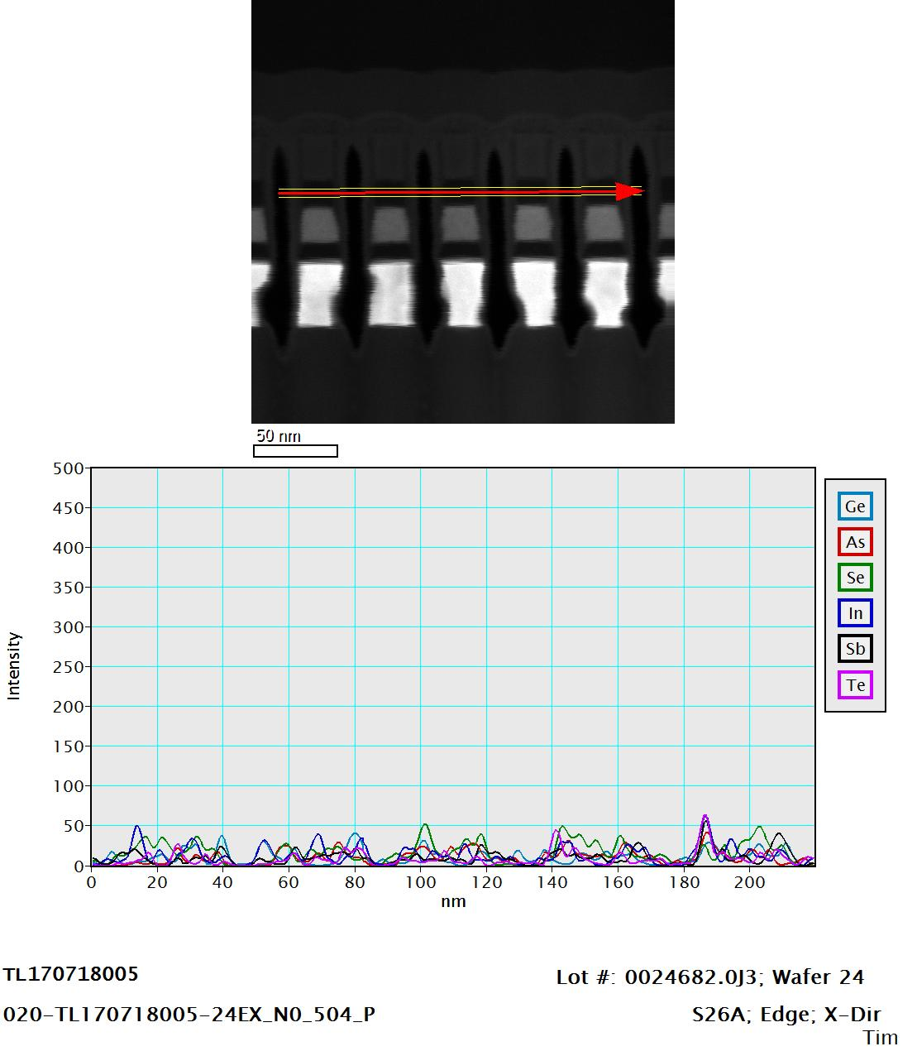
EDS Line Scan

Slide 44
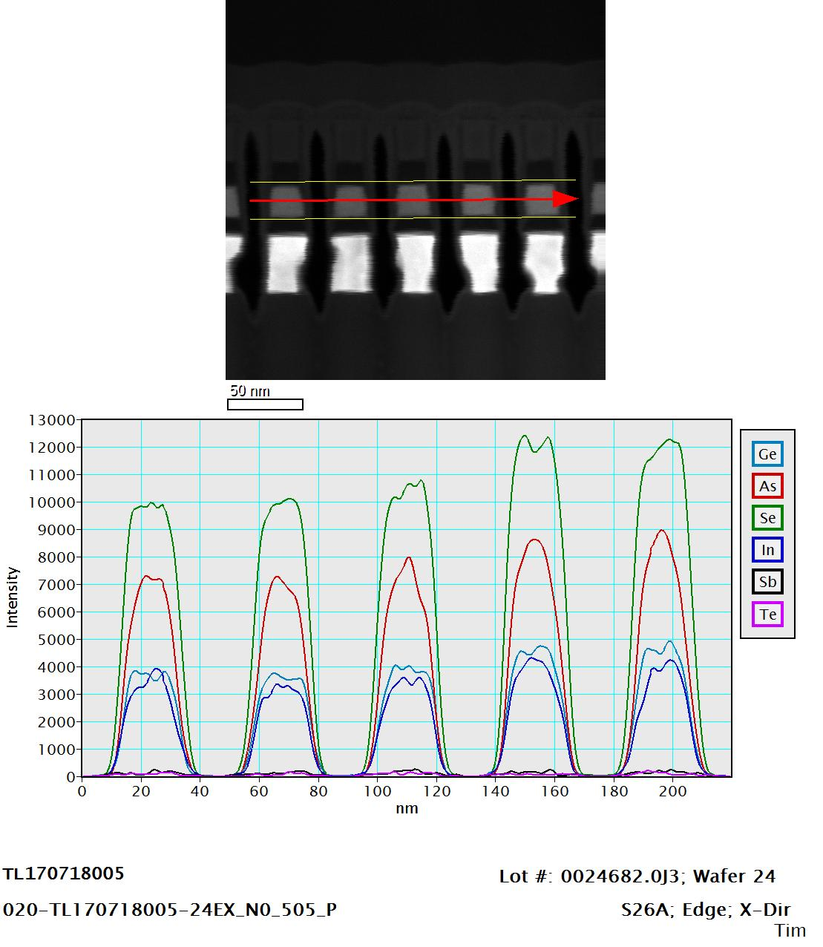
EDS Line Scan

Slide 45
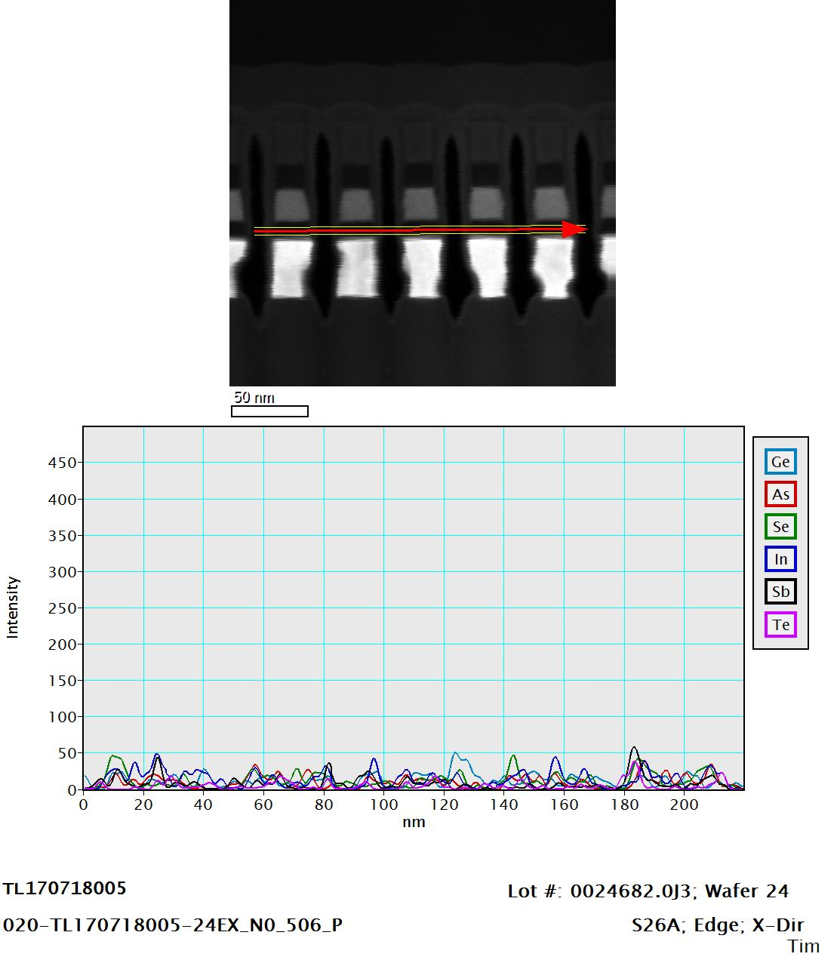
EDS Line Scan

Slide 46
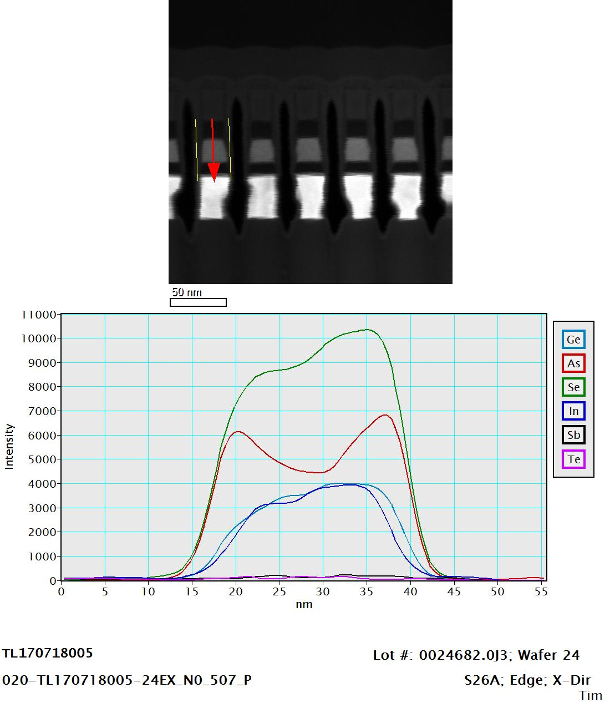
EDS Line Scan

Slide 47
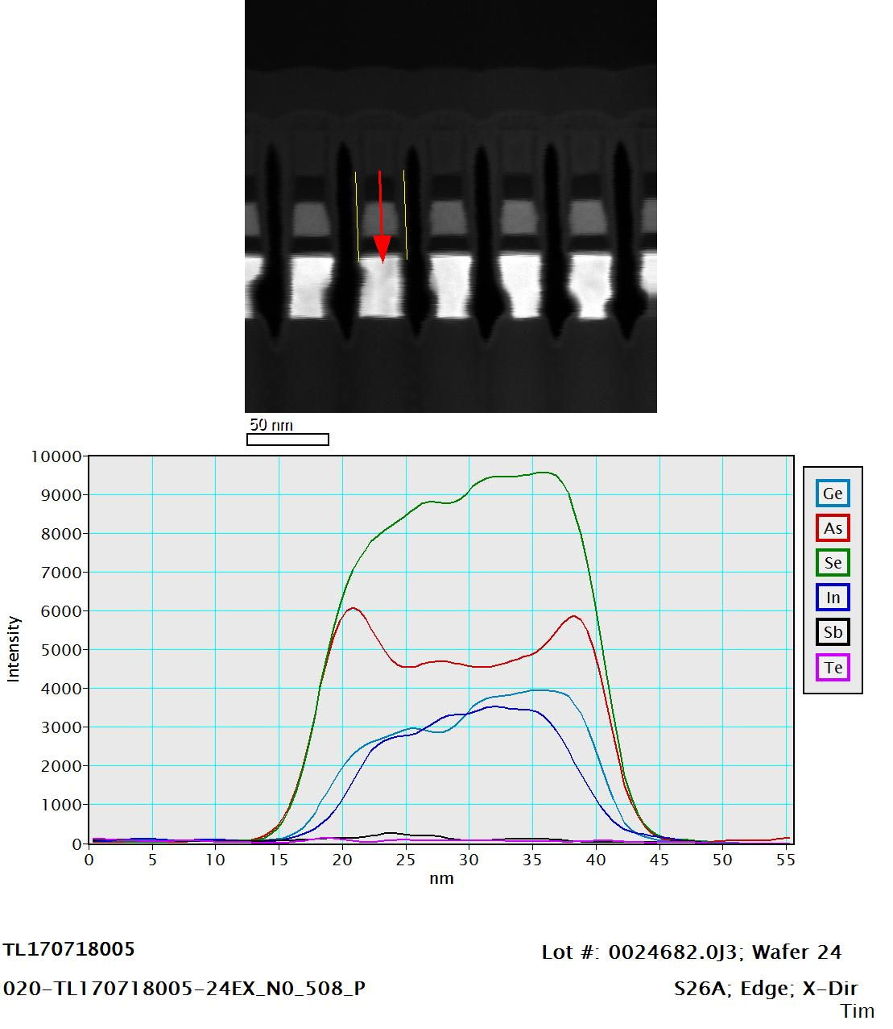
EDS Line Scan

Slide 48
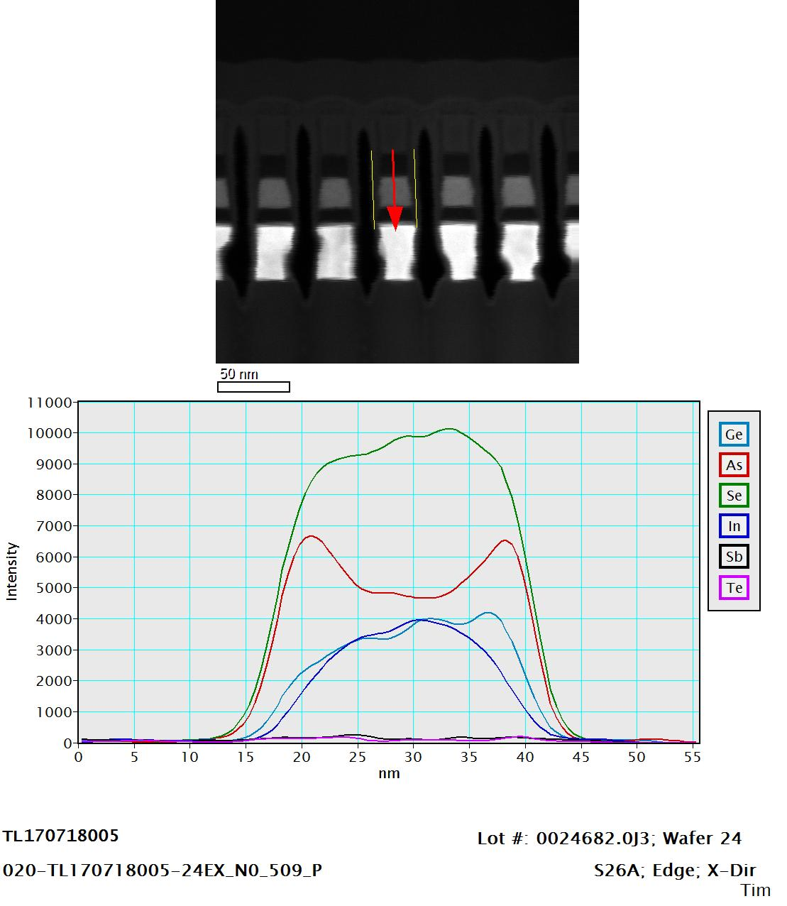
EDS Line Scan

Slide 49

EDS Line Scan

Slide 50

EDS Line Scan

Slide 51

80kV EDS Mapping

Slide 52

80kV EDS Mapping

Slide 53

EDS Line Scan

Slide 54

EDS Line Scan

Slide 55

EDS Line Scan

Slide 56

EDS Line Scan

Slide 57

EDS Line Scan

Slide 58

EDS Line Scan

Slide 59

EDS Line Scan

Slide 60

EDS Line Scan

Slide 61

EDS Atomic Percent Estimate
Sample | lot | wafer | design | location | direction | Deck Bit | SD Ge-K | SD As-K | SD Se-K | SD In-L | SD Sb-L | SD Te-L
020 | 0024682.0J3 | 24 | S26A | Edge | X-Dir | bit 1 | 14.2 | 27.13 | 49.9 | 8.74 | --- | 0.03
020 | 0024682.0J3 | 24 | S26A | Edge | X-Dir | bit 2 | 13.56 | 27.56 | 50.64 | 8.25 | --- | ---
020 | 0024682.0J3 | 24 | S26A | Edge | X-Dir | bit 3 | 14.41 | 27.08 | 50.24 | 8.11 | 0.08 | 0.08
020 | 0024682.0J3 | 24 | S26A | Edge | X-Dir | bit 4 | 13.84 | 26.5 | 51.38 | 8.28 | --- | ---
020 | 0024682.0J3 | 24 | S26A | Edge | X-Dir | bit 5 | 13.58 | 27.56 | 50.86 | 7.86 | 0.11 | 0.04

Slide 62

EDS Atomic Percent Estimate
Sample | lot | wafer | design | location | direction | Deck Bit | SD Ge-K | SD As-K | SD Se-K | SD In-L | SD Sb-L | SD Te-L
020 | 0024682.0J3 | 24 | S26A | Edge | X-Dir | bit 6 | 14.59 | 26.4 | 49.38 | 9.23 | 0.39 | ---
020 | 0024682.0J3 | 24 | S26A | Edge | X-Dir | bit 7 | 14.74 | 26.98 | 49.33 | 8.8 | 0.05 | 0.09
020 | 0024682.0J3 | 24 | S26A | Edge | X-Dir | bit 8 | 15.49 | 25.99 | 49.55 | 8.97 | --- | ---
020 | 0024682.0J3 | 24 | S26A | Edge | X-Dir | bit 9 | 14.36 | 26.12 | 50.42 | 9.04 | 0.06 | ---
020 | 0024682.0J3 | 24 | S26A | Edge | X-Dir | bit 10 | 13.83 | 27.9 | 48.95 | 9.32 | --- | ---

Slide 63
030
0024682.0J3-19
Center
X-Direction

Slide 64


Slide 65


Slide 66


Slide 67


Slide 68



Slide 69



Slide 70



Slide 71

80kV EDS Mapping

Slide 72

80kV EDS Mapping

Slide 73

EDS Line Scan

Slide 74

EDS Line Scan

Slide 75

EDS Line Scan

Slide 76

EDS Line Scan

Slide 77

EDS Line Scan

Slide 78

EDS Line Scan

Slide 79

EDS Line Scan

Slide 80

EDS Line Scan

Slide 81

80kV EDS Mapping

Slide 82

80kV EDS Mapping

Slide 83

EDS Line Scan

Slide 84

EDS Line Scan

Slide 85

EDS Line Scan

Slide 86

EDS Line Scan

Slide 87

EDS Line Scan

Slide 88

EDS Line Scan

Slide 89

EDS Line Scan

Slide 90

EDS Line Scan

Slide 91

EDS Atomic Percent Estimate
Sample | lot | wafer | design | location | direction | Deck Bit | SD Ge-K | SD As-K | SD Se-K | SD In-L | SD Sb-L | SD Te-L
030 | 0024682.0J3 | 19 | S26A | Center | X-Dir | bit 1 | 13.03 | 27.53 | 50.57 | 8.88 | --- | ---
030 | 0024682.0J3 | 19 | S26A | Center | X-Dir | bit 2 | 14 | 26.25 | 51.57 | 8.18 | --- | ---
030 | 0024682.0J3 | 19 | S26A | Center | X-Dir | bit 3 | 13.76 | 27 | 51.35 | 7.88 | --- | ---
030 | 0024682.0J3 | 19 | S26A | Center | X-Dir | bit 4 | 14.37 | 25.98 | 51.07 | 8.23 | 0.21 | 0.12
030 | 0024682.0J3 | 19 | S26A | Center | X-Dir | bit 5 | 13.47 | 26.89 | 51.33 | 8.29 | 0.02 | ---

Slide 92

EDS Atomic Percent Estimate
Sample | lot | wafer | design | location | direction | Deck Bit | SD Ge-K | SD As-K | SD Se-K | SD In-L | SD Sb-L | SD Te-L
030 | 0024682.0J3 | 19 | S26A | Center | X-Dir | bit 6 | 13.79 | 26.22 | 51.64 | 8.24 | 0.08 | 0.03
030 | 0024682.0J3 | 19 | S26A | Center | X-Dir | bit 7 | 13.99 | 25.99 | 50.53 | 9.42 | 0.01 | 0.06
030 | 0024682.0J3 | 19 | S26A | Center | X-Dir | bit 8 | 13.88 | 26.05 | 51.52 | 8.55 | --- | ---
030 | 0024682.0J3 | 19 | S26A | Center | X-Dir | bit 9 | 14.15 | 27.27 | 49.99 | 8.59 | --- | ---
030 | 0024682.0J3 | 19 | S26A | Center | X-Dir | bit 10 | 13.91 | 25.88 | 51.71 | 8.51 | --- | ---

Slide 93
040
0024682.0J3-19
Edge
X-Direction

Slide 94


Slide 95


Slide 96


Slide 97


Slide 98



Slide 99



Slide 100



Slide 101

80kV EDS Mapping

Slide 102

80kV EDS Mapping

Slide 103

EDS Line Scan

Slide 104

EDS Line Scan

Slide 105

EDS Line Scan

Slide 106

EDS Line Scan

Slide 107

EDS Line Scan

Slide 108

EDS Line Scan

Slide 109

EDS Line Scan

Slide 110

EDS Line Scan

Slide 111

80kV EDS Mapping

Slide 112

80kV EDS Mapping

Slide 113

EDS Line Scan

Slide 114

EDS Line Scan

Slide 115

EDS Line Scan

Slide 116

EDS Line Scan

Slide 117

EDS Line Scan

Slide 118

EDS Line Scan

Slide 119

EDS Line Scan

Slide 120

EDS Line Scan

Slide 121

EDS Atomic Percent Estimate
Sample | lot | wafer | design | location | direction | Deck Bit | SD Ge-K | SD As-K | SD Se-K | SD In-L | SD Sb-L | SD Te-L
040 | 0024682.0J3 | 19 | S26A | Edge | X-Dir | bit 1 | 14.95 | 27.14 | 50.4 | 7.35 | 0.16 | ---
040 | 0024682.0J3 | 19 | S26A | Edge | X-Dir | bit 2 | 13.01 | 27.85 | 51.06 | 7.81 | 0.23 | 0.04
040 | 0024682.0J3 | 19 | S26A | Edge | X-Dir | bit 3 | 14.43 | 26.44 | 51.32 | 7.72 | --- | 0.09
040 | 0024682.0J3 | 19 | S26A | Edge | X-Dir | bit 4 | 13.89 | 27.88 | 51.19 | 7.05 | --- | ---
040 | 0024682.0J3 | 19 | S26A | Edge | X-Dir | bit 5 | 14.8 | 25.22 | 52.07 | 7.91 | --- | ---

Slide 122

EDS Atomic Percent Estimate
Sample | lot | wafer | design | location | direction | Deck Bit | SD Ge-K | SD As-K | SD Se-K | SD In-L | SD Sb-L | SD Te-L
040 | 0024682.0J3 | 19 | S26A | Edge | X-Dir | bit 6 | 15.08 | 26.96 | 50.15 | 7.81 | --- | ---
040 | 0024682.0J3 | 19 | S26A | Edge | X-Dir | bit 7 | 13.96 | 26.25 | 51.09 | 8.43 | 0.26 | ---
040 | 0024682.0J3 | 19 | S26A | Edge | X-Dir | bit 8 | 13 | 28.1 | 51.12 | 7.77 | --- | ---
040 | 0024682.0J3 | 19 | S26A | Edge | X-Dir | bit 9 | 13.97 | 26.39 | 50.99 | 8.31 | 0.13 | 0.2
040 | 0024682.0J3 | 19 | S26A | Edge | X-Dir | bit 10 | 14.29 | 26.9 | 50.12 | 8.46 | --- | 0.23

