Slide 1
TL170718004
SD only SSM flow on S26A WL etch development with In doped SD stack; PROD SWR # 8527404 group 3E,4E:
Prepared by : Hongqi Li/John Jin

Slide 2
Job Description
wf#25 group 3E: SSM SD 22nm 2% In; 21s SD etch no SO2; 15/22s W etch wf#23 group 4E: SSM SD 22nm 5% In; 21s SD etch no SO2; 15/22s W etch
Need EDS composition estimates, maps, and line scan across TE,BE and SD.
Including Si/O/N/Al maps in addition to chalc. composition elements.

Slide 3
Sample ID

Slide 4
Item #: 010
Lot #: 0024682.0J3
Wafer #: 25
Part type: S26A
Location: Center; X-Dir

Slide 5
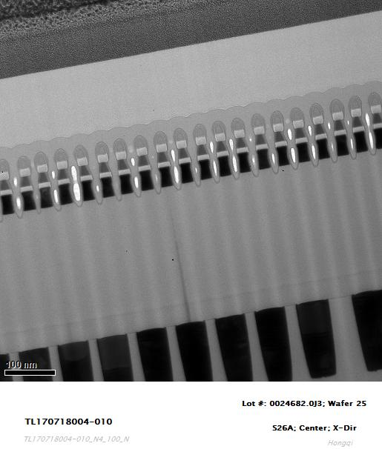
TEM Image

Slide 6
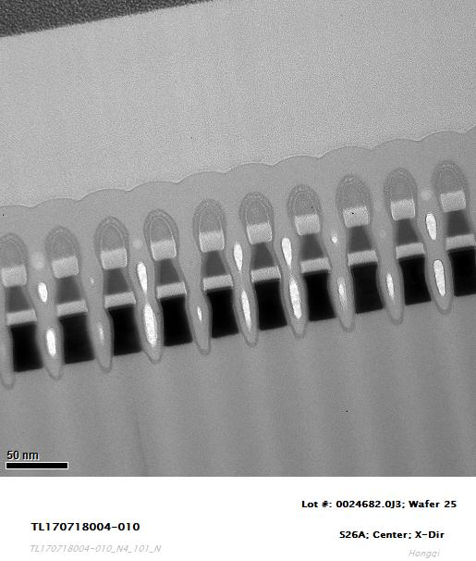
TEM Image

Slide 7
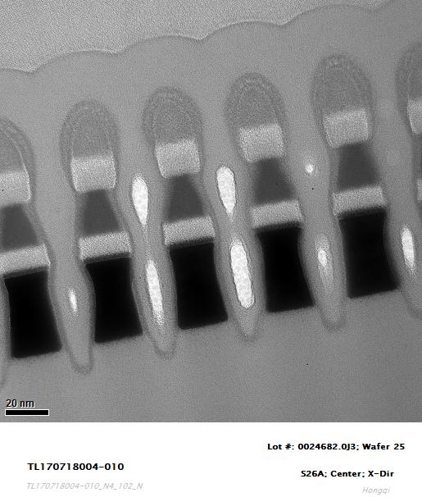
TEM Image

Slide 8
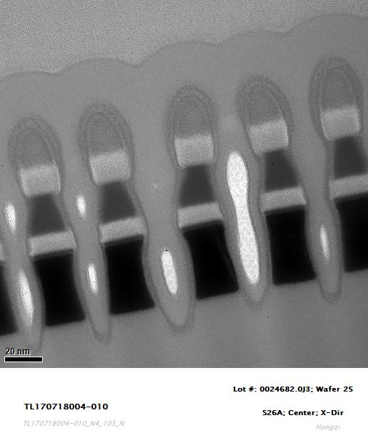
TEM Image

Slide 9
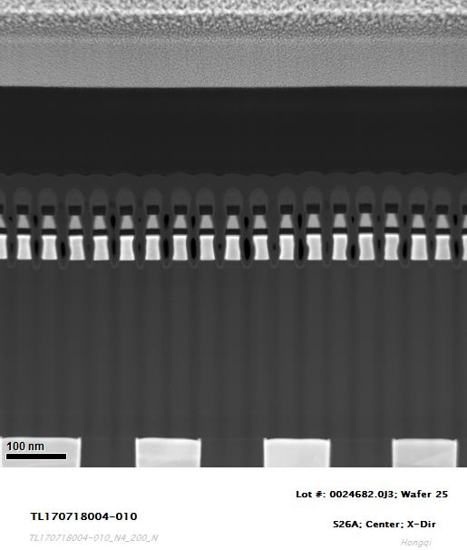
STEM Image

Slide 10
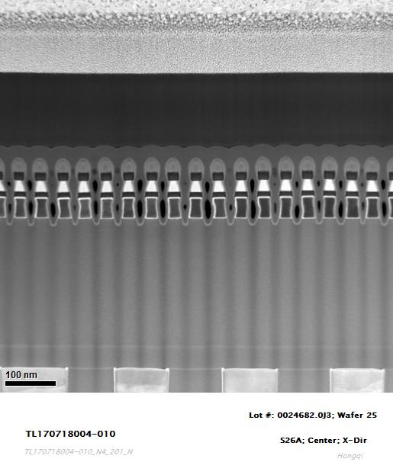
STEM Image

Slide 11
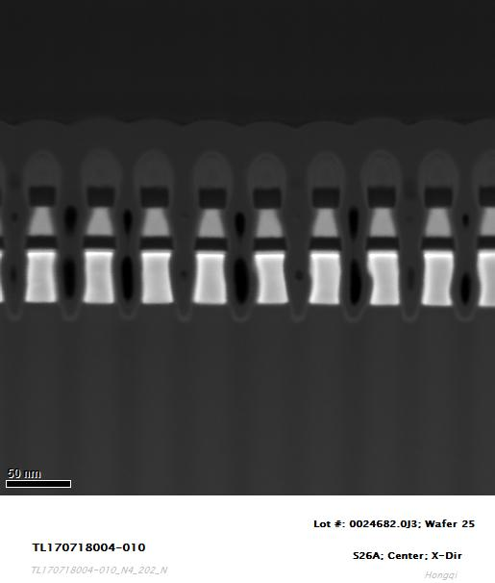
STEM Image

Slide 12
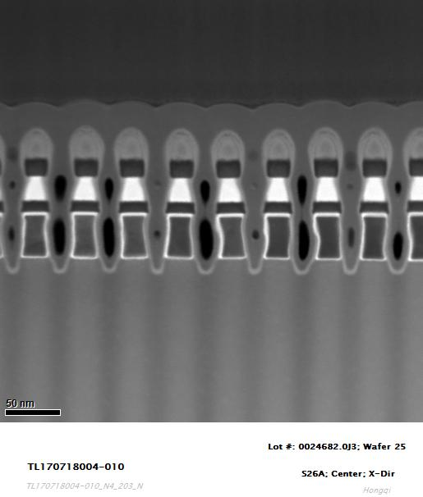
STEM Image

Slide 13
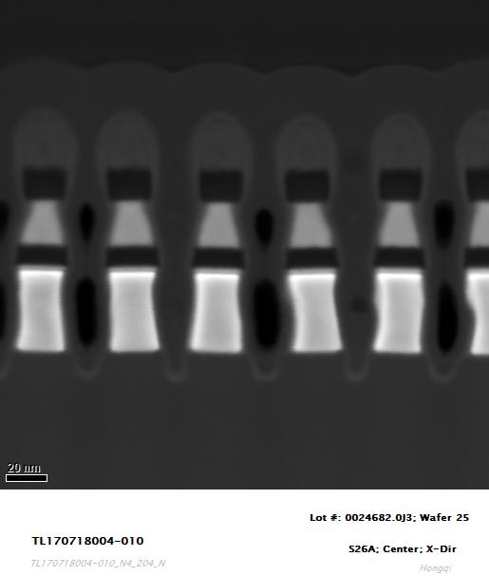
STEM Image

Slide 14
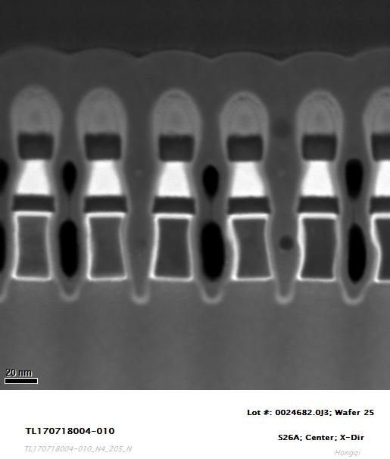
STEM Image

Slide 15
EDS Element Mapping
In map
Sb map
Te map
Se map
As map
Ge map

Slide 16
EDS Element Mapping
C map
O map
Si map
N map
W map
Ar map

Slide 17
EDS Element Line Scan

Slide 18
EDS Element Line Scan

Slide 19
EDS Element Line Scan

Slide 20
EDS Element Line Scan

Slide 21
EDS Element Line Scan

Slide 22
EDS Element Line Scan

Slide 23
EDS Element Line Scan

Slide 24
EDS Element Line Scan

Slide 25
Item #: 020
Lot #: 0024682.0J3
Wafer #: 25
Part type: S26A
Location: Edge; X-Dir

Slide 26
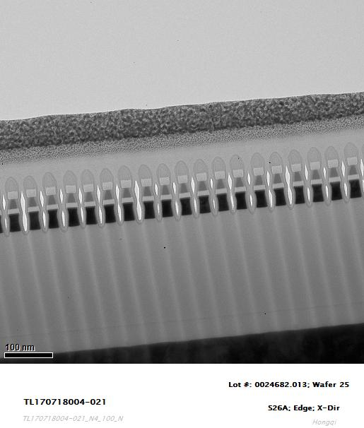
TEM Image

Slide 27
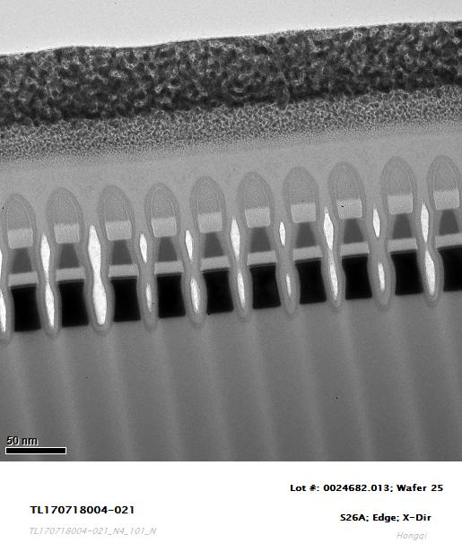
TEM Image

Slide 28
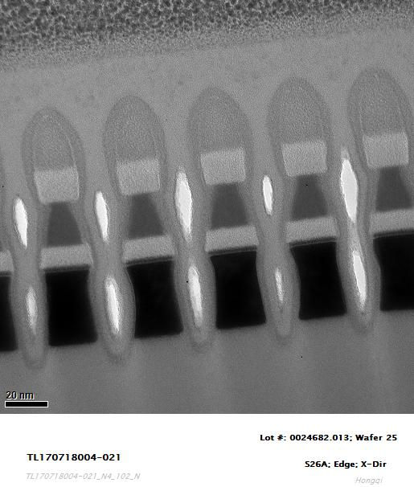
TEM Image

Slide 29
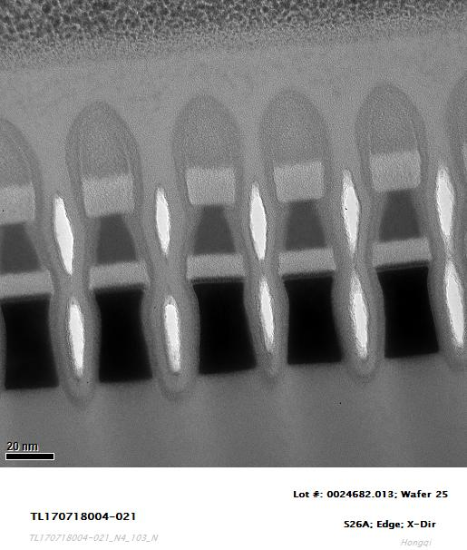
TEM Image

Slide 30
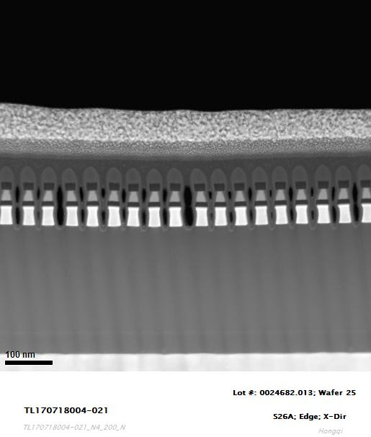
STEM Image

Slide 31
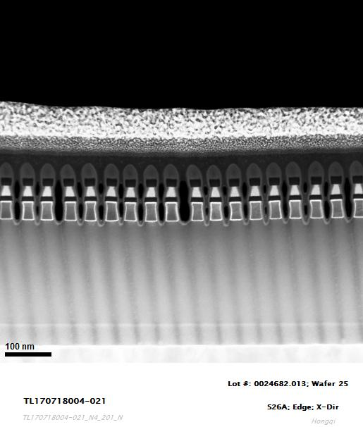
STEM Image

Slide 32
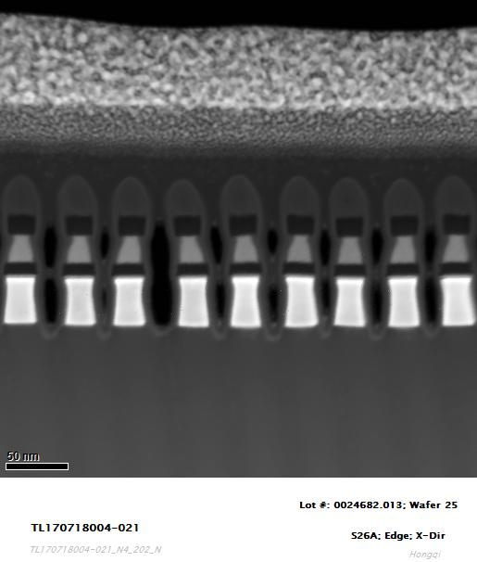
STEM Image

Slide 33
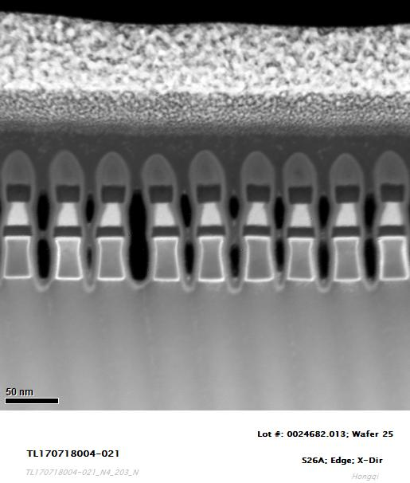
STEM Image

Slide 34
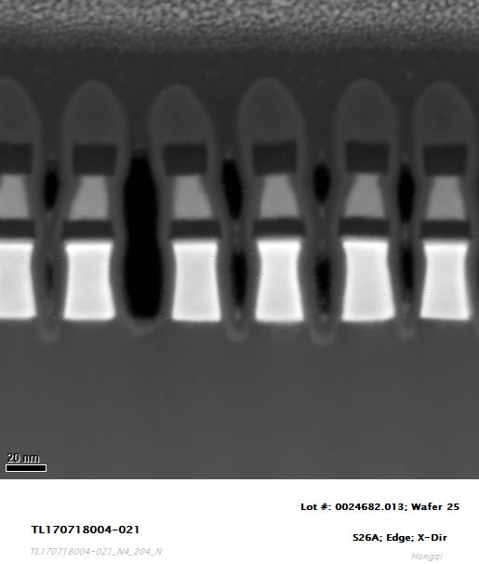
STEM Image

Slide 35
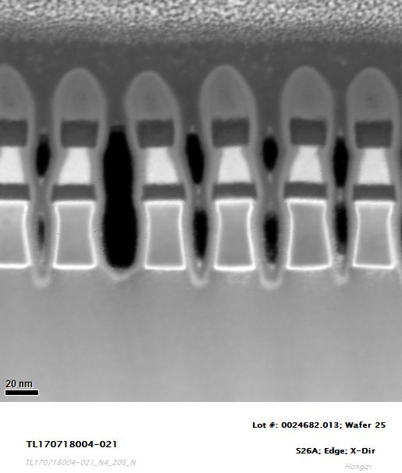
STEM Image

Slide 36
EDS Element Mapping
In map
Sb map
Te map
Se map
As map
Ge map

Slide 37
EDS Element Mapping
C map
O map
Si map
N map
W map
Ar map

Slide 38
EDS Element Line Scan

Slide 39
EDS Element Line Scan

Slide 40
EDS Element Line Scan

Slide 41
EDS Element Line Scan

Slide 42
EDS Element Line Scan

Slide 43
EDS Element Line Scan

Slide 44
EDS Element Line Scan

Slide 45
EDS Element Line Scan

Slide 46
Item #: 030
Lot #: 0024682.0J3
Wafer #: 23
Part type: S26A
Location: Center; X-Dir

Slide 47
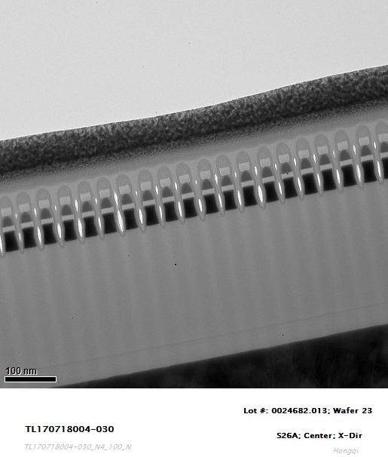
TEM Image

Slide 48
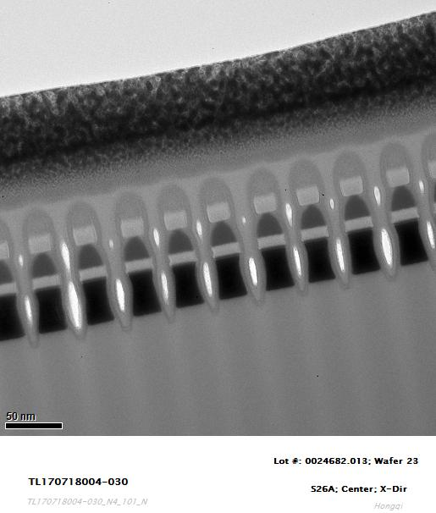
TEM Image

Slide 49
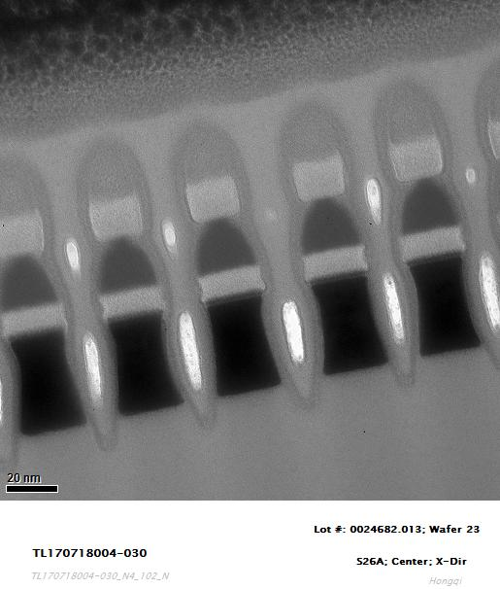
TEM Image

Slide 50
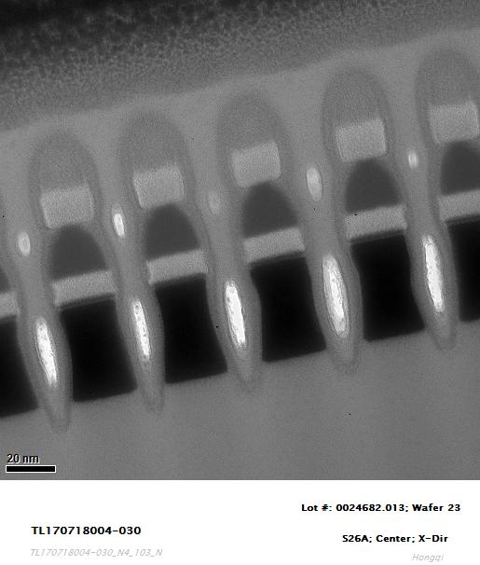
TEM Image

Slide 51
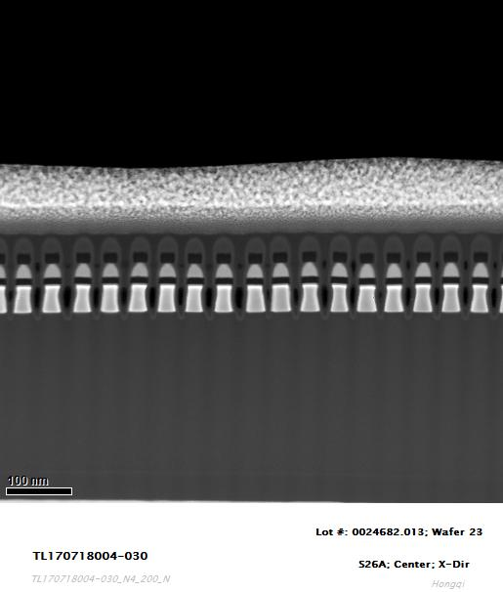
STEM Image

Slide 52
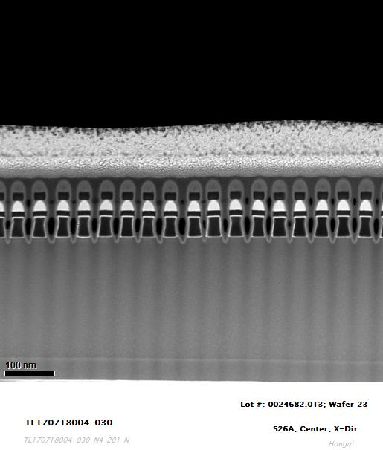
STEM Image

Slide 53
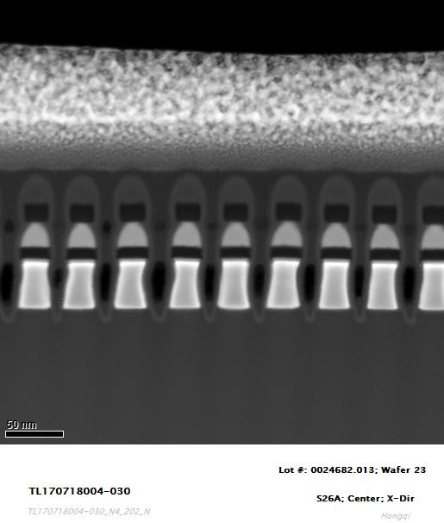
STEM Image

Slide 54
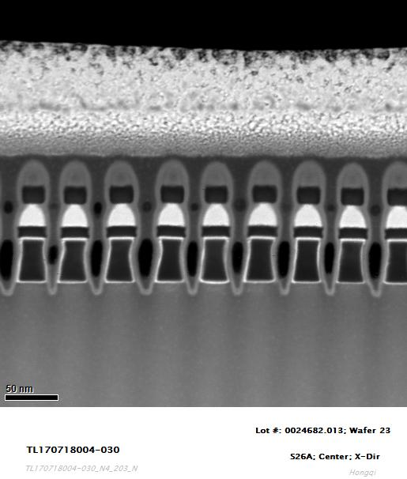
STEM Image

Slide 55
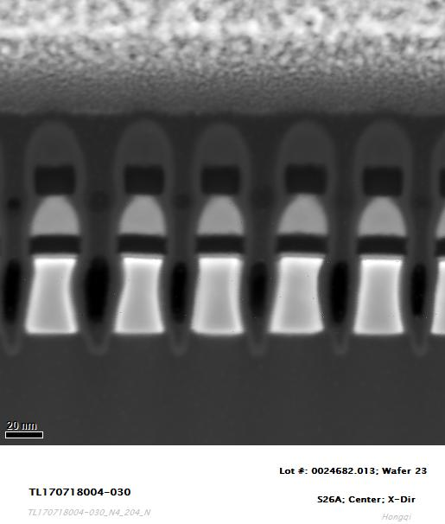
STEM Image

Slide 56
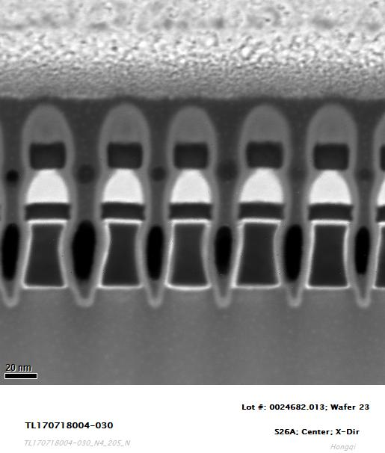
STEM Image

Slide 57
EDS Element Mapping
In map
Sb map
Te map
Se map
As map
Ge map

Slide 58
EDS Element Mapping
C map
O map
Si map
N map
W map
Ar map

Slide 59
EDS Element Line Scan

Slide 60
EDS Element Line Scan

Slide 61
EDS Element Line Scan

Slide 62
EDS Element Line Scan

Slide 63
EDS Element Line Scan

Slide 64
EDS Element Line Scan

Slide 65
EDS Element Line Scan

Slide 66
EDS Element Line Scan

Slide 67
Item #: 040
Lot #: 0024682.0J3
Wafer #: 23
Part type: S26A
Location: Edge; X-Dir

Slide 68
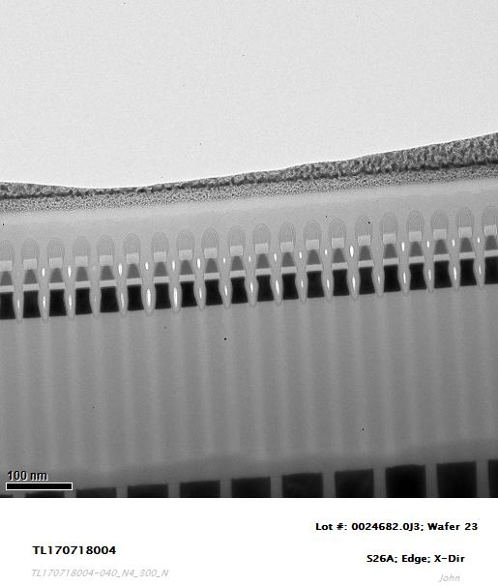
TEM Image

Slide 69
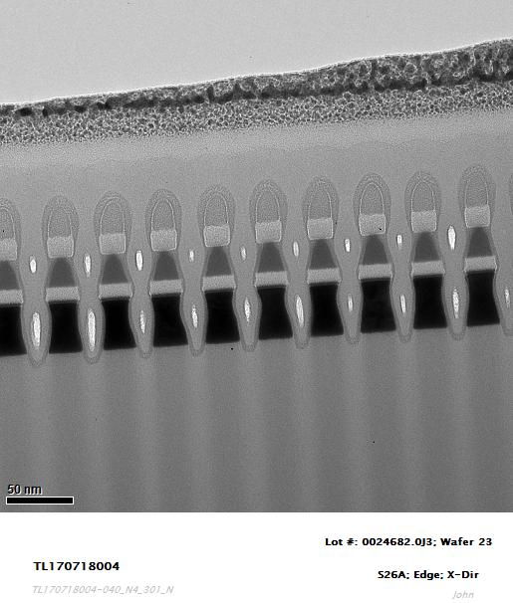
TEM Image

Slide 70
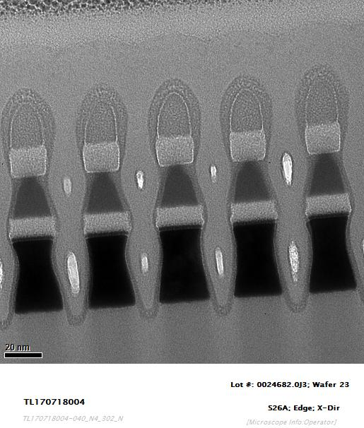
TEM Image

Slide 71
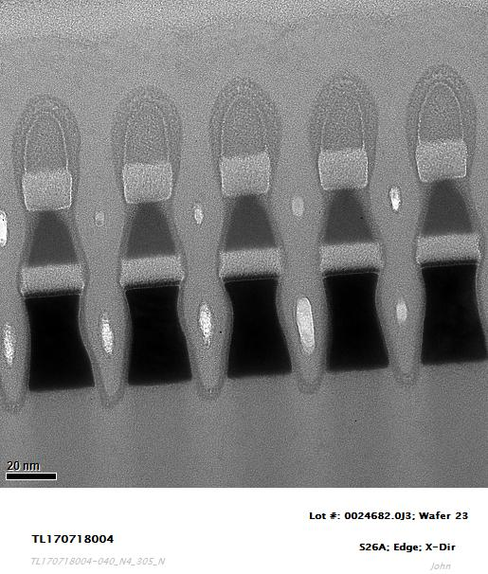
TEM Image

Slide 72
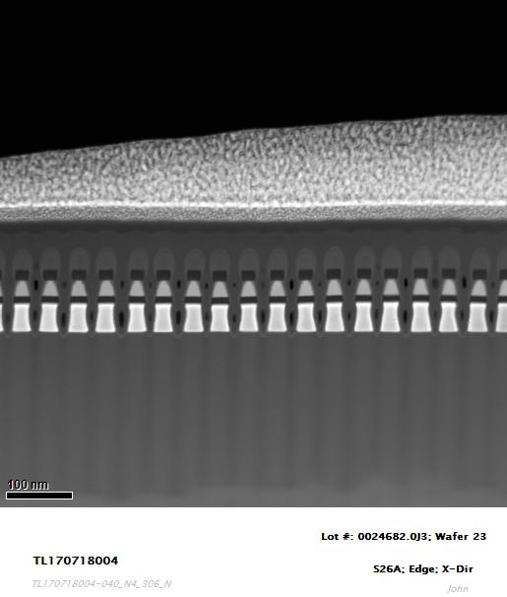
STEM Image

Slide 73
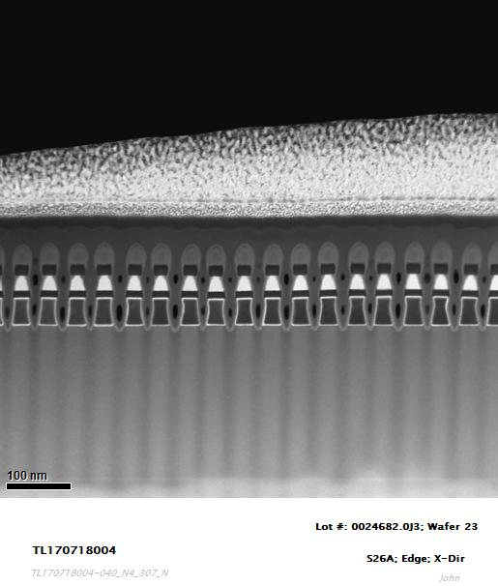
STEM Image

Slide 74
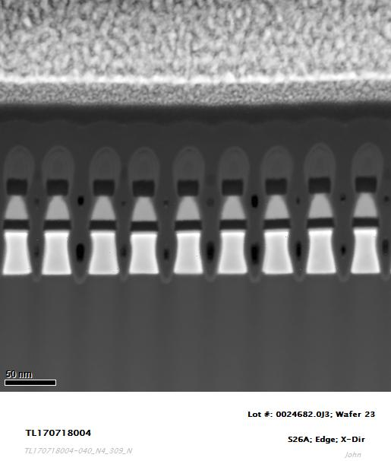
STEM Image

Slide 75
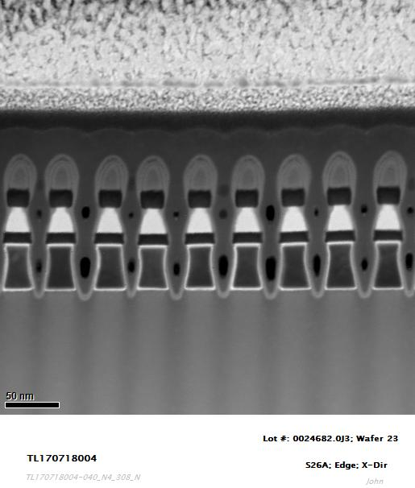
STEM Image

Slide 76
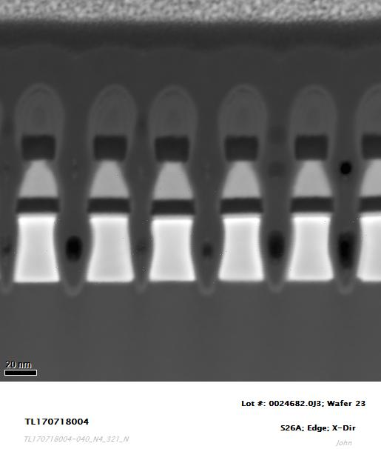
STEM Image

Slide 77
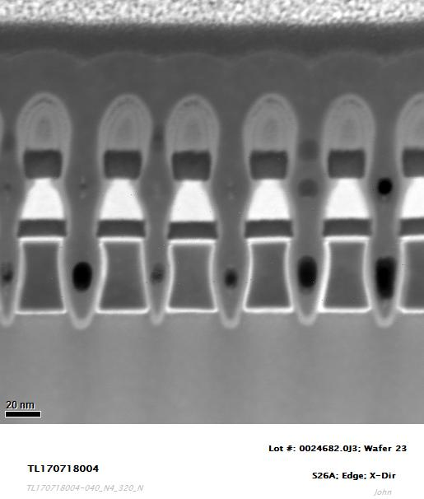
STEM Image

Slide 78
EDS Element Mapping
In map
Sb map
Te map
Se map
As map
Ge map

Slide 79
EDS Element Mapping
C map
O map
Si map
N map
W map
Ar map

Slide 80
EDS Element Line Scan

Slide 81
EDS Element Line Scan

Slide 82
EDS Element Line Scan

Slide 83
EDS Element Line Scan

Slide 84
EDS Element Line Scan

Slide 85
EDS Element Line Scan

Slide 86
EDS Element Line Scan

Slide 87
EDS Element Line Scan

Slide 88
EDS Element Composition Estimate: at.%
Job ID | Sample ID | Lot ID | Wafer ID | Die XY | Cut Dir | Bit | PM Ge | PM As | PM Se | PM In | PM Sb | PM Te | SD Ge | SD As | SD Se | SD In | SD Sb | SD Te
TL170718004 | 010 | 0024682.0J3 | 25 | Center | X | 1 |  |  |  |  |  |  | 14.29 | 27.10 | 53.06 | 5.55
TL170718004 | 010 | 0024682.0J3 | 25 | Center | X | 2 |  |  |  |  |  |  | 13.84 | 27.58 | 53.48 | 5.10
TL170718004 | 010 | 0024682.0J3 | 25 | Center | X | 3 |  |  |  |  |  |  | 13.82 | 27.35 | 53.44 | 5.39
TL170718004 | 010 | 0024682.0J3 | 25 | Center | X | 4 |  |  |  |  |  |  | 14.45 | 27.38 | 54.02 | 4.15
TL170718004 | 010 | 0024682.0J3 | 25 | Center | X | 5 |  |  |  |  |  |  | 13.78 | 28.24 | 52.83 | 5.15
TL170718004 | 010 | 0024682.0J3 | 25 | Center | X | 6 |  |  |  |  |  |  | 14.05 | 26.92 | 54.03 | 5.00
TL170718004 | 010 | 0024682.0J3 | 25 | Center | X | 7 |  |  |  |  |  |  | 14.76 | 26.83 | 53.99 | 4.42
TL170718004 | 010 | 0024682.0J3 | 25 | Center | X | 8 |  |  |  |  |  |  | 14.05 | 27.67 | 53.70 | 4.58
TL170718004 | 010 | 0024682.0J3 | 25 | Center | X | 9 |  |  |  |  |  |  | 14.29 | 27.04 | 54.02 | 4.65
TL170718004 | 010 | 0024682.0J3 | 25 | Center | X | 10 |  |  |  |  |  |  | 14.17 | 27.68 | 53.16 | 4.99

Slide 89
EDS Element Composition Estimate: at.%
Job ID | Sample ID | Lot ID | Wafer ID | Die XY | Cut Dir | Bit | PM Ge | PM As | PM Se | PM In | PM Sb | PM Te | SD Ge | SD As | SD Se | SD In | SD Sb | SD Te
TL170718004 | 020 | 0024682.0J3 | 25 | Edge | X | 1 |  |  |  |  |  |  | 14.15 | 26.98 | 54.36 | 4.51
TL170718004 | 020 | 0024682.0J3 | 25 | Edge | X | 2 |  |  |  |  |  |  | 13.99 | 26.70 | 54.75 | 4.56
TL170718004 | 020 | 0024682.0J3 | 25 | Edge | X | 3 |  |  |  |  |  |  | 14.01 | 26.52 | 54.58 | 4.89
TL170718004 | 020 | 0024682.0J3 | 25 | Edge | X | 4 |  |  |  |  |  |  | 13.99 | 27.59 | 54.42 | 4.00
TL170718004 | 020 | 0024682.0J3 | 25 | Edge | X | 5 |  |  |  |  |  |  | 14.04 | 26.94 | 54.84 | 4.18
TL170718004 | 020 | 0024682.0J3 | 25 | Edge | X | 6 |  |  |  |  |  |  | 14.33 | 27.30 | 54.07 | 4.30
TL170718004 | 020 | 0024682.0J3 | 25 | Edge | X | 7 |  |  |  |  |  |  | 13.68 | 27.09 | 54.58 | 4.65
TL170718004 | 020 | 0024682.0J3 | 25 | Edge | X | 8 |  |  |  |  |  |  | 14.20 | 26.48 | 54.72 | 4.60
TL170718004 | 020 | 0024682.0J3 | 25 | Edge | X | 9 |  |  |  |  |  |  | 14.05 | 26.83 | 54.27 | 4.85
TL170718004 | 020 | 0024682.0J3 | 25 | Edge | X | 10 |  |  |  |  |  |  | 14.53 | 26.26 | 54.63 | 4.58

Slide 90
EDS Element Composition Estimate: at.%
Job ID | Sample ID | Lot ID | Wafer ID | Die XY | Cut Dir | Bit | PM Ge | PM As | PM Se | PM In | PM Sb | PM Te | SD Ge | SD As | SD Se | SD In | SD Sb | SD Te
TL170718004 | 030 | 0024682.0J3 | 23 | Center | X | 1 |  |  |  |  |  |  | 13.32 | 26.39 | 52.08 | 8.21
TL170718004 | 030 | 0024682.0J3 | 23 | Center | X | 2 |  |  |  |  |  |  | 14.29 | 26.59 | 51.86 | 7.26
TL170718004 | 030 | 0024682.0J3 | 23 | Center | X | 3 |  |  |  |  |  |  | 13.53 | 26.98 | 52.38 | 7.11
TL170718004 | 030 | 0024682.0J3 | 23 | Center | X | 4 |  |  |  |  |  |  | 13.77 | 26.28 | 51.87 | 8.08
TL170718004 | 030 | 0024682.0J3 | 23 | Center | X | 5 |  |  |  |  |  |  | 13.31 | 26.14 | 53.05 | 7.50
TL170718004 | 030 | 0024682.0J3 | 23 | Center | X | 6 |  |  |  |  |  |  | 13.50 | 26.83 | 51.98 | 7.69
TL170718004 | 030 | 0024682.0J3 | 23 | Center | X | 7 |  |  |  |  |  |  | 13.21 | 27.19 | 51.99 | 7.61
TL170718004 | 030 | 0024682.0J3 | 23 | Center | X | 8 |  |  |  |  |  |  | 13.47 | 26.35 | 51.99 | 8.19
TL170718004 | 030 | 0024682.0J3 | 23 | Center | X | 9 |  |  |  |  |  |  | 13.68 | 26.35 | 52.18 | 7.79
TL170718004 | 030 | 0024682.0J3 | 23 | Center | X | 10 |  |  |  |  |  |  | 13.51 | 26.68 | 52.18 | 7.63

Slide 91
EDS Element Composition Estimate: at.%
Job ID | Sample ID | Lot ID | Wafer ID | Die XY | Cut Dir | Bit | PM Ge | PM As | PM Se | PM In | PM Sb | PM Te | SD Ge | SD As | SD Se | SD In | SD Sb | SD Te
TL170718004 | 040 | 0024682.0J3 | 23 | Edge | X | 1 |  |  |  |  |  |  | 13.97 | 25.37 | 52.70 | 7.96
TL170718004 | 040 | 0024682.0J3 | 23 | Edge | X | 2 |  |  |  |  |  |  | 13.88 | 25.68 | 53.00 | 7.44
TL170718004 | 040 | 0024682.0J3 | 23 | Edge | X | 3 |  |  |  |  |  |  | 13.93 | 26.13 | 52.26 | 7.68
TL170718004 | 040 | 0024682.0J3 | 23 | Edge | X | 4 |  |  |  |  |  |  | 13.58 | 26.06 | 52.79 | 7.57
TL170718004 | 040 | 0024682.0J3 | 23 | Edge | X | 5 |  |  |  |  |  |  | 13.91 | 25.63 | 52.48 | 7.98
TL170718004 | 040 | 0024682.0J3 | 23 | Edge | X | 6 |  |  |  |  |  |  | 13.56 | 26.55 | 52.35 | 7.54
TL170718004 | 040 | 0024682.0J3 | 23 | Edge | X | 7 |  |  |  |  |  |  | 13.77 | 26.48 | 51.52 | 8.23
TL170718004 | 040 | 0024682.0J3 | 23 | Edge | X | 8 |  |  |  |  |  |  | 13.91 | 26.02 | 52.60 | 7.47
TL170718004 | 040 | 0024682.0J3 | 23 | Edge | X | 9 |  |  |  |  |  |  | 13.86 | 26.17 | 52.29 | 7.68
TL170718004 | 040 | 0024682.0J3 | 23 | Edge | X | 10 |  |  |  |  |  |  | 13.56 | 26.41 | 51.92 | 8.11

