Slide 1
TL170627003
S26A SSM (SD-only) In-Doped SD with 2x AlOx lamina TEM Analysis -- post 51 WL seal (AUTOSTEM prep)
Prepared by : Ning Lu

Slide 2
Job Description
SD only SSM flow on S26A WL etch development with In doped SD stack; PROD SWR # 8412604 group 8E:
wf#25 SSM SD 22nm 2% In; 5A AlOx lamina top and bot dual airbreak; 23s SD etch no SO2; 18/25s W etch
Need EDS composition estimates, maps, and line scan across TE,BE and SD. Including Si/O/N/Al maps in addition to chalc. composition elements.
Item# | Lot# | Wafer# | Part Type | Location | Direction | Remarks
010 | 9971352.0M3 | 25 | S26A | Center | X-Direction
020 | 9971352.0M3 | 25 | S26A | Edge | X-Direction
030 | 9971352.0M3 | 25 | S26A | mid-radius | X-Direction

Slide 3
Sample ID :
Item# | Lot# | Wafer# | Part Type | Location | Direction | Remarks
010 | 9971352.0M3 | 25 | S26A | Center | X-Direction

Slide 4
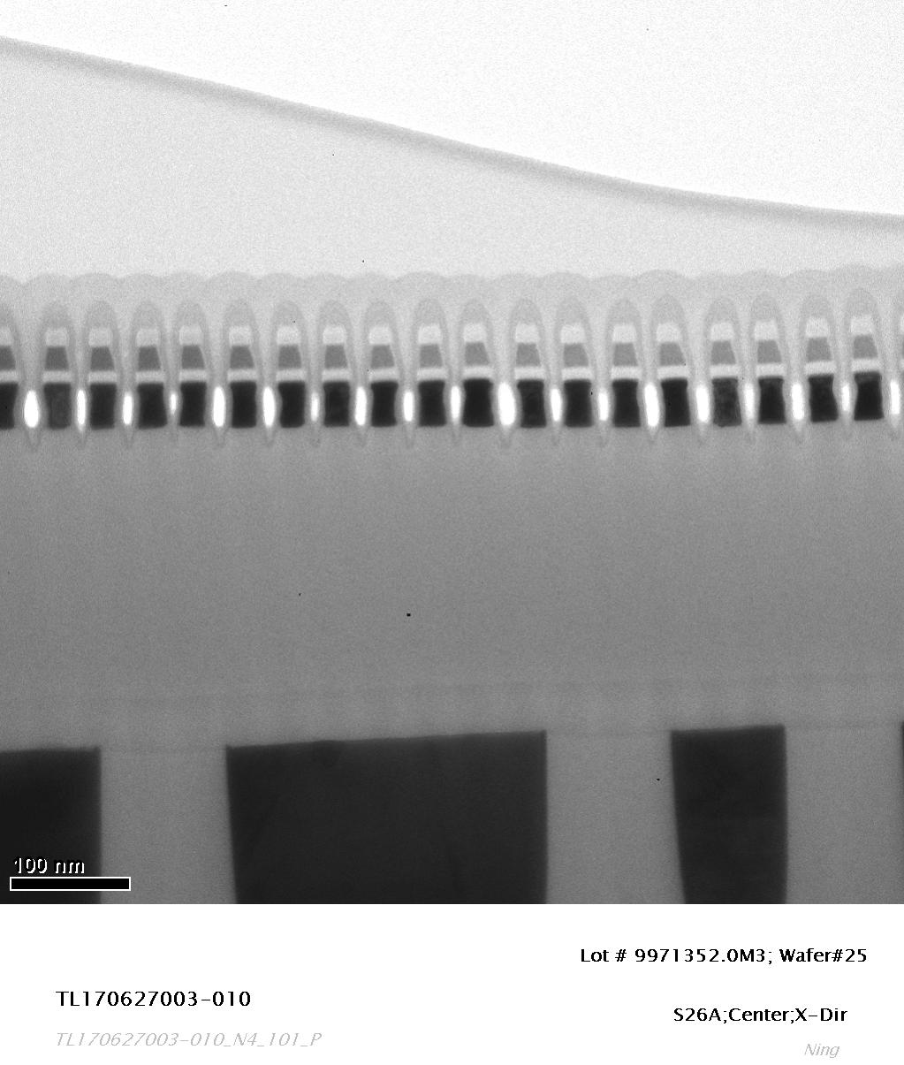
TEM Image

Slide 5
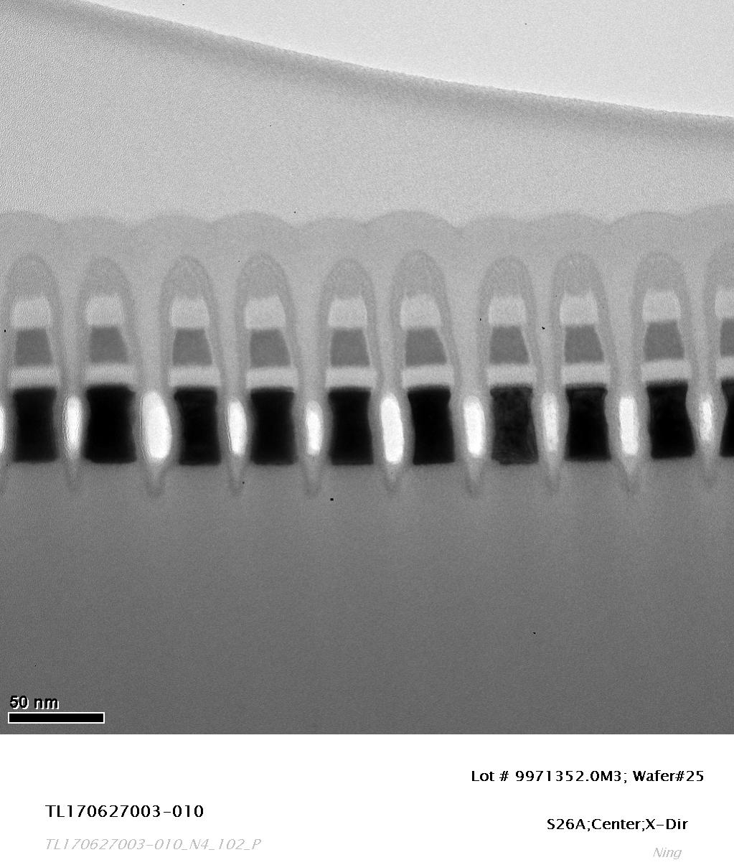
TEM Image

Slide 6
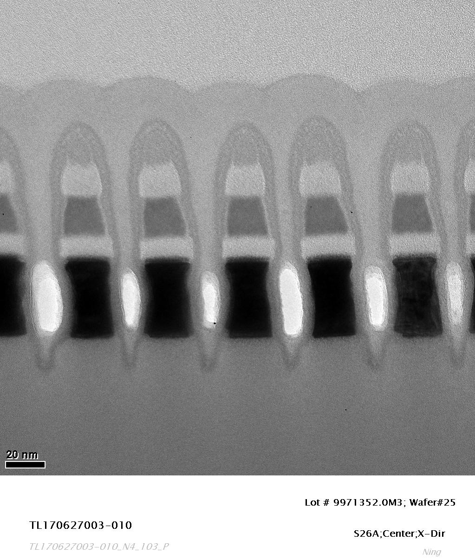
TEM Image

Slide 7
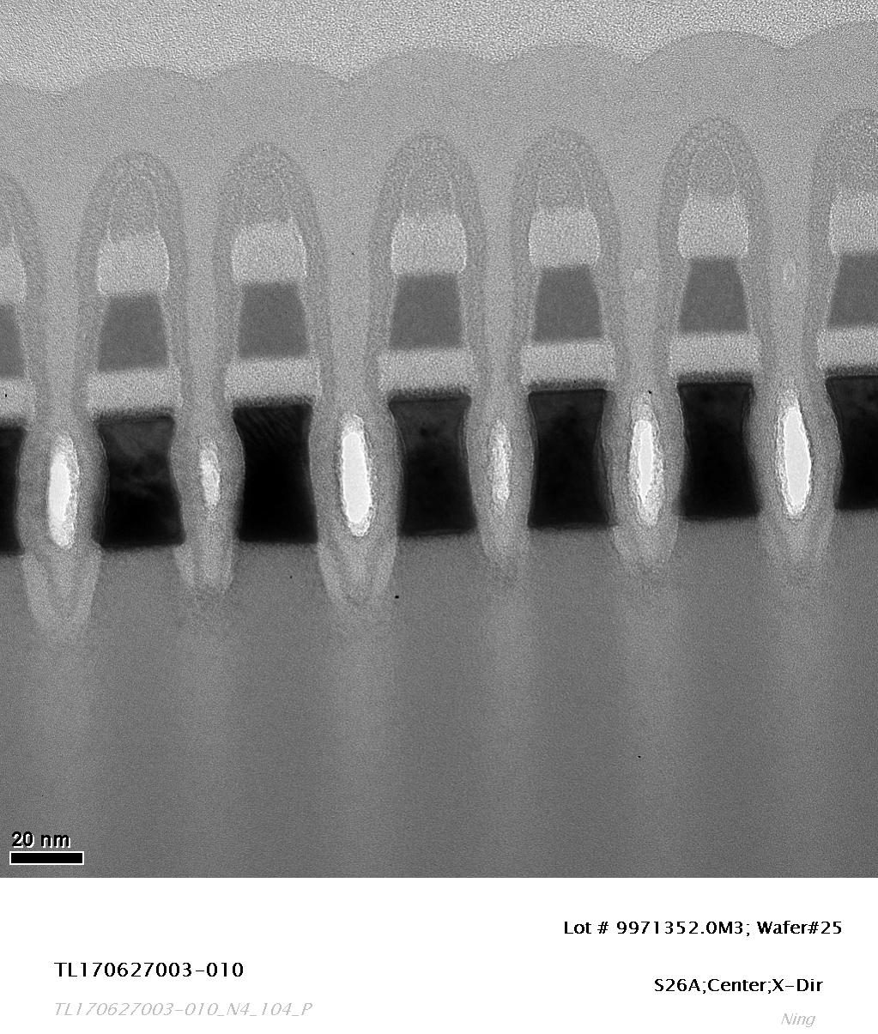
TEM Image

Slide 8
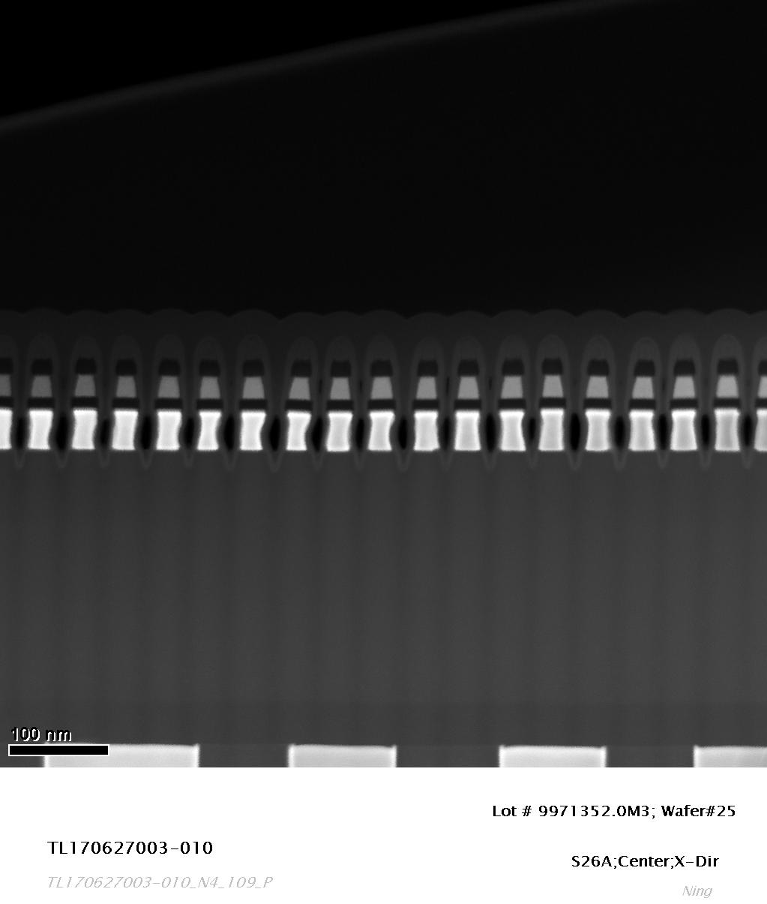
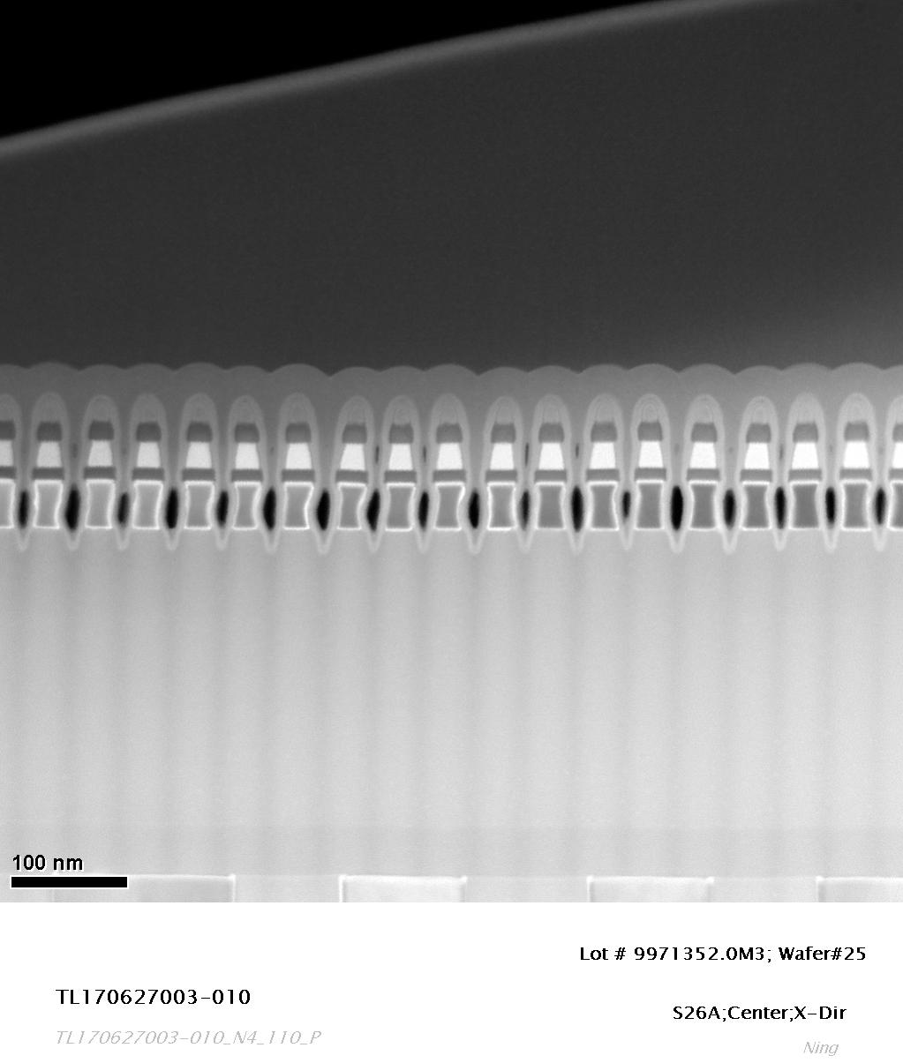
STEM Images

Slide 9
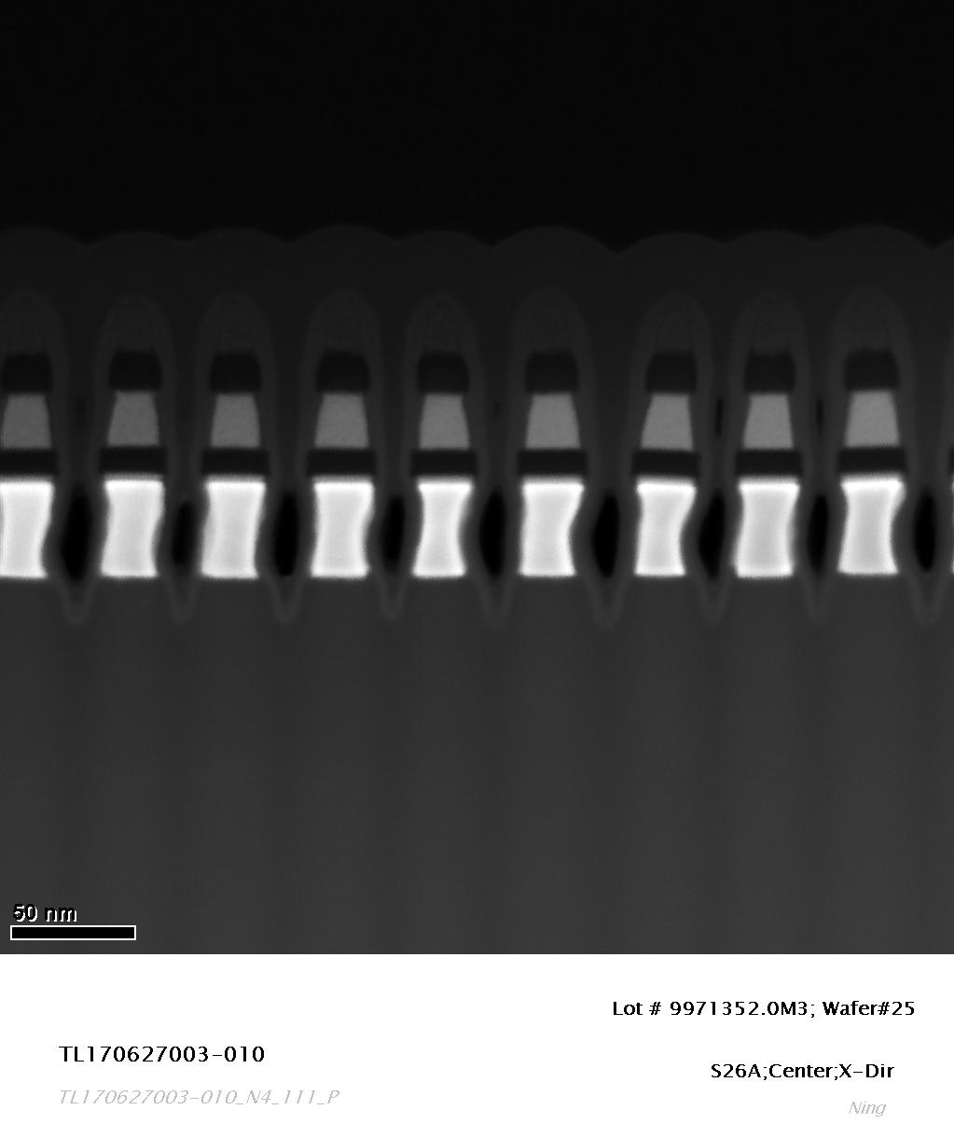
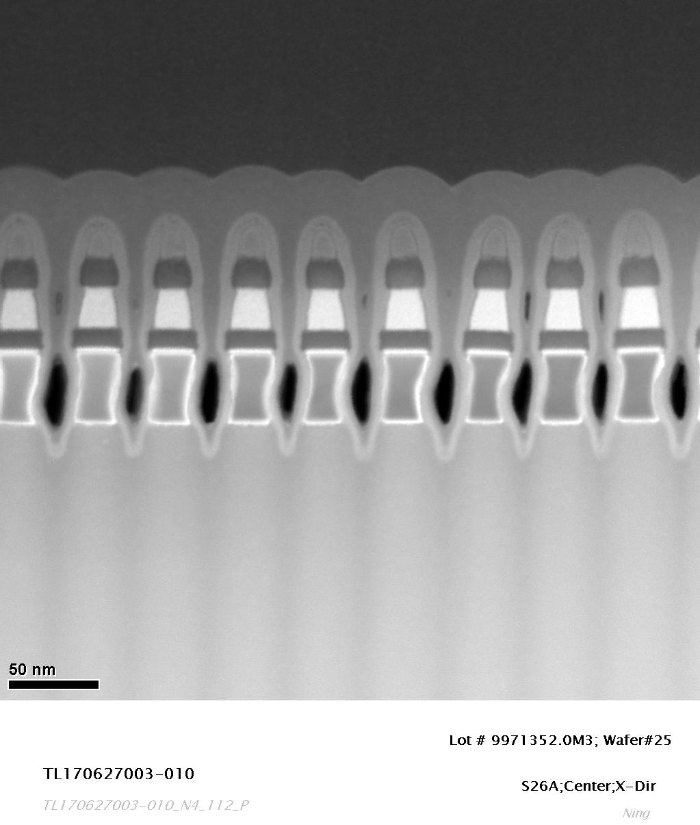
STEM Images

Slide 10
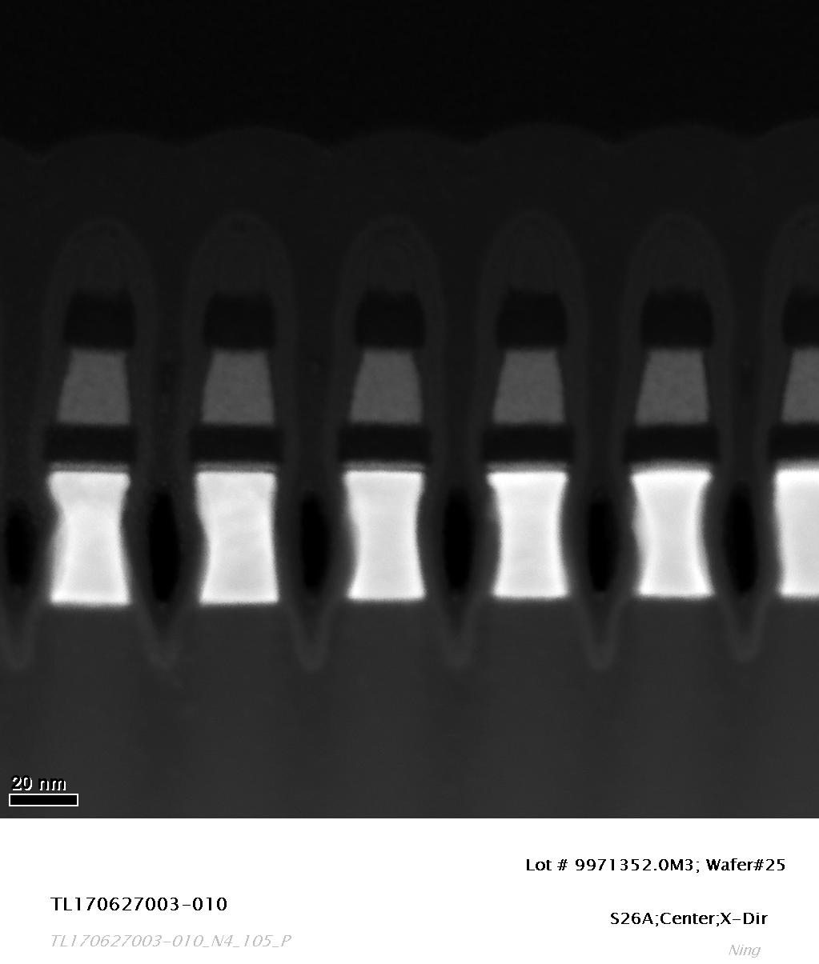
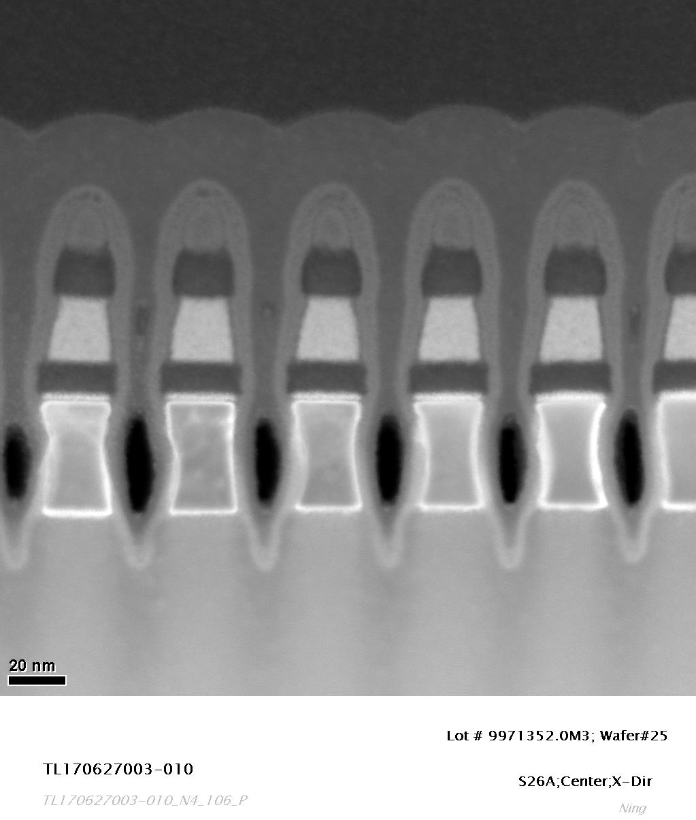
STEM Images

Slide 11
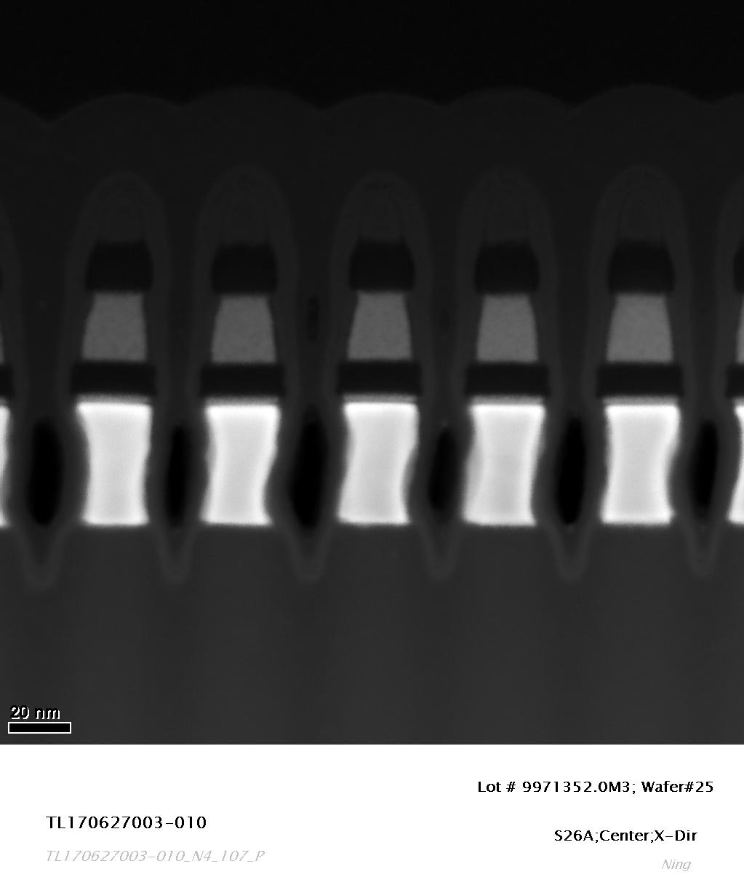
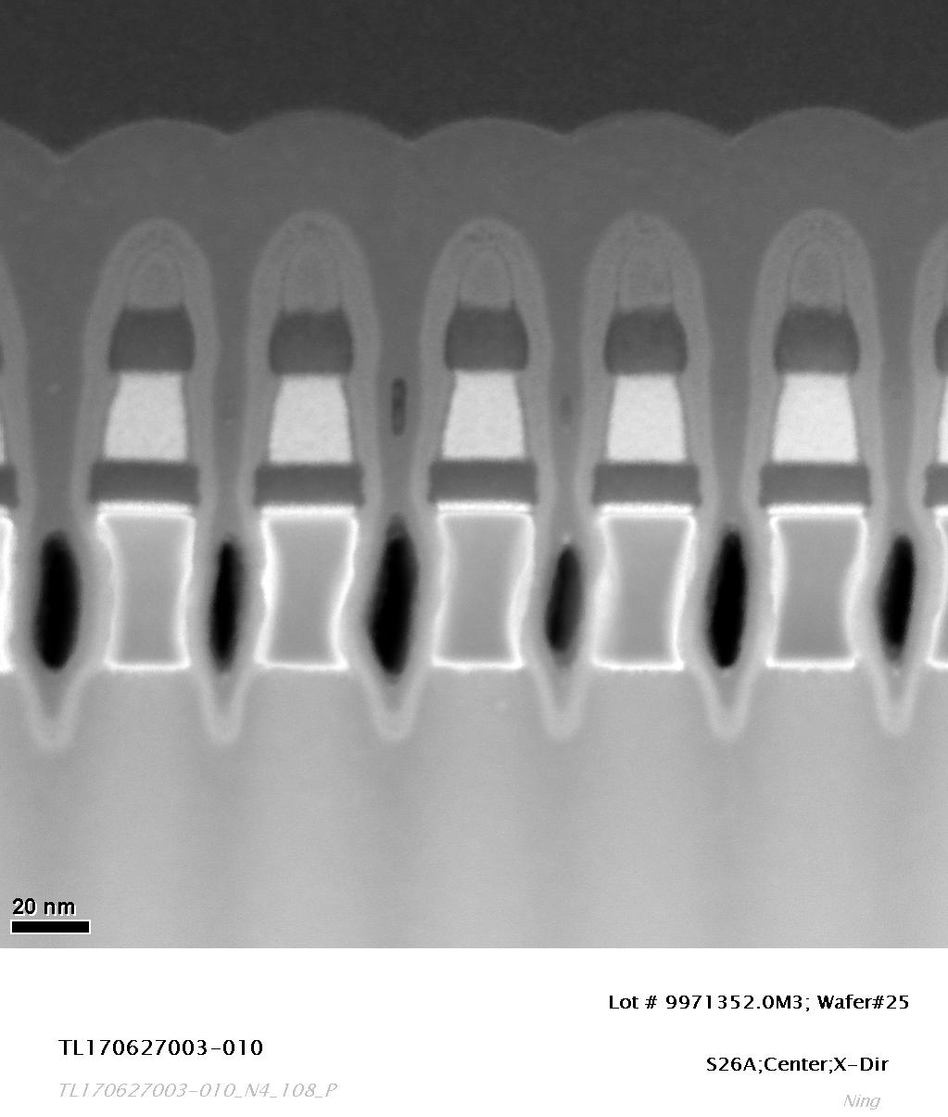
STEM Images

Slide 12
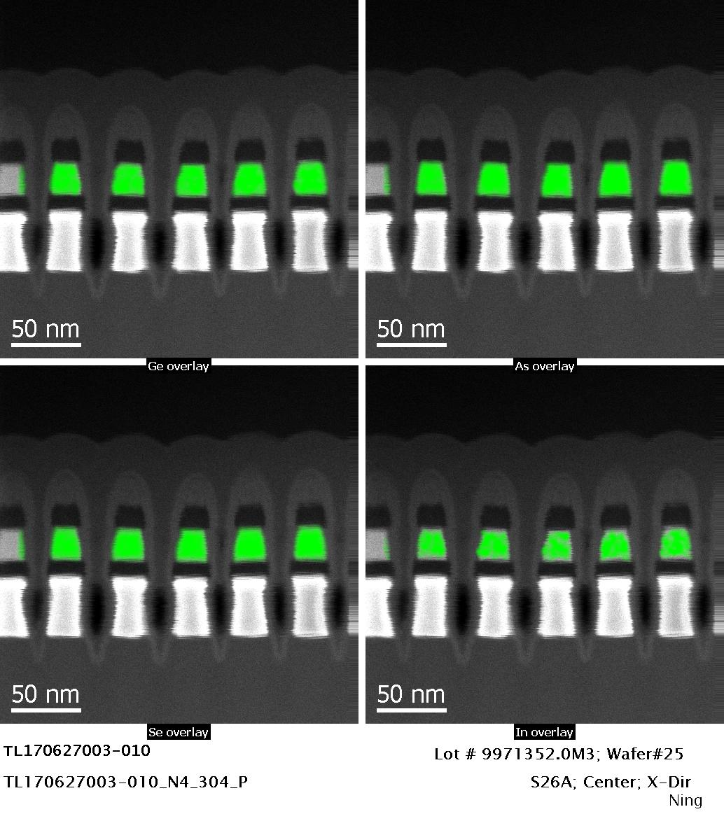
EDS Elemental Maps

Slide 13
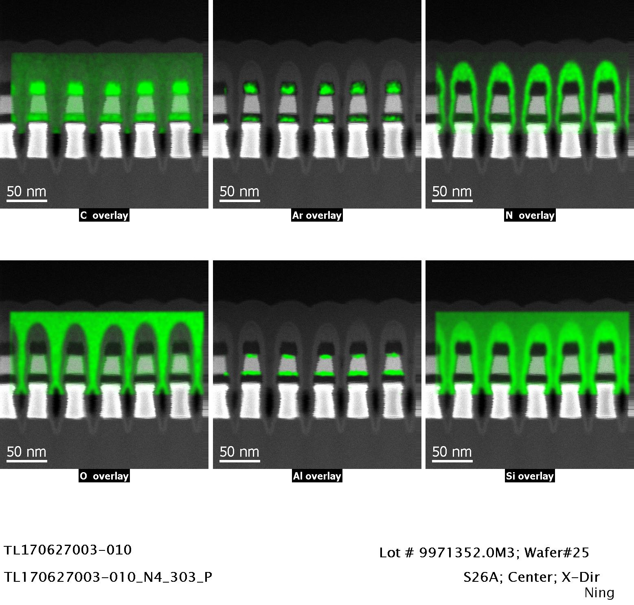
EDS Elemental Maps

Slide 14
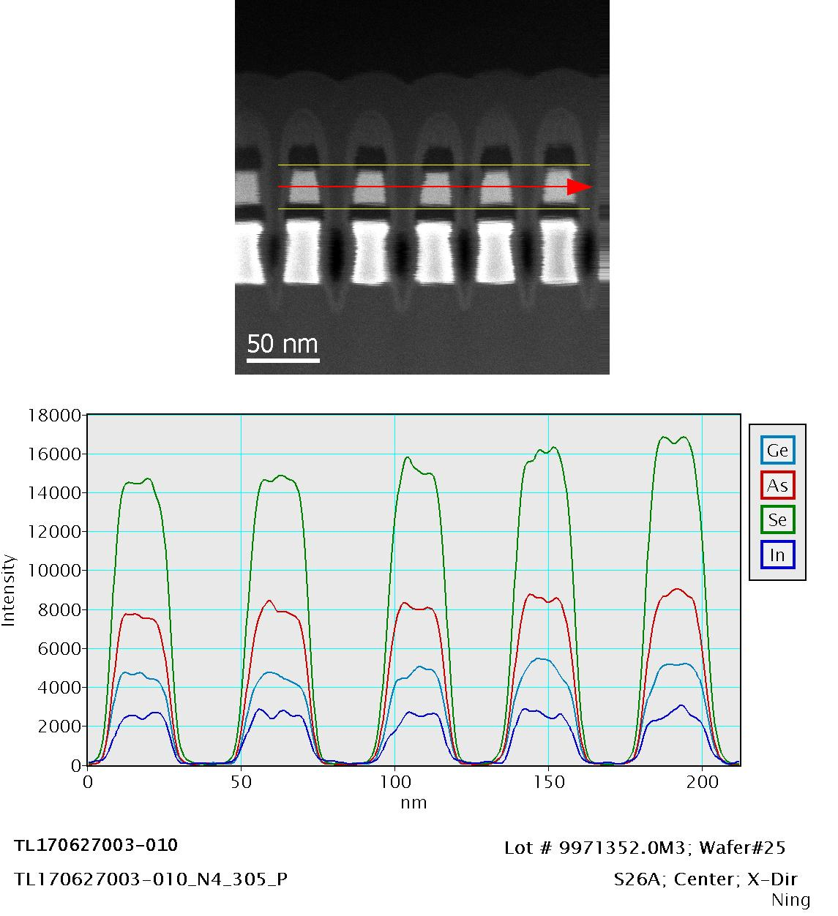
EDS Line Scanning Profile

Slide 15
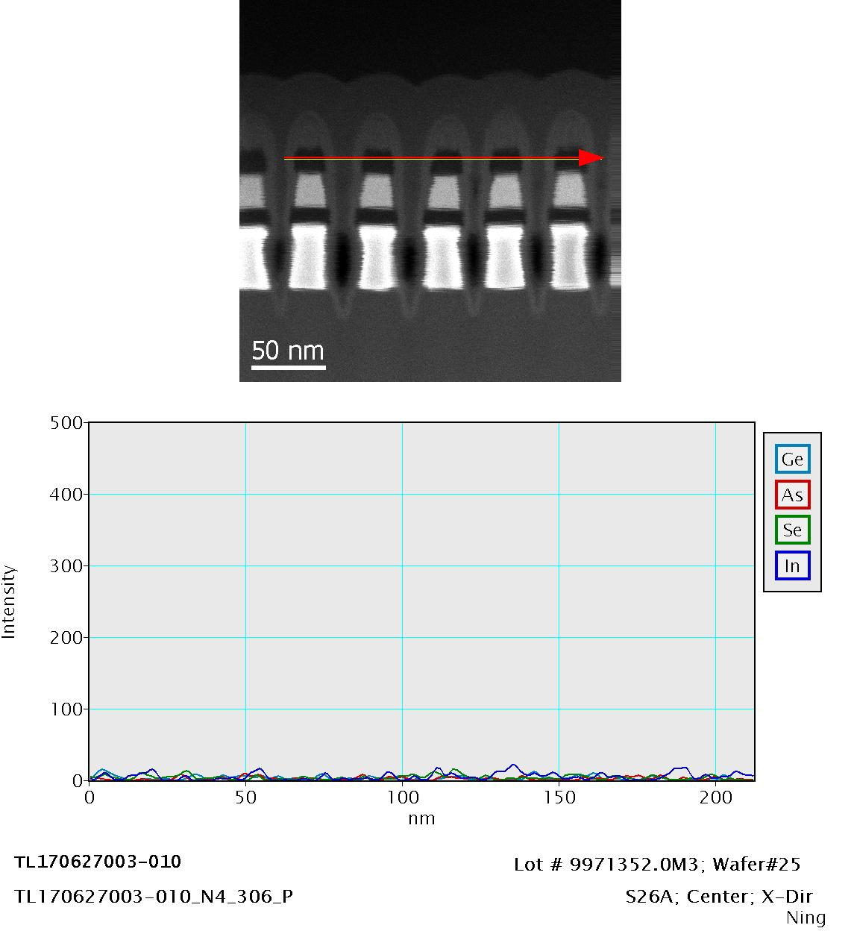

Slide 16
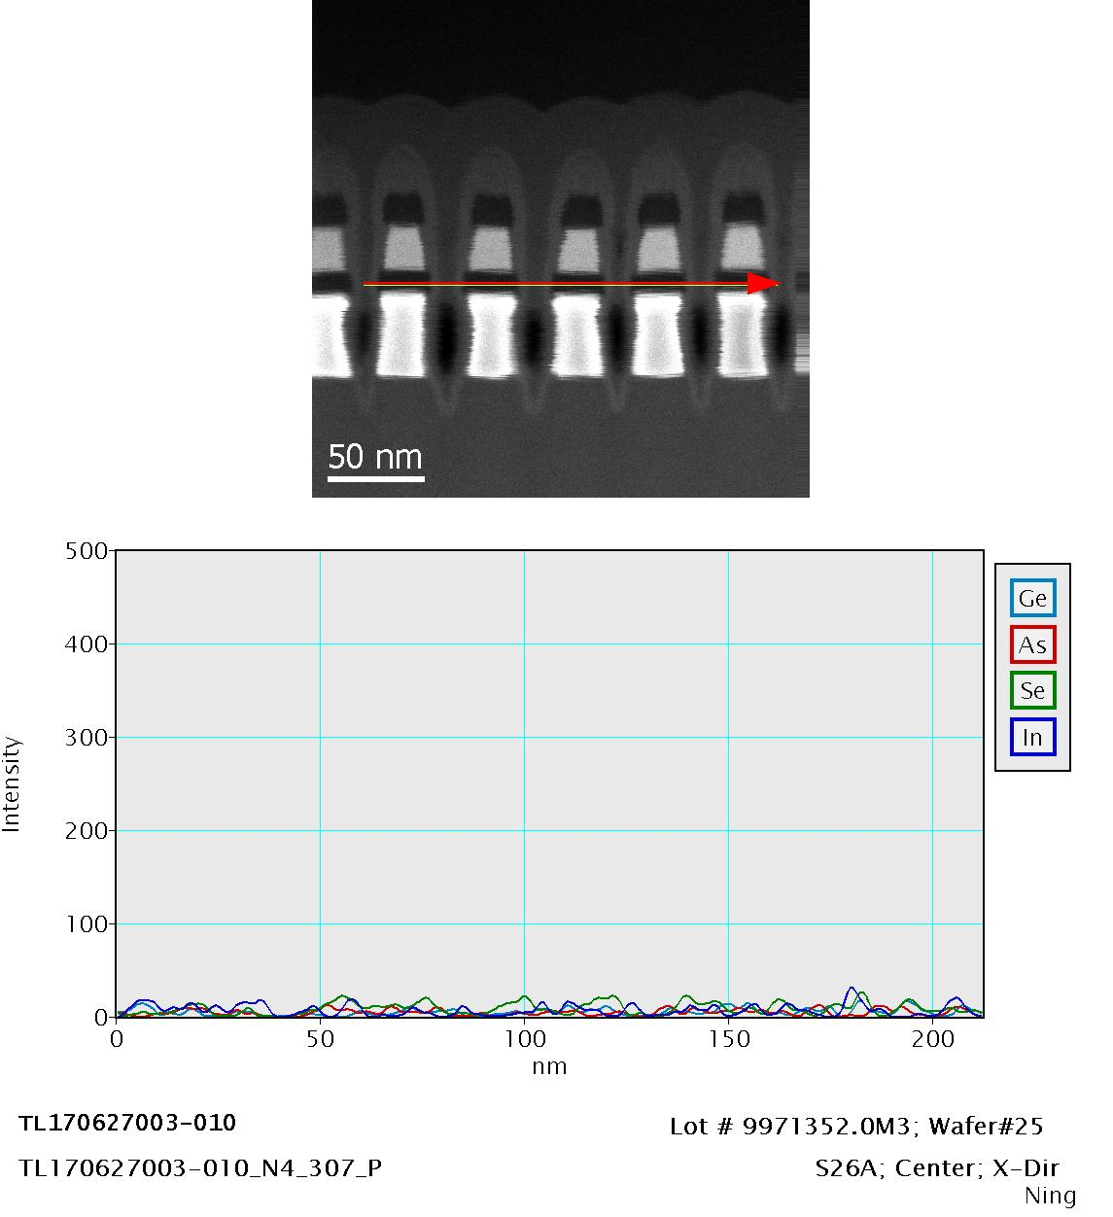

Slide 17
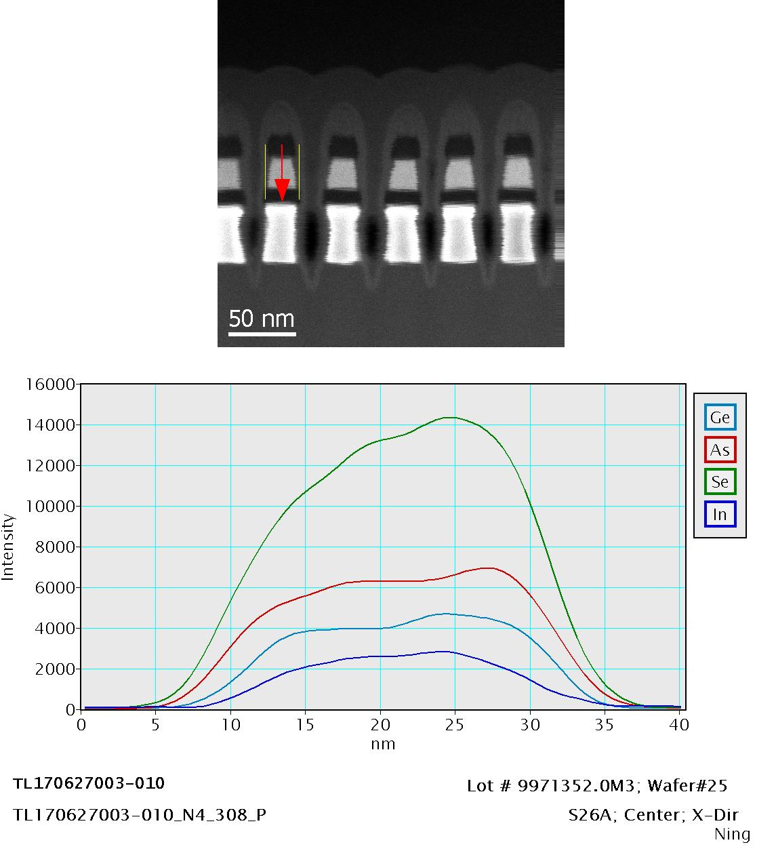

Slide 18
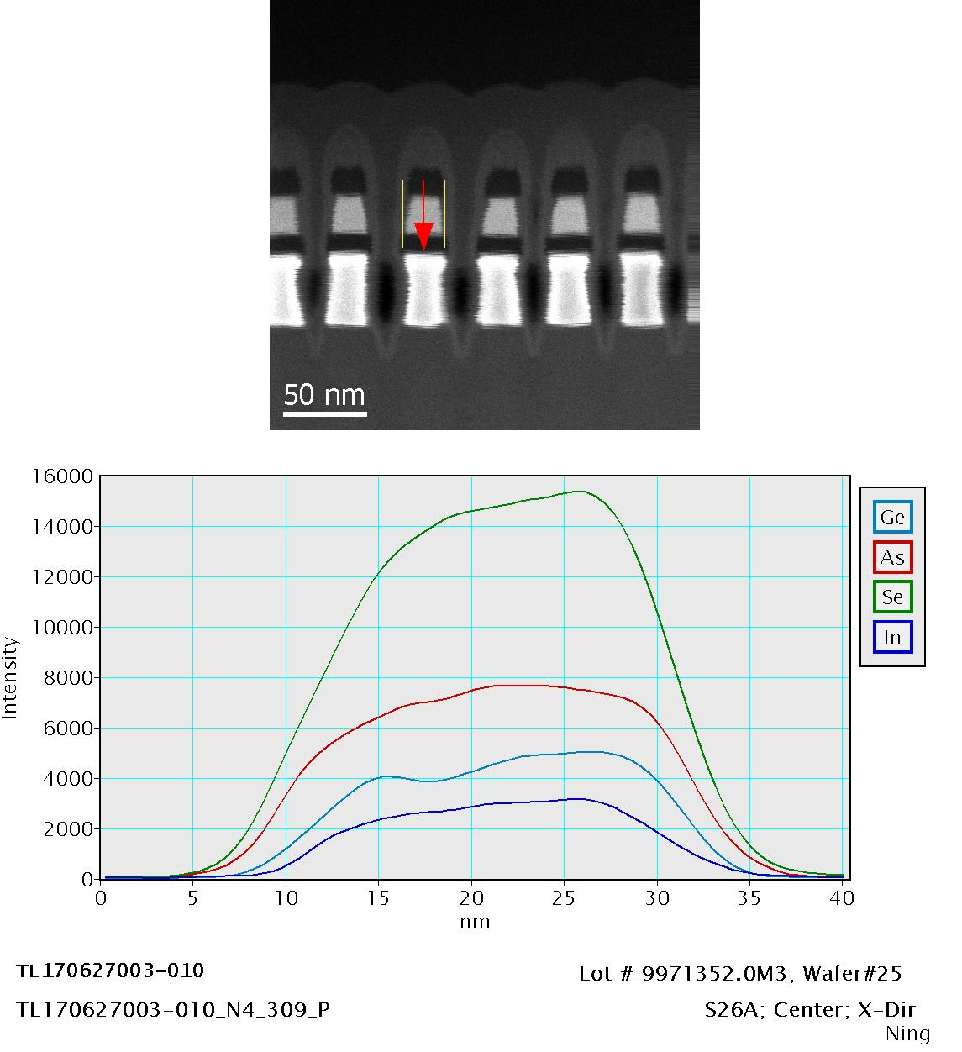

Slide 19
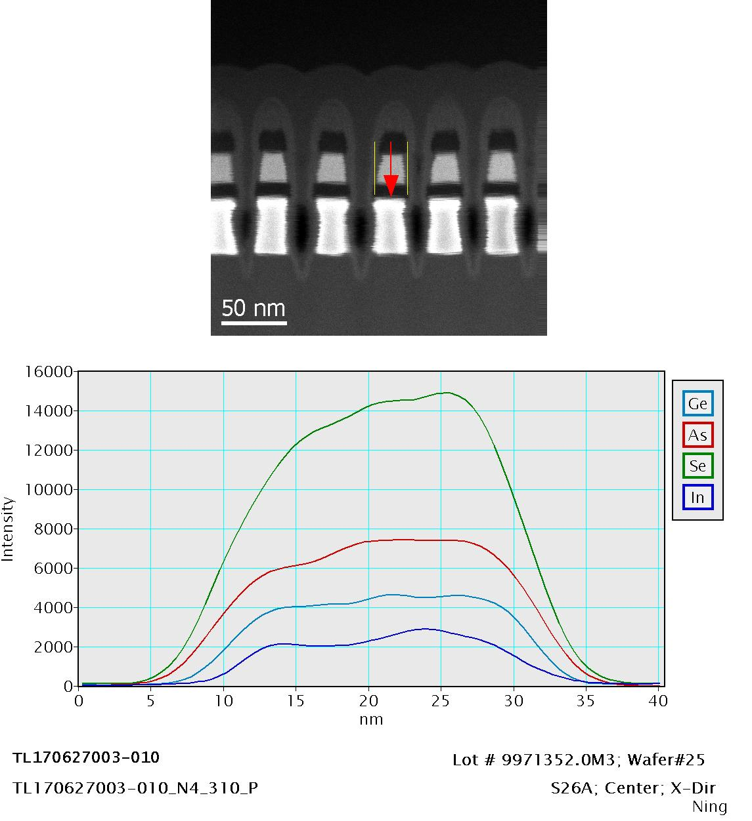

Slide 20
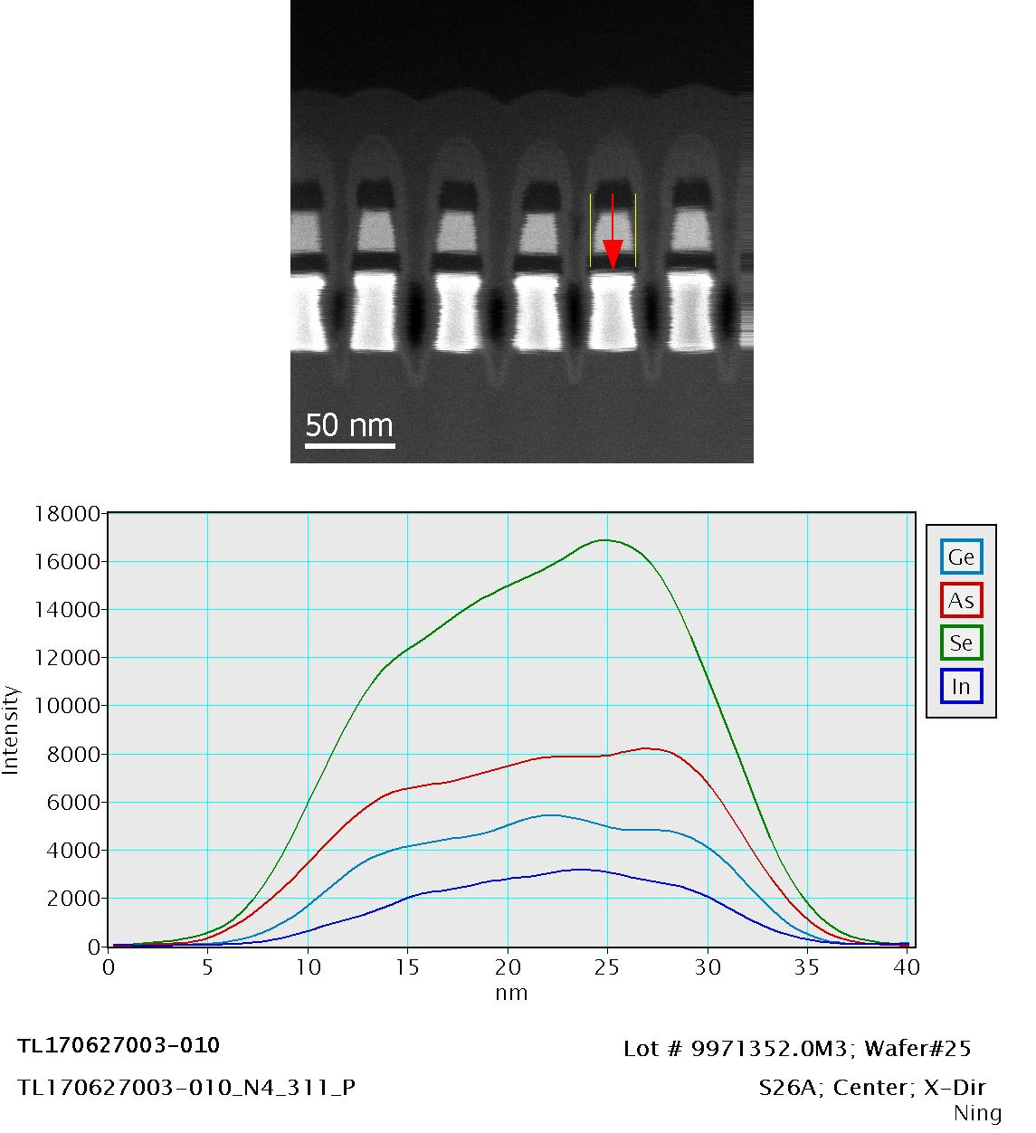

Slide 21
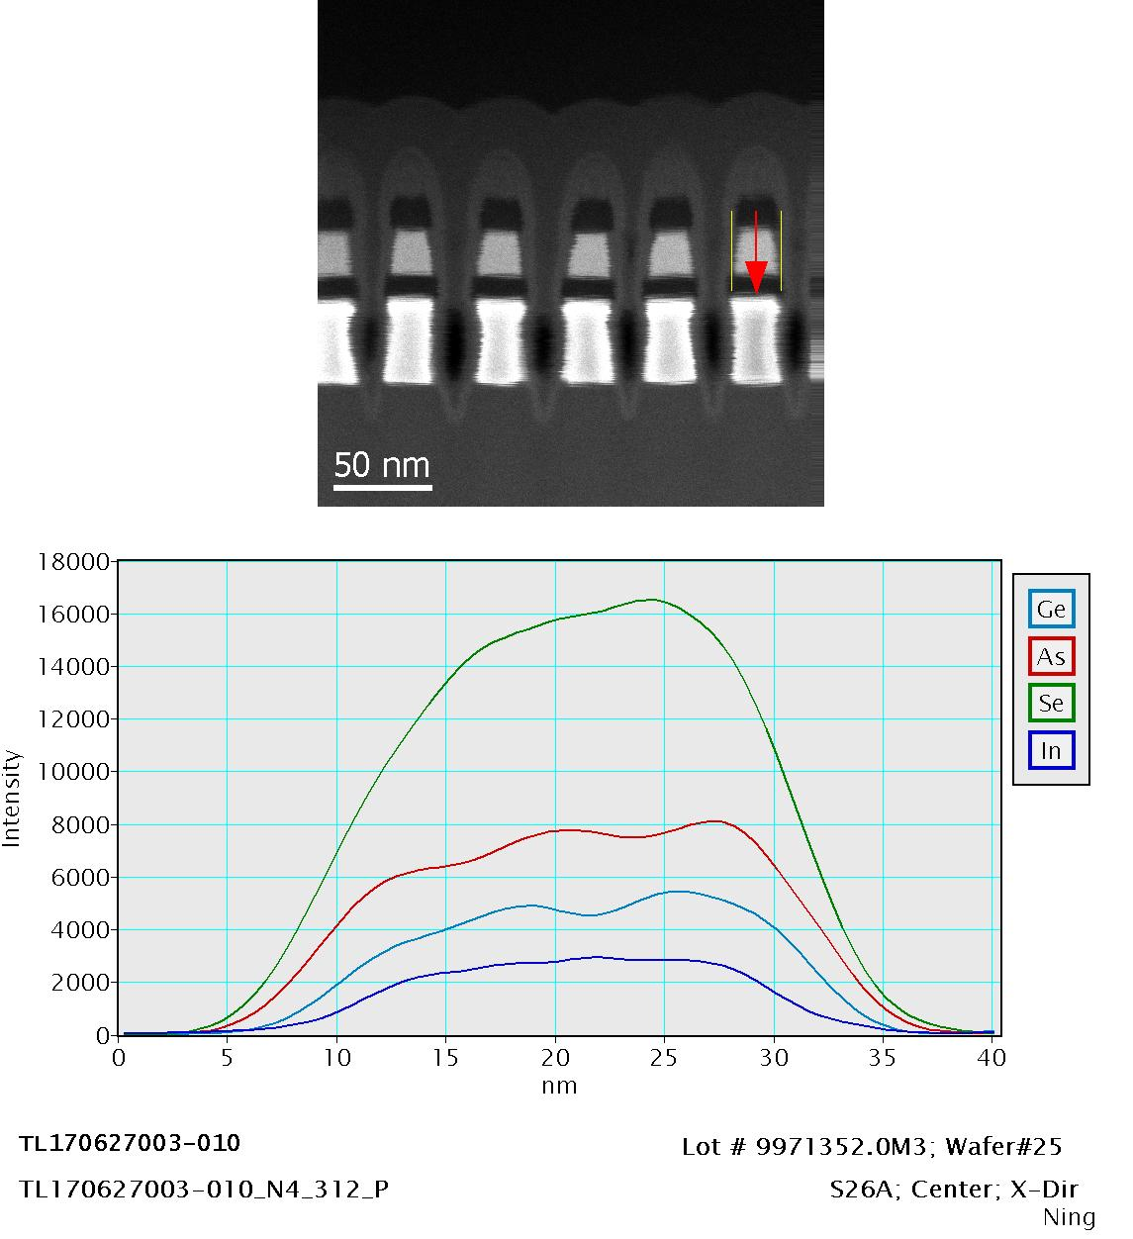

Slide 22
Sample ID :
Item# | Lot# | Wafer# | Part Type | Location | Direction | Remarks
020 | 9971352.0M3 | 25 | S26A | Edge | X-Direction

Slide 23
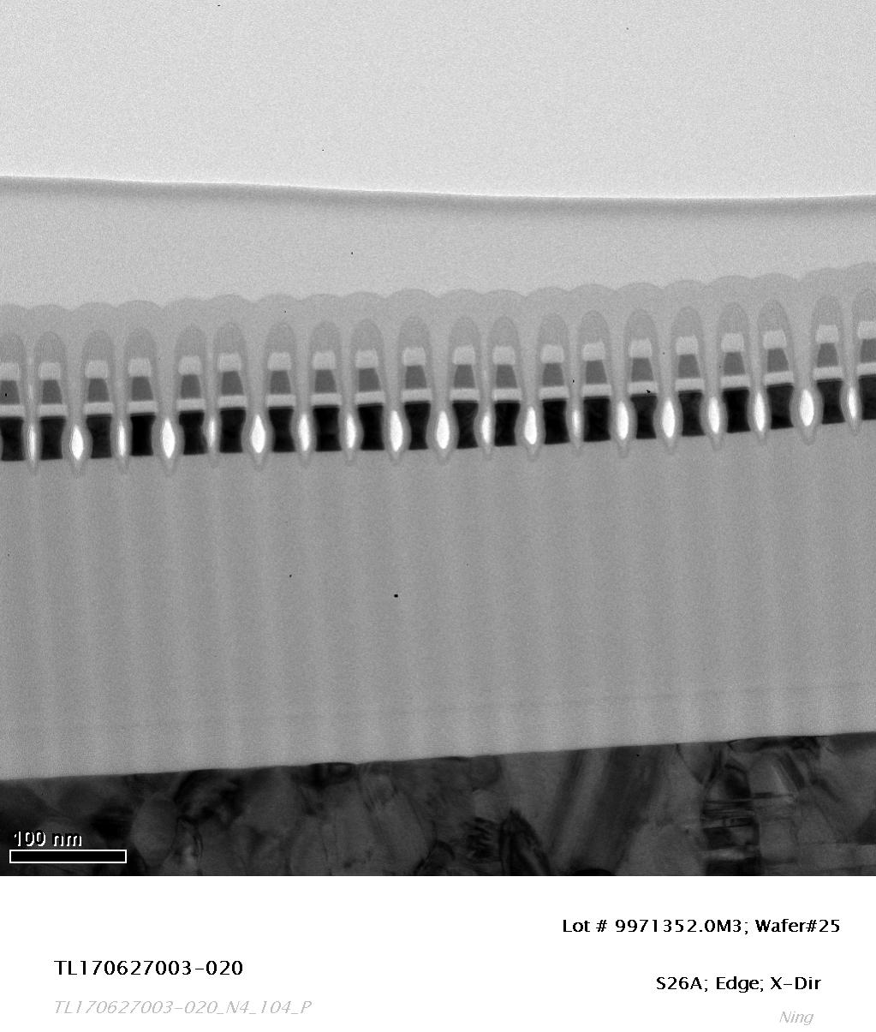
TEM Image

Slide 24
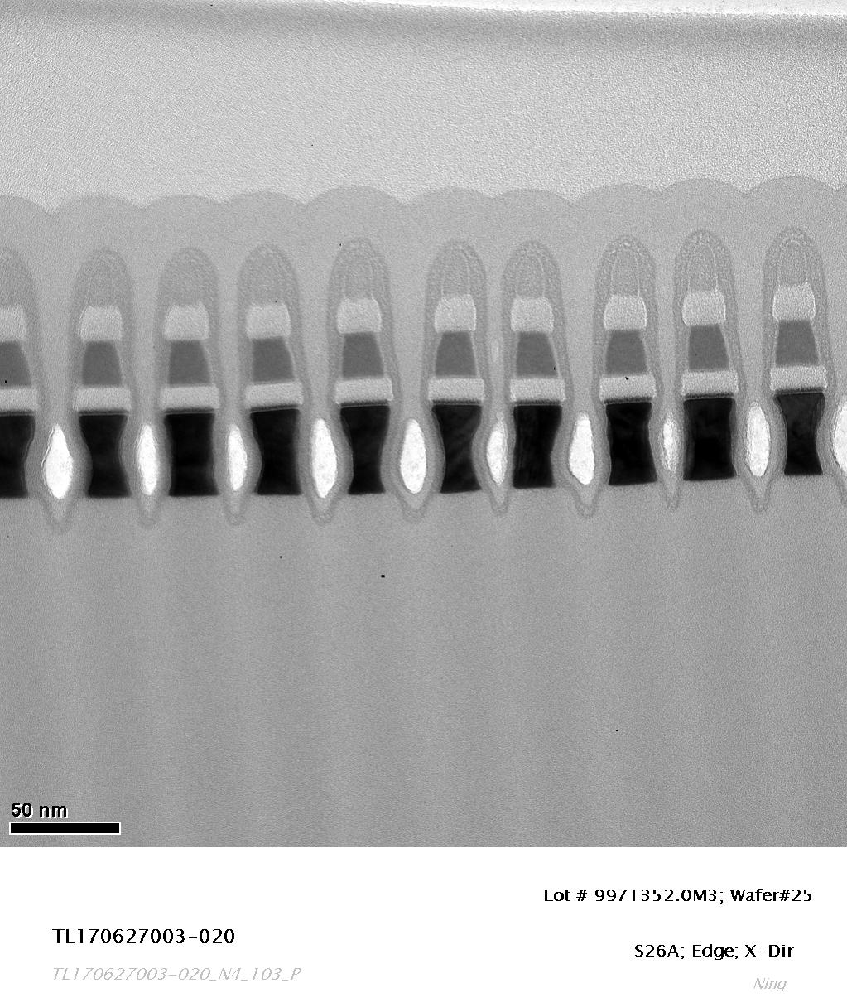
TEM Image

Slide 25
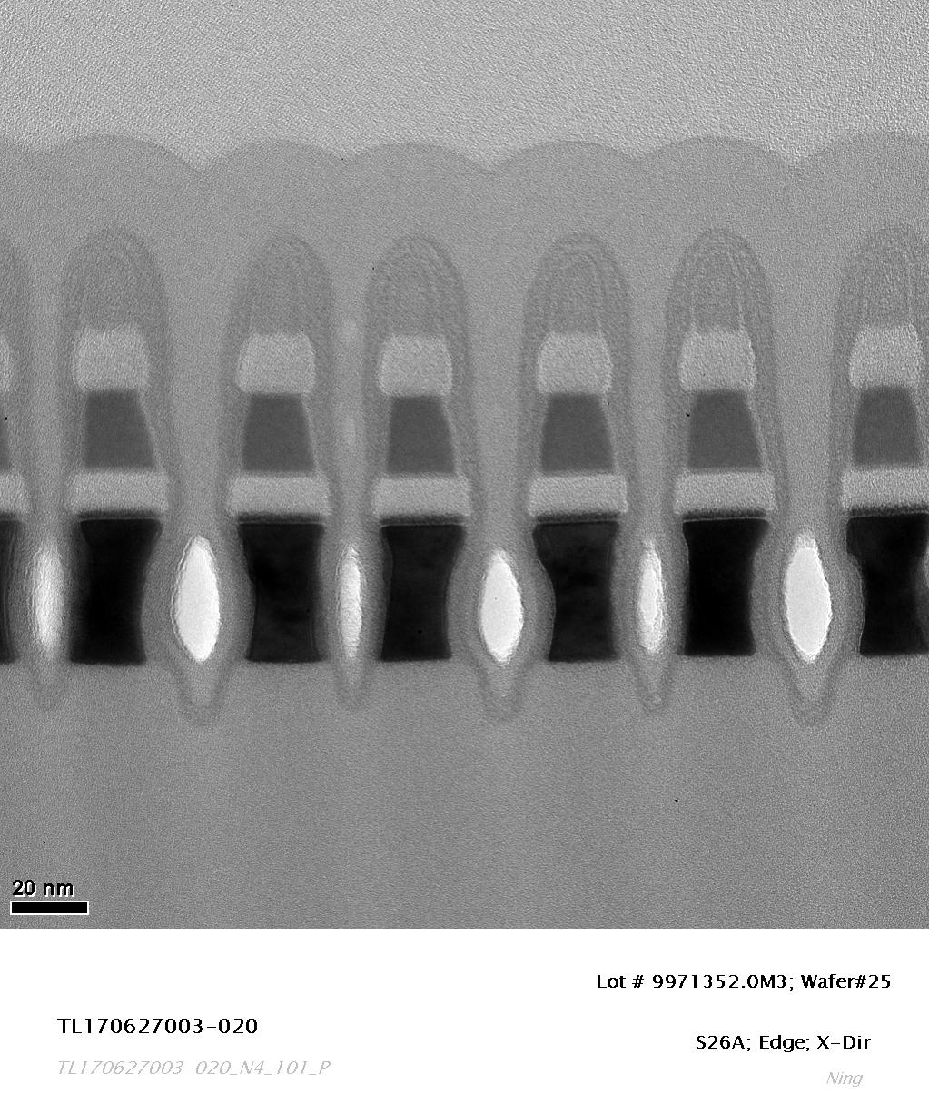
TEM Image

Slide 26
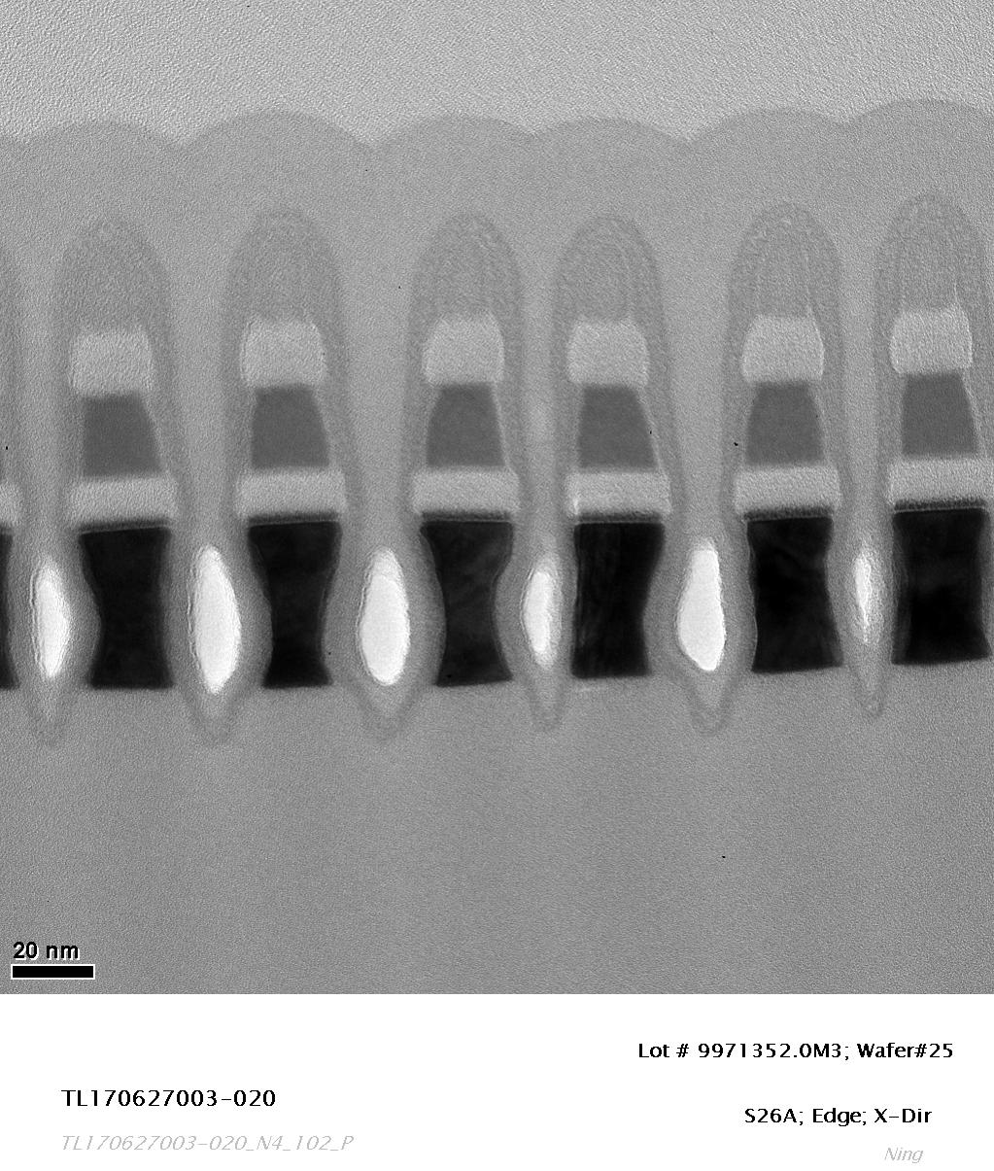
TEM Image

Slide 27
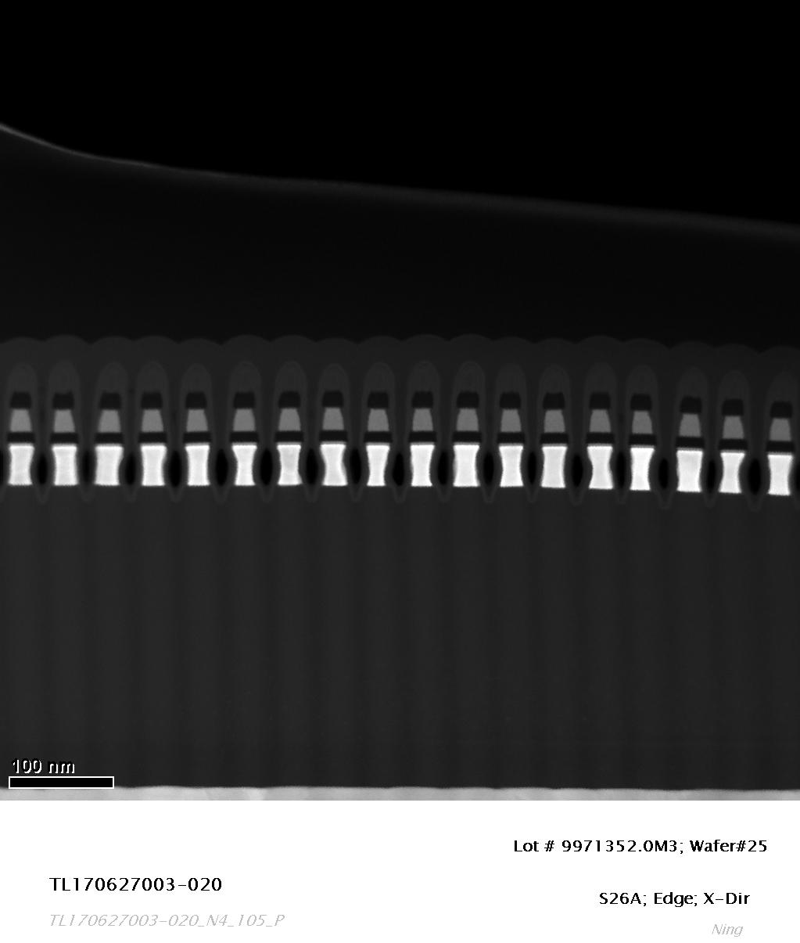
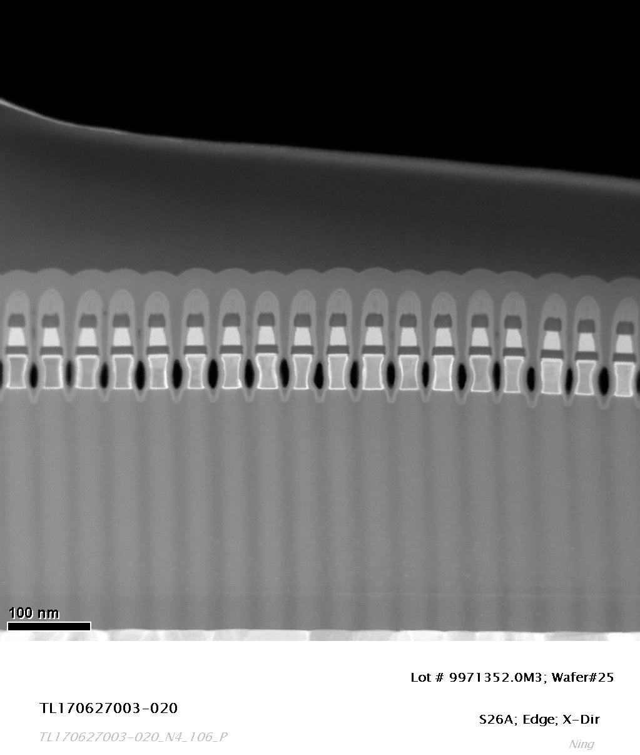
STEM Images

Slide 28
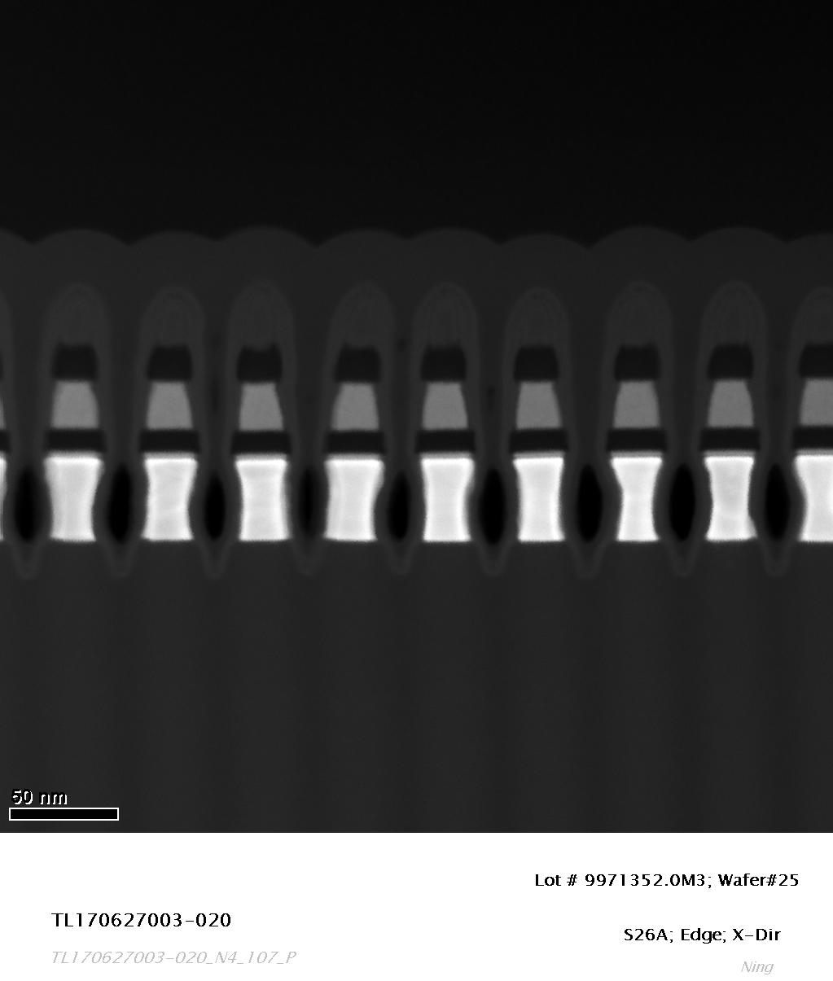
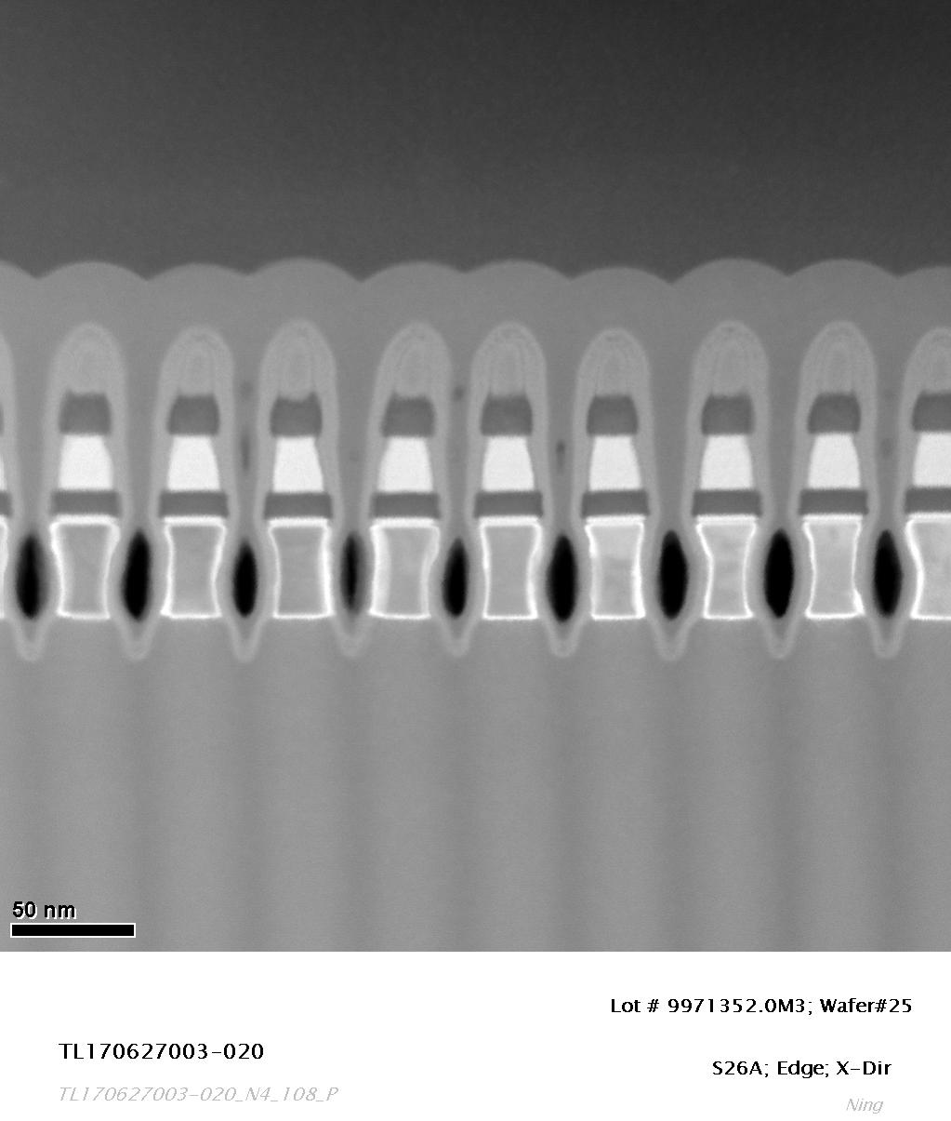
STEM Images

Slide 29
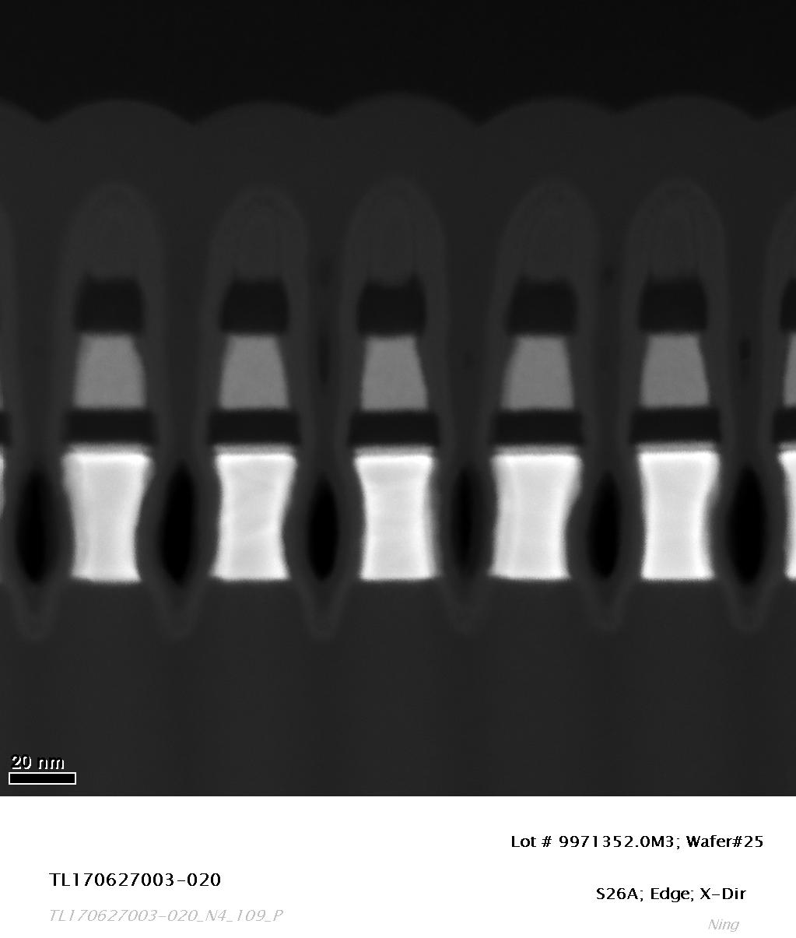
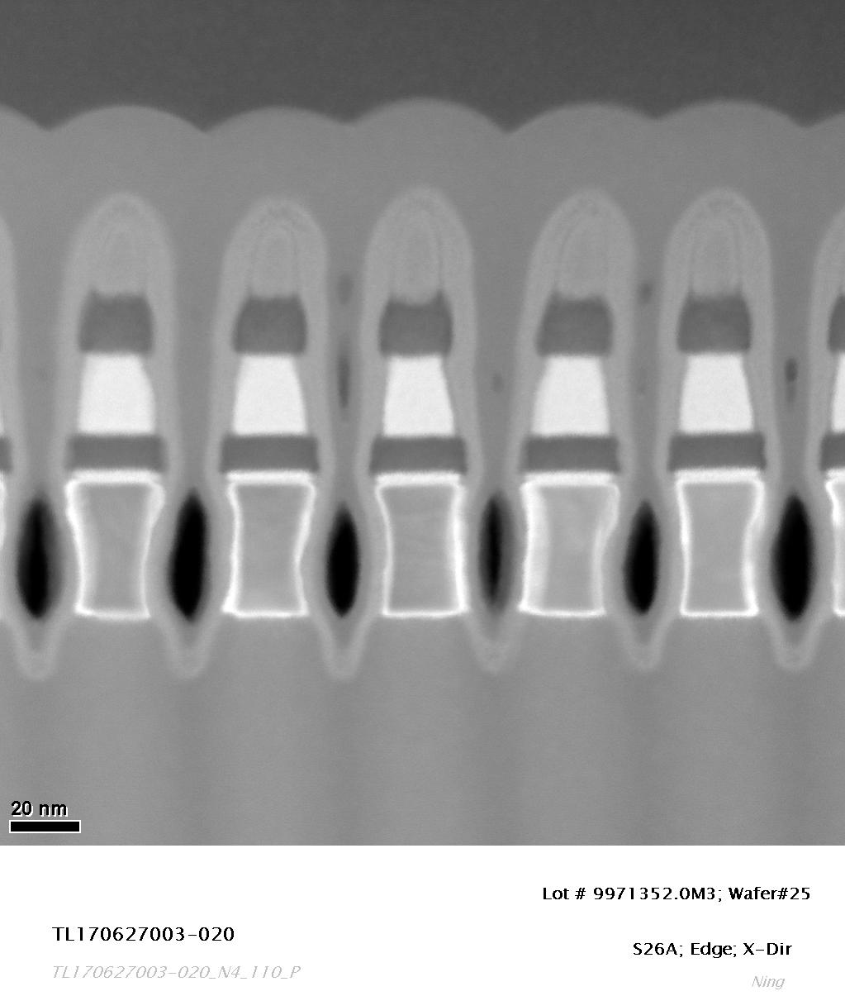
STEM Images

Slide 30
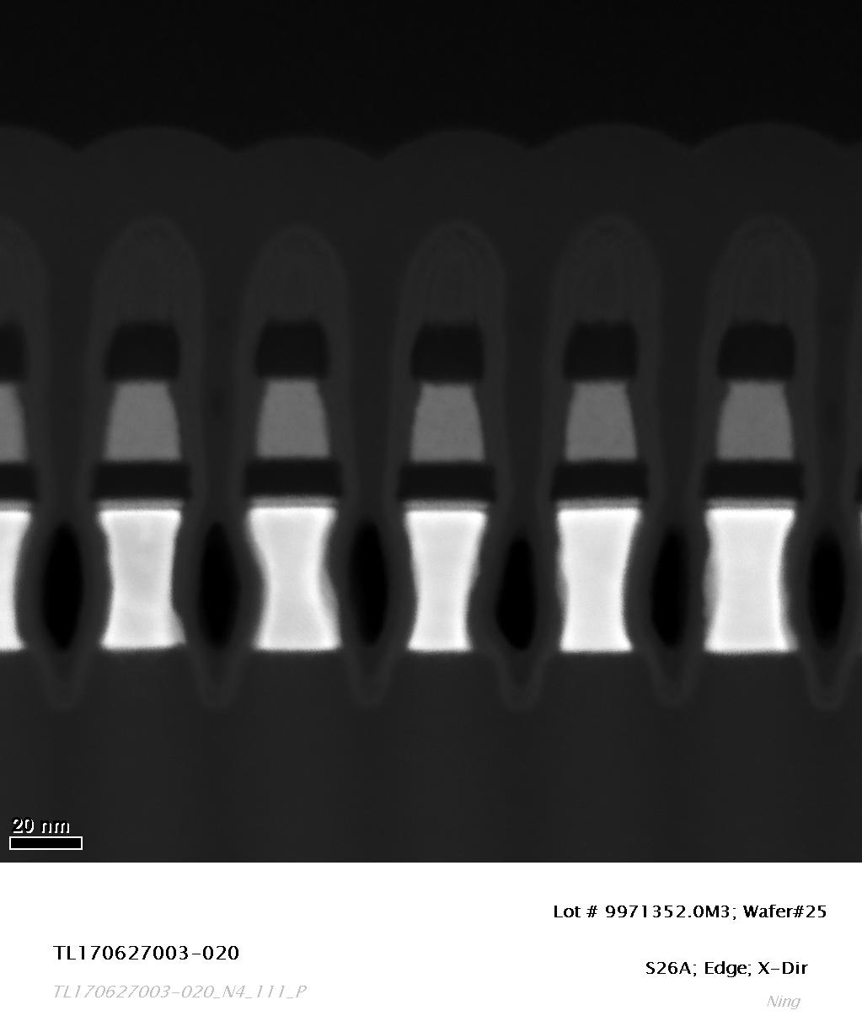
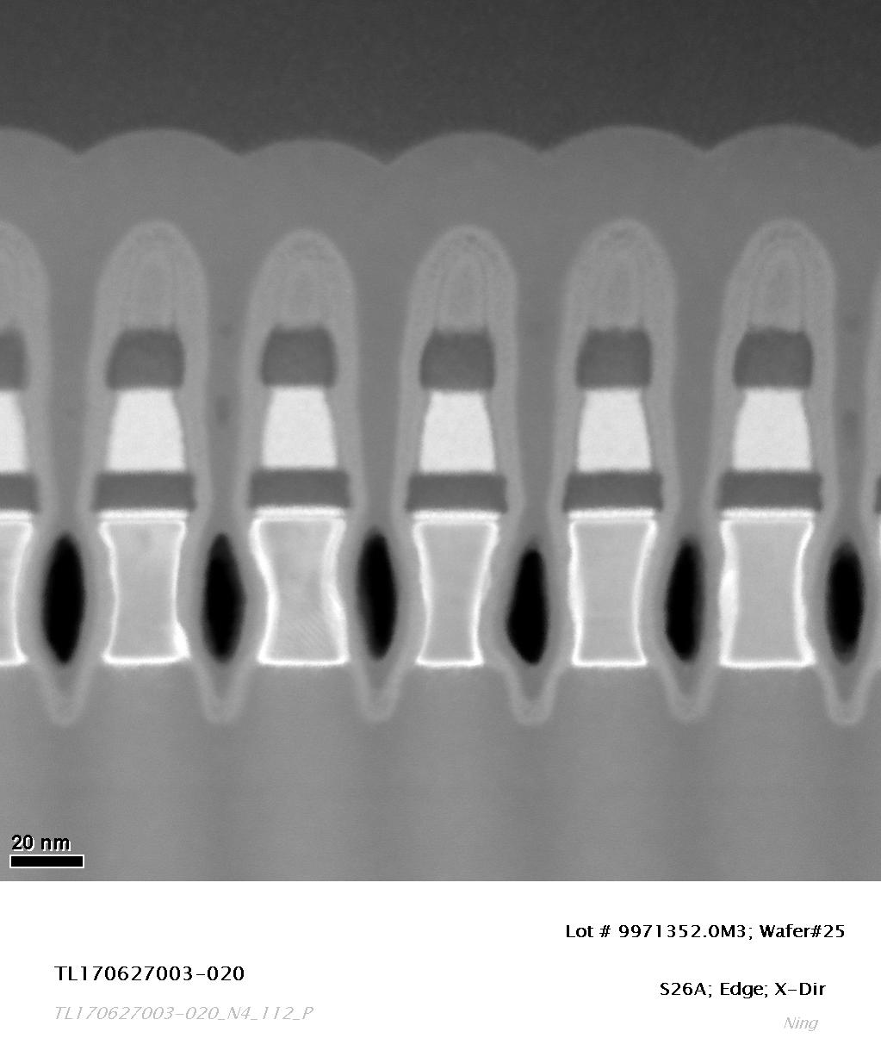
STEM Images

Slide 31
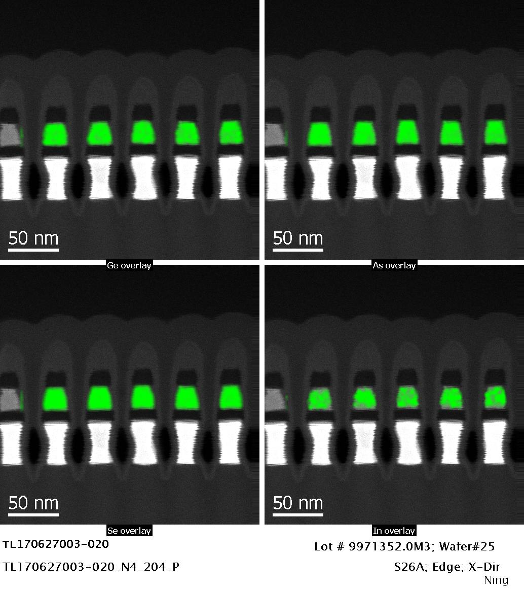
EDS Elemental Maps

Slide 32
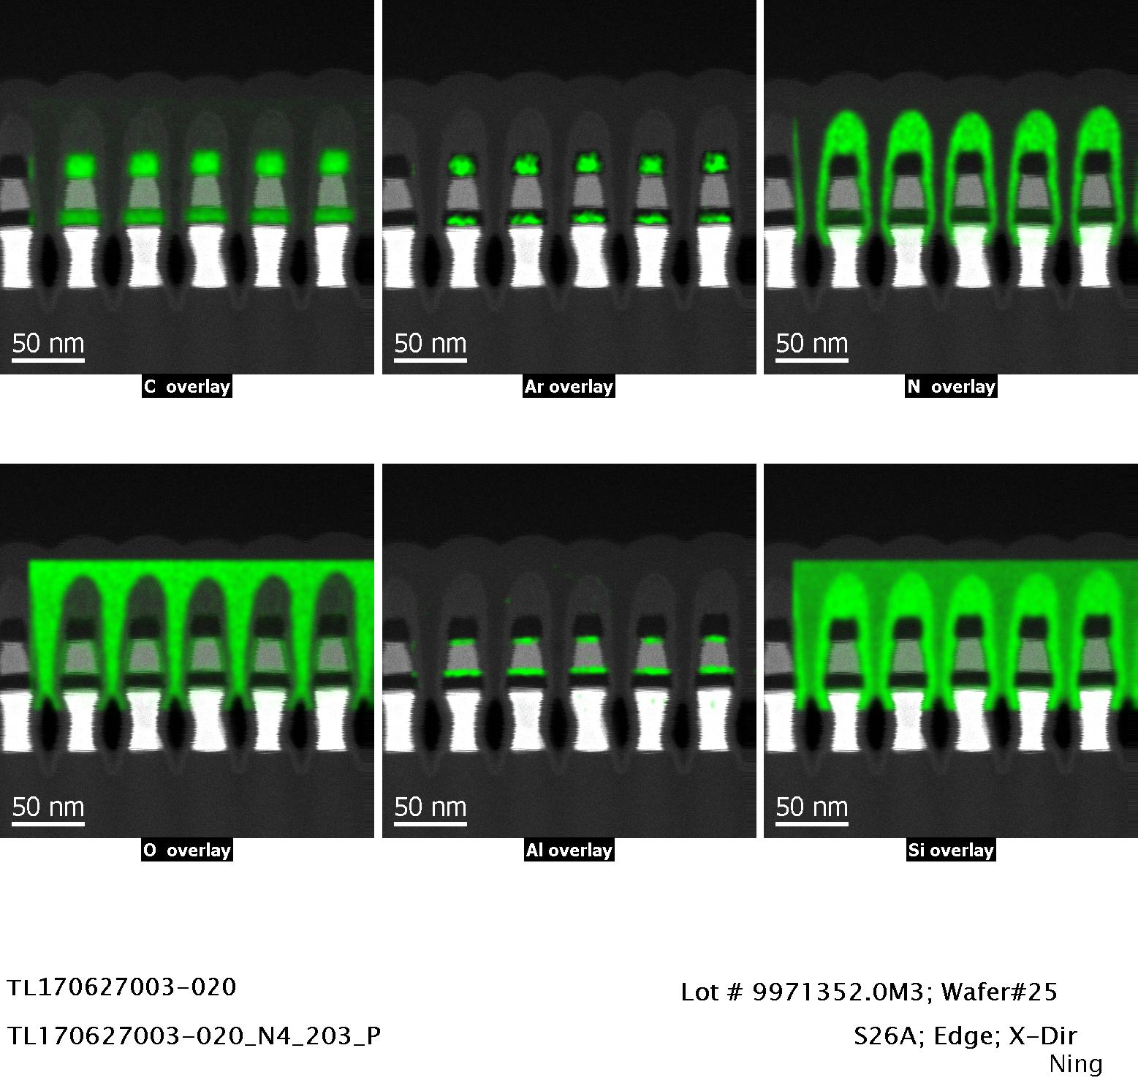
EDS Elemental Maps

Slide 33
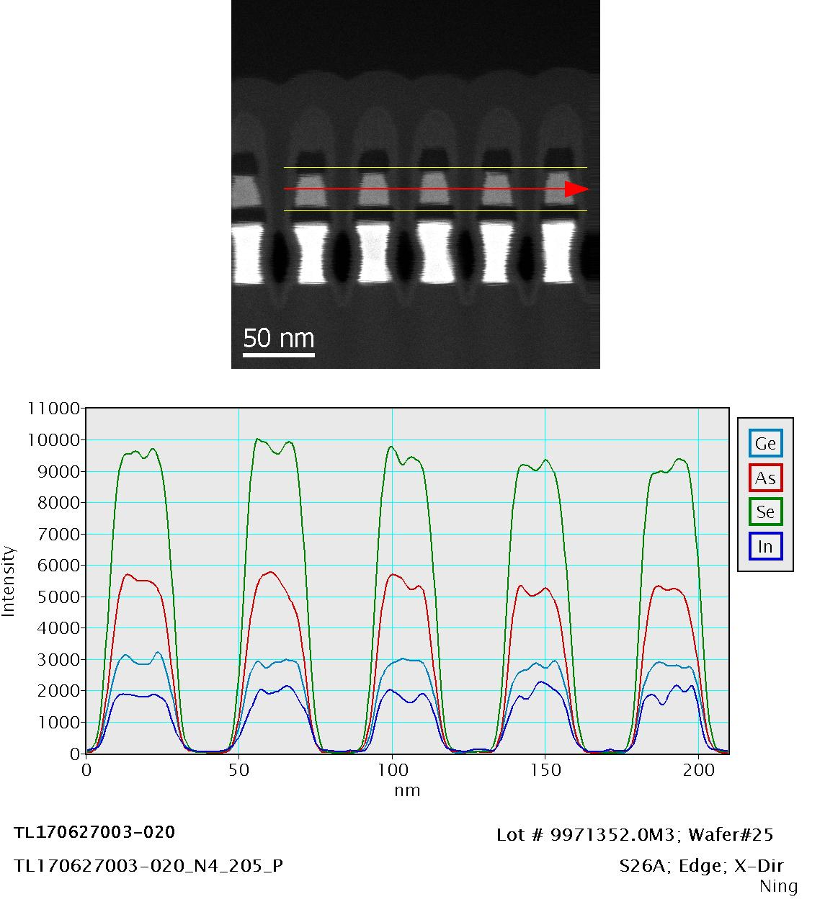
EDS Line Scanning Profile

Slide 34
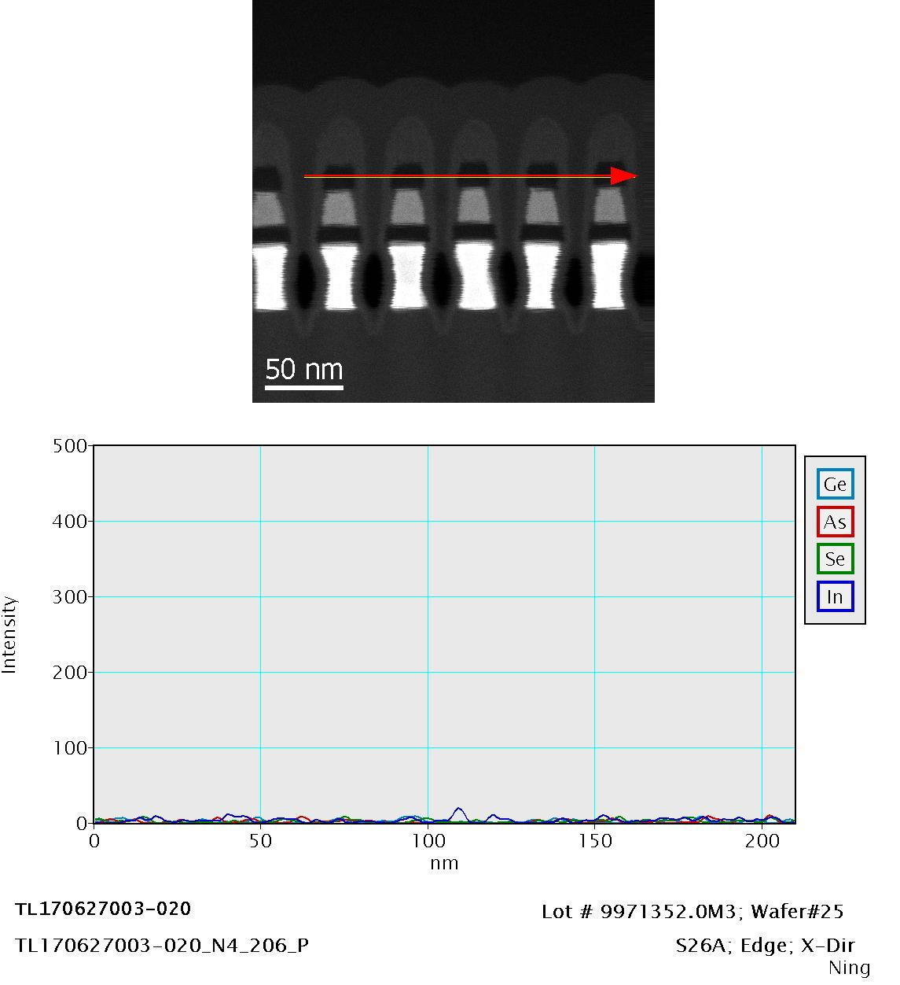

Slide 35
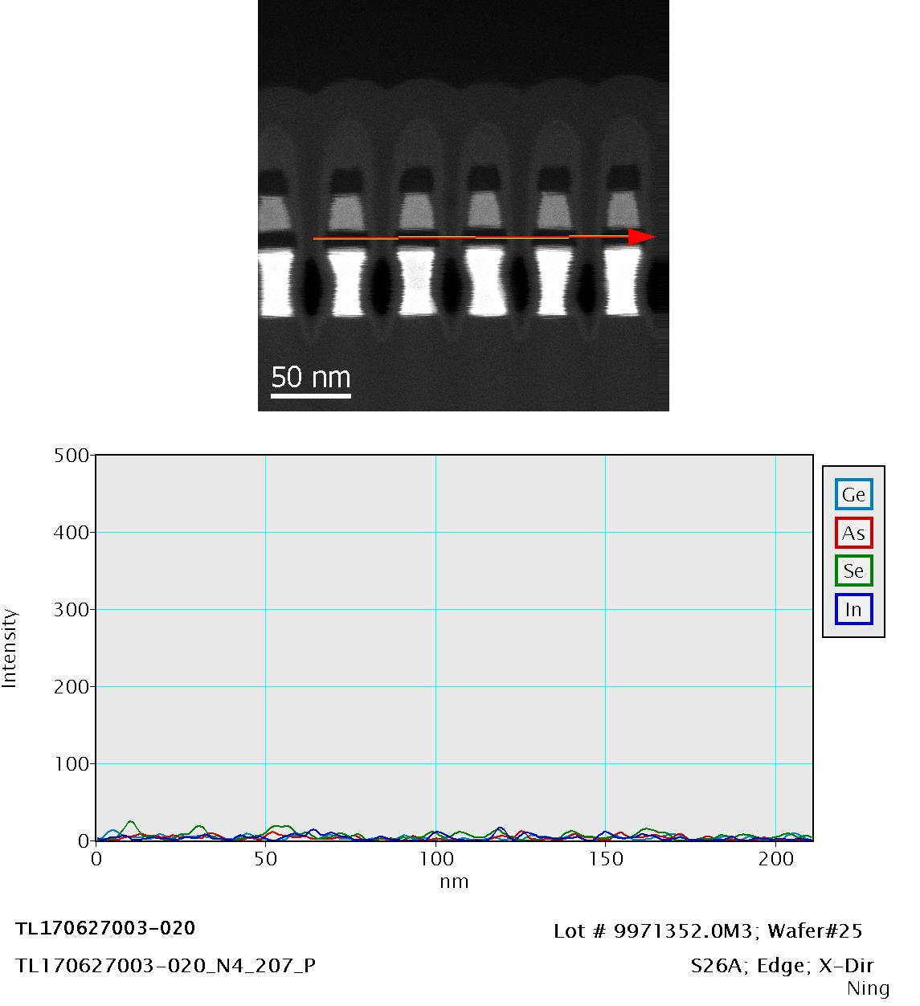

Slide 36
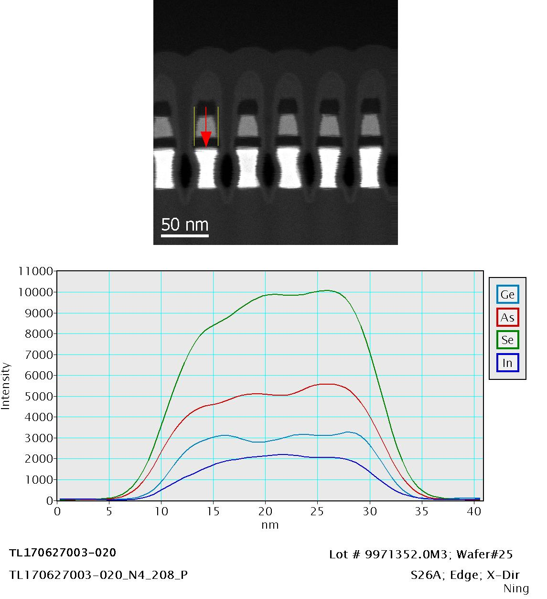

Slide 37
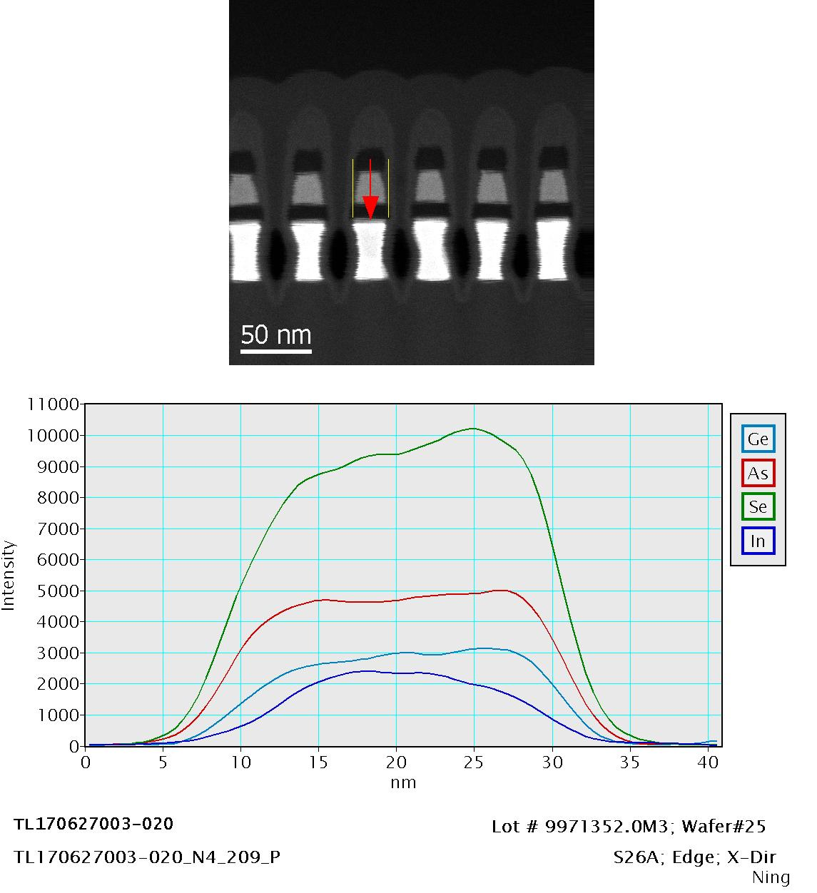

Slide 38
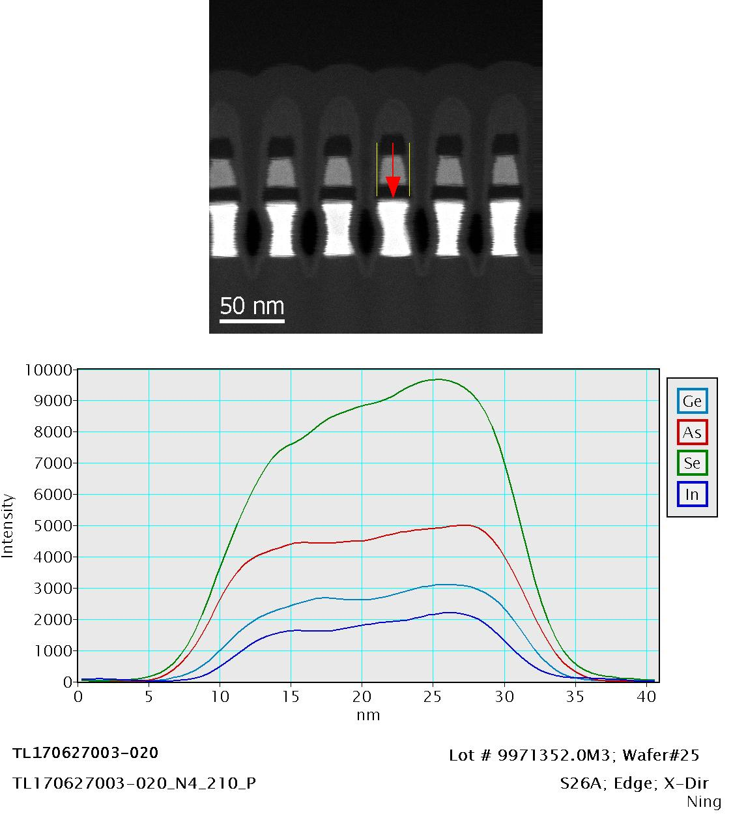

Slide 39
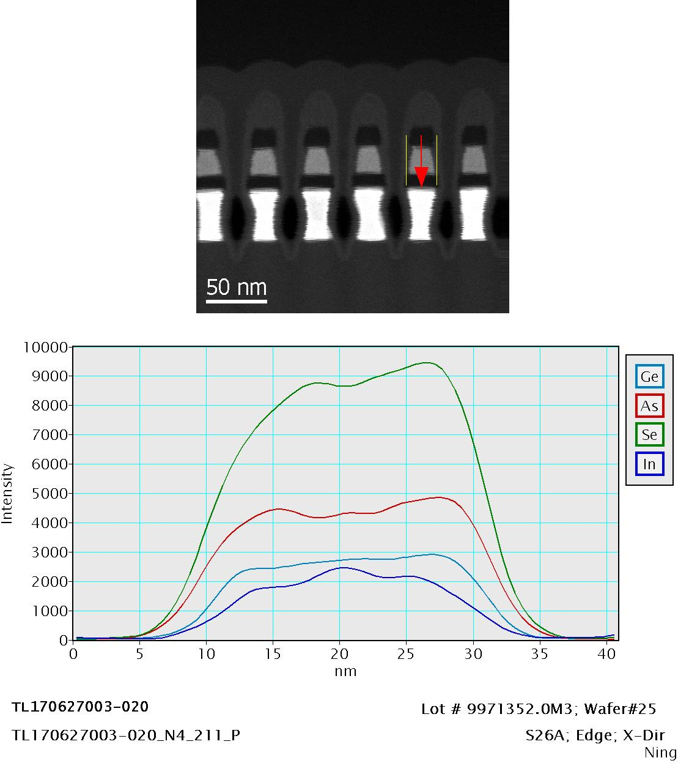

Slide 40
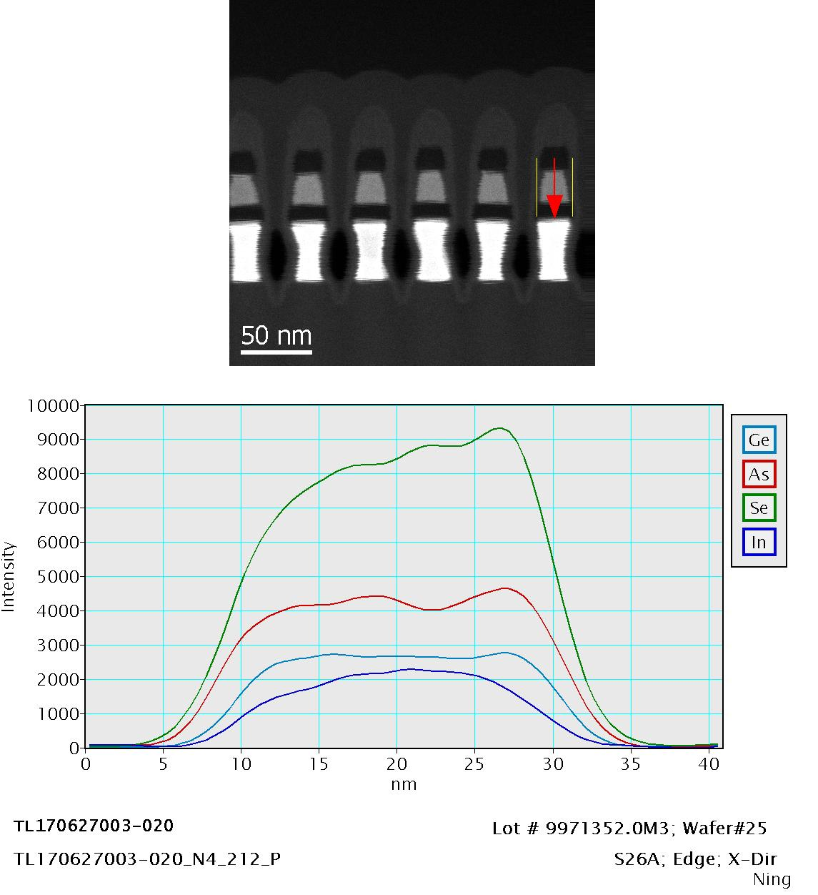

Slide 41
Sample ID :
Item# | Lot# | Wafer# | Part Type | Location | Direction | Remarks
030 | 9971352.0M3 | 25 | S26A | mid-radius | X-Direction

Slide 42
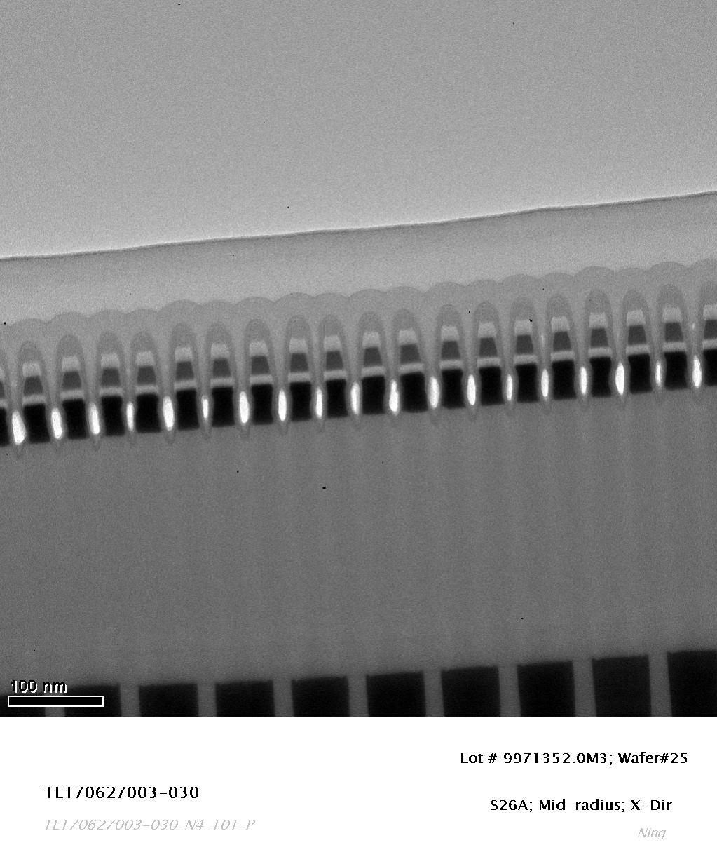
TEM Image

Slide 43
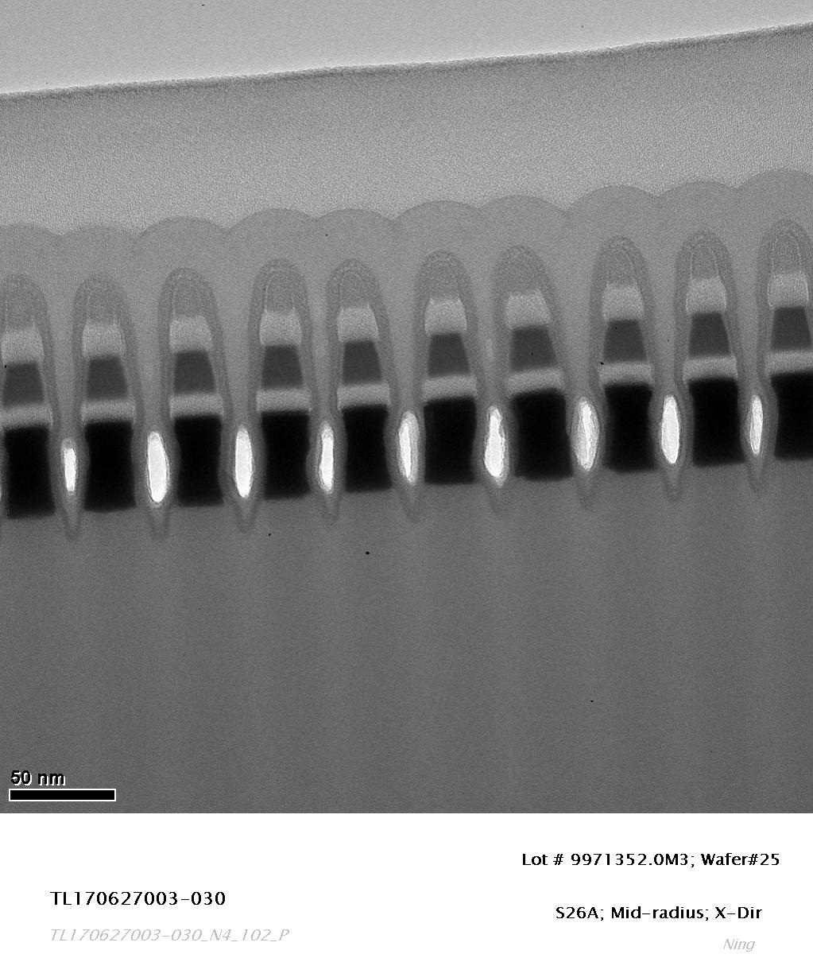
TEM Image

Slide 44
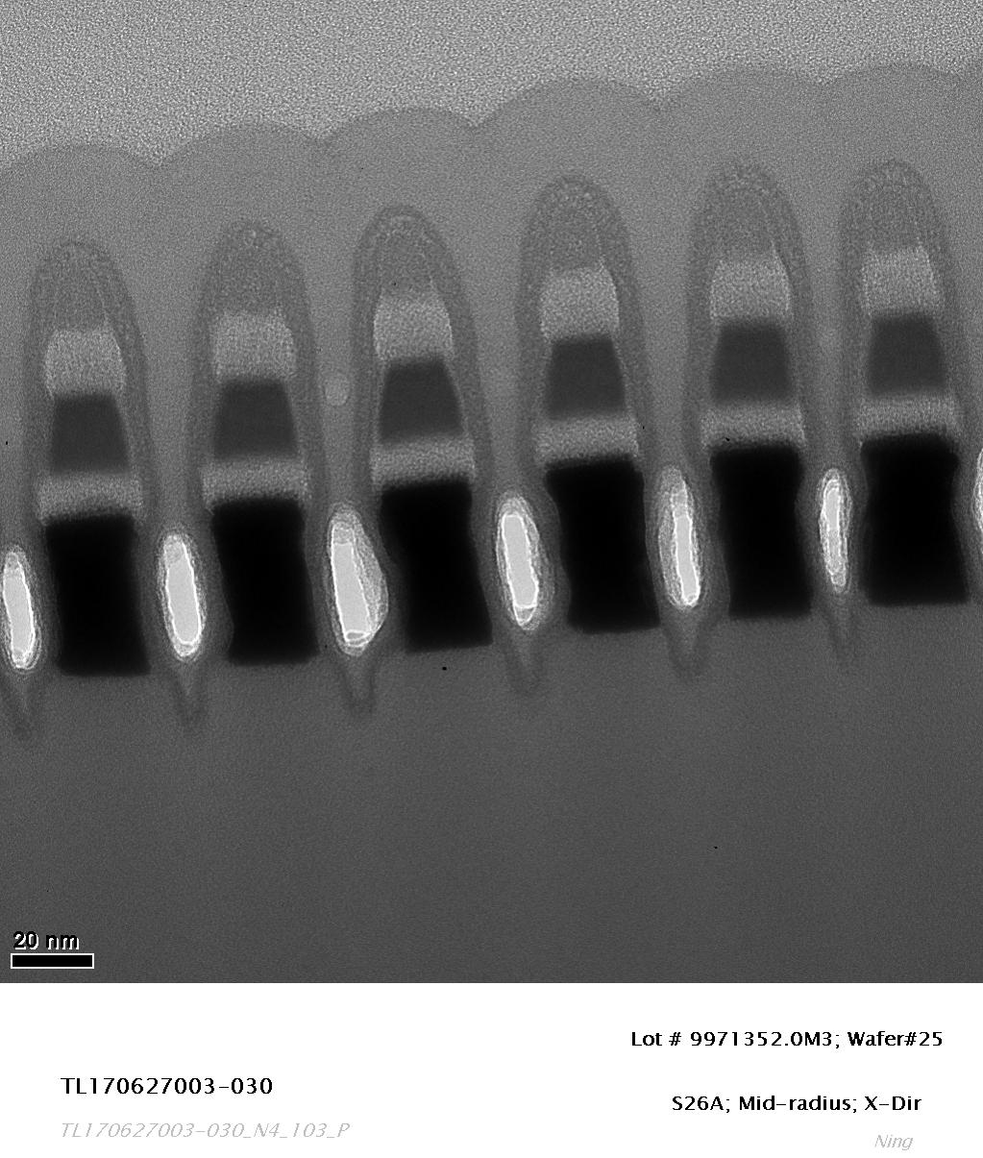
TEM Image

Slide 45
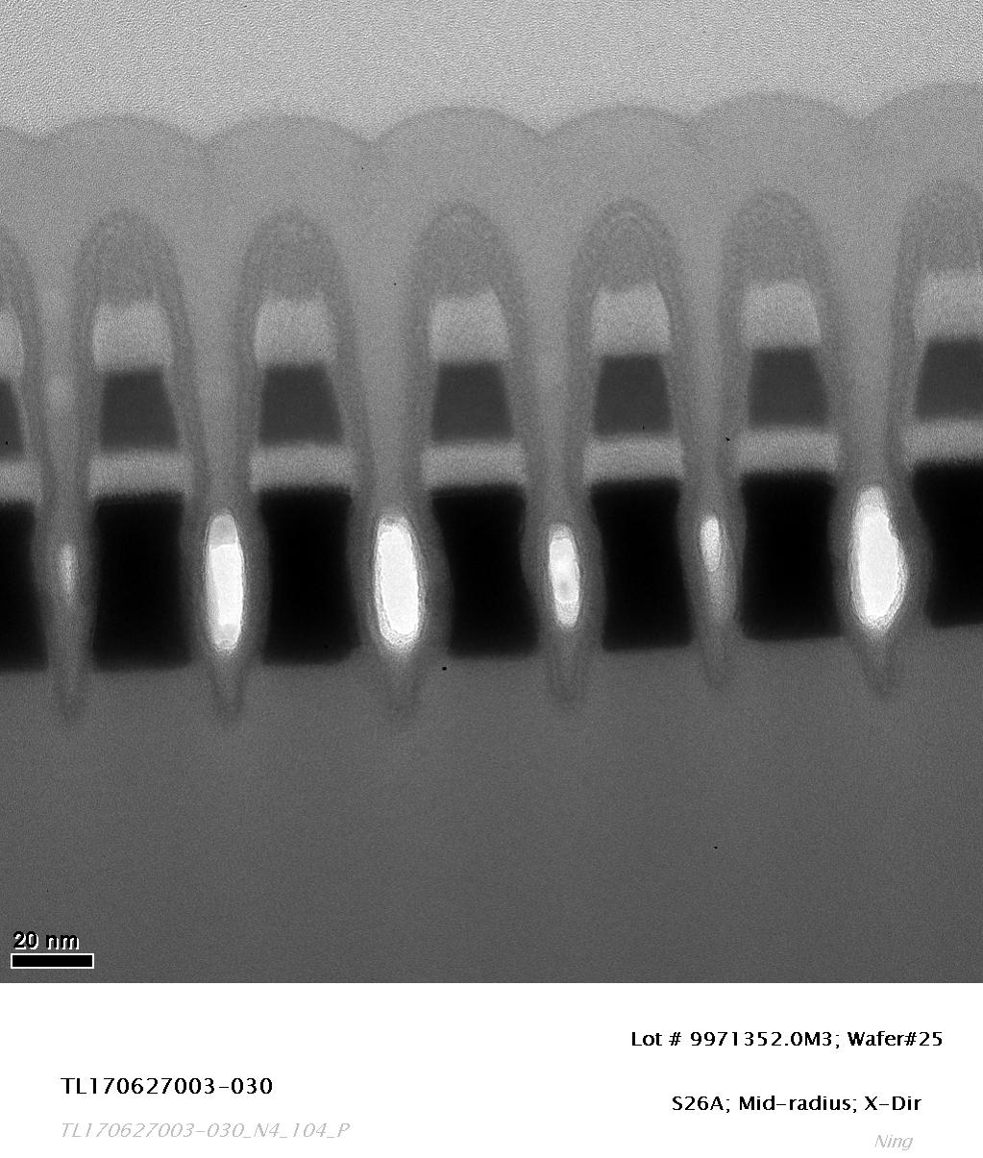
TEM Image

Slide 46
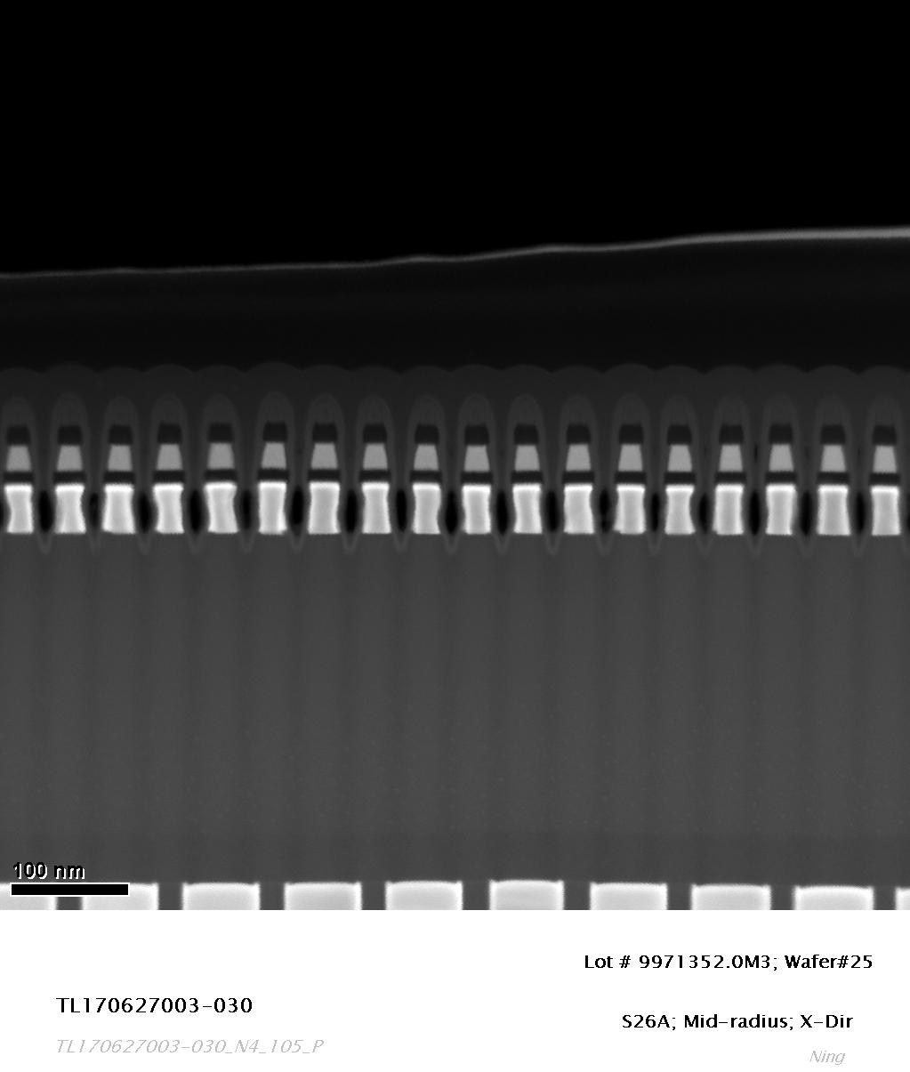
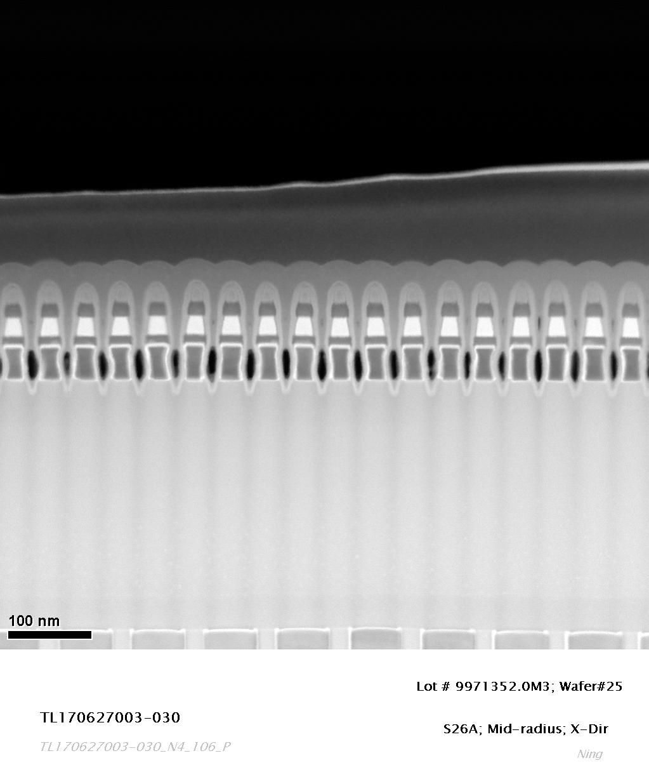
STEM Images

Slide 47


STEM Images

Slide 48


STEM Images

Slide 49


STEM Images

Slide 50

EDS Elemental Maps

Slide 51

EDS Elemental Maps

Slide 52

EDS Line Scanning Profile

Slide 53


Slide 54


Slide 55


Slide 56


Slide 57


Slide 58


Slide 59


Slide 60
EDS Element Composition Estimate: at.%
Job ID | Sample ID | Lot ID | Wafer ID | Part Type | Location | Cut Dir | Bit | SD Ge | SD As | SD Se | SD In
TL170627003 | 010 | 9971352.0M3 | 25 | S26A | Center | D0; X | 1 | 13.38 | 25.76 | 55.08 | 5.78
TL170627003 | 010 | 9971352.0M3 | 25 | S26A | Center | D0; X | 2 | 13.66 | 25.37 | 55.33 | 5.64
TL170627003 | 010 | 9971352.0M3 | 25 | S26A | Center | D0; X | 3 | 13.6 | 25.73 | 55.06 | 5.61
TL170627003 | 010 | 9971352.0M3 | 25 | S26A | Center | D0; X | 4 | 13.54 | 24.67 | 55.89 | 5.9
TL170627003 | 010 | 9971352.0M3 | 25 | S26A | Center | D0; X | 5 | 13.28 | 25.25 | 55.99 | 5.49
TL170627003 | 010 | 9971352.0M3 | 25 | S26A | Center | D0; X | 6 | 13.55 | 25.61 | 55.6 | 5.24
TL170627003 | 010 | 9971352.0M3 | 25 | S26A | Center | D0; X | 7 | 12.74 | 26.1 | 55.14 | 6.01
TL170627003 | 010 | 9971352.0M3 | 25 | S26A | Center | D0; X | 8 | 13.07 | 25.97 | 55.89 | 5.07
TL170627003 | 010 | 9971352.0M3 | 25 | S26A | Center | D0; X | 9 | 13.57 | 25.6 | 55.6 | 5.23
TL170627003 | 010 | 9971352.0M3 | 25 | S26A | Center | D0; X | 10 | 12.97 | 25.63 | 56.09 | 5.31

Slide 61
EDS Element Composition Estimate: at.%
Job ID | Sample ID | Lot ID | Wafer ID | Part Type | Location | Cut Dir | Bit | SD Ge | SD As | SD Se | SD In
TL170627003 | 020 | 9971352.0M3 | 25 | S26A | Edge | D0; X | 1 | 13.21 | 25.34 | 55.23 | 6.22
TL170627003 | 020 | 9971352.0M3 | 25 | S26A | Edge | D0; X | 2 | 13.61 | 25.37 | 55.2 | 5.82
TL170627003 | 020 | 9971352.0M3 | 25 | S26A | Edge | D0; X | 3 | 13.61 | 25.37 | 55.27 | 5.74
TL170627003 | 020 | 9971352.0M3 | 25 | S26A | Edge | D0; X | 4 | 12.74 | 26.16 | 55.23 | 5.86
TL170627003 | 020 | 9971352.0M3 | 25 | S26A | Edge | D0; X | 5 | 13.3 | 25.67 | 54.9 | 6.14
TL170627003 | 020 | 9971352.0M3 | 25 | S26A | Edge | D0; X | 6 | 13.42 | 25.45 | 54.98 | 6.14
TL170627003 | 020 | 9971352.0M3 | 25 | S26A | Edge | D0; X | 7 | 13.05 | 25.08 | 55.77 | 6.1
TL170627003 | 020 | 9971352.0M3 | 25 | S26A | Edge | D0; X | 8 | 13.29 | 25.35 | 54.84 | 6.53
TL170627003 | 020 | 9971352.0M3 | 25 | S26A | Edge | D0; X | 9 | 13.12 | 26.23 | 54.62 | 6.03
TL170627003 | 020 | 9971352.0M3 | 25 | S26A | Edge | D0; X | 10 | 13.17 | 25.51 | 54.48 | 6.85

Slide 62
EDS Element Composition Estimate: at.%
Job ID | Sample ID | Lot ID | Wafer ID | Part Type | Location | Cut Dir | Bit | SD Ge | SD As | SD Se | SD In
TL170627003 | 030 | 9971352.0M3 | 25 | S26A | Mid-radius | D0; X | 1 | 13.04 | 25.21 | 56.19 | 5.56
TL170627003 | 030 | 9971352.0M3 | 25 | S26A | Mid-radius | D0; X | 2 | 13.54 | 25.27 | 55.3 | 5.89
TL170627003 | 030 | 9971352.0M3 | 25 | S26A | Mid-radius | D0; X | 3 | 12.85 | 24.64 | 56.32 | 6.19
TL170627003 | 030 | 9971352.0M3 | 25 | S26A | Mid-radius | D0; X | 4 | 13.36 | 24.72 | 56.17 | 5.75
TL170627003 | 030 | 9971352.0M3 | 25 | S26A | Mid-radius | D0; X | 5 | 12.88 | 25.2 | 56.37 | 5.54
TL170627003 | 030 | 9971352.0M3 | 25 | S26A | Mid-radius | D0; X | 6 | 13.02 | 25.92 | 55.22 | 5.84
TL170627003 | 030 | 9971352.0M3 | 25 | S26A | Mid-radius | D0; X | 7 | 13.41 | 24.8 | 56.07 | 5.72
TL170627003 | 030 | 9971352.0M3 | 25 | S26A | Mid-radius | D0; X | 8 | 13.83 | 24.61 | 55.75 | 5.81
TL170627003 | 030 | 9971352.0M3 | 25 | S26A | Mid-radius | D0; X | 9 | 13.51 | 25.75 | 55.2 | 5.55
TL170627003 | 030 | 9971352.0M3 | 25 | S26A | Mid-radius | D0; X | 10 | 13.31 | 25.35 | 55.37 | 5.97

Slide 63
Calibrated SD composition estimate: at.% (calibrated based on ICP composition in TL170621002)
Center of wafer, Si concentration is assumed to be 7 at% in SD
Job | Sample | Lot | Wafer | Part Type | Location | Cut | Bit | SD | SD | SD | SD | SD
ID | ID | ID | ID |  |  | Dir |  | Ge | As | Se | In | Si
TL170627003 | 010 | 9971352.0M3 | 25 | S26A | Center | D0; X | 1 | 13.00 | 23.92 | 52.96 | 3.12 | 7
TL170627003 | 010 | 9971352.0M3 | 25 | S26A | Center | D0; X | 2 | 13.29 | 23.47 | 53.05 | 3.19 | 7
TL170627003 | 010 | 9971352.0M3 | 25 | S26A | Center | D0; X | 3 | 12.97 | 23.75 | 53.35 | 2.93 | 7
TL170627003 | 010 | 9971352.0M3 | 25 | S26A | Center | D0; X | 4 | 12.93 | 23.25 | 53.80 | 3.02 | 7
TL170627003 | 010 | 9971352.0M3 | 25 | S26A | Center | D0; X | 5 | 12.83 | 23.73 | 53.65 | 2.78 | 7
TL170627003 | 010 | 9971352.0M3 | 25 | S26A | Center | D0; X | 6 | 13.03 | 23.44 | 53.95 | 2.59 | 7
TL170627003 | 010 | 9971352.0M3 | 25 | S26A | Center | D0; X | 7 | 12.68 | 24.30 | 53.32 | 2.70 | 7
TL170627003 | 010 | 9971352.0M3 | 25 | S26A | Center | D0; X | 8 | 13.03 | 23.82 | 53.53 | 2.62 | 7
TL170627003 | 010 | 9971352.0M3 | 25 | S26A | Center | D0; X | 9 | 13.01 | 24.20 | 53.15 | 2.64 | 7
TL170627003 | 010 | 9971352.0M3 | 25 | S26A | Center | D0; X | 10 | 12.90 | 23.86 | 53.54 | 2.70 | 7

Slide 64
Calibrated SD composition estimate: at.% (calibrated based on ICP composition in TL170621002)
Edge of wafer, Si concentration is assumed to be 7 at% in SD
Job | Sample | Lot | Wafer | Part Type | Location | Cut | Bit | SD | SD | SD | SD | SD
ID | ID | ID | ID |  |  | Dir |  | Ge | As | Se | In | Si
TL170627003 | 020 | 9971352.0M3 | 25 | S26A | Edge | D0; X | 1 | 12.85 | 23.12 | 53.94 | 3.09 | 7
TL170627003 | 020 | 9971352.0M3 | 25 | S26A | Edge | D0; X | 2 | 13.23 | 23.28 | 53.36 | 3.12 | 7
TL170627003 | 020 | 9971352.0M3 | 25 | S26A | Edge | D0; X | 3 | 13.62 | 23.03 | 53.33 | 3.03 | 7
TL170627003 | 020 | 9971352.0M3 | 25 | S26A | Edge | D0; X | 4 | 13.04 | 23.34 | 53.55 | 3.07 | 7
TL170627003 | 020 | 9971352.0M3 | 25 | S26A | Edge | D0; X | 5 | 13.02 | 23.97 | 52.99 | 3.01 | 7
TL170627003 | 020 | 9971352.0M3 | 25 | S26A | Edge | D0; X | 6 | 13.17 | 23.55 | 53.22 | 3.06 | 7
TL170627003 | 020 | 9971352.0M3 | 25 | S26A | Edge | D0; X | 7 | 12.87 | 23.15 | 53.75 | 3.23 | 7
TL170627003 | 020 | 9971352.0M3 | 25 | S26A | Edge | D0; X | 8 | 13.00 | 23.69 | 53.02 | 3.28 | 7
TL170627003 | 020 | 9971352.0M3 | 25 | S26A | Edge | D0; X | 9 | 13.05 | 23.62 | 53.09 | 3.25 | 7
TL170627003 | 020 | 9971352.0M3 | 25 | S26A | Edge | D0; X | 10 | 13.02 | 23.27 | 53.34 | 3.37 | 7

Slide 65
Calibrated SD composition estimate: at.% (calibrated based on ICP composition in TL170621002)
Middle of wafer, Si concentration is assumed to be 7 at% in SD
Job | Sample | Lot | Wafer | Part Type | Location | Cut | Bit | SD | SD | SD | SD | SD
ID | ID | ID | ID |  |  | Dir |  | Ge | As | Se | In | Si
TL170627003 | 030 | 9971352.0M3 | 25 | S26A | Middle | D0; X | 1 | 12.77 | 23.29 | 54.03 | 2.91 | 7
TL170627003 | 030 | 9971352.0M3 | 25 | S26A | Middle | D0; X | 2 | 13.06 | 23.07 | 53.78 | 3.09 | 7
TL170627003 | 030 | 9971352.0M3 | 25 | S26A | Middle | D0; X | 3 | 12.72 | 22.94 | 54.43 | 2.90 | 7
TL170627003 | 030 | 9971352.0M3 | 25 | S26A | Middle | D0; X | 4 | 13.21 | 23.06 | 53.81 | 2.92 | 7
TL170627003 | 030 | 9971352.0M3 | 25 | S26A | Middle | D0; X | 5 | 13.21 | 23.06 | 53.81 | 2.92 | 7
TL170627003 | 030 | 9971352.0M3 | 25 | S26A | Middle | D0; X | 6 | 12.96 | 23.19 | 53.74 | 3.11 | 7
TL170627003 | 030 | 9971352.0M3 | 25 | S26A | Middle | D0; X | 7 | 12.79 | 23.54 | 53.68 | 2.99 | 7
TL170627003 | 030 | 9971352.0M3 | 25 | S26A | Middle | D0; X | 8 | 12.75 | 23.39 | 53.87 | 2.99 | 7
TL170627003 | 030 | 9971352.0M3 | 25 | S26A | Middle | D0; X | 9 | 13.22 | 22.94 | 53.89 | 2.95 | 7
TL170627003 | 030 | 9971352.0M3 | 25 | S26A | Middle | D0; X | 10 | 12.99 | 23.22 | 53.81 | 2.98 | 7

