Slide 1
SSM update
2017-Wk24
SSM team

Slide 2
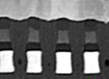
SD Polarity Effect in Crossbar architecture
2xCMOS data
A Vth window has been observed by applying programming pulses to the SD device with opposite polarity
The most accredited mechanism underlying this effect is the vertical movement of atomic species inside the chalcogenide material
The effect has been experimentally observed on several vehicles (50nm PTX SD-only, 20nm S15/S26 SD-only and Full Stack), test structures (2xCMOS, 2xNMOS, SR71) and for various SD compositions (SD1 and SDδ alloys)
The mechanism is extremely fast (Set/Reset in ~20ns) and the endurance is better than 3DXPoint (~10M cycles)
BL
TE
SD
Vertical Position
BE
WL

Slide 3
SSM goals and milestones
Complete Self-Selector Memory (SSM) Architecture and Capability Assessment
Describe preliminary assessment of mechanism and propose path forward
Milestones for July/17
  Assessment of drift mechanisms of the different states and mitigation opportunities
  Demonstrate window improvement with alumina lamina and selector composition trials
  Proposal of SSM development strategy

Slide 4
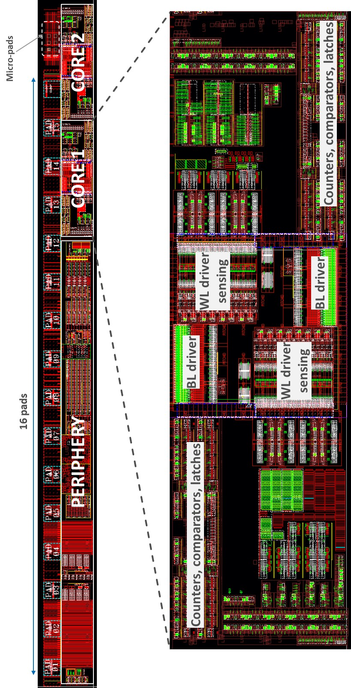
Silicon and test vehicles used for the assessment
SSM flow is based on S26A SxP process
  6 SSM lots evaluated for March/17 assessment
  6 additional SSM lots out and tested → today’s presentation
  8 SSM lots (segmentation and combo lots) planned out and tested for the end of July
Main vehicle for the assessment is the SR71B test chip on S26A test pattern
  2x256kb test chip arrays (active cells are spread inside a 2x4Mb physical arrays) with dual polarity program capability and single polarity read
Additional characterizations not feasible on SR71B are performed at intrinsic level on single cell structures (2xCMOS structure)
256kb active array
(physical array is 4Mb)

Slide 5
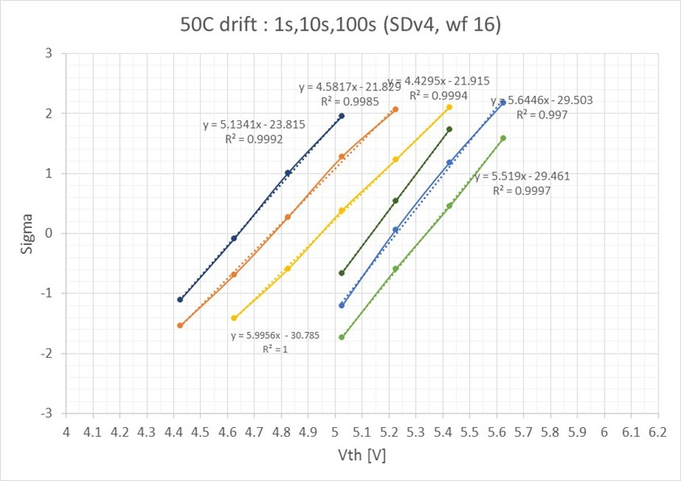
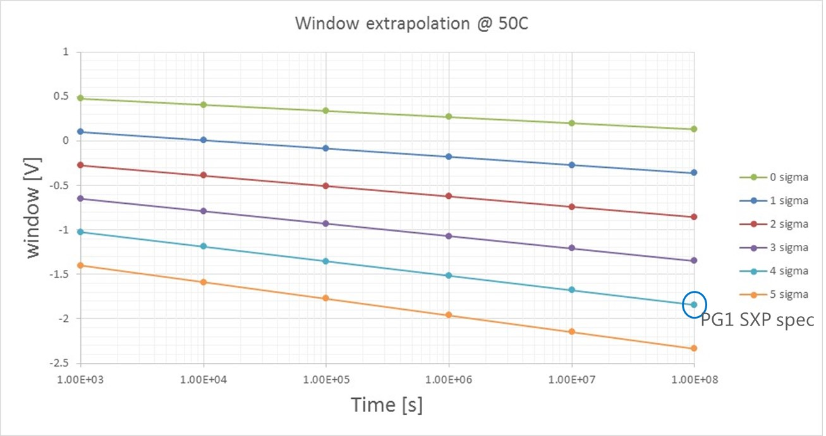
SSM risks – Drift/data retention
Drift is the most critical effect in SSM because it translates into a data retention issue
  Set states drift as in SxP
  Reset state drift less in median
  Both states shows a degradation of the distribution spread
With the different drift behavior for Set and Reset
  Multiple Vdm tracking strategy is not effective for mitigating Vth window reduction
  Power-on spec may be relaxed with the introduction of a refresh strategy, but power-off spec cannot be mitigated at system level
  Drift evolution must be accounted for in the RWB
    Gap to goal for 17nm SDδ ver12 with PG1 SxP spec is around 1.8V
Set
Reset
Gap to goal
1.8V

Slide 6
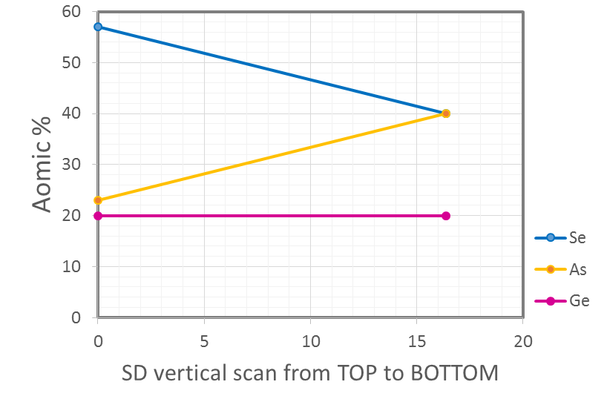
Background on drift in SxP and its application to SSM
Low Vth case (SxP)
Vth evolution over time (drift) in SxP is usually associated to a band-gap widening over time
In SxP, Vth is mainly determined by the energy gap in the As-rich region (low Vth)
Since SSM high Vth state is related to the energy gap of the Se-rich region, an analogous energy gab widening can take place → High Vth may evolve over time with a specific law
  Low and high Vth state share the same physical mechanism for drift, but the magnitude of this phenomenon is related to the local SD composition
Highest II probability for holes
Hole velocity
+
-
SD thickness
Holes II region - low E_{G} (low Se%)

Slide 7
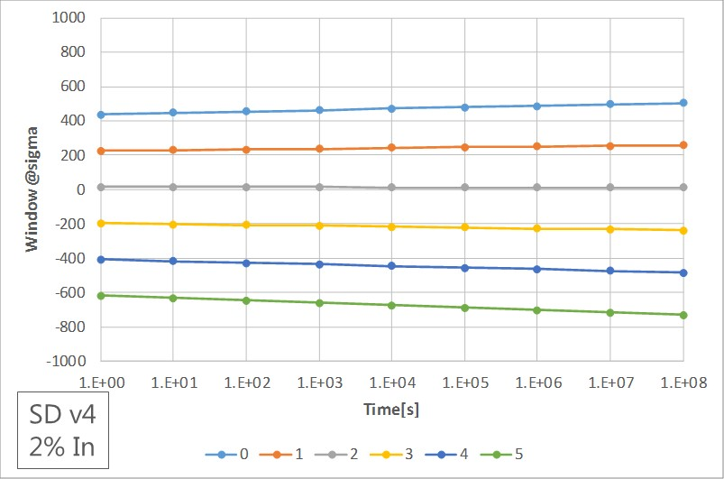
In-doped SD results - Drift
50C drift: 100ms, 1s, 10s, 100s (SDd v4 + In)
17nm In-doped SD shows consistent improvements for SSM
  Significant reduction for FF (about 1V less!)
  Slight reduction of the Vth window
  Significant reduction of distribution spread
    100mV/sigma compared with 150mV/sigma in the reference
  Significant reduction of drift compared to the reference
    Drift rate reduction (in particular for the low Vth state) and equalization among the two states, with almost no sigma degradation
    Gap to goal is reduced from 1.8V to 0.5V for the functionality window
    Multiple Vdm are required for managing the residual drift (as in SxP)
Set
Reset
Vth window extrapolation @50C
Gap to goal
500mV

Slide 8
SSM risks – Functionality window
Functionality window is intended as median window required to accommodate distribution with SxP PG1 BER (about 4σ) and including retention loss mechanisms (true window)
Intrinsic Vth window for 17nm SDδ ver4 with 2% In is 450mV
  In-doping provides a dramatic reduction of FF and distribution spread
  In-doping basically remove any concern about data retention
  Gap to goal for functionality window is 500mV
Known Vth window enlargement knobs to fill the gap to goal
 | Expected contribution | Confirmation | Confidence
AlOx lamina | +200mV | wk27 | High
Negative reading on thicker SD | +400mV | wk30 | Medium
Sensing scheme | +600mV | wk30 | Low
O2 flash @ 52 | +200mV | wk28 | Low

Slide 9
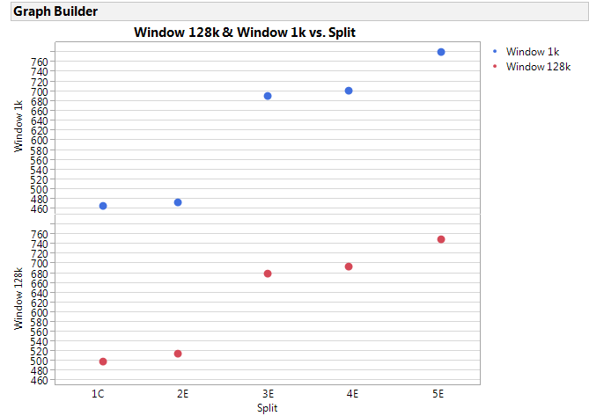
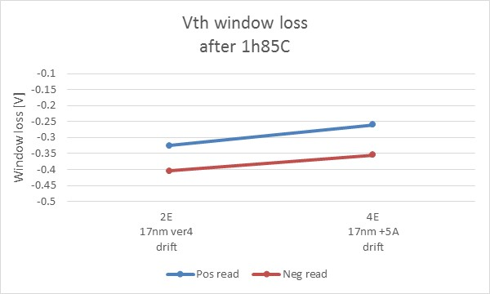
AlOx lamina top/bottom
1k cycles
10A AlOx
Old SD-only lot showed an improvement of the Vth window by adding an AlOx PVD-deposited lamina top&bottom
About 200mV Vth window improvement has been confirmed on two lots with 5Å of AlOx lamina
Distribution spreads and Vth evolution over cycling are equal or better with the 5Å AlOx lamina
Slight improvement in drift has been observed
Vth window [mV]
5A AlOx
Ver12
Ver4
128k cycles
Vth window [mV]
2xCMOS data

Slide 10
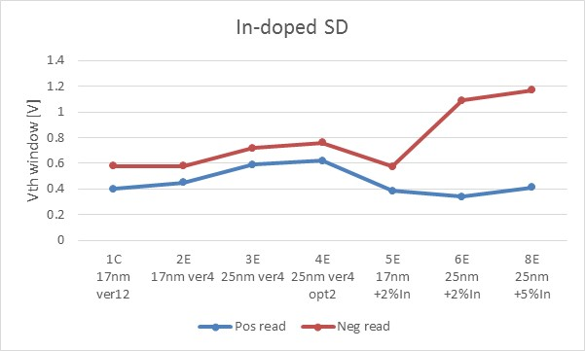
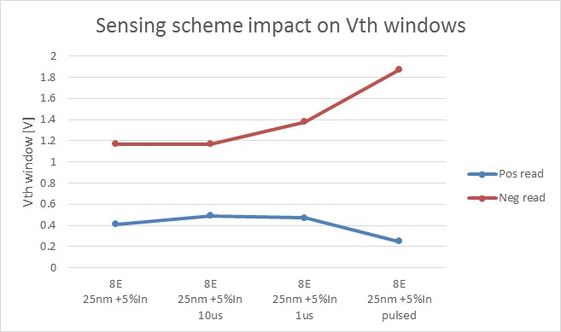
Negative reading and sensing scheme (2xCMOS data)
2xCMOS data
2xCMOS allow for negative reading, while SR71B can explore only positive reading
  Negative reading window has been always higher and few times equal to the positive reading one
  Some trials show an enhanced asymmetry between the two reading polaritie, as for 25nm In-doped SD
  SR71B new design with negative reading released on wk22 for S26A1 mask set
  SR71B workaround for negative reading on few cell is expected out and tested by the end of July
2xCMOS standard sensing is much slower than SR71B
  A faster sensing on 2xCMOS exacerbate the asymmetry between positive and negative reading
  Sensing scheme closest to SR71B shows a negative reading window up to 1.9V
Negative reading window asymmetry
Thickness
for std SDδ
Fast sensing (similar to SR71B)
Faster sensing
2xCMOS data

Slide 11
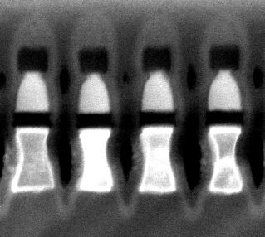
Model for negative reading boost
Negative reading boost was observed on some 25nm SD trials (AlOx lamina, In doping) that are critical for etching
Tapered cell profile clearly observed on 25nm In-doped SD
Tentative model:
  Negative reading senses the SD composition in the top part of the cell
  Smaller cells usually shows a pronounced windows
→ Negative reading window boost is due to the small size of the cell in the top SD part
SD region sensed by negative reading
2xNMOS test structure, 22nm SDδ

Slide 12
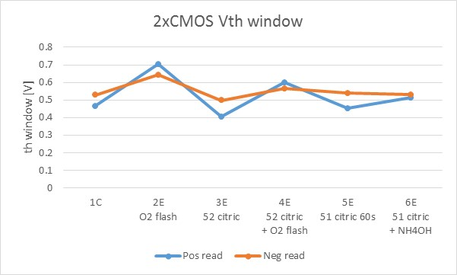
O2 flash @52 etch
Window boosting observed on 2xCMOS, but it is not confirmed on SR71B
  This lot has big CMOS issues, worst yield up to now
  Positive reading window is equal to the negative reading one
Need to re-check the signal on a new lot with better health
2xCMOS data

Slide 13
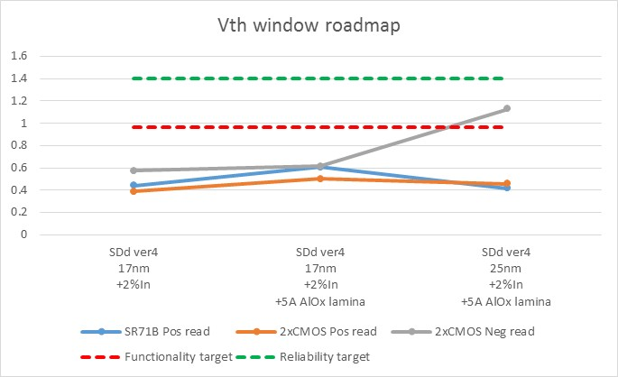
Vth window roadmap for July/17 assessment
Vth window roadmap including medium/high confidence ingredients
Reliability target assumes some system mitigations, similar to SxP
25nm SD estimate is based on In-doped SD thickness sensitivity that shows a strong asymmetry between positive and negative reading
  Negative reading on SR71B is a key ingredient for the demonstration
Reliability target
Target for SR71B with negative reading
Functionality target

Slide 14
Next activities
Assessment by July of the functionality window achieved on SR71B
  8 segmentation/combo lots planned out to confirm/refine the Vth window enlargement roadmap
PVD chamber conversion to sustain the SSM activity
  SDd ver12 with In-doping + AlOx lamina → POR flow starting from wk25
  Camp F* extension to investigate the role of As/Se/Ge and to explore bi-layer deposition to reduce FF
  Camp K* in quadrupole cathode chamber → explore In-doping (As2Se3+In2Se3) + Ge and Si content
S26A1 DBR in wk22 includes a new version of SR71B
  Full bipolar operation with positive and negative reading on all bits
  Current control in both polarities
  Improved high voltage capability
  Parallel read/write operations
Inclusion of SR71B in S36X (30s spider chip mask set based on S26A1)
Segmenting the SSM underlying physical mechanism

Slide 15
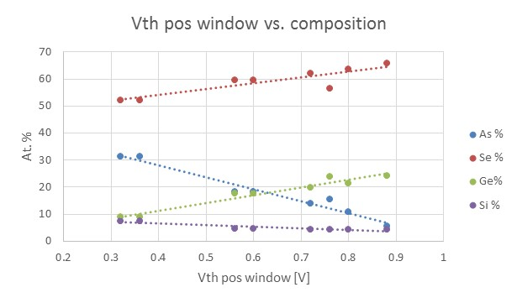
In-SiSAG optimization strategy
Camp F* extension (SiSAG system)
  Camp F* already showed a doubling of the Vth window on 10s SxP
  Main drawbacks are FF and drift increasing
  Scope of the new campaign: discover the optimal composition for enlarging Vth window
2xCMOS data
Camp K* (In-SiSAG)
  In-doping SDδ shows a strong mitigation of drift
  Scope of the new campaign: discover the optimal In-doping for reducing drift
Set
Reset

