Slide 1
SSM technology description and exploitation
WW1646
kyastreb, apirovan

Slide 2
Outline
Self-Select Memory (SSM) concept
Current assessment on S15C
Performance
Reliability
SSM optimization perspective
Research Mission & Strategy

Slide 3
SD polarity effect
Polarity naming always assumes 1D0 convention:
Positive: 1D0 BL high/pos voltage, 1D0 WL low/neg voltage, current flowing from BL to WL
Negative: 1D0 BL low/neg voltage, 1D0 WL high/pos voltage, current flowing from WL to BL
S15B SD-only, lot 8792062, 18nm SDδ ver 4
Positive programming pulse
VTH
Negative VT detection → VT=5.6V → VTHigh
Negative programming pulse
VTL
Negative VT detection → VT=4.7V → VTLow
A VT window has been observed by applying programming pulses to the SD device with opposite polarity
The mechanism underlying this effect is unknown (atomic species electromigration is the leading candidate model), but the effect has been experimentally observed on several vehicles (PTX SD-only, S15 SD-only, S15 FS), test structures (2xCMOS, 2xNMOS) and for various SD compositions (SD1 and several version of SDδ)

Slide 4
SD polarity effect exploitation
SD polarity effect may be exploited for
Stand-alone Self-Selecting Memory (SSM) device with
Simpler process integration
Lower programming current
Faster program speed
Less reliability issues
Enabling eMLC capability in the SxP configuration, with 3 and 4 level intrinsic feasibility demonstrated
Widening the VT window in the SxP configuration
3D-NAND like architectures

Slide 5
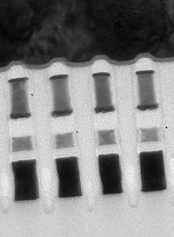
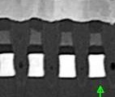
Process simplification
SSM is based on Single-chal SD-only process architecture
Basic flow already in place and used to segment SD selector behavior in SxP
SD-only flow overcomes several of the main process integration issues that we have in SxP
No cross-contamination between PM and SD → 1-step etch enabled as a result
Much lower cell aspect-ratio simplifies the cell sealing
The lower programming current reduces the requirements for metal lines (and for array decoders) and the associated array capacitance
Basic SD-only flow need to be optimized for a better exploitation of the SD-polarity effect
W BL
Carbon
W lamina
PM
Carbon
SD
Carbon
W WL
SxP
W BL
Carbon
SD
Carbon
W WL
SSM

Slide 6
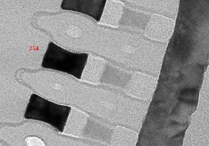
SD polarity effect (tentative) model
Negative reading
current injection
Positive reading
current injection
%
Positive programmed
Se
Virgin cell
As
%
Ge
Se
Position
Position
As
Ge
Negative reading
current injection
Negative programmed
Positive reading
current injection
Position
%
As
Se
Ge
Position
Leading candidate model is elemental segregation during program combined with a read-out that sense the Egap on the side far from the positive current injection side
Opposite reading polarity senses the Se-rich side leading to high VT, same polarity reading senses the As-rich side that is related to low VT
Model in agreement with existing data and PFA, more PFA analysis are needed to confirm

Slide 7
Why have we never used this effect before?
SD polarity effect was observed on PTX at 50nm, but the VT window was too small for any practical applications
On S15 at 20nm, the same SD composition leads to a much larger VT window
Area trend is favorable for scaling
2xNMOS test structure, 22nm SDδ

Slide 8
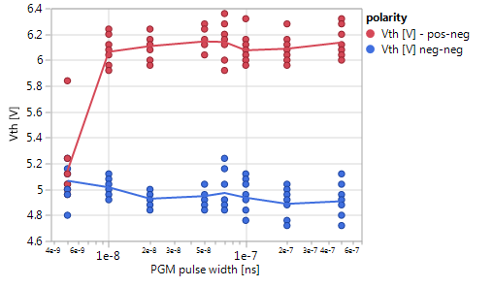
SSM performance
SD polarity effect is an extremely fast, symmetric, and low-current mechanism
A programming speed of 20ns is easily achieved
13x better than Memory Ship Release spec for set
39x faster than POR 3E set pulse in SxP
Vth-I characteristic is flat, thus allowing to use programming currents as low as 20-30uA
2-3x lower than Memory Ship Release spec for reset
5x lower than POR reset pulse in SxP
Average power consumption is 15x lower than SxP
SD polarity effect has no asymmetry for set and reset operation
SSM requires dual polarity decoders but with a much lower current capability
VTH
Vth [V]
VTL
Programming pulse width [s]
VTH
VTL

Slide 9
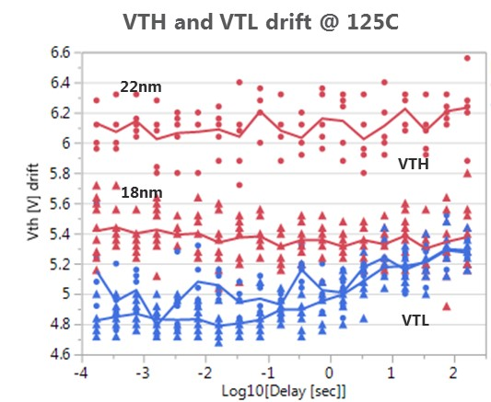
SSM intrinsic reliability
200ns pulse width endurance
Polarity effect is not interfering with the known SD functionality
Endurance is the same as for SD in SxP cell
More room for improvements due to lower programming currents and shorter pulses
Read endurance PG1 specs may be above today capability, but the SD-only flow is not optimized
No active or passive imprinting effect observed (in agreement with the actual model of the physical mechanism)
Read disturb is not visible for low and high Vt state
High Vt state disturb is related to bounce/delay time statistics
No “SoS” issue observed for low Vt state, just endurance limitation
No thermal disturb expected (apart drift activation)
Experimental data will be collected on S26
Drift of the low Vt state is the main reliability concern
Same contribution as in SxP, but impacting the overall Vt window
Same mitigation path as in SxP in term of technology, but may require different approaches in term of mitigation by design
High Vt stability allows to keep under control the maximum voltage

Slide 10
Overview of SSM window budget
Mean SD-polarity effect Vt
Mean SD Vt
Low Vt drift
E4
V_{inh} = inhibit margin
V_{Srm} = SET read margin
V_{Rrm} = RESET read margin
V_{Rwm} = RESET write margin
V_{inh}
V_{Srm}
V_{Rrm}
V_{Rwm}
V=SELBL (write)
V=DESWL/BL (write)
E1
E2
E3
V_{target}
V=SELWL=0
V=SELBL (read)
For SSM, the contributions to the window budget come from:
Available window between the low and high median Vt
Low Vt state sigma (bit variability+bounce, as measured on SD-only lots)
High Vt state sigma (bit variability+bounce, should be the same as for low Vth state)
Low Vt state drift (bias+unbias, as measured on SxP lots for set state)
xTile (as measured on SxP)

Slide 11
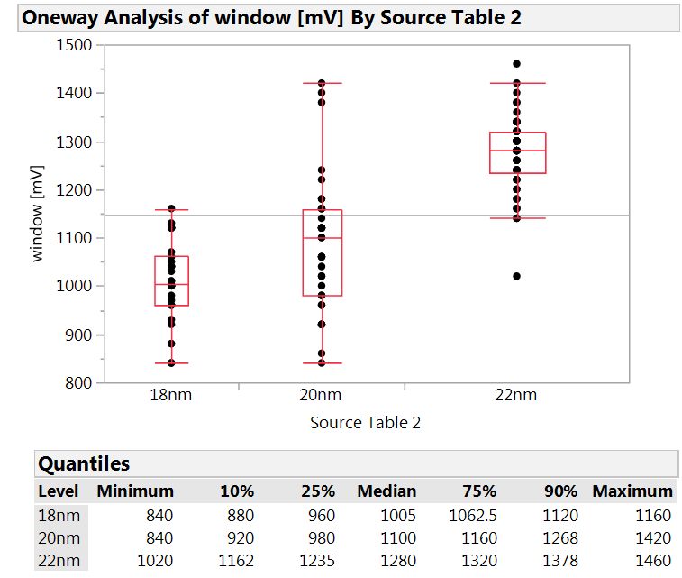
VT window modulation
VTH
The identified process toggle for the Vt window enlargement are:
the SD thickness, with a sensitivity of 70mV/nm
The SD composition, with a trade-off with maximum FF voltage and drift
E/SD interface, in particular at the BE (resistance or roughness)
SD thickness skew is the easiest trials still staying aligned with the SxP integration flow
Current SD thickness in SxP is 16nm, but for the SSM architecture a thicker film is preferable (maybe around 25nm)
The main drawback to achieve a larger window by increasing the SD thickness is the high voltage required for the FF and for program
Workarounds exist for reducing FF voltage
Despite the maximum programming voltage mat increase to enlarge the window, a key benefit is the stability of the high Vt state over time
VTL
SD thickness
SD thickness

Slide 12
Research Mission & Strategy
Self-Select Memory Research IM JDP SOW signed beginning of 2016
Mission – Seeking for Physics understanding to facilitate the long range strategic R&D for NVM
Algorithm and physics development of Self-Select Memory at 1st principle
Design SSM single cell and mini array in S26A scribe with opt-in metal jumper avoiding the incurred risk to S26A development
Develop S26A SD-only process flow and physical and electric performance metrics
Test and Characterize bi-direction Read/Write algorithm for NVM
Assess SSM for NVM limitation and trade-off
Including program transfer mechanisms, distribution, disturb and retention
Performance metrics subject to cell stack and architecture impact
Evaluate applicability of SSM basics for Comparable Technology Product such as
Stand alone SSM using SD only stack
SLC window expansion or MLC in S26A full stack

Slide 13
Milestones & Check points
# | Objectives | ECD* | Actual
1 | Test structures design validated, including Opt-in metal jumper in IG88 and QTT | Feb/16 | Feb/16
2 | SD-only flow portable to S26A | June/16 | Aug/16
3 | Silicon validated, including bi-direction operation for read/write | July/16 | Sept/16
4 | Validate SSM window & distribution for NVM retention and endurance | Aug/16 | FS Oct/16 SD-only Dec/16
5 | SSM architecture and capability assessment. The output provides preliminary physics understanding of the mechanism underlying SSM effect in order to conduct next level of memory array research. | Sept/16 | Feb/17
*: ECD aligned with S26A schedule and subject to delays on silicon execution
Milestones:
Concept demonstration on S26A → achieved on FS cells
Performance assessment → ECD Dec/16 with first SSM lot
Feasibility assessment with enlarged Vt-window → readiness for a complete performance/reliability assessment up to 4σ → Q1/17

Slide 14
Activities on S26A
Silicon with the new SSM flow
Baseline process (SD-only flow) → first SSM lot running
SD thickness is the preferred knobs for enlarging the window
Dual-polarity test-structure testing
2xCMOS → validated on FS
Intrinsic properties
SSM flow validation vs. S15C
IG88 → partially validated, metal opt-in is needed for activating this vehicle
Intrinsic properties with more statistics (52 cells)
More robust intrinsic assessment for forming/seasoning impact and for long-time drift/retention
QTT → design validation on-going → ECD Dec/16
ED impact
Thermal disturb
SR71B → design almost all validated → waiting for first SSM lot
4σ statistical validation with product-like algos

Slide 15
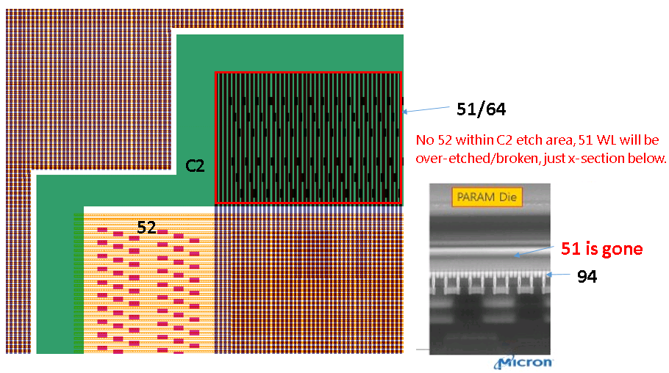
WL connection issue on mini-arrays in the S26A scribe lines
BL chop may etch the WL
This issue is impacting all the arrays in the scribe (2xCMOS, QTT, SR71)
SSM lots need to have the layout fix for the 52 mask → ECD wk46.7
Very few bits (5 of 292 tested) at the extreme edge of the first FS wafer were connected

Slide 16
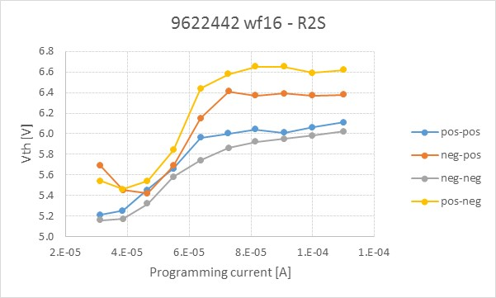
2xCMOS cell on S26A
S15C data are center wafer cells, S26A are from the extreme edge
Vehicle | S15C |  |  |  | S26A
Lot/rev | 7.13 | 7.13+N2 bake | 7.16 D0 | 7.16 D1 | 9622442 wf 16
FF | 7.16 | 7.20 | 6.99 | 7.05 | 6.96
pos-pos | 5.88 | 5.85 | 5.97 | 6.02 | 6.11
neg-pos | 6.28 | 6.2 | 6.33 | 6.4 | 6.38
neg-neg | 5.95 | 5.85 | 5.87 | 6.03 | 6.02
pos-neg | 6.41 | 6.25 | 6.52 | 6.51 | 6.62
DVth read pos | 0.4 | 0.35 | 0.36 | 0.38 | 0.27
DVth read neg | 0.46 | 0.4 | 0.65 | 0.48 | 0.6
Cells with working WL connection looks functional and basically aligned to 2xCMOS results on S15C lots
SD-polarity effect is confirmed on S26A → Milestone 1 partially achieved

