Slide 1
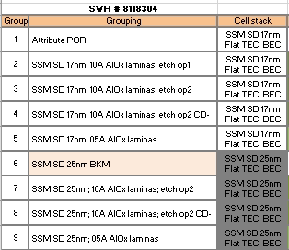
10s SXP Experiment Lot Report
Lot ID |  |  | SWR #, step set # |  |  | 8118304 |  | Classification: Screening Max score: 3 |  |  | Report Date Final Score
Owner | KYASTREB |  |  |  |  |  | EFA Engineer |  |  | EFA engineer name here
Device Flow | SD only SSM, |  |  | Vehicle (design ID) |  |  | S26A
POR synopsis | SSM rev3 (flat carbons, SD thickness 17nm/25nm) |  |  |  |  |  |  |  |  |  |  | Cell rev |  | SSM
Focus area | SSM Vt window, drift;
Why this exp is necessary? What decision depends on results? | Evaluate AlOx lamina on top and bottom of SD layer as a diffusion barrier for SD compositional preservation
What are key metrics for this exp and desired direction? | 51,52 level X-sections, CD metrics
Experiment design: split factors and hypotheses being tested
Decisions Made | Document group decision upon final data review
Links | Key Results | Split Chart |  |  | Process Details |  | Test Method |  | Your links here
Notes:
Lot ID: Name of lot
Lot #: Eight digit lot number
ELF: ELF ID
Report Date: Date of last report revision
Int. Owner / Int. Tech: Names of lot owner and technician
Lot Type: FL (full loop), SL (short loop), L1D
Product: Product (use actual product ID, not code name)
Process Rev: Revision of baseline/control split
Silicon Start: Start date for lot
Silicon Out: Fab out date for lot
Routes Used: Baseline route first, short loop routes afterwards
Pilots: Listing of key pilots on lot.
Deviations: Listing of key process deviations on lot.
Focus Areas: Focus teams reviewing lot (Frontend, Midsection, Backend, Cell, CMOS, Patterning, etc)
Lot Purposes: Bulletized lot purposes
Desired Resp: Conversion, changes, decisions desired from lot (may be same as lot purpose)
Key Splits: High level description of individual splits (factors/variations)
Decisions Made: Key changes and decisions made based on experiment results.
Links: Add links to reports.
Lot owner is responsible for summarizing key results.
Lot owner is responsible for pulling inline NDI.
Lot owner is responsible for e-test report.
Fingerprint refers to any XSEM links.
Indicators: Lot rating on scale of 1-10. Execution based on meeting lot purposes. Schedule based on Si start to Si out.

Slide 2
Analysis Input
Analysis Required
DOE Design Details
If Fractional Factorial, what interactions can we neglect (what interactions can we convolute, assuming they are not significant)?
Key metrics to analyze as DOE (if different than listed in coversheet)
Any other design details (replicates, center points, alias/confounding structure, DOE matrix, Blocking, easy/hard to change factors)*
*Please list any unforeseen issues with SWR and how it impacted the design

Slide 3
Key Results
Key Results | Observations and/or measured constants: RDA report: In-line data summary
Known process issues (mis-processing, errors)
What unknowns remain? Plans to follow up.

Slide 4
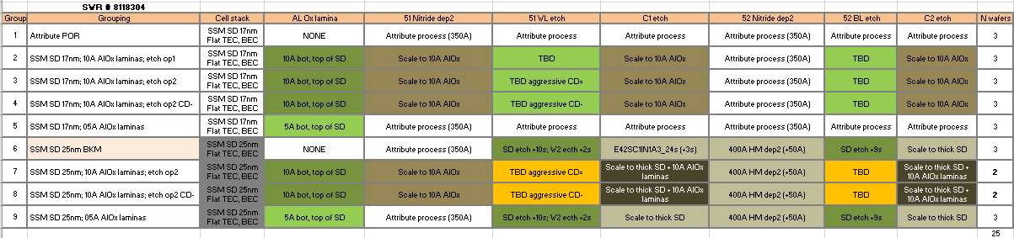
Split Chart SWR

Slide 5
SWR Effectiveness Scoring Guidelines
Class of Experiment | Purpose | Example | SxP Program Value Aligned with SWR committee | Scoring Guidelines Scored by SWR owner, Ratified by Integration Manager/SWR Committee
Classify and Score prior to SWR committee submission. Enter scoring in SWR coversheet and insert the link in SWR. Will be transferred to tracking dB by PI tech |  |  |  | Score post probe and final report completion. Enter score in SWR coversheet. Will be transferred to tracking dB by PI tech
Screening | Establish model or causal factors for a critical problem | Establish Physical Model by segmentation of factors or DOE of critical variables | 3 - urgent/program show stopper 2 - program high risk 1 - for others | a) Multiplier =1 when a clear model is established with potential approach to solution b) Reduce score to 0.5X when experiment clearly refutes existing models but does not establish new model c) Score 0 when a,b are not true
Solution | Establish solution path for a problem | Solution of WL-lkg, PVS etc | 3 - urgent/program show stopper 2 - program high risk 1 - for others | a) Multiplier =1 when new usable toggle is determined b) Reduce score to 0.75X when (a) is not true, but new factor is identified which needs re-integration to negate downside c) Reduce score to 0.5X when (b) is not true, but experiment clearly points to solution path (with risk reduction) or confirms previous experiment d) Score 0 when a,b,c are not true
Bundle | Verify integration of several piecewise improvements | Yield Bundles, Cell Revs | 3 - urgent/program show stopper 2 - program high risk 1 - for others | a) Multiplier =1 when line converted to one of the options in experiment. b) Reduce score to 0.5X when an adjustment needing a new info turn is needed to convert the line. c) Reduce score to 0 when non-mitigatable surprise identified requiring new integration strategy or dropping of critical elements
Conversion | Convert to new process recipe or tool | Cost, MOR, TOR driven conversions | 1 -unless pre-approved by PI Manager | a) Multiplier =1 when process conversion is achieved b) Reduce score to 0.5X when a) is not true but clear path established for conversion c) Reduce score to 0 when a,b are not true
Characterization | Determine true specs/window and process centering |  | 1 - unless pre-approved by PI Manager | a) Multiplier =1 when line action taken based on characterization b) Reduce score to 0.5X when line action not taken but clear true specs established c) Reduce score to 0 when window characterization not achieved
Manufacturing | Redundancy, HVM, Data coll.,POR optimization, alignment |  | NA | NA

