Slide 1
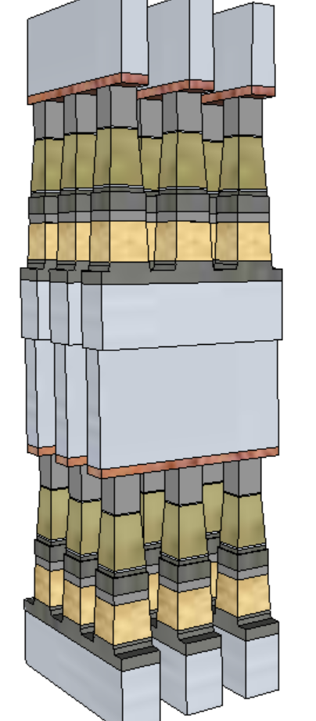
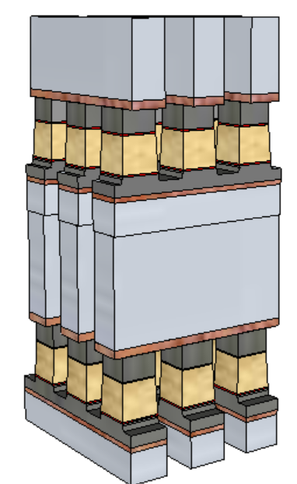
20nm Performance & Cell Architecture Comparison
 |  | Read |  | Write
 |  | 3DXP | SSM | 3DXP | SSM
Latency | ns | 105 | 105 | 465 | 175
Energy | pJ/b | 52 | 52 | 118 | 109
Latency limited BW | MB/s | 4876 | 4876 | 1101 | 2926
Power limited BW | MB/s | 1601 | 1601 | 800 | 866
 | 1st Cut |  | 2nd Cut
 | 3DXP | SSM | 3DXP | SSM
Stack height [nm] | 141 | 69 | 152 | 85
Stack Height, inc. HM [nm] | 296 | 142.6 | 297 | 191.7
Height/ Space for FP [nm] | 212.5/25.5 |  | 261/21.7
Height/ Space for LP [nm] | 246/19.6 | 142.6/19.6 | 182/18.4 | 191.7/18.4
Space Aspect Ratio for FP | 6.4 |  | 6.7
Space Aspect Ratio for LP | 8.4 | 4.8 | 9.1 | 5.4
SSM
3DXP

Slide 2
Circuit topology comparisons – Physical geometry insensitive
WL2
 | READ
 | 3DXP |  | SSM
 | Lower Deck | Upper Deck | Lower Deck | Upper Deck
WL2 | 0 | − | 0 | +
BL | + | + | − | −
WL1 | − | 0 | + | 0
WL2
 | SET
 | 3DXP |  | SSM
 | Lower Deck | Upper Deck | Lower Deck | Upper Deck
WL2 | +Vcc | − | -Vcc | +
BL | + | + | − | −
WL1 | − | +Vcc | + | -Vcc
SSM
BL
BL
3DXP
 | RESET
 | 3DXP |  | SSM
 | Lower Deck | Upper Deck | Lower Deck | Upper Deck
WL2 | +Vcc | − | +Vcc | −
BL | + | + | + | +
WL1 | − | +Vcc | − | +Vcc
WL1
WL1

Slide 3
Circuit topology comparisons – Profile dependent
WL2
 | READ
 | 3DXP |  | SSM
 | Lower Deck | Upper Deck | Lower Deck | Upper Deck
WL2 | 0 | − | 0 | −
BL | + | + | − | +
WL1 | − | 0 | + | 0
WL2
 | SET
 | 3DXP |  | SSM
 | Lower Deck | Upper Deck | Lower Deck | Upper Deck
WL2 | +Vcc | − | -Vcc | −
BL | + | + | − | +
WL1 | − | +Vcc | + | +Vcc
SSM
BL
BL
3DXP
 | RESET
 | 3DXP |  | SSM
 | Lower Deck | Upper Deck | Lower Deck | Upper Deck
WL2 | +Vcc | − | +Vcc | +
BL | + | + | + | −
WL1 | − | +Vcc | − | -Vcc
WL1
WL1

