Slide 1
SSM Update to JDP COMM
Jun/8/2018
Status and Plan
Baseline and Roadmap
SDK-A14 (co-sputter targets) demonstrates RWB gap within 100mV for PG1T1.
Lead SD.k2 (small monolithic target) exhibits elevated SWL/BinP; at SR71 testing for RWB/Rel confirmation.
Good structure health demonstrated for SD.k2 (Single Deck) and SD.k1 (Dual Deck)
Projected 15% gap to goal for SDk2 2D: Gap pareto and strategies identified.
Primary gap vs MTS is in SD profile (due to high doping): Significant progress in gap closure over the last week with key read on 2nd cut in 3 weeks and 1st cut needing additional refinement.
SD.k1 Dual Deck demonstrating reasonable offset on 1D (drop-off) to 2D (+225mV), Deck to Deck (+75mV) and Read Polarity (~200mV); electrical vs. physical segmentation is being planned.
SR71 on A3 Single Deck is validated. SR71 A3 Dual Deck will be hitting probe @ WW24.
S24S Design achieved Rev2 (WW20). DBR on track to WW39.
S24S startup planning in discussion, including pre-si DV and post-si PV, test spec, yield definition & fail-fast criteria, F2 coverage/transfer, and 14nm (S36X plate) and scalability development.

Slide 2
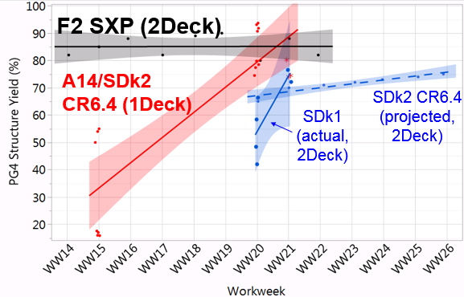
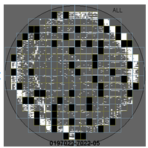
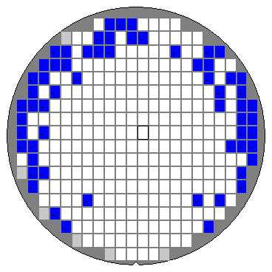
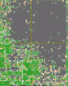
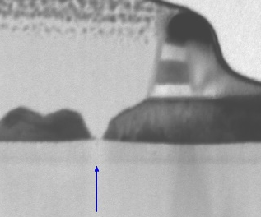
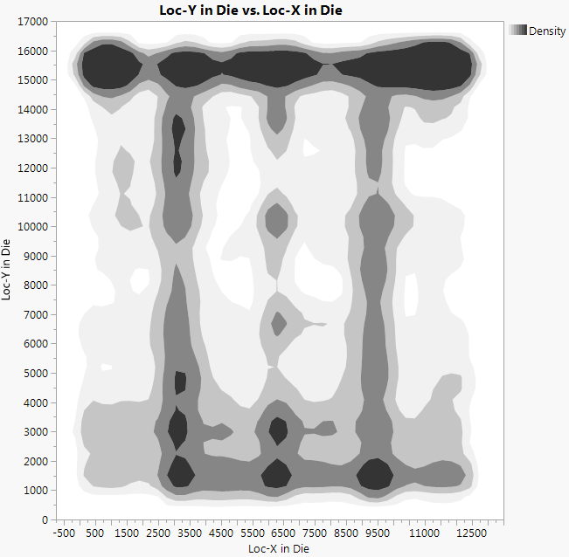
Structure yield Goal: SSM CR6.4 (SDk2) match F2 2-Deck S26A
2D data on SD.k2 not yet available.
Projected 15% gap to goal based on SDk1 2D and SDk2->SDk1 1D0.
Gap pareto and strategies identified.
Read points over the next 3 weeks to validate closure.
66NCMP margin – center using S26A dual slurry POR
CR 6.4 broken WLs – center C2 overetch (C2 etch reduction)
SWL vertical leakage – center SD thickness
SSM Single deck and Dual deck vs SXP dual deck
66 NCMP edge of tile damage
CR6.4 single deck yield limiter
RDA OP die shading matches probe
Reticle shaded C2 overetch broken WLs
PFA
66 NCMP OP RDA

Slide 3
SD Alloys – CR5.4/6.4 Status
Baseline (CR5.4)
SD.k1 monolithic target results showing a RWB gap ~300-350mV.
Cell Roadmap
SD.k-A14 demonstrated a RWB gap within 100mV (VDM1: -80/-100mV; VDM2: +250mV):
SD.k2 Single Deck available and being tested for confirmation and transition to CR6.4.
Campaign G* first 2 lots (SSM66,SSM67) have been released and last lot (SSM68) expected to start next week: at probe starting ww24-25.

Slide 4
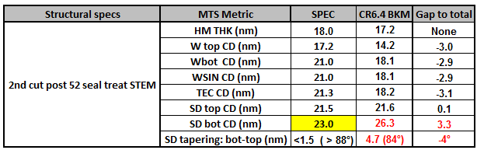
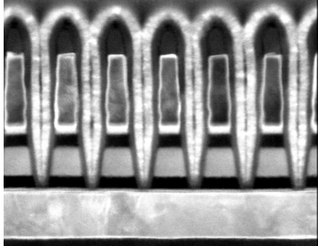
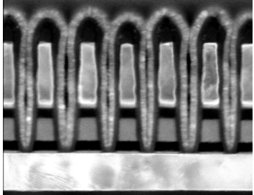
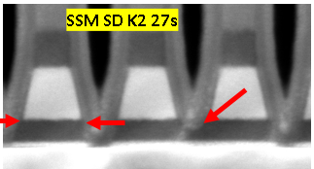
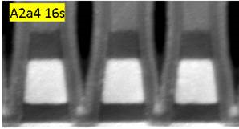
CR6.4 MTS Gap to Goal
Primary gap is in SD profile. High doping impacts etch biproduct volatility.
Significant progress in gap closure over the last week with key read on 2nd cut in 3 weeks and 1st cut needing additional refinement.
1st cut (2 steps)
2nd cut (single step)
Structure Specs | MTS Metric | SPEC | CR6.4 BKM | Gap to toal
Post FP | WL FP SD bot (nm) | 18.9 | 24.85 | 5.95
 | WL SD SWA (degree) | >88º | ~79º | -10º
Post LP | WL LP SD bot (nm) | 18.9 | 17.8 | -1.1
 | SD SWA | >89º | 88º | -1º
 | WL LP W Sep (nm) | 20.8 | 18.7 | -2.1
 | WL LP W Bot (nm) | 21.2 | 22.3 | 1.1
2nd cut Insitu DE main gap is SD sidewall angle:
- Status 84º vs 87º Q3 Goal
Most recent L1D experiment (lower N2 flow and higher H2 flow @SD etch) shows SD SWA ~ 86.7º
1D0 Probe expected WW26
1st cut FP DE main gap is SD sidewall angle:
- Status 79º vs 87º Q3 goal
- Latest L1D status: SD SWA>86º, risk is WL W resputter + W separation degradation, further development in progress to mitigate
Current baseline SD SWA=79º
Best L1D SD SWA ~86º
First Partial
CR6.4 POR
New recipe

Slide 5
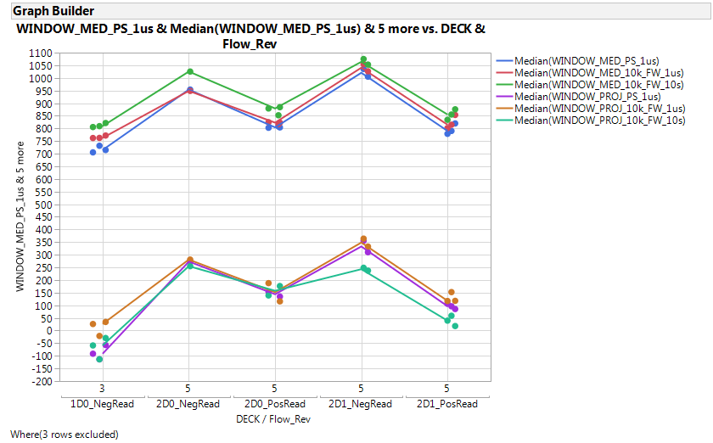
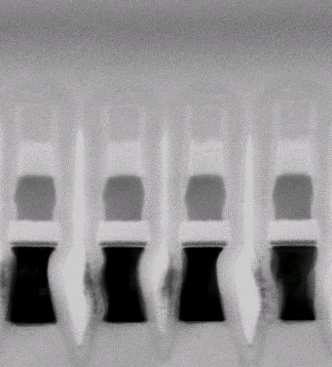
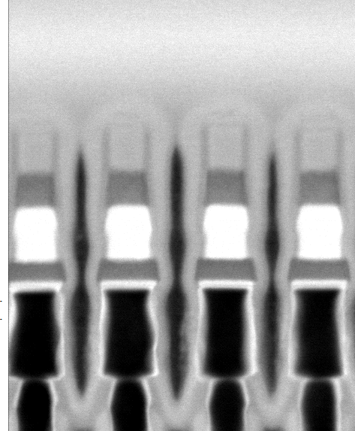
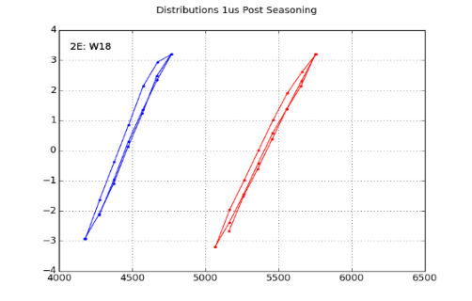
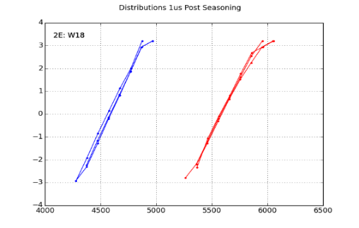
Dual Deck – SD.k1
A1 Dual Deck silicon functional: symmetry/offset under segmentation
Read Polarity: PosRead→NegRead : +150mV 2D0, +225mV 2D1
Dual Deck integration: 1D0 →2D0: +225mV
Deck to Deck: 2D0→2D1: +75mV NegRead, -25mV PosRead
Good morphological alignment between 2D1 and 2D0 on the first SD.k1 lot, to be further validated with SD.k2 with vertical profile > 87°
10s@10KFW
∆V_{T} [mV]
1𝛍s@EOS
1𝛍s@10KFW
CR5.3 Auto
-
stem 1
cut D0 vs D1 (median)
st
D0
D1
Vt distributions (1us delay) after seasoning
Vt distributions (1us delay) after 4M FW
4
3
2
1
0
-1
-2
-3
-4
2D0
2D1
2D0
2D1
Vt [mV]
Vt [mV]
4000
5000
4000
5000
Vt [mV]
Vt [mV]

Slide 6
S24S0 Design Update iWW23
Full Chip Validation and Spec Evaluation Ramping up / On Track to Rev3 Freeze WW31:
Next Major Milestone Target (Rev3) | Current Projection: WW31 | WW31
DBR Target | Current Projection: WW39 | WW39
Die Size Target | Current Projection: Matched to S26A Size & Padout| 197.87mm² (12.65mm x 15.64mm)
DBR Rd/Wr Energy Target | Current Projection (TT/85): 84pJ/b / 168pJ/b | TBD / TBD
DBR Rd/Wr Energy Target | Current Projection (FF/85): 89pJ/b / 179pJ/b | TBD / TBD
Rd/Wr Completion Time Target (800MHz) | Current Projection: 95ns / 240ns | TBD / TBD
Rev3 focused on bitmap (check addressing with new decoders), array functionality and performance, and layout
Improved bitmap methodology (vs S26A0) rotorooter completed
Sim coverage requirements identified & first sims (BL/WL indexing) in the queue
Array Functional Model (AFM) development & QA sims completed
Sim coverage plan in place including all decoder configurations, all modes of operation, and all critical features
Launch of priority 1 sims pending
LVS clean tile layout achieved providing high confidence of overall global routability
Termination tiles, CMOS DRC cleanup, and partition build out up next
Energy & Performance Spec assessments captured within AFM validation suite / initial results targeted for ~WW25

