Slide 1
Self-Select Memory Research IM JDP SOW
Version 1.0
January 20, 2016

Slide 2
Signature Page
This SxP Joint Development Program Statement of Work Rev 1.0 (“Self-Select Memory SOW”), having been approved by the JDP Committee is hereby approved by Intel and Micron respectively effective as of Jan 20, 2016, as signified by the signature of each company’s authorized representative below. It is understood and agreed that this JDP SOW may be amended in due course in accordance with the procedures set forth in the Joint Development Program Agreement.
MICRON TECHNOLOGY, INC |  |  | INTEL CORPORATION
By: |  |  | By:
Name: |  |  | Name:
Date: |  |  | Date:

Slide 3
Revision Page
Approval Date | REV | Pages Affected | Was | Is | Comments
Jan-20-2016 | 1.0 | ALL |  | Initial Self-Select Memory SOW
Notes:
3

Slide 4
SOW Contacts
Name | Function | Company
Russ Meyer | JDP co-manager | Micron
Al Fazio | JDP co-manager | Intel
Hernan Castro | Design | Micron
Sandeep Guliani | Design | Intel
Kiran Pangal | Array Development | Intel
Fabio Pellizzer | Technology Development | Micron
DerChang Kau | Technology Development | Intel

Slide 5
SOW Contents
0.0 Purpose
1.0 Background
2.0 Scope
3.0 Strategy
4.0 Milestones
5.0 Design
6.0 Process
7.0 Test
8.0 Budget & Assumptions
Backup (success criterial placeholder)

Slide 6
0.0 Purpose

Slide 7
Purpose of SOW Rev 1.0
To introduce self-select memory
To define the research strategy for 3DXP technology capability expansion
To define project deliverables through calendar year 2016
To define performance metrics to track the progress towards the milestones for decision making
To define the resource and the budget to achieve the targeted deliverables

Slide 8
1.0 Background
Introduction to self-select memory and the novelty

Slide 9
Self-Select Memory (SSM) concept
S15B SD-only, lot 8792062, 18nm SDδ ver 4
Positive programming pulse
VTH
Negative Vth detection → Vth=5.6V → VTHigh
Negative programming pulse
VTL
Negative Vth detection → Vth=4.7V → VTLow
A Vth window has been observed by applying programming pulses to the SD device with opposite polarity
The mechanism underlying this effect is unknown (atomic species electromigration is the leading candidate model), but the effect has been experimentally observed on several vehicles (PTX SD-only, S15 SD-only, S15 FS) and for various SD compositions (SD1 and several version of SDδ)

Slide 10
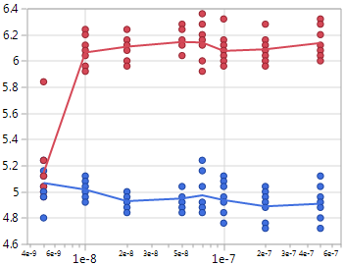
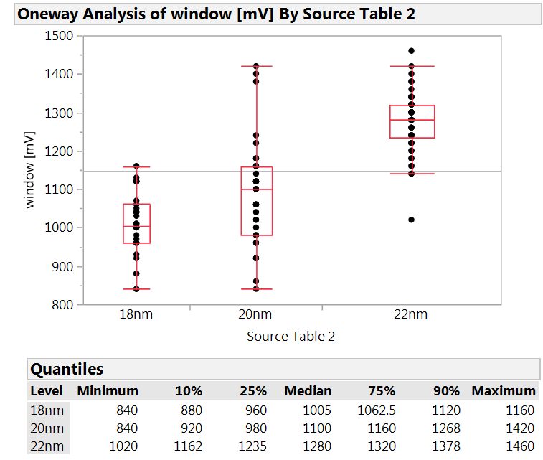
Key features
Simpler process integration, with lower aspect ratio and no cross-contamination
Flat VT-I with programming currents as low as Ihold (25uA)
Fast program (20ns easily achieved) and short delay between program and read (100ns demonstrated)
Vth window depends on SD thinckness (70mV/nm sensitivity on SDδ)
W BL
Carbon
PM
W BL
Carbon
Carbon
SD
SD
Carbon
Carbon
W WL
W WL
Self-selector
SxP
VTH
Vth [V]
Vth window [mV]
VTL
SD thickness
Pulse width [s]

Slide 11
SD polarity effect exploitation
SD polarity effect may be exploited for
Stand-alone self-selecting memory device with
Simpler process integration
Lower programming current
Faster program speed
Less reliability issues
Enabling eMLC capability in the SxP configuration, with 3 and 4 level intrinsic feasibility demonstrated
Widening the Vt window in the SxP configuration

Slide 12
2.0 Scope

Slide 13
Scope
Self-select memory (SSM) cell
Evaluate operating scheme in seeking for fundamental understanding, supported with ±3 sigma statistics for Read/Write and retention.
Develop basic cell architecture including electrode, interface and it’s interaction with self-select memory.
Application of SSM in 3DXP architecture
Read/Write scheme and retention fundamentals to support cross point memory array
Window expansion of 3DXP SLC
MLC enablement and performance assessment

Slide 14
3.0 Strategy

Slide 15
Research Strategy
Algorithm and physics development of Self-Select Memory at 1st principle
Design SSM single cell and mini array in S26A scribe with opt-in metal jumper avoiding the incurred risk to S26A development
Develop S26A SD-only process flow and physical and electric performance metrics
Test and Characterize bi-direction Read/Write algorithm for NVM
Assess SSM for NVM limitation and tread-off
Including program transfer mechanisms, distribution, disturb and retention
Performance metrics subject to cell stack and architecture impact
Evaluate applicability of SSM basics for Comparable Technology Product such as
Stand along SSM using SD only stack
SLC window expansion or MLC in S26A full stack

Slide 16
4.0 Milestones

Slide 17
Milestones & Check points
# | Objectives | ECD
1 | Test structures design validated, including Opt-in metal jumper in QTT | Feb/16
2 | SD-only flow portable to S26A | May/16
3 | Design validated, including bi-direction operation for ead/write | June/16
4 | Validate SSM window & distribution for NVM retention and endurance | July/16
5 | Risk assessment of SSM architecture and capability for the decisions on Comparable Technology Product direction | July/16
6 | Define the next phase of research scope and success criteria for research exit if #5 passes. The success criteria are tangible for process architecture, device performance, scalability projection and product architecture.
i | S26A SD only flow improvement for stand alone SSM | Q3/16
ii | Algorithm development and validation for S26A window expansion | Q4/16
iii | Algorithm development and validation for 3DXP full stack MLC | Q4/16

Slide 18
5.0 Design

Slide 19
Test structures on S26A
On S15C the reverse polarity measurement capability is established with the 2xCMOS test structure. 2xCMOS structure can provide intrinsic information, but no statistics (ramdom) and no info on ED variation (sysmatic) impact.
In addition to 2XCMOS strcture, reverse polarity capability with larger cell count will be added to S26A scribe in order to support both the investigation on single deck wafer of the second deck behavior, and the reverse polarity effects.
IG88– Addressable single cell test structure: This is based on S26A-IG88. Opt-in metal jumper for metal mask optional TO to enable bidirectional operation schematics.
QTT– A electrically bi-directional operable mini array test structure: This is based on S26A-QTT. A subset cells in QTT array are designed with opt-in metal jumper for bi-directional operable circuit scheme .
SR71 – A brand new bi-directional operable 4Mb array: Array characterization using Magnum tester is required.

Slide 20
6.0 Process

Slide 21
Masks and Process Flow
Enable Opt-in metal jumper for bidirectional operation in parallel with S26A POR TO
Process Flow #1: for SSM Integration:
SD-only process flow based on S26A
Process Flow #2: for Window expansion and MLC
Identical to S26A Full loop process flow

Slide 22
7.0 Test

Slide 23
Characterization and Algorithm
Key tasks include
test structure design validation
Device and Array Characterization
Algorithm development
Test instruments include
Test Structures | Tester
2XCMOS | WLC platform
IG88 | WLC platform
QTT | WLC platform
SR71 | Magnum Tester

Slide 24
8.0 Budget

Slide 25
Budget and Assumptions
This SOW project scope activities for 2016 are consistent with the 2016 SXP JDP budget.
Resources and logistics are part of S26A development work
Budgets for subsequent years of this SOW will be adopted on a yearly basis, as part of the overall SXP JDP budget.

Slide 26
Back-up slides

Slide 27
Intrinsic Performance
Comparable leakage (same SD material).
More flexible Read algo (no spurious reset of Set bit).
Similar Set Vt, but much faster (~20ns demonstrated) and simple (no pulse shaping needed) and lower current Set operation.
Similar ΔVt, but much lower reset current (~1/3 of actual SxP current).
Negative polarity needed for reset operation (added decoder complexity/area).
A thicker SD is preferable (better Vth window, leakage and drift), so higher voltages may be needed.

Slide 28
Reliability
Comparable Drift for Set (same SD material) and better Drift for Reset (no additional Drift of reset PM).
No Read Disturb on Set
Read Disturb on Reset represents the only failure mode specifically related to the proposed approach → > 10⁴ reads feasible up to 125C
No Proximity Thermal Disturb (very low current and temperatures).
Similar Write and Read Endurance.
Good retention up to 125C, but activation energy still to be quantified (wip).
> 1E4 reads

