Slide 1
SSM and Bipolar Architecture
DerChang & Balaji, WW15.4/2018
What is SSM and what we (think we) know
How is it different from SXP
How does it benchmark with other RRAM
Bipolar decoder and architecture

Slide 2
Content
What is SSM and what we (think we) know
How is it different from SXP
How does it benchmark with other RRAM
Bipolar decoder and architecture

Slide 3
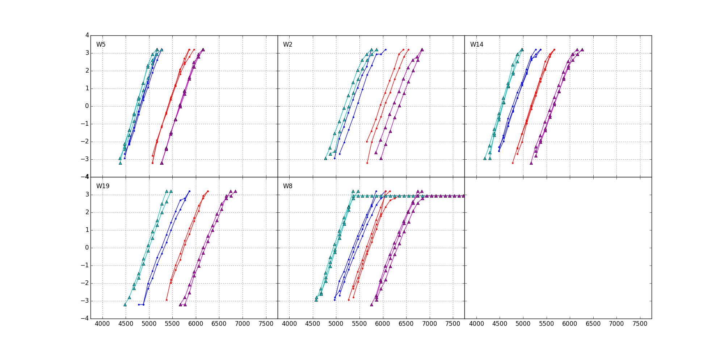
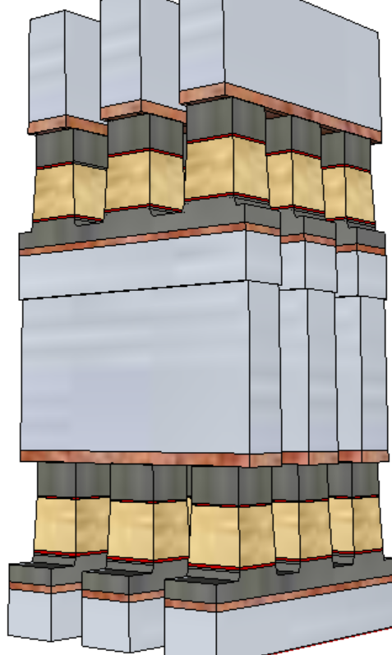
Introduction to SSM
+/+
−/+
S15B SD-only, lot 8792062, 18nm SDδ ver 4
Write/Read
Polarity
−/−
+/−
V_{T,High}
Positive
Write
σ of bit distribution
Pulse Polarity
Negative
read
TE
900mV
SD
V_{T,Low}
Negative
Write
Negative
read
BE
V_{TH} [mV]
Self Select Memory, a.k.a. SSM, is a SD only memory cell.
Physical construction of SSM is X-Y cross point array BEOL stackable, compatible with mainstream CMOS.
Read/write is to threshold a cell in a tile while the rest of cells are inhibited in subthreshold bias.
It exhibits a window (∆V_{T}) by applying programming pulses with opposite polarity.
The best known ∆V_{T} physics is an electrochemical potential modulation due to mass transport by polarity.
Since the memory and selector are built-in with single elelement, hence Self-Select Memory is coined.

Slide 4
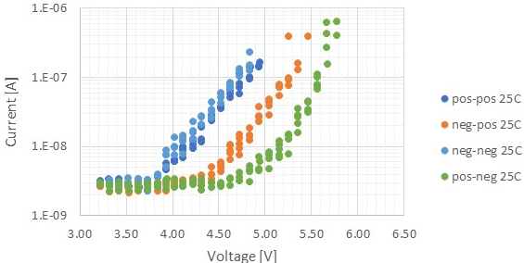


Electrical Equivalent Circuit and Possible Underline Physics
A V_{T} window (∆V_{T}) has been observed by applying programming pulses with opposite polarity. The best known ∆V_{T} physics is an electrochemical potential modulation effect subject to mass transport by polarity.
Near parallel shift on SubVt I-V between opposite polarities
The equivalent circuit – a programmable battery connected to a Chal Glass Resistor serially
From empirical to physical
Write –Band offset switching subject to mass transport.
Read – Space Charge modulation results in voltage shift
Post
Neg
Write
C
As+/Ge+
SAG
C
SD Resistor
⊖
⊕
$$\vec{ℰ}$$
ϕ
(−)
(−)
⊖
⊕
$$\vec{ℰ}$$
ϕ
Read Polarity
0V
0V
$$\vec{ℰ}$$
ϕ
(+)
⊖
⊕

Slide 5
Content
What is SSM and what we (think we) know
How is it different from SXP
How does it benchmark with other RRAM
Bipolar decoder and architecture

Slide 6
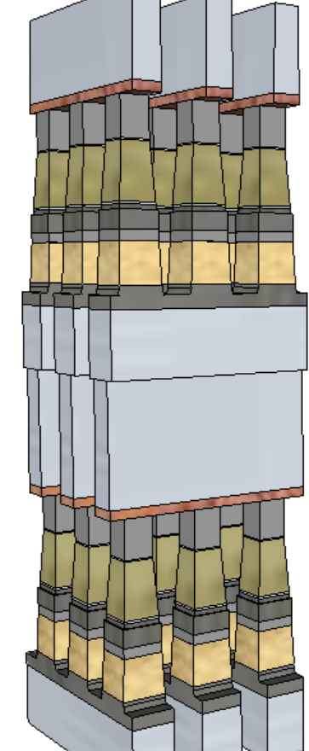
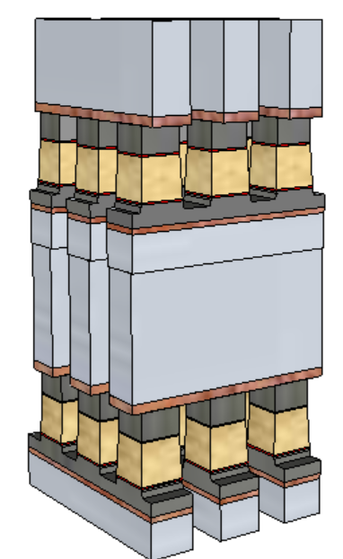
SXP vs. SSM – Cell Architecture (20nm Comparison)
SSM potentially overcomes several SXP issues
No cross-contamination between PM and SD
Lower cell aspect-ratio simplifies the cell sealing
Lower programming current ➔ relaxes metal (WL/BL) requirements and associated array capacitance
 | 1st Cut |  | 2nd Cut
 | SXP | SSM | SXP | SSM
Stack height [nm] | 141 | 69 | 152 | 85
Stack Height, inc. HM [nm] | 296 | 142.6 | 297 | 191.7
Height/ Space for FP [nm] | 212.5/25.5 |  | 261/21.7
Height/ Space for LP [nm] | 246/19.6 | 142.6/19.6 | 182/18.4 | 191.7/18.4
Space Aspect Ratio for FP | 6.4 |  | 6.7
Space Aspect Ratio for LP | 8.4 | 4.8 | 9.1 | 5.4
SSM
SXP

Slide 7
SXP vs. SSM – Array Architecture (20nm Comparison, Sharing Partition Architecture)
Potential for improving one of the key limiters of SXP: High Write completion time (vs Read latency)
Write latency may need to also consider spike mitigation and pulse termination, up to 50ns adder. (Worst case latency limited BW: 3GB/s)
No MLC capability identified with demarcation read algorithm
 |  | Read |  | Write
 |  | SXP | SSM | SXP | SSM
Die Size | mm² | 197
Algo |  | Same |  | N.Write | F.Write
Latency | ns | 95 | 95 | 465 | 95~125
Energy | pJ/b | 52 | 52 | 118 | 118
Latency limited BW | MB/s | 5389 | 5389 | 1101 | 4096+
Power limited BW | MB/s | 1601 | 1601 | 800 | 800
SSM
SXP

Slide 8
SXP vs. SSM – Algorithm
READ
SET
RESET
SXP
P3
Sense
essr
P1
Setback
TSENSE
PW
Occupancy
Data transfer to IO
T0 - Selection
T1 – nucleation
T3 growth
T4
SSM
P1
P4
Sense
P1
P4
TSENSE
Occupancy
Data transfer to IO
T0 - Selection
T1
T4
T0 - Selection
T1
T4

Slide 9
3DXP Projects
Project | Architecture |  | PLC
S15 | Cell | 20nm SXP, Unipolar, SLC | α-product 128Gb PG4 Qual’d, PG1 Q1/18 Qual
 | Tile | 2-deck 2Kx4K, 1b/tile
 | Core | 128b/partition, 4-slice, 16-partition
 | Component | R1600/W550 MB/s, DDR4
S26 | Cell | 20nm SXP, Unipolar, SLC | α-product 256Gb Q2/18 PG4 Qual Q3/18 PG1 Qual Chop = low cost S15
 | Tile | 4-deck 4Kx4K Quilt, 1b/tile
 | Core | 128b/partition, 1-slice, 32-partition
 | Component | R1600/W800 MB/s, DDR4
S37 | Cell | 14nm SXP, Unipolar, SLC | XP03: CMOS/BEOL development S36X: Spider based on S26 CMOS α-product 512Gb DBR Q4/18 Chop = DDR5 low cost S26 Phase 2: R4800/W1600 MB/s
 | Tile | 4-deck 4Kx4K Quilt, 1b/tile
 | Core | 128b/partition, 2-slice, 32-partition
 | Component | R3200/W1100 MB/s, DDR5
SSM (S26S as placeholder) | Cell | 20nm SSM, Bipolar, SLC | SR71B for cell fundamental learning S24S for array feature development α-Product decision pending on design and process development
 | Tile | 4-deck 4Kx4K Quilt, 1b/tile
 | Core | 128b/partition, 1-slice, 32-partition
 | Component | R1600/W800 MB/s, DDR4

Slide 10
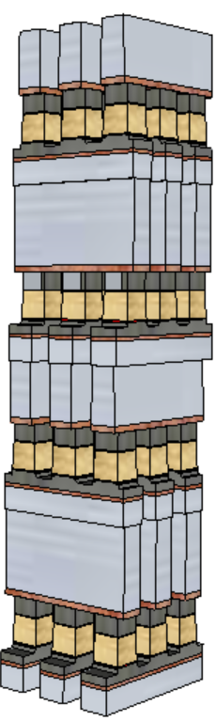
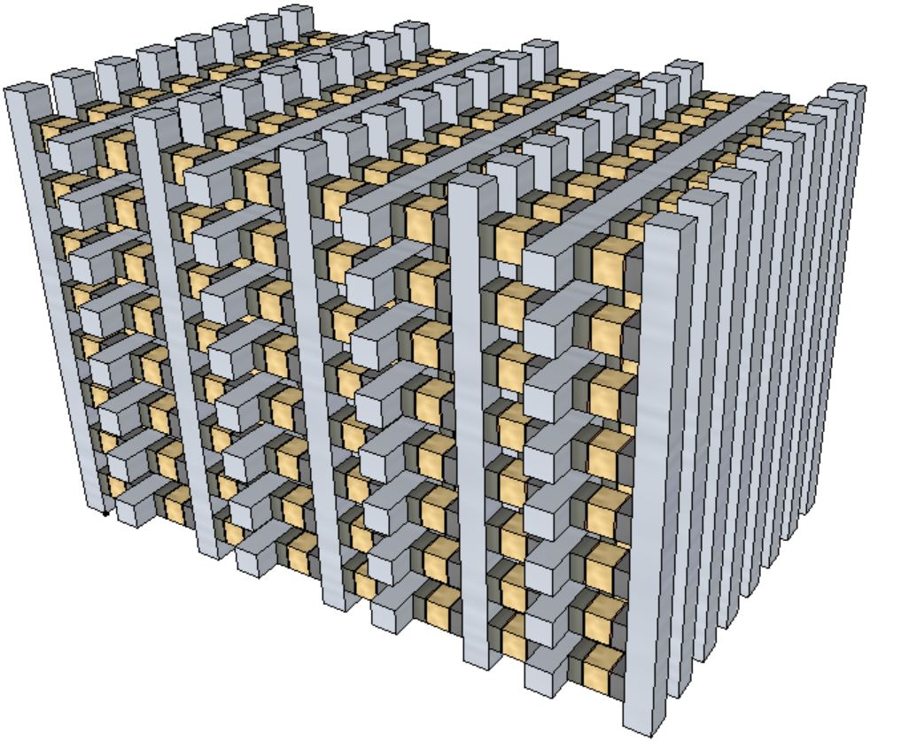
An possibility into 3D-NAND Like Scaling
Scaling Expectation
Density: doubling every generation
Latency: equal or reduce
Bandwidth/GB: Equal or improve
Expected Roadmap
Beyond S48S
Reference architecture: SXP stack vs. 3D-NAND tier
Scalable architecture development starts when 1. Switching mechanism is manageable and 2. 20nm Product Vehicle is DBR’d
3D-stack
 | S26S | S37S | S48S
Density/Die Size | 256Gb / 197mm² | 512Gb / 195mm² | 1Tb /<200mm²
half pitch | 20.5nm | 14nm | 10.25nm
Read/Write Latency | 95/240 ns | 80/240 ns | 80/80~120 ns
Read/Write Energy | 52/118 pJ/b | 26/59 pJ/b | 13/30 pJ/b
Read/Write Thruput | 1600/800 MB/s | 3200/1600 MB/s | 6400/3200 MB/s
I/O and Transfer Rate | DDR4 1600MT/s | DDR5 3200MT/s | DDR5 6400MT/s
3D-tier

Slide 11
Content
What is SSM and what we (think we) know
How is it different from SXP
How does it benchmark with other RRAM
Bipolar decoder and architecture

Slide 12
Classes of “Ducks”
See also: https://en.wikipedia.org/wiki/Resistive_random-access_memory
https://semiengineering.com/what-happened-to-reram/
https://semiengineering.com/a-new-memory-contender/ (FECAP/FEFET)
2-T NVM (focus on memory element)
Other NVM (not benchmarked)
PCM (Samsung, Micron, IBM/Macronix)
SSM (Intel/Micron)
VMCO/CMOx (IMEC, Unity)
4DS: PCMO (CMOSx) with HGST/WD partnership?
WD/Toshiba: Binary conductive oxide instead of PCMO
IMEC: VMCO
CMOx: Unity (Rambus)
V_{O}RAM/CBRAM (Redox)
Weebit: Porous SiO, TaO
Panasonic/Fujitsu/HP: TaO
TSMC/ITRI: HfO
Macronix: WO
Adesto: Te in AlO
Micron/Sony: Cu in GdO
NEC: Cu in oxide(?) – targeting FPGA
Crossbar: Ag/Cu in α-Si (with Si/SiO diode)
STT (too many)
FTJ
Toshiba: HfO + interface layer
AIST consortium: UoTokyo and etc
SXP-like
Intel/Micron
Macronix/IBM: Si-STAG + N doped 225
Hynix: As doped SiO + ReRAM(?)
IMEC: N doped GeSe (selector only)
LETI: GeSe + HfO
FECAP as in 1T1C
IMEC, NAMLAB (GF), MFC, Hynix/LAM : HfO
TI: PZT in production/ research HfO
Panasonic: PZT in production
Sony: SBT in production
FEFET
NRAM (Nantero)
Charge trap

Slide 13
“Hysteresis” of Transfer characteristics
Hysteresis: Output traces subject to input and prior history in a cyclic loop SRAM PCM
Transfer characteristics:
Input (WRITE) metrology actuates the switching mechanism
Output (READ) metrology manifests the switched physics
Comparing RRAMs with the similar transfer characteristics to construct physical hypothesis
o/p [v]
V_{T} [v]
i/p
o/p
i/p [v]
Pulse [μA]

Slide 14
PCM
V_{T} [v]
Write: Polarity symmetry
Current pulse from 5 to 40 MA/cm² (20~160uA of 20nm cell)
Pulse width from 10ns to 200nsc
Typical I_{melt} ~15MA/cm²
Typical I_{sat} ~ 25 MA/cm²
Read: Polarity symmetry
Vt detect, either by SCU 30ns pulse or QS I-V scan for 1uA or snapback detect, in both polarity.
Typical Set Vt is ~0.1V
Typical Reset Vt is ~1V
Pulse width effect
Insignificant impact from low to high Vt
Strong influence from high to low Vt
Polarity Symmetry: Axial symmetry both in read and write
❹
❷
❸
❶
Pulse [μA]
10ns
200ns
Pulse [μA]

Slide 15
PCM
V_{T} [v]
Log(I@0.4V]
❹
❷
❷
❸
❸
❶
❹
❶
Pulse [μA]
Pulse [μA]
10ns
200ns
200ns
Pulse [μA]
10ns
Pulse [μA]

Slide 16
SSM
Write:
Current pulse from 7.5 to 25 MA/cm² (30~100uA of 20nm cell)
Pulse width from 20ns to 500nsc
Read
FVMI or Vt detect, either by SCU 30ns pulse or QS I-V scan for snapback detect, in both polarity.
Typical Set Vt is ~4.8@22nm
Typical Reset Vt is ~5.7V@22nm
Insignificant pulse width effect on the range explored (20ns to 500ns)
Polarity Symmetry: Point Refection at origin
❹
V_{T} [v]
Slope 1~5KΩ
❸
❷
≈
❶
≈
Pulse [μA]
Log(I@3.5V)
Pulse [μA]

Slide 17
Transfer Charx Summary
Log(I@0.4V]
Log(I@3V)
❸
❷
Log(I@3.5V)
❷
❹
❶
❸
❶
❸
❷
❹
❶
Pulse [μA]
Pulse [μA]
❹
Pulse [V]
PCM
SSM
VMCO/CMOx
Log(I@0.5V)
I@0.1V
Log(I@3V)
❷
❹
❶
❸
❷
❸
❶
❸
❷
❹
❶
❹
Pulse [V]
Pulse [V]
Pulse [V]
V_{O}RAM/CBRAM
STT
FTJ

Slide 18
Content
What is SSM and what we (think we) know
How is it different from SXP
How does it benchmark with other RRAM
Bipolar decoder and architecture

Slide 19
Unipolar vs. Bipolar
Unipolar
Bipolar

Slide 20
Challenge in Decoder Size & Energy
Invention | Architecture & Key Features | Problem addressed | Embodiments
Current Art of Unipolar Architecture | One MOSFET to select or inhibit in each of global decoder | Best Known Architecture for most compact decoder (die size) and lowest operation energy | S26A POR
Current Art of Bipolar Architecture | Inverters for global select and inhibit bias for bipolar operation, one inverter for each polarity | To address bipolar bias for wordline and bitline potential but double transistor count for global decoder & higher operating energy required | SR71 POR S24S POR
Idea #1 | Global bipolar select bias and one MOSFET for global inhibit bias | To reduce global decoder footprint and reduce energy from current art of bipolar architecture | Embodiment #1 Embodiment #2
Idea #2 | Global bipolar select bias and one MOSFET for global inhibit bias with additional high voltage MOSFET | To further reduce operating energy of idea #1 And reduce address transition sequencing | Embodiment #3 Embodiment #4 Embodiment #5 Embodiment #6

Slide 21
Embodiments of Bipolar Decoder
S24S POR
SR71 POR
Embodiment1
Embodiment2
Embodiment3
S26A POR
Embodiment6
Embodiment5
Embodiment4
“TO” → HV Transistor

Slide 22
S24S decoder
Uses separate paths to support positive and negative polarity biases.

Slide 23
Voltage Stress
POSITIVE POLARITY
POSITIVE POLARITY
Oxide Stress MAX (purple)
VPP or |VNN|
Jn Stress MAX (green)
VPP-VNN
VSS
NEGATIVE POLARITY
NEGATIVE POLARITY
VPP
VPP
Selected decoder
Deselected decoder
“Uses S26S CMOS”
VSS
Selected decoder
Deselected decoder

Slide 24
Why S24S decoder has higher energy?
Deselects gates need to toggle from VPP → VNN
or VNN → VPP when switching polarity.
This node has high fanout causing a large CV^2 component of energy when compared with the POR S26A. ~50% higher.

