Slide 1
SSM RWB assessment: WW47-48 Plan
DerChang & Agostino
0th step: create the key exhibits list for RWB Principles
1st step: compile the exhibits, id knowns and unknowns
2nd step: Synthesize the knowns for model validation. Collect additional unknowns, adding to step-1 unknown list.
3rd step: make a 2-week data collection plan to comprehend the critical missing exhibit (WW49-51 action plan).
By WW51, RWB principle will be established ➔ Technology half of SOW.
In parallel, Sandeep and team are preparing for the other half of SOW (array architecture for density, energy, latency, concurrency and BW)

Slide 2
Principle of 3DXP RWB
V_{DM1}
V_{DM3} tracking (net expansion)
Window generation:
  mean to mean shift at 1us
Window consumption:
  0 to 3.54 of E2 and E3
  E2 drift from 1us to 10s (retention tacking)
  E3 shift at 12.5K FW (wear management)
Window generation:
  E3 expansion from 1us to 3s
Window consumption:
  E2 drift from 10sec to
No additional consumption after drift
Developing SSM RWB Strategy
New ideas needed for V_{DM}
Key Characterizations for RWB
Window generation:
  mean to mean shift at 1us
Window consumption:
  0 to 3.54 of E2 and E3
Retention management
Wear management on E2 and E3
∆V_{T} physics – transport mechanisms, constituents vs. contaminants, interface vs. bulk
E2, E3 variability – repeatability, PA/PW (slope-1/2/3 characteristics), snapback effects (ED), bit-2-bit
E2 / E3 retention: Drift, RD, WD
Bathtub characteristics – including IPD

Slide 3
Generation: ∆V_{T} physics
Transport mechanisms:
  constituents or contaminants
  Filament or bulk
    If bulk, local movement (Å) or mass transport (nm)
Key exhibits
  Vt-I on 2XCMOS (in 4 quadrants) → OK
  SR71 distribution → OK
  Subthreshold I-V for./rev. program X for./rev. read → limited data
  Temp Co, E_{A} of subthreshold conduction → limited data, no E_{A}
  TTT to establish migration models (with temp or time) → OK

Slide 4
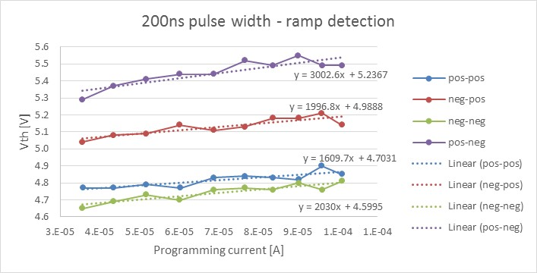
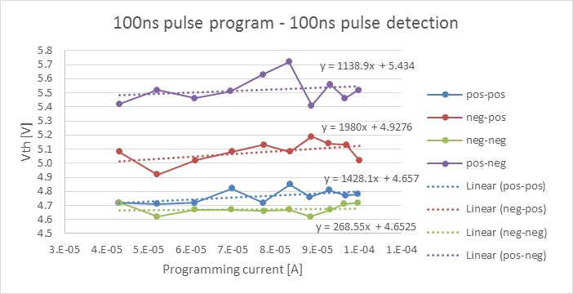
2xCMOS cell on SSM lot #1 – trial 4E – VTI
VTI showing a small (100-150mV) memory effect
Ramp detection and 100ns pulse detection show similar results (small differences arise from the different Vth definition in the two cases)

Slide 5
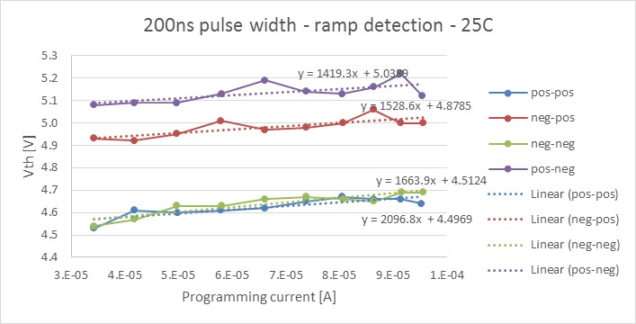
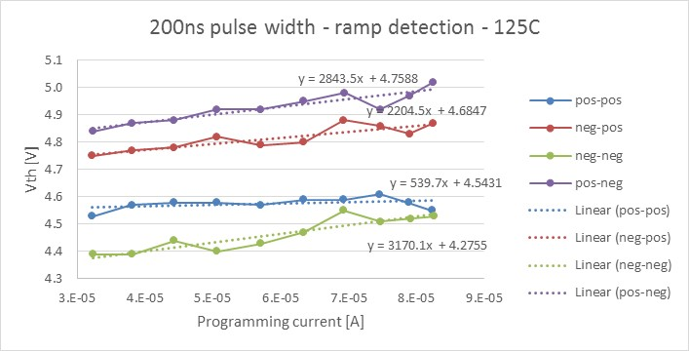
High Temperature functionality - VTI
SD-polarity effect is slightly affected by the temperature
Typical Vt activation around -2mV/°C

Slide 6
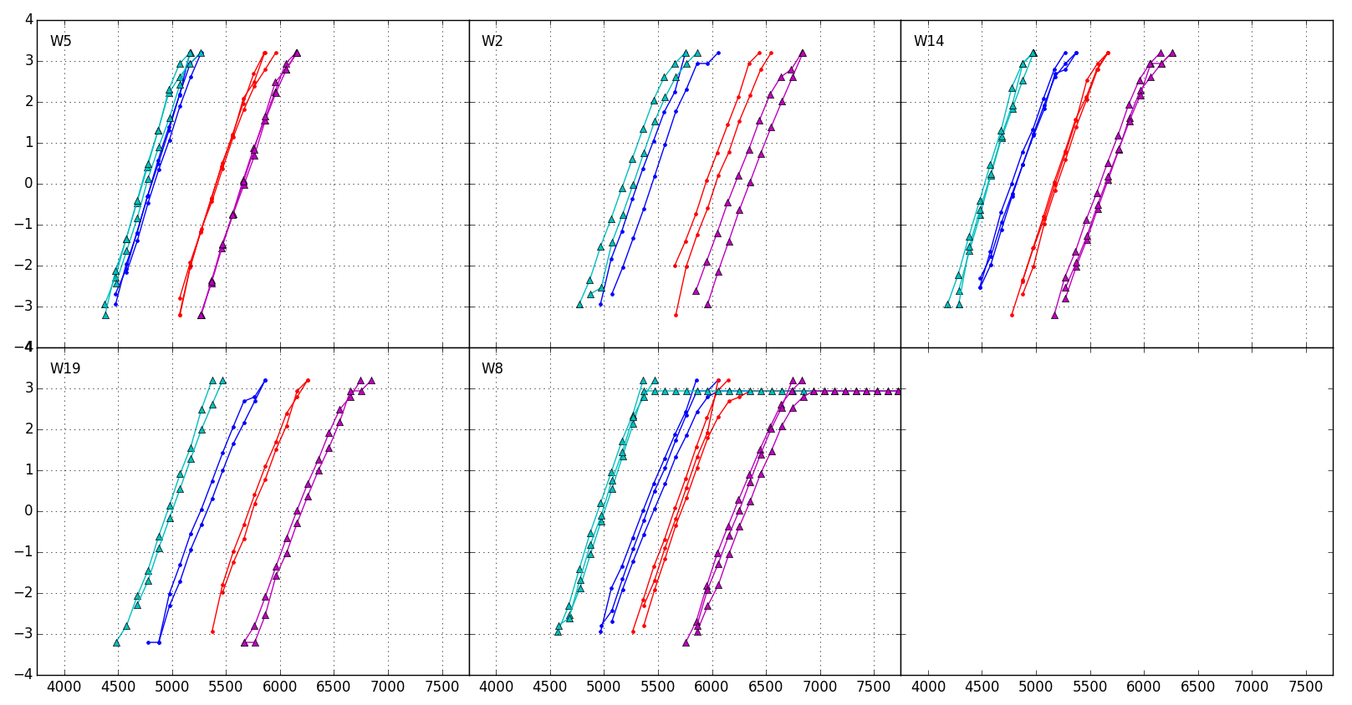
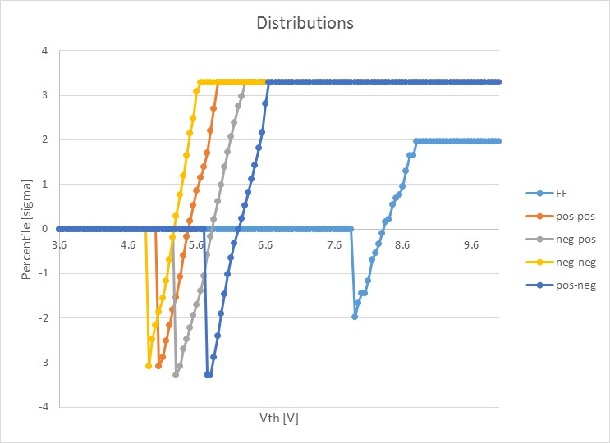
SR71B A1 first lot: Distributions @128k cycles
Triangles → negative reading
1C
22nm 2% In
T&B lamina
No SO2
2E
25nm 2% In
T&B lamina
No SO2
4E
22nm 2% In
No lamina
No SO2
5E
25nm 2% In
No lamina
SO2
6E
25nm 2% In
No lamina
No SO2
6E 2xCMOS
25nm 2% In
No lamina
No SO2

Slide 7
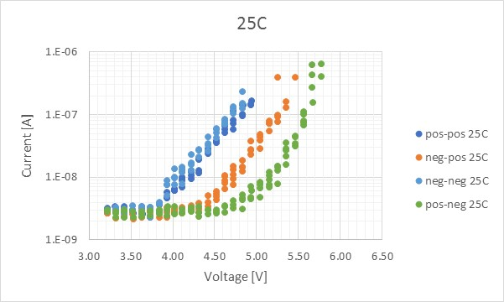
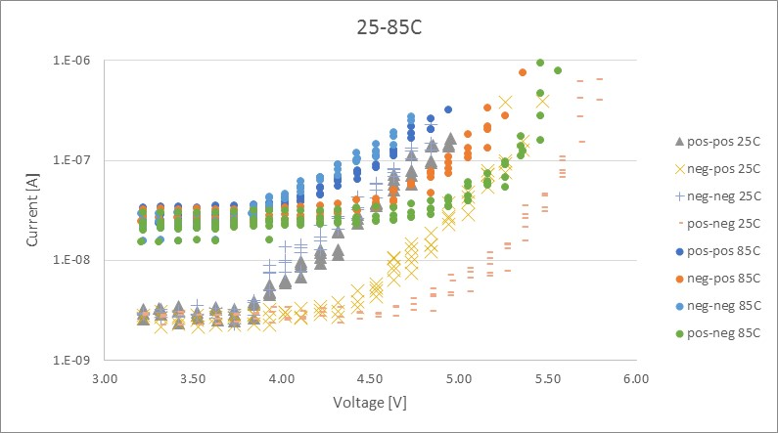
Sub-threshold I-V on 2xCMOS
Leakage is limiting the visibility below 1nA

Slide 8
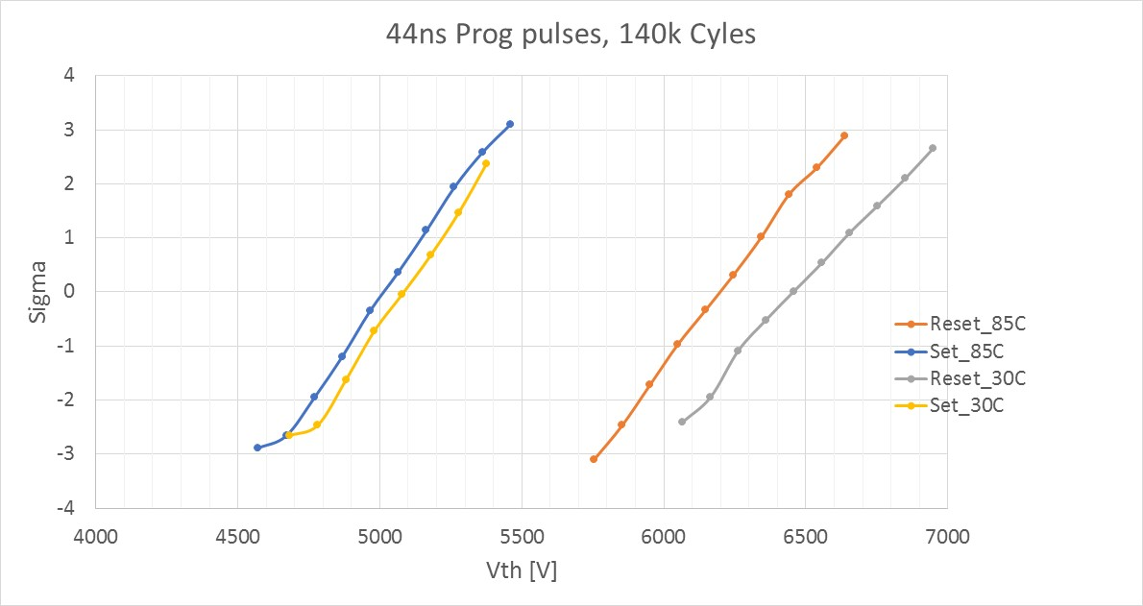
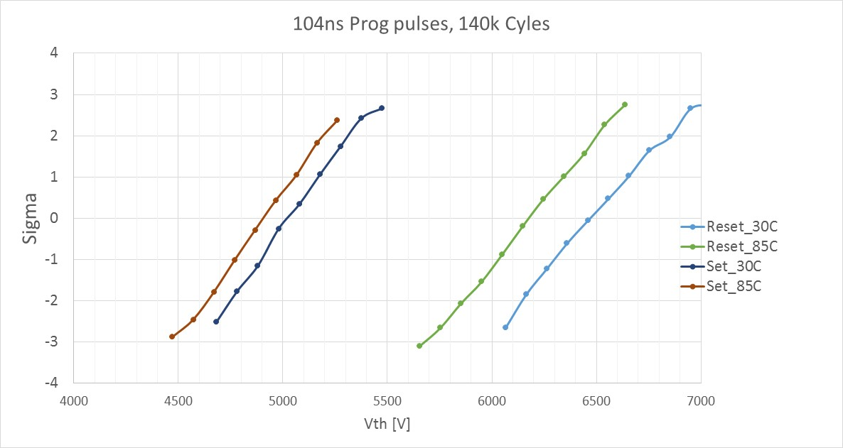
SR71B: Temp co, 100ms write to read delay
Activation energy of reset more than double with respect to set (set 2 mv/C, reset 5mV/C)
Need to check clean data pre-drift (1us write to read delay)

Slide 9
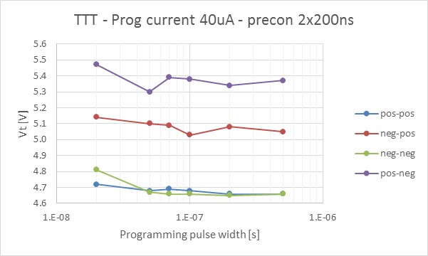
2xCMOS cell on SSM lot #1 – trial 4E – TTT
Cell is always preconditioned in the opposite state
Consistent programmed window in the range 20ns-500ns
A small time dependence of the Vth on all the states is visible

Slide 10
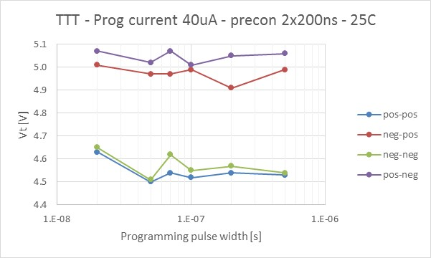
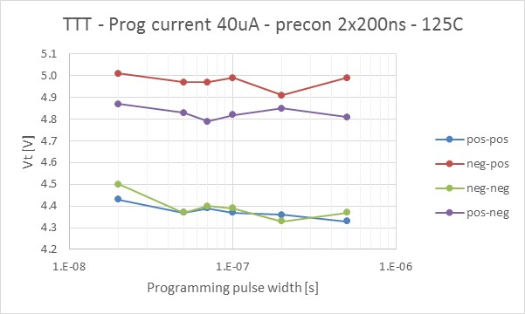
High Temperature functionality - TTT
No significant pulse width dependence in the range 20ns-500ns at RT and 125°C, maybe a small Vt reduction for longer pulses for all the polarities

Slide 11
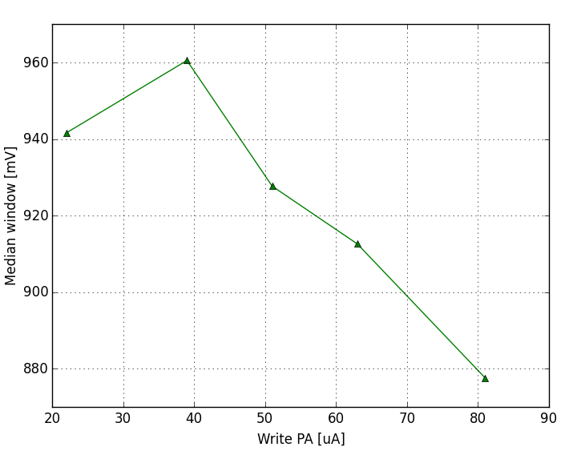
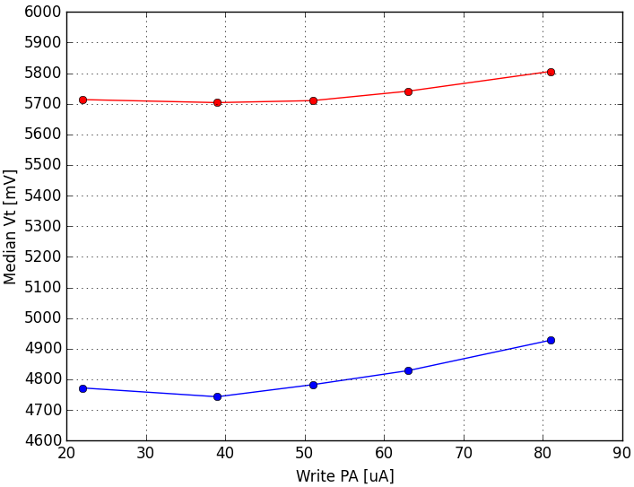
SR71B - Write PA skew
Fixed Write PW (43ns)
Fixed Read PW (43ns)
Write-to-read delay 100ms
Increasing PA sigmas get better, but intrinsic window gets smaller → there is optimum range for true window (40~50uA).
With unbalanced currents, best case would be set at low current (40uA) and reset at higher current (80uA) → 130mV projected true window gain
Intrinsic window
Set & Reset median Vt

Slide 12
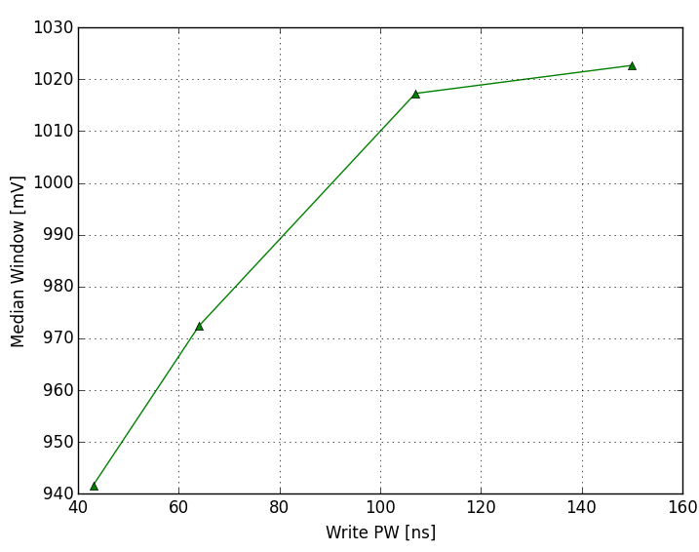
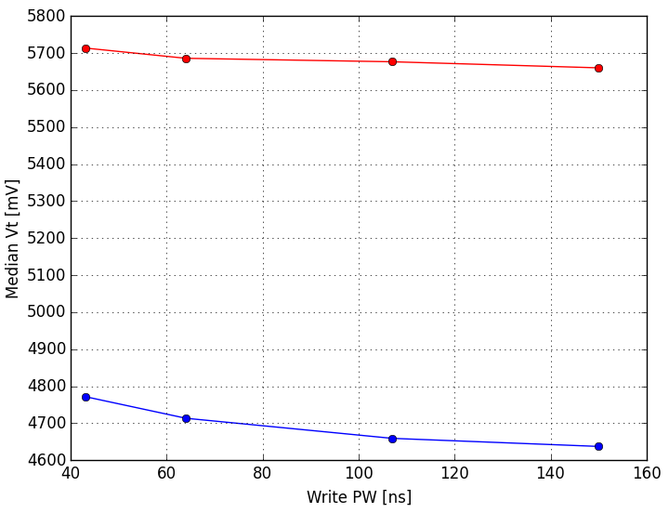
SR71B - Write PW skew
Fixed Write PA (22uA)
Fixed Read PW (43ns)
Write-to-read delay 100ms
Increasing PW has some beneficial effect in terms of intrinsic window, no significant toggles for sigma.
With unbalanced PW, best case would be set at long PW (150ns) and reset at short PW (40ns) → 140mV projected true window gain
Intrinsic window
Set & Reset median Vt

Slide 13
Consumption: E2, E3 Variability
Variability including
  Same bit: Repeatability (bounce)
  B2B
    circuit/device interaction such as PA/PW (slope-1/2/3 characteristics),
    Cross Tile (ED) such as snapback effects
    Device physical differences
  Ambient: temperature
Key exhibits
  Intrinsic sigma such as bounce → no data on SR71B, 2xCMOS data available
  S2R “TTT” – PA, PW, and number of pulse → no data with number of pulse
  R2S “TTT” – PA, PW, and number of pulse → no data with number of pulse
  “ED” or cross tile → limited data → data collection planned
  Geometric impact: lateral, vertical and profile → several data, significant toggles, learning to be completed
  Composition learnings → several data, significant toggles, learning to be completed
  Cross vs. extrinsic contamination learnings (sealing experiment) → several data, no toggle
  Temperature effects, thermal co and E_{A} of Vt
“corner” definitions

Slide 14
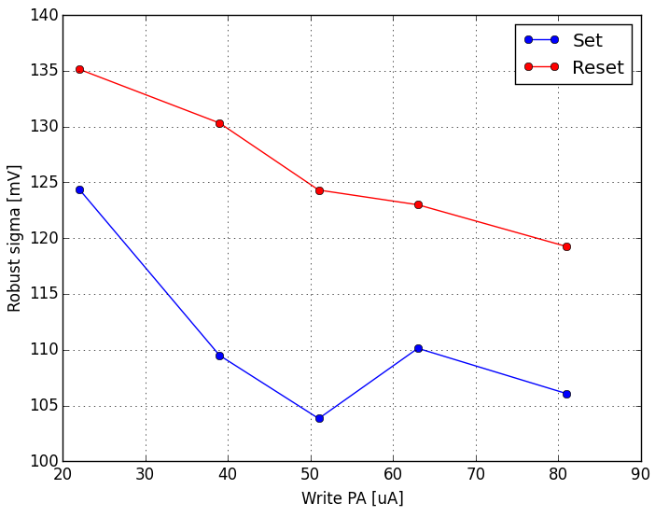
Write PA skew
Fixed Write PW (43ns)
Fixed Read PW (43ns)
Write-to-read delay 100ms
Robust sigma
Increasing PA sigmas get better, but intrinsic window gets smaller → there is optimum range for true window (40~50uA).
With unbalanced currents, best case would be set at low current (40uA) and reset at higher current (80uA) → 130mV projected true window gain

Slide 15
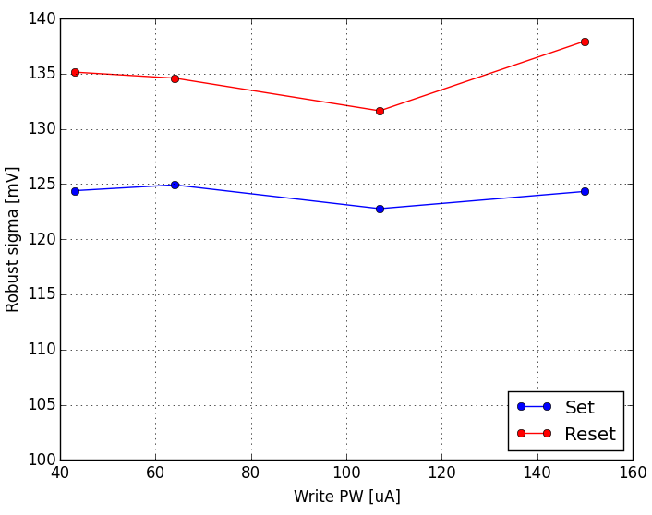
Write PW skew
Fixed Write PA (22uA)
Fixed Read PW (43ns)
Write-to-read delay 100ms
Increasing PW has some beneficial effect in terms of intrinsic window, no significant toggles for sigma.
With unbalanced PW, best case would be set at long PW (150ns) and reset at short PW (40ns) → 140mV projected true window gain
Robust sigma

Slide 16
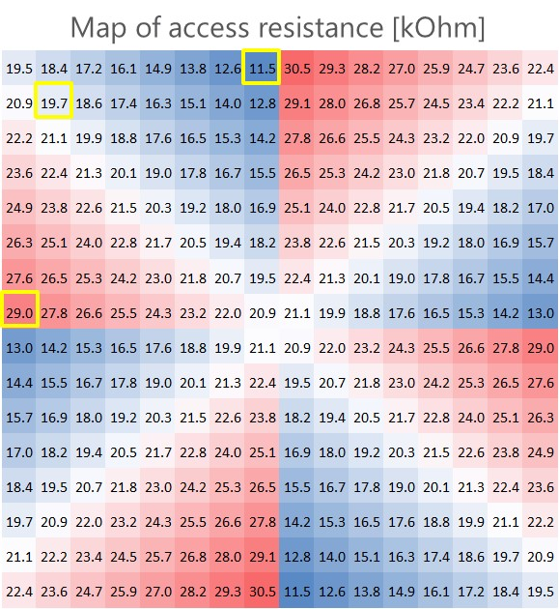
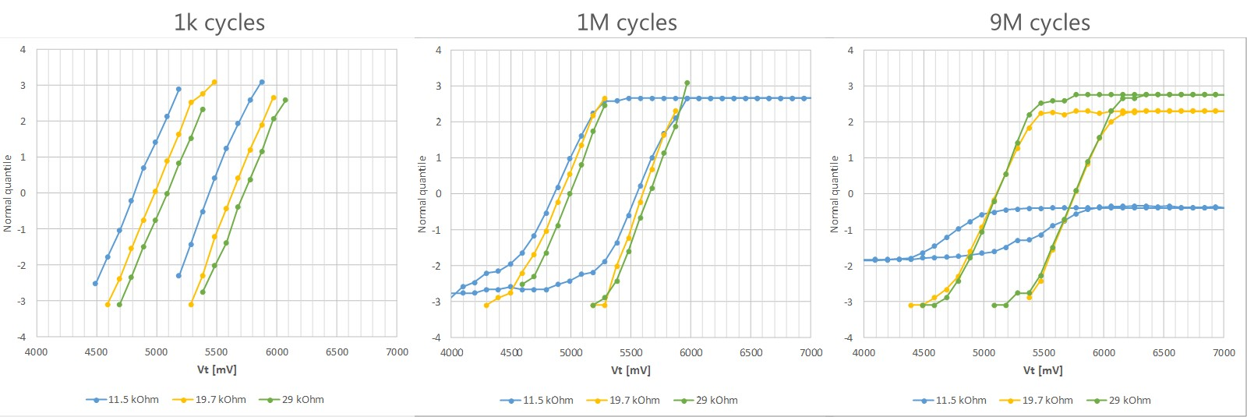
Extended cycling – electrical distance
Higher electrical distance (access resistance) mitigate the spike at selection, thus extending the cell endurance
Additional room for improvement
  W thickness reduction experiment (about half of actual thickness) planned for increasing the endurance and simplifying the process
  Spike mitigation algo

Slide 17
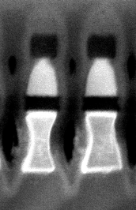
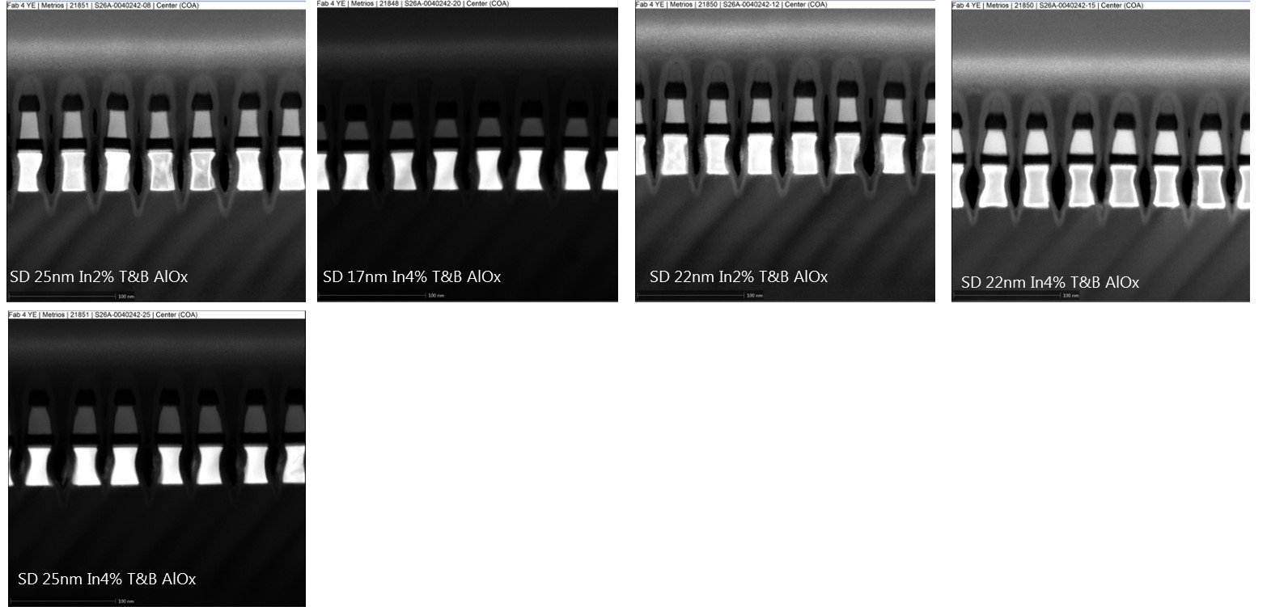
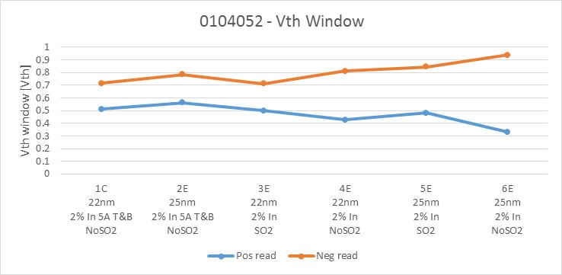
SD shape: A1 opener lot
In this lot the programming windows looks more correlated with SD thickness
Strong correlation between offset and area slope (as expected from previous morpho analysis)

Slide 18
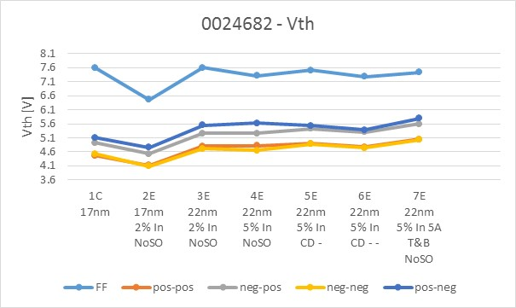
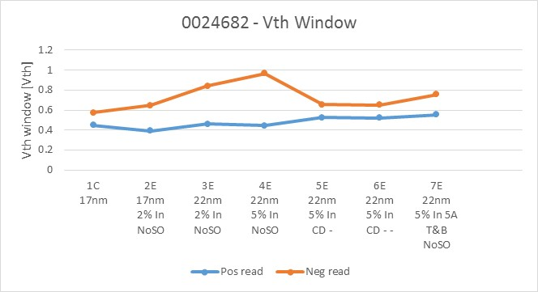
2xCMOS data: Vth and window
Tapered SD
Straight SD
FF trend as expected
Largest negative reading window for groups 3E and 4E, with a marginal increasing moving from 2% to 5% In/doping
  No difference between CD – and CD - - → asymmetry is controlled by tapering

Slide 19
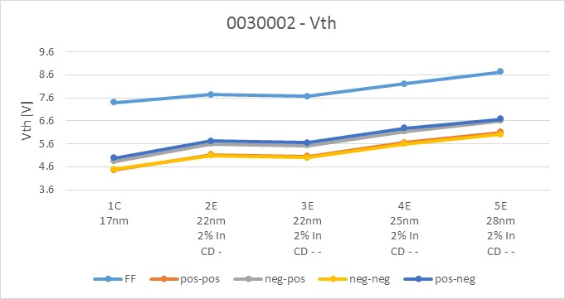
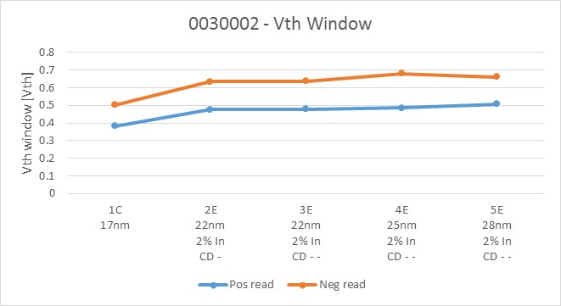
SD straight profile: thickness skew
Thickness skew visible on FF and Vth values
Positive and negative reading window almost constant on the 22nm+In
  Thickness skew shows a Vth window sensitivity around 5mV/nm

Slide 20
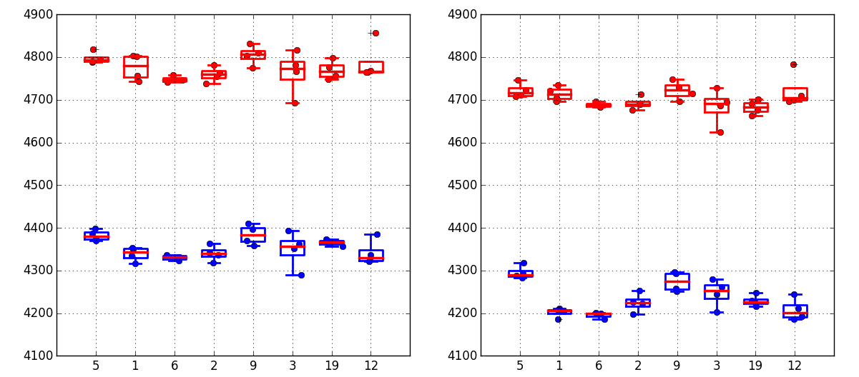
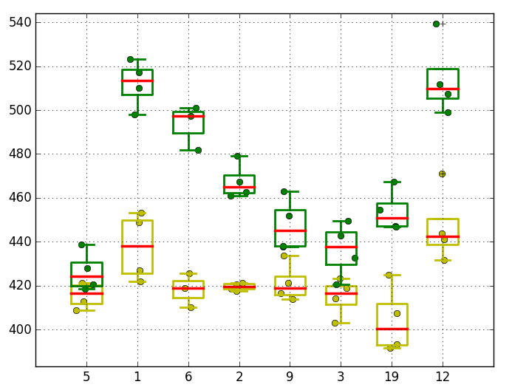
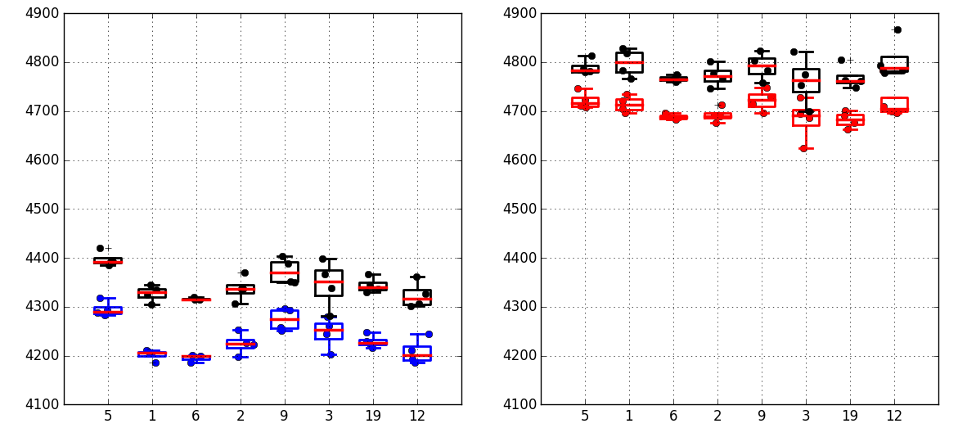
Lot 1: Annealing @ 52, 69 and 80
1k cycles
128k cycles
Window @ 1k/128k cycles
80
69
52
52
69
52
80
52
69
80
52
80
69 T*
52
80
80 T*
80
69
52
52
69
52
80
52
69
80
52
80
69 T*
52
80
80 T*
SET 128k cycles
+ 10s drift @50C
80
69
52
52
69
52
80
52
69
80
52
80
69 T*
52
80
80 T*
RESET 128k cycles
+ 10s drift @50C
No significant modulation

Slide 21
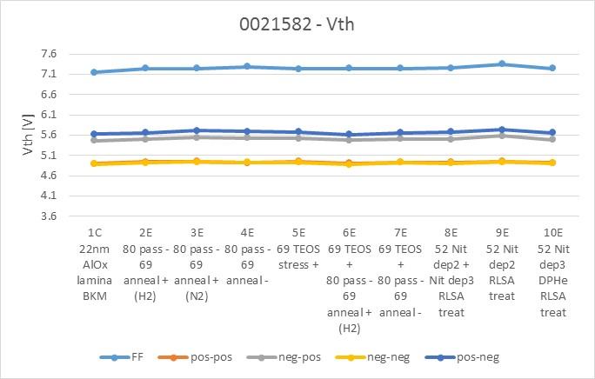
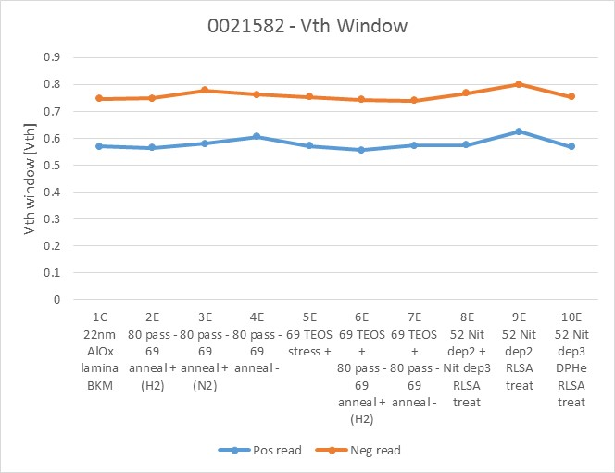
Lot 2: annealing @ 52, 69, and 80
No significant modulation in the SWR of FF, median Vths and SSM window
Need SR71B testing for better assessment

Slide 22
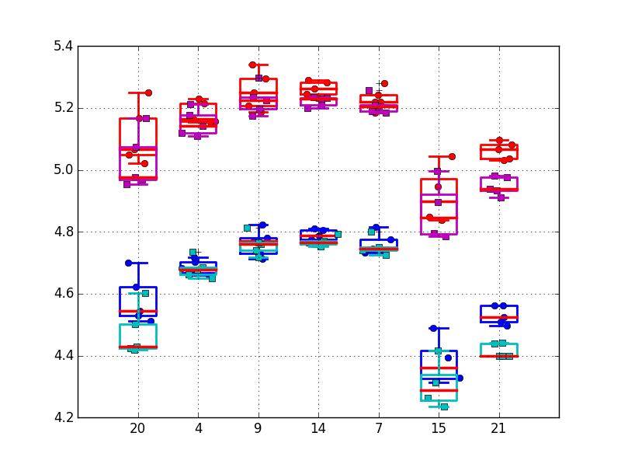
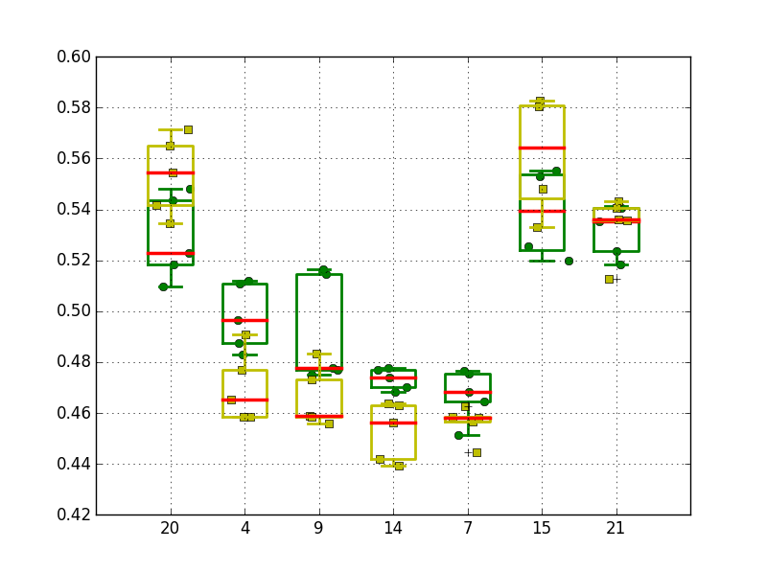
Electrode experiment
Blue/Red: 1k cycles ---- Cyan/Magenta: 128k cycles
Green: 1k cycles --- Yellow: 128k cycles

Slide 23
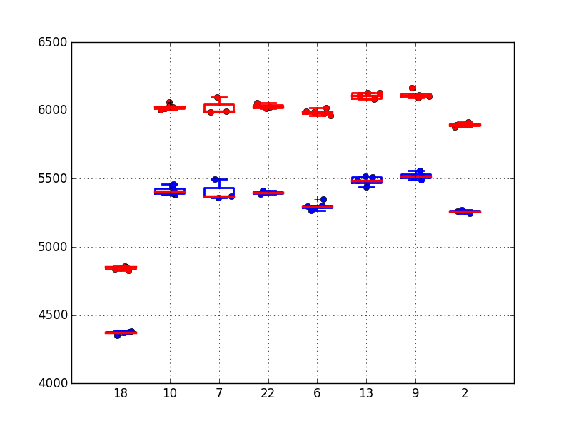
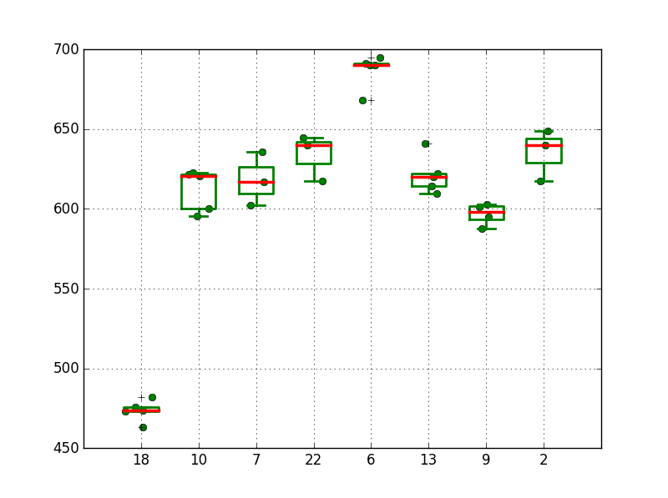
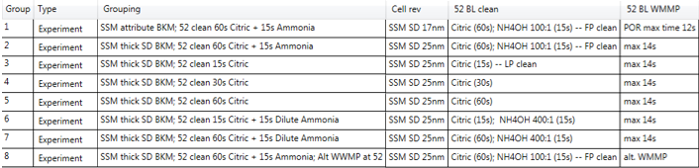
BL cleaning experiment
Set/Reset
Window
Poor modulation
1E
2E
3E
4E
5E
6E
7E
8E
1E
2E
3E
4E
5E
6E
7E
8E

Slide 24
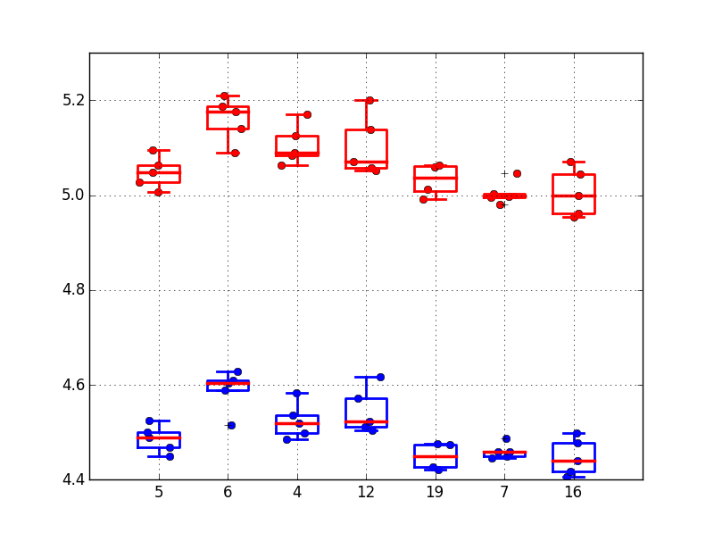
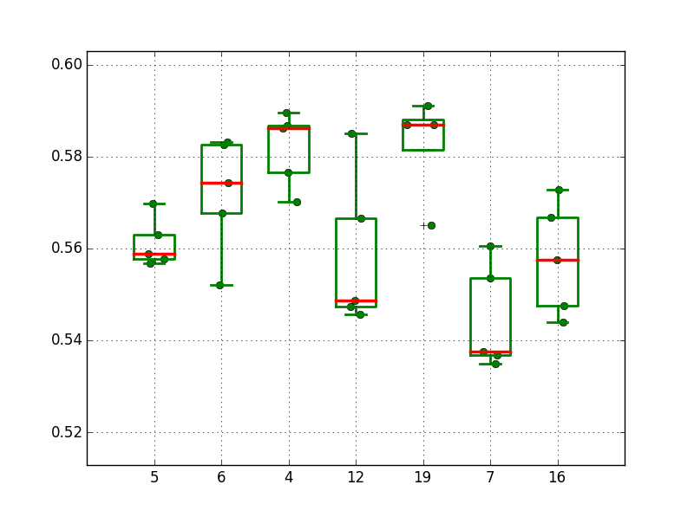
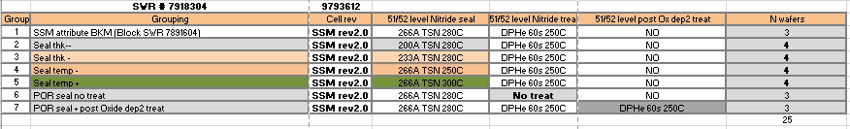
Lot 1: sealing experiment
1
2
3
4
5
6
7
1
2
3
4
5
6
7
Median Vt
No modulation
Window
@ 0sigma

Slide 25
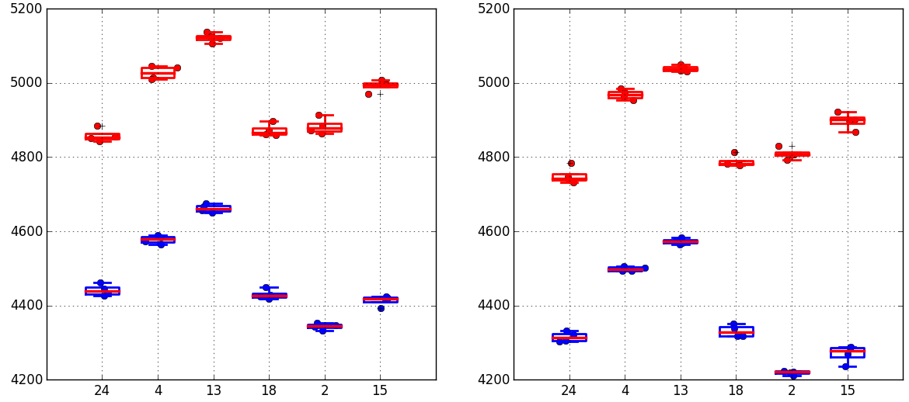
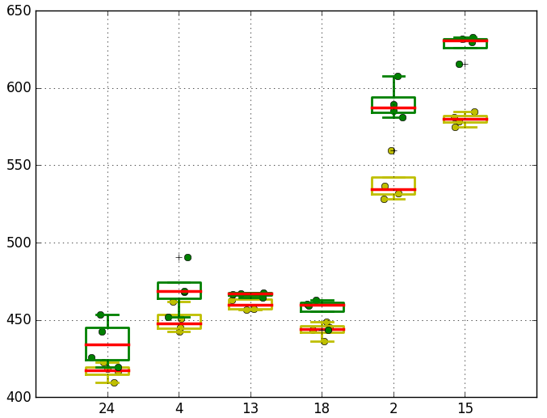
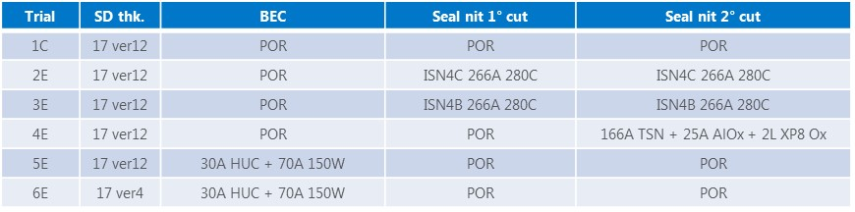
Lot 2: sealing experiment
Set/Reset Vt @1k
Set/Reset Vt @128k
Window @ 1k/128k cycles
No modulation
1C
2E
3E
4E
5E
6E
1C
2E
3E
4E
5E
6E
1C
2E
3E
4E
5E
6E

Slide 26
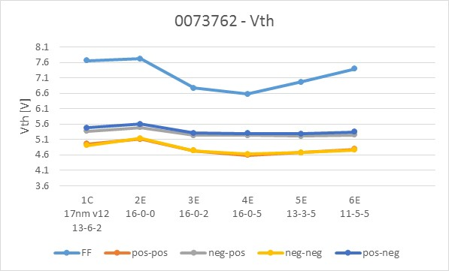
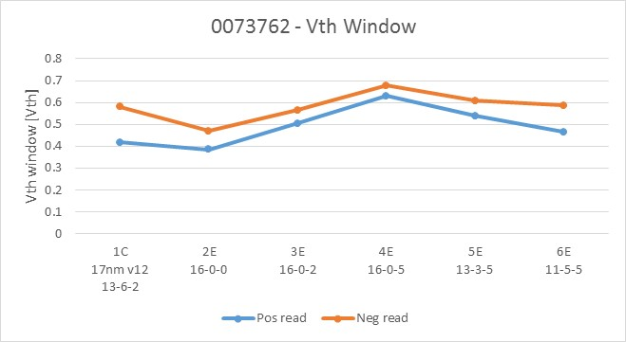
K* camp lot 1: median Vth and Vth window
SWR labels: Ge%-Si%-In %
Group 7E looks very bad (not reported)
Significant FF modulation:
  In-doping reduces FF (and median Vth)
  Si-doping increases FF
Small asymmetry between positive and negative read, consistent with SD straight profile
Significant Vth window odulation:
  In-doping increases the Vth window
  Ge-doping increases the Vth window
K* Camp lot #1

Slide 27
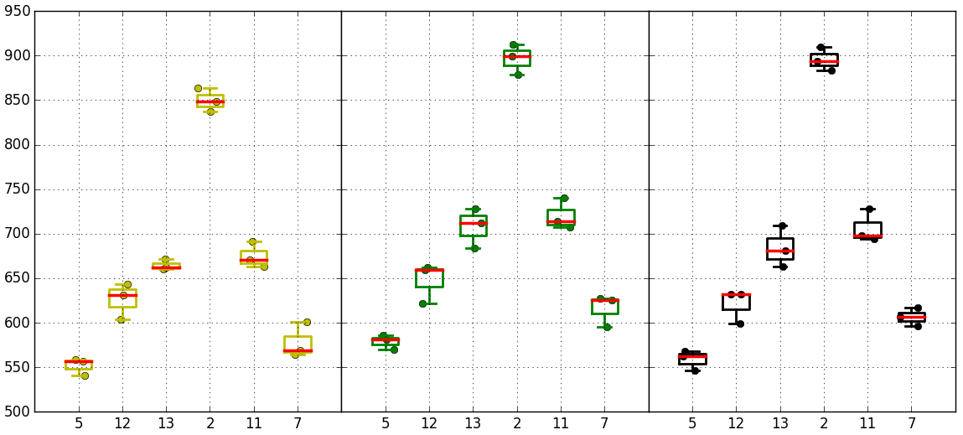
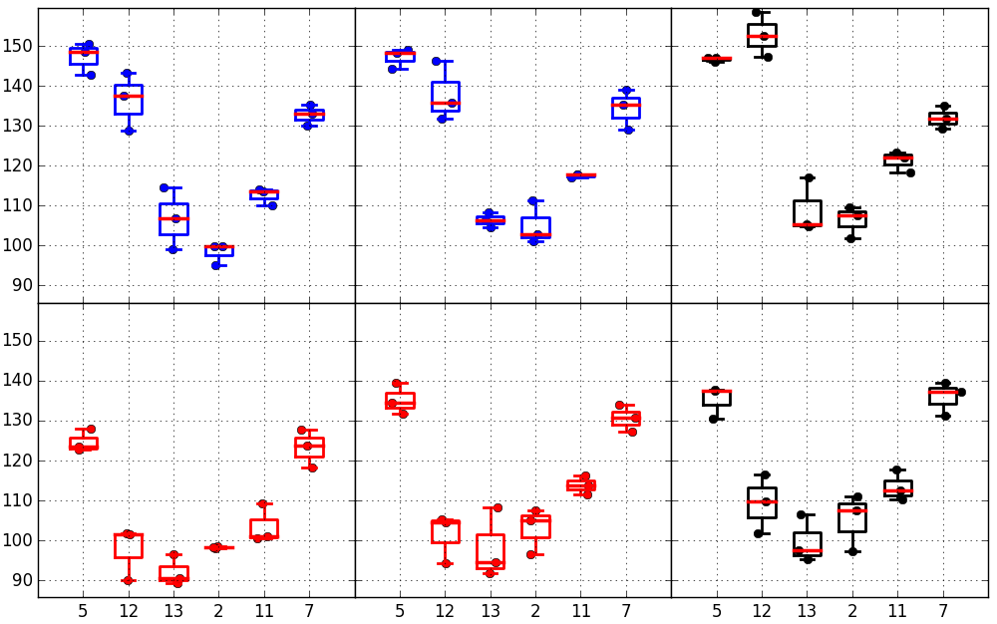
K* camp lot 1: SR71B
1k cycles
128k cycles
128k cycles + 10s drift
Trial | Ge % | Si % | In % | As+Se %
1C | 13 | 6 | 2 | 79
2E | 16 | 0 | 0 | 84
3E | 16 | 0 | 2 | 82
4E | 16 | 0 | 5 | 79
5E | 13 | 3 | 5 | 79
6E | 11 | 5 | 5 | 79
7E | 9 | 7 | 5 | 79
Median
Window
1C
2E
3E
4E
5E
6E
1C
2E
3E
4E
5E
6E
1C
2E
3E
4E
5E
6E
Group 4E has best window (+300mV gain on control group). Need to check on A1 to get window free of memory effect component
Si % increase correlates with worse distribution sigma (possibly enhanced by presence of liner). On the other side, In % increase yields a better sigma
SET
Robust Sigma
1k cycles
128k cycles
128k cycles + 10s drift
RESET
K* Camp lot #1
1C
2E
3E
4E
5E
6E
1C
2E
3E
4E
5E
6E
1C
2E
3E
4E
5E
6E

Slide 28
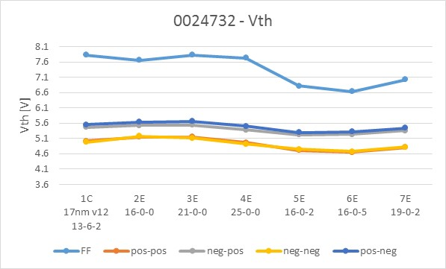
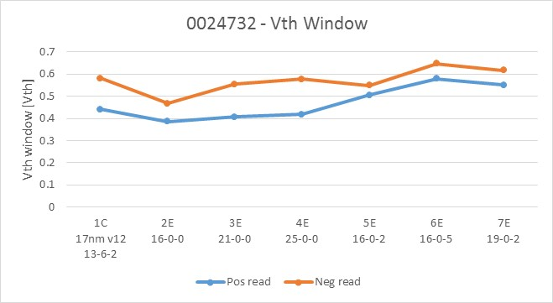
K* camp lot 2: median Vth and Vth window
SWR labels: Ge%-Si%-In %
Significant FF modulation:
  In-doping reduces FF (and median Vth)
  Ge-doping is not affecting FF
Small asymmetry between positive and negative read, consistent with SD straight profile
Significant Vth window modulation:
  In-doping increases the Vth window
  Ge-doping has small/negligible impact on the Vth window
K* Camp lot #2

Slide 29
SR71B: Temp co, 100ms write to read delay
Activation energy of reset more than double with respect to set (set 2 mv/C, reset 5mV/C)
Need to check clean data pre-drift (1us write to read delay)

Slide 30
Retention/Disturb: Drift, RD, WD
Drift characterization
  Set and Reset states
  UD and BD
  1u up to 48Hrs
  E_{A}
Read Disturb and more
  Set State: Analog to Set on Set (or Reset on Reset?)
    PW vs. number of pulses
  Reset State: RD retention
Write Disturb
  Set and Reset state
  E_{A}
Rainbow characteristics
  E_{A} of Set and Reset state retention → no data available, data collection planned

Slide 31


Drift 1us-10s @50C (128k cycles)
Trial | SD thk. | In % | AlOx lamina | WL W thk. | 2° cut seal
1C | 22 ver16 | 2% | 5A T&B | 37nm | POR
2E | 22 ver12 | 2% | 5A T&B | 37nm | POR
3E | 22 ver12 | 4% | 5A T&B | 37nm | POR
4E | 22 ver16 | 2% | 5A T&B | 20nm | POR
5E | 22 ver16 | 2% | 5A T&B | 37nm | High-k
6E | 22 ver16 | 2% | - | 37nm | POR
7E | 22 ver16 | 2% | - | 20nm | POR
Median drift
SET/RESET
1C
2E
3E
4E
5E
6E
7E
1C
2E
3E
4E
5E
6E
7E
Negative reading
SD version: v16 and v12 aligned (1C vs 2E)
In doping: with In 2%→4% small improvement in set and small worsening in reset (2E vs 3E)
AlOx lamina: drift reduction with no lamina only for reset (1C vs 6E)
WL W thickness: with lower W thk, reduction of drift both for set and reset (1C vs 4E, 6E vs 7E)
2nd cut seal: no significant toggles, high-k slightly worse (1C vs 5E)
Relative drift
SET/RESET
1C
2E
3E
4E
5E
6E
7E
1C
2E
3E
4E
5E
6E
7E
1C
2E
3E
4E
5E
6E
7E

Slide 32
Long time drift set & reset (16k precycled samples)
Reference: 10s @50C
Drifted: 3days @90C
Different subtiles measured for each Vdm (negative reading)
1C

Slide 33
Bias drift : 65k X 32 selections along WL and/or BL
65k reads X 32
Vdm stress
Bias drift
(250mV worst case)
Yellow is A cell bias, along WL
Blue/grey is B cell bias along BL
BL bias is too aggressive with respect to WL bias (around 4V, SXP worst case is around 3.8V)
Open test (extended cycling) + bake
Read disturb test (cell cycled with 65k write before read disturb test to stabilize Vth)
Vth reduction when bias stress is very close to switching point
Bias drift along WL (A cells)
Bias drift along BL (B cells)

Slide 34

Read disturb on reset state : Distribution shape vs read number
Vdm read stress

Slide 35

Read disturb on reset state : Distribution shape vs Vdm
Vdm read stress reduction
Strong sensitivity to Vdm level

Slide 36

Read disturb on reset state : Distribution shape vs sense time
Vdm read stress
Weak sensitivity to sense time (PG4 vs PG1 like)

Slide 37

BER vs VDM (nominal value) vs Read stress

Slide 38

BER trend for larger statistics
Pretty rigid shift down to low statistic

Slide 39


Vdm Margin vs initial distribution

Slide 40
RD on reset RBER @50C (32k precycled samples)
1C
6E

Slide 41
Vdm Margin vs Read cycles
Margin of Vdm vs E3 @-3.54 sigma, that we have to take to accommodate a given number of consecutive read cycles
One point was measured @85C for 1k read cycles. RD is slightly better than 50C data, probably due to the stronger drift that helps build margin during disturb.
5E @ 85C

Slide 42
Read endurance (read cycles on low Vth + interlaced write check, ED4)
Vdm stress=6V
Vth shift after read cycles, no opens up to 150M
Partial cycling program recovery
Read endurance is different from write endurance: no open appears, intrinsic shift is less
Small tail in reset distribution after 150M reads: possible “imprinting”?
Delta Vth after read endurance is partially recoverable after write cycles: need to check a possible usage model (mix of read and write) to have a more reliable assessment for VDM tracking
Write endurance,
Many opens appears after 2M switches
(Mattia)

Slide 43
Read disturb (read cycles on low Vth state + Vdm final sweep) vs drift
No tails appearing up to 3 sigma
100ms set drift
Read cycles
10 s set drift
100mV shift @ 3 sigma between 1k and 1M read cycles. In any case shift up to 3 sigma is contained inside std drift between 100ms and 10s @ 50C (100mV) that is the time range of the measure assuming drift erasing after read

Slide 44
Read disturb: Clamp current effect (Low Vth state)
Low clamp current (30uA)
High clamp current (50uA)
Read cycles
Read cycles
Amount of intrinsic Vth shift (between 1k and 1M reads) increase with clamp current

Slide 45

Read disturb with all unipolar writes (to compare with SXP)
S15C SXP, cell rev 7.64: intrinsic shift (100mV)+ bending (ED4)
SR71, SSM (ED4), intrinsic shift only, less than 100mV up to 1M reads

Slide 46



SSM reliability – Program disturb
Simulated temperature on victim cell
No thermal disturb in SSM
  Due to the low programming current and the closer thermal boundaries, the temperature rise during program operation is much lower than in SxP → simulated victim temperature is in the range 90-125C
  SD-polarity effect shows almost no temperature dependence
  Main impact of the temperature increase is related to drift acceleration, but the contribution looks negligible compared to the drift requirements (stress time in the range of few seconds considering the endurance capability of the aggressor)
  No impact (apart bias drift) measured up to 512kcycles for the aggressors
Operating conditions
Set
Reset
Solid black – Time0 victims
Solid colored – After 512kcycles disturb
Dashed colored – After 512kcycles bias drift
Vth [V]
Vth [V]

Slide 47
Endurance: Bathtub characteristics
S26 single chal vs. 3DXP vs. S15 3DXP bathtub with IPD skewed
SR71 bathtub → limited data, IPD skew new data collection on-going
Bake and recovery (virgin bathtub vs. cycled/baked➔bathtub) → limited data

Slide 48


Interlaced cycling (+60/-60 uA): Median Vth evolution
Interlaced cycling is not time cumulative, seems more spike driven (absolute number of pulses)
Spike is maximum in interlaced cycling
Bathtub curve still the same of unipolar cycling
100mV/dec
Robust sigma: no clear reduction

Slide 49




Median Vth evolution: Positive only vs negative only cycling
Positive only cycling (+60uA)
Negative only cycling (-60uA)
Vth shift rate not constant
Vth shift rate not constant
No time cumulative
Evolution (rescaling)
Not clear if cumulative
(rescaling)

Slide 50


Vth evolution vs InterPulseDelay (IPD), +60uA 140ns square pulses
Vth goes down increasing IPD but sigma goes up
IPD
IPD
Pulses #

Slide 51


Vth evolution vs InterPulseDelay (IPD), +60uA 14ns square pulses
IPD
Pulses #
IPD

Slide 52
9768252: Extended Endurance czn: 134M cycles and bake recovery (260C-4h)
Interlaced distributions (minimum drift time)
Final failure mechanism is open that is bake recoverable, even if distribution shapes (sigma and window) are strongly degraded.

Slide 53
Backup Materials

Slide 54
Critical path for SSM Strategy development Plan18 of SOW Approval
Need date: WW47
SSM Physics
  Models of memory windows at first principle and the ranking.
  Each model must examine the following attributes against the best known memory research with a self-consistent rigor .
  Drift fundamentals such as constituents vs. contaminants actions in window evolutions
  Read/Write disturb mechanisms
  Corner case understanding
  Window subject to pulsing (polarity, amplitude, transient and duty)
  Solidify window budget principles to establish pathfinding strategy
  Scalability in window budget, disturbs, energy, physical dimensions and speed
  Algorithm learning in device physics and circuit interactions
Complete data collection in benchmarking/referencing to 3DXP, including
  S26 Array probe
  S26 Array WLR
  Bath-Tub curves of cycling/bake/re-cycling
  Probe platform, data collection and infrastructure

