Slide 1
SSM RWB assessment: WW47-48 Plan
DerChang & Agostino
0th step: create the key exhibits list for RWB Principles
1st step: compile the exhibits, id knowns and unknowns
2nd step: Synthesize the knowns for model validation. Collect additional unknowns, adding to step-1 unknown list.
3rd step: make a 2-week data collection plan to comprehend the critical missing exhibit (WW49-51 action plan).
By WW51, RWB principle will be established ➔ Technology half of SOW.
In parallel, Sandeep and team are preparing for the other half of SOW (array architecture for density, energy, latency, concurrency and BW)

Slide 2
Principle of 3DXP RWB
V_{DM1}
V_{DM3} tracking (net expansion)
Window generation:
mean to mean shift at 1us
Window consumption:
0 to 3.54 of E2 and E3, including ED, U2U
E2 drift from 1us to 10s (retention tacking)
E3 shift at 12.5K FW (wear management)
Window generation:
E3 expansion from 1us to 3s
Window consumption:
E2 drift from 10sec to
No additional consumption after drift
Developing SSM RWB Strategy
Constituents of V_{DM}
Key Characterizations for RWB
Window generation:
mean to mean shift at 1us
Window consumption:
0 to 3.54 of E2 and E3
Retention management
Wear management on E2 and E3
∆V_{T} physics – transport mechanisms, constituents vs. contaminants, interface vs. bulk
E2, E3 variability – repeatability, PA/PW (slope-1/2/3 characteristics), snapback effects (ED), bit-2-bit
E2 / E3 retention: Drift, RD, WD
Bathtub characteristics – including IPD

Slide 3
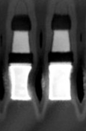
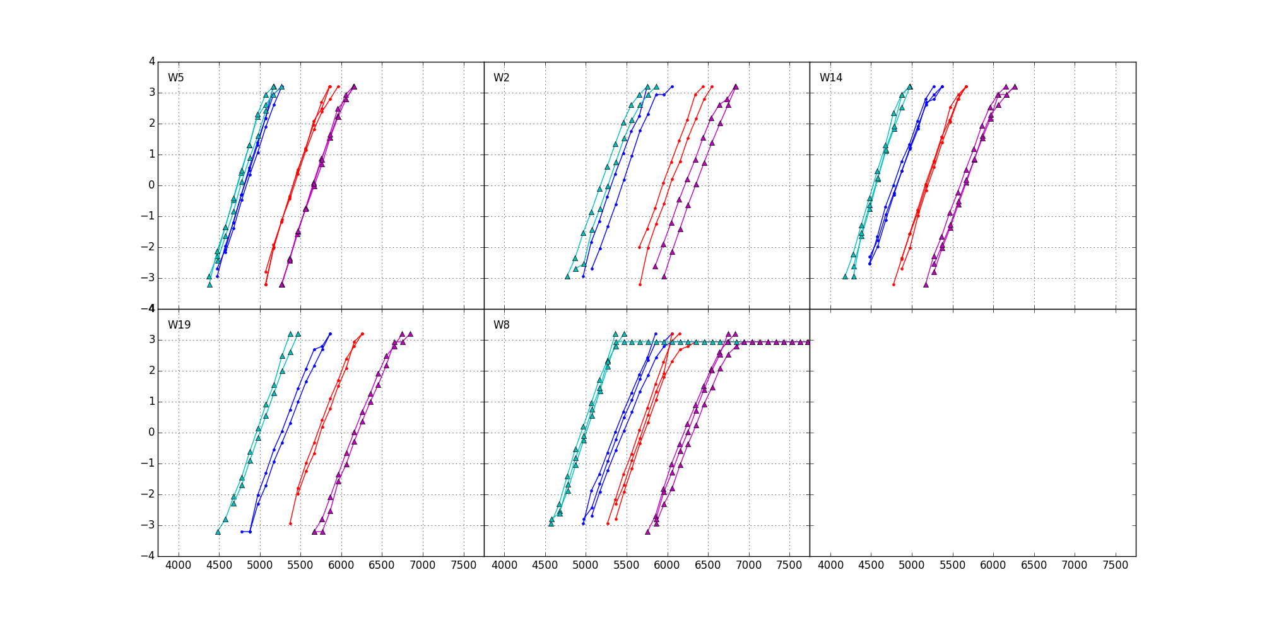
SSM POR RWB
∆V_{T}=900mV, 1usec mean to mean shift
Sigma – limited by “intrinsic”
SET=115mV
Reset=125mV
Drift: (Similar to SXP)
Single V_{DM} – 1us~48Hr@ 85C
550mV
20K E3 shift: 150mV (similar to SXP)
Cross Tile: 50mV (Follow SXP BKM)
Reset Read Disturb: (SSM uniquely required)
300mV
RWB: -1V; Recovery ideas include
Vertical Profile engineering: 300 to 600mV
In/Ge optimization: 200~300mV
Electrode Selection: ~100mV
Program Algo such as Amplitude, Width and Termination: 100 to 300mV
(RWB Strategy: ∆V_{T} – 3.54∙(σ_{SET}+ σ_{RESET}) – E2 Drift – Cross Tile – E3 Shift – Reset RD GB)
Write/Read
Polarity
Rev/ReV
45nm BL W
15nm HUC TE
5Å Al2O3 lamina
900mV
22nm 2% In-doped V12
For/Rev
5Å Al2O3 lamina
3nm HUC/7nm CNx BE
37nm WL W

Slide 4
The Understanding of Window Components for RWB Synthesis
∆V_{T} surviving physics: an interfacial modulation effects with bipolar operations
Bipolar Read exhibiting parallel subV_{th} I-V shift suggests carrier injection but bulk transport
Bipolar Write supports mass transport model between interfaces
Modulated by In/Ge composition skew, Etch/Vertical profile, Electrode types and Algorithm
Insensitive to 2nd cut clean, Seal type, and Pre-/Post-2nd cut & passivation anneal
V_{T} vs. PA/PW results not meeting expectation (window expansion/saturation) need to be understood
E2/E3 Variability: Intrinsically, V_{T} repeatability of SSM is expected equal to or higher than SXP due to interface atomic fluctuations in addition to ovonic threshold bounce.
Best exhibited V_{T} Sigma: σ_{Set} is 115mV (105mV bounce) and σ_{Reset} is 125mV (125mV bounce)
Drift: Set drift is similar to SXP; however, reset drift is ½ of Set’s.
Dual VDM strategy of SXP is not applicable. Single VDM is POR; new V_{DM} tracker ideas needed
Read Disturb: High tolerance to Set while Reset disturb requires additional RWB margin
Reset: ~0.3V Reset Margin is needed to protect from 20K reads. Mechanism to be segmented
Set: ~100mV shift up @10M reads (I_{clamp}=30uA);
No Write Disturb issues
Endurance: Bathtub shape of E2 and E3 is similar of SXP with lower VT turnaround (detailed quantification is WIP)
Retention: WIP

Slide 5
Backup

Slide 6
Generation: ∆V_{T} physics
Transport mechanisms:
Filament (Parallel) or Bulk (Serial)
If bulk, local movement (Å) or mass transport (nm)
Constituents or Contaminants
Key exhibits
for./rev. program X for./rev. read
Subthreshold I-V ➔ –40℃ WIP
SR71 V_{T}/∆V_{T} distribution
Temp Co, E_{A} of subV_{th} conduction ➔ WIP
TTT to establish migration models (with temp or time) ➔ limited data, wip
∆V_{T} subject to composition vs. Integration (clean, seal, bake)
Vt-I on 2XCMOS (in 4 quadrants)
The evidences of forward vs. reverse I-V and Vt indicate an interfacial modulation effects with bipolar operations
Not a parallel resistor network as exhibited with bipolar read ➔ Refute filament model
Parallel subV_{th} I-V shift suggests carrier injection but bulk transport ➔ Refute local structure (electronic configuration) changes (–40℃ WIP)
Supporting mass transport model between interfaces
∆V_{T} is
Insensitive to 2nd cut clean, Seal type, and Pre-/Post-2nd cut & passivation anneal
Modulated by In/Ge/Se composition skew ➔ composition vs. 1st/2nd cut profile segmentation needed
A function of Electrode process (HUC vs. HBC BE or C vs. CNx TE)
Inconsistency yet to be understood
Window expansion or saturation is expected as PW/PA increases
Negative slope on V_{T}-PW and positive slope on V_{T}-PA
Follow up with
“subV_{th} window” vs. PA/PW
Threshold “Point” (V_{TH}@I_{TH})
Spike Effects

Slide 7
Consumption: E2, E3 Variability
Variability including
Same bit: Repeatability (analog to Bounce of SXP)
Bit-2-Bit
circuit/device interaction such as PA/PW (slope-1/2/3 characteristics),
Cross Tile (ED) such as snapback effects
Deck-2-Deck offset
Device physical differences
Ambient: temperature
Key exhibits
Intrinsic sigma such as bounce
S2R “TTT” – PA, PW, and number of pulse
R2S “TTT” – PA, PW, and number of pulse
“ED” or cross tile
Geometric impact: lateral, vertical and profile
Composition learnings
Cross vs. extrinsic contamination learnings
Temperature effects, thermal co and E_{A} of Vt
“corner” definitions
Intrinsically, V_{T} repeatability of SSM is expected equal to or higher than SXP due to interface atomic fluctuations in addition to ovonic threshold bounce
V_{T} σ_{Set} is ~25mV and σ_{Reset} is ~45mV higher than SXP’s (80mV)
Higher PA lower V_{T} σ; insensitive to PW
ED dependence: systematic – near ED lower Vt
Follow-up: Spike Mitigation, BL/WL RC skew and Electrode (local R) experiment
Physical Geometry
Strong correlation on vertical profile – lower window with straight profile but insensitive to thickness and CD
Integration ➔ Lower sensitivity to foreign containment if any
52, 69 or 80 anneal is insensitive to ∆V_{T} (2XCMOS data, SR71 WIP)
BL clean, Seal thickness, temp or treat shows low impact to ∆V_{t}
SD Composition
In and Ge doping increases ∆V_{T}
Convoluted with vertical profile, to be segmented
Corner definition is yet to be developed

Slide 8
Retention/Disturb: Drift, RD, WD
Drift characterization
Set and Reset states
UD and BD
1u up to 48Hrs
E_{A}
Read Disturb and more
Set State: Analog to Set on Set (or Reset on Reset?)
PW vs. number of pulses
Reset State: RD retention
Write Disturb
Set and Reset state
E_{A}
Rainbow characteristics
E_{A} of Set and Reset state retention
Drift
Reset UnBias Drift is ~½ of Set’s
Bias Drift of E2 is similar to SXP
SXP drift Tracker cannot be deployed
Read Disturb
Reset Retention: ~0.3V Reset Margin is needed to protect from 20K reads.
Mechanism to be segmented
Tolerant to Set state:
~100mV@10M reads (I_{clamp}=30uA);
Higher spike and/or read current, higher shift
No Write Disturb issues
WIP: E_{A} of drift and Retention

Slide 9
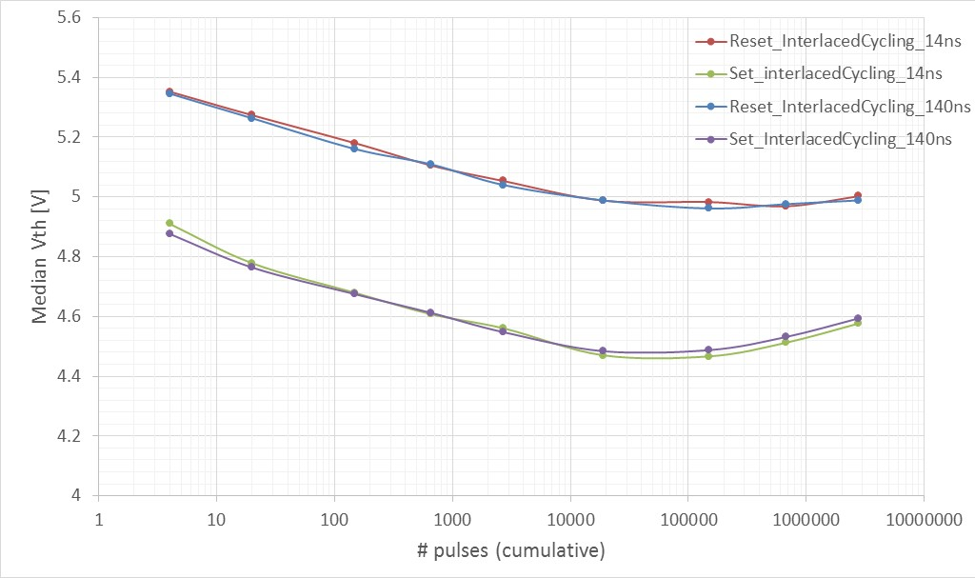
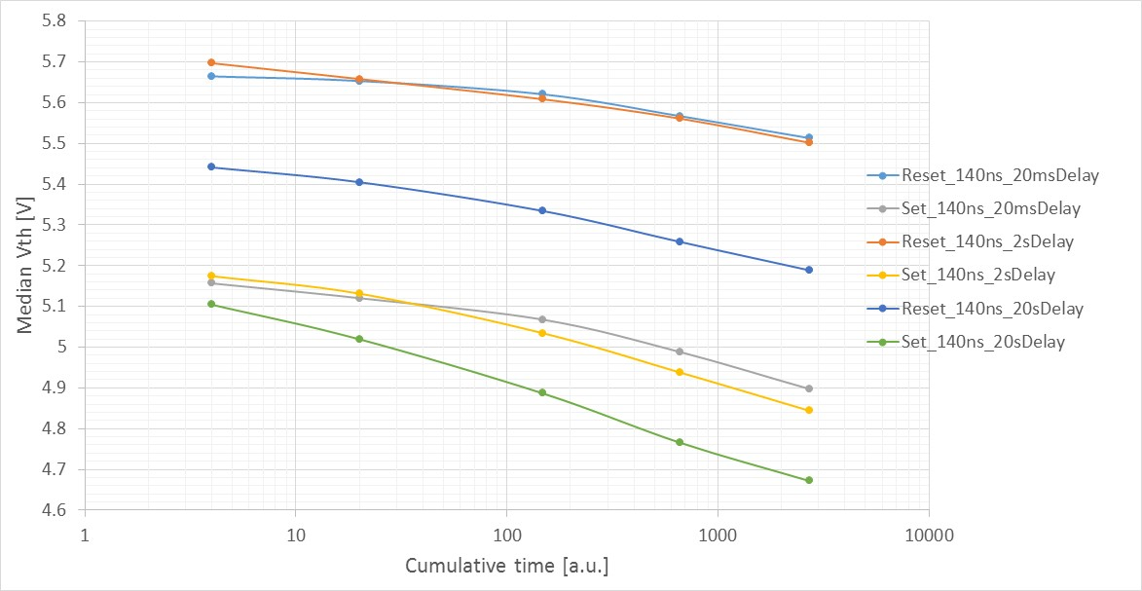
Endurance: Bathtub characteristics
Interlaced cycling (+60/-60 uA):
Median Vth evolution
Interlaced cycling is not time cumulative but spike (# of cycle) driven
Bathtub shape is similar of unipolar cycling
~100mV/dec
Interlaced cycling (+60/-60 uA): Median Vth evolution
RESET
20ms
Vth evolution with unipolar cycling,
+60uA 140ns square pulses
Median Vth evolution
Vth goes down increasing IPD but sigma goes up
SET
IPD
2s
20s
Pulses #

Slide 10
Backup Materials

Slide 11
Critical path for SSM Strategy development Plan18 of SOW Approval Need date: WW47
SSM Physics
Models of memory windows at first principle and the ranking.
Each model must examine the following attributes against the best known memory research with a self-consistent rigor .
Drift fundamentals such as constituents vs. contaminants actions in window evolutions
Read/Write disturb mechanisms
Corner case understanding
Window subject to pulsing (polarity, amplitude, transient and duty)
Solidify window budget principles to establish pathfinding strategy
Scalability in window budget, disturbs, energy, physical dimensions and speed
Algorithm learning in device physics and circuit interactions
Complete data collection in benchmarking/referencing to 3DXP, including
S26 Array probe
S26 Array WLR
Bath-Tub curves of cycling/bake/re-cycling
Probe platform, data collection and infrastructure

