Slide 1
RWB Models and voltages
RWB, inhibit and Select Voltage
Select/Inhibit with WLVDM0 Architecture

Slide 2
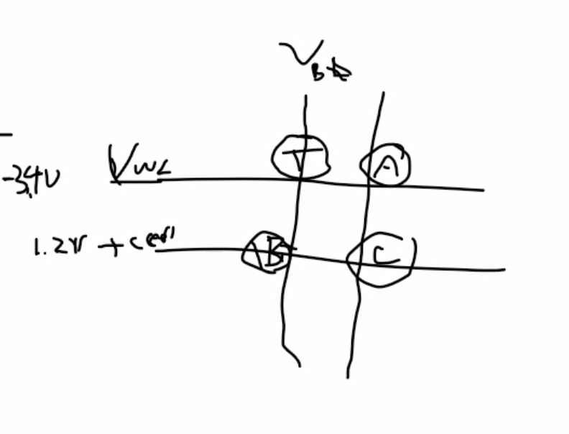
SSM RWB Model
Set@1us,
fresh
Reset@1us
fresh
∆V_{wlr}
dft_{rst}
3.54σ
TCs of V_{set} and V_{rst} are identical (-4~5mV/C).
Vt distributions parallel shift cross temperature
Set@2d
fresh
∆V_{T} = V_{rst} − V_{set} + V_{xt}
0σ
Reset@1us
EOL
Reset@2d
fresh
Set@1𝛍s
EOL
∆V_{inh}
E₃ − E₂ =
GB_{RD}
V_{para}
dft_{set}
GB_{endu}
3.54σ
V_{inh}
E₁
V_{set}
E₂
E₃
V_{rst}
E₄
V_{sel}
Voltage [V]
E₁ = V_{set} − n∙𝛔_{set} − ∆V_{wlr}
E₂ = V_{set} + n∙𝛔_{set} + dft_{set}
E₃ = V_{rst} − n∙𝛔_{rst} − GB_{end}
E₄ = V_{rst} + n∙𝛔_{rst} + dft_{rst}

Slide 3
SSM V_{T}’s, Inhibit & Select Voltages
∆V_{T} = GB_{end} + GB_{dist} + V_{xt} + dft_{set} + n∙(𝛔_{set} + 𝛔_{rst})
V_{set} = GB_{RD} + GB_{endu} + V_{xt} + V_{para} + dft_{set} + dft_{rst}
+ 2∙(∆V_{inh} + ∆V_{wlr} + n∙𝛔_{rst}) +
+ 3∙n∙𝛔_{set}
V_{rst} = V_{para} + dft_{rst}
+ 2∙(GB_{RD} + GB_{endu} + V_{xt} + dft_{set} + ∆V_{wlr} + ∆V_{inh})
+ 3∙n∙𝛔_{rst}
+ 4∙n∙𝛔_{set}
V_{inh} = GB_{RD} + GB_{endu} + V_{xt} + V_{para} + dft_{set} + dft_{rst} + ∆V_{inh} + ∆V_{wlr}
+ 2∙n∙(𝛔_{set} + 𝛔_{rst})
V_{sel} = 2∙(GB_{RD} + GB_{endu} + V_{xt} + V_{para} + dft_{rst} + dft_{set} + ∆V_{wlr} + ∆V_{inh})
+ 4∙n∙(𝛔_{rst} + 𝛔_{set} )

Slide 4
SSM RWB example

Slide 5
Local Wordline Voltage
0
0
0
0
0
0
0
0
I₀
I₁
I₂
………
I_{max}
V_{LWLSEL}
V_{LWLSEL} − I_{leak}∙R_{wl.eff}
C₀
C₁
C₂
C_{max}
I_{n-1}
I_{n}
V_{n-1}
V_{n}
max
∑ I_{i}⋅R_{WL}
i=n

Slide 6
Array Biases@85C
….
C₀…….
….
Selected
Reset Bit
R₀…….
V_{LWL}
….
V_{LBL}
Cell Leakage [A]
….

Slide 7
Backup

Slide 8
Max BL Bias @ WLVDM0 from 3.6V to 3.35V
Solid Set, row/col leakage ≃8uA
WLVDM0=3.35V, max V_{LBL}=3.36V
➔ V_{array}=6.7V@85C (or 7.3V@-40C)

