Slide 1
SSM Read/Writ Algo
Questions to POR
Developing Trimming methodology to prep for S24S startup

Slide 2
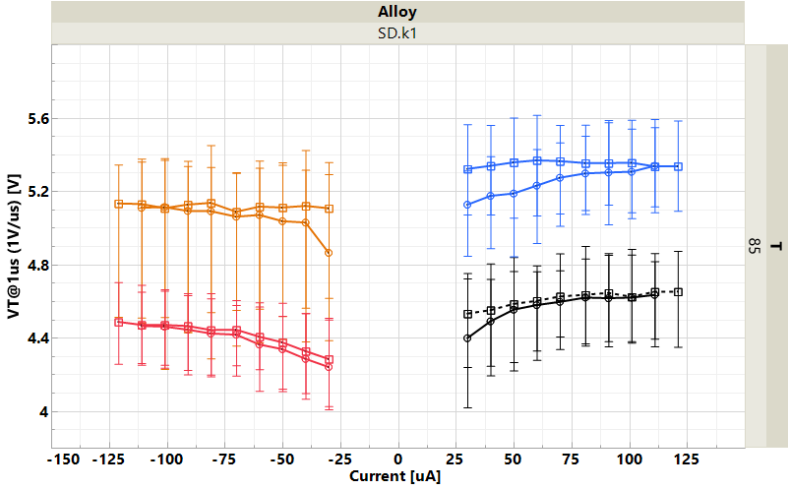
Placement of States
POR: ±44𝛍A/44ns and why
  Minimum doable on SR71 A1 reliably
  Avoiding ‘melting’
How to determine PA and PW
RWB evolutions, including drift and x’tile
Energy and current delivery (circuit arch)
Disturb impact
Write Algo Strategy from SR71 vs. S24S
(4x7(3) bits) x 4 repetitions median for SD.k1(A14); ZoneA-C
[FWD-REV]
[REV-FWD]
IV
II
?
I
III
[REV-REV]
[FWD-FWD]

Slide 3
Demarcation Read
POR: DC read T_{sense}=40ns and why
  Was float read
  Similar reasoning on write POR
Similar to the question to Write: V_{DM} vs. T_{sense}
Threshold delay vs. over voltage
  Sigma (including bounce)?
  Disturb GB?
  Ultimately RWB

Slide 4
Agenda Horizon
Write Algo
  Program Transfer Curves (square pulse)
  Retention of States
  Disturb
  Cycling Evolution (S26A main array as well?)
Read Algo
  Threshold Statics – OverVt vs. Delay (S26A metrology?)
  Vt distribution
  Disturb empirical – underVt vs. Tsense
  RWB based metric for Tsense selection

