Slide 1
Mission & Objective, SSM Advanced Pathfinding
Mission
Scalability and Roadmap Development of SSM Technology
Objectives
Seek for fundamental understandings of non-volatility of bipolar operation of SSM by demonstrating reliable Read Window Budget.
Validate bipolar decoder and power supply scheme with a multi-deck product by benchmarking density, energy and latency against the incumbent.
Develop world leading memory product roadmap based on SSM physics, low cost process enablers and high efficiency decoding scheme.

Slide 2
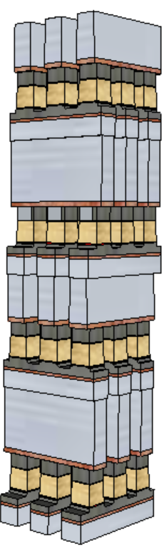
IM JDP Strategy
The strategy for ‘fast fail or succeed’ is built on ‘stepping-up’
SR71 – SSM basics, including scaling, symmetry with solid empiricals to support switching mechanism
S24S – Array feature development with high volume statistical validation with Probe, WLR, Burn and ULR metric.
Build alpha product – Design and process development in order to pick an array node, assess and develop required CMOS and Design Rules and BEOL, such that all work coherently for die size and performance matching or better than SXP counterpart.
Develop Scaling roadmap – Follow the general scaling expectation for cost and energy reduction
Density: doubling every generation
Latency: equal or reduce
Bandwidth/GB: Equal or improve

Slide 3
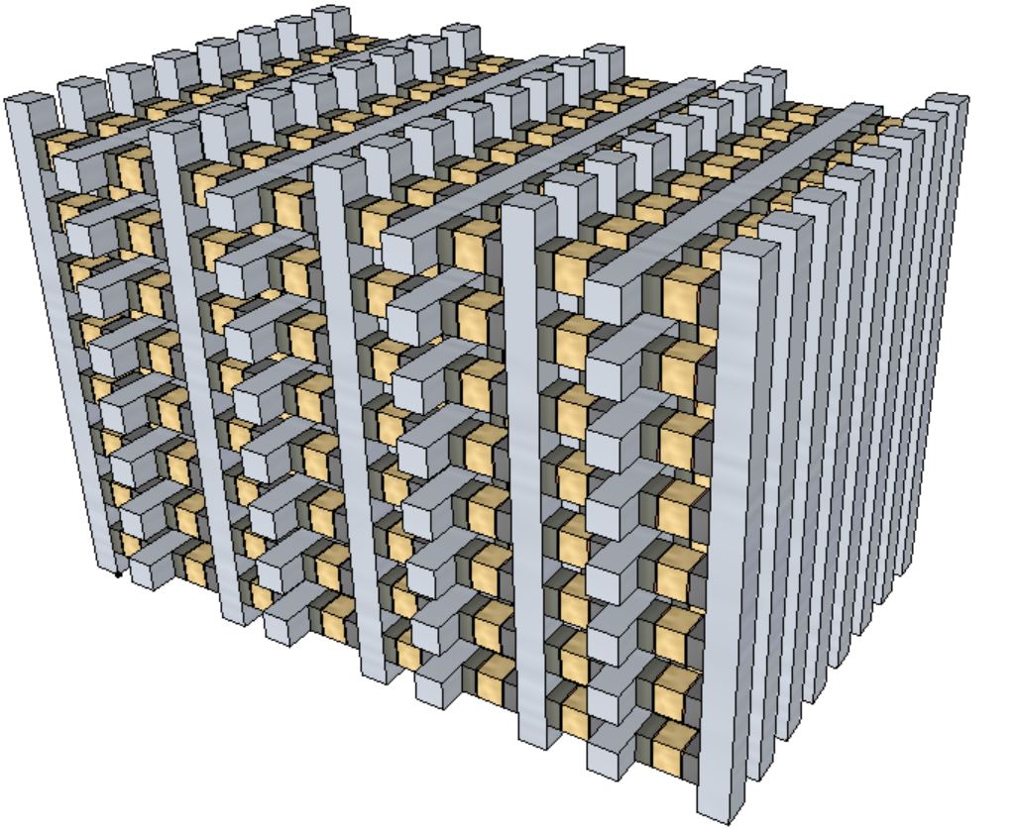
Intel 3D XPoint™ Strategy
The strategy for ‘fast fail or succeed’ is built on ‘stepping-up’
SR71 – SSM basics, including scaling, symmetry with solid empiricals to support switching mechanism
S24S – Array feature development with high volume statistical validation with Probe, WLR, Burn and ULR metric.
Build alpha product – Design and process development in order to pick an array node, assess and develop required CMOS and Design Rules and BEOL, such that all work coherently for die size and performance matching or better than SXP counterpart.
Develop Scaling roadmap – Follow the general scaling expectation for cost and energy reduction
Density: doubling every generation
Latency: equal or reduce
Bandwidth/GB: Equal or improve
Array Architecture: Stack (SXP-like) vs. Tier (3D NAND like)
3D-stack
3D-tier

Slide 4
IM JDP Milestones
Deliverables for “step up” or not
*Lead Product Path-Finding are the development in design and process in order to pick an array node. The key activities are assessing and developing required CMOS and Design Rules and BEOL. The success criteria are die size, cost and performance (energy, power, latency and intrinsic reliability) matching or better than SXP counterpart.

Slide 5
SSM Q2 iMBO @WW22
objective | As measured by | Status/Score WW22 | Tracking | ECD
Secure structural capability gaining confidence on memory switching | SD.K1 2D structure yield matched to S26A | 0.75 | 1@ WW26 (has to be 2D K2) (what & how?) | WW26
 | SD.K2 1D structure yield > 70% PG4 | 1 (With 1D A14) | 1.25@WW26 when match S26A | WW26
Fundamental understandings of memory switching | SR71 demonstrate reliable RWB (piecewise calibration to product usage & roadmap to within 100mV determined) | 1 (60mV with 1D A14) | 1:1DK2@WW26 1.25-2DK2@WW26 | WW26
 | Empirical cell models developed and predictive (read, write, disturb, imprint & retention up to 2M cycles) | 0.5 | 0.75@WW23 1 @ WW26~29 | WW26

Slide 6
SSM Q2 iMBO
objective | As measured by | Status/Score WW22 | Status/Score WW25 | Tracking | ECD
Secure structural capability gaining confidence on memory switching | SD.K1 2D structure yield matched to S26A | 0.75 | 0.75 | 0.75 Limited info turn | WW26
 | SD.K2 1D structure yield > 70% PG4 | 1 (With 1D A14) | 1 (With 1D K2) | 1 | WW26
Fundamental understandings of memory switching | SR71 demonstrate reliable RWB (piecewise calibration to product usage & roadmap to within 100mV determined) | 1 (60mV with 1D A14) | 1 (60mV with 1D K2) | 1 | WW26
 | Empirical cell models developed and predictive (read, write, disturb, imprint & retention up to 2M cycles) | 0.5 | 0.75 | 1 @ WW29 | WW26

Slide 7
30s Q2 iMBO
objective | As measured by | Status/Score WW23 | Tracking | ECD
S36X line "up" | lead electrical lot moving with no line holds pre-probe | 0.5 @1st cut LP L1D | 0.5 or 0 WW34 or longer | WW26
30s performance enablement | system performance path determined (4800 vs alternate path) |  |  | WW26
CMOS development on track
30s process arch. Build roadmap clarity to meet MTS @ 30nm PM height | S26A demo of alt via flow 1D0 (via Cs 65=64, current delivery +5uA) |  |  | WW26
 | alt HM candidates screened, L1D capable 1st/2nd cut - w/ path to MTS W thk |  |  | WW26
 | alt PM experimental strategy in execution, | 1.0: PM-AB defined | 1.0 | WW26
 | alt PM L1D capability demonstrated; | 0.5: Sb-Te segregation | 0.5 to 0
 | alt SD initial evaluation complete using 10s/20s full stack silicon | 0: Structure yield w/ V16 integration | 0
 | alt SD initial evaluation complete using 10s/20s SD only | 0.5: memory effects analysis pending | 1

Slide 8
SSM Q3 iMBO WIP
objective | As measured by | Status/Score | Tracking | ECD
S24S Startup Confidence | 2D structure yield 85%
 | 1st/2nd cut profile demonstrated MTS spec, with electrical response impacts mitigated
 | Deck symmetry POR established with Vt offset < 50mV
Fundamental understandings of memory switching | SR71 demonstrate integrated RWB for PG4 Spec
 | Memory Switching models quantified/ segmented
 | Pareto for Roadmap to Qual defined
S24S DBR | DBR, CMOS compatible with S36X Spider layout
 | Test Spec documented with Key Algo SIM verified
 | Probe/WLR/WLQ strategy and coverage, including Block and die functionality defined

Slide 9
SSM Q3 iMBO
objective | As measured by | Status/Score | Tracking | ECD
S36X line "up" | lead electrical lot to probe, cell visibility > 1.5 sigma |  |  | WW36
 | CR2 PG4 structure yield @ 80% |  |  | WW39
30s performance enablement | S37 performance goal established and 90% path to goal committed. |  |  | WW33
 | Path to meet PG1 write completion time
 | 100mV RWB recovery in memory effect
 | Energy Reduction strategy established, including 10uA Reset current reduction set back elimination 300mV lower V_{DM} 10X C-cell invocation
CMOS development on track
30s process arch. Build roadmap clarity to meet MTS @ 30nm PM height | alt HM candidate chosen, L1D capable 1st/2nd cut at MTS W thk (no underetch @ target HM remaining) |  |  | WW39
 | PM and SD candidates chosen, S26A data demonstrating value w/ downside risks judged capable of mitigation, 14nm L1D no showstoppers |  |  | WW39
 | alt PL flow demonstrating chal health within 2X(?) of 10s at target CDs |  |  | WW26

