Slide 1
Self Selector Memory (SSM)
Al Fazio
October 2017
Basic Concept Intro
Assuming it works, what do we gain?
Key things we know
Key things we DON’T know
Next Steps

Slide 2
Self Selector Memory (SSM)
Basic Concept Intro
Assuming it works, what do we gain?
Key things we know
Key things we DON’T know
Next Steps

Slide 3
3D XPoint™: Memory + Selector Device
Cross point requires very good selector
WL: Tungsten Wordline
BL: Tungsten Bitline
WL
WL
WL
+V
PM
PM
PM
V_{prog}
SD
SD
SD
-V
V_{prog}/2
V_{prog}/2
BL
PM: Phase Change Memory
SD: Ovonic Threshold Device Select Device
BL
PM
PM
PM
SD
SD
SD
WL
WL
WL
V_{prog}/2
Isolation
1 BL Sockets
2 WL Sockets
1st Generation (20nm): 2 Decks 128Gbit
0 V
Each deck is a repeat (process) of lower deck, but operated in reverse polarity
Each deck is always operated in the same uni-polar bias for read/write (not bi-polar per deck)
V_{prog}/2
WL
WL
WL
PM
PM
PM
SD
SD
SD
BL
BL
PM
PM
PM
SD
SD
SD
+V
WL
WL
WL
-V
WL
WL
WL
PM
PM
PM
Selector Device ensures high performance in terms of leakage and single cell selection
Memory element permits to store information using two stable states
SD
SD
SD
BL
BL
PM
PM
PM
SD
SD
SD
WL
WL
WL
Isolation
2 BL Sockets
2 WL Sockets
2nd Generation (20nm): 4-Decks 256Gbit
3rd Generation (14nm): 4 Decks 512Gbit

Slide 4
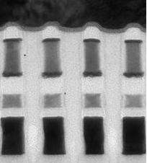
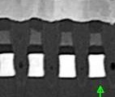
Ovonic Threshold Switch (SD) Polarity Effect
A VT window has been observed by applying programming pulses to the SD device with opposite polarity
S15B SD-only, lot 8792062, 18nm SDδ ver 4
Positive programming pulse
VT_High
Negative VT detection → VT=5.6V → VTHigh
Negative programming pulse
VT_Low
Negative VT detection → VT=4.7V → VTLow
Leads to possibility of a self-select-memory (SSM) of a single chalcogenide layer that has low field leakage, cell selection and stores information
W BL
Carbon
W BL
W lamina
PM
SxP
Carbon
SSM
Carbon
SD
SD
Carbon
Carbon
W WL
W WL

Slide 5
Self Selector Memory (SSM)
Basic Concept Intro
Assuming it works, what do we gain?
Key things we know
Key things we DON’T know
Next Steps

Slide 6
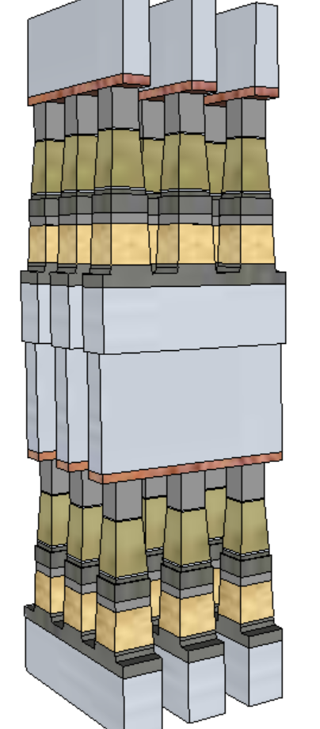
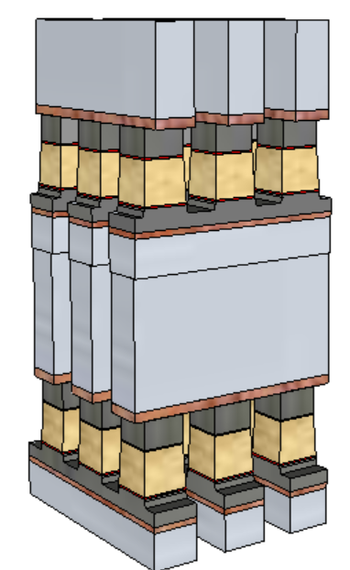
Potential Process Simplification (20nm Comparison)
SSM Potentially overcomes several SXP issues
  No cross-contamination between PM and SD
    Today: Etch done in 2 steps (First & Last Partial Etches: FP, LP) with liners deposited in between
  Lower cell aspect-ratio simplifies the cell sealing
  Lower programming current ➔ relaxes metal (WL/BL) requirements and associated array capacitance
 | 1st Cut |  | 2nd Cut
 | SXP | SSM | SXP | SSM
Stack height [nm] | 141 | 69 | 152 | 85
Stack Height, inc. HM [nm] | 296 | 142.6 | 297 | 191.7
Height/ Space for FP [nm] | 212.5/25.5 |  | 261/21.7
Height/ Space for LP [nm] | 246/19.6 | 142.6/19.6 | 182/18.4 | 191.7/18.4
Space Aspect Ratio for FP | 6.4 |  | 6.7
Space Aspect Ratio for LP | 8.4 | 4.8 | 9.1 | 5.4
SSM
SXP
Aspect Ratios, including hardmask resist are estimates – useful for comparative purposes

Slide 7
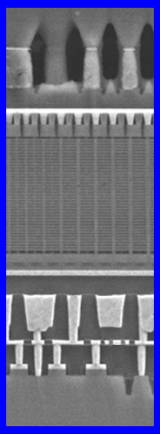
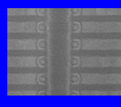
Process simplification ➔ Lower Cost & Further Opportunities
Definite: Removes all the PM related process cost (deposition, etch, liner, etc)
Possibility #1: Further Lower Cost Opportunities become potentially viable
  Lower mask count process: N+1 critical masks (vs. 2N) for N decks (use 2 step SXP-like etch/liner for 2 SSM decks)
Possibility #2: Potential for “3D-NAND-like” Cross-point array architecture, for lower cost
  Thinner/simpler stack might be possible for lateral cell (vs planar / subtractive in SXP)
  ALD required for SD switch (does not exist)
  Power/Performance unknown w/ larger array RC
    3D NAND-like architecture for RRAM was not as good as our present SXP approach when we explored in past
    Never as low cost as 3D NAND (NAND = MLC/TLC/QLC)
Replace floating gate Transistor of 3D NAND with SSM;
Replace channel with metal.
We think can work with FG NAND flow, but may require RG??

Slide 8
Performance Gain (20nm Comparison)
 |  | Read |  | Write
 |  | SXP | SSM | SXP | SSM
Latency | ns | 105 | 105 | 465 | 175
Energy | pJ/b | 52 | 52 | 118 | 109
Latency limited BW | MB/s | 4876 | 4876 | 1101 | 2926
Power limited BW | MB/s | 1601 | 1601 | 800 | 866
Potential for improving one of the key limiters of 3DXP: low write bandwidth (vs read and vs. DRAM)
Write latency will improve (more balanced, with typical compute workload of 2:1 read:write)
Write bandwidth is only slightly improved (<10%) normalized for power, but potential headroom (~3X) for improvement, if increased power can be supported
SSM
SXP

Slide 9
Self Selector Memory (SSM)
Basic Concept Intro
Assuming it works, what do we gain?
Key things we know
Key things we DON’T know
Next Steps

Slide 10
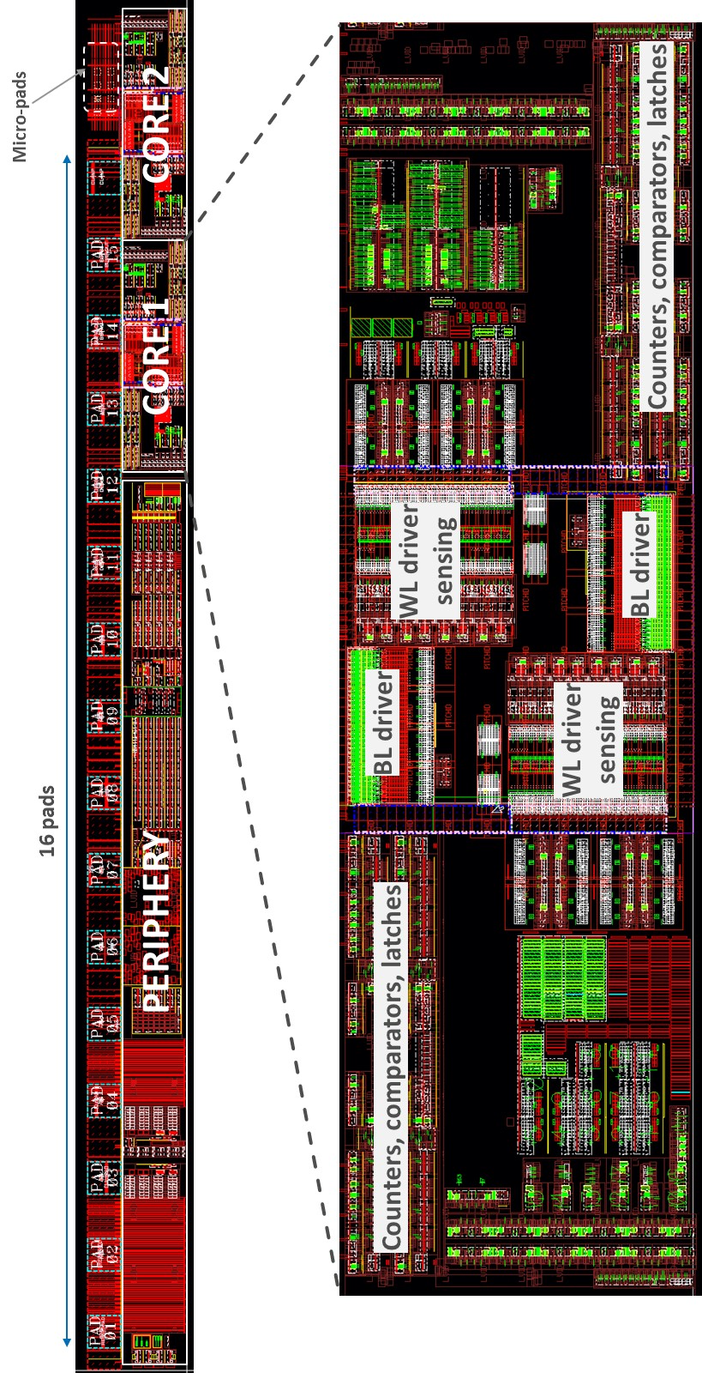
Recently attained Array Testing (vs previous single cell) confirming distributions
SD-polarity effect deeply investigated on S15 silicon single cells
Main vehicle for the assessment is the SR71B test chip on S26A test pattern
  2x256kb test chip arrays (active cells are spread inside a 2x4Mb physical arrays) with dual polarity program capability and single polarity read
  Experiments are usually run on 32x32 cells sub-arrays (1kb statistics, 3 sigma visibility)
SSM flow is based on S26A SxP process → 24 SSM lots out and tested up to now
New revision of SR71B with full bipolar capabilities (programming and reading) on A1 mask set
256kb active array
(physical array is 4Mb)

Slide 11
Endurance & Distributions
Good endurance preliminary results up to 9Mcycles
1C
1C

Slide 12
SSM Research Key Issue Summary
+ (good news)
  Write Disturb (Thermal heating of adjacent cell), issue on SXP, demonstrated not present on SSM
- (bad news)
  Read Disturb of high Vt state – new mechanism for SSM, not present in SXP – has to be comprehended in Vt window budgeting
  Drift is as anticipated, but also means we can’t exploit physics on SXP, where RESET state has two amorphous states (SD + PM), that drift faster and opens window ➔ SSM is a smaller window.
    Drift tracker concept we use on SXP System ASICs not directly usable
512K cycles Write Disturb
Reset Read Disturb
Set/Reset Drift

Slide 13
Self Selector Memory (SSM)
Basic Concept Intro
Assuming it works, what do we gain?
Key things we know
Key things we DON’T know
Next Steps

Slide 14
Don’t Know Basic Physics…yet
Switching mechanism not know ➔ lack the physics to guide our risk assessments / understanding
  Several speculations, but only speculations, e.g. ferroelectric-like atomic movement, contaminant movement causing interface barrier modulation, is it similar to ReRAMs (which we do not favor)???
  SD difficult to atomically probe (TEM energy changes distribution); electrical fingerprinting has been limited thus far
Scalability not known, nor can we speculate without a basic physical model or empirical data
Can 1’s→0’s Vt window be made large enough to be manufacturable?
Multi-deck results not yet attained: Are the effects solely due to geometry effects?

Slide 15
Don’t Know Circuit Topology to Fit CMOS under Array…yet
SXP cross section: array + circuits under tile
SXP has all CMOS under array for each sub-tile (decoders, sense circuits, etc).
Not fitting CMOS ➔ blows up die size??
Bi-polar operation adds transistors to critical pitch circuits under the array
Design / CMOS analysis has not yet started

Slide 16
Self Selector Memory (SSM)
Basic Concept Intro
Assuming it works, what do we gain?
Key things we know
Key things we DON’T know
Next Steps

Slide 17
Next Steps
Intel-Micron JDP looking to step-up SSM activities (from low level research)
Attempt to “fail fast”…or succeed fast
“POR is POR until we change the POR”
  POR roadmap for 3rd generation = SXP POR
    Scaled to 14nm

Slide 18
Backup

Slide 19
Circuit topology comparisons – Physical geometry insensitive
WL2
 | READ
 | 3DXP |  | SSM
 | Lower Deck | Upper Deck | Lower Deck | Upper Deck
WL2 | 0 | − | 0 | +
BL | + | + | − | −
WL1 | − | 0 | + | 0
WL2
 | SET
 | 3DXP |  | SSM
 | Lower Deck | Upper Deck | Lower Deck | Upper Deck
WL2 | +Vcc | − | -Vcc | +
BL | + | + | − | −
WL1 | − | +Vcc | + | -Vcc
SSM
BL
BL
3DXP
 | RESET
 | 3DXP |  | SSM
 | Lower Deck | Upper Deck | Lower Deck | Upper Deck
WL2 | +Vcc | − | +Vcc | −
BL | + | + | + | +
WL1 | − | +Vcc | − | +Vcc
WL1
WL1

Slide 20
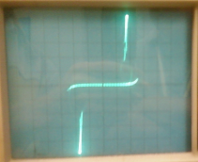
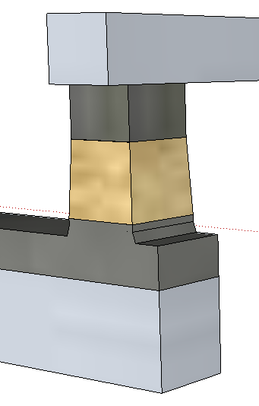
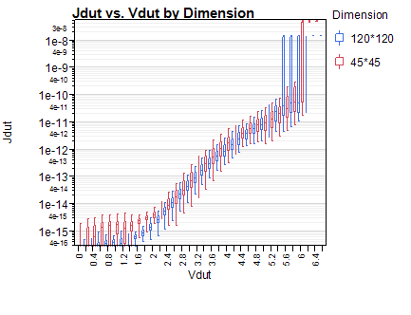
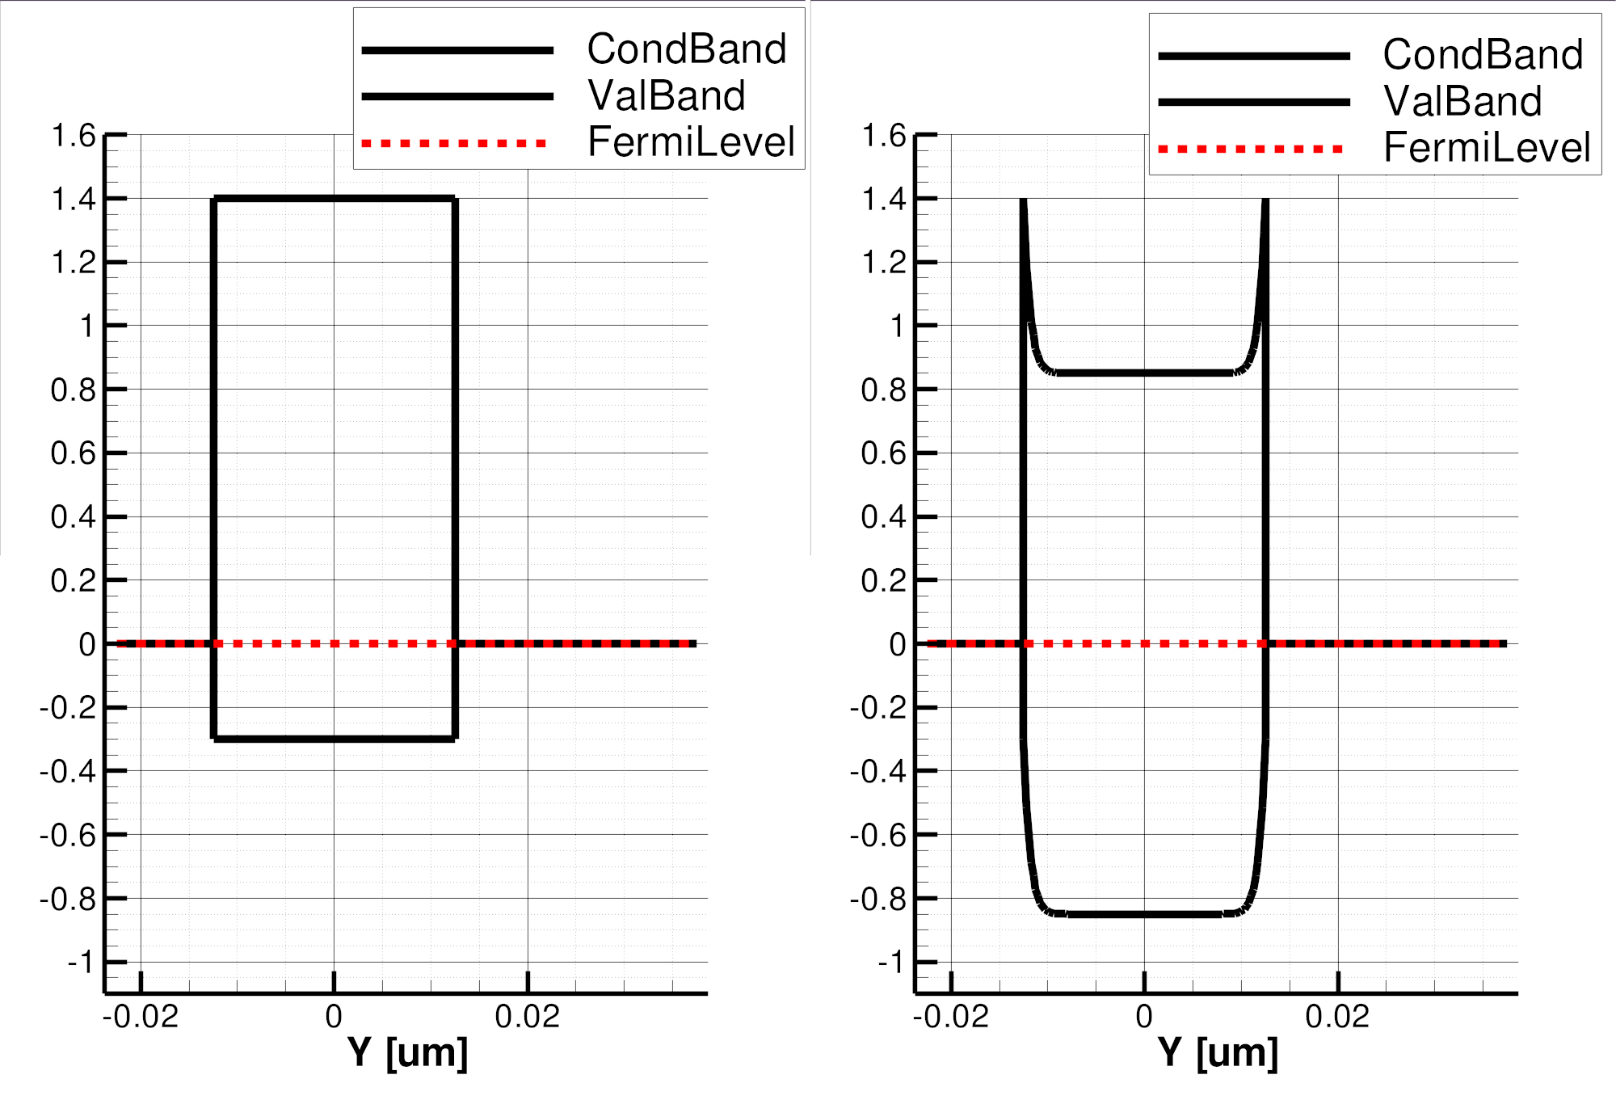
3D XPointTM Selector Element : Ovonics Threshold Switch
Amorphous Semiconductor
Near Threshold
On-state
BE
BE
Top
Electrode
TE
TE
Selector
64
J [A/nm²]
(120nm)²
J [MA/cm²]
Bottom
Electrode
(45nm)²
48
32
Full-STACK
Electrode only
16
φ_{B}=.85eV
3.0eV
4.4eV
V [Volts]
V [Volts]
1.7
1.7eV
E_{F}
BE
TE
BE
BE
SubThreshold
PF conduction
Threshold,
(positive feedback)
Snapback Regime
TE
TE

