Slide 1
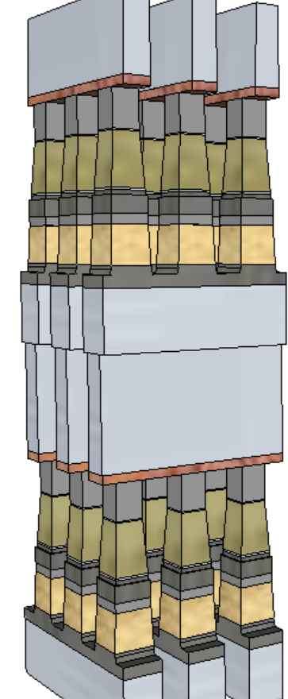
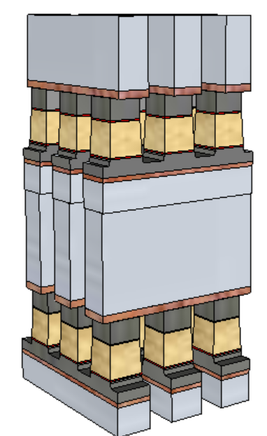
Potential Process Simplification (20nm Comparison)
SSM Potentially overcomes several SXP issues
  No cross-contamination between PM and SD
  Lower cell aspect-ratio simplifies the cell sealing
  Lower programming current ➔ relaxes metal (WL/BL) requirements and associated array capacitance
 | 1st Cut |  | 2nd Cut
 | SXP | SSM | SXP | SSM
Stack height [nm] | 141 | 69 | 152 | 85
Stack Height, inc. HM [nm] | 296 | 142.6 | 297 | 191.7
Height/ Space for FP [nm] | 212.5/25.5 |  | 261/21.7
Height/ Space for LP [nm] | 246/19.6 | 142.6/19.6 | 182/18.4 | 191.7/18.4
Space Aspect Ratio for FP | 6.4 |  | 6.7
Space Aspect Ratio for LP | 8.4 | 4.8 | 9.1 | 5.4
SSM
SXP

Slide 2
Preliminary Analysis on Bipolar Array architecture
(20nm Comparison)
Potential for improving one of the key limiters of 3DXP:
High Write Latency (vs read)
Write latency may need to also consider spike mitigation and pulse termination, up to 50ns adder.
(Worst case latency limited BW: 3GB/s)
 |  | Read |  | Write
 |  | SXP | SSM | SXP | SSM
Die Size | mm² | Same (200)
HVTs Gate oxide |  |  |  | 100Å | 100/200Å
Algo |  | Same |  | N.Write | F.Write
Latency | ns | 105 | 105 | 465 | 105~125
Energy | pJ/b | 52 | 52 | 118 | 118
Latency limited BW | MB/s | 4876 | 4876 | 1101 | 4096+
Power limited BW | MB/s | 1601 | 1601 | 800 | 800
SSM
SXP

Slide 3
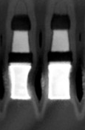
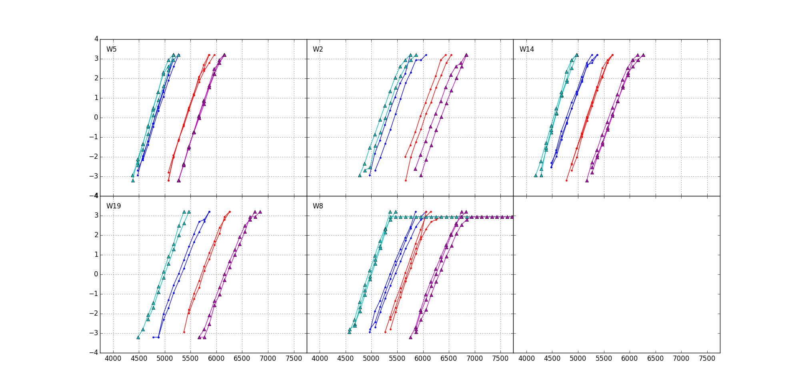
SSM POR RWB
RWB Strategy: ∆V_{T} = 3.54∙(σ_{SET}+ σ_{RESET}) + E2 Drift + Cross Tile + E3 Shift + Reset RD GB
∆V_{T}=900mV, 1usec mean to mean shift
Sigma: dominant by “intrinsic” (repeatability)
  SET=115mV
  Reset=125mV
Drift: 550mV (Similar to SXP)
  Single V_{DM} – 1us~48Hr@ 85C
20K E3 shift: 150mV (similar to SXP)
Cross Tile: 50mV (Follow SXP BKM)
Reset Read Disturb: (SSM uniquely required)
  300mV
RWB: -1V; Recovery ideas:
Write/Read Polarity
45nm BL W (not shown)
Fro/For
Rev/For
SXP POR TE
5Å Al₂O₃ lamina
Rev/ReV
22nm doped V12
5Å Al₂O₃ lamina
SXP POR BE
900mV
For/Rev
37nm WL W
Vertical Profile engineering | 300~600mV
Composition optimization | 200~300mV
Electrode selection | 100mV
Algorithm development | 100~300mV

Slide 4
The Known Knowns
∆V_{T} physics: an interfacial modulation effect with bipolar operations
  Bipolar Read signature refutes filamentation or bulk transport; plus,
  Bipolar Write supports mass transport between interfaces
E2/E3 Variability: Intrinsically, V_{T} repeatability of SSM is expected equal to or worse than SXP due to atomistic fluctuations at interface (accumulation/depletion) in addition to ovonic threshold bounce.
  Intrinsic σ_{Set} is 105mV (vs. 80mV of SXP’s); Intrinsic σ_{Reset} is 125mV (vs. 70mV of SXP’s)
Drift: Set drift is similar to SXP; however, reset drift is ½ of Set’s (no window expansion post drift)
  Dual V_{DM} strategy of SXP is not applicable. Single V_{DM} is POR + invent new ideas on tracker/refresh
The Known Unknowns
Reset Read Disturb: ~0.3V Margin is needed to protect from 20K reads. Mechanism to be segmented
  V_{T} vs. PA/PW results not matching expectation (window expansion/saturation) need to be understood

Slide 5
2018 Strategy in development – Race to Succeed or Fail
Build a product worthy test vehicle for SSM
  Test complete array in high volume
  Validate product worthiness by building prototypes
  Potentially productize if everything looks good
Base it on S26 (as opposed to S37) for faster development
  Start from S26A database
  Keep same die floorplan and PAD placement
  Change decoders and algos; validate and DBR
  Thick oxide CMOS under evaluation (TBD)
Keep specs same as S26 or S25 with shorter (half or less) Write completion time
Estimated DBR: 2H 2018

Slide 6
Backup

Slide 7
Understanding Window Components for RWB Synthesis
∆V_{T} ‘surviving’ physics: an interfacial modulation effect with bipolar operations
  Bipolar Read exhibiting parallel subV_{th} I-V shift suggests ∆V_{T} due to carrier injection but not bulk transport nor filamentation; plus,
  Bipolar Write supports mass transport model between interfaces
  Modulated by composition skew, Etch/Vertical profile, Electrode types and Algorithm
  Insensitive to CD, SD thickness, 2nd cut clean, Seal types, Pre-/Post-2nd cut anneal and passivation anneal
  V_{T} vs. PA/PW results not matching expectation (window expansion/saturation) need to be understood
E2/E3 Variability: Intrinsically, V_{T} repeatability of SSM is expected equal to or worse than SXP due to atomistic fluctuations at interface (accumulation/depletion) in addition to ovonic threshold bounce.
  Best exhibited V_{T} Sigma: σ_{Set} is 115mV (105mV bounce) and σ_{Reset} is 125mV (125mV bounce)
Drift: Set drift is similar to SXP; however, reset drift is ½ of Set’s (no window expansion post drift)
  Dual VDM strategy of SXP is not applicable. Single VDM is POR; new V_{DM} tracker ideas needed
Read Disturb: Immunity to Set while Reset disturb requires additional RWB margin
  Reset: ~0.3V Margin is needed to protect from 20K reads. Mechanism to be segmented
No Write Disturb issues
Endurance: Bathtub shape of E2 and E3 is similar of SXP with lower V_{T} turnaround (detailed quantification is WIP)
Retention: WIP

Slide 8
Generation: ∆V_{T} physics
Transport mechanisms:
  Filament (Parallel) or Bulk (Serial)
    If bulk, local movement (Å) or mass transport (nm)
  Constituents or Contaminants
Key exhibits
  for./rev. program X for./rev. read
    Subthreshold I-V
    ➔ –40℃ WIP
    SR71 V_{T}/∆V_{T} distribution
  Temp Co, E_{A} of subV_{th} conduction
  ➔ WIP
  TTT to establish migration models (with temp or time)
  ➔ limited data, wip
  ∆V_{T} subject to composition vs. Integration (clean, seal, bake)
  Vt-I on 2XCMOS (in 4 quadrants)
The evidences of forward vs. reverse I-V and Vt indicate an interfacial modulation effects with bipolar operations
  Not a parallel resistor network as exhibited with bipolar read
  ➔ Refute filament model
  Parallel subV_{th} I-V shift suggests carrier injection but bulk transport
  ➔ Refute local structure (electronic configuration) changes (–40℃ WIP)
  Supporting mass transport model between interfaces
∆V_{T} is
  Insensitive to 2nd cut clean, Seal type, and Pre-/Post-2nd cut & passivation anneal
  Modulated by SD composition skew
  ➔ composition vs. 1st/2nd cut profile segmentation needed
  A function of Electrode process (HUC vs. HBC BE or C vs. CNx TE)
Inconsistency yet to be understood
  Window expansion or saturation is expected as PW/PA increases
  Negative slope on V_{T}-PW and positive slope on V_{T}-PA
  Follow up with
    “subV_{th} window” vs. PA/PW
    Threshold “Point” (V_{TH}@I_{TH})
    Spike Effects

Slide 9
Consumption: E2, E3 Variability
Variability including
  Same bit: Repeatability (analog to Bounce of SXP)
  Bit-2-Bit
    circuit/device interaction such as PA/PW (slope-1/2/3 characteristics),
    Cross Tile (ED) such as snapback effects
    Deck-2-Deck offset
    Device physical differences
  Ambient: temperature
Key exhibits
  Intrinsic sigma such as bounce
  S2R “TTT” – PA, PW, and number of pulse
  R2S “TTT” – PA, PW, and number of pulse
  “ED” or cross tile
  Geometric impact: lateral, vertical and profile
  Composition learnings
  Cross vs. extrinsic contamination learnings
  Temperature effects, thermal co and E_{A} of Vt
“corner” definitions
Intrinsically, V_{T} repeatability of SSM is expected equal to or higher than SXP due to interface atomic fluctuations in addition to ovonic threshold bounce
  V_{T} σ_{Set} is ~25mV and σ_{Reset} is ~45mV higher than SXP’s (80mV)
  Higher PA lower V_{T} σ; insensitive to PW
ED dependence: systematic – near ED lower Vt
  Follow-up: Spike Mitigation, BL/WL RC skew and Electrode (local R) experiment
Physical Geometry
  Strong correlation on vertical profile – lower window with straight profile but insensitive to thickness and CD
Integration ➔ Lower sensitivity to foreign containment if any
  52, 69 or 80 anneal is insensitive to ∆V_{T} (2XCMOS data, SR71 WIP)
  BL clean, Seal thickness, temp or treat shows low impact to ∆V_{t}
SD Composition
  “Mobile dopants” modulates ∆V_{T}
  Convoluted with vertical profile, to be segmented
Corner definition is yet to be developed

Slide 10
Retention/Disturb: Drift, RD, WD
Drift characterization
  Set and Reset states
  UD and BD
  1u up to 48Hrs
  E_{A}
Read Disturb and more
  Set State: Analog to Set on Set (or Reset on Reset?)
    PW vs. number of pulses
  Reset State: RD retention
Write Disturb
  Set and Reset state
  E_{A}
Rainbow characteristics
  E_{A} of Set and Reset state retention
Drift
  Reset UnBias Drift is ~½ of Set’s
  Bias Drift of E2 is similar to SXP
  SXP drift Tracker cannot be deployed
Read Disturb
  Reset Retention: ~0.3V Reset Margin is needed to protect from 20K reads.
    Mechanism to be segmented
  Tolerant to Set state:
    ~100mV@10M reads (I_{clamp}=30uA);
    Higher spike and/or read current, higher shift
No Write Disturb issues
WIP: E_{A} of drift and Retention

Slide 11
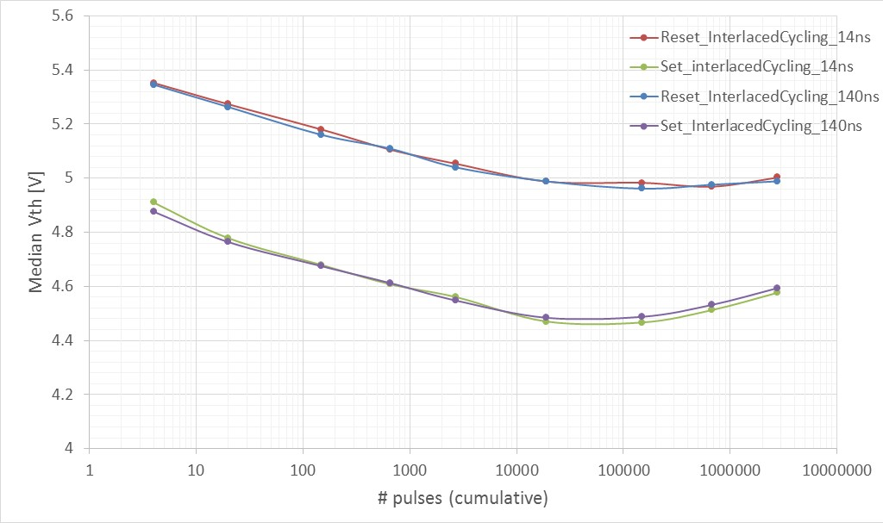
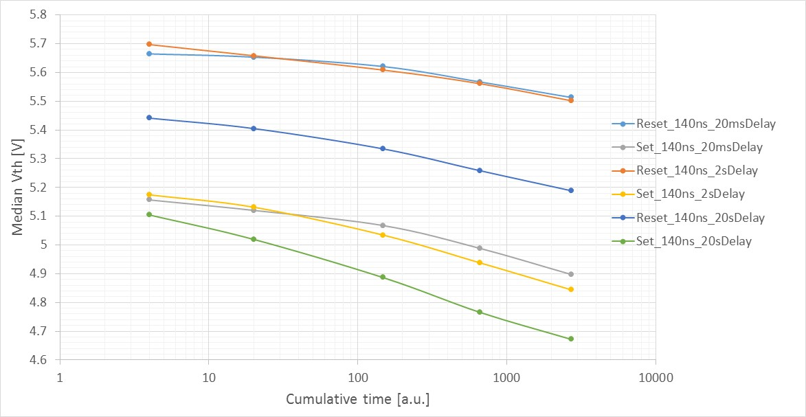
Endurance: Bathtub characteristics
Interlaced cycling (+60/-60 uA):
Median Vth evolution
Interlaced cycling is not time cumulative but spike (# of cycle) driven
Bathtub shape is similar of unipolar cycling
~100mV/dec
Interlaced cycling (+60/-60 uA): Median Vth evolution
RESET
20ms
Vth evolution with unipolar cycling,
+60uA 140ns square pulses
Median Vth evolution
Vth goes down increasing IPD but sigma goes up
SET
IPD
2s
20s
Pulses #

Slide 12
2017-2018 Focus Topics
Is SSM Array working?
  Q1/18 – TO SR71 Stepping for Dual Deck Testable
  2H’/18 – Tapeout S26-SSM
Processes: RWB understanding and Improvement
  Composition Exploration (for ∆V_{T} & sigma)
  Profile Engineering
  SXP POR Porting
Algo and Additional S26 Stepping: improve multi-deck cell Yield interaction with Tests
  Pulse Shapes (Spike mitigation learnings comes from S26 Array)
  Dual-deck (Quad-Deck is in idea stage)
New Vehicle: SSM Product Feasibility Assessment
  20nm 256Gb/200mm² design

Slide 13
Supporting Materials

Slide 14
Critical path for SSM Strategy development Plan18 of SOW Approval
Need date: WW47
SSM Physics
  Models of memory windows at first principle and the ranking.
  Each model must examine the following attributes against the best known memory research with a self-consistent rigor .
  Drift fundamentals such as constituents vs. contaminants actions in window evolutions
  Read/Write disturb mechanisms
  Corner case understanding
  Window subject to pulsing (polarity, amplitude, transient and duty)
  Solidify window budget principles to establish pathfinding strategy
  Scalability in window budget, disturbs, energy, physical dimensions and speed
  Algorithm learning in device physics and circuit interactions
Complete data collection in benchmarking/referencing to 3DXP, including
  S26 Array probe
  S26 Array WLR
  Bath-Tub curves of cycling/bake/re-cycling
  Probe platform, data collection and infrastructure

