Slide 1
What SSM gains if RWB works
DerChang, Fabio & Sandeep, WW45, 2017
Process Simplification
Performance Improvement
CMOS requirement
The big picture: Metric for EoQ4 assessment
RWB Principles and Strategy
Bipolar Array Architecture
RRAM Research Benchmarking

Slide 2
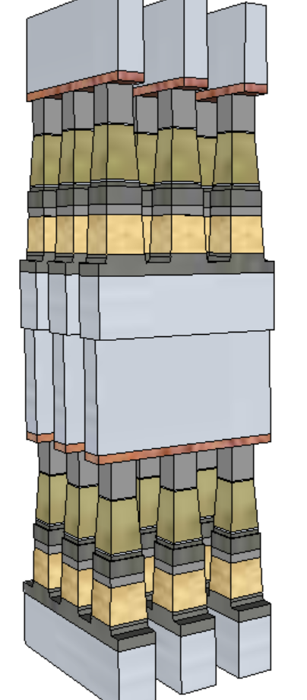
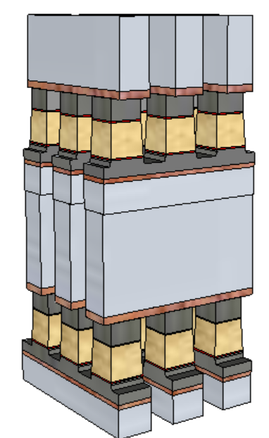
Potential Process Simplification (20nm Comparison)
SSM Potentially overcomes several SXP issues
No cross-contamination between PM and SD
Today: Etch done in 2 steps (First & Last Partial Etches: FP, LP) with liners deposited in between
Lower cell aspect-ratio simplifies the cell sealing
Lower programming current ➔ relaxes metal (WL/BL) requirements and associated array capacitance
 | 1st Cut |  | 2nd Cut
 | SXP | SSM | SXP | SSM
Stack height [nm] | 141 | 69 | 152 | 85
Stack Height, inc. HM [nm] | 296 | 142.6 | 297 | 191.7
Height/ Space for FP [nm] | 212.5/25.5 |  | 261/21.7
Height/ Space for LP [nm] | 246/19.6 | 142.6/19.6 | 182/18.4 | 191.7/18.4
Space Aspect Ratio for FP | 6.4 |  | 6.7
Space Aspect Ratio for LP | 8.4 | 4.8 | 9.1 | 5.4
SSM
SXP
Aspect Ratios, including hardmask resist are estimates – useful for comparative purposes

Slide 3
Preliminary Analysis on Performance Gain (20nm Comparison)
 |  | Read |  | Write
 |  | SXP | SSM | SXP | SSM
Latency | ns | 105 | 105 | 465 | 175
Energy | pJ/b | 52 | 52 | 118 | 109
Latency limited BW | MB/s | 4876 | 4876 | 1101 | 2926
Power limited BW | MB/s | 1601 | 1601 | 800 | 866
Potential for improving one of the key limiters of 3DXP: low write bandwidth (vs read and vs. DRAM)
Write latency will improve (more balanced)
Write bandwidth is only slightly improved (<10%) normalized for power, but potential headroom (~3X) for improvement, if increased power can be supported
SSM
SXP

Slide 4
Circuit topology comparisons – Physical geometry insensitive RWB
WL2
 | READ
 | 3DXP |  | SSM
 | Lower Deck | Upper Deck | Lower Deck | Upper Deck
WL2 | 0 | − | 0 | +
BL | + | + | − | −
WL1 | − | 0 | + | 0
WL2
 | SET
 | 3DXP |  | SSM
 | Lower Deck | Upper Deck | Lower Deck | Upper Deck
WL2 | +Vcc | − | -Vcc | +
BL | + | + | − | −
WL1 | − | +Vcc | + | -Vcc
SSM
BL
BL
3DXP
 | RESET
 | 3DXP |  | SSM
 | Lower Deck | Upper Deck | Lower Deck | Upper Deck
WL2 | +Vcc | − | +Vcc | −
BL | + | + | + | +
WL1 | − | +Vcc | − | +Vcc
WL1
WL1

Slide 5
Circuit topology comparisons – Profile dependent RWB
WL2
 | READ
 | 3DXP |  | SSM
 | Lower Deck | Upper Deck | Lower Deck | Upper Deck
WL2 | 0 | − | 0 | −
BL | + | + | − | +
WL1 | − | 0 | + | 0
WL2
 | SET
 | 3DXP |  | SSM
 | Lower Deck | Upper Deck | Lower Deck | Upper Deck
WL2 | +Vcc | − | -Vcc | −
BL | + | + | − | +
WL1 | − | +Vcc | + | +Vcc
SSM
BL
BL
3DXP
 | RESET
 | 3DXP |  | SSM
 | Lower Deck | Upper Deck | Lower Deck | Upper Deck
WL2 | +Vcc | − | +Vcc | +
BL | + | + | + | −
WL1 | − | +Vcc | − | -Vcc
WL1
WL1

Slide 6
The Big Picture
The Metric for SSM assessment and The Expected Outcome in EoQ4 Proposal

Slide 7
Principle of 3DXP RWB
V_{DM1}
V_{DM3} tracking (net expansion)
Window generation:
mean to mean shift at 1us
Window consumption:
0 to 3.54 of E2 and E3
E2 drift from 1us to 10s (retention tacking)
E3 shift at 12.5K FW (wear management)
Window generation:
E3 expansion from 1us to 3s
Window consumption:
E2 drift from 10sec to
No additional consumption after drift
Developing SSM RWB Strategy
New ideas needed for V_{DM}
Key Characterizations for RWB
Window generation:
mean to mean shift at 1us
Window consumption:
0 to 3.54 of E2 and E3
Retention management
Wear management on E2 and E3
∆V_{T} physics – transport mechanisms, constituents vs. contaminants, interface vs. bulk
E2, E3 variability – repeatability, PA/PW (slope-1/2/3 characteristics), snapback effects (ED), bit-2-bit
E2 / E3 retention: Drift, RD, WD
Bathtub characteristics – including IPD

Slide 8
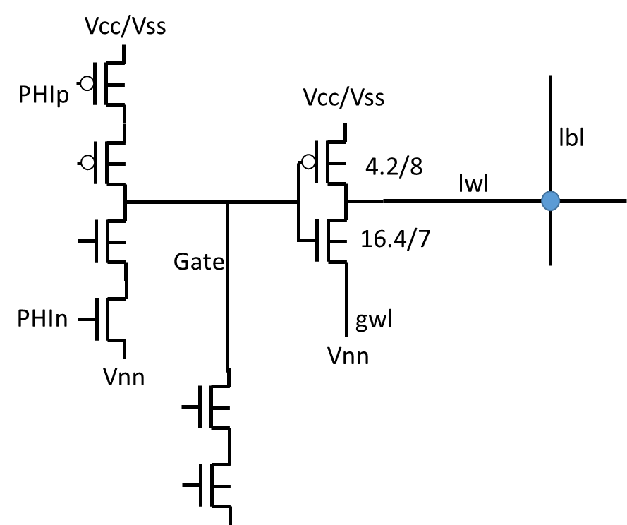
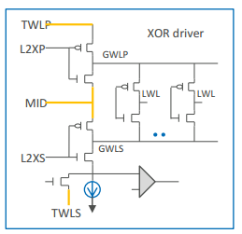
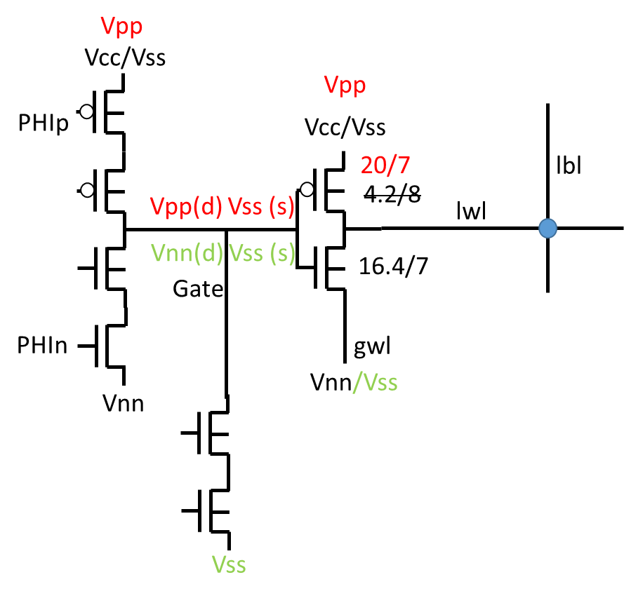
Three Array Architecture Benchmark
S26 based - SSM
S26-SXP
SR71B
Metric based on Die size, Energy and Latency Projection

Slide 9
Switching mechanism adjacency and Benchmark
Best Known Resistive Change Mechanism
Interfacial barrier (VCMO, MIEC)
Filamentation (Metal Oxide or Solid Electrolyte)
Ferroelectricity (FeRAM, ϵ_{eff} change ➔ E_{G} change)
Phase Change
Mechanical Switches (NRAM)
Literature searches on
“E_{A}” of retention and electrical conductivity of states (S/R)
“Forces” to change states

