Slide 1
S26A starting point
Vpp
PHIp
Vcc/Vss
Vpp
20/7
lbl
Vpp(d) Vss (s)
4.2/8
lwl
Vnn(d) Vss (s)
Gate
16.4/7
PHIn
gwl
Vnn/Vss
Vnn
No spike mit yet
Vcc/Vnn
Global decode signal
Precharge to Vpp for pos polarity and Vnn for negative Polarity
Vss

Slide 2
PHIp
20/7
lbl
4.2/8
lwl
Gate
16.4/7
PHIn
Vnn
gwl
Vnn
No spike mit yet
Vcc/Vnn
Global decode signal
Vss

Slide 3
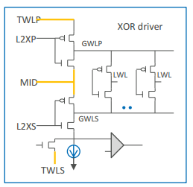
Vcc/Vss
PHIp
Vcc/Vss
lbl
4.2/8
lwl
16.4/7
Gate
PHIn
gwl
Vnn
Vnn

Slide 4
Vpp
Vcc/Vss
Vpp
PHIp
Vcc/Vss
20/7
lbl
Vpp(d) Vss (s)
4.2/8
lwl
Vnn(d) Vss (s)
16.4/7
Gate
PHIn
gwl
Vnn/Vss
Vnn
Vss

Slide 5
PHIp
lbl
lwl
Gate
PHIn
gwl
Vnn
No spike mit yet
Vcc/Vnn
Global decode signal
Vss

