Slide 1
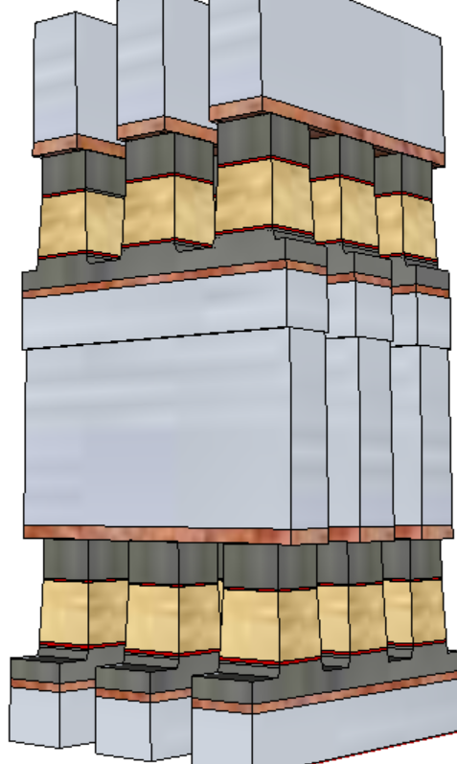
S26-SSM Read scheme – Polarity vs. Orientation Cathode@TE vs. Reconfigurable read for S26
Odd/Even
±
∓
−
+
−V_{DM}
+V_{DM}
−V_{DM}

Slide 2
S26-SSM Read scheme – Polarity vs. Orientation Cathode@TE vs. Reconfigurable read for S26
+
−
AXN
V_{DM}

Slide 3
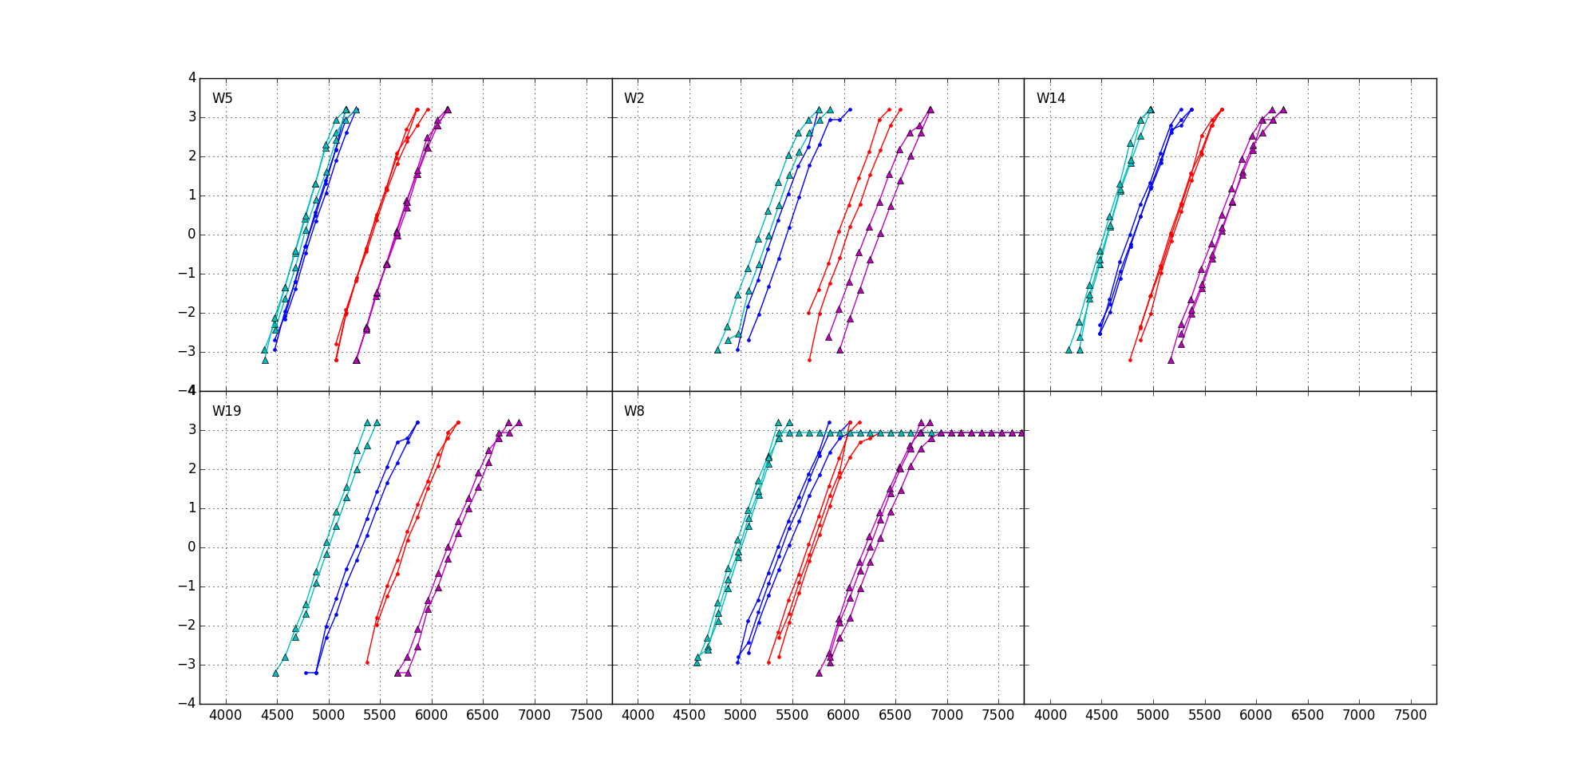
Pulse Polarity
NN
PP
NP
PN
State Change | Pulse Sequence | Selection Voltage
SET → RST | Neg → Pos | NP (5.7V)
RST → RST | Pos → Pos | PP (5.4V)
SET → SET | Neg → Neg | NN (5.0V)
RST → SET | Pos → Neg | PN (6.2V)
Polarity: WR

Slide 4
Page Open: Access DRAM Array
http://www.cse.scu.edu/~tschwarz/coen180/LN/DRAM.html
V_{b}
(Column)
BL
V₊
V_{sh}
V_{b}
(Row)
WL
V₋
V_{c}
V_{b}
V_{c}
V₊
C_{b}
C_{c}
V_{b}
V₋
Definitions:
V_{b}: bit voltage; either V₊ or V₋
V₊: +Supply rail, state-1 bit voltage
V₋: −Supply rail, state-0 cell voltage
V_{c}: Pre-charges Col/BL voltage
C_{c}: Col/(BL) capacitance
C_{b}: bit capacitance
Array access:
Pre-charge: Col voltage from V_{b} to V_{c} – Energy: (V_{c} − V_{b} )² ∙ C_{c} ÷ 2 ≡ ∆V² ∙ C_{c} ÷ 2
Access: Turns on Array x’istor for charge sharing – V_{sh} ∙ (C_{b} + C_{c}) = (V_{b} ∙C_{b} + V_{c} ∙ C_{c}) ➔ V_{sh} = (V_{b} ∙ C_{b} + V_{c} ∙C_{c}) ÷ (C_{b} + C_{c})
Signal V_{s} developed – V_{s} = V_{b} − V_{sh} = (V_{b} − V_{c}) ∙ C_{c} ÷ (C_{b} + C_{c})
Restores (Write) state – Energy: (V_{b} − V_{sh} )² ∙ (C_{b} + C_{c}) ÷ 2 = V_{s}² ∙ (C_{b} + C_{c}) ÷ 2
Page Access Energy per bit – [V_{s}² ∙ (C_{b} + C_{c}) + ∆V_{c}² ∙ C_{c}] ÷ 2

