Slide 1
3.2 Product POR and Decision Process for POR Change
In order to meet die size and energy of SXP counter part, SSM has high design collateral scope & risk
More aggressive DR is needed to fit more transistors for bipolar decoder
TGnMOST development is required in compliant to energy spec
S24S Design Start
100% S26A collateral
CMOS Bipolar Decoder (no HV Stress)
50% high switching energy
S26A3 footprint @ ¼ of density
S24S
No TGnMOST, No DR change
Lower BW, 64Gb
EoQ1 RA for Q3 TO
Risk in DR
High Risk
20nm Design Collateral
Decoder fitted
TGnMOST meet I-V requirement
S26S’
No TGnMOST, low risk DR change
Lower BW, 256Gb
Low Risk
Risk in TGNMOST
High Risk
S26S
TGnMOST, low risk DR change
S26A spec compliant DBR
Low Risk
POR
PrePOR
Evaluation/Decision
14nm Collateral Development
TGnMOST
14nm SSM Design Collateral
To fit in S37A density/die size
S37S
TGnMOST, S37S DR
S37A Spec compliant DBR

Slide 2
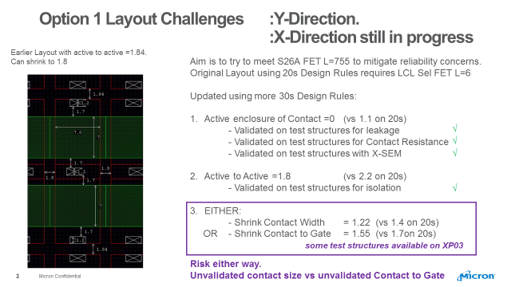
Design Rule Risks for Option 1 ➔ S26S’

Slide 3
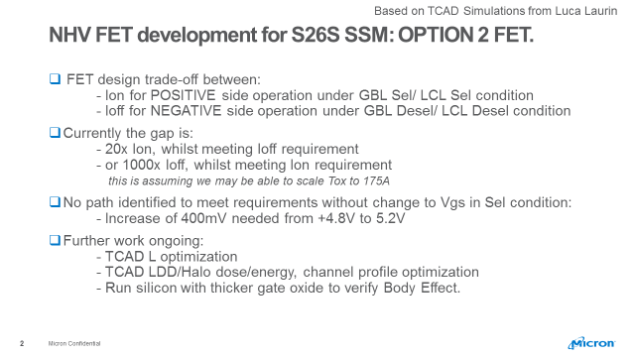
TGnMOST Risks for Option 2 → S26S DBR

Slide 4
Mitigation and Containment for Option 1
S24S
64Gb
PICO
PICO
S25.2S
144Gb
PICO
PICO

Slide 5
WIP S25S vs. S24S Design, Test and Backend analysis WIP ➔ ECD to ratify POR plan is WW07.5

