Slide 1
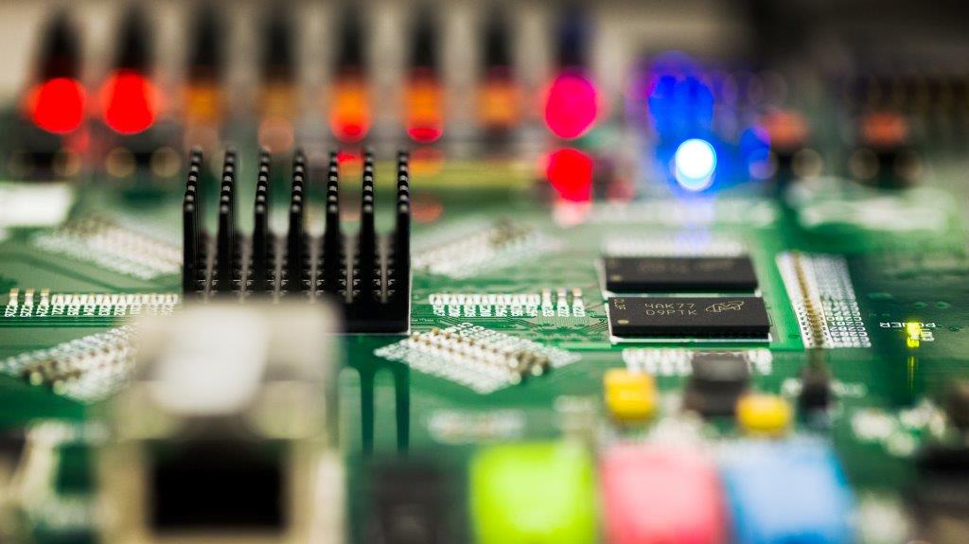
Vimercate SR71B array characterization
To create this effect:
  From Selection Pane, hide Tinted Rectangle.
  Use Change Picture command to place photo.
  Or replace it with a Clipboard paste or a drag and drop from a folder.
  Unhide Tinted Rectangle and set it to desired level of transparency. (25% usually works well.)
  From the Title Slide layout, copy and paste the circuit line and the logo onto this slide.
Reliability update @85C (Bias drift, ReadDisturb distributions)
©2016 Micron Technology, Inc. All rights reserved. Information, products, and/or specifications are subject to change without notice. All information is provided on an “AS IS” basis without warranties of any kind. Statements regarding products, including regarding their features, availability, functionality, or compatibility, are provided for informational purposes only and do not modify the warranty, if any, applicable to any product. Drawings may not be to scale. Micron, the Micron logo, and all other Micron trademarks are the property of Micron Technology, Inc. All other trademarks are the property of their respective owners.

Slide 2
SSM reliability assessment on neg read window : czn priority list
  1us interlaced set/reset algo (Hernan to release the routine, need to ask also the fast read disturb pointed out by Al)
Current functionality skew ( 20uA --> 80uA) and time ( 45ns--> 150ns)
Skew of read sense (40ns -->150ns)
25C vs 85C Vth / window sensitivity extraction with Temperature (best prog/read conditions)
Extended cycling on best split
Reset read disturb (@ 85C)
Long Time drift for best split (2d @ 85C)
  Cycling vs IPD
  Bias drift
Read endurance
Thermal disturb check
Full tile testing/cross tile (256kb)
------------------------------------------------- (end of scorecard)-------------------------------------
Write cycling vs ED
First Fire recovery @ high T (4 cases for each bake)
Done
Next priority

Slide 3
SSM: negative read validation on SR71B – A1 mask release
Lot 0104052
Trial | SD thk. | In-doping | AlOx lamina | WL etch | Wf
1C | 22 v12 | 2% | 5A T&B | No SO2 | 5,20,23
2E | 25 v12 | 2% | 5A T&B | No SO2 | 2,13,16
3E | 22 v12 | 2% | - | SO2 | 1,6,15,22
4E | 22 v12 | 2% | - | No SO2 | 4,9,14,24
5E | 25 v12 | 2% | - | SO2 | 7,10,12,19
6E | 25 v12 | 2% | - | No SO2 | 8,11,25
IPD check onPOR (wf 20)
High window split
All tests done @ 85C

Slide 4
Single Vdm test: sampling block on diagonal tile (20k access resistance)
1st core
BL number
Blocks circled in green are cycled with same selection voltage
Blocks circled in red are experiencing bias drift due to selection voltage along the column of cycled blocks (Cells have been previously seasoned with 32k cycles and placed in set state)
Each red block is read with different Vdm to extract the final distribution
Second core is used as reference to track unbias drift during cycling
Same technique is used for read disturb, stressing red block with same Vdm read cycles
Reset (+40uA)
WL number
135us
135us
40ns
40ns
Set (-40uA)

Slide 5
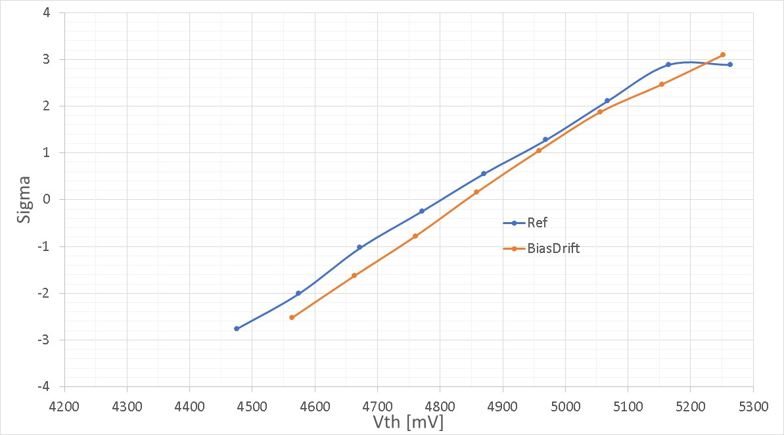
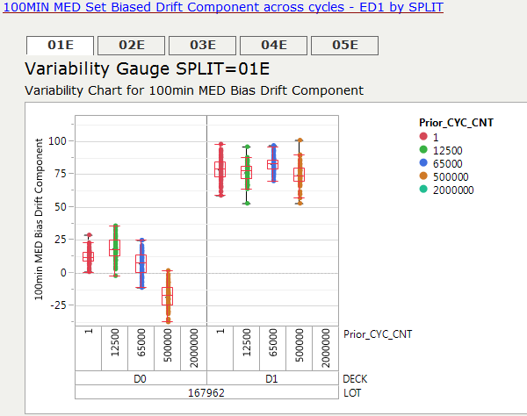
Bias drift: SSM vs SXP
17M writes (50%set/50%reset, 40ns pulses), 7.2V selection voltage
Continuous stress: is it already decoupled from unbias drift?
0.7s total bias time (50% positive, 50% negative)
32k prior cycles (64k writes) on the cells before bias stress
< 50mV median shift
SXP (Joe)
3.6V?

Slide 6
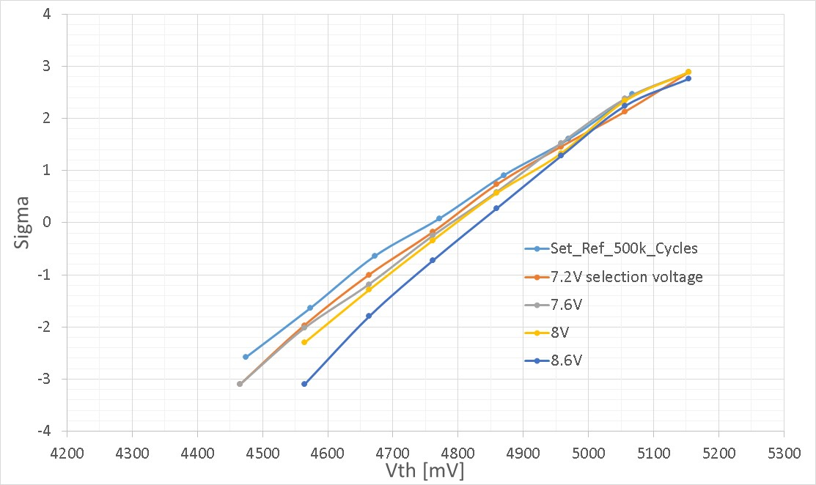
Bias drift on SSM: selection voltage skew
1M total writes bias stress (50% set / 50% reset, 40ns pulses)
Ref distribution taken after same total drift time of bias stress
Bias drift tend to rotate the distributions (adding a contribution to unbiased drift at low sigma, improving E1 margin)
Acceleration with deselection voltage is expected, no clear change in RWB on top of unbiased drift
For typical selection voltages (<8V ) median biased drift is less than 50mV
Deselection bias acceleration, E1 margin improves

Slide 7
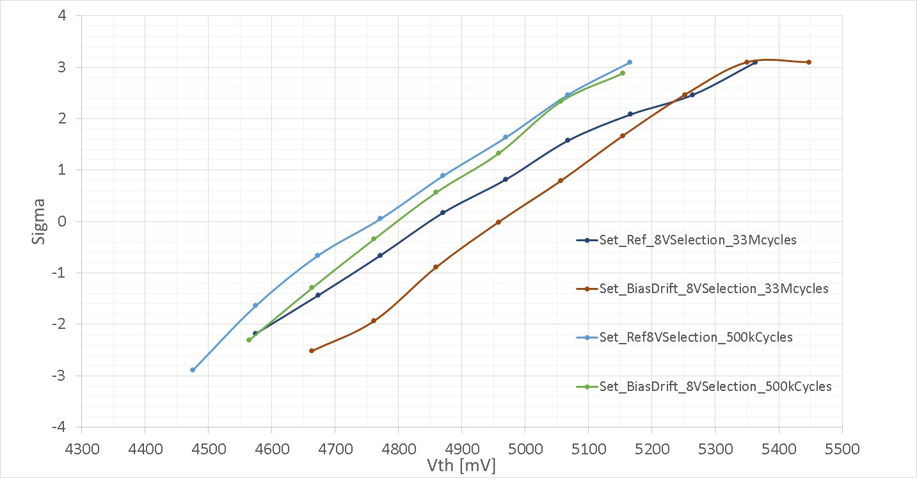
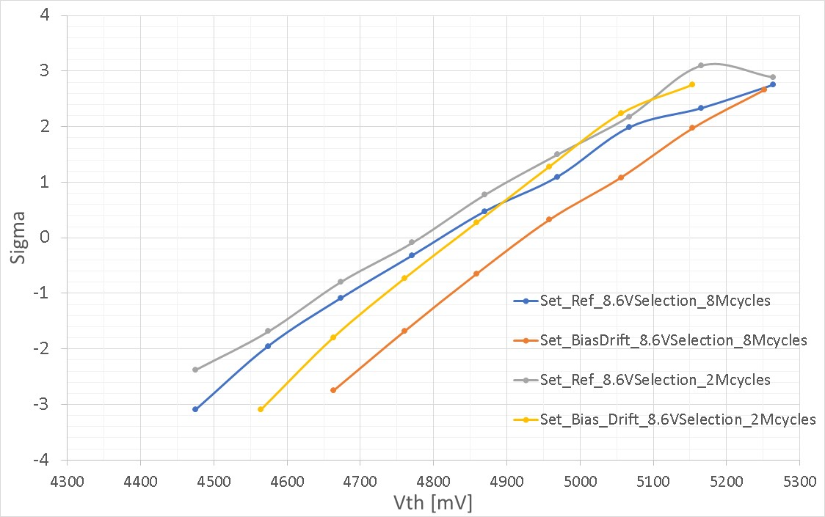
Bias drift on SSM : cycles skew
Selection voltage = 8V
Deselection voltage = 4V
Selection voltage = 8.6V
Deselection voltage = 4.3V
8Mcycles take 100s drift time @ 85C: reference distribution placement depends on total unbias drift time needed for cycling
Distributions tend to rotate also with cycles, so no clear erosion of window budget added on top of unbiased drift

Slide 8
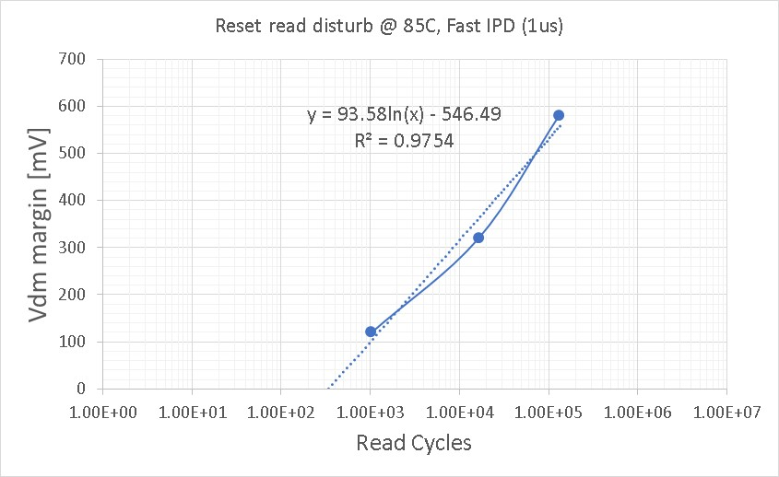
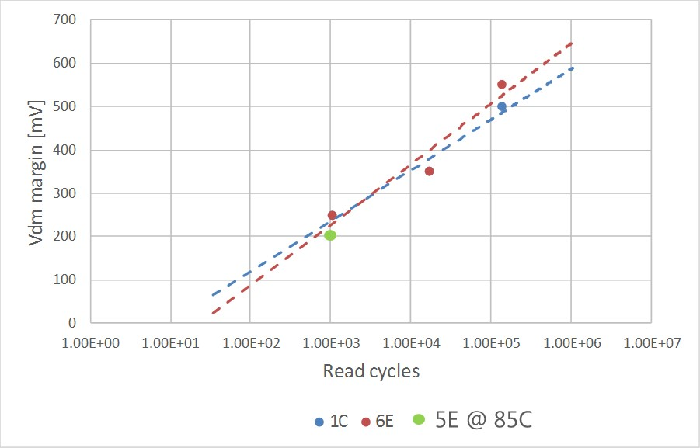
Read disturb: slow vs fast IPD on POR (margin for 3.54sigma)
Read disturb slow, 135us IPD
R
Read disturb fast, 1us IPD
R
2.5s
1us
1us
ReadOut
single Vdm
2.5s
ReadOut
single Vdm
Drift impact reduces at high cycle counts
Slow IPD (135us), Split 1 and 6 tested @ 50C
Split 1C (POR), fast IPD
Tested @ 85C
Steepness increased
Drift @ 85C can help in reducing margin required at low cycle counts

Slide 9
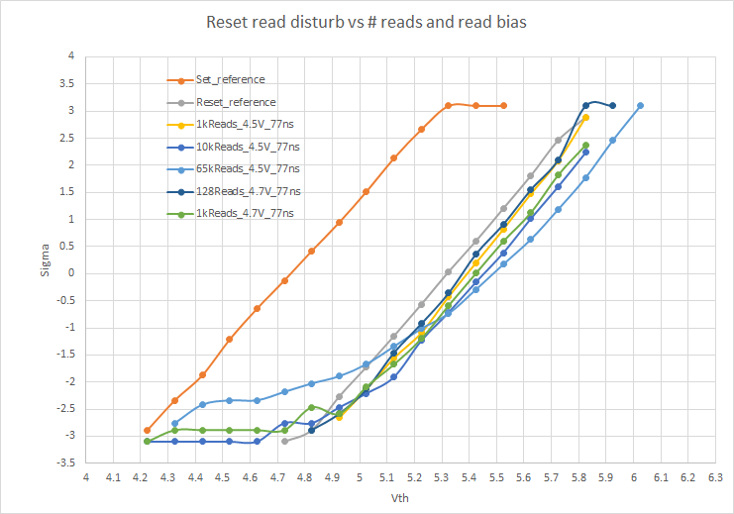
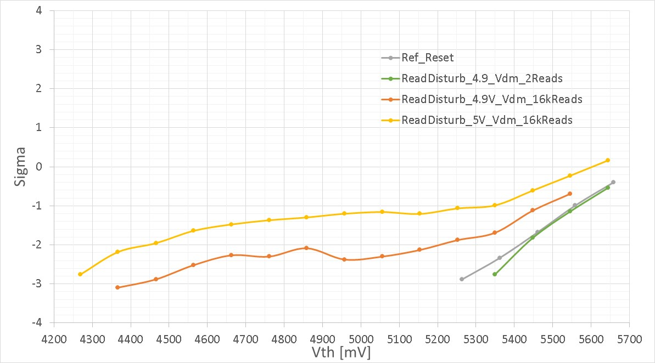
Read disturb distributions: single Vdm detection
Single Vdm, negative reading
Cumulative Histo, positive reading (old data)
Accelerated drift
Tail appearing confirmed
Tail growth

Slide 10
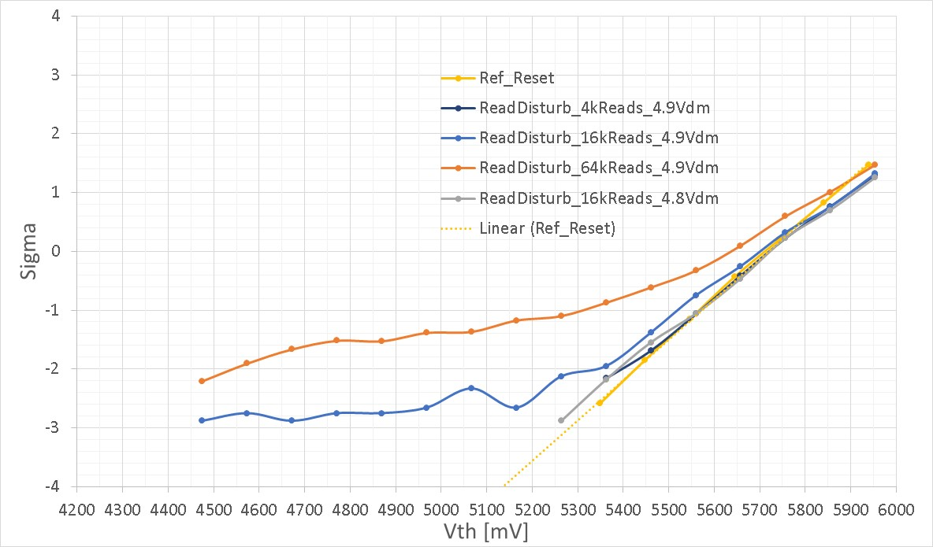
Margin check for 16k Reads
450mV is the min required margin after drift
Vdm
Bias rotation

Slide 11
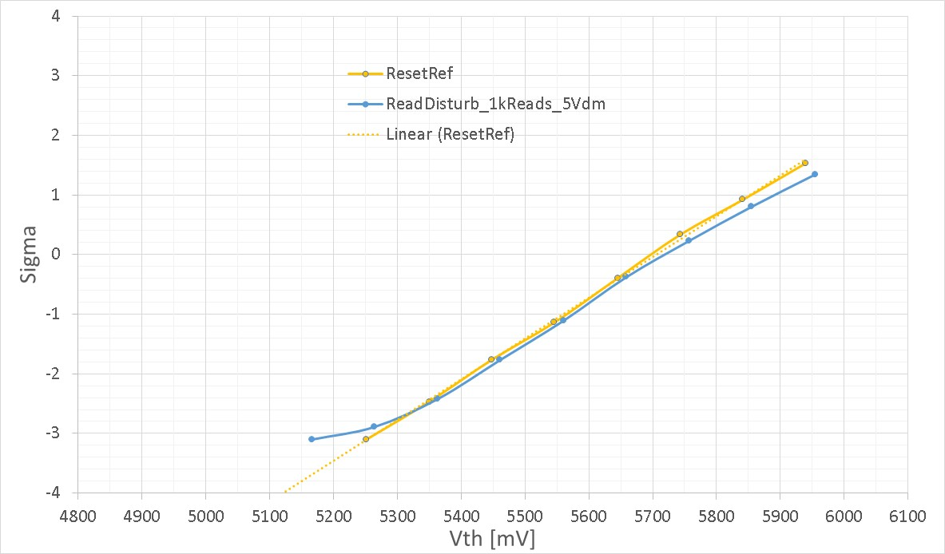
Margin check for 1k reads
Vdm
200mV

Slide 13
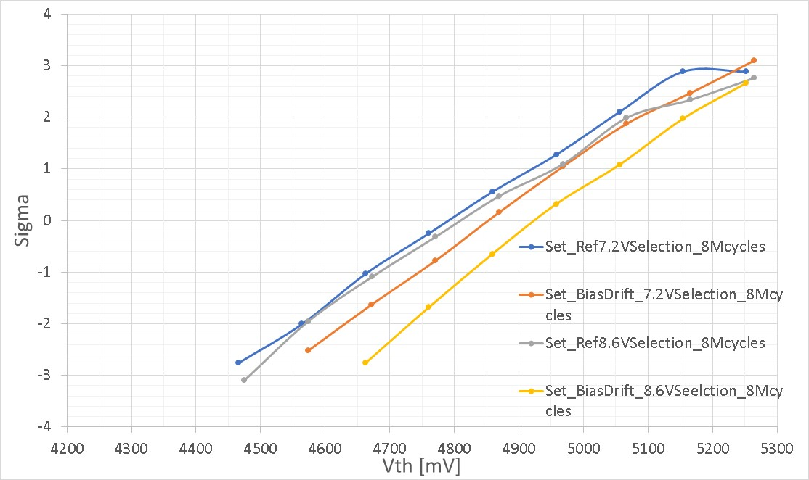
Selection voltage skew on longer cycle stress
17M total writes bias stress (50% set / 50% reset, 40ns pulses)
< 75mV median shift for 16M writes with typical selection

Slide 14
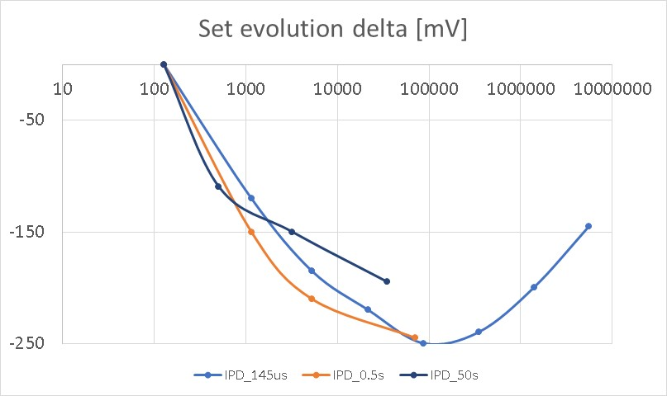
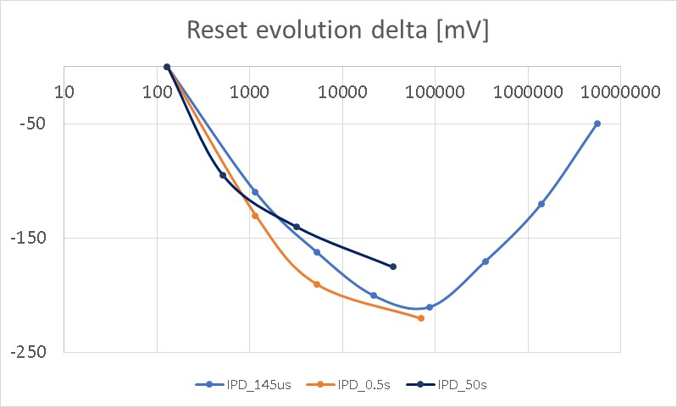
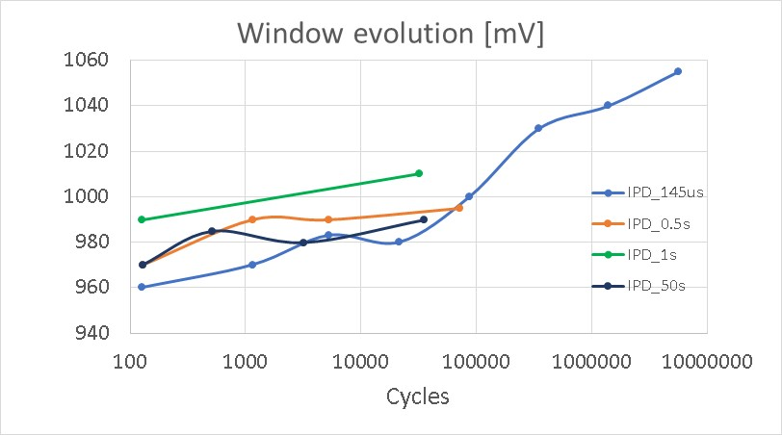
Evolution summary on same die (1,1), different blocks, Neg reading
32k added with IPD 145us
200ns read delay
No clear turnaround anticipation for long IPD and short drift time
Different die

Slide 15
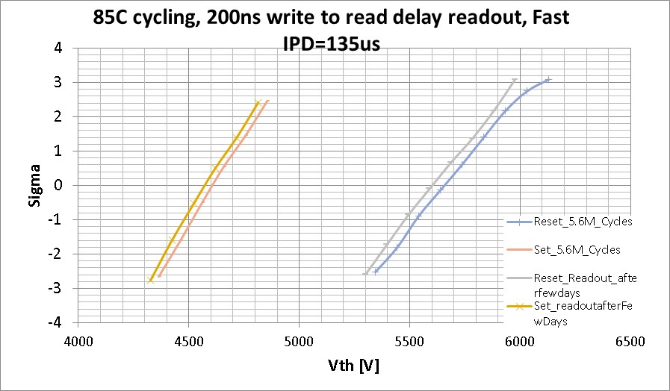
Is turn around irreversible?
~1 week wait time @ 85C

Slide 16
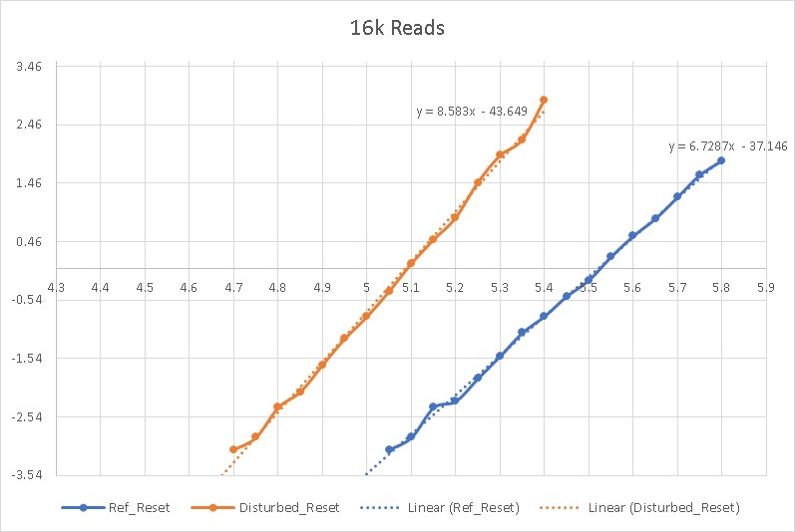
Read disturb margin extraction method
85C

Slide 17
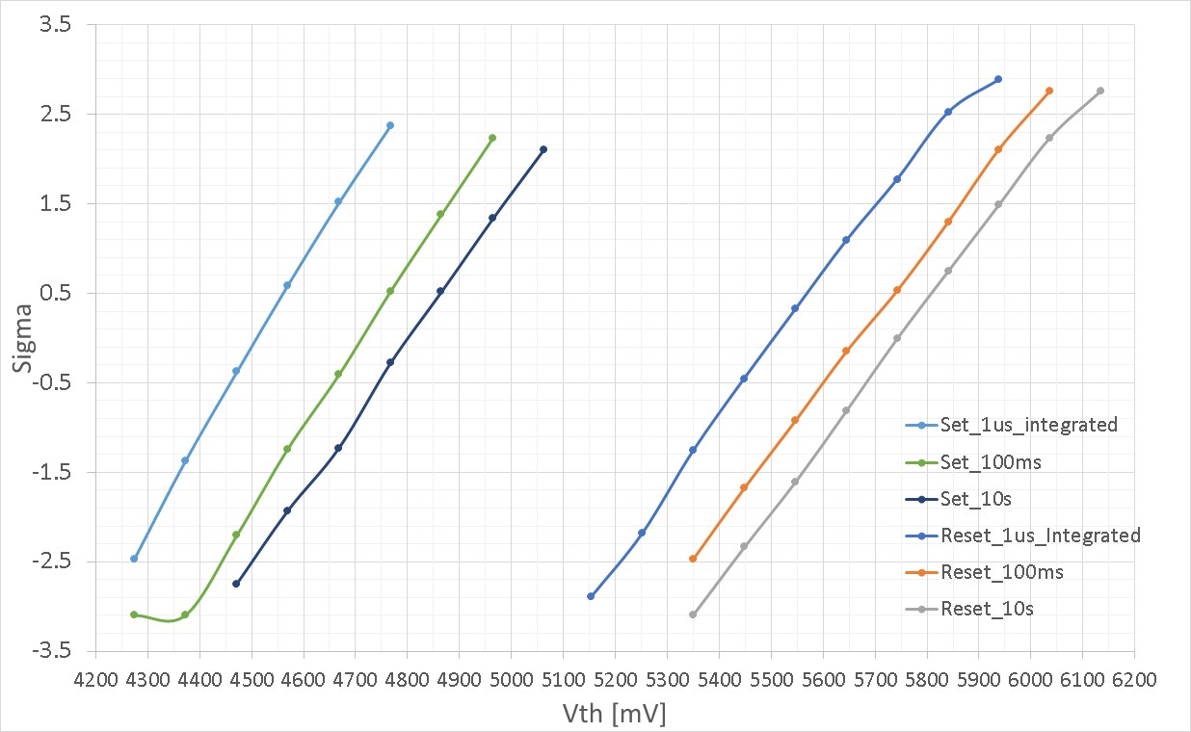
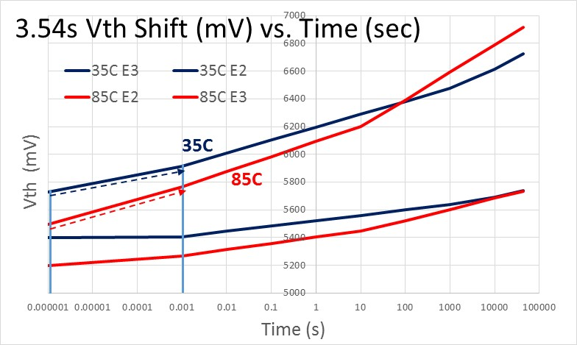
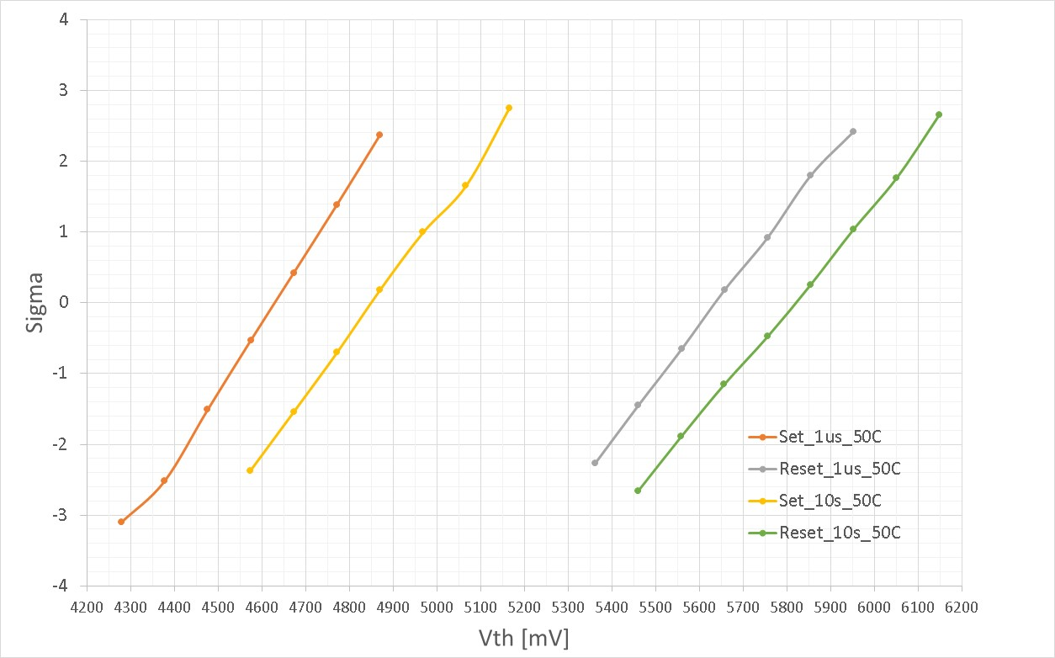
Short time Drift, 1us→ 10s (128k Cycles)
85C
250mV shift
SXP ref from Bob
300mV shift
250mV
50C
Set drift is consistent with SXP data @ 85C
Window loss for SSM in the range of 50mV from 1us to 10s
225mV shift
180mV shift

Slide 18
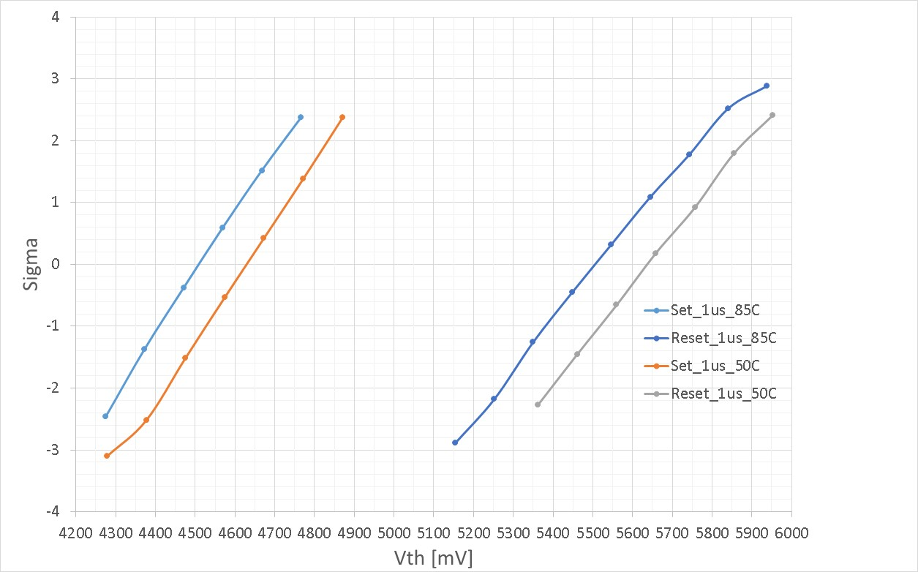
Vth temp dependence, 128k cycles
1us write to read delay
-4.0mV/C
-3.5mV/C

Slide 19
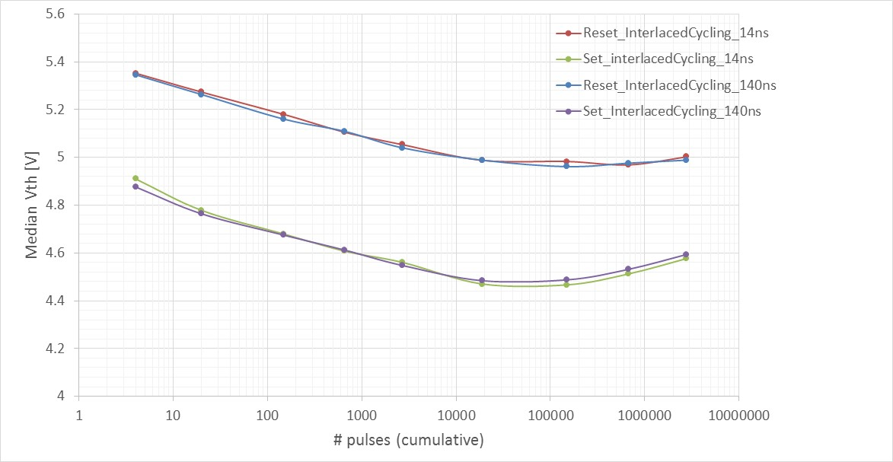
Interlaced cycling (+60/-60 uA): Median Vth evolution, historical data on A0 (17nm SD , no Indium doping)
IPD=135us, Positive read (old A0 data)
Interlaced cycling is not time cumulative, seems more spike driven (absolute number of pulses)
Spike is maximum in interlaced cycling
Bathtub curve still the same of SXP, window tend to close after 100k cycles
100mV/dec
Window closure
(EOL)
Seasoning region
(probe)
Typical Seasoning seen at probe
Turn around region
Set (+60uA)
IPD
IPD
Probe sample points
Reset (-60uA)

Slide 20
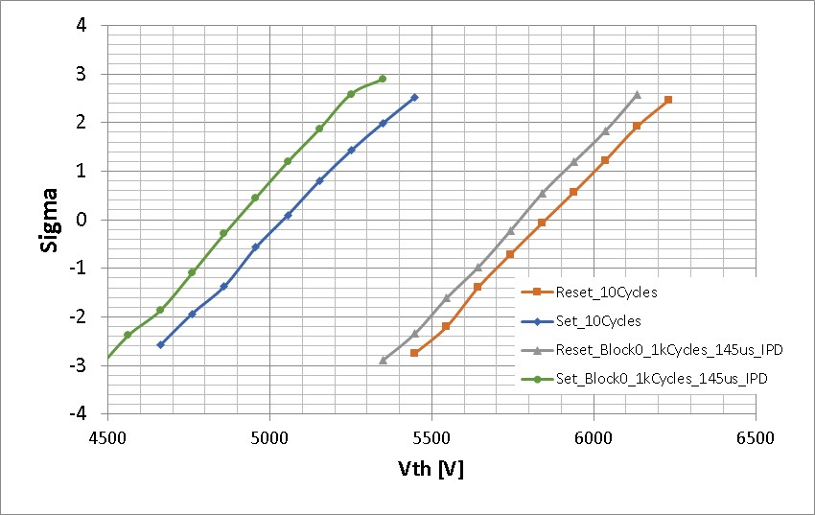
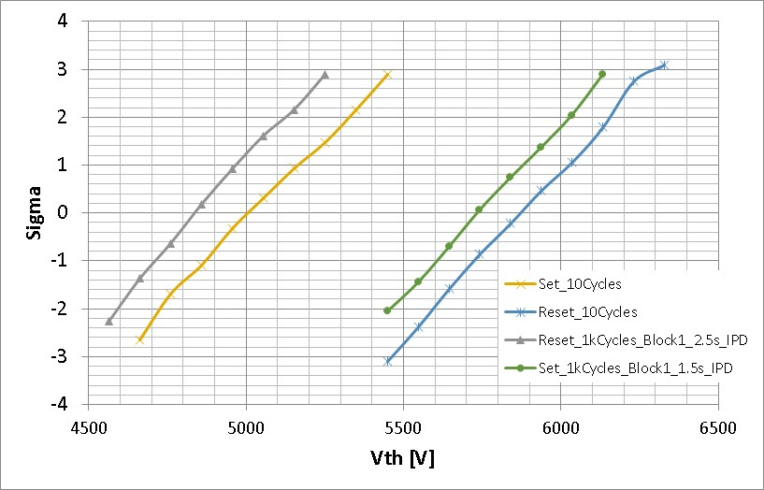
Split 1 IPD skew on different blocks: time zero vs 1k cycles (seasoning only)
Fast 135us Slow : 2.5s
100ms W2R delay
Reset (+50uA)
Small acceleration of reset seasoning for large IPD, no change of sigma
Readout is done with 100ms prog to read delay
IPD
IPD
Set (-50uA)

Slide 21
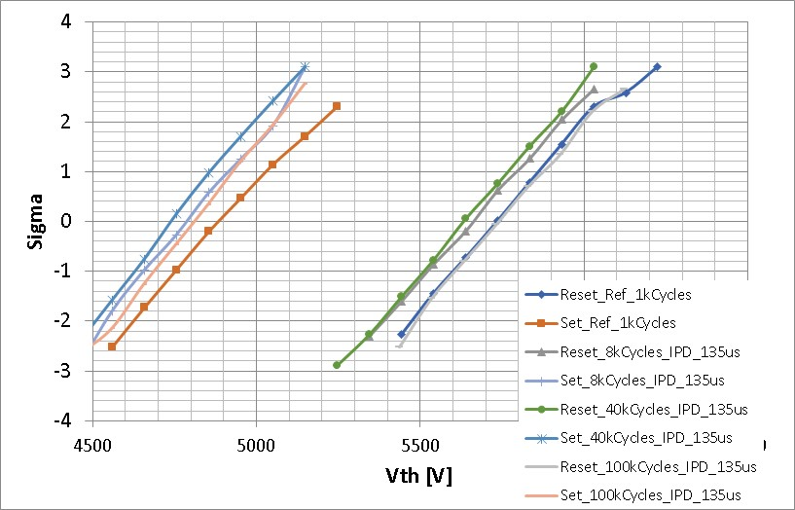
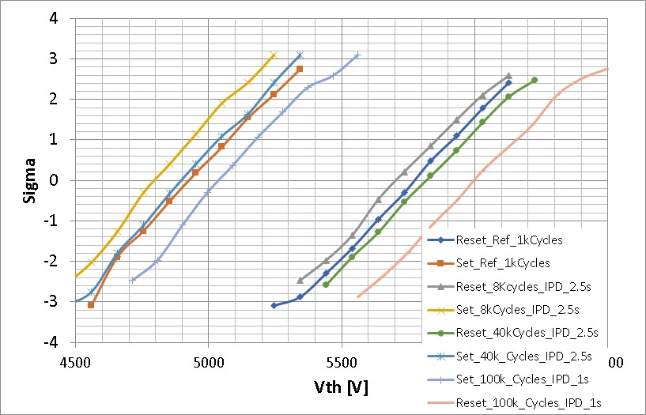
Split 1 IPD skew on different blocks: longer cycle counts after 1k seasoning
40k cycles: no turnaround
40k cycles: turnaround already evident (above seasoning)
Fast : 135us (std probe) Slow : 2.5s
100ms W2R delay
100k Cycles used 1s IPD because this is the max time of integrated routine
Not possible to explore IPD > 1s for cycles > 10k due to uM3 equipment stability
Clear change of turnaround vs IPD, no clear sigma change
Reset (+50uA)
IPD
IPD
40ns
40ns
Set (-50uA)

Slide 22
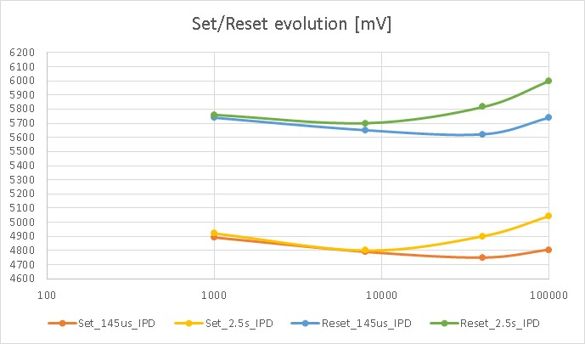
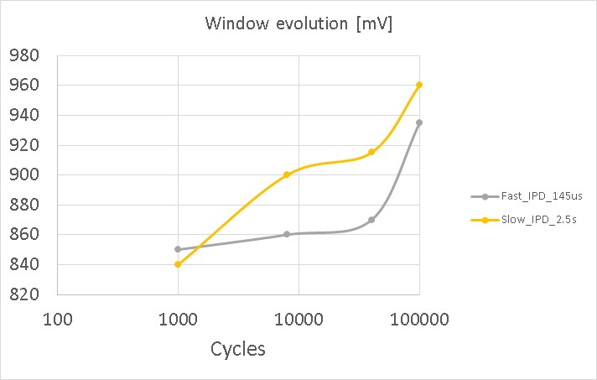
Intrinsic window evolution vs IPD, 50uA current , 100ms delay
1s IPD
Window does not close with IPD after 100ms drift readout

Slide 23
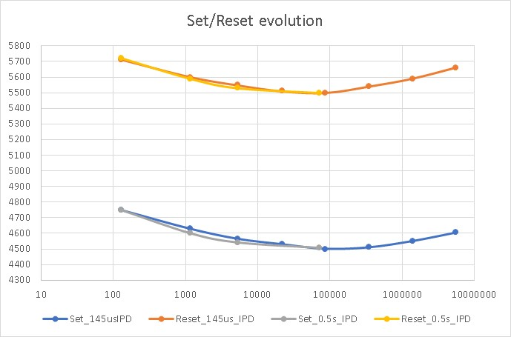
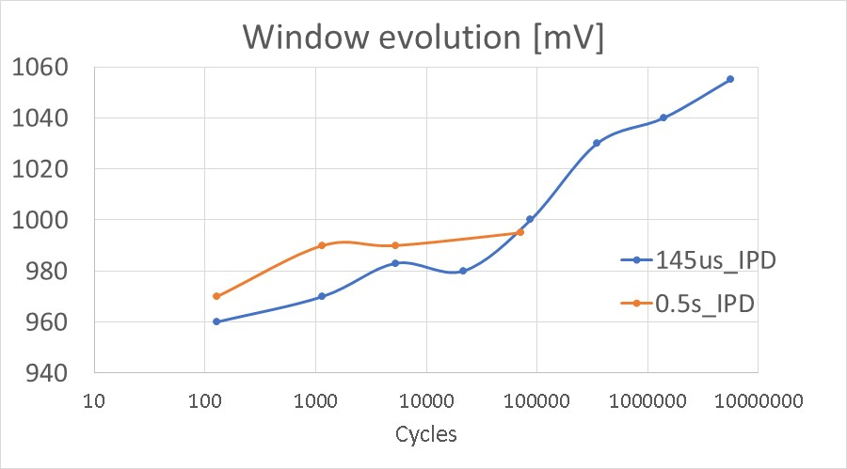
40uA prog current, 200ns W2R delay (pre drift readout)
Vth [mV]
Reset (+40uA)
IPD
IPD
40ns
40ns
Cycles [#]
Set (-40uA)

Slide 24
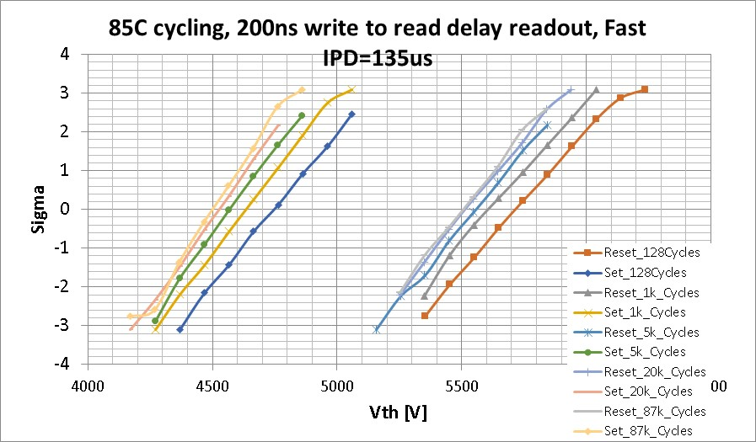
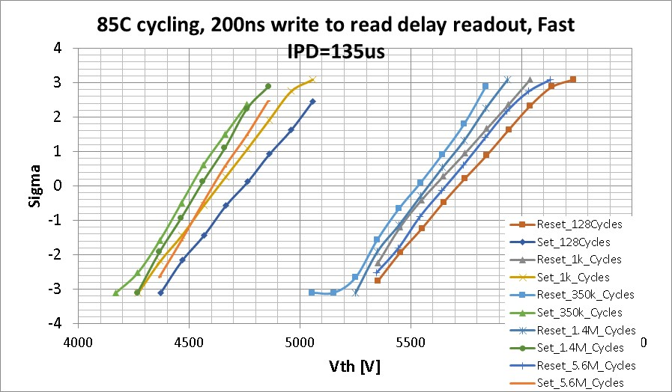
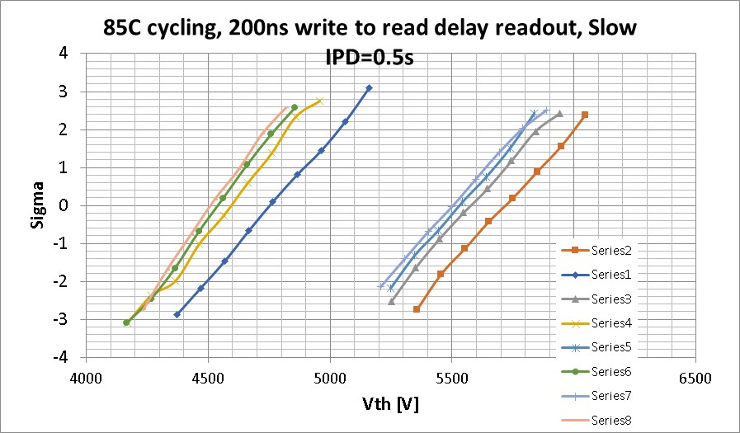
Distributions
No clear sigma change with cycling IPD
cycling

Slide 25
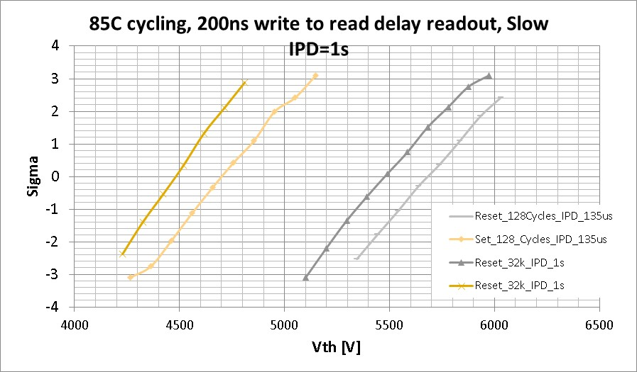
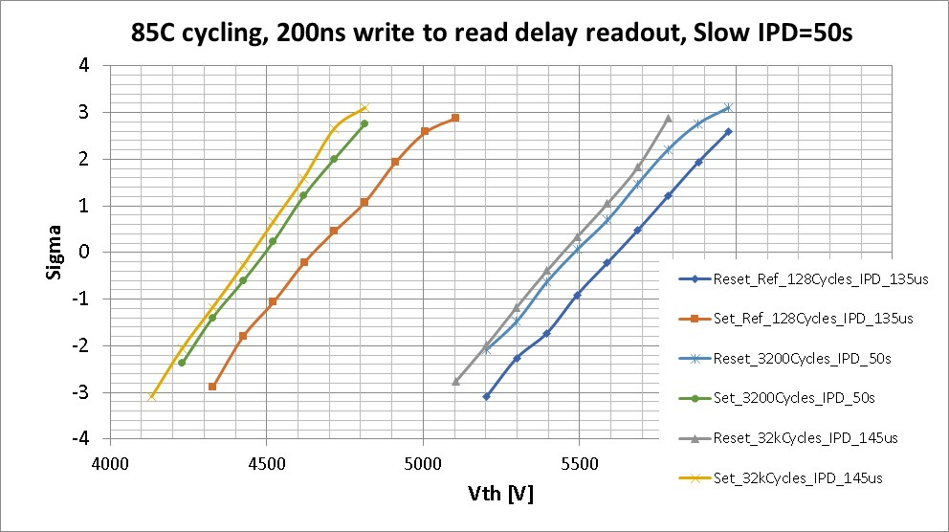
Very long IPD, same die, different diagonal block (ED4)

Slide 26
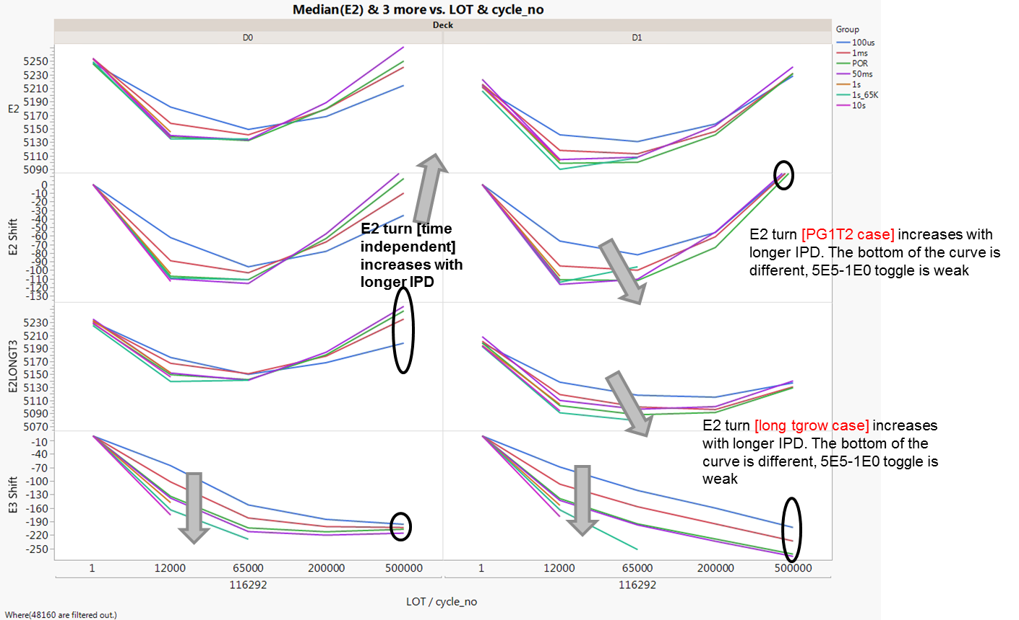
IPD impact through cycles
100us, 1ms, POR (~30ms), 50ms – 500k cycles; 1s and 10s are to lower cycling points
Vt evolution is impacted by IPD and not latency
Vt (E2/E3) reduction through cycles occurs faster with increase in IPD
D0 – no degradation in final E3 shift, while E2 is degrades with increasing IPD
D1 – E3 continues to degrade (shift lower), while E2 does not degrade (and PM set latency degradation is not any faster)
Cycling has two components
  Seasoning (set/reset evolves similarly)
  Degradation (mem effect loss?)
Points to – SD?
Growth deg

Slide 27
Conclusions
IPD change turnaround of Vth evolution
IPD does not affect window evolution
IPD does not change sigma evolution through cycling

Slide 28
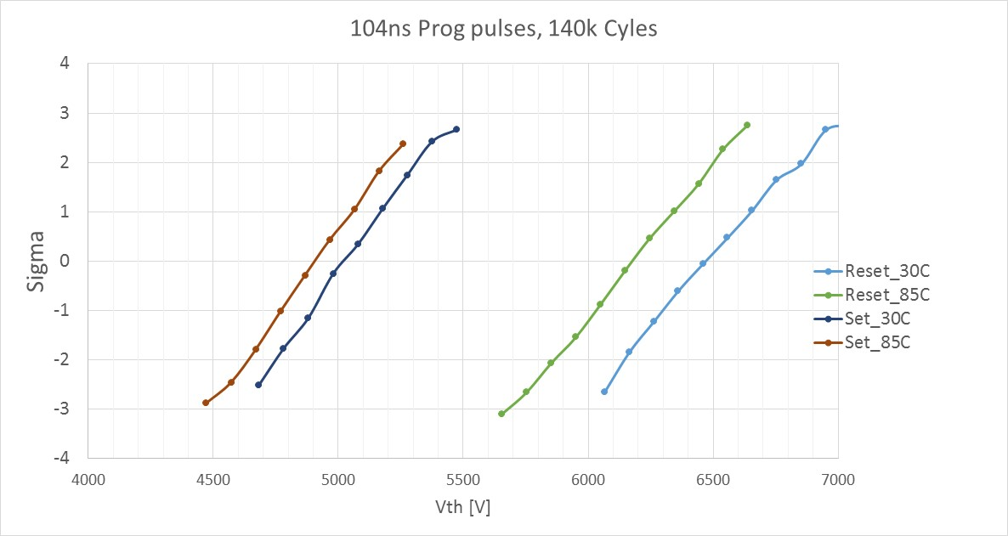
Vth Temperature activation , 100ms write to read delay (split 5)
Activation energy of reset more than double with respect to set (set 2 mv/C, reset 5mV/C)
Need to switch probe to 85C testing as soon as possible (both for window and short time drift visibility)
Need to check clean data pre-drift (1us write to read delay)

