Slide 1
SXP 20S Quilt Socket Treatment

Slide 2
Current BE Assumptions
  Key Differences from 10s
    2 more decks
      4 more WL/BL levels + 2 more array via levels
    For stacked WL/BL levels, array vias connect to the upper instead of the lower level
      A must-have feature for 65L (AV1) because some of the 65 vias (AV7 landing pads) need to land on 51L WL’s
      A nice-to-have feature for 66L & 67L to help control the near-near cell SET current spike
    69L (TV1) will likely need to stack on top of the array via levels
    Quilt Architecture driving different integration needs in the socket area
69L
68L
67L
66L
65L
64L

Slide 3
Level Designation (Temporary)
S26A Mask Levels | description
64 | AV0+AV1+AV3+AV5
03 | 03-AM1 ALIGN
04 | 04-AM1 CLEAR
51 | WL1 [AM1]
52 | WL1 Chop
05 | 05-AM2 ALIGN
06 | 06-AM2 CLEAR
55 | BL1 [AM2]
56 | BL1 Chop
65 | AV1+AV3+AV5+AV7
07 | 07-AM3 ALIGN
08 | 08-AM3 CLEAR
57 | BL2 [AM3]
58 | BL2 Chop
09 | 09-AM4 ALIGN
0A | 0A-AM4 CLEAR
53 | WL2 [AM4]
54 | WL2 Chop
66 | AV3+AV5+AV7
0D | 0D-AM5 ALIGN
0E | 0E-AM5 CLEAR
5A | WL3 [AM5]
5B | WL3 Chop
0F | 0F-AM6 ALIGN
0G | 0G-AM6 CLEAR
5C | BL3 [AM6]
5D | BL3 Chop
67 | AV5+AV7
0H | 0H-AM7 ALIGN
0I | 0I-AM7 CLEAR
5E | BL4 [AM3]
5F | BL4 Chop
68 | AV7
0J | 0J-AM8 ALIGN
0K | 0K-AM8 CLEAR
5G | WL4 [AM8]
5H | WL4 Chop
69 | TV1
0B | 0B-TM1 CLEAR
75 | TM1
There array via levels are relocated to post BL1/WL2/BL3 chop

Slide 4
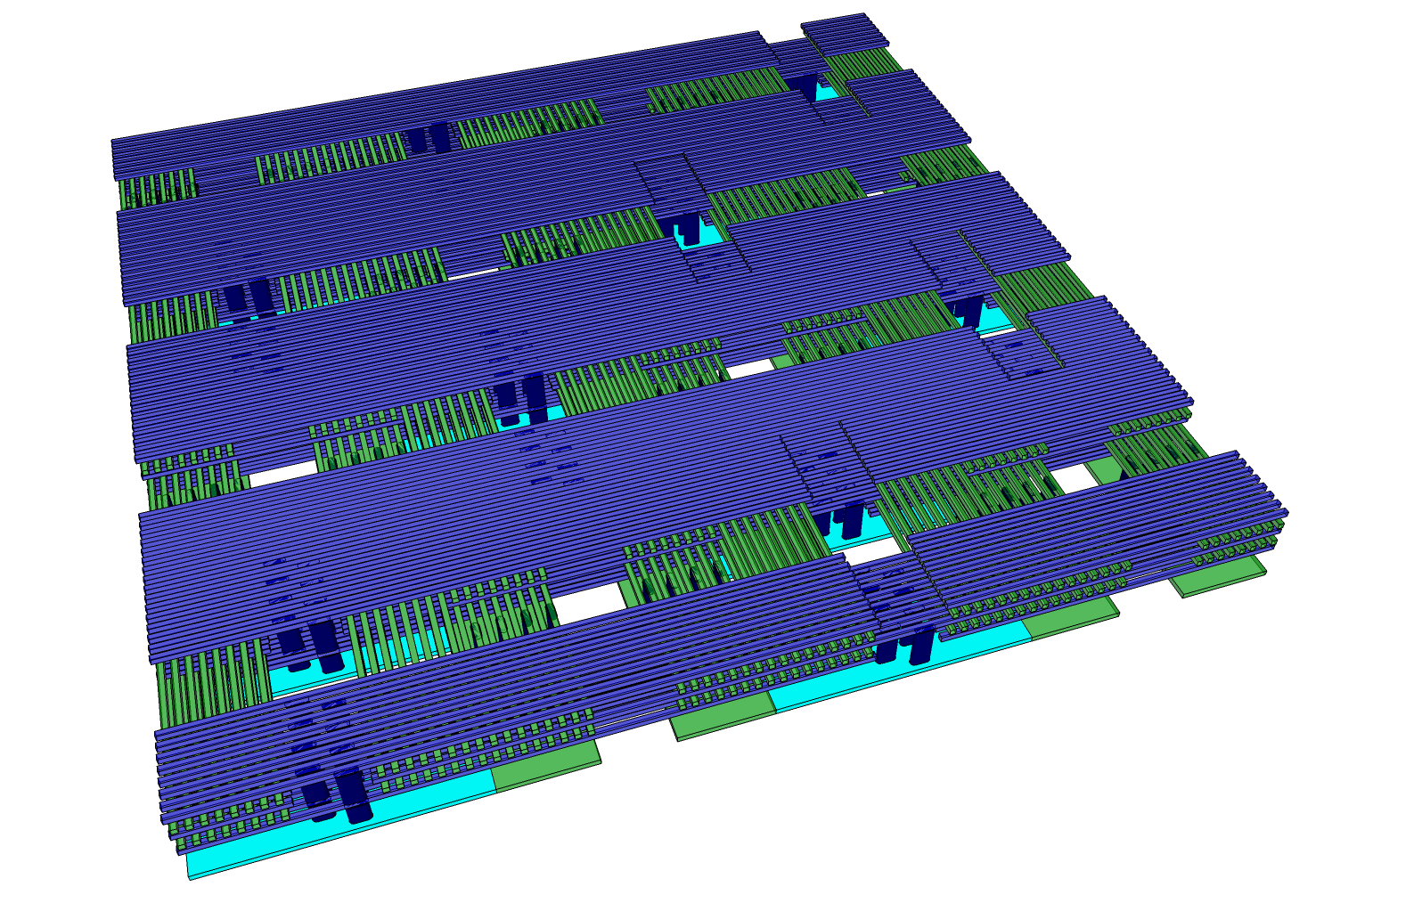
Quilt Architecture

Slide 5
Socket Area
Two options to handle the Socket area
  Option 1 – Leave a gap
    Current POR
    Need to introduce dummies (not to be chopped away) and edge progression at patch boundaries
  Option 2 – Fill it with on-pitch dummy WL/BL then chop away
    Good for CD control
    Chop-at-pitch is a requirement already
    ~2% tile size saving
      If CMOS can take advantage of the smaller tile
  If move to Option 2, the new locations of the 65/66/67 via levels and the need to chop away the dummy WL/BL in the socket area may drive significant departure from the moat-chop scheme of 10S

Slide 6
Option 1 vs. Option 2 Tile Size
Option1: 16 dummy WLs in dark black lines
Option2: 4~6 dummy WLs in dark black lines
Active WL
c-cell/gnd or float
Floating without diffusion
BL Socket
WL Chop in BL Socket
Floating without diffusion
c-cell/gnd or float
Active WL
Option 2 presents a ~2% tile size saving opportunity
  10~12 dummy WL/BL per patch (1K live WL/BL)
  CMOS has to be able to fit under the smaller tiles to realize the die-size saving

Slide 7
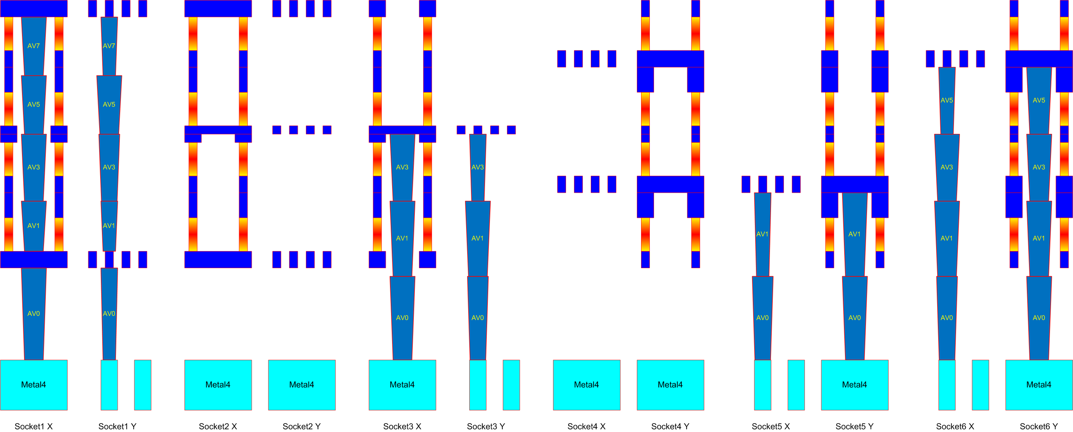
6 Types of Sockets
  WL sockets: WL1/WL4 connection, WL2/3 connection, No connection
  BL sockets: BL1/2 connection, BL3/4 connection, No connection

Slide 8
Chop Masks in Sockets
Option 1 – No on-pitch dummies in sockets
Option 2 – On-pitch dummies in sockets
 | WL1/WL4 | WL PT | WL2/3 | BL PT | BL1/2 | BL3/4
WL1 Chop | Closed | Closed | Open | Not Care | Not Care | Not Care | Can be Combined
BL1 Chop | Not Care | Not Care | Not Care | Not Care | Open | Open
BL2 Chop | Not Care | Not Care | Not Care | Closed | Closed | Open | Can be Combined
WL2 Chop | Open | Not Care | Open | Not Care | Not Care | Not Care
WL3 Chop | Open | Closed | Closed | Not Care | Not Care | Not Care | Can be Combined
BL3 Chop | Not Care | Not Care | Not Care | Not Care | Open | Open
BL4 Chop | Not Care | Not Care | Not Care | Closed | Open | Closed | Can be Combined
WL4 Chop | Closed | Closed | Open | Not Care | Not Care | Not Care
 | WL1/WL4 | WL PT | WL2/3 | BL PT | BL1/2 | BL3/4
WL1 Chop | Closed | Closed | Open | Open | Open | Open
BL1 Chop | Open | Open | Open | Not Care | Open | Open
BL2 Chop | Open | Open | Open | Closed | Closed | Open
WL2 Chop | Open | Not Care | Open | Open | Open | Open
WL3 Chop | Open | Closed | Closed | Open | Not Care | Open
BL3 Chop | Open | Open | Open | Not Care | Open | Open
BL4 Chop | Open | Open | Not Care | Closed | Open | Closed
WL4 Chop | Closed | Closed | Open | Open | Not Care | Open
Each WL/BL level needs its only chop mask, an cost adder of 4 mask levels

Slide 9
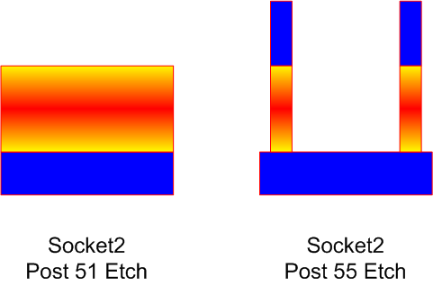
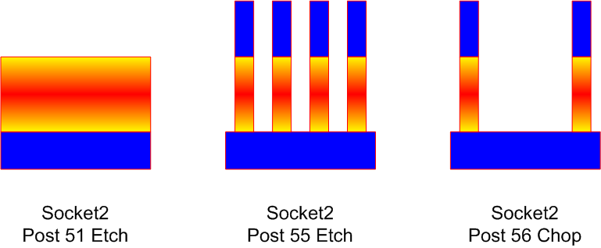
Other Considerations
In either option, chop masks need to open the whole socket (~2um wide) as opposed to ~300nm wide chop in 10s
  Need thicker oxide to fill
It may be more difficult to preserve continuous W across sockets in Option 1
  Option 1
    BL-BL short vs. 51 W preservation in sockets
  Option 2
    Dense pattern in sockets @ 55L
    Socket area is cleared at 56L

