Slide 1
Quilt vs External comparison
(01-20-11)
Conclusion:
For same budget requirements, same litho node, same transistor technology
Quilt offers smaller die size, cheaper metallization.
Other areas to analyze:
Design complexity
Defectivity
Socket complexity
scalability
2K x 1K footprint (4Mbit tile)
2K WL drivers, 2K BL drivers
Shared BL, 2 deck
2K x 1K footprint (4Mbit tile)
2K WL drivers, 2K BL drivers
Shared BL, 2 deck
 | Ext driver | Quilt option 0
Glue layers | 2@4F | 1@4F
Die size – comparison only. | 202mm^2 | 157mm^2
WL leakage | 2K cells | 2K cells
IR drop in array | 2560r+driver | 1216r+driver
Area per WL/BL driver available | 1.72/1.12 um^2 | 1.04/0.68 um^2
Area per WL/BL driver required | 1.72/1.12 um^2 | 0.83/0.55 um^2
1.12um^2/Bldriver
1.72um^2/WLdriver
Tapping at mid-point of electrodes, reduces IR due to WL’s and BL’s significantly. This array IR advantage trades off against the reduced area available for the drivers.

Slide 2
Socket Complexity
Socket has been analyzed by litho team in Agrate.
The only obvious differences that come to my mind, comparing our preferred solutions for External and for Quilt are:
Quilt is more demanding on chop masks, because of the “sliding bundles” approach;
Quilt is more demanding on PV3 alignment requirements, due to the “traffic” of PM1 lines going from one tile to the other.

Slide 3
Socket concept
(WL drivers for 2 decks example)
Cross-section view
Word-line drivers
Bit-lines
Word-lines
Even Pair
or even bundle
One driver connected to only one word-line layer
Odd Pair or odd bundle
Bundle up electrodes and drive from opposite sides to create space for upper deck feed-through
Top view
Deck 1 WL
Deck 2 WL

Slide 4
Same socket approaches work for External and Quilt tile architectures
Connections to 2nd WL layer driver
Simplest case
First Deck WL example
QUILT
OPTION
Connections to 2nd WL layer driver
Connections to 2nd WL layer driver
EXTERNAL
DRIVER
OPTION

Slide 5
Compatible with SADP – various options evaluated
Core Mask
Spacer pattern
Specifics of sockets to be discussed by Fabio

Slide 6
Number of Sockets
Single Deck word-line sockets depicted as example
Same array litho node for two architectures
1 socket per tile in horizontal direction
4 sockets per tile in horizontal direction

Slide 7
Socket Dimensions
(Assuming 10F pitch between geometries in orthogonal direction to array plus 10F on each side for array termination dummies. No vias under array)
Ext: need 1 of these per tile
Quilt: need 4 of these per tile
110F
70F
One layer
Bundle of 8
190F
110F
Two layers
70F
50F
One layer
Bundle of 4
110F
70F
Two layers

Slide 8
Bundle of 8

Slide 9
Defectivity handling
There are no isolated tiles in a quilt architecture
3D Cross-point memories can repair WL-BL shorts
  This has been the primary reason to repair entire tiles in planar technologies.
  Defects in the memory layers do not affect CMOS supply lines.
CMOS defect rates are low compared to array defect rates.
  PCM yield group estimates no significant yield loss due to this restriction

Slide 10
BL-WL shorts
Intersecting ‘super-BL’ and ‘super-WL’ must be mapped out
Current during ABC biasing will be limited by resistance of deselection path.
Small current compared to leakage in 2T driver implementations.
AB or V/2 are not an issue.

Slide 11
BL-WL shorts
Sort/First Fire
  BL-WL shorts are detected at sort and mapped out (or repaired)
  Cells on this BL or this WL do not First-Fire → therefore the thresholds for these cells are very large.
  If cells do FF and are able to SET, then it should be able to be RESET.
  If cells do FF and end up SET but cannot RESET, then allow them to drift.
AB biasing: Read, RESET, low Vth SET
  Since type C cells are shorted, there is no impact to other cells in the array
  No additional power dissipation
ABC biasing: high Vth SET
  Low resistance short may bring the affected BL/WL to intermediate value between DESWL and DESBL, which creates larger biasing for affected BL/WL.
  Additional bias on these cells do not impact de-biasing of high threshold cells (need to quantify limits)
  Short current is limited by deselected BL driver in series with deselected WL driver – estimated ~50uA. This is small compared to total leakage current in large arrays during ABC biasing.
7v
Example during ABC biasing with BL-WL short
Short current
0.5v bias
3.5v bias of high Vth cell
3v
4v
~3.5v
4v
0.5v bias
3.5v bias of high Vth cell
~3.5v
3v
0v
Option: if likely-hood of high Vth SET is low, can allow ECC to correct for this?
Cross-point biasing allows for BL-WL repairs even when BL and WL are shorted

Slide 12
Replacing Bad Clusters
Smallest array unit to repair is a cluster.
Cluster size can be adjusted against cluster overhead to allow for process maturity
A 128Gb device has 512 clusters
  1K x 2K x 2d tiles
  64 quilt-tiles per cluster (8x8 tiles per cluster)

Slide 13
Budget
IR drop, Leakage, CMOS
Midpoint taps reduces IR drop and voltage requirement
  This reduced IR drop means the transistor requirements can also be reduced.
  Area required is also reduced
Additional resistance reduction because of quilting offset effect
  The farthest bit on the word-line, never aligns with the farthest bit on a bit-line. Offset is 25% for one or the other electrode.
The benefit can be traded off against
  Window budget
  CMOS process complexity
  Voltage requirement

Slide 14
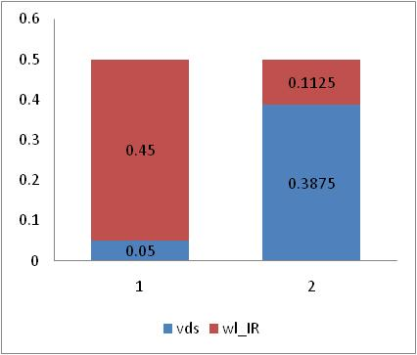
Driver Vds versus electrode IR trade-off
Transistor size limited by leakage requirements during selection of reset cells.
Same terminal voltage at Vx (and Vy).
Ignore leakage variation along WL or BL.
Ignore offset component due to voltage variation in array and drivers.
Ignore additional length of WL or BL due to socket differences.
E
Q
Z/L
Z”/L
512 r/2
(512+512)ileak
1024 r/2
384 r/2
1024r
1024r
Vy
2048r
Vx
Vx
(1024+1024)ileak
Z’/L
128 r/2
2048ileak
Vy
dVQ ~ 0.5(1024ileak *1024r) = ¼ dVE
Z/L
dVE ~ 0.5(2048ileak *2048r)

Slide 15
Bias Budget
Selection of ULR in 2Kx1K x2 tile with static biasing
IRB
Balanced BIAS requirement:
ULR=LLSA+IRA+LLSB+IRB
LLSB
ULR
LLSA set by total leakage < 50uA
LLSB set by acceptable rate of parasitic snap-back of B cells
Vx = combined voltage of driver + electrode at point of selection.
CENTER BIAS
Word-line direction
Bit-line direction
LLSA
LLSA
IRB
Vx = IR_e + VDS
For constant Vx, and constant Center Bias (ULR), leakage current is lower in Quilt than External. (LLSA under-utilized).
For Vx, the rate of failure is lower in Quilt than External (LLSB also under-utilized).
LLSB
ULR
CENTER BIAS
LLSA
Vx = IR_e + VDS

Slide 16
Bias Budget
Selection of ULR in 2Kx1K x2 tile with static biasing
Break up ULR into two components:
ULR = ULRA + ULRB
Condition for constant ULR:
ULR_A=LLSA_e + IRA_e = LLSA_q + IRA_q
LLSA_q = LLSA_e – deltaIRA
Same applies to ULRB
246mV VDS advantage
Assume total Vx = 600mV
VDSe = 600-282mV = 318mV
VDSq = 318+246mV = 564mV
Ratio to Q current to E current = 0.814
Zq/Ze = 0.814 * 318/564 = 0.459

Slide 17
Metallization
Quilt architecture allows placement of the sockets centered over the driver area
  Done for both BL sockets and WL sockets.
This reduces the routing pitch requirement for the socket connection by ½ compared to placement at the edges of the arrays.
This reduced pitch requirement can be traded off against number of interconnect layers.

Slide 18
Motivation/Feature 2
Quilt architecture requires simpler metallization than external driver architecture
Example of 2K x 1K x2
512 lines at 4F (BL connection)
512 lines at 8F (WL connection)
1024 lines at 4F (BL)
512 lines at 4F (2nd deck WL)
External 2 Deck | Quilt 2 Deck
G1 at 4F with orthogonal capability | G1 at 4F in one direction (8F in orthogonal direction)
G2 at 4F in one direction
512 lines at 4F (first deck WL)

Slide 19
Why?
Possible because sockets can be placed at midpoint of driver groups
Sockets are key
WL
WL
BL
4F in one direction
BL
4F in one direction
WL
WL
G2
4F in orthogonal directions
G1
G1
M3
M3
M2
M2
M1
M1

Slide 20
SADP - immersion
4F - immersion
8F-12F - dry
2+1 quilt options @F=20.5nm
No direct-self-aligned vias required.
‘PCMS-via’ not used
1Deck Quilt
2Deck Quilt
3Deck Quilt
4Deck Quilt
G1: 8F
M2: 10.6F
M1: 10.6F
G1: 4F/8F
M2: 10.6F
M1: 10.6F
G1: 4F
M2: 10.6F
M1: 10.6F
G1: 4F
M2: 10.6F
M1: 10.6F
 | F=20.5nm Quilt
 | 1D | 2D | 3D | 4D
SADP | 2 | 3 | 4 | 5
immersion | 0 | 4 | 6 | 7
8F-12F dry | 7 | 4 | 3 | 3
Cu metallization assumed for M1, M2, G1.

Slide 21
Die Size
Quilt ideal 4F → ~5F effective cell size because of the socket and cluster termination overhead (conservative)
Depends on number of decks.

Slide 22
Overhead Calculation
4 WL sockets per tile
4 BL sockets per tile
Overhead per cluster:
¾ of BL drivers within 1 tile,
¾ of WL drivers within 1 tile
Applies to 1,2,3,4 decks.
Socket overhead (2 deck, shared BL):
4 sockets per tile, horizontal and vertical
30 pitches in WL direction (guess)
20 pitches in BL direction (guess)
tile footprint: 2kBL x 4kWL
(2K+4*30)*(4K+4*20)/16Kcells = 0.54F^2
Cluster overhead (8x8T/CL):
In WL direction: 3 WL drivers.
In BL direction: 1.5 BL drivers for two edges
BL driver ~ 256 pitches
WL driver ~ 256 pitches
(2K*8+3*256)*(2K*8+1.5*256)/2^28 = 1.0714
Driver area: (4F^2) (2Kbl x 4Kwl)/(2x4K+2K)
= 800’pitch’^2/drv = 1.38um^2 /drv
Combined:
Cluster cell size: ddd

Slide 23
Number of Sockets
Single Deck word-line sockets depicted as example
Same array litho node for two architectures
1 socket per tile in horizontal direction
4 sockets per tile in horizontal direction

Slide 24
Socket Dimensions
(Assuming 10F pitch between geometries in orthogonal direction to array plus 10F on each side for array termination dummies. No vias under array)
Ext: need 1 of these per tile
Quilt: need 4 of these per tile
110F
70F
One layer
Bundle of 8
190F
110F
Two layers
70F
50F
One layer
Bundle of 4
110F
70F
Two layers

Slide 25
Required CMOS for isolated clusters
07-01-11
1.5X the WL drivers in one patch per side of cluster.
Estimate for XP20: 1.2X of one regular patch width.
Sockets for 1 tile
CMOS for 1 tile
WL drivers
1.5X the BL drivers in one patch per side of cluster.
Estimate for XP20: 0.6X of one regular patch height.
BL drivers

Slide 26
Motivation/Feature 1
Quilt architecture re-arranges drivers and sockets so that all drivers are under array
2K x 1K x 2
@20.5nm
2K x 1K x 2
@~25nm
Reduces litho requirement of array for same CMOS driver capability

Slide 27
Example of 202mm^2 128Gb estimate
Uses Intel analysis for NAND competitive lead product
From DK document 06-08-10
2048+4 + 2*41p
87.5um
2048 + 4 + 2*41p
109.1um
1024+4+ 2*318p
68.19um
1024+4+41
54.6um
20.5nm
25.6nm
 | External | Quilt
Die size | 202mm2 | 202mm2 ***
metallization | 3+2 | 3+1
Array pitch | 2x20.5nm | 2x25.2nm
WC IR in RESET | 2560 cells * | 1248 cells **
WL leakage | 2K cells | 2K cells
Required WL Decoder Area/cell | 1.364um2 | 1.364um2
** assumes double BL electrodes ** 256*0.875 + 1K for quilt *** ~7% area overhead for cluster termination at 8x8 clusters
Option1: Keep same cell size, increase line spaces
  Lower parasitic capacitance
  Same Reset current requirement
  Higher R per cell but lower electrode resistance
Option2: larger cell size
  Larger reset current
  Reduced cell and electrode resistance compensates for constant driver size

Slide 28
Why should it be limited to driver circuits?
Include: Global drivers, repeaters, write circuits, sensing, data interface, etc.
2048+4+2*41p
87.5um
2048+4+ 2*41p
128.3um
1024+4+4*318p
94.3um
1024+4+41p
64.3um
Estimated ‘other’ area = Area of BL drivers
30.1nm
20.5nm

Slide 29
If drivers could be drawn smaller
(new rules, new tricks, etc.)
2048+4 + 2*41p
87.5um
2048 + 4 + 2*41p
87.5um
1024+4+ 2*318p
68.19um
1024+4+41
43.8um
20.5nm
20.5nm
~50% area improvement
1.364um^2/WL → 0.63um^2/WL

Slide 30
Design Complexity
There is no clean array boundary compared
Decoding at the edges of the array requires extra decoders, sensing and other circuits. These must be switched in depending on address pattern.

Slide 31
Cluster termination mapping
06-29-11
Example of 4-tile-wide cluster
PY2
PY3
PY0
PY1
PY2
PY3
PY0
PY1
PY2
PY3
PY0
PY1
PY2
PY3
PY0
PY1
PY2
PY3
PY0
PY1
SA / WL driver group locations
PX0
L3X0
L3X1
PX1
L3X1
L3X0
PX2
L3X0
L3X1
PX3
L3X1
L3X0
TTL
T0
T1
T2
T3
TTR
Shift left
No shift
Shift right
WL driver / SA group |  | BL driver location (L2Y high order bits) | SA data valid
(L3X bit) | RX value
Top half of patch L3X=0 | P0 | P0, P1, P2 | No shift
 |  | P3 | Shift Right
 | P1 | P0, P1, P2 | No shift
 |  | P3 | Shift Right
 | P2 | P1, P2, P3 | No shift
 |  | P0 | Shift Left
 | P3 | P1, P2, P3 | No shift
 |  | P0 | Shift Left
Bottom half of patch L3X=1 | P0 | P0, P1 | No shift
 |  | P2, P3 | Shift Right
 | P1 | P2, P3, P0, P1 | No shift
 | P2 | P2, P3, P0, P1 | No shift
 | P3 | P0, P1 | Shift Left
 |  | P2, P3 | No shift
Valid data
SA
TTL
T0
T1
T2
T3
TTR
Depending on X and Y address range, valid SA-group data shifts location.
Shifting at tile level done in this design. Optionally, the shifting can be done at cluster or chip level.

Slide 32
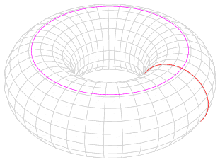
Decoding on a toroidal surface
One Tile:
Repeating unit for Socket
Decoding must wrap-around the edges of the CLUSTER.
In this example, 16 unique bits can be selected. Only one Bit per WL or BL driver.
Cluster example: 4 tiles x 4 tiles
4 word-line segments
4 bit-line segments

Slide 33
Cluster Termination
07-01-11
Provides drivers for the extra electrode segments required to support the active array
One tile

Slide 34

Decoding on a Toroidal surface
Edges of cluster are not clean. Ideally, the last set of bit-lines (or word-lines) should mesh with the first set of bit-lines (or word-lines).
To correctly terminate the cluster array in a planar surface, requires an extra set of drivers at each end. These are located at the termination tiles.
The array termination and termination drivers create address dependent ‘fanthom’ array regions. Data bits may be generated at the cluster edges that must be mixed with the rest of the data away from the cluster edge.

Slide 35
other

Slide 36
Design path choices
External
  1T drivers
    floating electrodes
      Large line to line coupling
      Complex timing
      Budget impact
Positive/Negative voltage drivers
    More complex CMOS requirements
    Potential for latchup or snap-back of CMOS
Combination
    No room for multiple limit circuits
      High WL capacitance ➔ snapback disturb sensitivity
      More timing complexity, slower access, higher power
Because of limited CMOS area.
Proposed XP20 uses ‘junky’ deselect transistors.
Not necessarily due to tile arch choice. XP20 uses all positive voltages.
XP20 has 64 limiters per tile.

Slide 37
Goal of present analysis: 4k x 4k x 2 @ 20.5nm
Example area allocation for circuits under a tile for an evaluation done at F=52nm
Area available per driver under the tile
This is the area to be used for 1T, 2T, 3T drivers etc.
BL and WL drivers may occupy different areas.

Slide 38
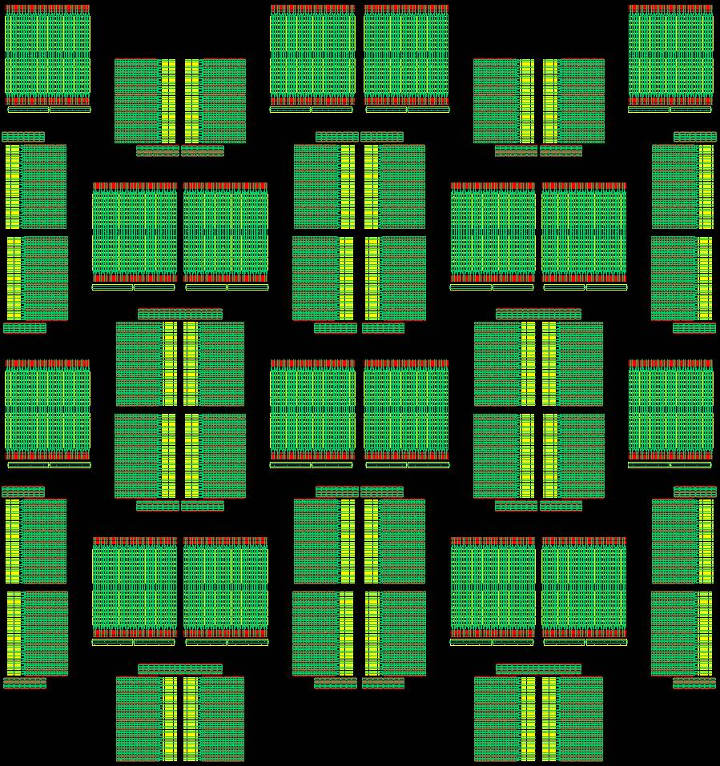
Goal of present analysis: 4k x 4k x 2 @ 20.5nm
174um
Tile
Patch
Layout is still under way
Local drivers fit within allocated area
173um

Slide 39
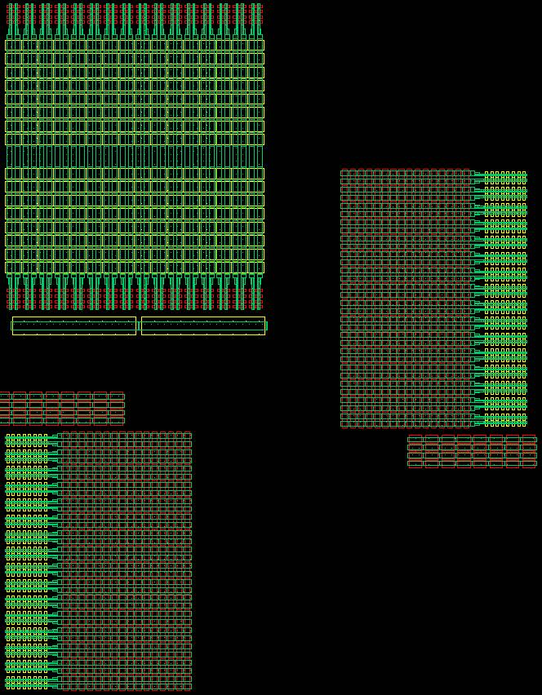
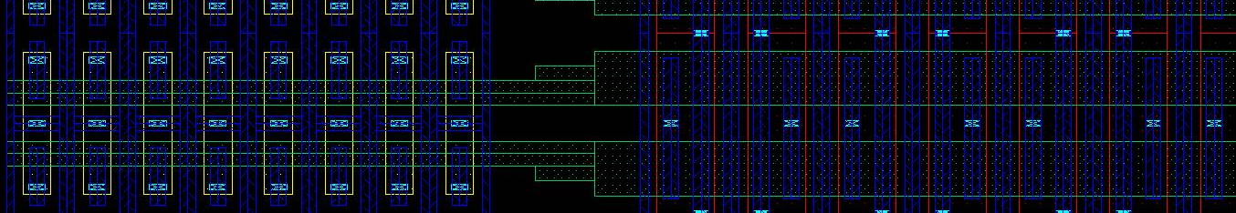
Local BL driver de-selector
Local BL driver selector
Local WL driver selector
Local WL driver de-selector
~75% of area per tile (or patch) is allocated to driving the word-lines and bit-lines.
This includes selection and de-selection devices.
Global BL driver
Local WL driver selector
Global WL driver

Slide 40
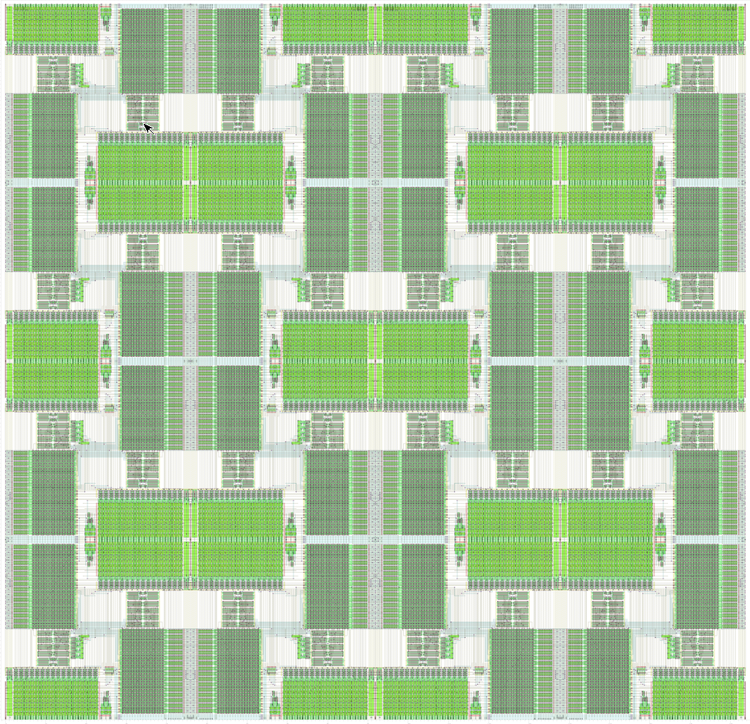
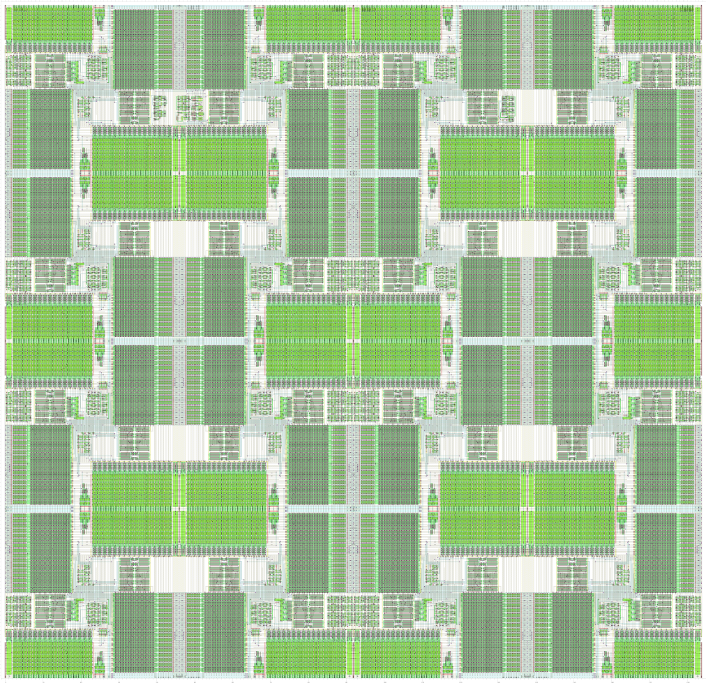
Tile with patch / tile level LV
07-20-11
Tile with no LV
Red boxes available for cluster level circuits (256 tiles per cluster).

