Slide 1
S26A Core Architecture
March 20, 2015

Slide 2
S15C Architecture
one tile
WL0
WL0
WL0
WL0
WL0
WL0
WL0
WL1
WL0
WL1
WL0
WL1
Column decoding is outside of the array. Costing diesize
BL0
BL0
BL0
WL0
WL0
WL0
WL0
WL0
WL0
WL0
WL1
WL0
WL1
WL0
WL1

Slide 3
Step 1: Double WL length
one tile
WL0
WL0
WL0
WL0
WL0
WL0
WL0
WL1
WL0
WL1
BL0
BL0
WL0
WL0
WL0
WL0
WL0
WL1
0
WL1

Slide 4
Step 2: Increase Stagger
one tile
WL0
WL0
WL0
WL1
WL0
WL1
WL0
WL0
WL0
WL1
WL0
WL1
BL0
BL0
BL0
BL0
BL0
BL0
WL0
WL0
WL0
WL1
WL0
WL1
WL0
WL0
WL0
WL1
WL0
WL1

Slide 5
Step 2: Stagger Bitlines
one tile
WL0
WL0
WL0
WL1
WL0
WL1
WL0
WL0
WL0
WL1
WL0
WL1
WL1
BL0
BL0
BL0
BL0
BL0
BL0
WL0
WL0
WL0
WL1
WL0
WL1
WL1
WL0
WL0
Notes:
Note this isn’t free…. we have to open the WL squares for space of BL socket

Slide 6
Step 3: Move BL sockets
one tile
WL0
WL0
WL0
BL0
WL1
BL0
WL0
BL0
WL1
WL0
WL0
WL0
WL1
BL0
WL0
BL0
WL1
BL0
WL0
WL0
WL0
WL1
WL0
WL1
WL0
WL0
WL0
WL1
WL0
WL1
Result: Quilting
Notes:
Note this isn’t free…. we have to open the WL squares for space of BL socket

Slide 7
S15C
WL
WL
WL
PM
PM
PM
SD
SD
SD
BL
BL
PM
PM
PM
SD
SD
SD
WL
WL
WL
Isolation
BL Socket
2 WL Sockets

Slide 8
S26A Adding another BL deck
New: Super WL Via
WL
WL
WL
PM
PM
PM
SD
SD
SD
BL
BL
PM
PM
PM
SD
SD
SD
WL
WL
WL
WL
WL
WL
PM
PM
PM
SD
SD
SD
BL
BL
PM
PM
PM
SD
SD
SD
WL
WL
WL
Isolation
2 BL Sockets
2 WL Sockets

Slide 9
Step 4: Add another deck
WL0
WL0
BL0
BL0
WL0
WL0
WL0
WL0
WL1
BL0
WL0
BL0
WL1
BL1
BL1
WL0
WL0
WL1
BL1
WL0
BL1
WL1
Notes:
Note this isn’t free…. we have to open the WL squares for space of BL socket

Slide 10
Step 5: Rotate
WL0
WL0
BL0
BL0
WL0
WL0
WL0
WL0
WL1
BL0
WL0
BL0
WL1
BL1
BL1
WL0
WL0
WL1
BL1
WL0
BL1
WL1
Notes:
Note this isn’t free…. we have to open the WL squares for space of BL socket

Slide 11
S26A Partition
A S26A tile has 4 times more cells than a S15C tile (2x for 4k WL and 2x for extra BL deck)
The S26A tile has the same size and functionality as a S15C stick.
The terms stick and slice have been abandoned on S26A.
S26A tiles are arranged in 8 by 16 array instead of the S15C’s 128 by 1 array.
Partition

Slide 12
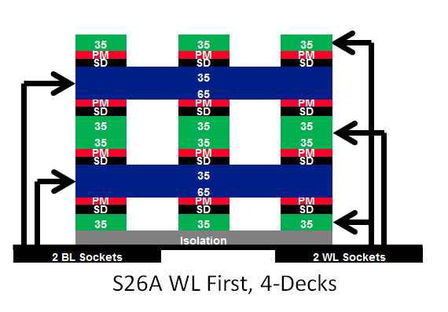
Tile Bitlines
2k
2k
2k
2k
WL0
WL0
WL0
WL0
WL1
BL1
WL1
BL0
1k bitlines
WL0
WL0
WL0
WL0
BL1
WL1
BL0
WL1
1k bitlines
WL0
WL0
WL0
WL0
WL0
BL1
WL0
BL0
1k bitlines
WL0
WL0
WL0
WL0
BL1
WL0
BL0
WL0
BL1
WL0
WL1
BL0
1k wordlines
1k wordlines
1k wordlines
1k wordlines

Slide 13
Tile Bitlines
WL0
WL0
WL0
WL0
WL1
BL1
WL1
BL0
WL0
WL0
WL0
WL0
BL1
WL1
BL0
WL1
WL0
WL0
WL0
WL0
WL0
BL1
WL0
BL0
WL0
WL0
WL0
WL0
BL1
WL0
BL0
WL0

Slide 14
Tile Bitlines
WL0
WL0
WL0
WL0
WL1
BL1
WL1
BL0
WL0
WL0
WL0
WL0
BL1
WL1
BL0
WL1
WL0
WL0
WL0
WL0
WL0
BL1
WL0
BL0
WL0
WL0
WL0
WL0
BL1
WL0
BL0
WL0

Slide 15
Tile Wordlines
WL0
WL0
WL0
WL0
WL1
BL1
WL1
BL0
WL0
WL0
WL0
WL0
BL1
WL1
BL0
WL1
WL0
WL0
WL0
WL0
WL0
BL1
WL0
BL0
WL0
WL0
WL0
WL0
BL1
WL0
BL0
WL0

Slide 16
Tile Wordlines
WL0
WL0
WL0
WL0
WL1
BL1
WL1
BL0
WL0
WL0
WL0
WL0
BL1
WL1
BL0
WL1
WL0
WL0
WL0
WL0
WL0
BL1
WL0
BL0
WL0
WL0
WL0
WL0
BL1
WL0
BL0
WL0

Slide 17
Tile Wordlines
WL0
WL0
WL0
WL0
WL1
BL1
WL1
BL0
WL0
WL0
WL0
WL0
BL1
WL1
BL0
WL1
WL0
WL0
WL0
WL0
WL0
BL1
WL0
BL0
WL0
WL0
WL0
WL0
BL1
WL0
BL0
WL0

Slide 18
The Worst Case
Consider this cell on WL0 and BL0
WL0
WL0
WL0
WL0
WL1
BL1
WL1
BL0
WL0
WL0
WL0
WL0
BL1
WL1
BL0
WL1
WL0
WL0
WL0
WL0
WL0
BL1
WL0
BL0
WL0
WL0
WL0
WL0
BL1
WL0
BL0
WL0
In S15C the worst case was 3k (2k BL + 1k WL)
In S26C the worst case is 3.5k (2k WL + 1.5k BL)

Slide 19
Bitline termination
How to deal with edge tiles.
Partition (128 tiles)
In S26A’s implementation of quilting we consider any WL or BL that leaves a tile is an ACTIVE WL/BL. This requires REAL cells wherever it goes.

Slide 20
Bitline Termination
0.5k
1.5k
WL0
WL0
WL0
WL0
WL1
BL1
WL1
BL0
WL1
WL0
WL0
WL0
WL0
BL1
WL1
BL0
WL1
WL1
WL0
WL0
WL0
WL0
WL0
WL0
BL1
WL0
BL0
WL0
WL0
WL0
WL0
WL0
BL1
WL0
BL0
WL0
WL0
Add WL sockets with WL support circuitry.

Slide 21
Bitline Termination
0.5k
1.5k
WL0
WL0
WL0
WL0
WL1
BL1
WL1
BL0
WL1
WL0
WL0
WL0
WL0
BL1
WL1
BL0
WL1
WL1
WL0
WL0
WL0
WL0
WL0
WL0
BL1
WL0
BL0
WL0
WL0
WL0
WL0
WL0
BL1
WL0
BL0
WL0
WL0
Add WL sockets with WL support circuitry.
Add dummy BL1s added over active BL0s
Add dummy BL0s on stagger section that “ends” early

Slide 22
Bitline termination
How to deal with edge tiles.
Partition (128 tiles)

Slide 23
Bitline Termination
WL0
WL0
WL0
WL0
WL1
WL1
BL1
WL1
BL0
WL0
WL0
WL0
WL0
WL1
BL1
WL1
BL0
WL1
WL0
WL0
WL0
WL0
WL0
WL0
BL1
WL0
BL0
WL0
WL0
WL0
WL0
WL0
WL0
BL1
WL0
BL0
WL0
Add WL sockets with WL support circuitry.
Add dummy BL1s added over active BL0s
Add dummy BL0s on stagger section that “ends” early

Slide 24
Wordline termination
How to deal with edge tiles.
Partition (128 tiles)

Slide 25
Wordlines Termination
WL0
WL0
WL0
WL0
WL1
BL1
WL1
BL0
WL0
WL0
WL0
WL0
BL1
WL1
BL0
WL1
WL0
WL0
WL0
WL0
WL0
BL1
WL0
BL0
WL0
WL0
WL0
WL0
BL1
WL0
BL0
WL0
DWL1
BL1
DWL1
BL0
BL1
BL0
DWL1
DWL1
DWL0
DWL0

Slide 26
Bitline termination
How to deal with edge tiles.
Partition (128 tiles)

Slide 27
Wordline Termination
WL0
WL0
WL0
WL0
WL1
BL1
WL1
BL0
WL0
WL0
WL0
WL0
BL1
WL1
BL0
WL1
WL0
WL0
WL0
WL0
WL0
BL1
WL0
BL0
WL0
WL0
WL0
WL0
BL1
WL0
BL0
WL0

Slide 28
Wordline Termination
DWL1
DWL1
DWL0
BL1
DWL0
BL0
BL1
DWL0
BL0
DWL0
WL0
WL0
WL0
WL0
WL1
BL1
WL1
BL0
WL0
WL0
WL0
WL0
BL1
WL1
BL0
WL1
WL0
WL0
WL0
WL0
WL0
BL1
WL0
BL0
WL0
WL0
WL0
WL0
BL1
WL0
BL0
WL0

Slide 29
Dummies
WL0
WL0
WL0
WL0
WL1
BL1
WL1
BL0
WL0
WL0
WL0
WL0
BL1
WL1
BL0
WL1
WL0
WL0
WL0
WL0
WL0
BL1
WL0
BL0
WL0
WL0
WL0
WL0
BL1
WL0
BL0
WL0

Slide 30
Dummies
WL0
WL0
WL0
BL0
WL0
WL0
BL0
WL0

Slide 31
Dummies
WL0
There are 8 dummy
BLs on either side of socket areas.
0
The BL dummy adjacent to active BLs is grounded the remaining seven dummies are floated.

Slide 32
Dummies
Consider the upper deck BLs
WL0
Opposite deck BLs terminate at sockets
0
The BL dummy adjacent to active BLs is grounded the remaining seven dummies are floated.

Slide 33
Dummies
This is accomplished by
the BL1 cut layer
WL0
Two dummy BLs are added on either side of the edge to handle potential cut mask mis-registration.
0
The BL dummy adjacent to active BLs is grounded the remaining seven dummies are floated.

Slide 34
Dummies
WL0
2
8
8
2
0
2
8
8
2
The dummy pattern of 2-8-8-2 is used per patch in both BL and WL directions

Slide 35
Redundancy
32x2 Added WLs
WL0
WL0
WL0
WL0
64x2 Added WLs
WL1
BL1
WL1
BL0
WL0
WL0
WL0
WL0
BL1
WL1
BL0
WL1
WL0
WL0
WL0
WL0
WL0
BL1
WL0
BL0
WL0
WL0
WL0
WL0
BL1
WL0
BL0
WL0

Slide 36
END

Slide 37
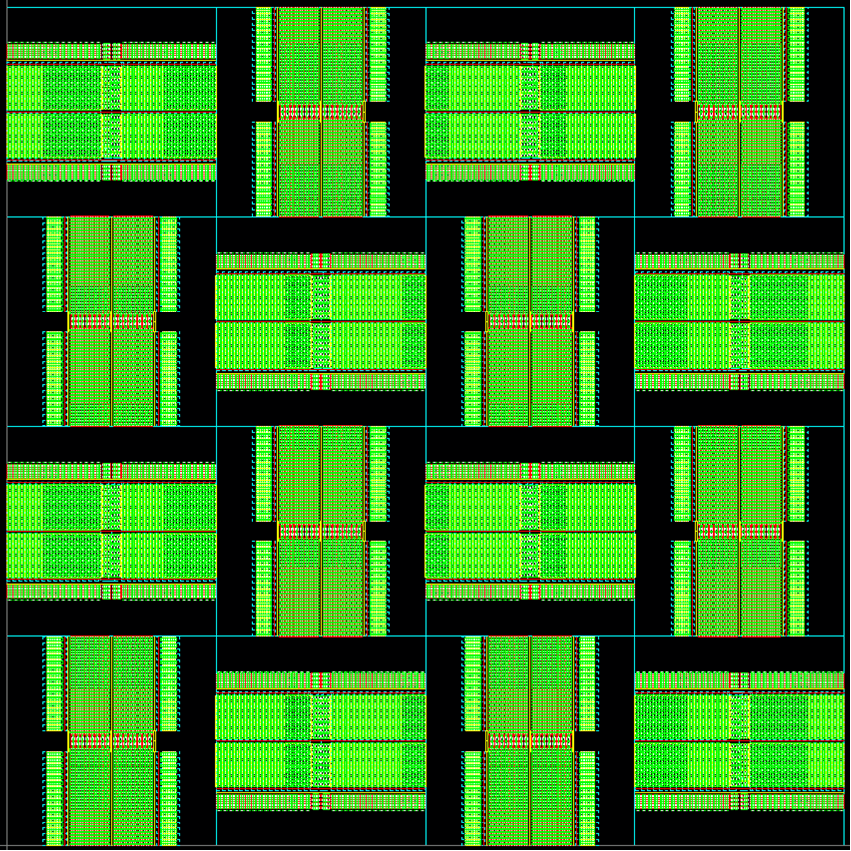
Tile Architecture
TILE ARCHITECTURE
Each tile has 8 WL patches and 8 BL patches.
4 patches in x direction and 4 patches in y direction
Length of WL = 4K
Length of BL = 4K
Number of BL decks = 2
Number of WL decks = 2
PATCH
Each Patch has 1K bitlines/deck
Each Patch has 1K Wordlines/deck.
WL Patch
BL Patch
WL Patch
BL Patch
BL Patch
WL Patch
BL Patch
WL Patch
WL Patch
BL Patch
WL Patch
BL Patch
BL Patch
WL Patch
BL Patch
WL Patch

Slide 38
Tile Floorplan
Reset CM CAPS
Mask WL
deckwl1
HV Seq Switch
deckbl0
VDM + LVL Shifters
Mask BL , Mis Tile logic
VDM caps
WLVDM
Gwl gnd
Gwl gnd
tile data
Ccell
WLVDM
Hnreg SW
Hnreg CNTL
LXS MUX
Hnreg SW
Gwl gnd
Seq bl lv
HV Seq Switch
deckbl0
HV Seq Switch
BL SA
deckwl1
VDM + LVL Shifters
Ccell
Ccell
Gwl gnd
HV Seq Switch
Ccell
Pmos SF
CAP
VDM + LVL Shifters
HV Seq Switch
HV Seq Switch
deckwl0
deckwl1
deckwl0
Pmos SF
CAP
deckbl1
deckbl1
deckbl0
Set CM
Set CM Caps
VDMS Caps
Ccell
Reset CM
Ccell
Gwl gnd
Gwl gnd
Hnreg SW
Hnreg CNTL
LXS MUX
Hnreg SW
Gwl gnd
HV Seq Switch
deckbl1
HV Seq Switch
SA Caps
Set CM
deckwl0
deckwl1
deckwl0
deckbl1
deckbl0
Ccell
Set CM Caps
Gwl gnd
Ccell

Slide 39
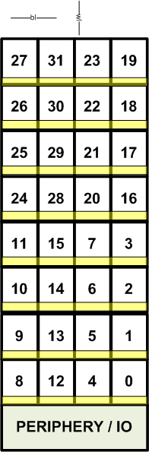
Chip Architecture
Die Architecture
32 partitions (4 x 8 = 32)
Bitlines run in x-direction
Wordlines run in y-direction.
Periphery & IO at the bottom like S15C.
Partition Architecture
128 tiles in 1 partition (16 x 8 = 128)
2 partitions share 1 PCL block.
LXS & GYS Drivers on the bottom of the partition.
PCL Buffers outside the PCL block.
LYS Drivers on the green side.
GWS Drivers on the blue side.
2 buses for SDIO OUT & 1 bus for SDIO IN per partition column.
Partition Floorplan ( 2 partitions showing 1 control logic blocks )
Chip Area Floorplan
Notes:
Basic Chip Architecture

