Slide 1
Material strategy update Oct 30th

Slide 2
Campaign planning – gantt chart
Aug.28 to today schedule update

Slide 3
Material exploration strategy update
Framework update
focus on PVD uniformity / defectivity has reduced the bandwidth for campaigns (~1m delay since Aug)
Increasing focus on SD optimization and understanding for SSM window:
2 vectors: Ge-Si role, with drift mitigation by In, on campaign K*; Se role by campaign F*
push to run F* (SAG map, Si 6%) with Indium as well, for SSM window & bi-layer experiment
F*+In on 3C: need to order small targets. Campaign start by end Dec.17
F*+In on 4C – time depending on K* (In-SiSAG skewing Si&Ge) results, by mid Nov.17
A] K* providing an SDx alloy potentially better than V16, promoted to pre-POR
Order an SDx monolithic target, K* remaining installed up to validation (~Mar.18) to run SSM wip
Sub-case: K* providing good signals but need a 2nd run, results in Jan.18 → K* remains installed even more
F* with indium must be planned on 3C → need to order 3 small targets for In+F*,
B] K* providing minor signals, need of a 2nd run, but no clear perspective to get a pre-POR
target change on 4C could be possible by mid Dec, possible conflict with planned PM campaign
PM for 30S: Y-GST or Hf-GST, if value demonstrated on 3C. PM results expected by Dec.17
C] K* providing no signals of interest → SD F* + InSe could be installed by mid Nov.17
Note: F* (without indium) was planned on 3C in Jan.2018 after SiN+SAG exploration.
Recommendation: if we want to ensure F* with Indium capability by end of year, better to order small target

Slide 4
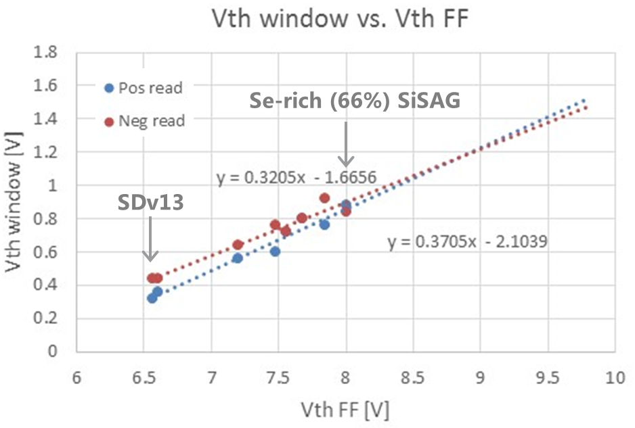
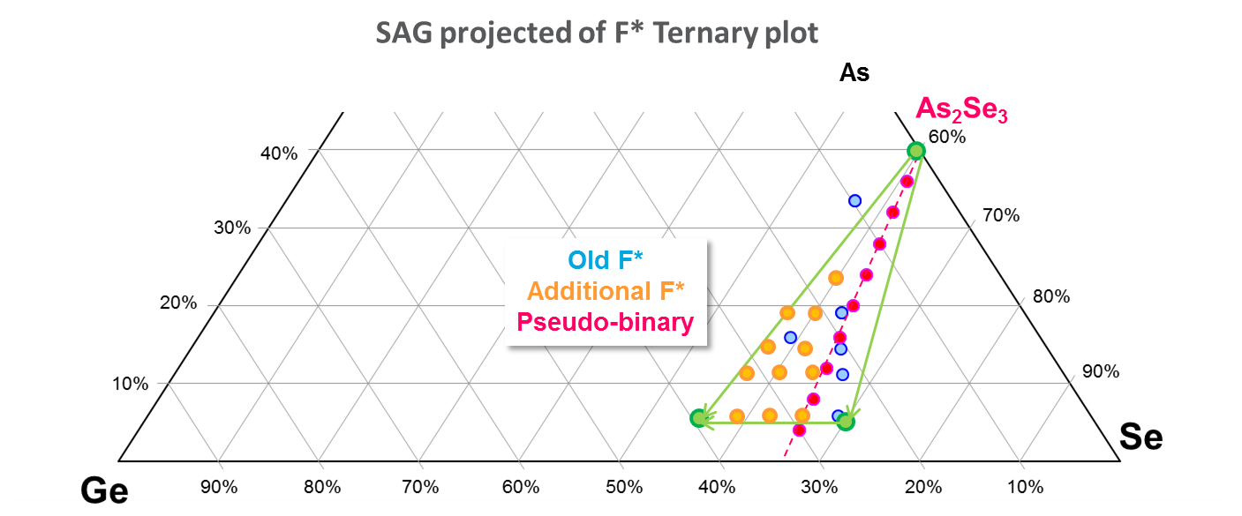
SD options summary 3 – other opportunities
Aug.2017
F* campaign (As/Se ratio) for SSM window (link)
Aim 1: F* showed the possibility to double the SSM window on SxP: from ~0.4 V to ~0.9V. In particular, the Se-rich (anion enrichment) alloys drive the window widening. But the role of Se and Ge need to be de-coupled
Aim 2: By using the F* target configuration we could deposit SD as two-steps layered stoichiometry instead of uniform stoichiometry. This strategy allows emulating the programming-induced vertical segregation and get learning on SD VT evolution
The opportunity to run the F* campaign with Indium (2%-5%) was debated. Std F* campaign appears more straightforward, since it can provide useful knowledge, without request of supplementary integration effort and target purchase
Rational behind: get asap As/Se signal to prepare a combined K*+F* final campaign (still valid)
Today update:
In doping moves F* to better drift/sigma baseline → self-consistent campaign for SSM (but fixing 2% In, 6% Si, before any feedback from K*)
SD etch not so demanding on SSM vehicle; We have time to purchase In-doped F* targets

Slide 5
Campaign priorities & planning – integration effort

