Slide 1
SSM process development update
ww1807

Slide 2
Summary
PI team is growing with Kyle (kritter) and Eva (ehsmith) from Intel JDP joining SSM project.
PVD gate should be open for CR5.3 during the weekend or early next week.
Si inventory is high: 7 lots in Fab4 buffer and 5 more running in Fab2; Only 1 lot is active in Fab4 line.
Next 4 week focus:
  CR5.3 conversion + 55nm W at 52 level + Nitride cap at 2nd cut
  K* wave 3 execution
  DD setup

Slide 3
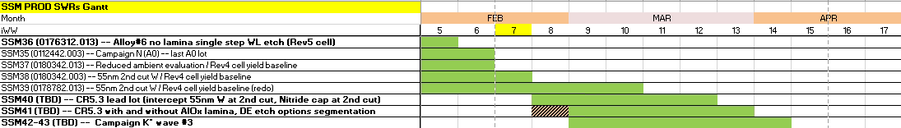
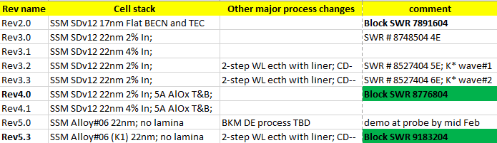
WIP status update
  Short term line conversions:
    Rev5.3 – SD.K1, 2-step WL etch – conversion in progress
    Additional baseline conversions: 55nm W at 52 level and Nitride cap flow at 52-C2 module – intercept DD lead lot
    Further away: 65 NCMP FSL slurry and 350A 51 Nitride Cap (improve periphery dishing)

Slide 4
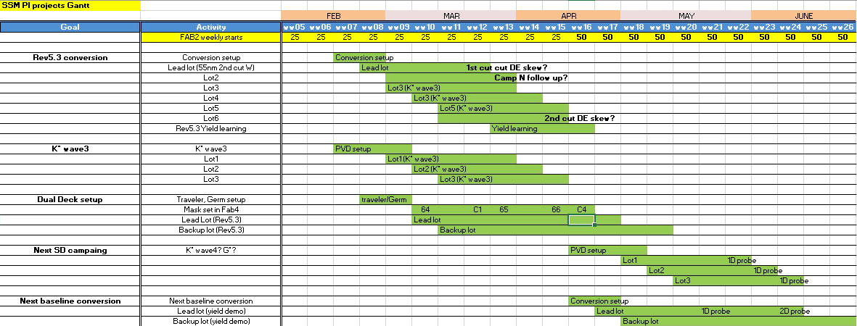
Q1-Q2 PI Gantt Chart
Additional experiments TBD (Si is available)
S26S tape-out is planned to Q3’18, allowing 2 info-turns on dual deck and 2 material exploration campaigns

Slide 5
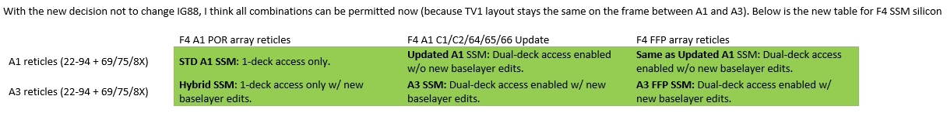
SSM dual deck assessment on SR71B and 2D structural yield
Tape-out in late February
    Schedule:
      64 reticle tape out is expected to be ww9;
      Rest of the schedule is derived from 64 tape out based on the screamer time to step projection.
      Lead lot to start ww10;
      Detailed plan TBD (Number of wafers, in-line targeting, backup lots)
    Initial material will run on 2D based on CR5.3 + 55nm W at 52 level + Nitride cap flow at 2nd cut

