Slide 1
SSM WSiN elimination - 0176312.003
2018-Wk07
SSM team

Slide 2
SSM WSiN elimination - 0176312.003
Scope of the lot
  Evaluate pro/con of eliminating WSiN at WL only, at BL only, and at both BL and WL

Slide 3
Lot trials
Trial | Cell stack | WSiN @ WL | WSiN @ BL | Wf
1C | 22nn ver12+2% In + T&B AlOx | Yes | Yes | 2,4,5,15
2E | 22nn ver12+2% In + T&B AlOx | No | Yes | 8,9,11
3E | 22nn ver12+2% In + T&B AlOx | Yes | No | 6,10,13,14
4E | 22nn ver12+2% In + T&B AlOx | No | No | 1,3,7,12
Wafer #6 missing

Slide 4
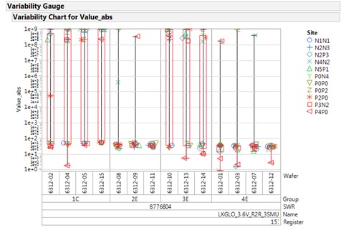
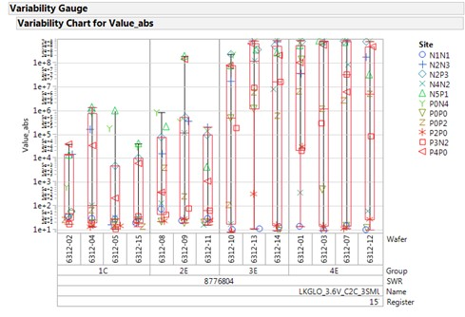
Param testing: R2R and C2C
R2R
  R2R leakage is generally quite good
  Some defectivity on 1C and 3E
C2C
  C2C leakage looks worse for 3E and 4E (WSiN removal at BL)

Slide 5
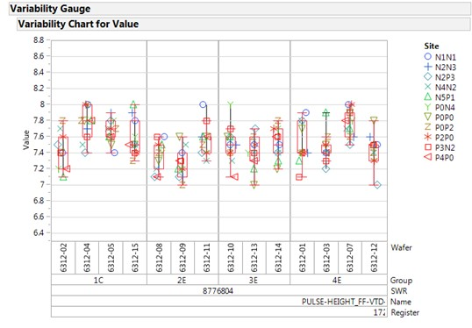
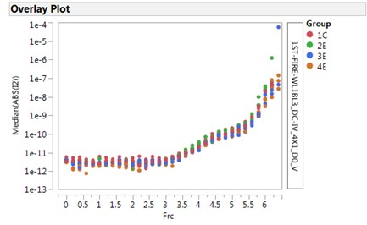
FF and OCL I-V curves
FF and OCL I-V are good

Slide 6
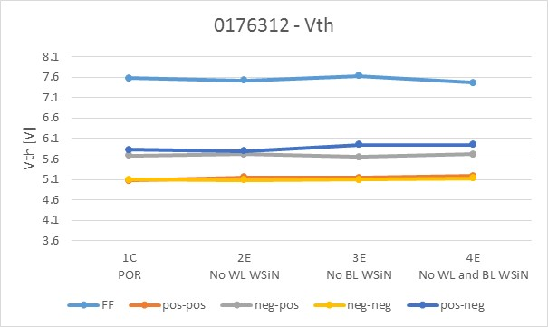
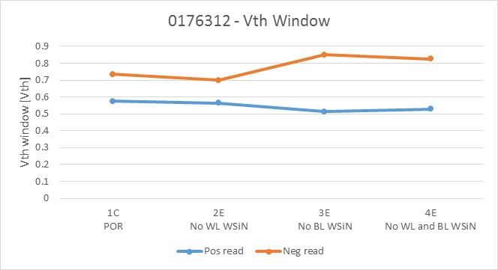
2xCMOS data: Median Vth and Vth window
FF and Vth window trend
  No significant modulation in FF
  WSiN removal at BL shows an increasing of the Vth window asymmetry

Slide 7
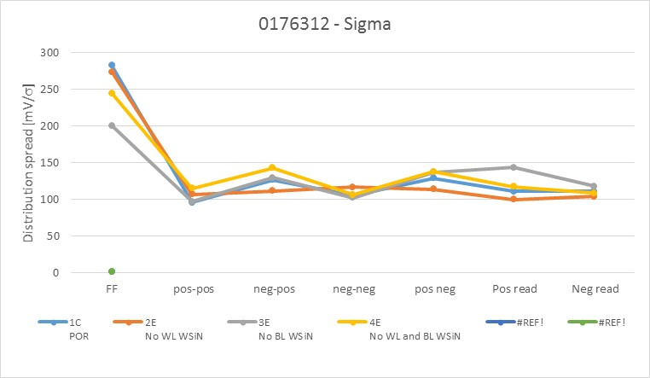
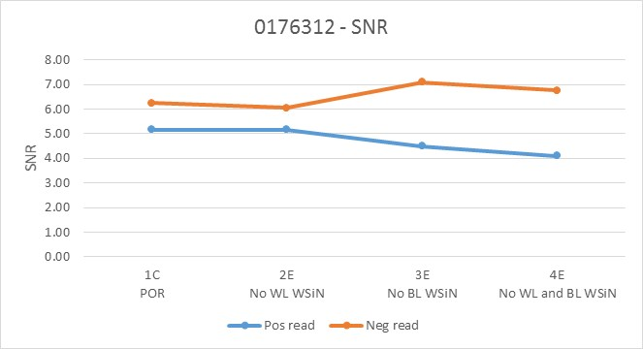
2xCMOS data: distribution spread and SNR
No significant toggles

Slide 8
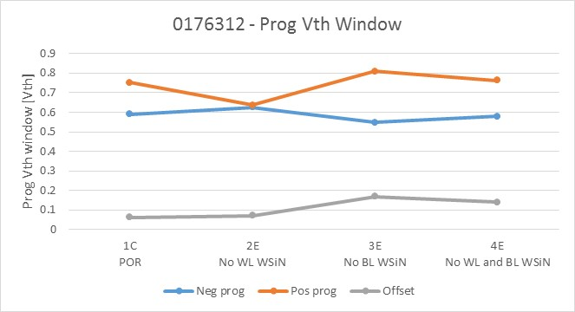
2xCMOS data: programming Vth window
Programming Vth window trend
  WSiN removal at BL shows a significant Offset

