Slide 1
S26A SD only K* wave2 probe summary
ww8
Lidia

Slide 2
Summary
Main advantage found from SD only lot SWR (different integration, different probe flow, S26 product)
Consistent memory effect increase in trend with In content; +100mV between SET/RST from POR SD to In-SAG at 5% → to demonstrate the transfer to full stack window
SET sigma improvement, might be -10mV
Possible downside and warning, how far with In concentration?
Cell
Drift increase, data are noisy and collected with long sense time (PG4 spec)
VL increase minor
Structure
SWL WLICS increase, not intrinsic but due to damage by seasoning (pending PFA)
Unknown metrics
E1 knee not available
Given downsides, recommendation is to limit to 5% In
Full stack integration concern
SD thickness adjustment and etch.
To match SET Vt, SD thickness has to be higher than FS POR. Imply etch adjustment with possibly different response of the new alloy to the chemistry.
SD liner protection: all the exp here shown have the so called 2-step WL etch with PL to preserve SD and give a straight CD profile

Slide 3
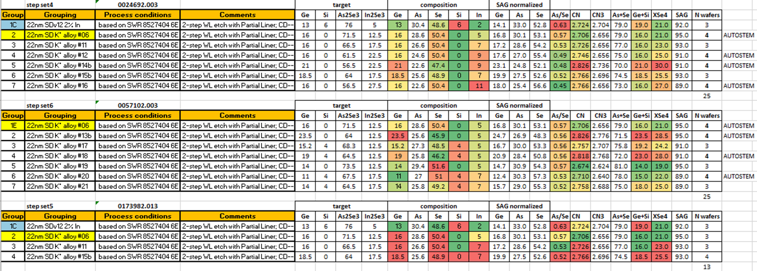
SWR/Lots considered for this presentation (S26 2nd wave K* SD only campaign)
PR 28 at 50C
A0 reticle
Explores In from 5 to 11%
PR 28 at 85C
A0 reticle
1E has forward looking alloy for SSM project
Other exp are not today focus→ too high Ge or Si addition
PR 29 at 85C
A1 reticle
Explores In from 5 to 7%
No significant change with probe rev; IRST fixed at 120uA and SET pulse fixed at P1=22.5uA, P3 = 25uA, P4 = 22.5uA
One lot has been probed at 50C unintentionally

Slide 4
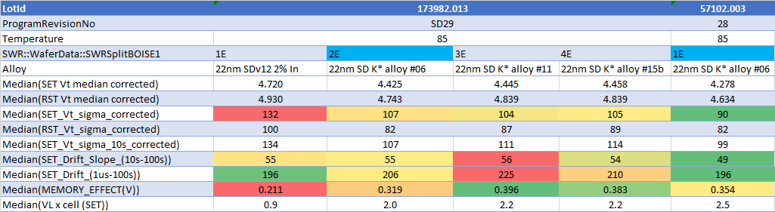
85C probe 0173982.013 + a repetition of Alloy 6 on 0057102.003
Zone A/B
median after filtering from structure fail
ED3
All the metrics have been corrected for the access transistor and refer to the voltage across the cell
Need to evaluate the impact on the array with proper access transistor contribution that differs between S15C and S26A
The lowest SET Vt can be over- estimated by the sweep range with current DAC. In general 10s SET Vt is properly extracted. Other metrics that uses 1us SET Vt can be also affected (memory effect is eventually under-estimated)

Slide 5
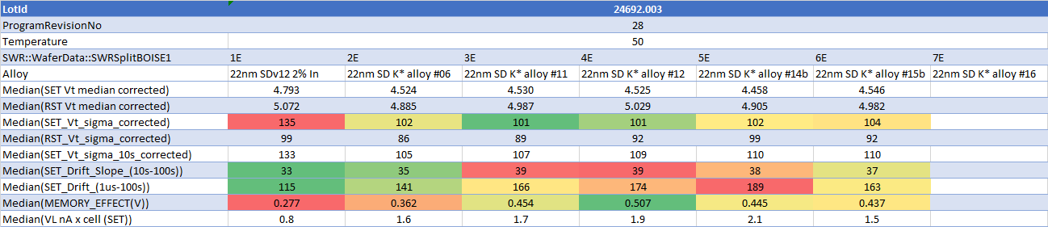
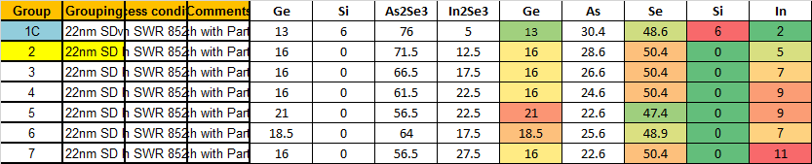
0024692.003 full lot (50C)
Fail at periph

Slide 6
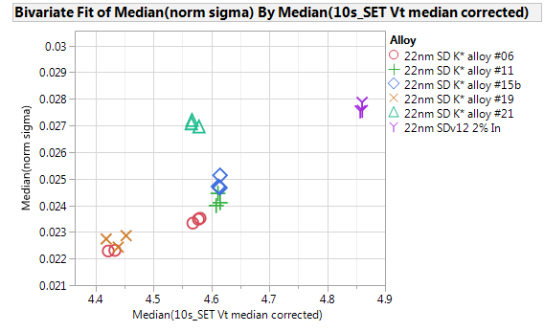
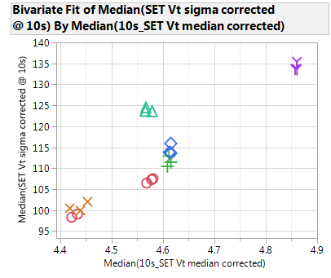
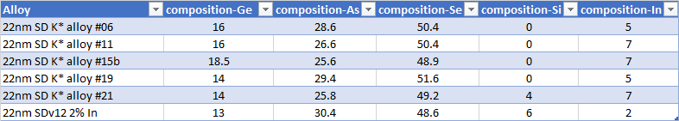
Vt sigma (10s)
Norm Vt sigma vs Vt 10s
Vt sigma vs Vt 10s
In-SAG: SET sigma improvement
no clear worsening from 5% to 7%
Carefully evaluate L2L
wave2 results better than wave1, that was structurally compromised
In Si-SAG
In SAG
K* lots have 22nm thick SD
Line is roughly where S15C CR 7.72 full stack is (corrected Vt by -400mV)
Eventually skew SD thickness lower than 22nm to match Vt
0024692
0057102
Alloys with much different composition have been intentionally excluded from this plot

Slide 7
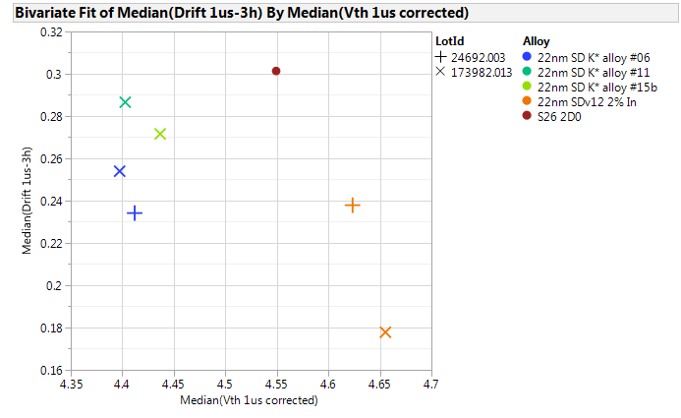
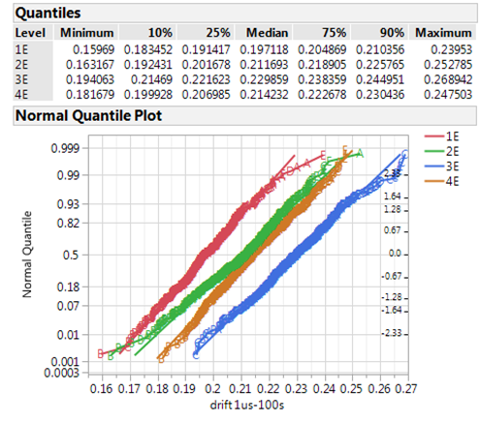
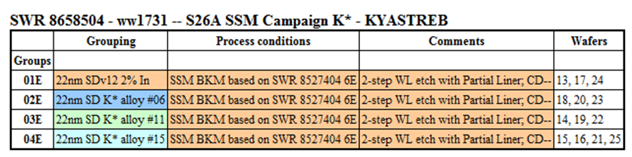
Drift
WLR 3H-1us 85C
Probe 100s -1us 85C
7% InSAG
5% InSAG
POR
PG4 sensing time (75ns) One of the two lots is neutral for drift comparison POR vs 5% InSAG; the other one shows +70mV
All SD only lots have lower drift than full stack S26 ref
Also from Probe, downside with In%

Slide 8
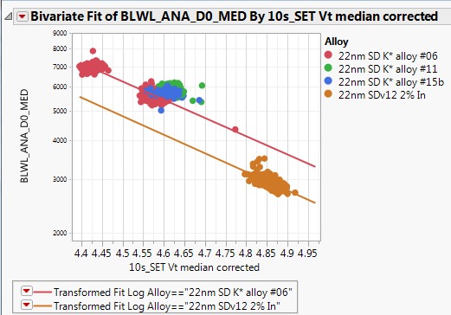
VL vs SET Vt
+25%

Slide 9
Structural

Slide 10
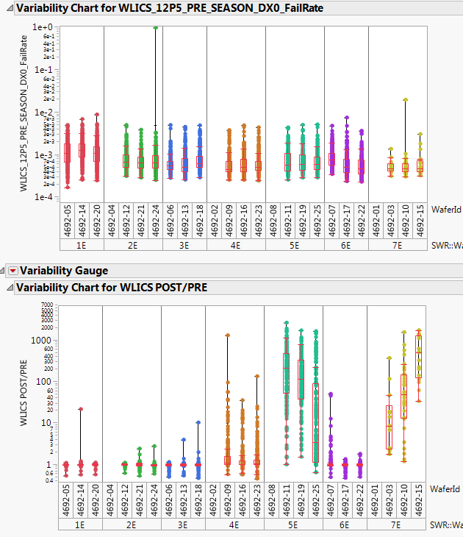
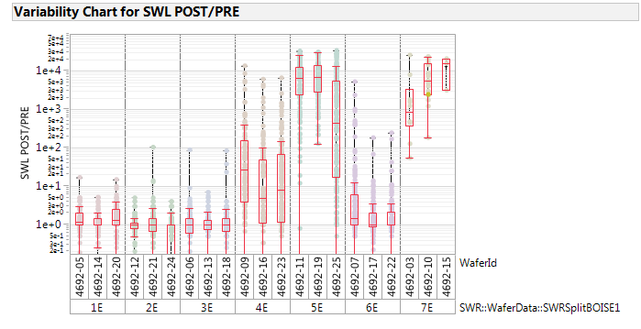
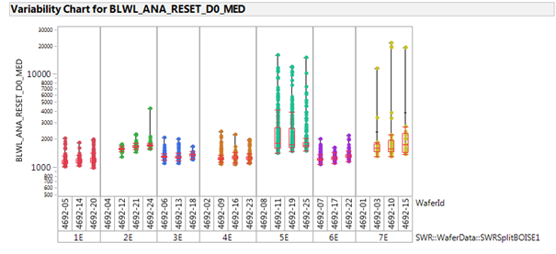
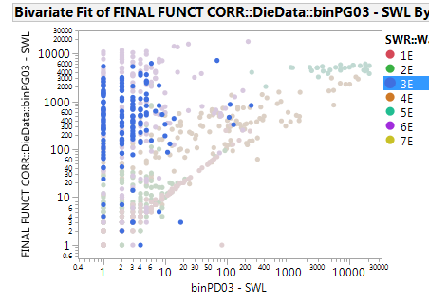
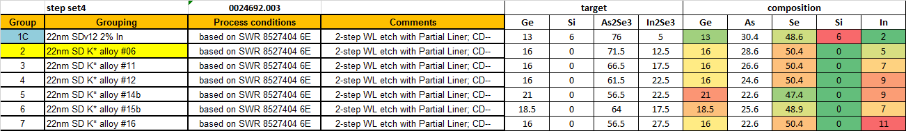
WLICS SWL increase with high In post Seasoning
WLICS huge increase after Seasoning for highest In composition, two worst grp 5E/7E have also tails of high VL, suspecting damage (IRST for seasoning at 120uA). Upon retest degradation continue and 3E is hit also
WLICS pre is clean
9%
9%
11%
In%
SWL at re-probe vs SWL after 1st seasoning

Slide 11
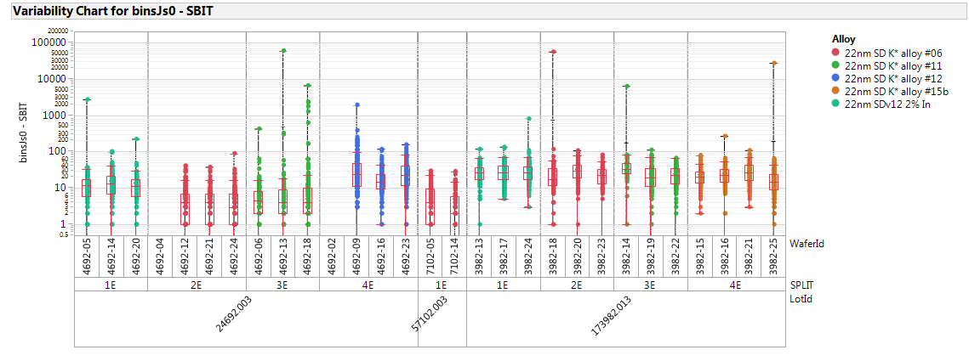
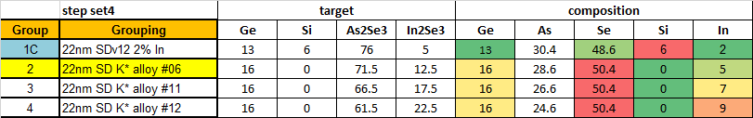
Opens SBIT
No toggle for opens
9%
Single bit after filtering from WLICS
Zone A-C

Slide 12
Back up

Slide 13
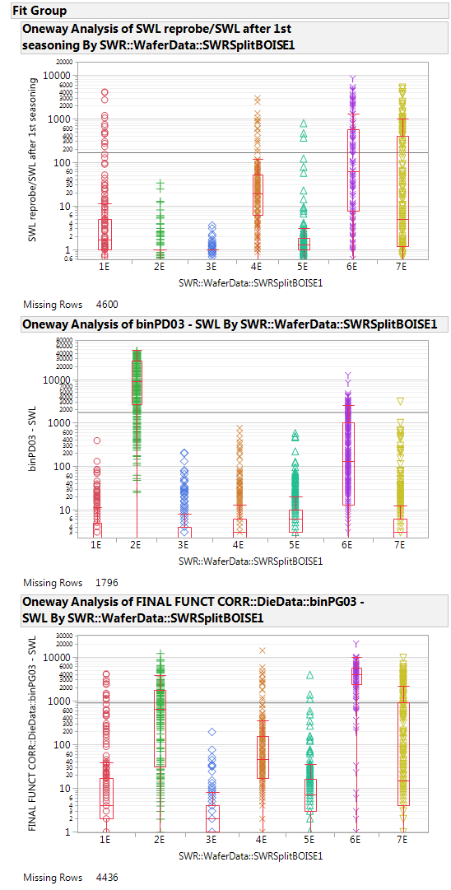
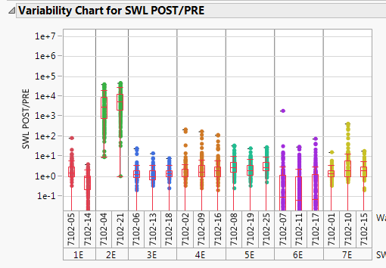
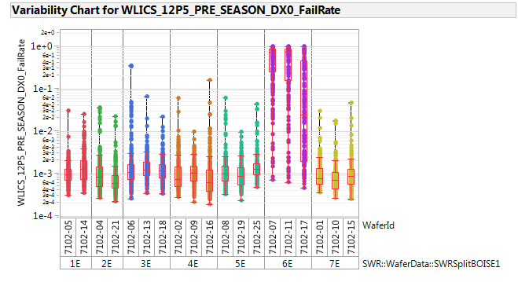
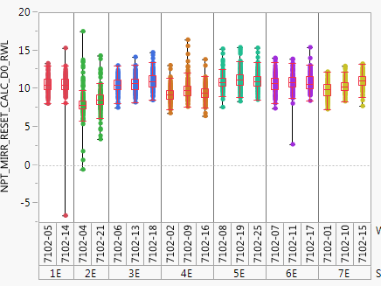
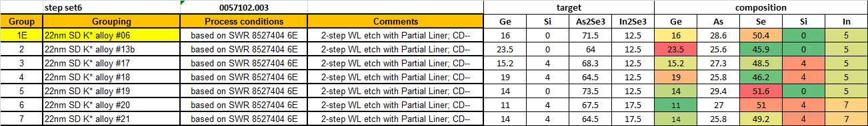
WLICS
With re-probe SWL increase extends to other alloys
SWL Re-probe/ 1st season
WLICS huge increase after Seasoning VL for 2E; 6E railed for SWL already before Seasoning
0057102.003
WLICS –pre seasoning
Grp in order of gravity:
6E>2E>4E>7E>5E=1E>3E
Difficult to find a toggle with alloy composition
SWL
SWL after 1st season
SWL at re-probe

Slide 14
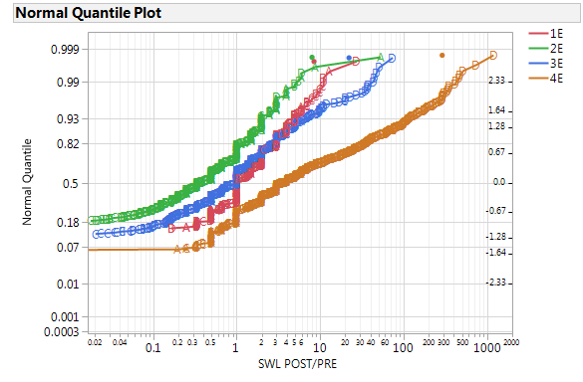
0173982 WLICS
SWL PRE/POST
4E is minimally marginal
No re-probe data for this lot

Slide 15
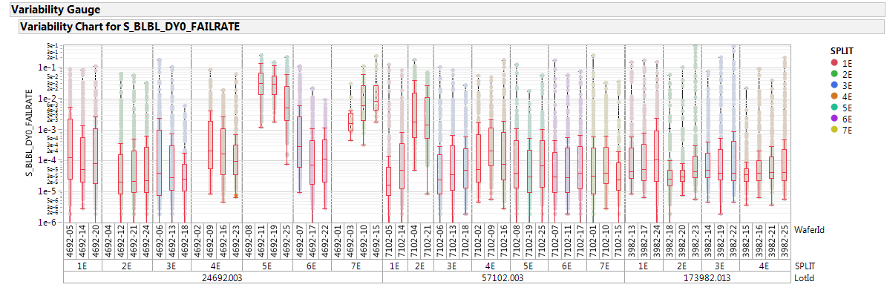
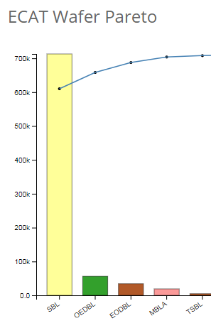
Other Structure BLBL
Some marginal grps than from WLICS
SBL Ecats

Slide 16
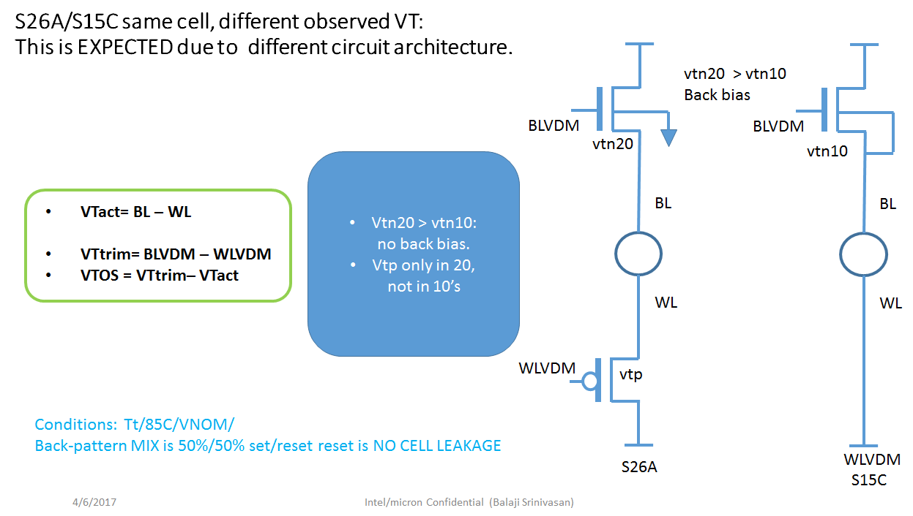
VT OFFSET (Balaji/John)

Slide 17
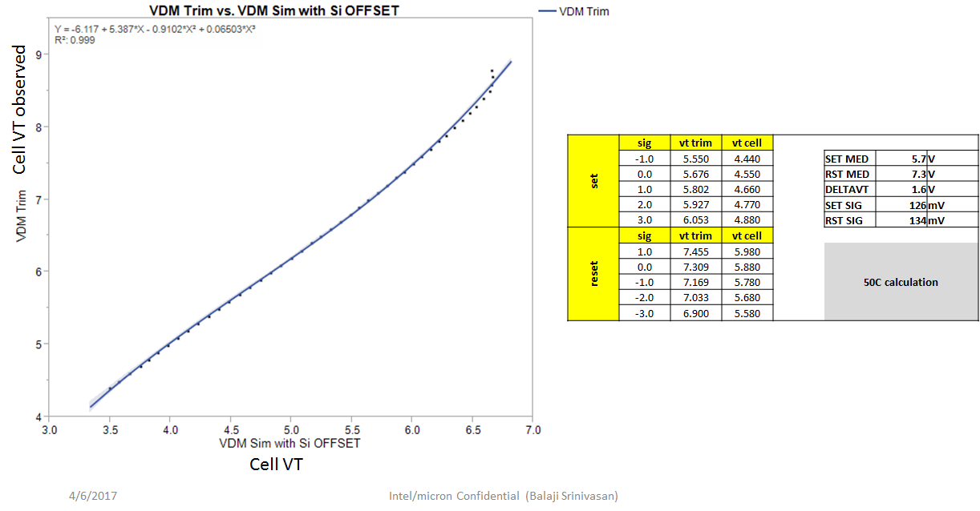
VT OFFSET (Balaji/John)

