Slide 1
0176312 SR71B

Slide 2
Summary
Lot with some marginality for BL leakage
Screening was not 100% effective and some dice were not working properly during array characterization flow
Misalignment of some POR metrics wrt previous lots, group to group comparison still valid
Trial | Cell stack | WSiN @ WL | WSiN @ BL | Wf
1C | 22nn ver12+2% In + T&B AlOx | Yes | Yes | 2,4,5,15
2E | 22nn ver12+2% In + T&B AlOx | No | Yes | 8,9,11
3E | 22nn ver12+2% In + T&B AlOx | Yes | No | 6,10,13,14
4E | 22nn ver12+2% In + T&B AlOx | No | No | 1,3,7,12

Slide 3
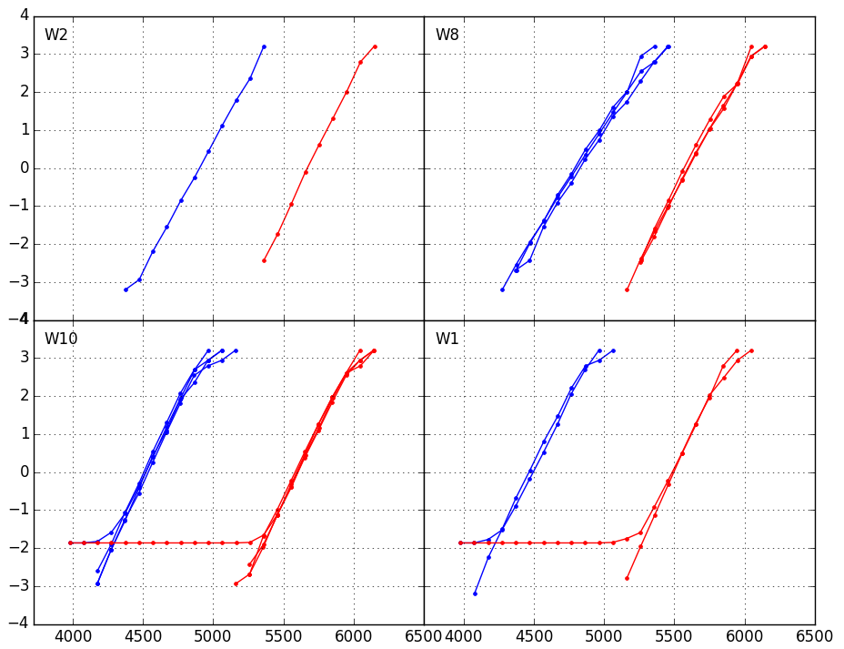
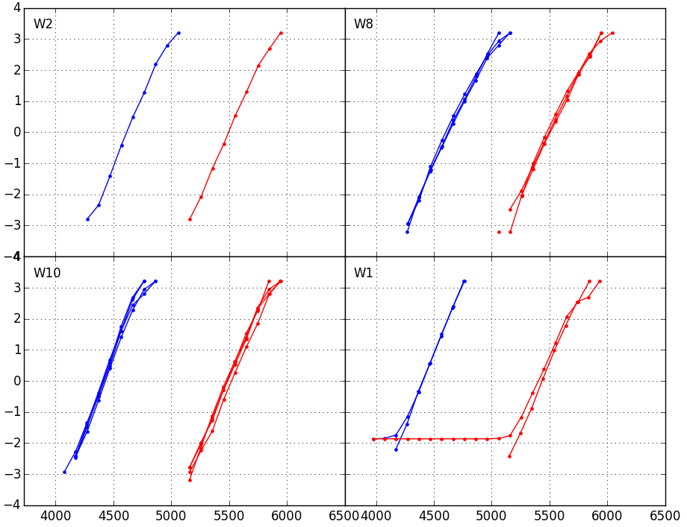
Distributions 1us
1k cycles
128k cycles
1C
WSiN
@WL: YES
@BL: YES
2E
WSiN
@WL: NO
@BL: YES
1C
WSiN
@WL: YES
@BL: YES
2E
WSiN
@WL: NO
@BL: YES
3E
WSiN
@WL: YES
@BL: NO
4E
WSiN
@WL: NO
@BL: NO
3E
WSiN
@WL: YES
@BL: NO
4E
WSiN
@WL: NO
@BL: NO
No degradation of distribution up to 128k cycles for all the groups

Slide 4
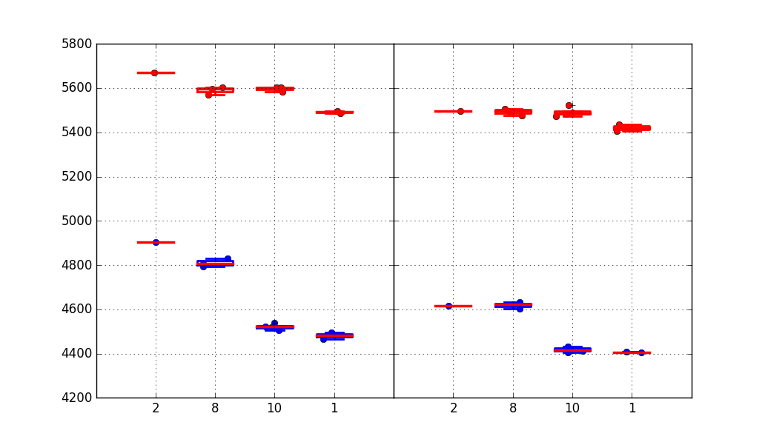
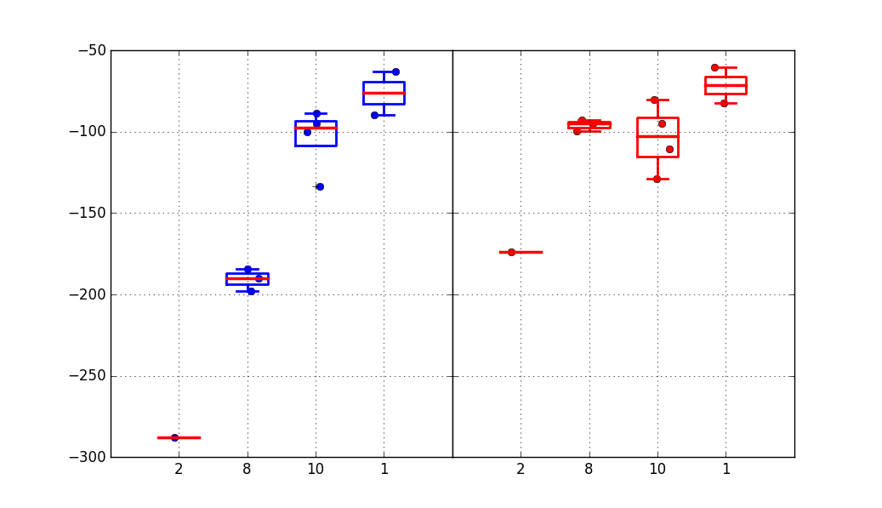
Vt Medians + Vt shift
Without WSiN we get lower Vts (faster seasoning). Major toggle is with WSiN @BL
Vt shift 1k→128k cycles is much smaller for no WSiN @BL, consistent with a more effective 1k seasoning
1k cycles
128k cycles
Median Vt
1C
2E
3E
4E
1C
2E
3E
4E
Vt shift 1k→128k cycles
SET
RESET
Trial | Cell stack | WSiN @ WL | WSiN @ BL
1C | 22nn ver12+2% In + T&B AlOx | Yes | Yes
2E | 22nn ver12+2% In + T&B AlOx | No | Yes
3E | 22nn ver12+2% In + T&B AlOx | Yes | No
4E | 22nn ver12+2% In + T&B AlOx | No | No
1C
2E
3E
4E
1C
2E
3E
4E

Slide 5
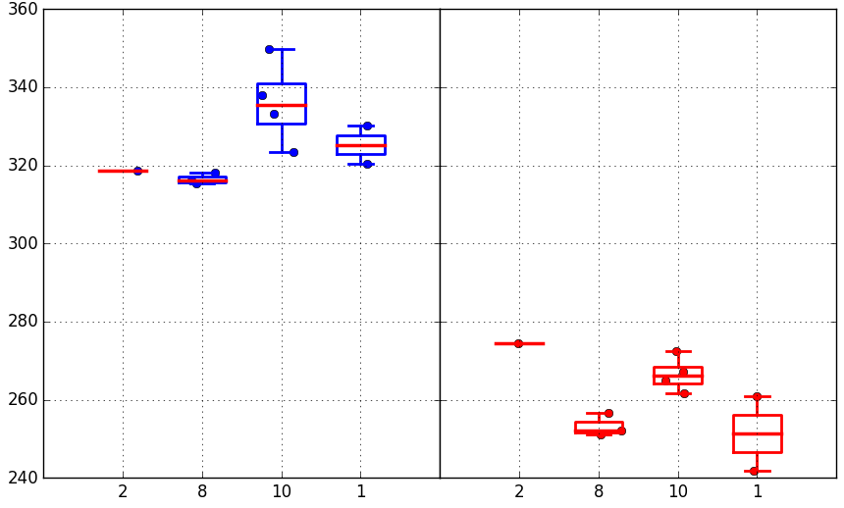
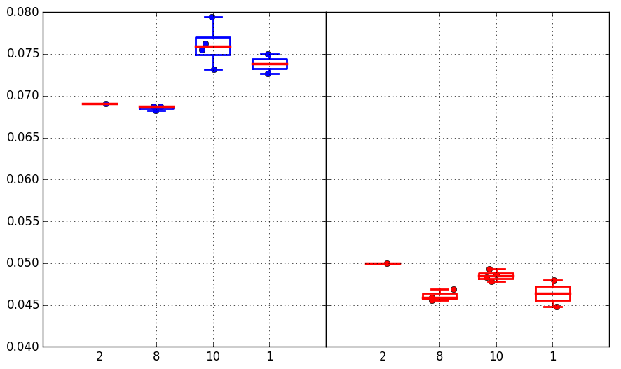
Median drift 1us-10s @85C
(128k cycles)
Absolute drift mV
SET/RESET
Trial | WSiN @ WL | WSiN @ BL
1C | Yes | Yes
2E | No | Yes
3E | Yes | No
4E | No | No
Set drift slightly larger when removing WSiN @BL
Reset drift has instead some beneficial effect when removing WSiN @WL
1C
2E
3E
4E
1C
2E
3E
4E
Relative drift
SET/RESET
1C
2E
3E
4E
1C
2E
3E
4E

Slide 6
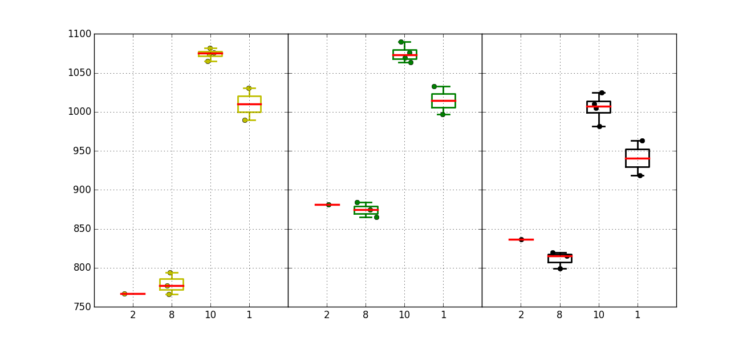
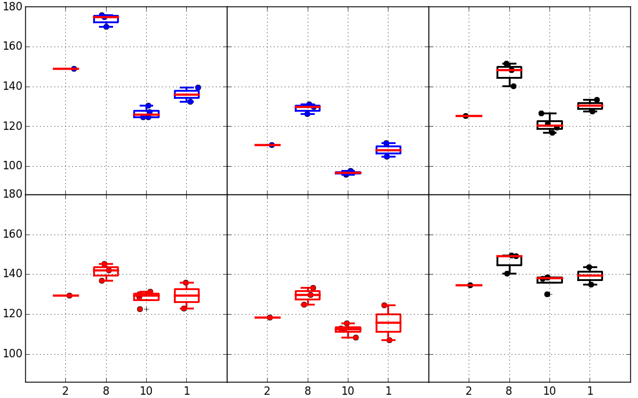
Window & sigma
Largest median window for no WSiN @BL
Median
Window
Better seasoning generally yields better sigmas.
Exception is when removing WSiN @WL → the distribution sigma gets worse
1C
2E
3E
4E
1C
2E
3E
4E
1C
2E
3E
4E
1k cycles 1us
128k cycles 1us
128k cycles 10s
Robust
sigma
SET
Trial | Cell stack | WSiN @ WL | WSiN @ BL
1C | 22nn ver12+2% In + T&B AlOx | Yes | Yes
2E | 22nn ver12+2% In + T&B AlOx | No | Yes
3E | 22nn ver12+2% In + T&B AlOx | Yes | No
4E | 22nn ver12+2% In + T&B AlOx | No | No
RESET
1C
2E
3E
4E
1C
2E
3E
4E
1C
2E
3E
4E

Slide 7
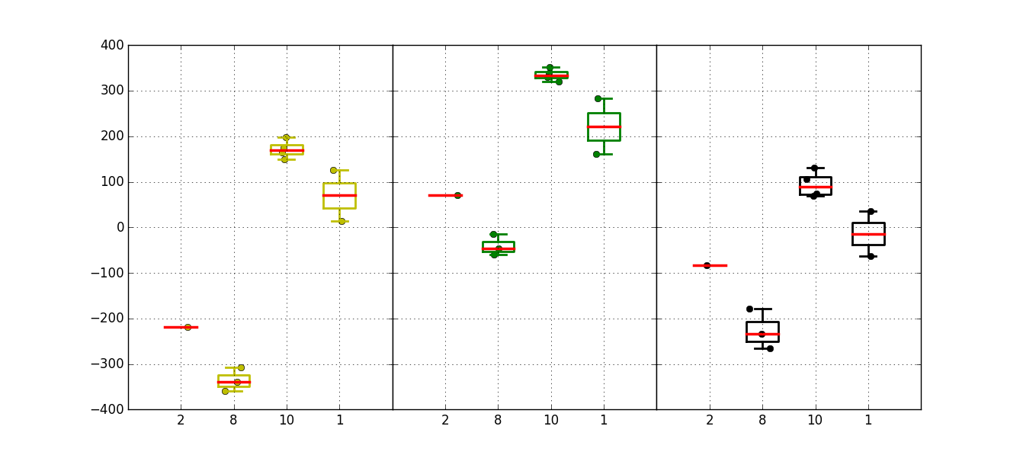
Projected window @3.54 sigma
Trial | Cell stack | WSiN @ WL | WSiN @ BL
1C | 22nn ver12+2% In + T&B AlOx | Yes | Yes
2E | 22nn ver12+2% In + T&B AlOx | No | Yes
3E | 22nn ver12+2% In + T&B AlOx | Yes | No
4E | 22nn ver12+2% In + T&B AlOx | No | No
No WSiN @BL groups benefit from a larger window. For group 3E, coupled with a better sigma, we have a projected window of +200~+300mV
1k cycles 1us
128k cycles 1us
128k cycles 10s
1C
2E
3E
4E
1C
2E
3E
4E
1C
2E
3E
4E

Slide 8
Conclusions
Significant impact on seasoning when removing WSiN, especially @BL
→ together with lower Vt, this means a smaller Vt evolution for cycles between 1k and 128k
Removing WSiN @BL brings also a wider median window
Distribution sigmas are improved as well with stronger seasoning, with exception of removed WSiN @WL, that shows an increasing in sigmas
Lot is impacted by leakage @BL, not many readable dice. Definitely worth confirming above signals on a cleaner lot
Endurance on no WSiN needs to be assessed

