Slide 1
SSM Rev5 opener - 0176312.013
2018-Wk06
SSM team

Slide 2
SSM WSiN elimination - 0176312.013
Scope of the lot
Rev 5 opener with 2 tentative BKM process
Alloy #6 without lamina but tapered

Slide 3
Lot trials
Trial | Cell stack | WL etch | Wf
1C | 22nn ver12+2% In + T&B AlOx | 23s SD etch no SO2; 18/25s W etch | 18,20,23,25
2E | 22nn alloy #6 | 21s SD etch no SO2; 15/22s W etch | 16,21,24
3E | 22nn alloy #6 | High pressure SD 20/17s; hi N2 in W1, lo in W2 | 17,19,22

Slide 4
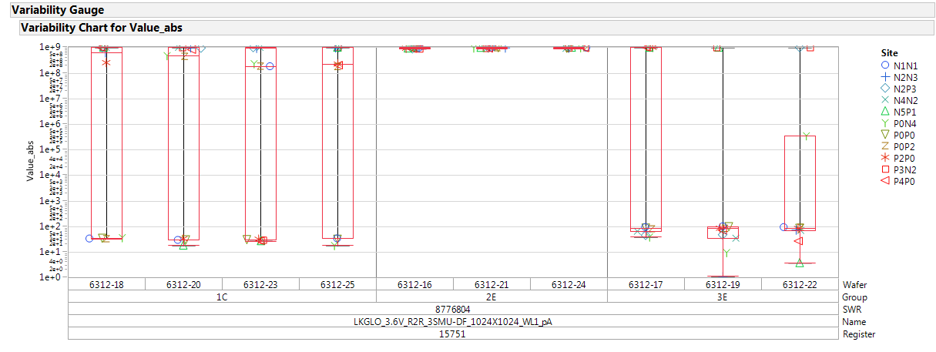
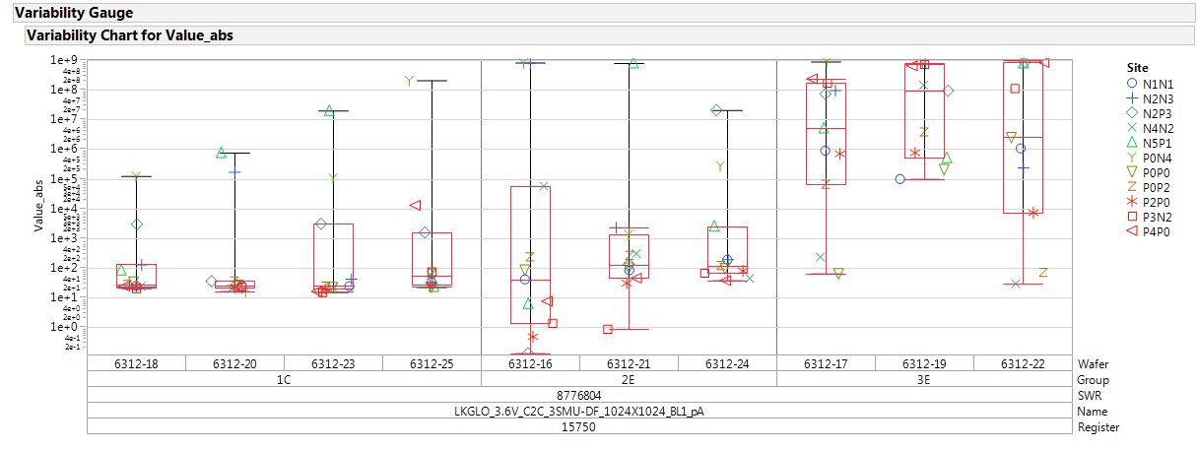
Param testing: R2R and C2C
R2R
R2R is very bad for group 2E
Group 3E is marginally better than 1C
C2C
C2C leakage worsen for group 3E

Slide 5
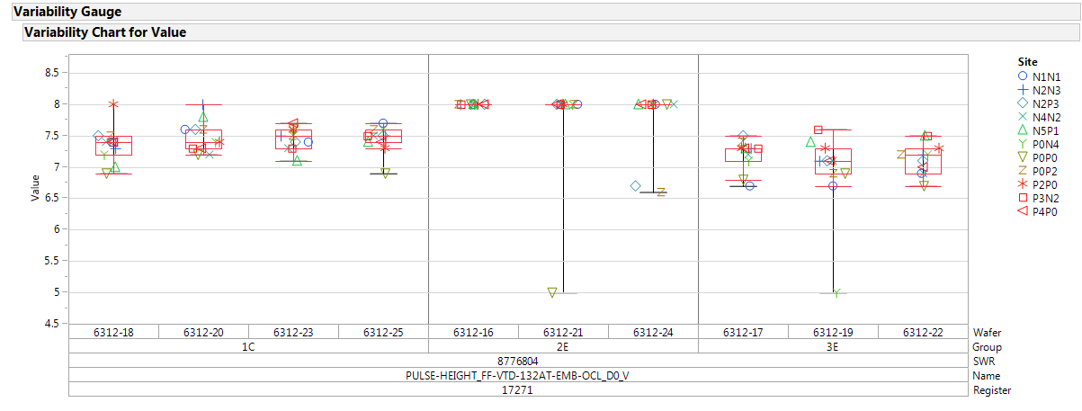
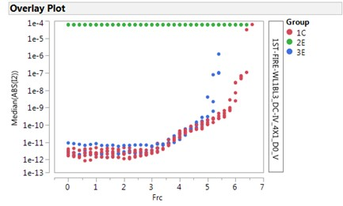
FF and OCL I-V curves
FF and OCL I-V are good

Slide 6
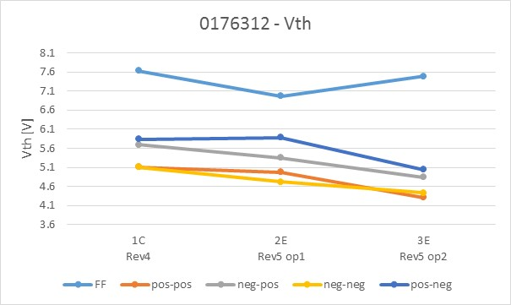
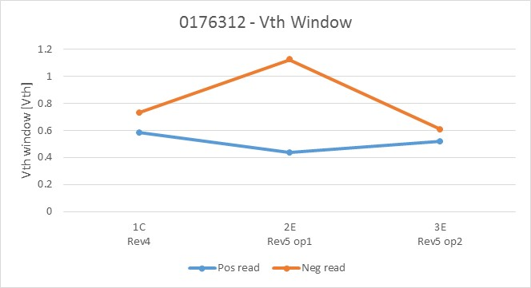
2xCMOS data: Median Vth and Vth window
FF and Vth window trend
Expected trend for Vth and window from 1C to 2E
2E strongly affected by WL-WL shorts even on 2xCMOS structure
Completely unexpected behaviour for 3E

Slide 7
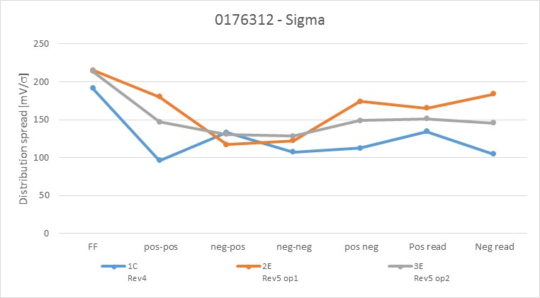
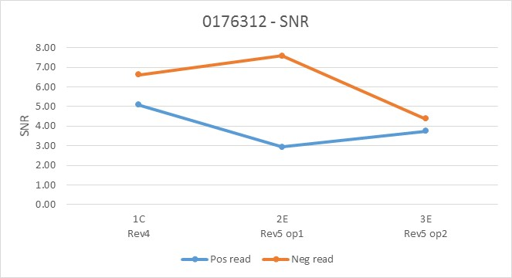
2xCMOS data: distribution spread and SNR
Sigma on 2E is affected by poor statistics due to WL-WL short issue

Slide 8
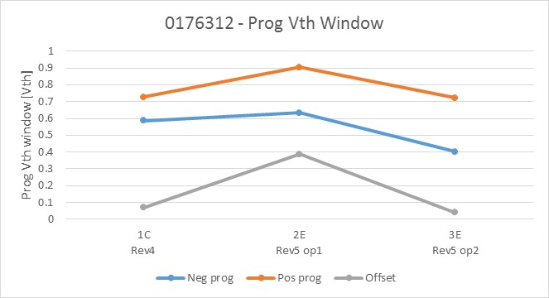
2xCMOS data: programming Vth window
Programming Vth window trend
Expected trend from 1C to 2E
Completely unexpected behavior for 3E (low offset and low programming windows)

Slide 9
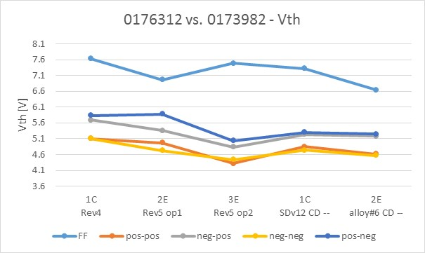
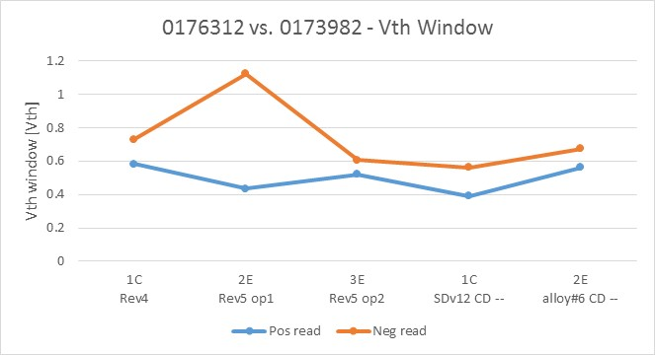
2xCMOS data: new lot vs. 2-step CD--
Straigth WL profile
Straigth WL profile
Rev5 op1 cell behaves as expected
Rev5 op1 shows potentially +400mV of negative reading Vth window

Slide 10
SR71B testing

Slide 11
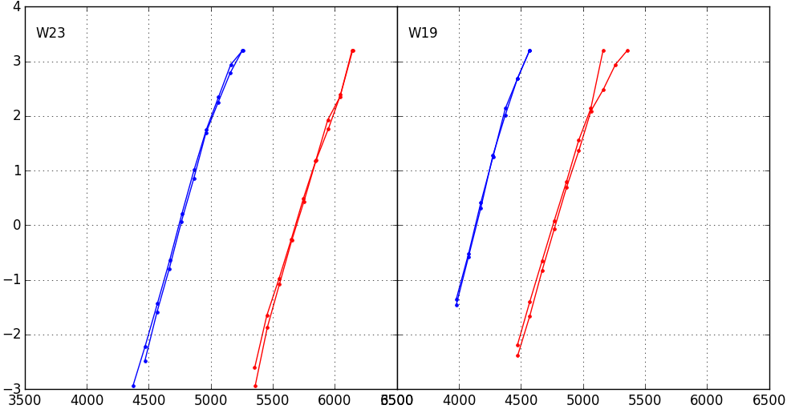
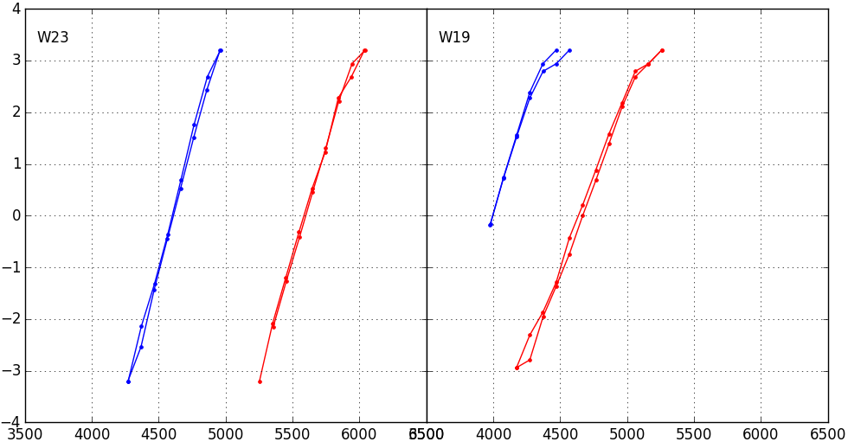
Distributions
1k cycles – 1us
1C
3E
Trial | Cell stack | WL etch
1C | POR | 23s SD etch no SO2; 18/25s W etch
2E | 22nn alloy #6 | 21s SD etch no SO2; 15/22s W etch
3E | 22nn alloy #6 | High pressure SD 20/17s; hi N2 in W1, lo in W2
Group 2E not tested: 100% of dice heavily impacted by WL-WL shorts
128k cycles – 1us
1C
3E

Slide 12
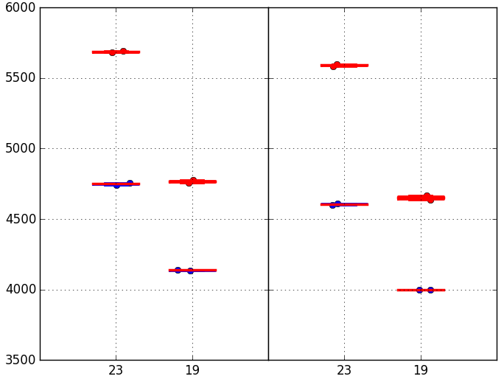
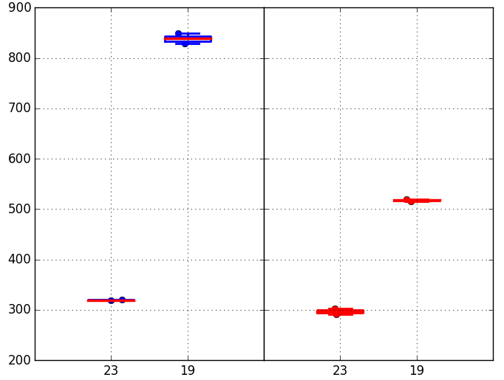
Median Vt and drift
Trial | Cell stack | WL etch
1C | POR | 23s SD etch no SO2; 18/25s W etch
2E | 22nn alloy #6 | 21s SD etch no SO2; 15/22s W etch
3E | 22nn alloy #6 | High pressure SD 20/17s; hi N2 in W1, lo in W2
The new high pressure SD / W etch has a negative impact on alloy #6 electrical performances:
Median Vt lower than expected
Window is lower than POR
Drift is out of control
Conclusion: due to new etch chemistry, group 3E alloy @EOL diverges from the expected alloy #6
Median drift
Set / Reset
Median Vt
1k cycles / 128k cycles
1C
3E
1C
3E
1C
3E
1C
3E

