Slide 1
0024692 SR71B

Slide 2
Summary
A0 lot, some limitations on testing
Only positive reading, some memory effect exploited in window (unbalanced currents)
Trial | SD thk. | Ge% | As% | Se% | In% | Si% | 51 WL etch | Wf
1C | 22 ver12 | 13 | 30.4 | 48.6 | 2 | 6 | CD - - | 5,14,20
2E | 22 | 16 | 28.6 | 50.4 | 5 | 0 | CD - - | 4,12,21,24
3E | 22 | 16 | 26.6 | 50.4 | 7 | 0 | CD - - | 6,13,18
4E | 22 | 16 | 24.6 | 50.4 | 9 | 0 | CD - - | 2,9,16,23
5E | 22 | 21 | 22.6 | 47.4 | 9 | 0 | CD - - | 8,11,9,25
6E | 22 | 19.5 | 25.2 | 48.3 | 7 | 0 | CD - - | 7,17,22
7E | 22 | 16 | 22.6 | 50.4 | 11 | 0 | CD - - | 1,3,10,15

Slide 3
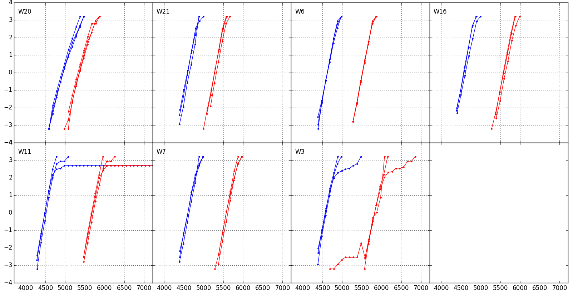
Distributions 100ms @1k cycles
1C v12
Ge 13%
In 2%
Si 6%
2E
Ge 16%
In 5%
3E
Ge 16%
In 7%
4E
Ge 16%
In 9%
Some alloys show high Vt tails / open bits on specific dice
→ Process marginalities?
5E
Ge 21%
In 9%
6E
Ge 19.5%
In 7%
7E
Ge 16%
In 11%

Slide 4
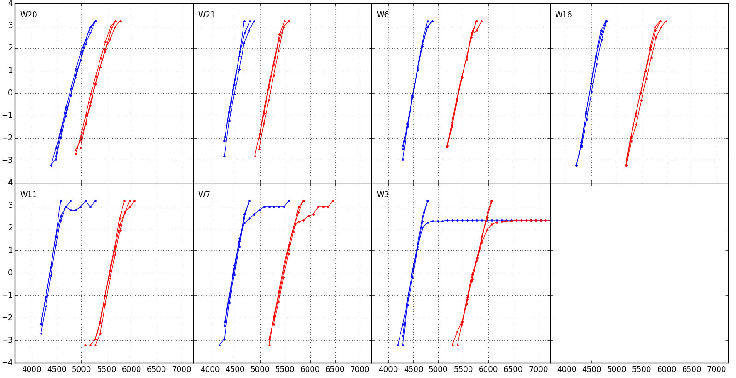
Distributions 100ms @128k cycles
1C v12
Ge 13%
In 2%
Si 6%
2E
Ge 16%
In 5%
3E
Ge 16%
In 7%
4E
Ge 16%
In 9%
5E
Ge 21%
In 9%
6E
Ge 19.5%
In 7%
7E
Ge 16%
In 11%

Slide 5
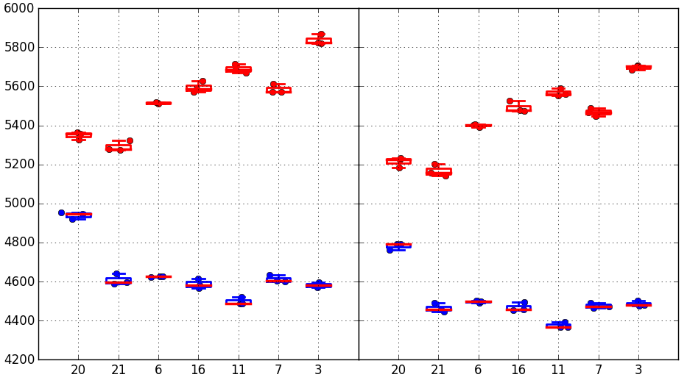
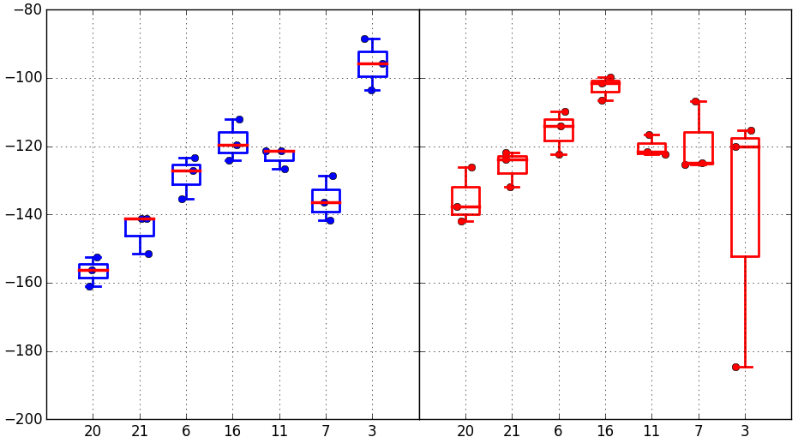
Vt Medians + Vt shift
Confirmed: Set Vt pretty insensitive to K* alloy Exception → group 5E has lower Vt
Confirmed: Reset Vt trends with decreasing As% and increasing (In+Ge)%
Vt shift 1k→128k trends with In%, especially for Set
Median Vt
1k cycles
128k cycles
1C
2E
3E
4E
5E
6E
7E
1C
2E
3E
4E
5E
6E
7E
Vt shift 1k→128k cycles
SET
RESET
Trial | Ge% | As% | Se% | In% | Si%
1C | 13 | 30.4 | 48.6 | 2 | 6
2E | 16 | 28.6 | 50.4 | 5 | 0
3E | 16 | 26.6 | 50.4 | 7 | 0
4E | 16 | 24.6 | 50.4 | 9 | 0
5E | 21 | 22.6 | 47.4 | 9 | 0
6E | 19.5 | 25.2 | 48.3 | 7 | 0
7E | 16 | 22.6 | 50.4 | 11 | 0
1C
2E
3E
4E
5E
6E
7E
1C
2E
3E
4E
5E
6E
7E

Slide 6
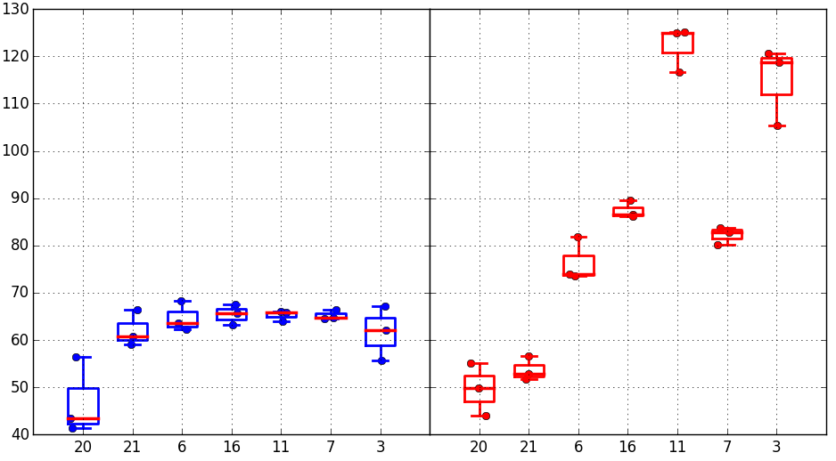
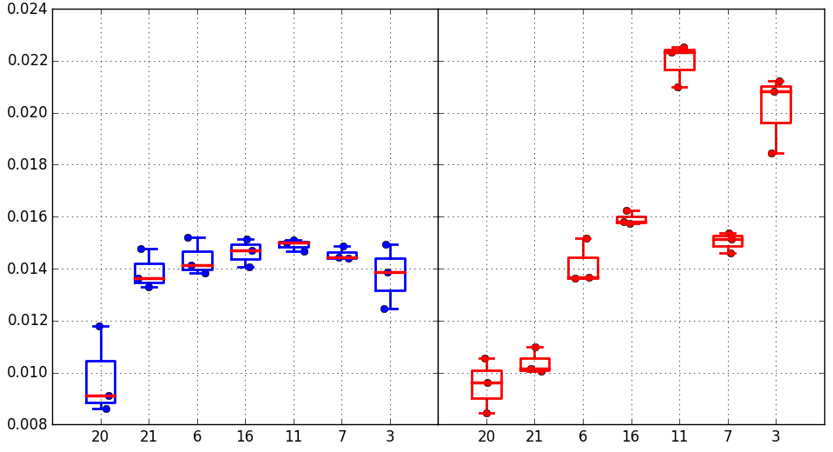
Median drift 100ms-10s @85C (128k cycles)
Trial | Ge% | As% | Se% | In% | Si%
1C | 13 | 30.4 | 48.6 | 2 | 6
2E | 16 | 28.6 | 50.4 | 5 | 0
3E | 16 | 26.6 | 50.4 | 7 | 0
4E | 16 | 24.6 | 50.4 | 9 | 0
5E | 21 | 22.6 | 47.4 | 9 | 0
6E | 19.5 | 25.2 | 48.3 | 7 | 0
7E | 16 | 22.6 | 50.4 | 11 | 0
Absolute drift mV
SET/RESET
1C
2E
3E
4E
5E
6E
7E
1C
2E
3E
4E
5E
6E
7E
Confirmed: Reset drift is in trend with As% vs (In+Ge)%
Not consistent with A1 lot: Set drift is aligned for K* alloys and higher than POR alloy. Some difference in electrical testing that might have an impact on this discrepancy:
Longer sense time (66ns vs 44ns of A1 lot)
Same width increase for program pulse
Unbalance set/reset currents
Different time window for drift: 100ms→10s vs 1us→10s
Relative drift
SET/RESET
1C
2E
3E
4E
5E
6E
7E
1C
2E
3E
4E
5E
6E
7E

Slide 7
Long time drift
2E
Like in A1 K* lot, reset drift long time slows down wrt set drift
→ Groups that have a widening of the window until 10s, tend to have similar drift for set and reset for long time
16k cycles preconditioning
Positive reading
Reference: 10s @85C
Drifted: 3d @90C
Trial | Ge% | As% | Se% | In% | Si%
1C | 13 | 30.4 | 48.6 | 2 | 6
2E | 16 | 28.6 | 50.4 | 5 | 0
3E | 16 | 26.6 | 50.4 | 7 | 0
4E | 16 | 24.6 | 50.4 | 9 | 0
5E | 21 | 22.6 | 47.4 | 9 | 0
6E | 19.5 | 25.2 | 48.3 | 7 | 0
7E | 16 | 22.6 | 50.4 | 11 | 0
4E
5E

Slide 8
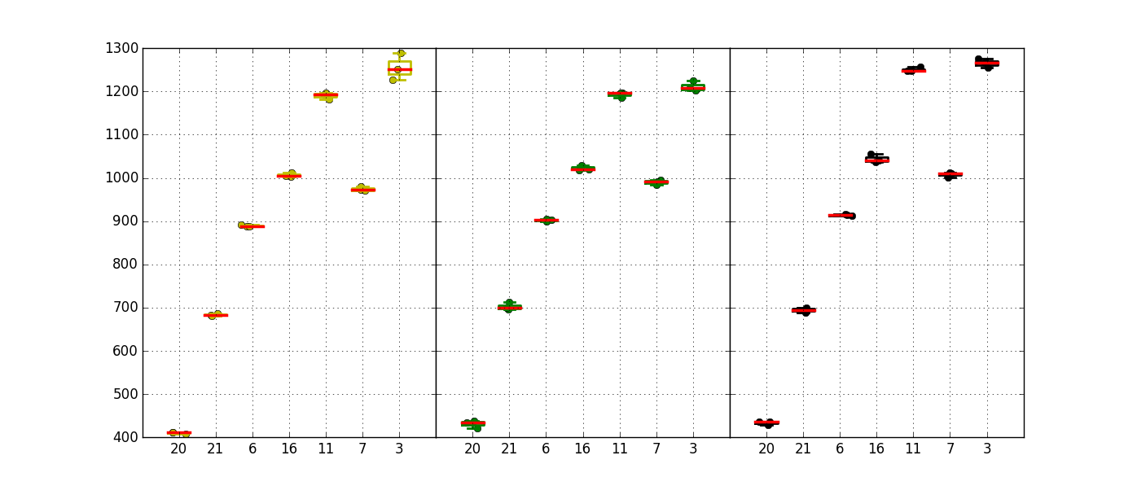
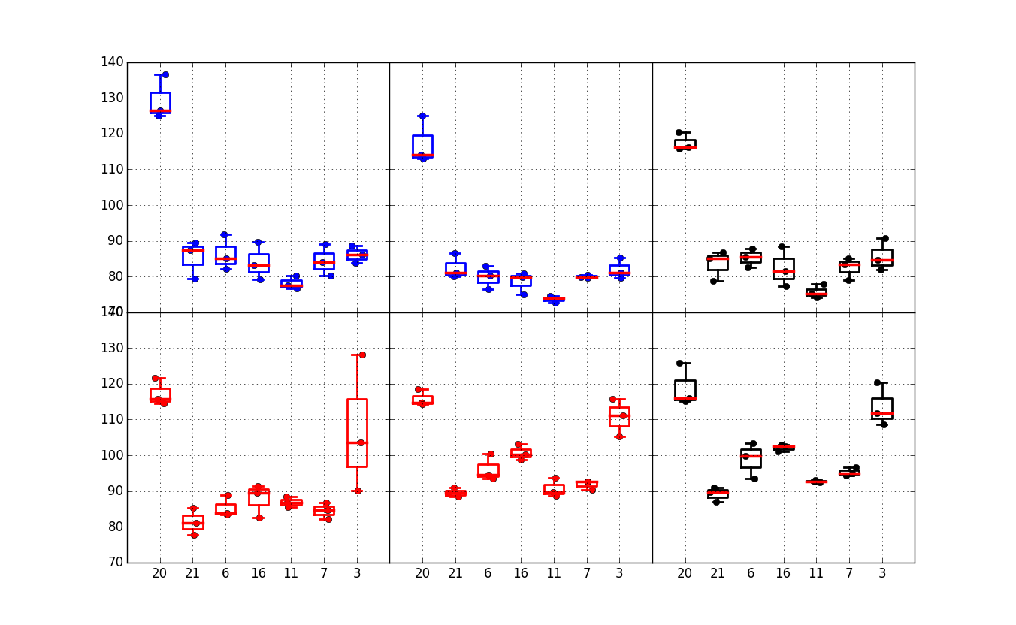
Window & sigma
Window correlates with Reset Vt trend: Lower As% → Higher window
Best alloys between 1.2V and 1.3V
Median
Window
Confirmed: In-SAG alloys have much better sigma than POR
Group 7E reset sigma is not in line
1C
2E
3E
4E
5E
6E
7E
1C
2E
3E
4E
5E
6E
7E
1C
2E
3E
4E
5E
6E
7E
1k cycles (100ms)
128k cycles (100ms)
128k cycles (10s)
Robust
sigma
SET
Trial | Ge% | As% | Se% | In% | Si%
1C | 13 | 30.4 | 48.6 | 2 | 6
2E | 16 | 28.6 | 50.4 | 5 | 0
3E | 16 | 26.6 | 50.4 | 7 | 0
4E | 16 | 24.6 | 50.4 | 9 | 0
5E | 21 | 22.6 | 47.4 | 9 | 0
6E | 19.5 | 25.2 | 48.3 | 7 | 0
7E | 16 | 22.6 | 50.4 | 11 | 0
RESET
1C
2E
3E
4E
5E
6E
7E
1C
2E
3E
4E
5E
6E
7E
1C
2E
3E
4E
5E
6E
7E

Slide 9
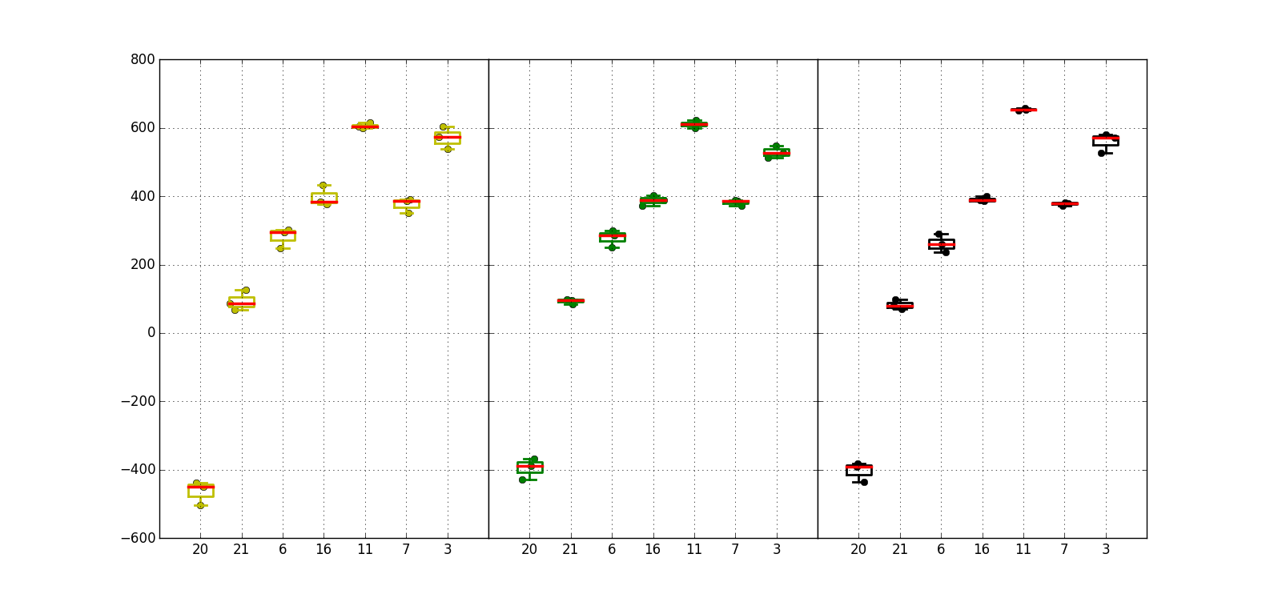
Projected window @3.54 sigma
Trial | Ge% | As% | Se% | In% | Si%
1C | 13 | 30.4 | 48.6 | 2 | 6
2E | 16 | 28.6 | 50.4 | 5 | 0
3E | 16 | 26.6 | 50.4 | 7 | 0
4E | 16 | 24.6 | 50.4 | 9 | 0
5E | 21 | 22.6 | 47.4 | 9 | 0
6E | 19.5 | 25.2 | 48.3 | 7 | 0
7E | 16 | 22.6 | 50.4 | 11 | 0
Good performance by increasing the ratio (In+Ge)% vs As%
→ +600mV projected window achieved (100ms drift)
1k cycles 100ms
128k cycles 100ms
128k 10s
1C
2E
3E
4E
5E
6E
7E
1C
2E
3E
4E
5E
6E
7E
1C
2E
3E
4E
5E
6E
7E

Slide 10
Conclusions
With a more As-poor alloy (replaced by Ge or In), it is confirmed that Reset Vt gets higher, and a larger median window can be achieved
Together with larger window, a larger reset drift is obtained with a possible enlargement of the window until 10s. When this happens, then long time drift shows a realignment of set and reset drift slope, and the window is maintained
K* alloys here show a larger set drift wrt POR alloy (not confirming data from lot 0173982). Results here are more in line with S26A probe, and one possible explanation is that they are driven by different electrical testing (A0 vs A1). In this picture, A0 electrical testing is closer to S26A testing than A1
This lot confirms very good improvement in distribution sigma for In-SAG vs Si-SAG alloy

