Slide 1
SSM A1 reduced ambient - 0173982.003
2018-Wk05
SSM team

Slide 2
SSM A1 reduced ambient - 0173982.003
Scope of the lot
  Evaluate reduced ambient effect on SSM

Slide 3
Lot trials
Trial | SD | WL W | Reduced ambient | Wf
1C | 22 ver12 2% In T&B | 37 | No | 2,5,9
2E | 22 ver12 2% In T&B | 20 | No | 3,7,12
3E | 22 ver12 2% In T&B | 20 | etch/clean TEL/seal except ox | 1,6,11
4E | 22 ver12 2% In T&B | 20 | etch/clean TEL (51) SCREEN (52)/seal except ox | 4,8,10
Wafer #6,10 and 12 in Boise

Slide 4
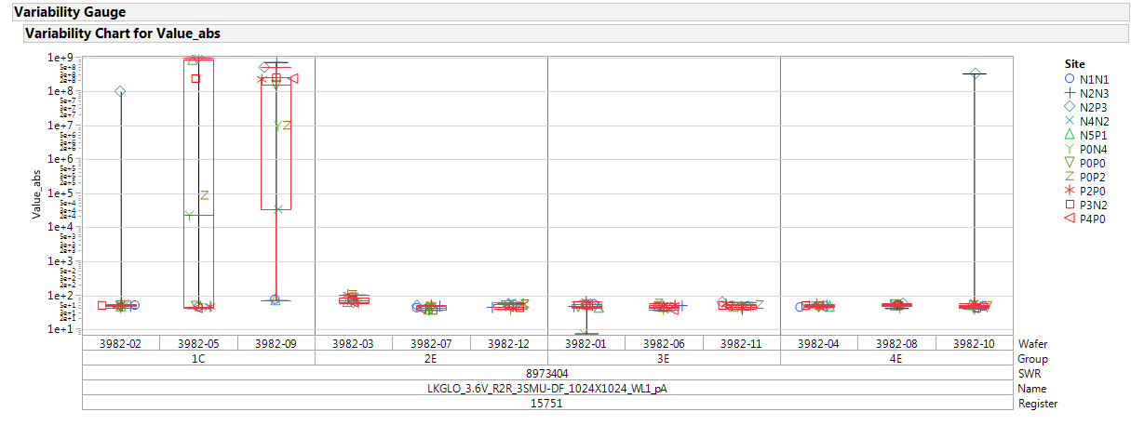
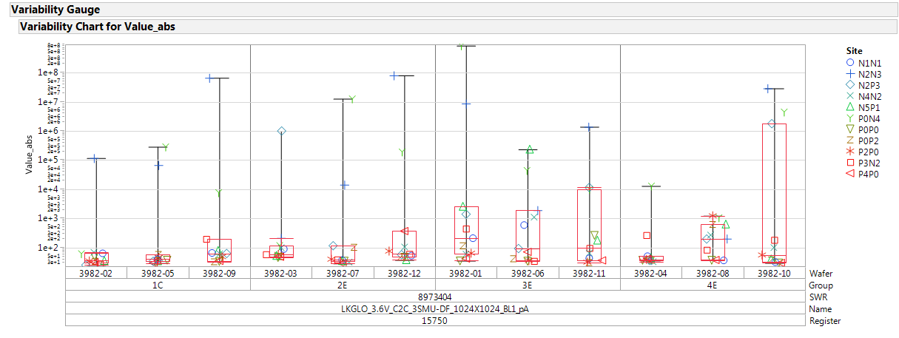
Param testing: R2R and C2C
R2R
  R2R leakage is good, some defectivity on some 1C wafers
C2C
  C2C leakage is good

Slide 5
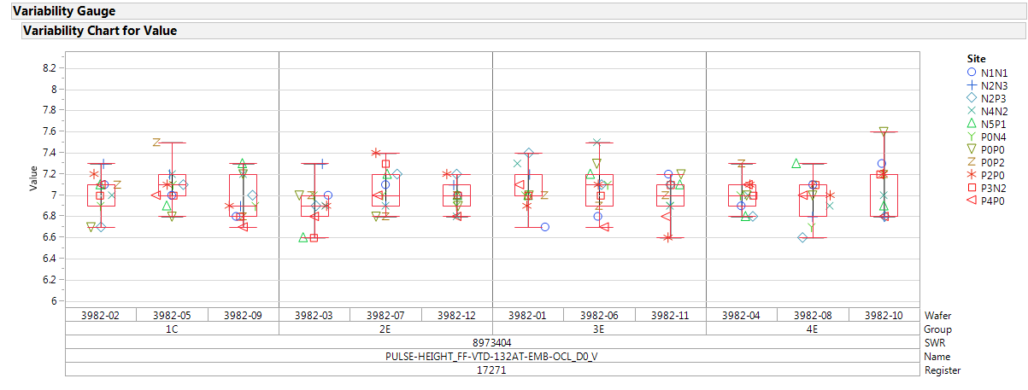
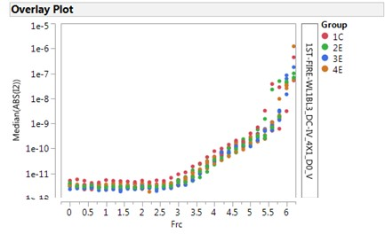
FF and OCL I-V curves
FF in not affected by the trial
OCL I-V are good

Slide 6
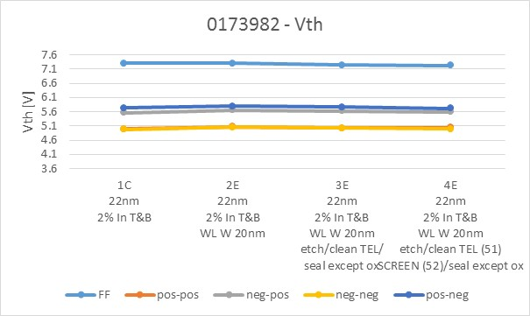
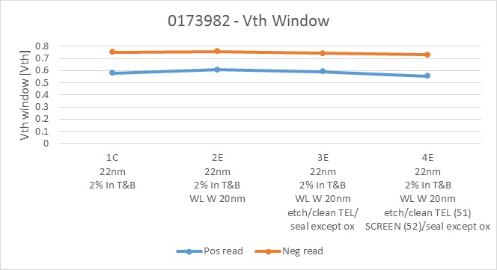
2xCMOS data: Median Vth and Vth window
Median Vth and Vth window do not show clear toggle

Slide 7
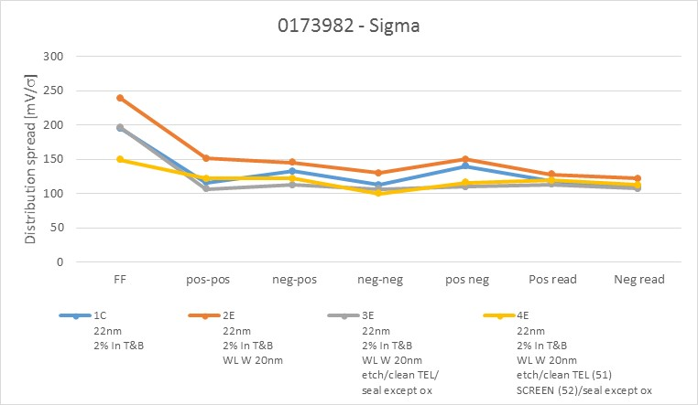
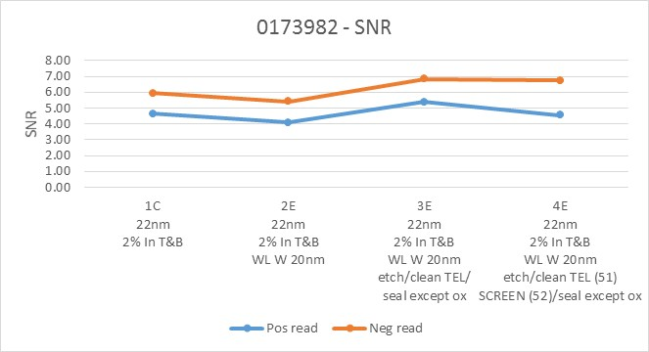
2xCMOS data: distribution spread and SNR
No clear toggle, reduced ambient sigma looks slightly better

