Slide 1
SSM A0 K* camp In-SAG - 0024692.003
2018-Wk05
SSM team

Slide 2
SSM A0 K* camp In-SAG - 0024692.003
Scope of the lot
Evaluate new In% and Ge% rich alloys
A0 mask set
CD - - straight WL profile

Slide 3
Lot trials
Trial | SD thk. | Ge% | As% | Se% | In% | Si% | 51 WL etch | Wf
1C | 22 ver12 | 13 | 30.4 | 48.6 | 2 | 6 | CD - - | 5,14,20
2E | 22 | 16 | 28.6 | 50.4 | 5 | 0 | CD - - | 4,12,21,24
3E | 22 | 16 | 26.6 | 50.4 | 7 | 0 | CD - - | 6,13,18
4E | 22 | 16 | 24.6 | 50.4 | 9 | 0 | CD - - | 2,9,16,23
5E | 22 | 21 | 22.6 | 47.4 | 9 | 0 | CD - - | 8,11,19,25
6E | 22 | 19.5 | 25.2 | 48.3 | 7 | 0 | CD - - | 7,17,22
7E | 22 | 16 | 22.6 | 50.4 | 11 | 0 | CD - - | 1,3,10,15
Wafer #1,2,4,8,9,12,14,17 and 18 in Boise

Slide 4
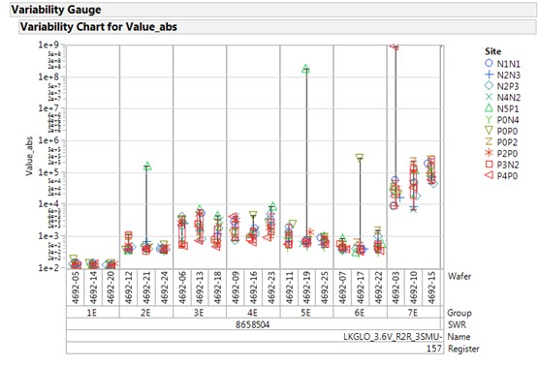
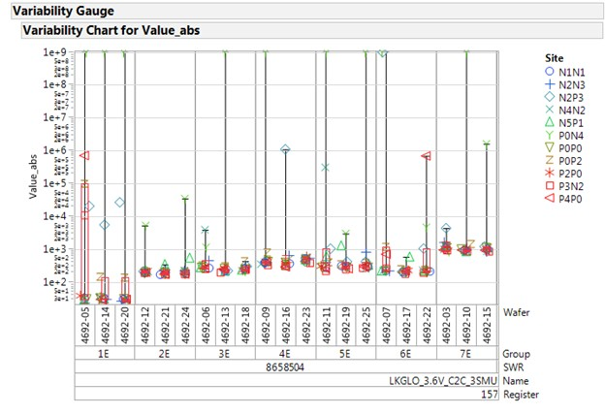
Param testing: R2R and C2C
R2R
R2R leakage is good, some defectivity in 7E
C2C
C2C leakage is good, some defectivity in 1C

Slide 5
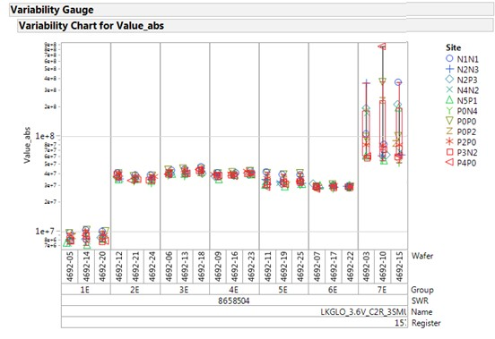
Param testing: C2R
C2R Leakage trend
Higher leakage on all the alloys
Some defectivity visible on group 7E

Slide 6
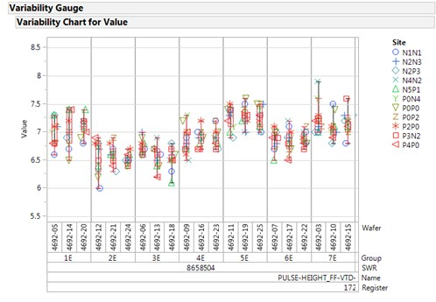
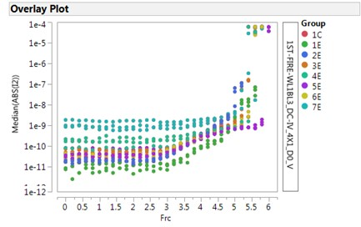
FF and OCL I-V curves
FF in lowered by In addition, but then looks increasing for group 5E and 7E
OCL I-V are good
a clear trend is visible in the sub-threshold leakage

Slide 7
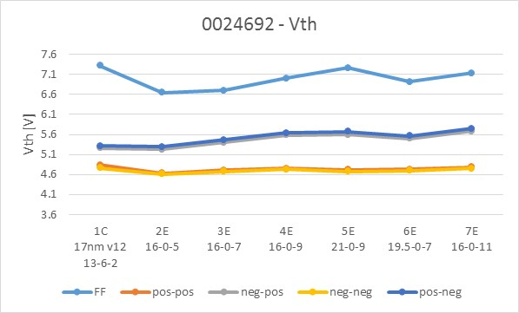
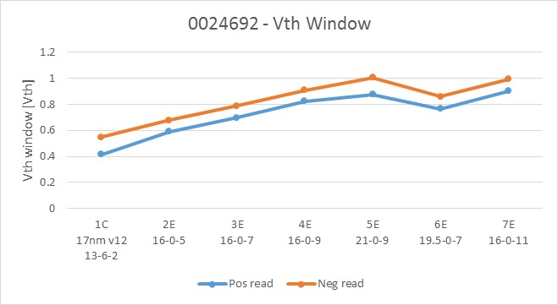
2xCMOS data: Median Vth and Vth window
Median Vth and Vth window trend as expected
Higher In% and Ge% increases the FF and the Vth window → Is it consistent with thermal stability?
Low Vth is poorly modulated

Slide 8
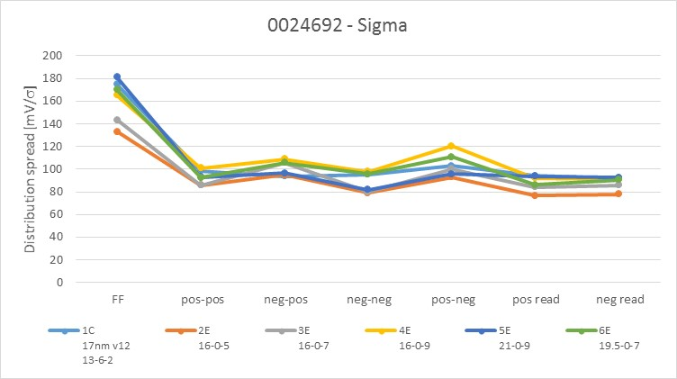
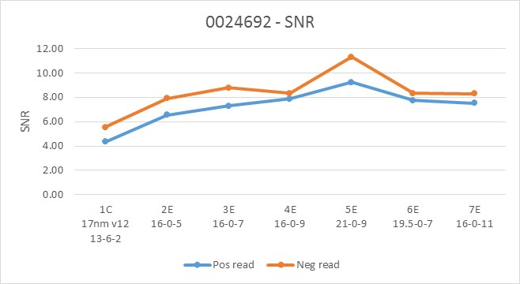
2xCMOS data: distribution spread and SNR
In-SAG alloys has a general better sigma and SNR
5E looks the best for SNR

Slide 9
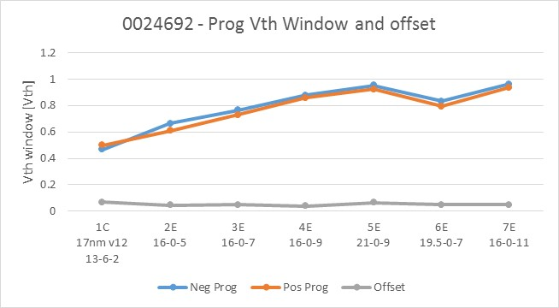
2xCMOS data: programming Vth window
Programming Vth window trend as expected
Offset is very low and constant due to the CD - - 2-step WL etch
Clear programming Vth window increasing with In% and Ge%

